Slide 1

NHL Draft Analysis
A project completed using Python by:
Nick Hammer

Slide 2
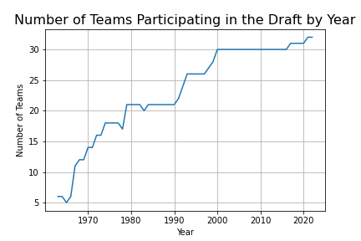
NHL Teams 1963-2022
Inaugural Draft Season
TEAM | YEAR
Detroit Red Wings | 1963
Toronto Maple Leafs | 1963
Boston Bruins | 1963
New York Rangers | 1963
Chicago Blackhawks | 1963
Montreal Canadiens | 1963
Minnesota North Stars | 1967
Los Angeles Kings | 1967
Pittsburgh Penguins | 1967
Philadelphia Flyers | 1967
Oakland Seals | 1967
TEAM | YEAR
St. Louis Blues | 1968
Vancouver Canucks | 1970
Buffalo Sabres | 1970
California Golden Seals | 1971
New York Islanders | 1972
Atlanta Flames | 1972
Kansas City Scouts | 1974
Washington Capitals | 1974
Colorado Rockies | 1977
Cleveland Barons | 1977
TEAM | YEAR
Quebec Nordiques | 1979
Winnipeg Jets | 1979
Hartford Whalers | 1979
Edmonton Oilers | 1979
Calgary Flames | 1980
New Jersey Devils | 1982
San Jose Sharks | 1991
Tampa Bay Lightning | 1992
Ottawa Senators | 1992
Anaheim Ducks | 1993
Dallas Stars | 1993
Florida Panthers | 1993
TEAM | YEAR
Colorado Avalanche | 1995
Phoenix Coyotes | 1996
Carolina Hurricanes | 1997
Nashville Predators | 1998
Atlanta Thrashers | 1999
Minnesota Wild | 2000
Columbus Blue Jackets | 2000
Arizona Coyotes | 2014
Vegas Golden Knights | 2017
Seattle Kraken | 2021
In this graph, ,we can see the growth of the NHL throughout the years. In 1963, the year of the first NHL draft, only 6 teams existed. The league is now at 32 after seeing a lot of growth in the 1960’s, 70’s, and 90’s. The last two teams to join were the Vegas Golden Knights in 2017 and the Seattle Kraken in 2021.
* Teams in bold participated in the 2022 NHL draft

Slide 3
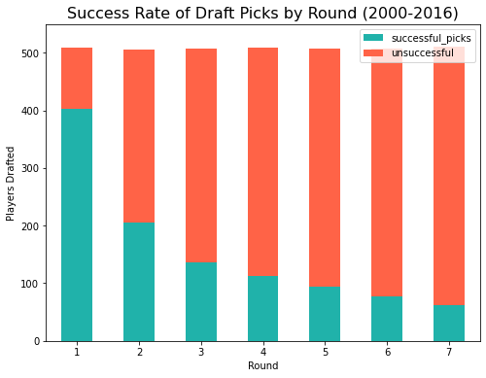
Draft Success Per Round
This graph shows the rate of drafting a successful player in each round of the draft from 2000–2016. I used these 17 years because there were 30 teams for each of these years and 2016 is far enough in the past to fairly judge the success of each pick. I defined success in the analysis as having played atleast 82 games which is the length of an NHL season.
Round | Successful Picks
1 | 402
2 | 206
3 | 137
4 | 112
5 | 94
6 | 78
7 | 62
Unsuccessful
107
300
371
397
414
429
448

Slide 4
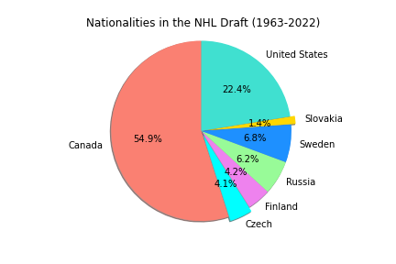
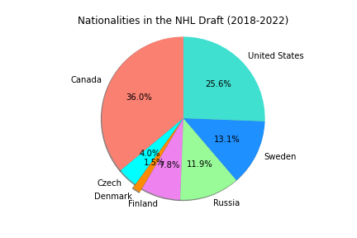
Nationalities in the NHL
These pie charts below show the percentage of each of the top nationalities present in the NHL. The pie chart on the left shows that over half of the players being drafted into the league have been Canadian. But, if we narrow the data down to just the last five years, we can see that just over a third of recent players drafted were Canadian and the number of players from Sweden, Russia, and the United States has grown.

Slide 5
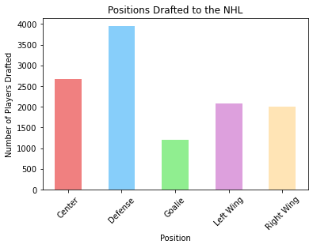
Positions Drafted
This graph and chart show what are the most popular player positions drafted by NHL teams. As we can see, defensive players are the most drafted position and goalies are the least drafted position.
Position | Count
C | 2674
D | 3950
G | 1211
LW | 2074
RW | 2011

