Slide 1
Chapter 14 JavaFX Basics

Slide 2
Motivations
This chapter serves two purposes:
First, it presents the basics of JavaFX programming. JavaFX is a new framework for developing Java GUI programs.
Second, it uses JavaFX to demonstrate OOP. Specifically, this chapter introduces the framework of JavaFX and discusses JavaFX GUI components and their relationships.

Slide 3
Objectives
To distinguish between JavaFX, Swing, and AWT (§14.2).
To write a simple JavaFX program and understand the relationship among stages, scenes, and nodes (§14.3).
To create user interfaces using panes, UI controls, and shapes (§14.4).
To use binding properties to synchronize property values (§14.5).
To use the common properties style and rotate for nodes (§14.6).
To create colors using the Color class (§14.7).
To create fonts using the Font class (§14.8).
To create images using the Image class and to create image views using the ImageView class (§14.9).
To layout nodes using Pane, StackPane, FlowPane, GridPane, BorderPane, HBox, and VBox (§14.10).
To display text using the Text class and create shapes using Line, Circle, Rectangle, Ellipse, Arc, Polygon, and Polyline (§14.11).
To develop the reusable GUI components ClockPane for displaying an analog clock (§14.12).

Slide 4
JavaFX vs Swing and AWT
Abstract Windows Toolkit (AWT)
the GUI library when Java was introduced
fine for simple GUIs, but not for comprehensive ones
prone to platform-specific bugs
Swing
a more robust, versatile, and flexible library
painted directly on canvases using Java code
depend less on the target platform and use less native GUI resource
JavaFX
replace Swing at the release of Java 8

Slide 5
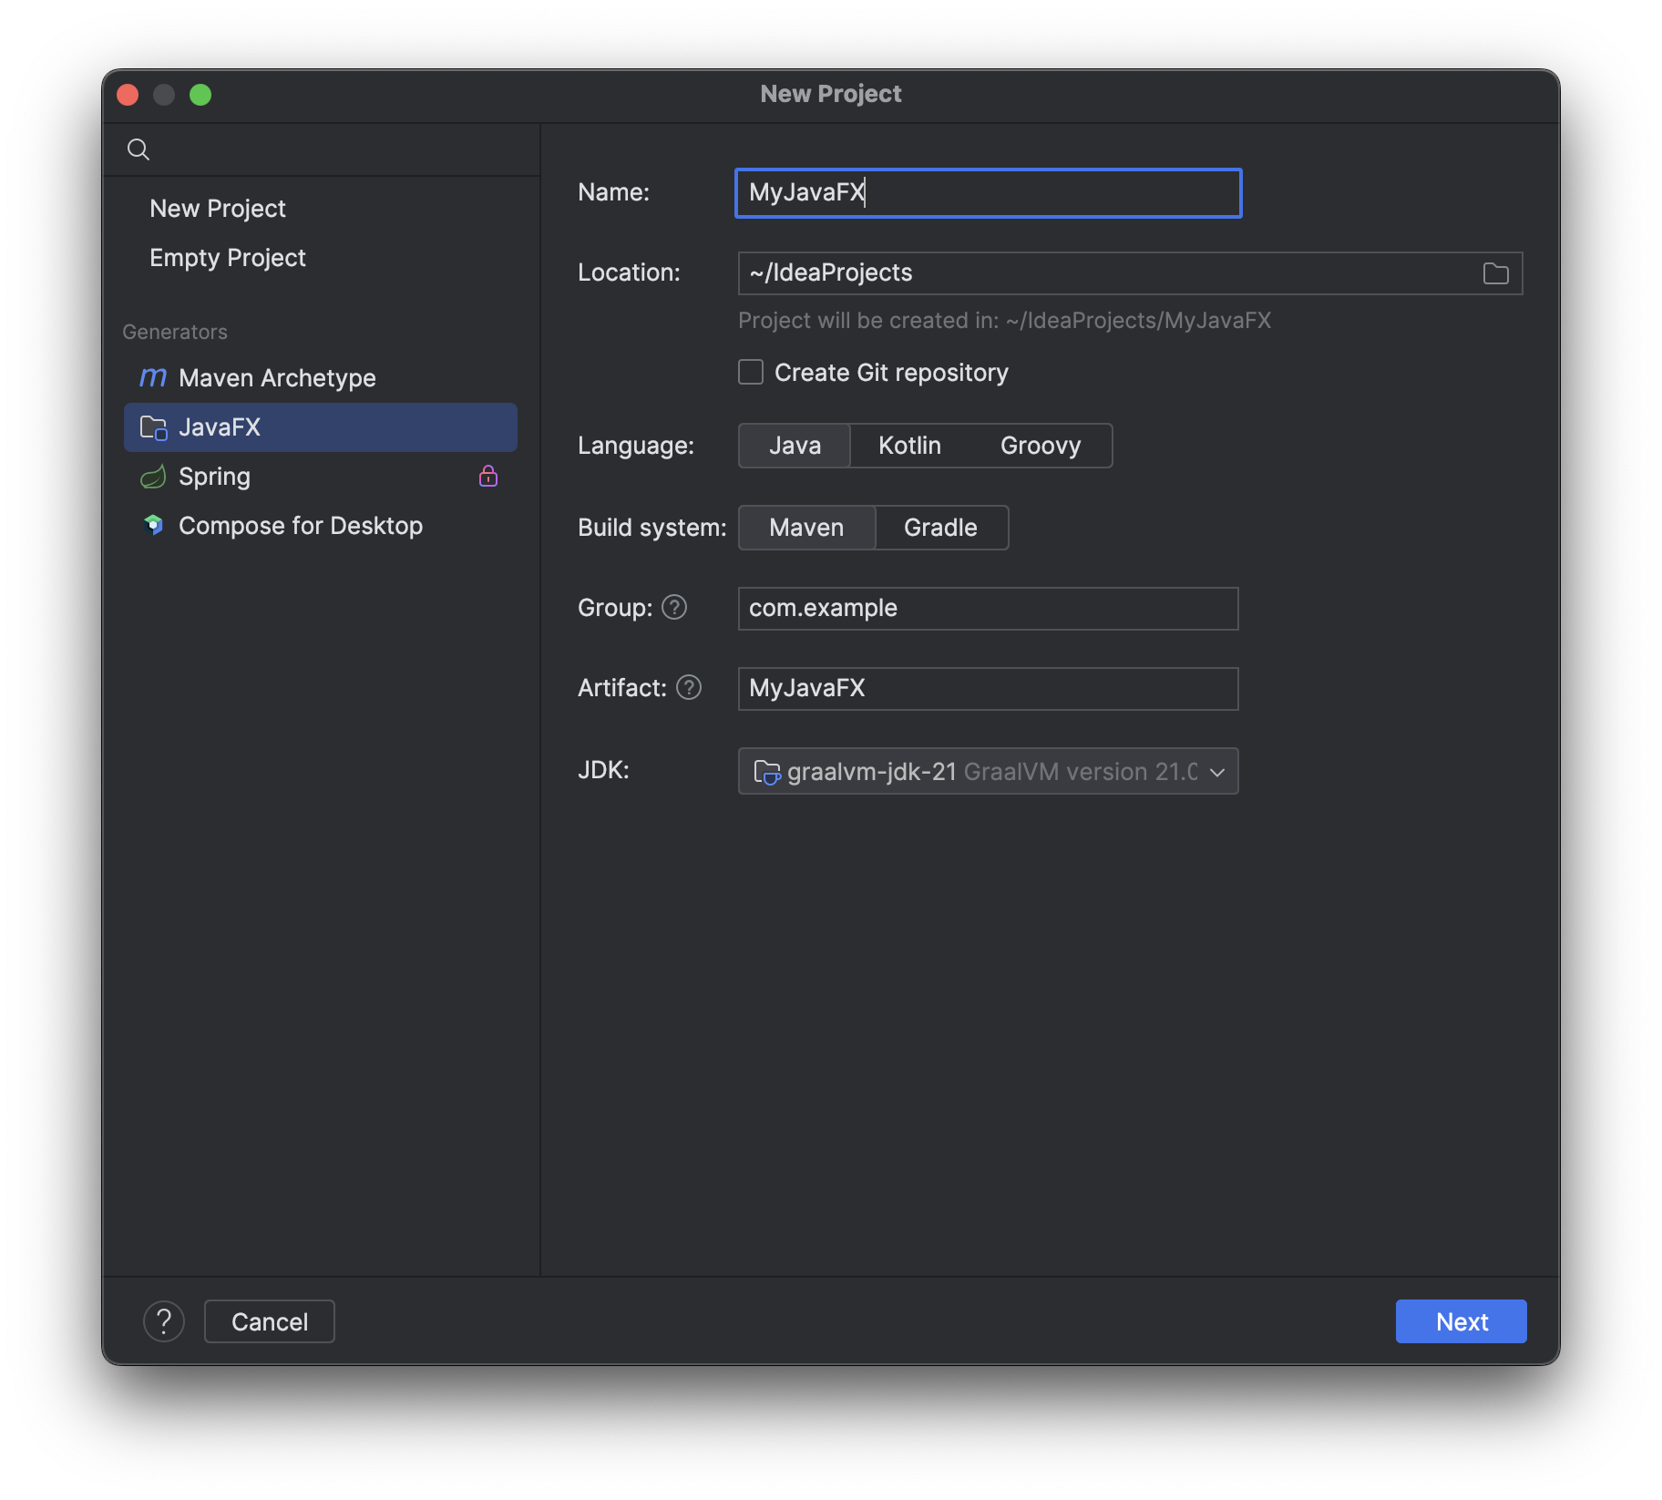
Before you start

Slide 6
Basic Structure of JavaFX
Application
Override the start(Stage) method
Stage, Scene, and Nodes
MyJavaFX
Run
MultipleStageDemo
Run

Slide 7
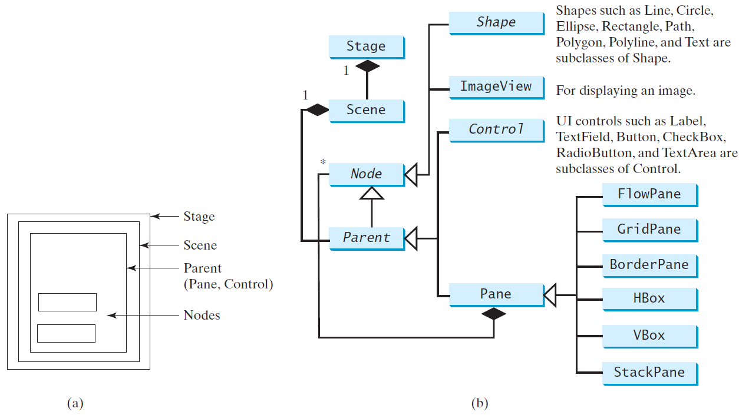
Panes, UI Controls, and Shapes
ButtonInPane
Run

Slide 8
Display a Shape
This example displays a circle in the center of the pane.
ShowCircle
Run

Slide 9
Binding Properties
JavaFX introduces a new concept called binding property that enables a target object to be bound to a source object.
If the value in the source object changes, the target property is also changed automatically.
The target object is simply called a binding object or a binding property.
ShowCircleCentered
Run

Slide 10
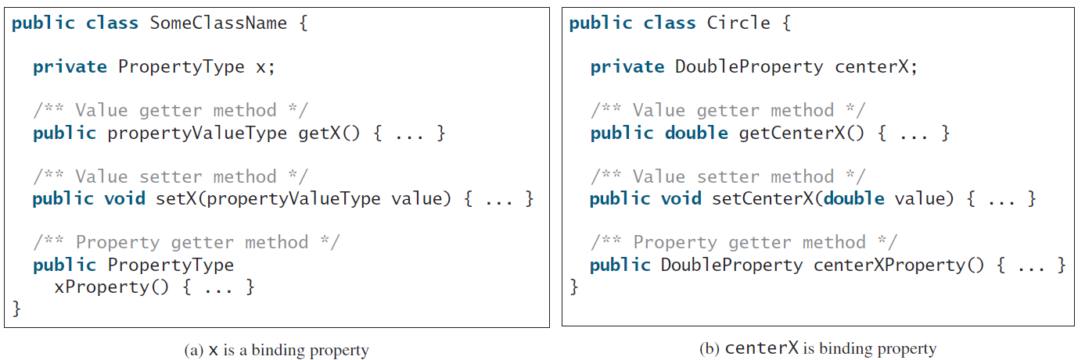
Binding Property: getter, setter, and property getter

Slide 11
Uni/Bidirectional Binding
BindingDemo
Run
BidirectionalBindingDemo
Run

Slide 12
Common Properties and Methods for Nodes
style: set a JavaFX CSS style
rotate: Rotate a node
NodeStyleRotateDemo
Run

Slide 13
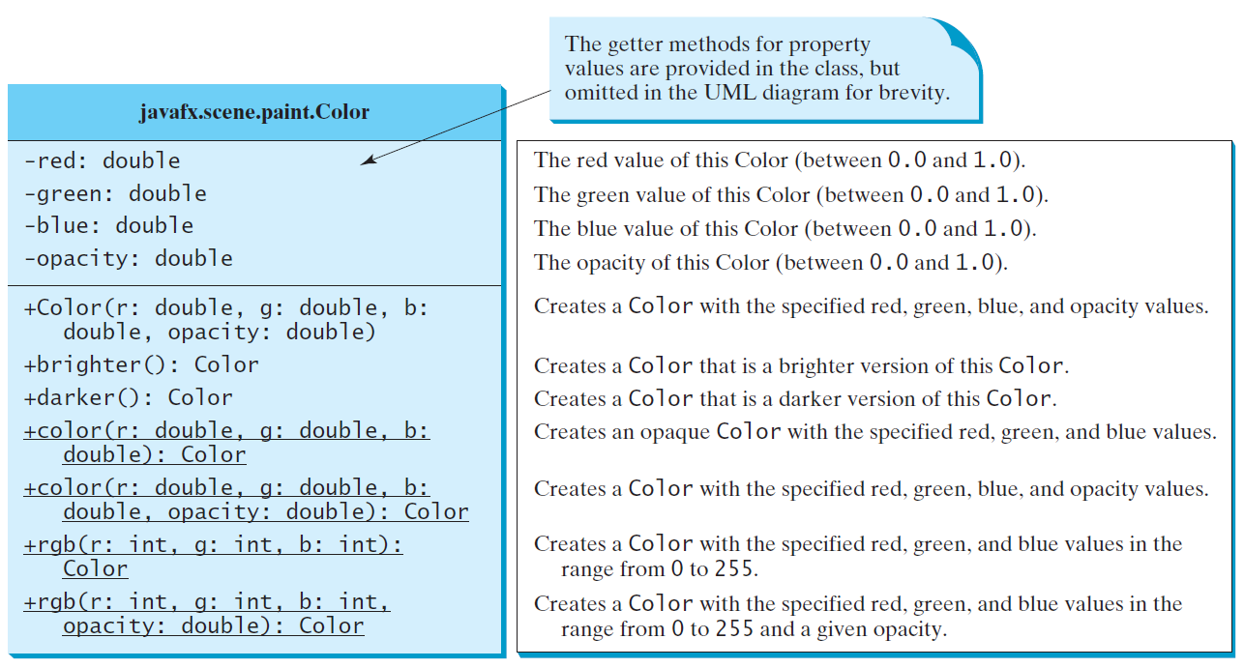
The Color Class

Slide 14
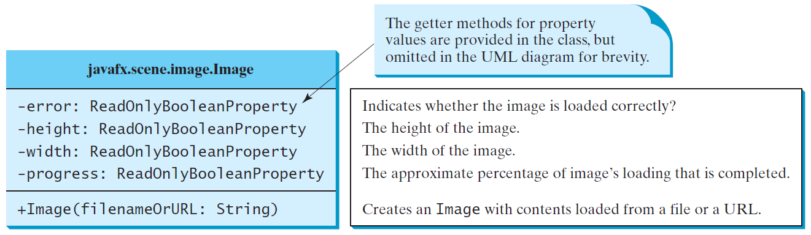
The Image Class

Slide 15
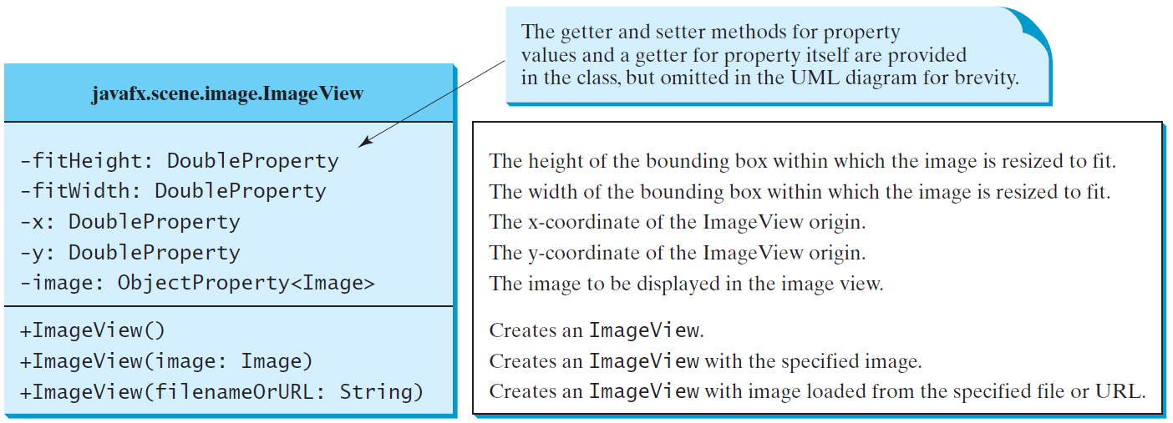
The ImageView Class
use: Image image = new Image(getClass().getResourceAsStream("image/us.gif"));
to replace: Image image = new Image("image/us.gif");
ShowImage
Run

Slide 16
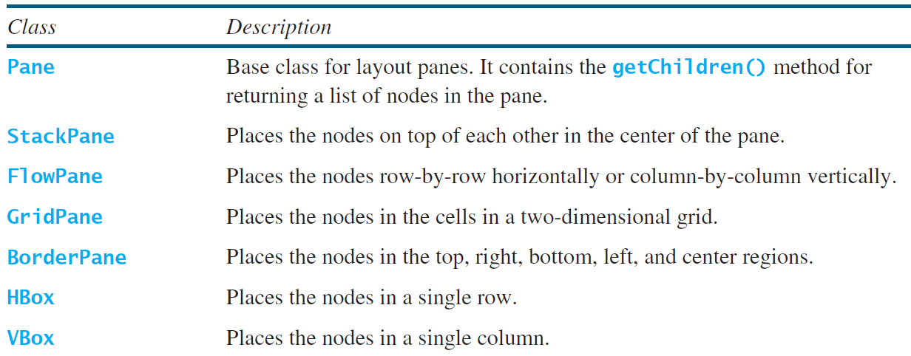
Layout Panes
JavaFX provides many types of panes for organizing nodes in a container.

Slide 17
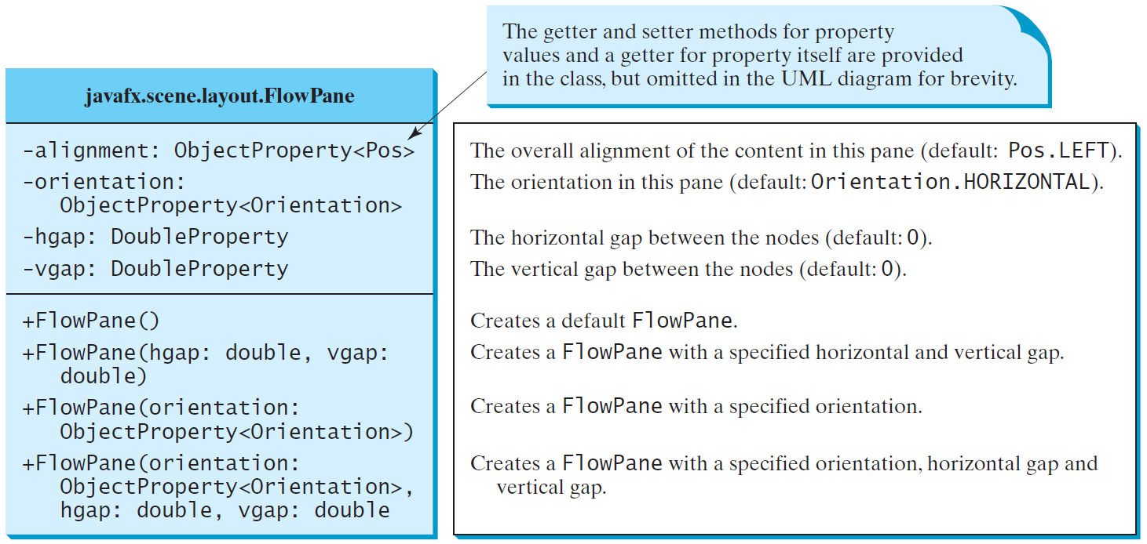
FlowPane
MultipleStageDemo
Run

Slide 18
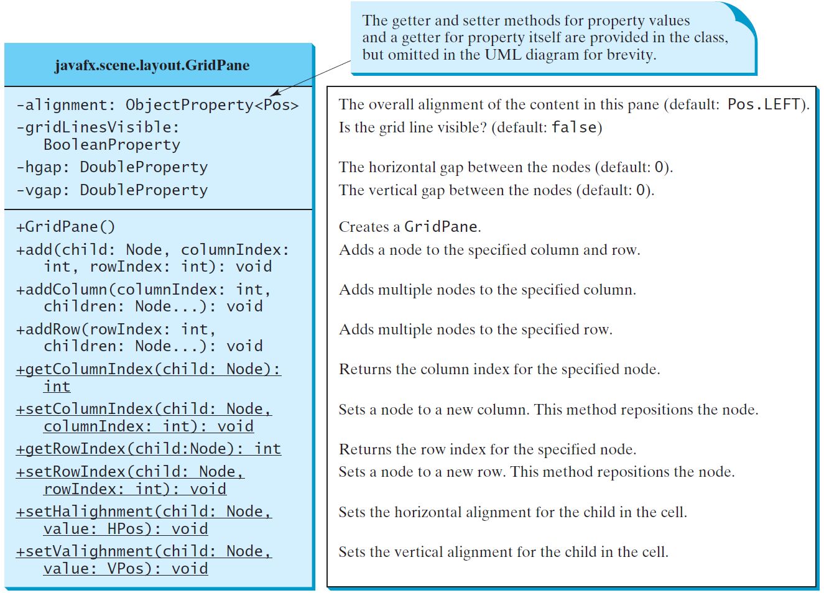
GridPane
ShowGridPane
Run

Slide 19
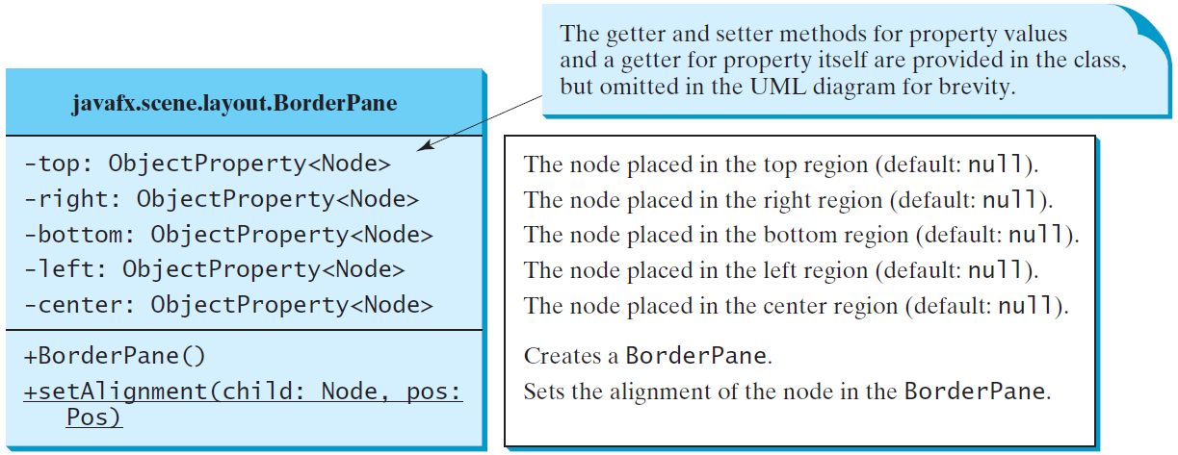
BorderPane
ShowBorderPane
Run

Slide 20
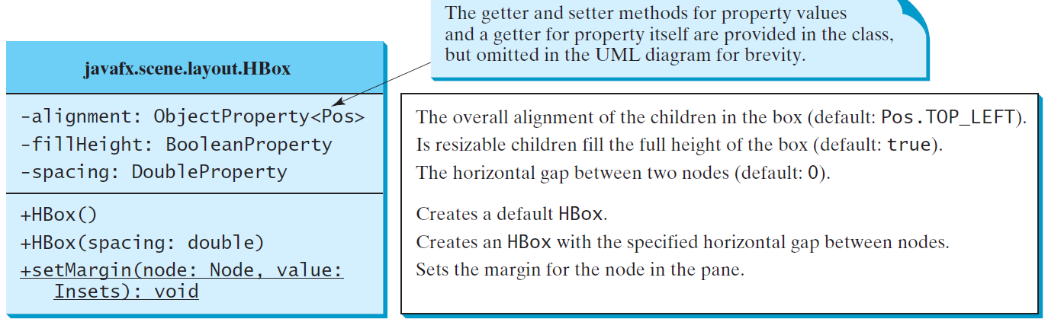
HBox

Slide 21
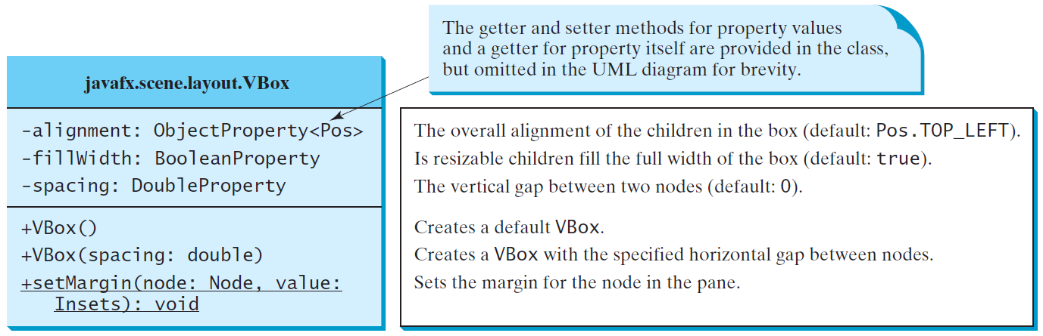
VBox
ShowHBoxVBox
Run

Slide 22
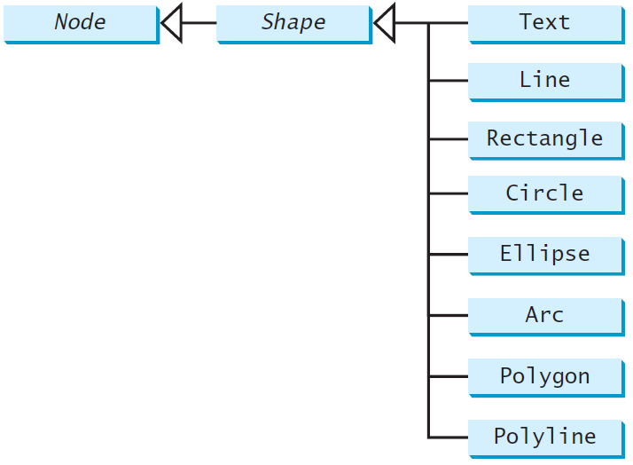
Shapes
JavaFX provides many shape classes for drawing texts, lines, circles, rectangles, ellipses, arcs, polygons, and polylines.

Slide 23
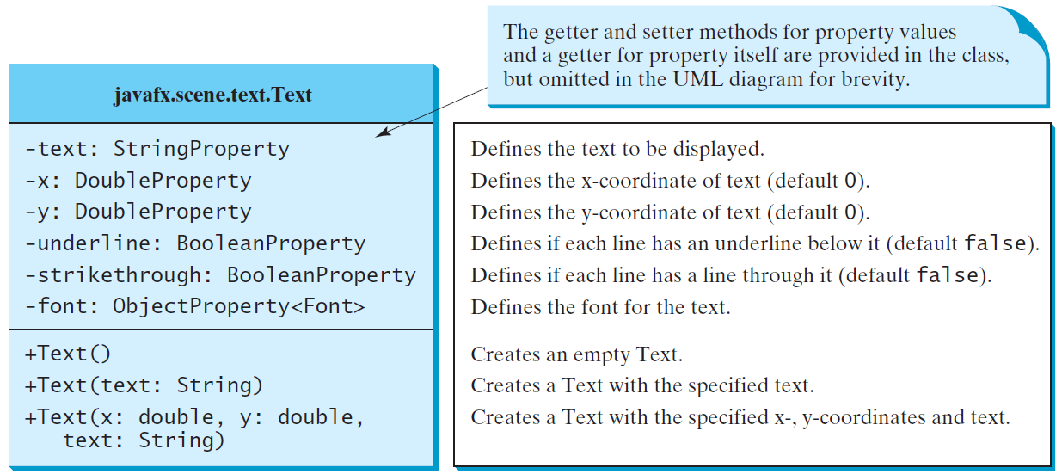
Text

Slide 24
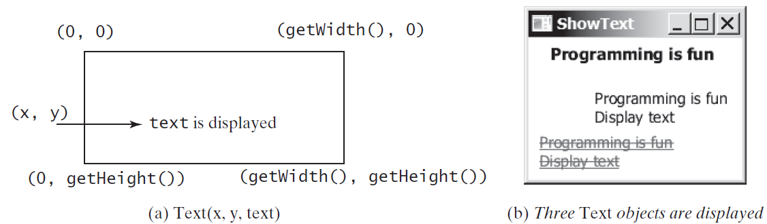
Text Example
ShowText
Run

Slide 25
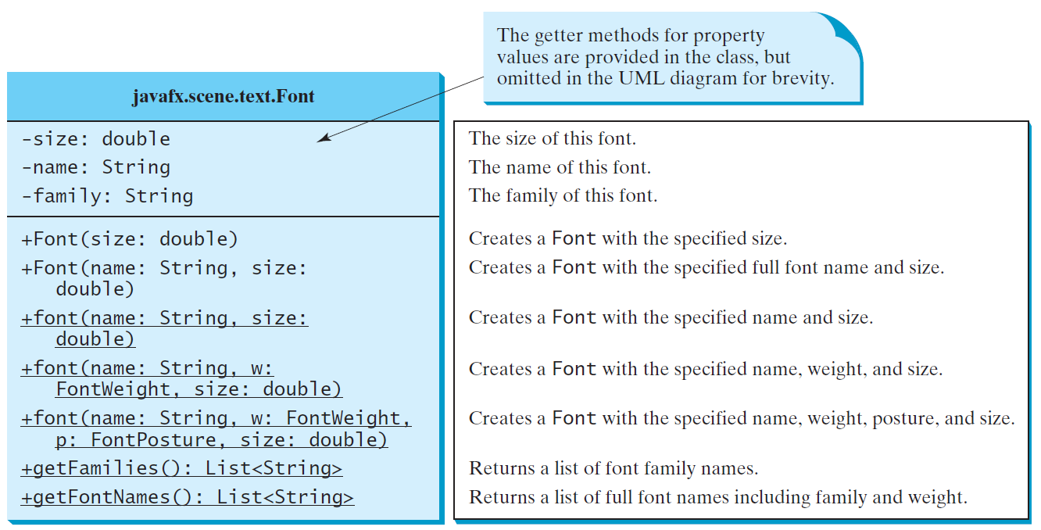
The Font Class
FontDemo
Run

Slide 26
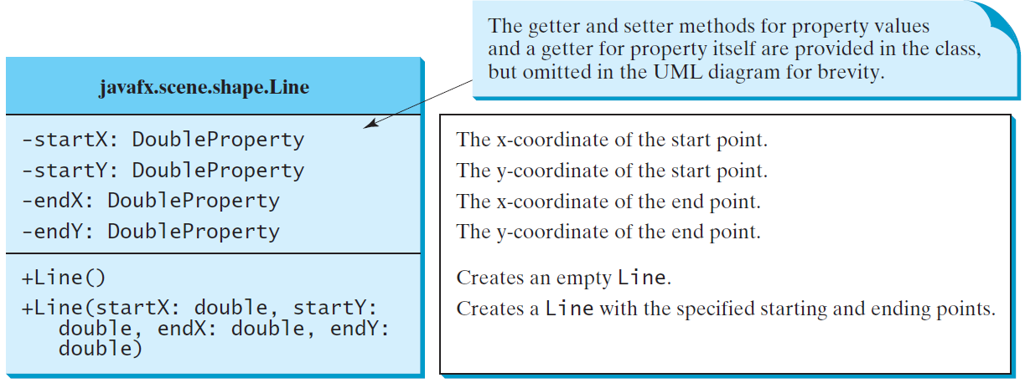
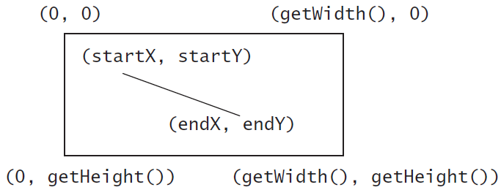
Line
ShowLine
Run

Slide 27
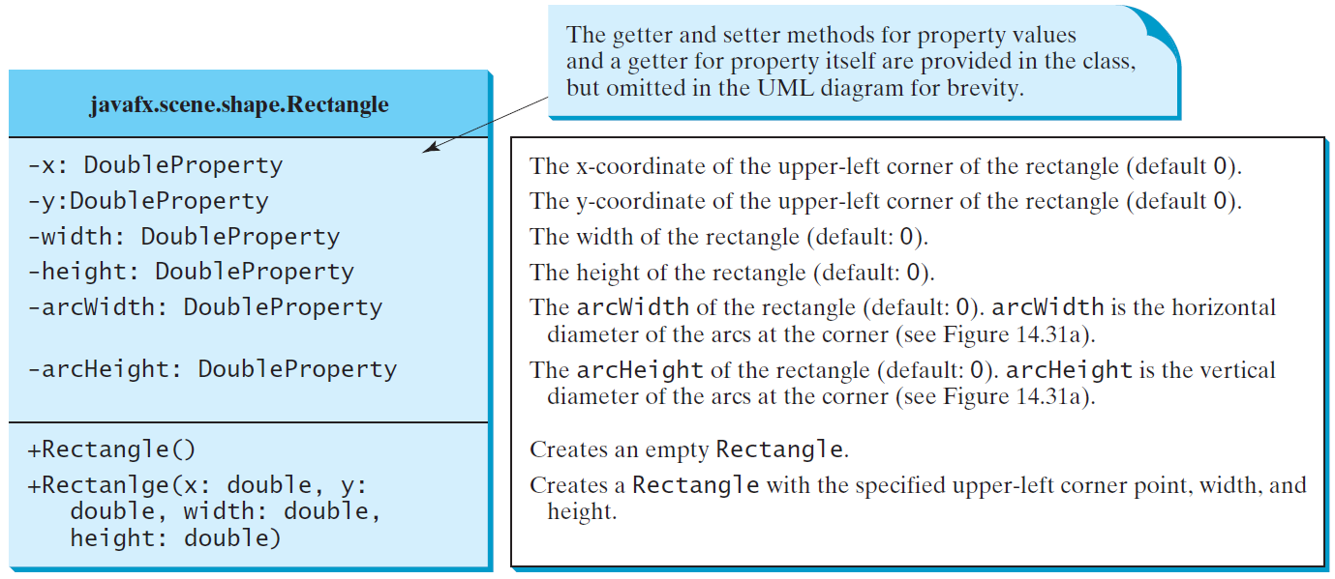
Rectangle

Slide 28
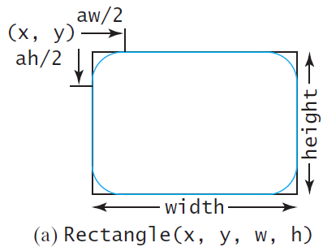
Rectangle Example
ShowRectangle
Run

Slide 29
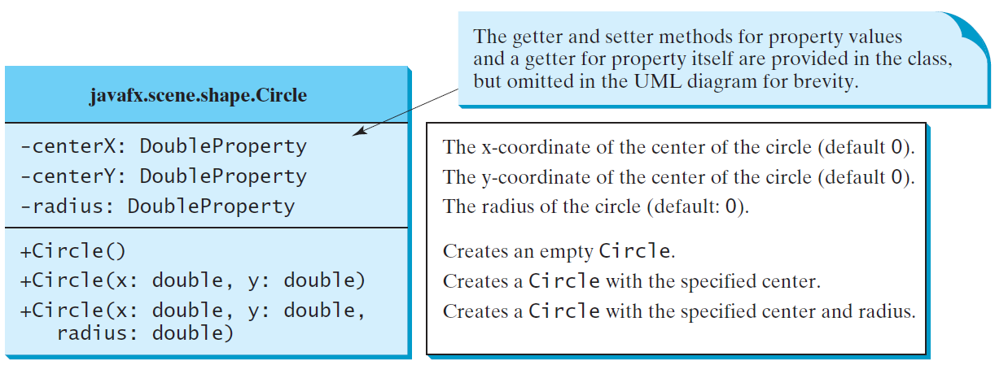
Circle

Slide 30
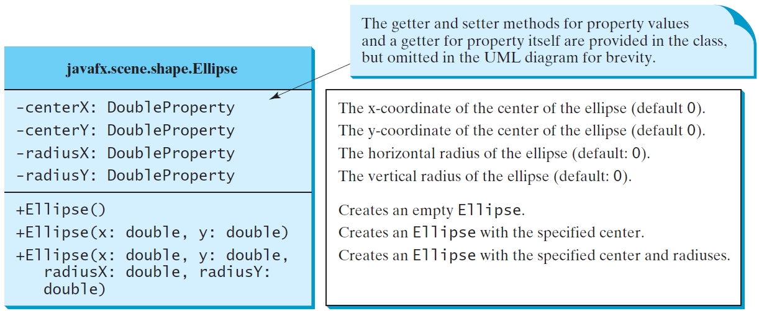
Ellipse
ShowEllipse
Run

Slide 31
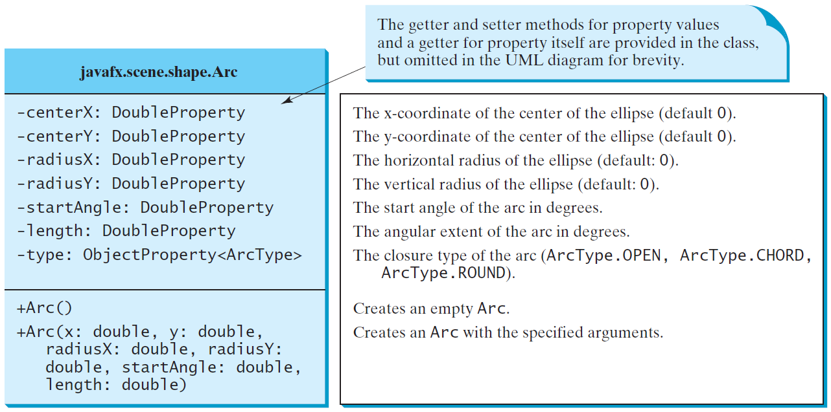
Arc

Slide 32
Arc Examples
ShowArc
Run

Slide 33
Polygon and Polyline

Slide 34
Polygon
ShowPolygon
Run

Slide 35
Case Study: The ClockPane Class
This case study develops a class that displays a clock on a pane.
ClockPane

Slide 36
Use the ClockPane Class
DisplayClock
Run

