Slide 1
Chapter 12 Exception Handling and Text IO

Slide 2
Motivations
When a program runs into a runtime error, the program terminates abnormally.
How can you handle the runtime error so that the program can continue to run or terminate gracefully?
This is the subject we will introduce in this chapter.

Slide 3
Objectives
To get an overview of exceptions and exception handling (§12.2).
To explore the advantages of using exception handling (§12.2).
To distinguish exception types: Error (fatal) vs. Exception (nonfatal) and checked vs. unchecked (§12.3).
To declare exceptions in a method header (§12.4.1).
To throw exceptions in a method (§12.4.2).
To write a try-catch block to handle exceptions (§12.4.3).
To explain how an exception is propagated (§12.4.3).
To obtain information from an exception object (§12.4.4).
To develop applications with exception handling (§12.4.5).
To use the finally clause in a try-catch block (§12.5).
To use exceptions only for unexpected errors (§12.6).
To rethrow exceptions in a catch block (§12.7).
To create chained exceptions (§12.8).
To define custom exception classes (§12.9).
To discover file/directory properties, to delete and rename files/directories, and to create directories using the File class (§12.10).
To write data to a file using the PrintWriter class (§12.11.1).
To use try-with-resources to ensure that the resources are closed automatically (§12.11.2).
To read data from a file using the Scanner class (§12.11.3).
To understand how data is read using a Scanner (§12.11.4).
To develop a program that replaces text in a file (§12.11.5).
To read data from the Web (§12.12).
To develop a Web crawler (§12.13).

Slide 4
Exception-Handling Overview
Show runtime error
Quotient
Run
Fix it using an if statement
QuotientWithIf
Run
With a method
QuotientWithMethod
Run

Slide 5
Exception Advantages
QuotientWithException
Run
Now you see the advantages of using exception handling. It enables a method to throw an exception to its caller. Without this capability, a method must handle the exception or terminate the program.

Slide 6
Handling InputMismatchException
InputMismatchExceptionDemo
Run
By handling InputMismatchException, your program will continuously read an input until it is correct.

Slide 7
Exception Types

Slide 8
System Errors
System errors are thrown by JVM and represented in the Error class. The Error class describes internal system errors. Such errors rarely occur. If one does, there is little you can do beyond notifying the user and trying to terminate the program gracefully.

Slide 9
Exceptions
Exception describes errors caused by your program and external circumstances. These errors can be caught and handled by your program.

Slide 10
Runtime Exceptions
RuntimeException is caused by programming errors, such as bad casting, accessing an out-of-bounds array, and numeric errors.

Slide 11
Checked vs. Unchecked Exceptions
unchecked exceptions
RuntimeException, Error and their subclasses
checked exceptions
all other exceptions
compiler forces the programmer to check and deal with the exceptions

Slide 12
Unchecked Exceptions
Unchecked exception.

Slide 13
Unchecked Exceptions
Unchecked exceptions reflect programming logic errors that are not recoverable, and should be corrected e.g.:
NullPointerException: if you access an object through a reference variable before an object is assigned to it
IndexOutOfBoundsException: if you access an element in an array outside the bounds of the array
Unchecked exceptions can occur anywhere in the program.
To avoid cumbersome overuse of try-catch blocks, Java does not mandate you to write code to catch unchecked exceptions.

Slide 14
Declaring, Throwing, and Catching Exceptions

Slide 15
Declaring Exceptions
Declaring Exceptions: Every method must state the types of checked exceptions it might throw.
public void myMethod() throws IOException
public void myMethod()
throws IOException, OtherException

Slide 16
Throwing Exceptions
Throwing an Exception: When the program detects an error, the program can create an instance of an appropriate exception type and throw it.
throw new TheException();
TheException ex = new TheException(); throw ex;

Slide 17
Throwing Exceptions Example
/** Set a new radius */
public void setRadius(double newRadius)
throws IllegalArgumentException {
if (newRadius >= 0)
radius = newRadius;
else
throw new IllegalArgumentException(
"Radius cannot be negative");
}

Slide 18
Catching Exceptions
try {
statements; // Statements that may throw exceptions
}
catch (Exception1 exVar1) {
handler for exception1;
}
catch (Exception2 exVar2) {
handler for exception2;
}
...
catch (ExceptionN exVar3) {
handler for exceptionN;
}

Slide 19
Catch or Declare Checked Exceptions
Suppose p2 is defined as follows:

Slide 20
Catch or Declare Checked Exceptions
Java forces you to deal with checked exceptions. If a method declares a checked exception (i.e., an exception other than Error or RuntimeException), you must invoke it in a try-catch block or declare to throw the exception in the calling method. For example, suppose that method p1 invokes method p2 and p2 may throw a checked exception (e.g., IOException), you have to write the code as shown in (a) or (b).

Slide 21
Example: Declaring, Throwing, and Catching Exceptions
Objective: This example demonstrates declaring, throwing, and catching exceptions by modifying the setRadius method in the Circle class defined in Chapter 9.
The new setRadius method throws an exception if radius is negative.
CircleWithException
TestCircleWithException
Run

Slide 22
Rethrowing Exceptions
try {
statements;
}
catch(TheException ex) {
perform operations before exits;
throw ex;
}

Slide 23
The finally Clause
try {
statements;
}
catch(TheException ex) {
handling ex;
}
finally {
finalStatements;
}

Slide 24
Trace a Program Execution
animation
Suppose no exceptions in the statements
try {
statements;
}
catch(TheException ex) {
handling ex;
}
finally {
finalStatements;
}
Next statement;

Slide 25
Trace a Program Execution
animation
The final block is always executed
try {
statements;
}
catch(TheException ex) {
handling ex;
}
finally {
finalStatements;
}
Next statement;

Slide 26
Trace a Program Execution
animation
Next statement in the method is executed
try {
statements;
}
catch(TheException ex) {
handling ex;
}
finally {
finalStatements;
}
Next statement;

Slide 27
Trace a Program Execution
animation
try {
statement1;
statement2;
statement3;
}
catch(Exception1 ex) {
handling ex;
}
finally {
finalStatements;
}
Next statement;
Suppose an exception of type Exception1 is thrown in statement2

Slide 28
Trace a Program Execution
animation
try {
statement1;
statement2;
statement3;
}
catch(Exception1 ex) {
handling ex;
}
finally {
finalStatements;
}
Next statement;
The exception is handled.

Slide 29
Trace a Program Execution
animation
try {
statement1;
statement2;
statement3;
}
catch(Exception1 ex) {
handling ex;
}
finally {
finalStatements;
}
Next statement;
The final block is always executed.

Slide 30
Trace a Program Execution
animation
try {
statement1;
statement2;
statement3;
}
catch(Exception1 ex) {
handling ex;
}
finally {
finalStatements;
}
Next statement;
The next statement in the method is now executed.

Slide 31
Trace a Program Execution
animation
try {
statement1;
statement2;
statement3;
}
catch(Exception1 ex) {
handling ex;
}
catch(Exception2 ex) {
handling ex;
throw ex;
}
finally {
finalStatements;
}
Next statement;
statement2 throws an exception of type Exception2.

Slide 32
Trace a Program Execution
animation
try {
statement1;
statement2;
statement3;
}
catch(Exception1 ex) {
handling ex;
}
catch(Exception2 ex) {
handling ex;
throw ex;
}
finally {
finalStatements;
}
Next statement;
Handling exception

Slide 33
Trace a Program Execution
animation
try {
statement1;
statement2;
statement3;
}
catch(Exception1 ex) {
handling ex;
}
catch(Exception2 ex) {
handling ex;
throw ex;
}
finally {
finalStatements;
}
Next statement;
Execute the final block

Slide 34
Trace a Program Execution
animation
try {
statement1;
statement2;
statement3;
}
catch(Exception1 ex) {
handling ex;
}
catch(Exception2 ex) {
handling ex;
throw ex;
}
finally {
finalStatements;
}
Next statement;
Rethrow the exception and control is transferred to the caller

Slide 35
Catching Exceptions
If exception is with type Exception3: Process ex3, S6, S7, S3, S4, S8, S1, S2, S9
If exception is with type Exception2: S7, Process ex2, S4, S8, S1, S2, S9
If exception is with type Exception1: S7, S8, Process ex1, S2, S9

Slide 36
Cautions When Using Exceptions
Exception handling separates error-handling code from normal programming tasks, thus making programs easier to read and to modify.
However, exception handling usually requires more time and resources because it requires
instantiating a new exception object
rolling back the call stack
propagating the errors to the calling methods

Slide 37
When to Throw Exceptions
An exception occurs in a method.
If you want the exception to be processed by its caller, you should create an exception object and throw it.
If you can handle the exception in the method where it occurs, there is no need to throw it.

Slide 38
When to Use Exceptions
When should you use the try-catch block in the code?
Use it to deal with unexpected error conditions.
Do not use it to deal with simple, expected situations.
try {
System.out.println(refVar.toString());
}
catch (NullPointerException ex) {
System.out.println("refVar is null");
}

Slide 39
When to Use Exceptions
is better to be replaced by
if (refVar != null)
System.out.println(refVar.toString());
else
System.out.println("refVar is null");

Slide 40
Defining Custom Exception Classes
Use the exception classes in the API whenever possible.
Define custom exception classes
if the predefined classes are not sufficient
by extending Exception or a subclass of Exception

Slide 41
Custom Exception Class Example
In Listing 13.8, the setRadius method throws an exception if the radius is negative. Suppose you wish to pass the radius to the handler, you have to create a custom exception class.
InvalidRadiusException
CircleWithRadiusException
TestCircleWithRadiusException
Run

Slide 42
Assertions
An assertion is a Java statement that enables you to assert an assumption about your program.
An assertion contains a Boolean expression that should be true during program execution.
Assertions can be used to assure program correctness and avoid logic errors.

Slide 43
Declaring Assertions
An assertion is declared using the new Java keyword assert in JDK 1.4 as follows:
assert assertion;
or
assert assertion : detailMessage;
assertion: a Boolean expression
detailMessage: a primitive-type or an Object value

Slide 44
Executing Assertions
When execute an assertion, Java evaluates the assertion, if false:
An AssertionError will be thrown
The program displays a message on the console and exits
because AssertionError is a subclass of Error
The AssertionError class has
a no-arg constructor
For the first assert statement with no detail message
seven overloaded single-argument constructors of type int, long, float, double, boolean, char, and Object.
For the second assert statement with a detail message
an appropriate AssertionError constructor is used to match the data type of the message

Slide 45
Executing Assertions Example
public class AssertionDemo {
public static void main(String[] args) {
int i; int sum = 0;
for (i = 0; i < 10; i++) {
sum += i;
}
assert i == 10;
assert sum > 10 && sum < 5 * 10 : "sum is " + sum;
}
}

Slide 46
Compiling Programs with Assertions
Since assert is a new Java keyword introduced in JDK 1.4, you have to compile the program using a JDK 1.4 compiler.
Furthermore, you need to include the switch –source 1.4 in the compiler command as follows:
javac –source 1.4 AssertionDemo.java
NOTE: If you use JDK 1.5, there is no need to use the –source 1.4 option in the command.

Slide 47
Running Programs with Assertions
By default, the assertions are disabled at runtime. To enable it, use the switch –enableassertions, or –ea for short, as follows:
java –ea AssertionDemo
Assertions can be selectively enabled or disabled at class level or package level. The disable switch is –disableassertions or –da for short. For example, the following command enables assertions in package package1 and disables assertions in class Class1.
java –ea:package1 –da:Class1 AssertionDemo

Slide 48
Exception Handling or Assertions?
Assertion should not be used to replace exception handling.
Exception handling
addresses robustness
deals with unusual circumstances during execution
Assertion
addresses correctness of the program
not used for normal tests
used for internal consistency and validity checks
checked at runtime
can be turned on or off at startup time

Slide 49
Exception Handling or Assertions?
Do not use assertions for argument checking.
Valid arguments that may be passed to a public method are considered to be part of the method’s contract. The contract must always be obeyed whether assertions are enabled or disabled.
For example, the following code in the Circle class should be rewritten using exception handling.
public void setRadius(double newRadius) {
assert newRadius >= 0;
radius = newRadius;
}

Slide 50
Exception Handling or Assertions?
Use assertions to reaffirm assumptions.
This gives you more confidence to assure correctness of the program.
A common use of assertions is to replace assumptions with assertions in the code.

Slide 51
Exception Handling or Assertions?
Another good use of assertions is place assertions in a switch statement without a default case. For example,
switch (month) {
case 1: ... ; break;
case 2: ... ; break;
...
case 12: ... ; break;
default: assert false : "Invalid month: " + month
}

Slide 52
The File Class
The File class is intended to provide an abstraction that deals with most of the machine-dependent complexities of files and path names in a machine-independent fashion.
The filename is a string.
The File class is a wrapper class for the file name and its directory path.

Slide 53
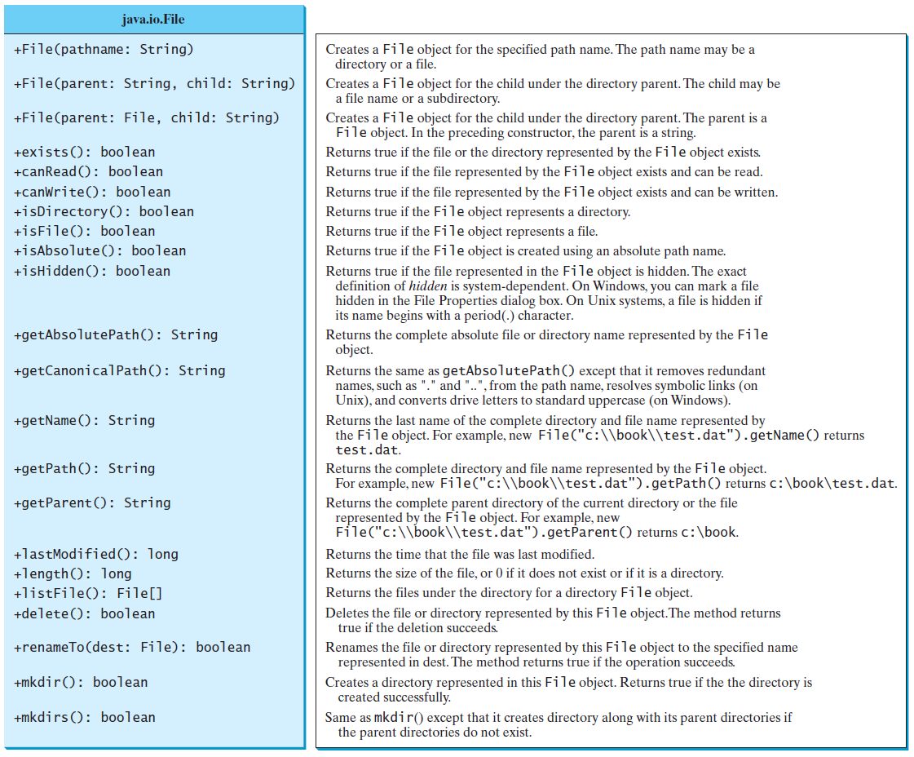
Obtaining file properties and manipulating file

Slide 54
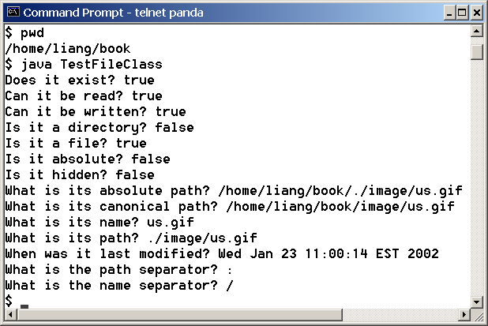
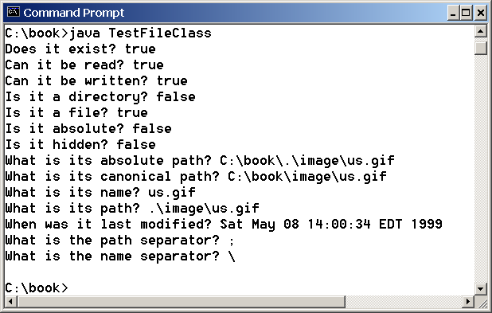
Problem: Explore File Properties
Objective: Write a program that demonstrates how to create files in a platform-independent way and use the methods in the File class to obtain their properties. The following figures show a sample run of the program on Windows and on Unix.
TestFileClass
Run

Slide 55
Text I/O
A File object encapsulates the properties of a file or a path, but does not contain the methods for reading/writing data from/to a file.
In order to perform I/O, you need to create objects using appropriate Java I/O classes. The objects contain the methods for reading/writing data from/to a file.
We can read/write strings and numeric values from/to a text file using the Scanner and PrintWriter classes.

Slide 56
Writing Data Using PrintWriter
WriteData
Run

Slide 57
Try-with-resources
Programmers often forget to close the file.
JDK 7 provides the followings new try-with-resources syntax that automatically closes the files.
try (declare and create resources) {
Use the resource to process the file;
}
WriteDataWithAutoClose
Run

Slide 58
Reading Data Using Scanner
ReadData
Run

Slide 59
Problem: Replacing Text
Write a class named ReplaceText that replaces a string in a text file with a new string. The filename and strings are passed as command-line arguments as follows:
java ReplaceText sourceFile targetFile oldString newString
For example, invoking
java ReplaceText FormatString.java t.txt StringBuilder StringBuffer
replaces all the occurrences of StringBuilder by StringBuffer in FormatString.java and saves the new file in t.txt.
ReplaceText
Run

Slide 60
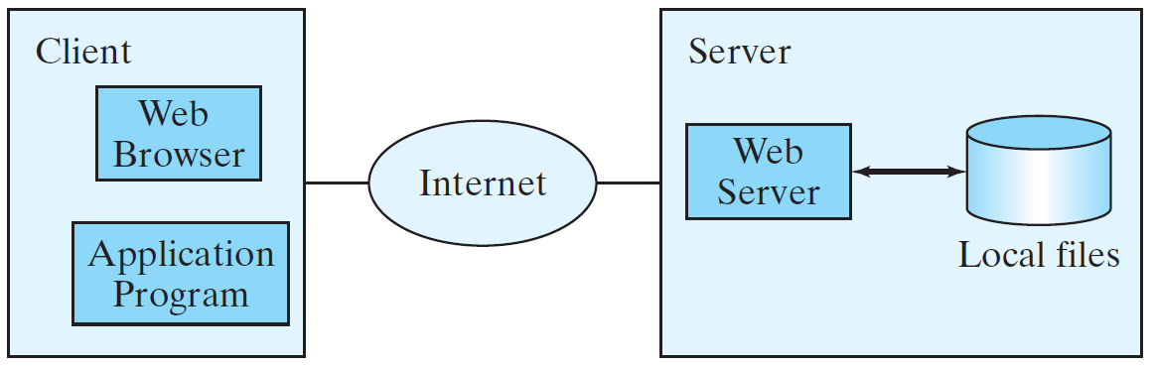
Reading Data from the Web
Just like you can read data from a file on your computer, you can read data from a file on the Web.

Slide 61
Reading Data from the Web
URL url = new URL("www.google.com/index.html");
After a URL object is created, you can use the openStream() method defined in the URL class to open an input stream and use this stream to create a Scanner object as follows:
Scanner input = new Scanner(url.openStream());
ReadFileFromURL
Run

Slide 62
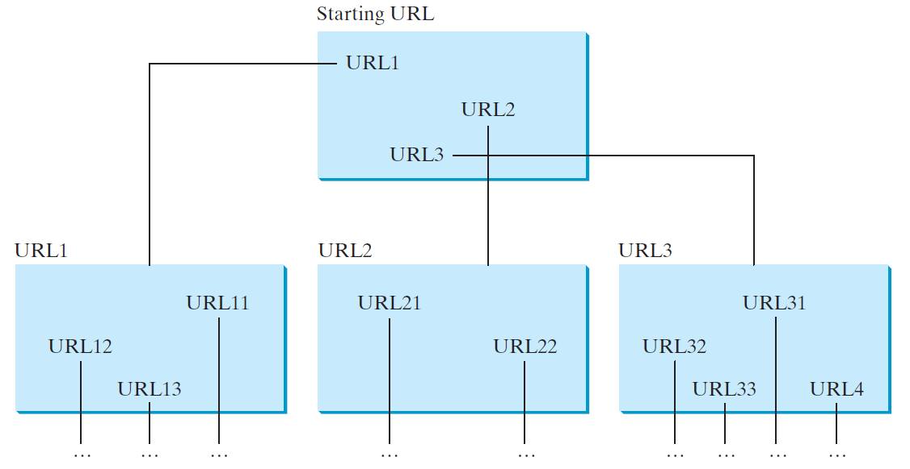
Case Study: Web Crawler
This case study develops a program that travels the Web by following hyperlinks.

Slide 63
Case Study: Web Crawler
The program follows the URLs to traverse the Web.
To avoid that each URL is traversed only once, the program maintains two lists of URLs:
list 1 stores the URLs pending for traversing
list 2 stores the URLs that have already been traversed

Slide 64
Case Study: Web Crawler
Add the starting URL to a list named listOfPendingURLs;
while listOfPendingURLs is not empty {
Remove a URL from listOfPendingURLs;
if this URL is not in listOfTraversedURLs {
Add it to listOfTraversedURLs;
Display this URL;
Exit the while loop when the size of S is equal to 100.
Read the page from this URL and for each URL contained in the page {
Add it to listOfPendingURLs if it is not is listOfTraversedURLs;
}
}
}
WebCrawler
Run

