Slide 1
Chapter 32 Multithreading and Parallel Programming

Slide 2
Objectives
To get an overview of multithreading (§32.2).
To develop task classes by implementing the Runnable interface (§32.3).
To create threads to run tasks using the Thread class (§32.3).
To control threads using the methods in the Thread class (§32.4).
To control animations using threads and use Platform.runLater to run the code in application thread (§32.5).
To execute tasks in a thread pool (§32.6).
To use synchronized methods or blocks to synchronize threads to avoid race conditions (§32.7).
To synchronize threads using locks (§32.8).
To facilitate thread communications using conditions on locks (§§32.9–32.10).
To use blocking queues to synchronize access to an array queue, linked queue, and priority queue (§32.11).
To restrict the number of accesses to a shared resource using semaphores (§32.12).
To use the resource-ordering technique to avoid deadlocks (§32.13).
To describe the life cycle of a thread (§32.14).
To create synchronized collections using the static methods in the Collections class (§32.15).
To develop parallel programs using the Fork/Join Framework (§32.16).

Slide 3
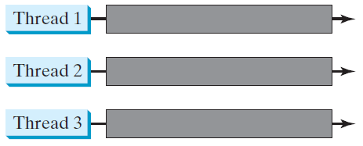
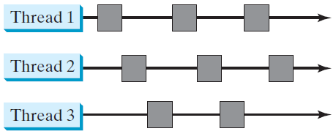
Threads Concept
Multiple threads on multiple CPUs
Multiple threads sharing a single CPU

Slide 4
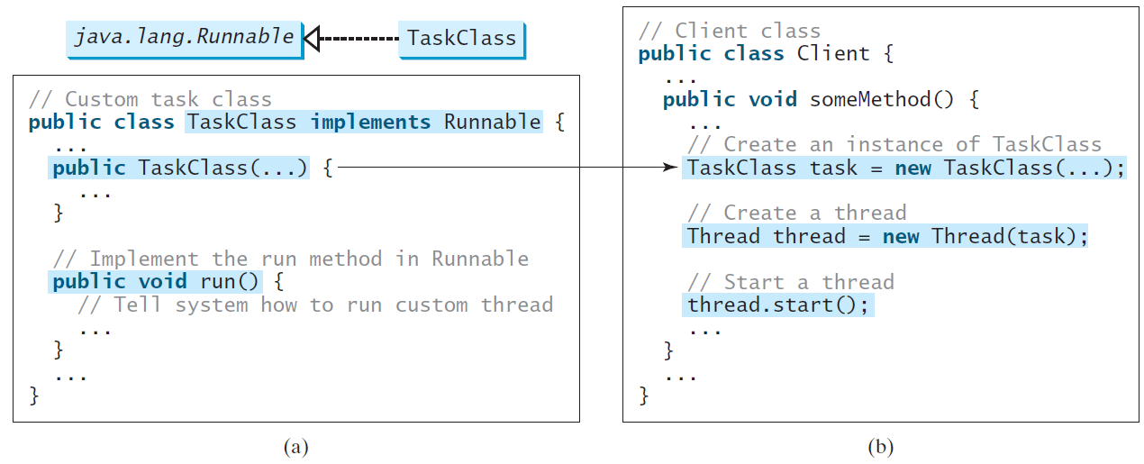
Creating Tasks and Threads

Slide 5
Example: Using the Runnable Interface to Create and Launch Threads
Objective: Create and run three threads:
The 1st thread prints the letter a 100 times.
The 2nd thread prints the letter b 100 times.
The 3rd thread prints the integers 1 through 100.
System.out.print(charToPrint);
to
System.out.print(" "+charToPrint);
TaskThreadDemo
Run

Slide 6
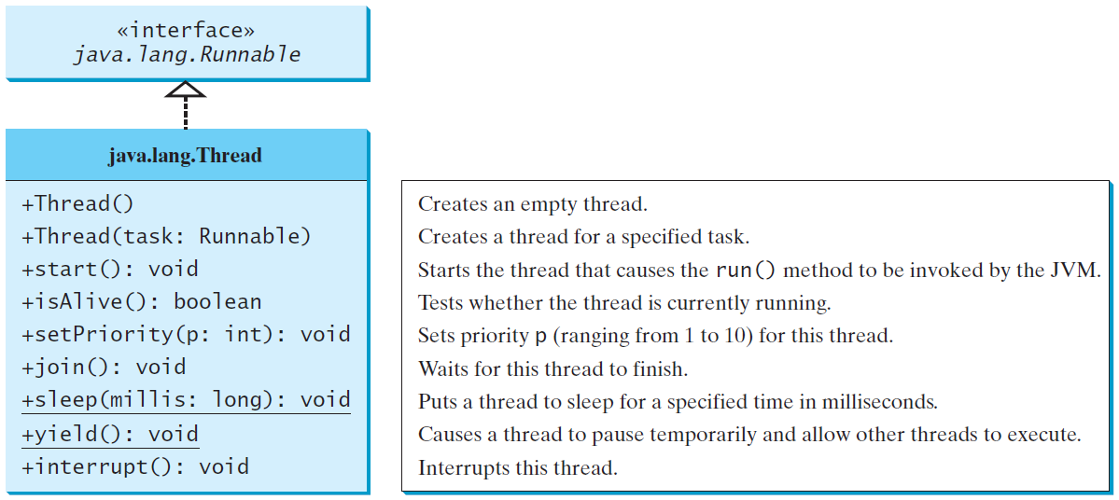
The Thread Class

Slide 7
The Static yield() Method
You can use the yield() method to temporarily release time for other threads. For example, suppose you modify the code in Lines 53-57 in TaskThreadDemo.java as follows:
public void run() {
for (int i = 1; i <= lastNum; i++) {
System.out.print(" " + i);
Thread.yield();
}
}
Every time a number is printed, the print100 thread is yielded. So, the numbers are printed after the characters.

Slide 8
The Static sleep(milliseconds) Method
The sleep(long mills) method puts the thread to sleep for the specified time in milliseconds. For example, suppose you modify the code in Lines 53-57 in TaskThreadDemo.java as follows:
public void run() {
for (int i = 1; i <= lastNum; i++) {
System.out.print(" " + i);
try {
if (i >= 50) Thread.sleep(1);
}
catch (InterruptedException ex) {
}
}
}
Every time a number (>= 50) is printed, the print100 thread is put to sleep for 1 millisecond.

Slide 9
The join() Method
You can use the join() method to force one thread to wait for another thread to finish. For example, suppose you modify the code in Lines 53-57 in TaskThreadDemo.java as follows:
The numbers after 50 are printed after thread printA is finished.

Slide 10
isAlive(), interrupt(), and isInterrupted()
The isAlive() method is used to find out the state of a thread. It returns true if a thread is in the Ready, Blocked, or Running state; it returns false if a thread is new and has not started or if it is finished.
The interrupt() method interrupts a thread in the following way: If a thread is currently in the Ready or Running state, its interrupted flag is set; if a thread is currently blocked, it is awakened and enters the Ready state, and an java.io.InterruptedException is thrown.
The isInterrupt() method tests whether the thread is interrupted.

Slide 11
The deprecated stop(), suspend(), and resume() Methods
NOTE: The Thread class also contains the stop(), suspend(), and resume() methods.
As of Java 2, these methods are deprecated (or outdated) because they are known to be inherently unsafe.
You should assign null to a Thread variable to indicate that it is stopped rather than use the stop() method.

Slide 12
Thread Priority
Each thread is assigned a default priority of Thread.NORM_PRIORITY. You can reset the priority using setPriority(int priority).
Some constants for priorities include Thread.MIN_PRIORITY Thread.MAX_PRIORITY Thread.NORM_PRIORITY

Slide 13


Example: Flashing Text
FlashText
Run

Slide 14
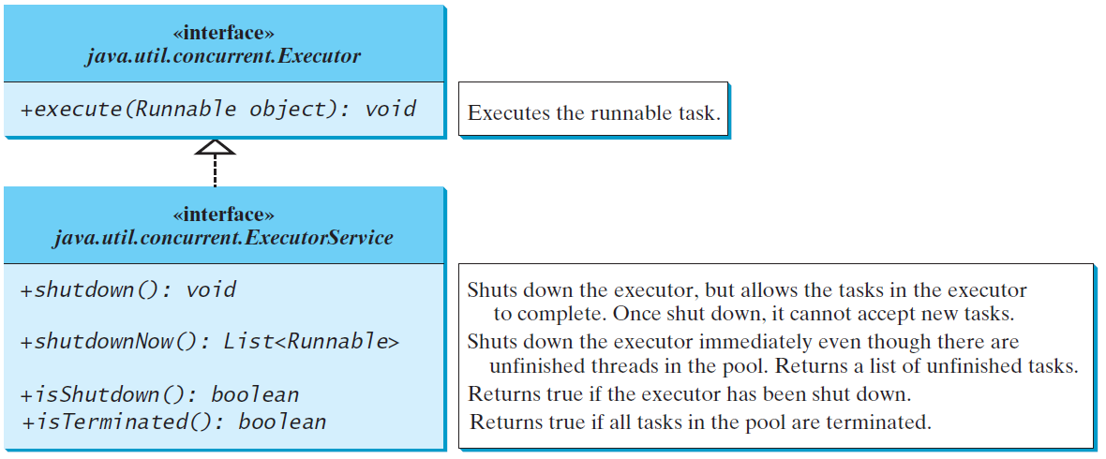
Thread Pools
Starting a new thread for each task could limit throughput and cause poor performance. A thread pool is ideal to manage the number of tasks executing concurrently.
JDK 1.5 uses the Executor interface for executing tasks in a thread pool and the ExecutorService interface for managing and controlling tasks.

Slide 15
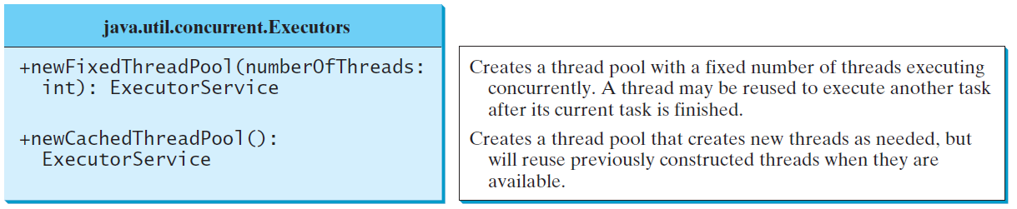
Creating Executors
To create an Executor object, use the static methods in the Executors class.
ExecutorDemo
Run

Slide 16
Thread Synchronization
A shared resource may be corrupted if it is accessed simultaneously by multiple threads. For example, two unsynchronized threads accessing the same bank account may cause conflict.

Slide 17
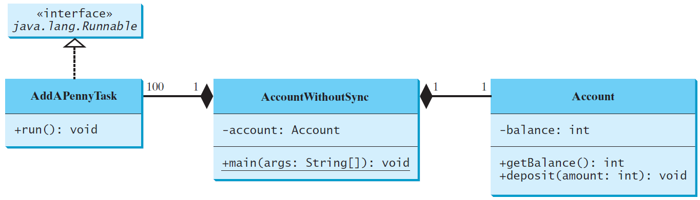
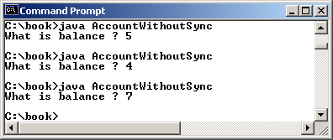
Example: Showing Resource Conflict
Objective: Write a program that demonstrates the problem of resource conflict. Suppose that you create and launch one hundred threads, each of which adds a penny to an account. Assume that the account is initially empty.
AccountWithoutSync
Run

Slide 18
Race Condition
What, then, caused the error in the example? Here is a possible scenario:
The effect of this scenario is that Task 1 did nothing, because in Step 4 Task 2 overrides Task 1's result. Obviously, the problem is that Task 1 and Task 2 are accessing a common resource in a way that causes conflict. This is a common problem known as a race condition in multi-threaded programs. A class is said to be thread-safe if an object of the class does not cause a race condition in the presence of multiple threads. As demonstrated in the preceding example, the Account class is not thread-safe.

Slide 19
The synchronized keyword
To avoid race conditions, more than one thread must be prevented from simultaneously entering certain part of the program, known as critical region.
The critical region in the Listing 32.5 is the entire deposit method. You can use the synchronized keyword to synchronize the method so that only one thread can access the method at a time:
public synchronized void deposit(double amount)

Slide 20
Synchronizing Methods
A synchronized method acquires a lock before it executes.
In the case of an instance method, the lock is on the object for which the method was invoked.
In the case of a static method, the lock is on the class.
If one thread invokes a synchronized method, the lock of that object (or class) is acquired first, then the method is executed, and finally the lock is released.
Another thread invoking the same method of that object (or class) is blocked until the lock is released.

Slide 21
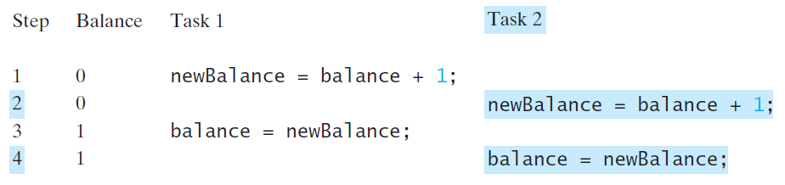
Synchronizing Methods
With the deposit method synchronized, the preceding scenario cannot happen.
If Task 2 starts to enter the method, and Task 1 is already in the method, Task 2 is blocked until Task 1 finishes the method.

Slide 22
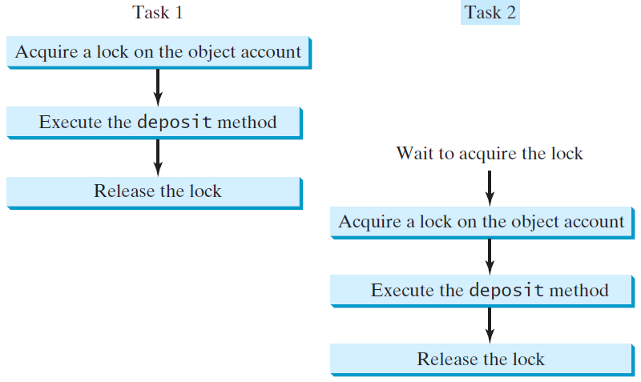
Synchronizing Tasks

Slide 23
Synchronizing Statements
A synchronized statement can be used to acquire a lock on any object, not just this object, when executing a block of the code in a method.
Following block is referred to as a synchronized block:
synchronized (expr) {
statements;
}
The expression expr must evaluate to an object reference
If the object is already locked by another thread, the thread is blocked until the lock is released.
When a lock is obtained on the object, the statements in the synchronized block are executed, and then the lock is released.

Slide 24
Synchronizing Statements vs. Methods
Any synchronized instance method can be converted into a synchronized statement.
Suppose that the following is a synchronized instance method:
public synchronized void xMethod() {
// method body
}
This method is equivalent to
public void xMethod() {
synchronized (this) {
// method body
}
}

Slide 25
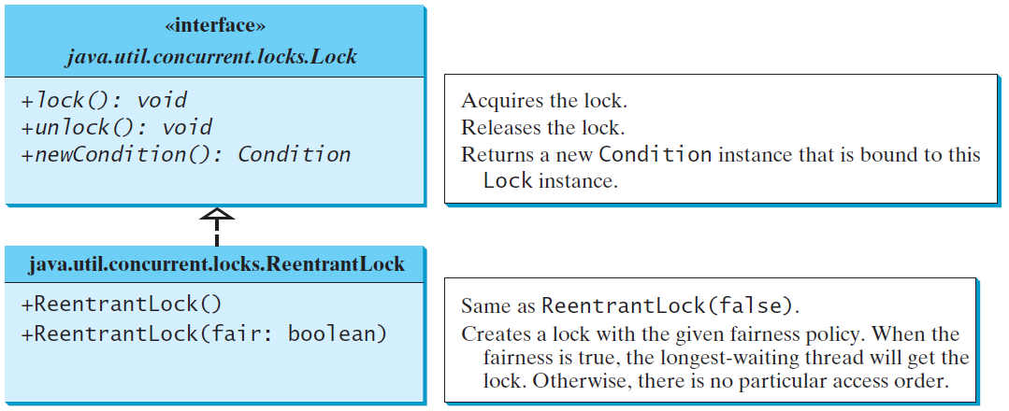
Synchronization Using Locks
A synchronized instance method implicitly acquires a lock on the instance before it executes the method. JDK 1.5 enables you to use locks explicitly. The new locking features are flexible and give you more control for coordinating threads.
A lock is an instance of the Lock interface, which declares the methods for acquiring and releasing locks. ReentrantLock is a concrete implementation of Lock for creating mutual exclusive locks.

Slide 26
Example: Using Locks
This example revises AccountWithoutSync.java to synchronize the account modification using explicit locks.
AccountWithSyncUsingLock
Run

Slide 27
Fairness Policy
You can create a lock with the specified fairness policy.
True fairness policies guarantee the longest-wait thread to obtain the lock first.
False fairness policies grant a lock to a waiting thread without any access order.
Programs using fair locks accessed by many threads may have poor overall performance than those using the default setting, but have smaller variances in times to obtain locks and guarantee lack of starvation.

Slide 28
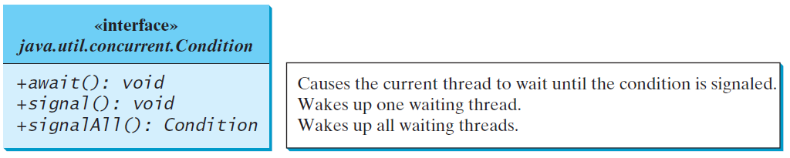
Cooperation Among Threads
A lock may use the newCondition() method to create any number of Condition objects, which can be used to facilitate communications among threads.
A thread can specify what to do under a certain condition.
You can use Condition’s methods for thread communications:
await(): causes the current thread to wait until being signaled.
signal(): wakes up one waiting thread
signalAll(): wakes all waiting threads

Slide 29
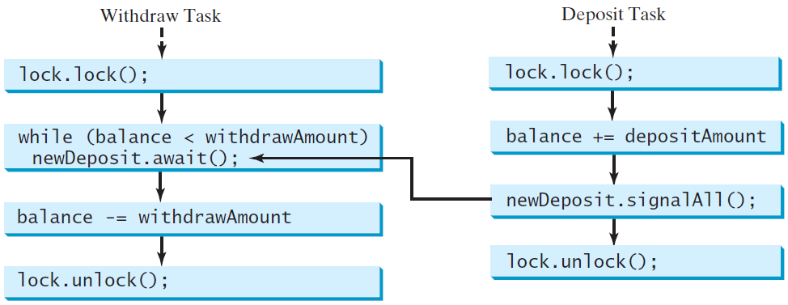
Cooperation Among Threads
To synchronize the operations, use a lock with a condition: newDeposit (i.e., new deposit added to the account).
If the balance is less than the amount to be withdrawn, the withdraw task will wait for the newDeposit condition.
When the deposit task adds money to the account, the task signals the waiting withdraw task to try again.

Slide 30
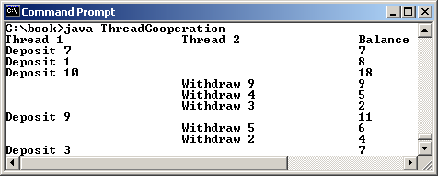
Example: Thread Cooperation
Suppose that you create and launch two threads, one deposits to an account, and the other withdraws from the same account. The second thread has to wait if the amount to be withdrawn is more than the current balance in the account. Whenever new fund is deposited to the account, the first thread notifies the second thread to resume. If the amount is still not enough for a withdrawal, the second thread has to continue to wait for more fund in the account. Assume the initial balance is 0 and the amount to deposit and to withdraw is randomly generated.
ThreadCooperation
Run

Slide 31
Java’s Built-in Monitors (Optional)
Locks and conditions are new in Java 5.
Prior to Java 5, thread communications are programmed using object’s built-in monitors.
Locks and conditions are more powerful and flexible than the built-in monitor. For this reason, this section can be completely ignored.
However, if you work with legacy Java code, you may encounter the Java’s built-in monitor.
A monitor is an object with mutual exclusion and synchronization capabilities. Any object can be a monitor.

Slide 32
Java’s Built-in Monitors (Optional)
Only one thread can execute a method at a time in the monitor.
A thread enters the monitor by acquiring a lock on the monitor and exits by releasing the lock.
An object becomes a monitor once a thread locks it.
Locking is implemented using the synchronized keyword on a method or a block.
A thread must acquire a lock before executing a synchronized method or block.
A thread can wait in a monitor if the condition is not right for it to continue executing in the monitor.

Slide 33
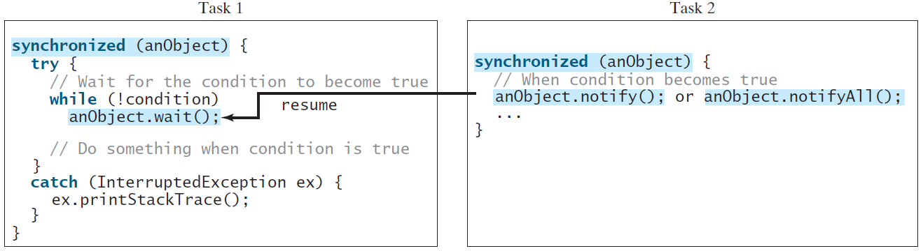
Example: Using Monitor (Optional)
When wait() is invoked, it pauses the thread and simultaneously releases the lock on the object. When the thread is restarted after being notified, the lock is automatically reacquired.
The wait(), notify(), and notifyAll() methods on an object are analogous to the await(), signal(), and signalAll() methods on a condition.
These methods must be called in a synchronized method or a synchronized block on the calling object of these methods. Otherwise, an IllegalMonitorStateException would occur.

Slide 34
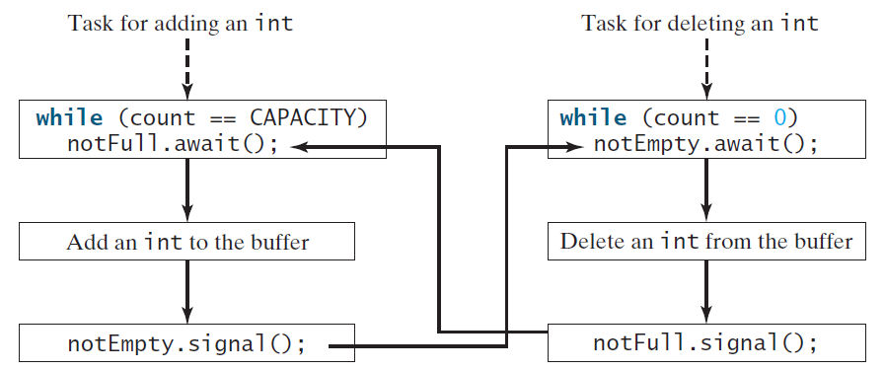
Case Study: Producer/Consumer (Optional)
Suppose you use a buffer to store integers. The buffer size is limited. The buffer provides the method write(int) to add an int value to the buffer and the method read() to read and delete an int value from the buffer. To synchronize the operations, use a lock with two conditions: notEmpty (i.e., buffer is not empty) and notFull (i.e., buffer is not full). When a task adds an int to the buffer, if the buffer is full, the task will wait for the notFull condition. When a task deletes an int from the buffer, if the buffer is empty, the task will wait for the notEmpty condition.

Slide 35
Case Study: Producer/Consumer (Optional)
The program contains the Buffer class and two tasks for repeatedly producing and consuming numbers to and from the buffer. The write(int) method adds an integer to the buffer. The read() method deletes and returns an integer from the buffer.
For simplicity, the buffer is implemented using a linked list. Two conditions notEmpty and notFull on the lock are created. The conditions are bound to a lock. A lock must be acquired before a condition can be applied. If you use the wait() and notify() methods to rewrite this example, you have to designate two objects as monitors.
ConsumerProducer
Run

Slide 36
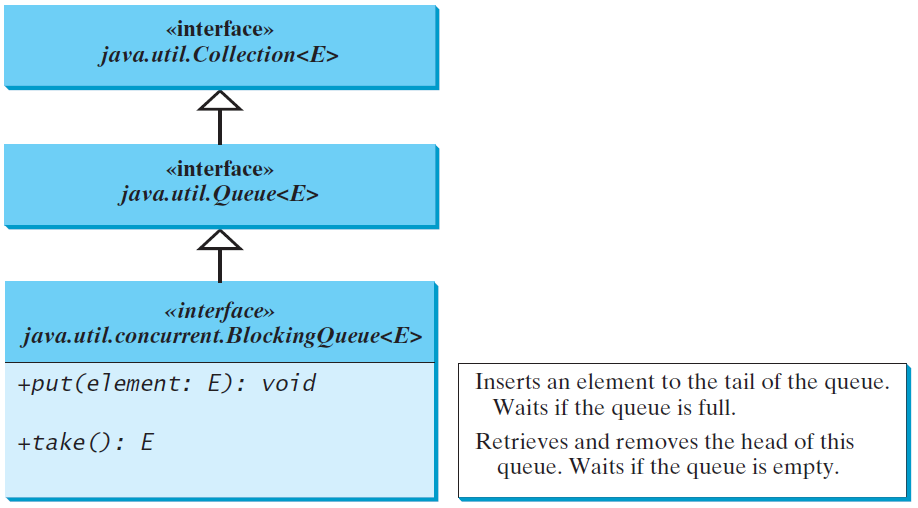
Blocking Queues (Optional)
A blocking queue causes a thread to block when you try to add an element to a full queue or to remove an element from an empty queue.

Slide 37
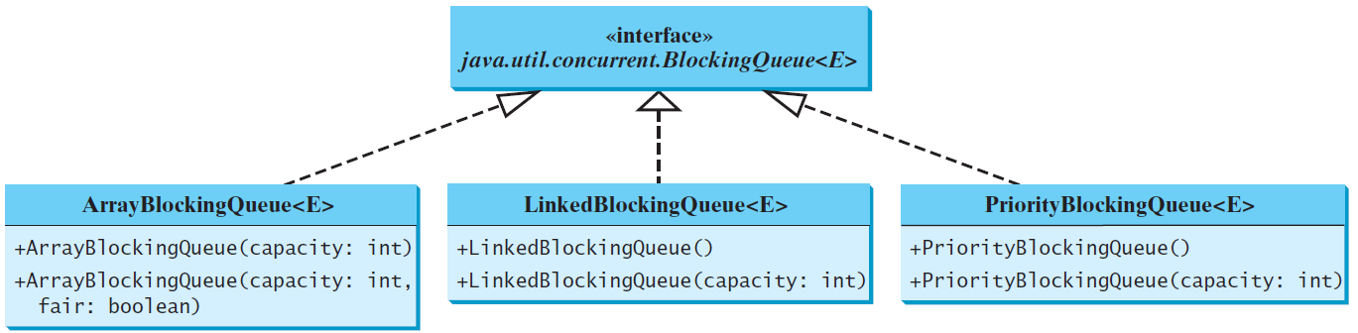
Concrete Blocking Queues (Optional)
Three concrete blocking queues in the java.util.concurrent package
ArrayBlockingQueue
mplements using an array, have to specify a capacity or an optional fairness
LinkedBlockingQueue
implements using a linked list, can be unbounded or bounded
PriorityBlockingQueue
is a priority queue, can be unbounded or bounded

Slide 38
Producer/Consumer Using Blocking Queues
The program gives an example of using an ArrayBlockingQueue for the Consumer/Producer problem.
ConsumerProducerUsingBlockingQueue
Run

Slide 39
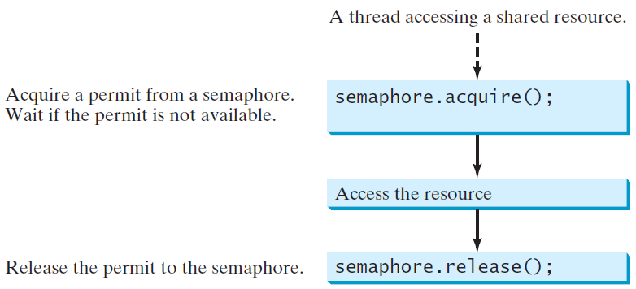
Semaphores (Optional)
Semaphores can be used to restrict the number of threads that access a shared resource.
A Thread must
acquire a permit from the semaphore before accessing
return the permit back to the semaphore after finishing

Slide 40
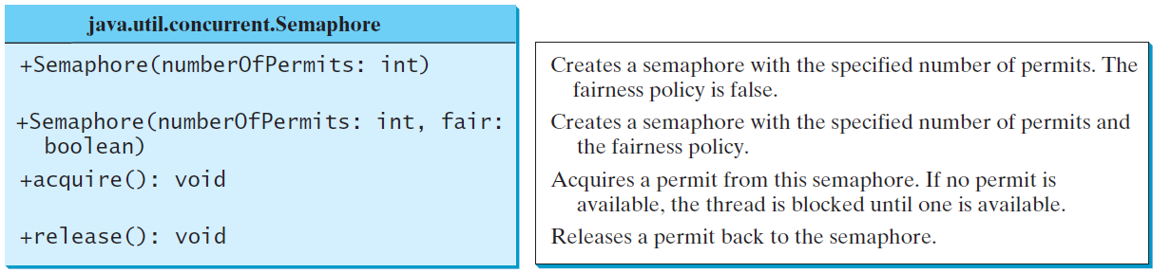
Creating Semaphores (Optional)
To create a semaphore, you have to specify the number of permits with an optional fairness policy.
A task acquires a permit by invoking the semaphore’s acquire() method and releases the permit by invoking the semaphore’s release() method.
The total number of available permits in a semaphore
is reduced by 1 once a permit is acquired
is increased by 1 once a permit is released

Slide 41
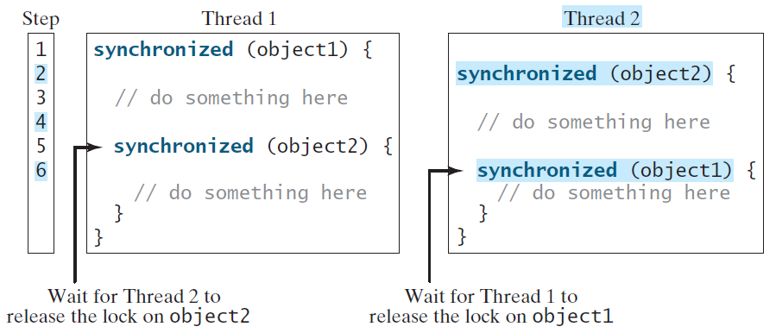
Deadlock
Sometimes two or more threads need to acquire the locks on several shared objects. This could cause deadlock, in which each thread has the lock on one of the objects and is waiting for the lock on the other object. Consider the scenario with two threads and two objects. Thread 1 acquired a lock on object1 and Thread 2 acquired a lock on object2. Now Thread 1 is waiting for the lock on object2 and Thread 2 for the lock on object1. The two threads wait for each other to release the in order to get the lock, and neither can continue to run.

Slide 42
Preventing Deadlock: Resource Ordering
Resource Ordering: assign an order on all the objects whose locks must be acquired and ensure that each thread acquires the locks in that order.
For the example, suppose the objects are ordered as object1 and object2. Using the resource ordering technique, Thread 2 must acquire a lock on object1 first, then on object2. Once Thread 1 acquired a lock on object1, Thread 2 has to wait for a lock on object1. So Thread 1 will be able to acquire a lock on object2 and no deadlock would occur.

Slide 43
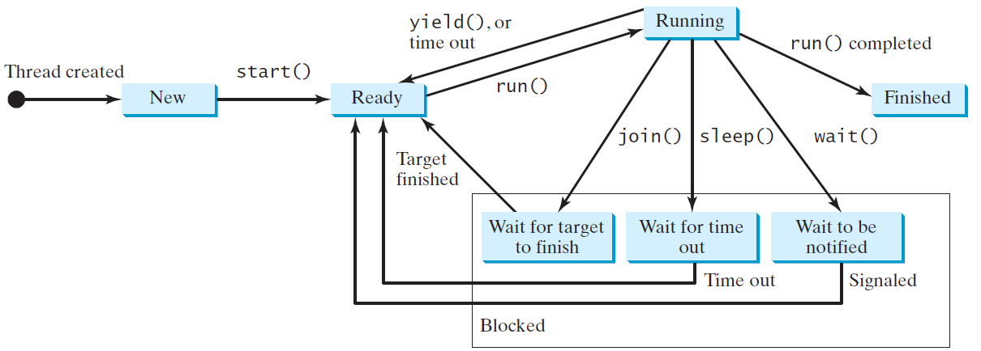
Thread States
A thread can be in one of five states:
New, Ready, Running, Blocked, or Finished.

Slide 44
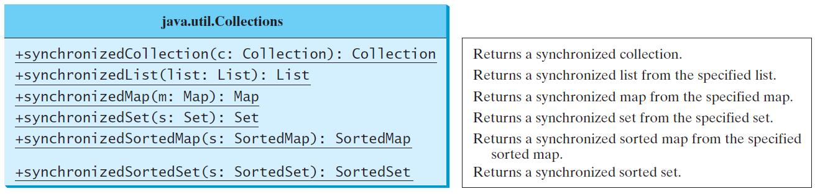
Synchronized Collections
The classes in the Java Collections Framework are not thread-safe, i.e., the contents may be corrupted if they are accessed and updated concurrently by multiple threads. You can protect the data in a collection by locking the collection or using synchronized collections.
The Collections class provides six static methods for wrapping a collection into a synchronized version. The collections created using these methods are called synchronization wrappers.

Slide 45
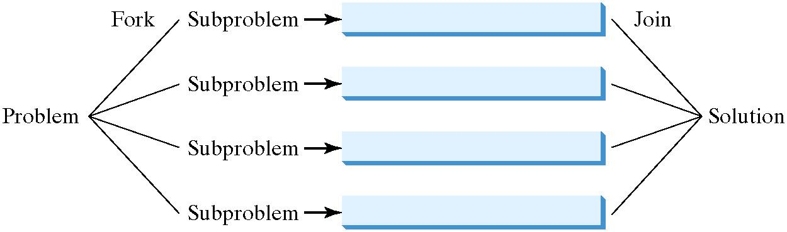
The Fork/Join Framework
To benefit from multicore processors, software needs to run in parallel.
JDK 7 introduces Fork/Join Framework for parallel programming, where a fork can be viewed as an independent task that runs on a thread.

Slide 46
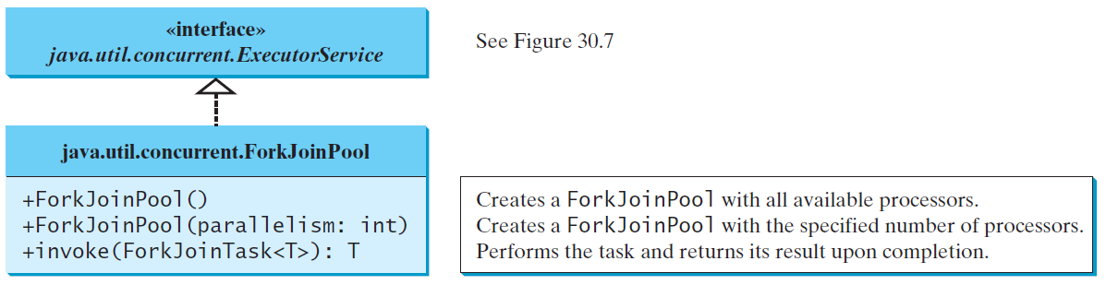
ForkJoinTask and ForkJoinPool
ForkJoinTask class defines a task executed in an instance of ForkJoinPool.

Slide 47
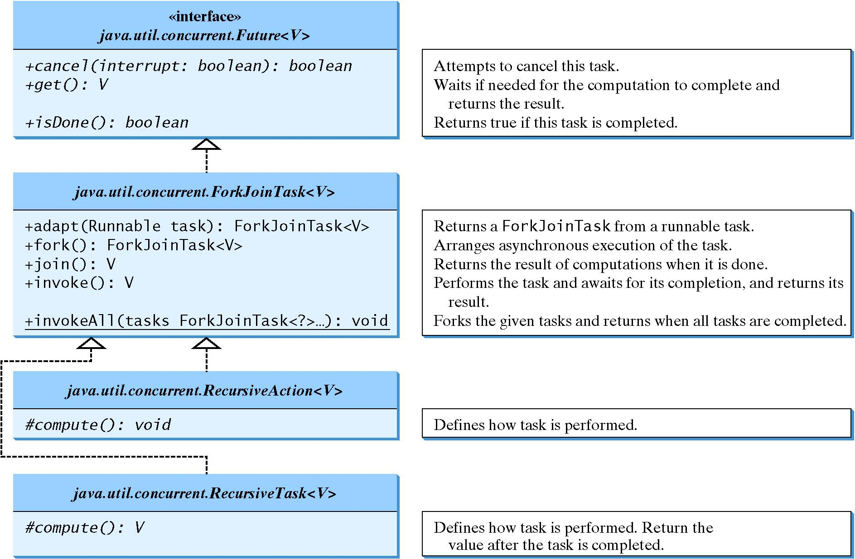
ForkJoinTask

Slide 48
Examples
ParallelMergeSort
Run
ParallelMax
Run

