Slide 1
Vehicle networks infrastructure
L03 exercise – CAN bus – Basic

Slide 2
Vehicle networks infrastructure
Available databases:
DBC – Data Base for CAN
LDF – LIN Description File
FIBEX – Field Bus Exchange Format (FlexRay, MOST, CAN, TTCAN, LIN and Ethernet)
ARXML – AutoSAR XML (FlexRay, MOST, CAN, TTCAN, LIN and Ethernet)

Slide 3

DBC format
The entire communication in the CAN network of one car is described in a special file that is recognizable by the fact that it ends with the extension .dbc (Data Base for CAN).
The tool that allows us to load existing .dbc files, modify them as well as create new .dbc files, is called CANdb ++ Editor.
The image shows the appearance of the window after starting the tool.

Slide 4
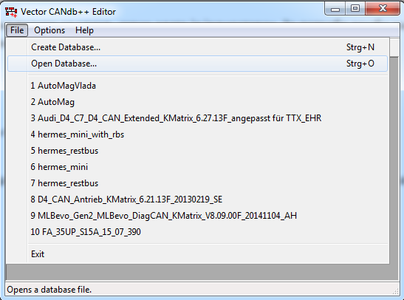
DBC format
Upload of .dbc file to CANdb ++ Editor tool

Slide 5
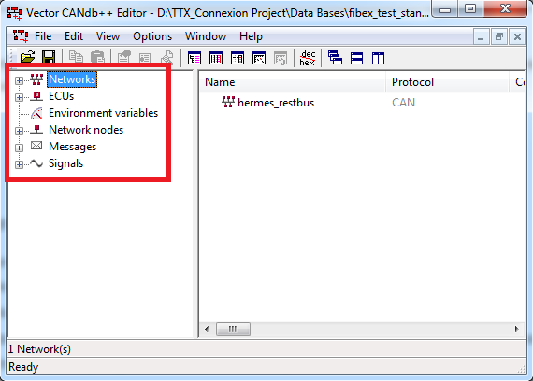
DBC format
After uploading the file, you get an insight into the entire CAN network with all the relevant parameters that describe it:
Networks
Control units
Environment variables
Network nodes
Messages
Signals

Slide 6
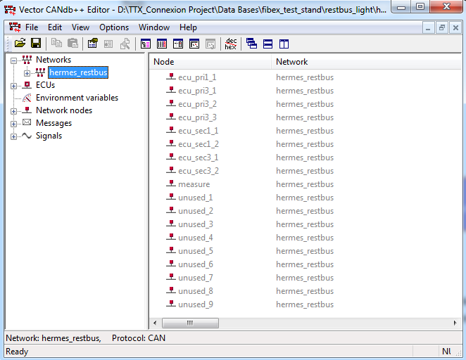
DBC format
CAN networks
All CAN networks can be defined with several smaller sub-networks, so-called clusters.
All clusters in the CAN network are located in the Networks section.
In the example of the .dbc file, the entire CAN network consists of one group, "hermes_restbus".

Slide 7
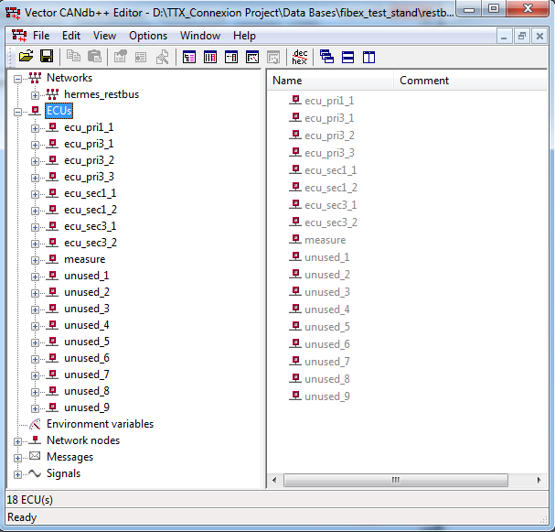
DBC format
CAN control units (ECUs)
CAN control units are distributed processor units within a CAN network.
The data which control unit exchange with the CAN network is sent and received via network node to which the control unit is connected.

Slide 8
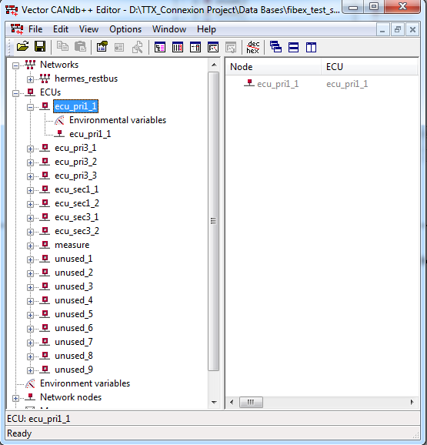
DBC format
CAN Control units (ECUs)
By selecting of any control units, the environment variables as well as the network nodes to which the selected control units is connected, become visible.

Slide 9
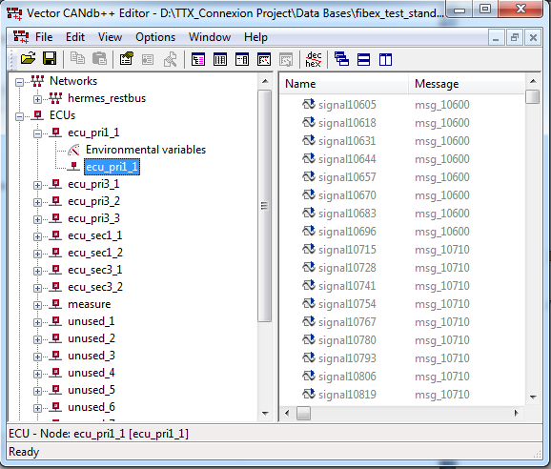
DBC format
CAN Control units (ECUs)
Further selecting of the Network node to which the control unit is connected, all signals become visible, as well as the corresponding messages.

Slide 10
DBC format
CAN Environment variables
Environment variables are variables that are associated with a control unit.

Slide 11
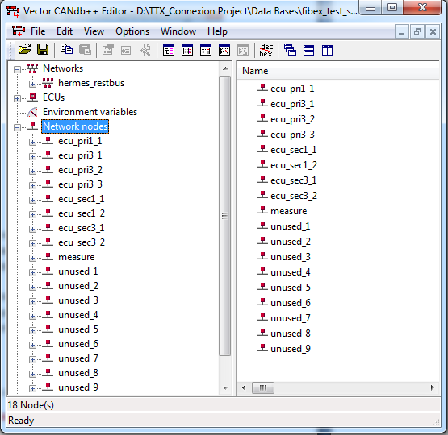
DBC format
CAN network nodes
CAN network nodes are the connection in communication of control units with the CAN network.
All messages and signals that the control unit sends to the network and receives from the network, are processed via network nodes.
List of all network nodes is available after selecting Network nodes.

Slide 12
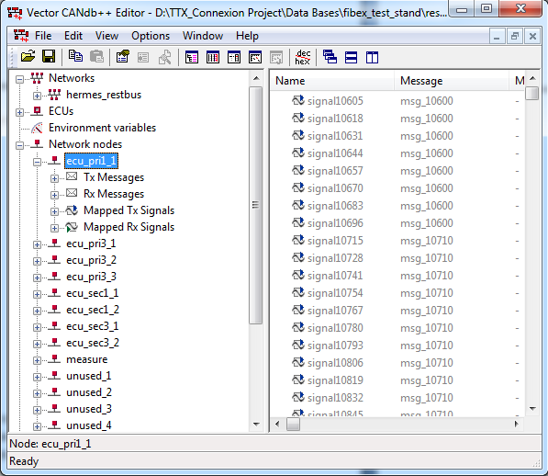
DBC format
CAN network nodes
For each selected network node, transmit messages, receive messages, mapped transmit and receive signals can be seen.

Slide 13
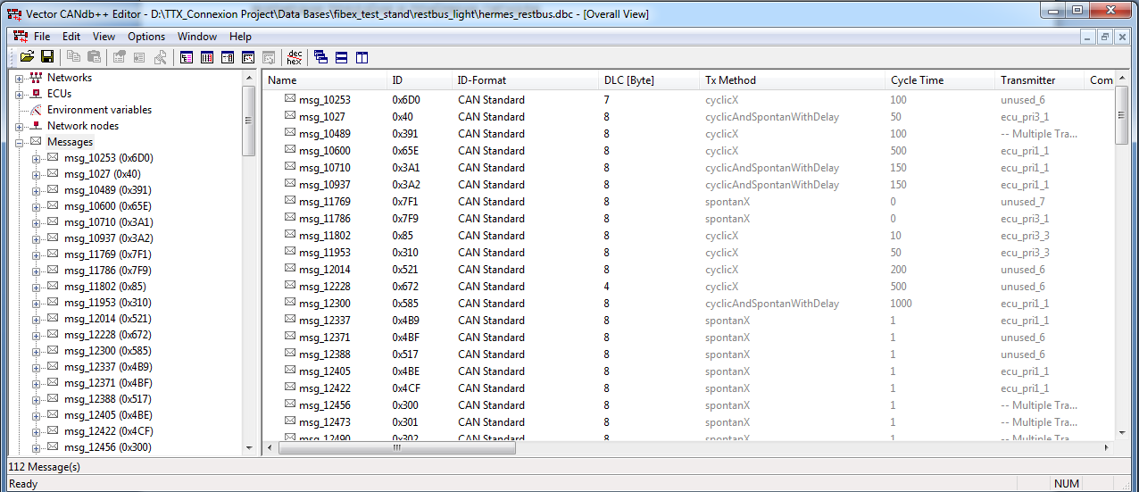
DBC format
CAN Messages
Each CAN message in the .dbc file is defined by the following parameters:
Symbolic message name
Unique identification number
Number of bytes in the segment for data DLC (Data Length Code)
Type of delivery (cyclically; spontaneously; cyclically and spontaneously)
Cycle time
Signals defined within the message

Slide 14
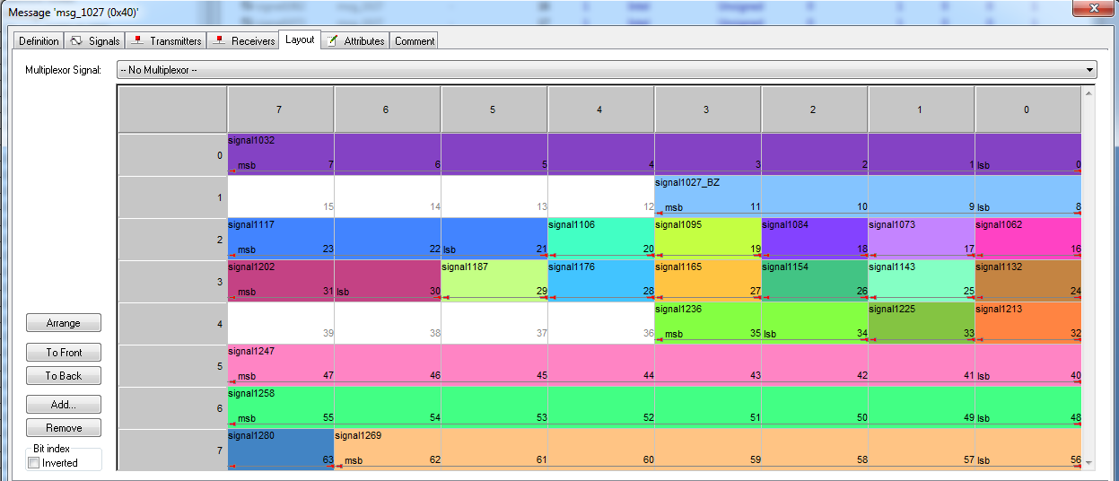
DBC format
CAN Messages
Signals within the CAN message
By double-clicking on any message and then selecting the Layout tab, you can see all the defined signals within the selected message.
The starting bit of each signal is given as well as the bit arrangement within the signal lsb (least significant bit) or msb (most significant bit).

Slide 15
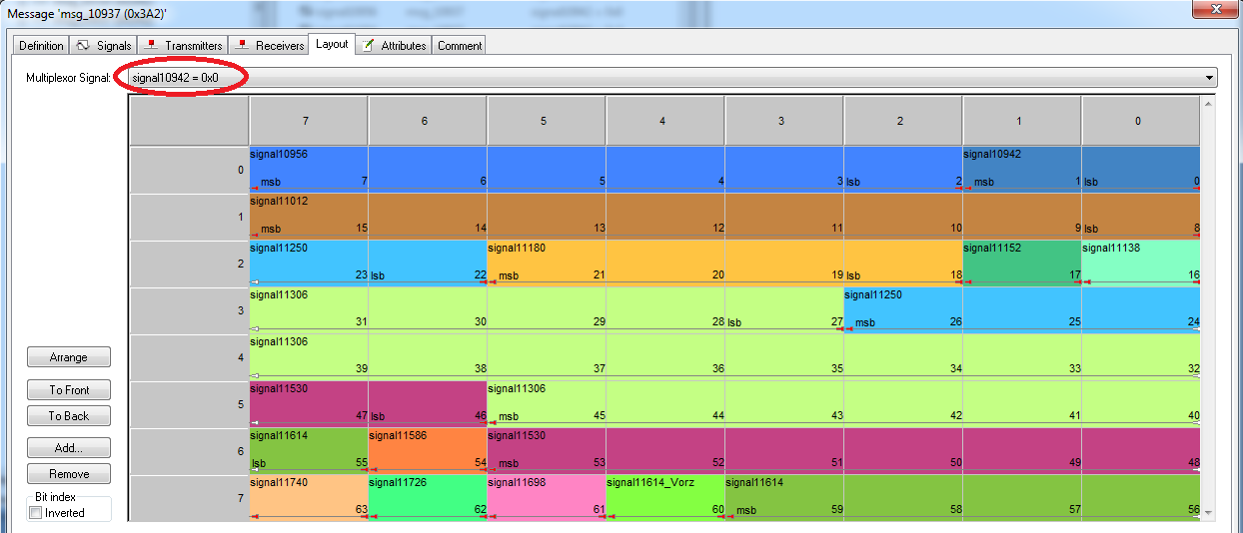
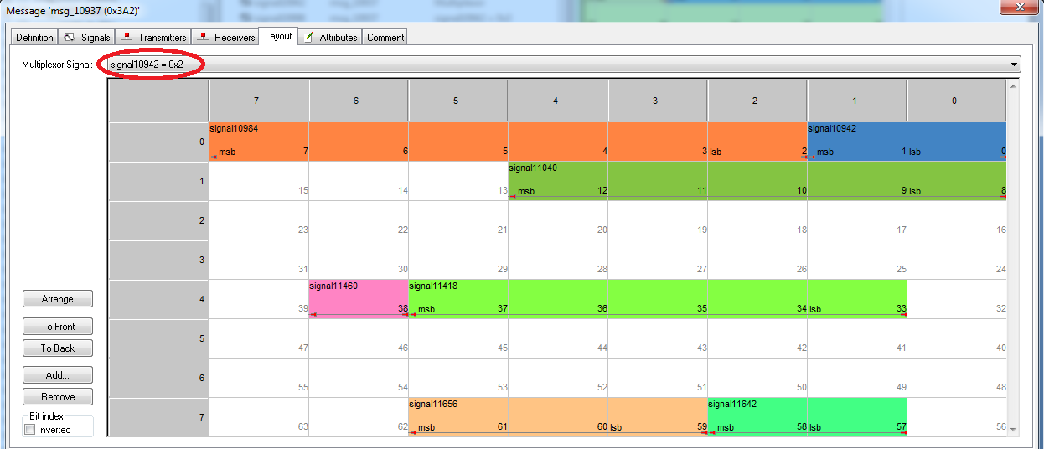
DBC format
CAN Messages
CAN multiplex messages
These messages are specific in that a so-called multiplex signal is defined within the message.
Depending on the value of the multiplex signal, the content of the message also changes.

Slide 16
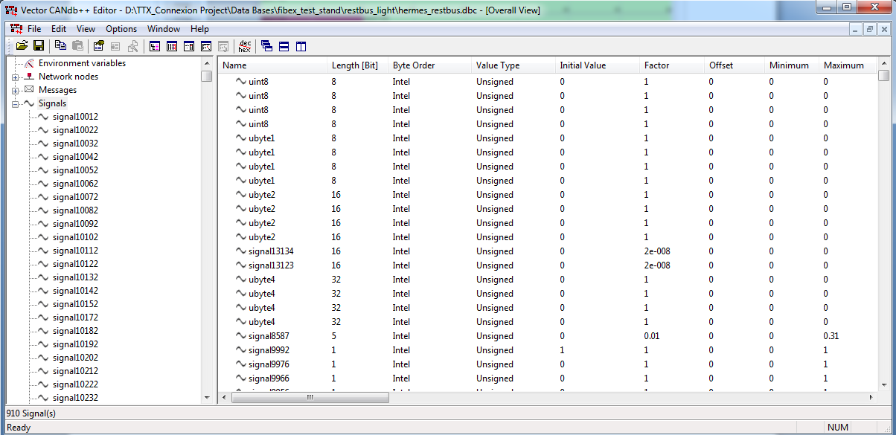
DBC format
CAN Signals
Each signal is characterized by:
Symbolic name
The length expressed in bits
Bit arrangement within the signal (Little or Big endian)
Value type
Initial value
Parameters for conversion from „raw“ to „physical“ value
Minimum and maximum values

Slide 17
DBC format
CAN Signals
Signal value types
An overview of the signal types, as well as the ranges for each of the types, is given in the table.
Signal type | Description
Signed | Signed integer The value is in range: 2^(signal length-1) to + 2^(signal length-1)-1
Unsigned | Unsigned Integer The value is in range: 0 to 2^signal length-1
IEEE Float | 32 Bit IEEE Float The value is in range: 3,4 * 10^-38 to 3,4 * 10^38, precision: 7 digit
IEEE Double | 64 Bit IEEE Double The value is in range: 1,7 * 10^-308 tо 1,7 * 10^308, precision: 15 digit

Slide 18
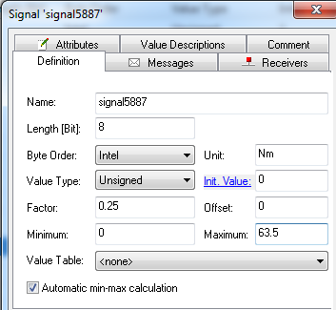
DBC format
CAN Signals
Conversion from raw to physical signal value
Each signal on the CAN bus, within the CAN network, is sent in raw format.
The physical value of a signal is the value of the physical quantity that represents the signal.
The formula that defines the conversion of signals from one format to another is:
[physical value] = [(raw value] * [factor]) + [offset]

Slide 19
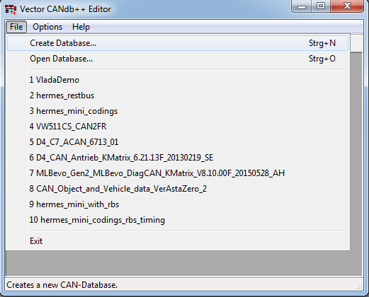
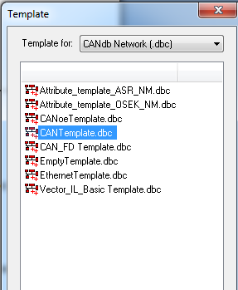
DBC format
Creating a .dbc file

Slide 20
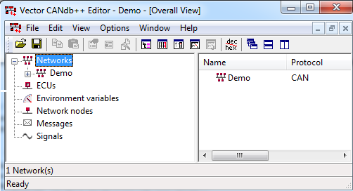
DBC format
CAN network name
After selecting CANTemplate.dbc, a new window will be open where you need to enter the name of the .dbc file you will create and click OK.

Slide 21
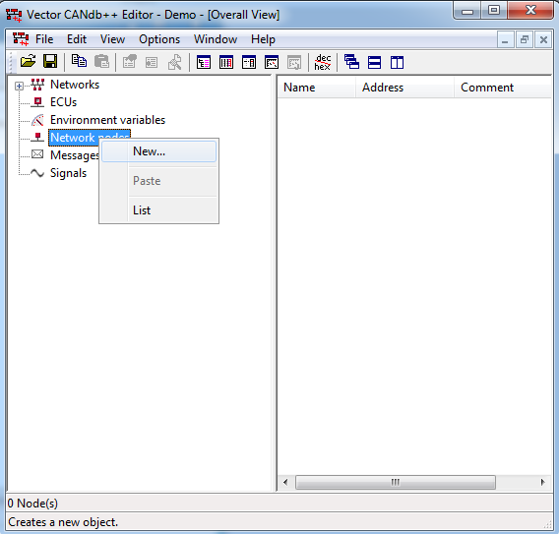
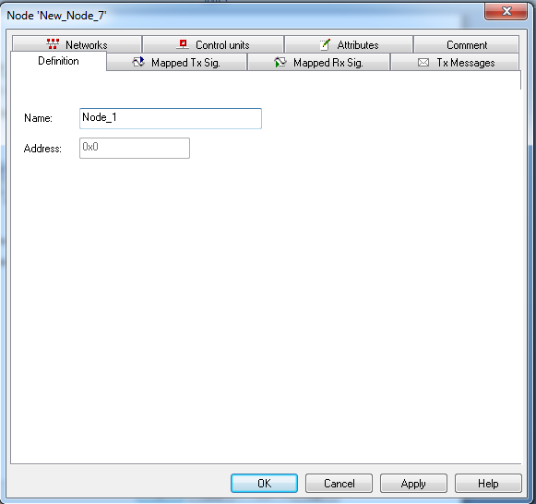
DBC format
Creating a network node

Slide 22
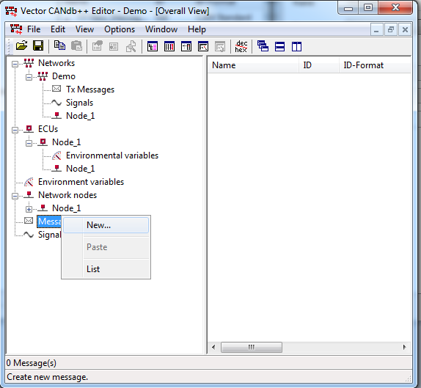
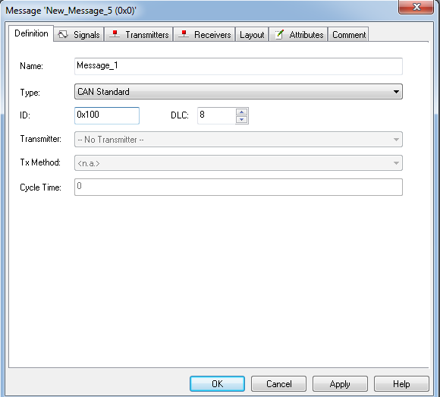
DBC format
Creating a new message

Slide 23
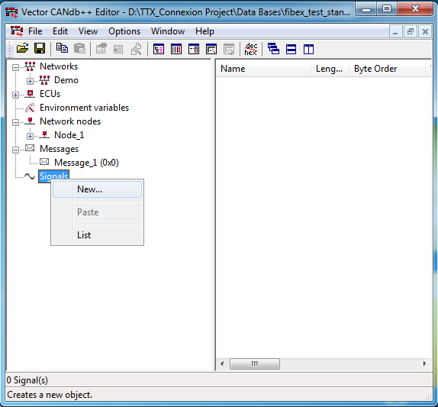
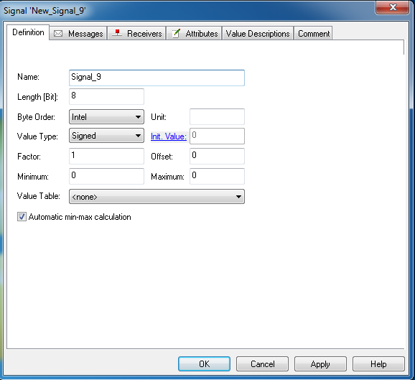
DBC format
Creating a new signal

Slide 24
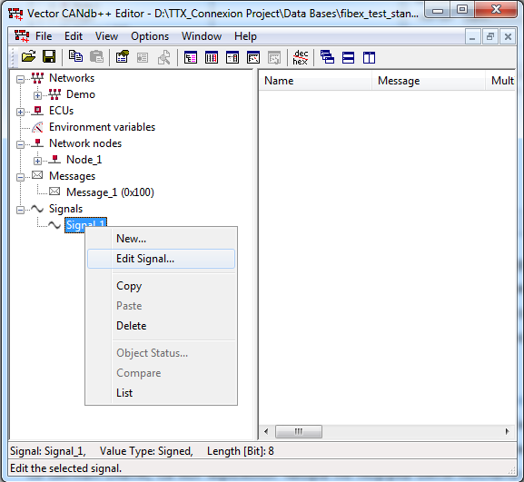
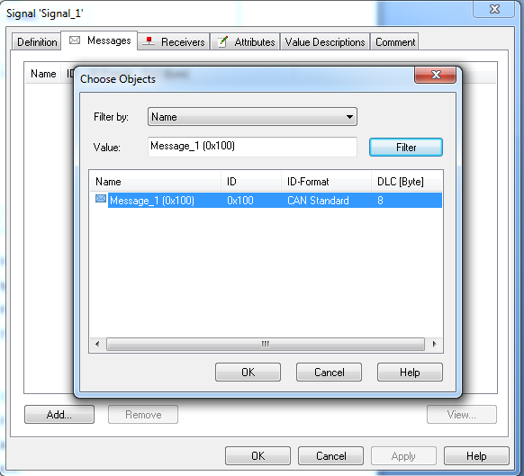
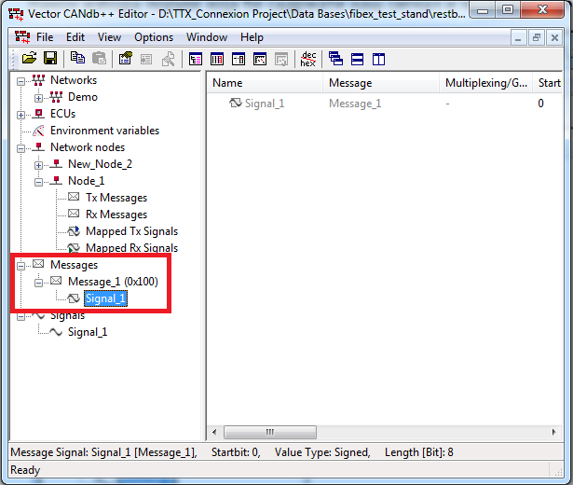
DBC format
Connection of signals, messages and network nodes.
Inserting a signal into the corresponding message

Slide 25
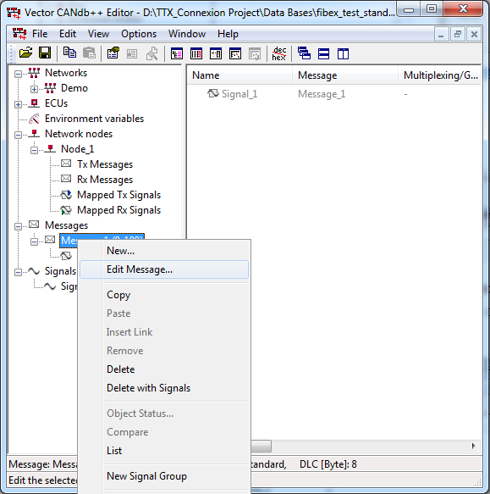
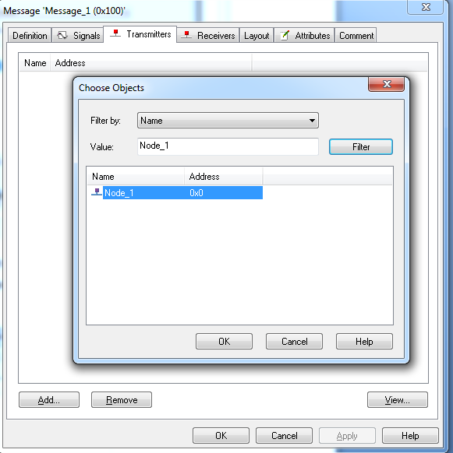
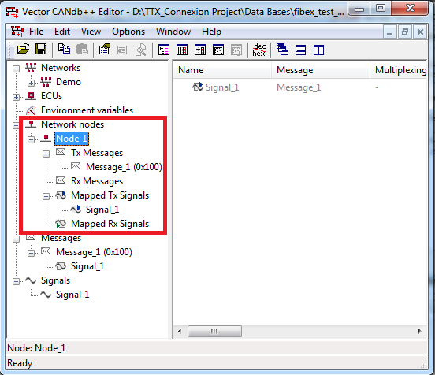
DBC format
Connection of signals, messages and network nodes.
Selection of the network node which will be transmitted for the message.

