Slide 1
Vehicle networks infrastructure
L09 exercise – FlexRay Advance

Slide 2
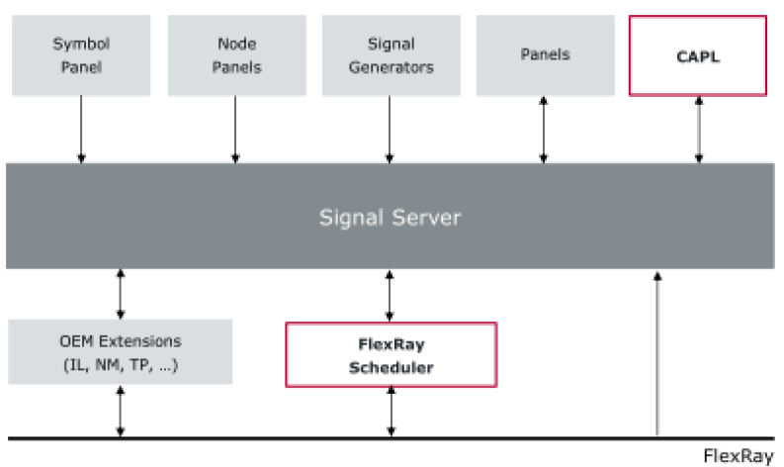
FlexRay Advance
CANoe Signal Server Concept

Slide 3
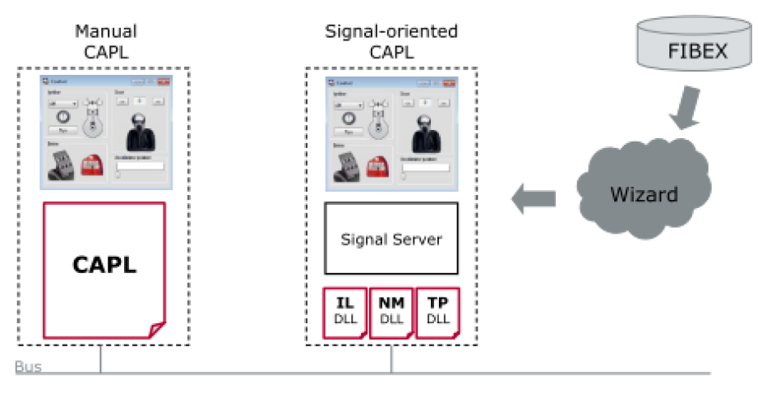
FlexRay Advance
CAPL Advance - recap

Slide 4
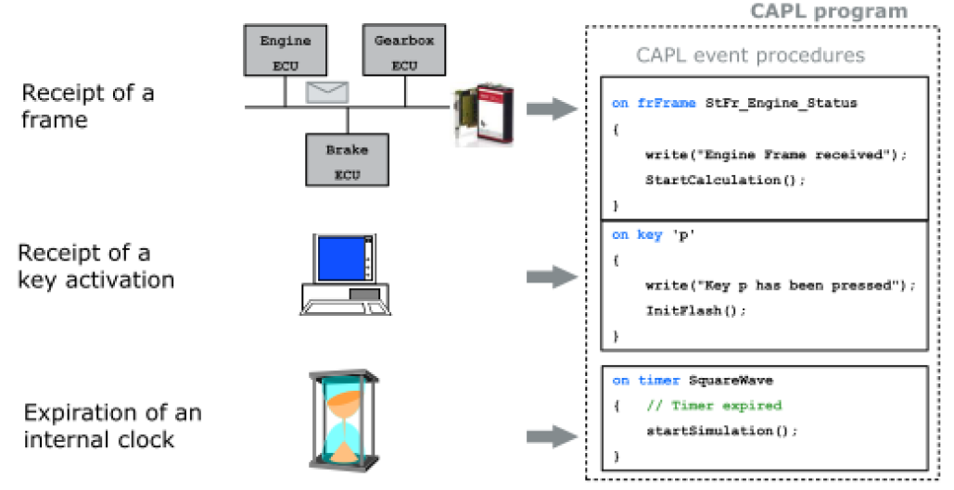
FlexRay Advance
Signal (event) oriented
An event procedure is only processed if its associated event has occurred
FIFO principle
Current event must be finished before the next event starts

Slide 5
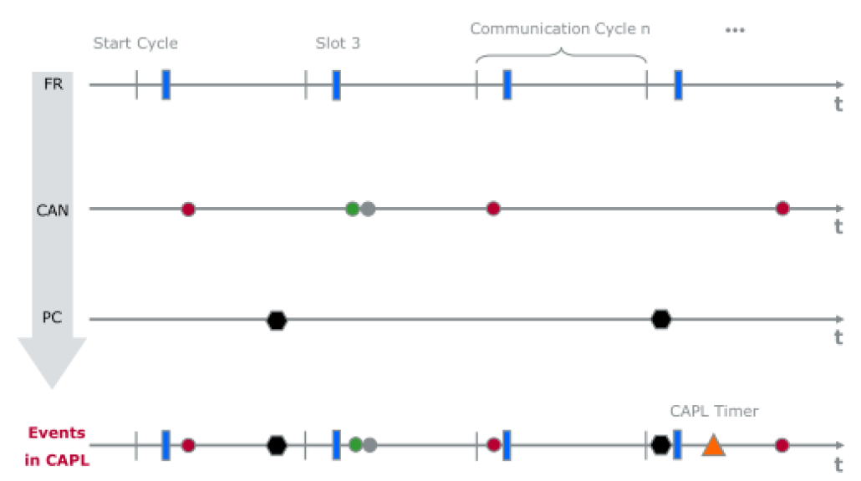
FlexRay Advance
Signal (event) oriented
Event procedures are independent of one another and do not exchange any data directly

Slide 6
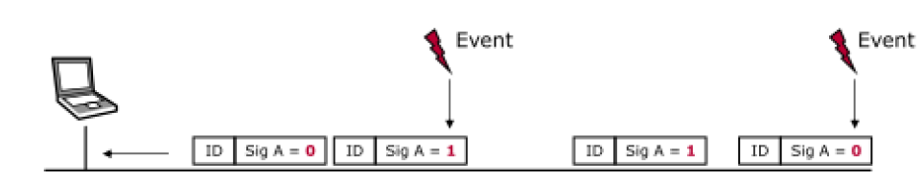
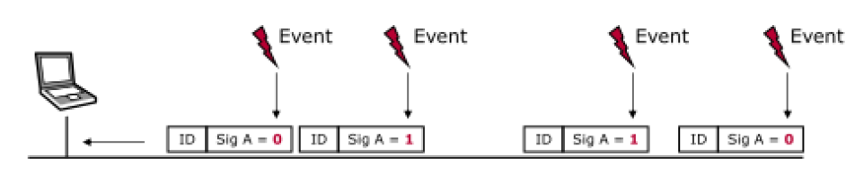
FlexRay Advance
Event procedure: Signal change
On signal <signal_name>
Event procedure: Signal update
On signal_update <signal_name>

Slide 7
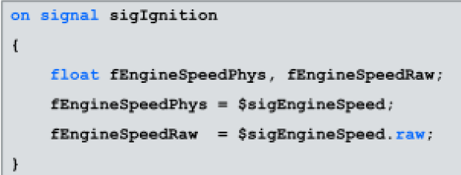
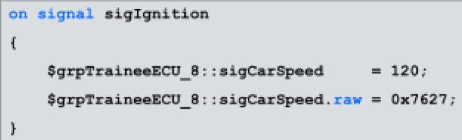
FlexRay Advance
Read signal values: <variable>=$<signal_name>
Write signal values: $<signal_name>= <variable>

Slide 8
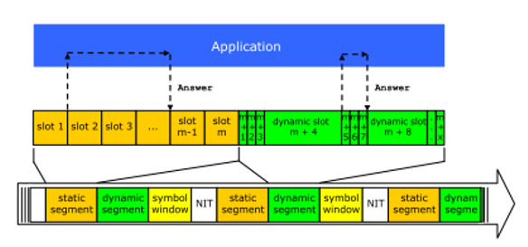
Event orientation and FlexRay
There is no synchronization between the FlexRay communication and execution of the CAPL program
The synchronization of the CAPL program can be established using event procedures

Slide 9
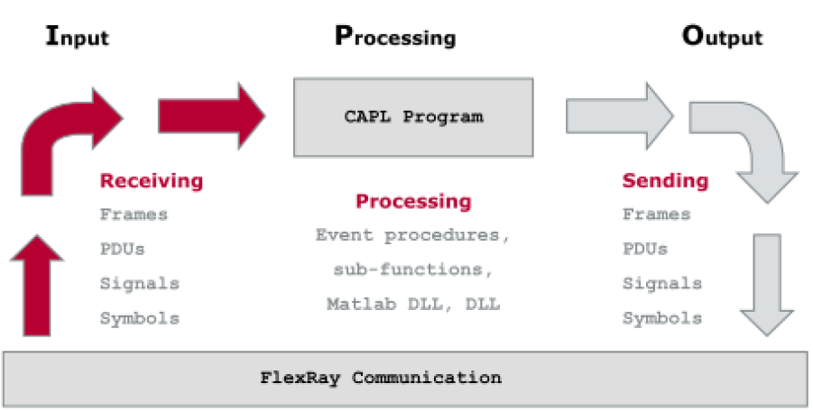
Event orientation and FlexRay
Information on the FlexRay bus is sent out in the form of frames or symbols
The individual signals are part of the frame

Slide 10
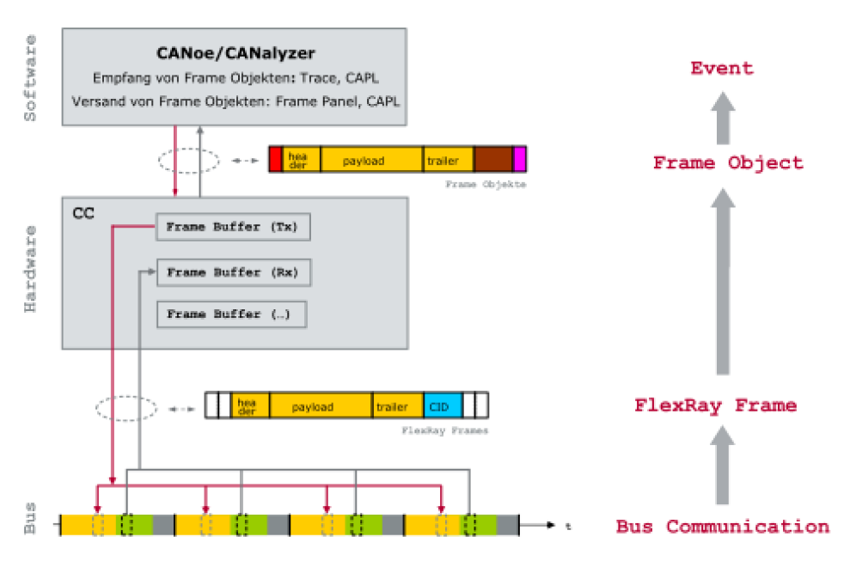
Event orientation and FlexRay
The bits and bytes are organized into the sections of header, payload, and trailer – frame object
All information about Frame Object can be displayed in Trace window

Slide 11
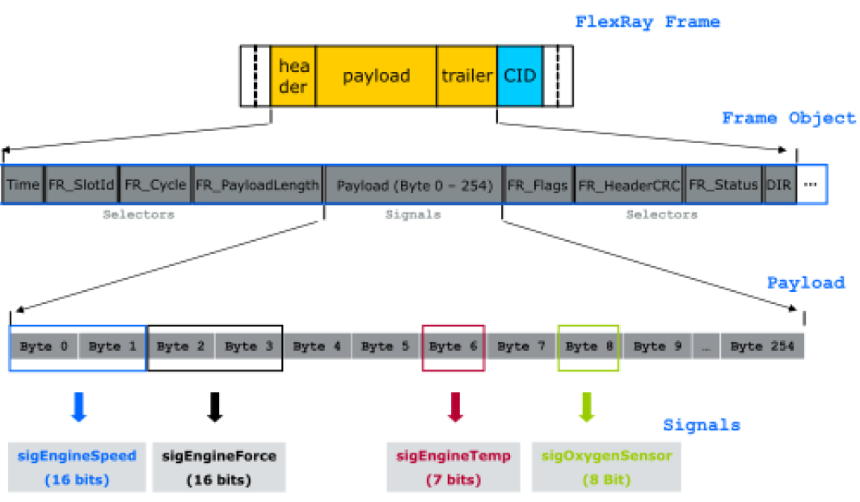
Event orientation and FlexRay
The CAPL program can access selectors and signals of the frame object
Selectors are supplemental information related to the frame
Signals are predefined sections within payload and transport the actual useful data

Slide 12
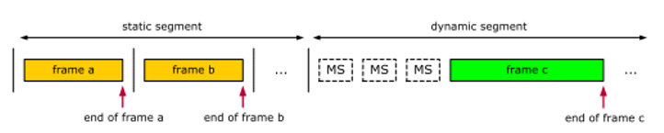
Event orientation and FlexRay
The event procedure is triggered by the end of the received frame
It’s possible to react on static and dynamic frame
The frame object is then available in the event procedure
On FRFrame *,
On FRFrame <name>,
On FRFrame (<slot ID>, <base cycle>, <cycle repetition>)

Slide 13
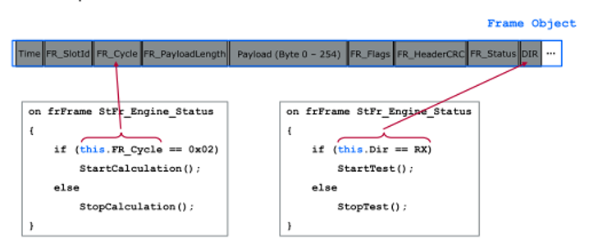
Event orientation and FlexRay
It’s possible to access the frame object within event procedures
Selectors and signals are accessed by the this operator
The frame object is then available in the event procedure
On FRFrame *,
On FRFrame <name>,
On FRFrame (<slot ID>, <base cycle>, <cycle repetition>)

Slide 14
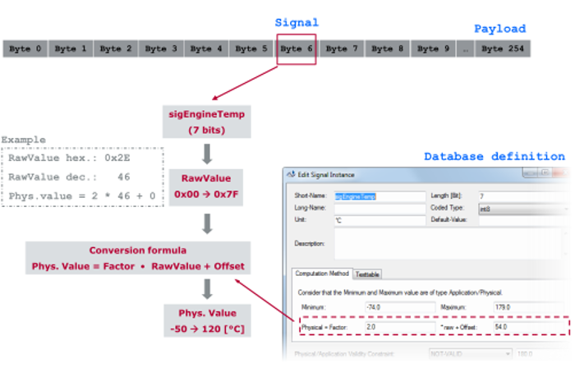
Event orientation and FlexRay
The conversion formula permits the conditioning of the digitally transmitted data.
The conversion formula is used to obtain a readable display in the Trace window or to simplify programming in CAPL.
Signals are automatically converted when, in accessing the signal, the .phys extension is appended to the combination of this.signalName.
Accessing a signal as a raw value:
gEngineTemp = this.sigEngineTemp
Accessing a signal as a physical value:
gEngine Temp = this.sigEngineTemp.phys;

Slide 15
Event orientation and FlexRay
Selectors of a frame object
The following information can be accessed using selectors.
Time - Tx or Rx time stamp
msgChannel - Selection of comm. controller
FR_ChannelMask - Entry of the FlexRay channel
FR_SlotID and FR_Cycle FR - Entry of current slot and cycle
FR_PayloadLength - Entry of the current number of data
Byte (x) - Access to the data bytes
FR_Flags - Detailed information on the header
FR_HeaderCRC - Access to the checksum
FR_Segment - Segment Information
FR_Status - Detailed information on the frame buffer
DIR and SIMULATED → Entry of the direction of the frame object

Slide 16
Event orientation and FlexRay
Other possible events
On FRFrame - Receipt of a valid frame
On FRSlot - Expiration of a slot
On FrStartCycle - Start of a new cycle
On FRPOCState - On CC state change
On FRFrameError - Occurrence of a frame error
On FRNullFrame - Receipt of a null frame
On FRSymbol - Receipt of a symbol
On FRError - General error on the bus
On FRPDU - Receipt of a PDU

Slide 17
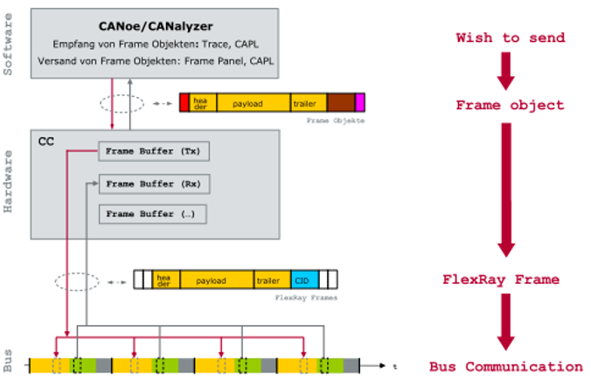
Event orientation and FlexRay
The mode of operation of the communication controller prescribes the method in CAPL for sending a FlexRay frame:
Create a frame object in the CAPL program:
A frame object can be created using the FlexRay database.
This object is a copy of the frame from the FlexRay database.
Create a frame buffer in the communication controller:
This frame buffer must be created during the start of the communication controller.
It is not possible to create a frame buffer later.
Updating the frame buffer:
If the FlexRay interface is operated in conjunction with CANoe, the contents of the frame objects can be written to the frame buffers.
The new contents of the frame buffers are then output in the relevant time slots of the FlexRay communication.

Slide 18
Event orientation and FlexRay
Functions for sending frames
Creating a frame buffer
FrSetSendFrame (<frame_name> , dword flags);
FrSetSendFrame (int slotId, int channelMask, int len, int cycleStart, int cycleRepetition, dword flags, int channel);
Updating the static frame buffer:
FRUpdateStatFrame( );
Updating the dynamic frame buffer:
FROutputDynFrame ( );

