Slide 1
Vehicle networks infrastructure
L09 exercise – FlexRay Advance

Slide 2
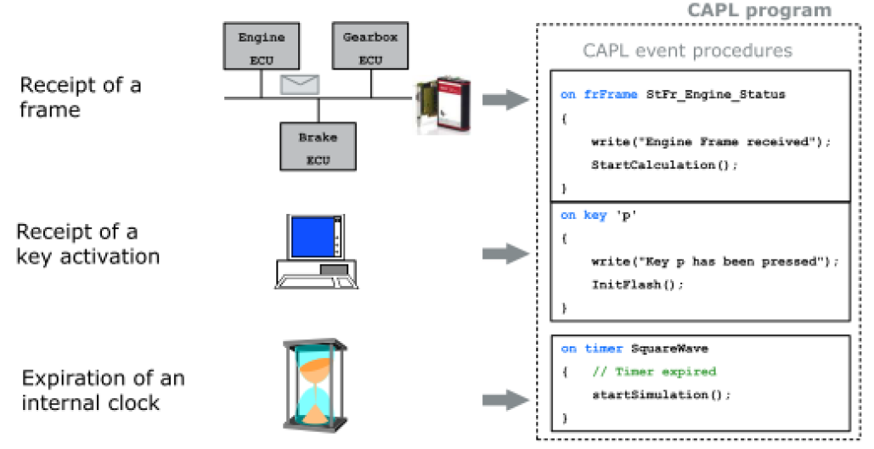
FlexRay Advance
Signal (event) oriented
An event procedure is only processed if its associated event has occurred
FIFO principle
Current event must be finished before the next event starts

Slide 3
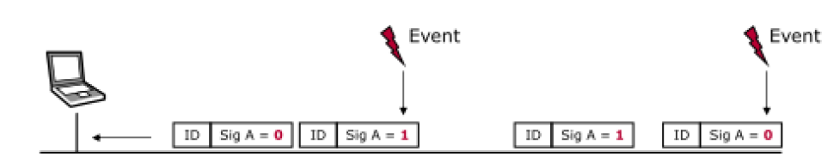
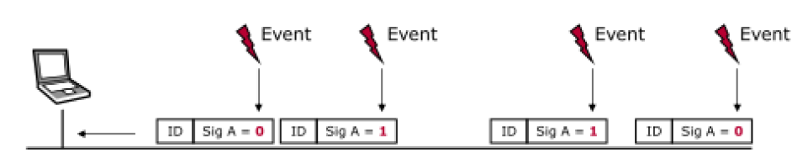
FlexRay Advance
Event procedure: Signal change
On signal <signal_name>
Event procedure: Signal update
On signal_update <signal_name>

Slide 4
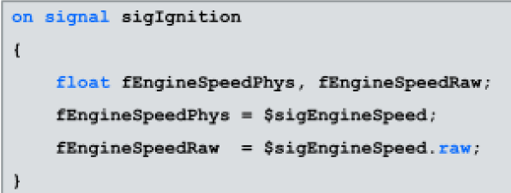
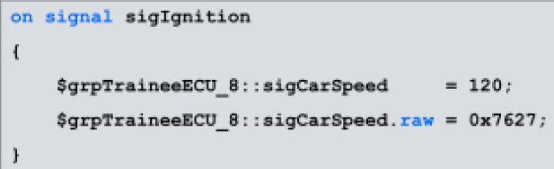
FlexRay Advance
Read signal values: <variable>=$<signal_name>
Write signal values: $<signal_name>= <variable>

Slide 5
Exercise feedback
Exercise 1
The task is to create a CAPL program that reacts to a change of the sigIgnition signal.
Create a new event procedure for the sigIgnition signal
The event procedure should only be triggered if the signal's value has changed.
Output the signal value in the Write window.
Also output a timestamp in the Write window.
Check for functionality
Start the measurement.
Manipulate the signal value from the Node Panel of the KeyunitECU.
Extend your program by distinguishing between cases
Insert a case differentiation, in which the four states of the signal can be evaluated.
Output a message to the Write window for each state change.
An error message should be output if an invalid value is received.

Slide 6
Exercise feedback
Exercise 2
The task is to create a CAPL program which calculates the sigCarSpeed signal
Create a new event procedure for calculating vehicle speed
The vehicle speed should only be calculated when the sig EngineSpeed changes
The sigCarSpeed signal should be calculated by the following formula: CarSpeed = ((EngineSpeed / 60) / 21.64) * pi * 0.6 * 3.6;
Write the calculated vehicle speed to the sigCarSpeed signal of your Trainee ECU (1-8).
Calculate vehicle speed using gear information
The sigCarSpeed signal should be calculated by the following formula:
CarSpeed = ((EngineSpeed / 60) / divisor) * pi * 0.6 * 3.6;
Insert a case differentiation in your event procedure that changes the Divisor value according to the gear
Check for functionality
Start measurement
The signal generator for the sigEngineSpeed signal must be active
Change the sigGear signal value using the slider on the panel

