Slide 1
Vehicle networks infrastructure
L07 exercise – FlexRay Bus - Basic

Slide 2
Vehicle networks infrastructure
Agenda:
DBC – Data Base for CAN
LDF – LIN Description File
FIBEX – Field Bus Exchange Format (FlexRay, MOST, CAN, TTCAN, LIN and Ethernet)
ARXML – AutoSAR XML (FlexRay, MOST, CAN, TTCAN, LIN and Ethernet)

Slide 3
The FIBEX format
The FIBEX is:
abbreviation of the “Field Bus Exchange Format” and an XML format used to describe complex, message-oriented communications systems
standard describes a multi-protocol-capable format for the exchange of data in message-oriented communications systems
format can be used to export on-board network databases, and for import into different types of tools during the development of vehicle networks
supporting the network protocols FlexRay, CAN, MOST, and LIN
covering from the design of complete clusters to their definition on the bit level, all information relevant to the description of vehicle networks can be defined using the FIBEX format

Slide 4
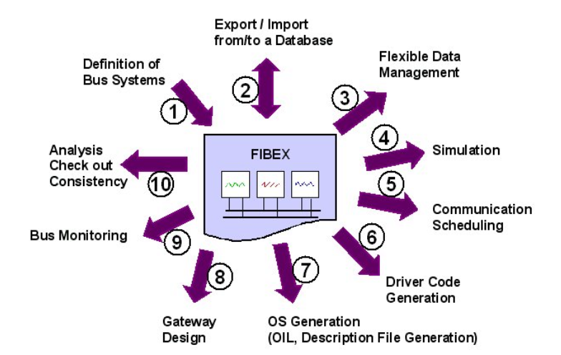
The FIBEX use-cases

Slide 5
The FIBEX use-cases
The definition of a bus system is a classic task. Generally, a bus with the connected ECUs, the signals, and frames is defined by using an appropriate design tool. The result should be written to a FIBEX XML file.
Import/Export to/from a database. This use case has to support the merging of typical network data with other data that may be stored in a more general database.
A flexible data management supports the distribution and gathering of data and portions of it between different companies (OEM and sub suppliers).
FIBEX may be used for offline simulation of the distributed application’s behavior (down to the time domain, by taking into account the frame timing information)
Within the Communication scheduling the timing of the transmitted signals and frames is defined. In synchronous systems such as FlexRay, this is an essential design step that may be performed by specialized tools.
With a driver code for software interfaces can be generated that allows the application to access the signals via an abstract API
FIBEX information can be completed with task information and HW information and can be used to describe ECU configuration (e.g. in OIL – OSEK Implementation Language) for code generation tools
Since gateways can be described in FIBEX, their configuration and mapping functions can be derived from FIBEX.
The network- and symbolic information of the frame contents can be passed to bus analyzing (bus monitoring) tools via FIBEX.
FIBEX can provide statistical information, e.g. for bus load and other analyses

Slide 6
Content of FIBEX
FIBEX can be understood as an object-oriented decomposition of communication systems into the following major elements:
ECU - Electronic Control Units contain the functions that communicate via the clusters.
Function - A function is a part of the distributed application running in an ECU. It is assigned to an arbitrary number of input ports (input signals) and output ports (output signals).
Signal - The signal entity serves two purposes: From the “functional” perspective, it is an input or output parameter of a function representing a physical or logical value of a specific data type. From the “communication” point of view, it is a stream of bits of a defined length.
Cluster – A cluster describes the ensemble of ECUs, which are linked by a communication medium of arbitrary topology (bus, star, ring, …). The nodes within the cluster share the same communication protocol, which may be event-triggered, time-triggered, or a combination of both.
Channel - The communication medium of a cluster consists of one or more communication channels. The channel entity interlinks the ECUs of a cluster physically: An ECU is part of a cluster if it contains at least one controller that is connected to at least one channel of the cluster. In single-channel systems, this entity is known as “bus”;
Frame - A frame is the smallest piece of information that is exchanged over the communication system. A frame is a datagram with a header section and a payload section of a certain length in bytes, which contains an arbitrary number of non-overlapping signals and/or multiplexers/sub frames. The send-stimuli of a frame are described in the “frame triggering” elements of a frame.
Gateway - A gateway is an ECU that is connected to two or more clusters (channels, but not redundant), and performs a frame or signal mapping function between them

Slide 7
Relationship diagram
Topology
Cluster
n
1
Channel
n
1
Connector
n
ECU
1
n
n
Frame
Frame Triggering
Function
Function
1
n
1
1
n
1
n
n
Timing
Input
Output
n
n
1
n
Signal Instance
Signal
n
1
Communication

Slide 8
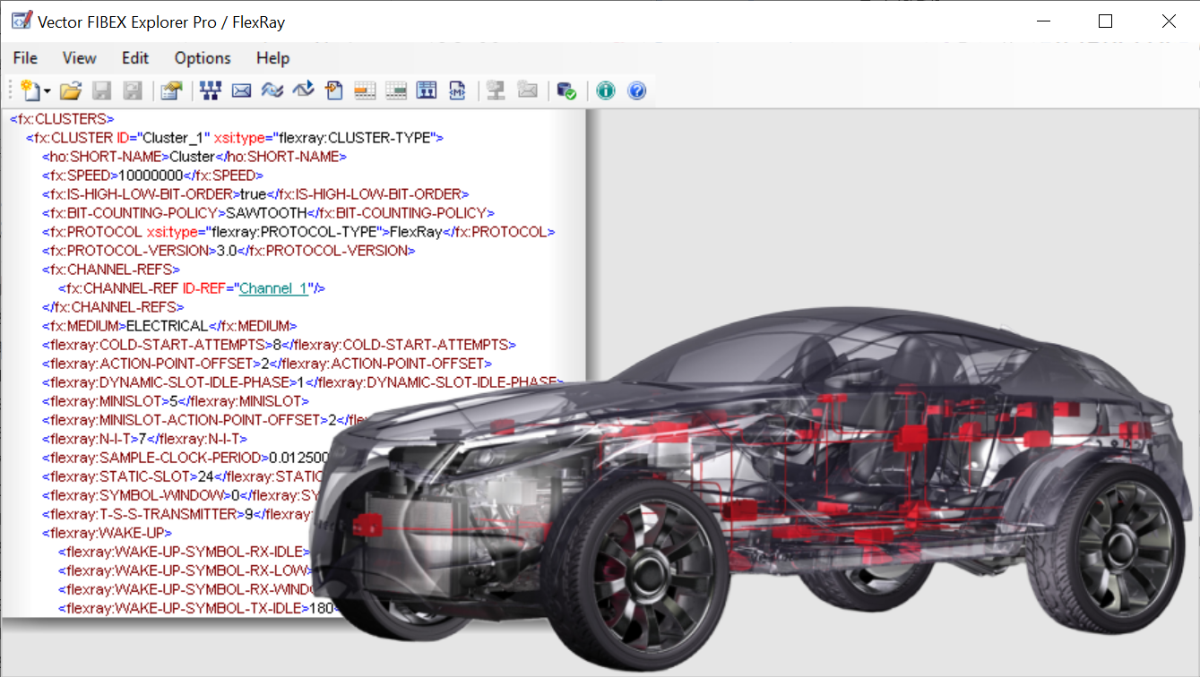
Vector FIBEX Explorer PRO
The FIBEX Explorer FlexRay is used for visualizing and editing FIBEX files for FlexRay.
The FIBEX Explorer offers a high level of abstraction for information described with FIBEX. It's a lossless application-oriented presentation of the original FIBEX data (XML).
The abstraction supports you in getting a fast and easy overview on the often quite comprehensive FIBEX files.
The main focus is on visualizing the communication, frame, PDU, signal, schedule and parameter relevant information of a FIBEX file. For each aspect a dedicated view is supported.
A further feature is that for each element, in one of these views, a link to its description in the FIBEX file is provided. This gives an easy way for locating OEM-specific information in form of manufacturer extensions.

Slide 9
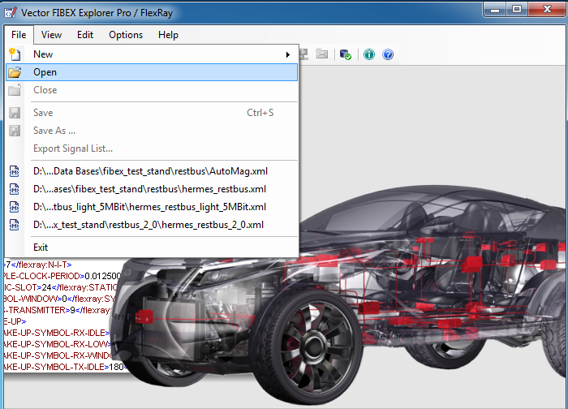
Vector FIBEX Explorer PRO
Download materials “FlexRay_Basic” from Canvas and save them in your workspace
Open an existing FIBEX database as shown in the picture
Name of the database is “VectorCar-FIBEX31.xml”

Slide 10
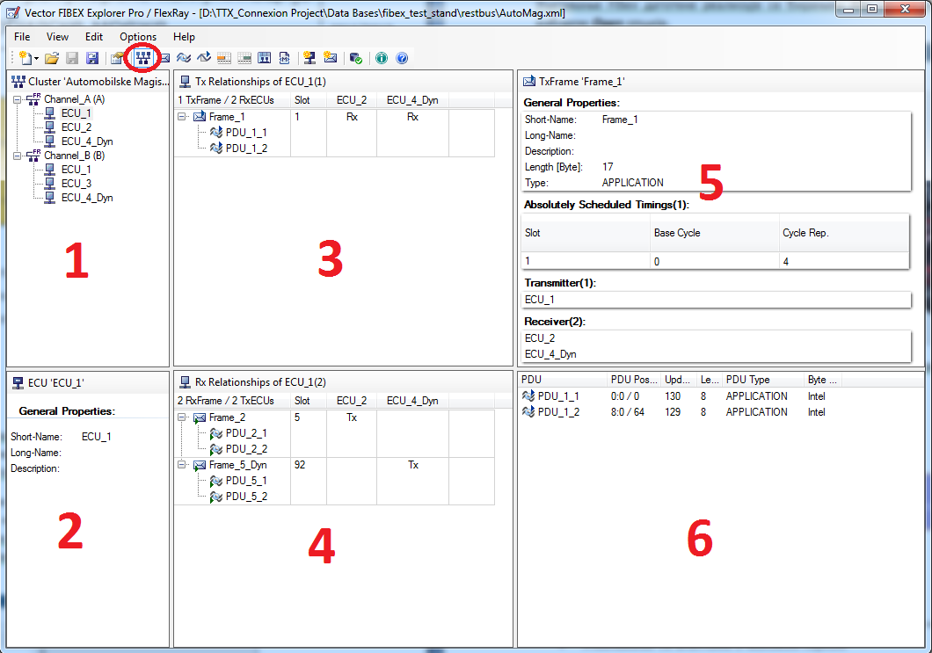
Vector FIBEX Explorer PRO
Selecting the “Tx/Rx Relationships” button from the tools bar, the view as described in the picture will be present:
Clusters
ECUs
Tx Relationship of ECU
Rx Relationship of ECU
Tx Frame
PDUs

Slide 11
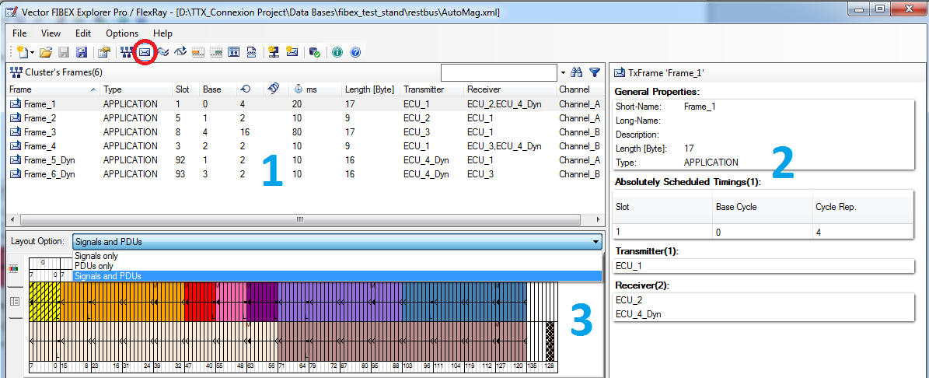
Vector FIBEX Explorer PRO
Selecting the “Cluster’s frame” button from the tools bar, the view as described in the picture will be present:
All available frames
Selected frame property
Layout

Slide 12
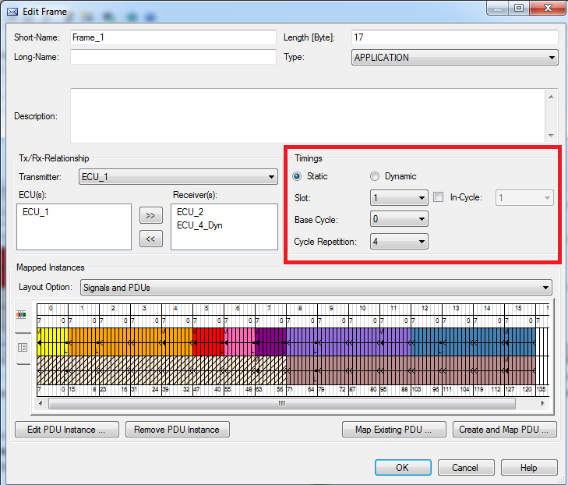
Vector FIBEX Explorer PRO
Double-clicking on the selected frame, the new window will pop up:
Short Name
Long Name
Length [Byte]
Type
Transmitter
Timings
Layout options

Slide 13
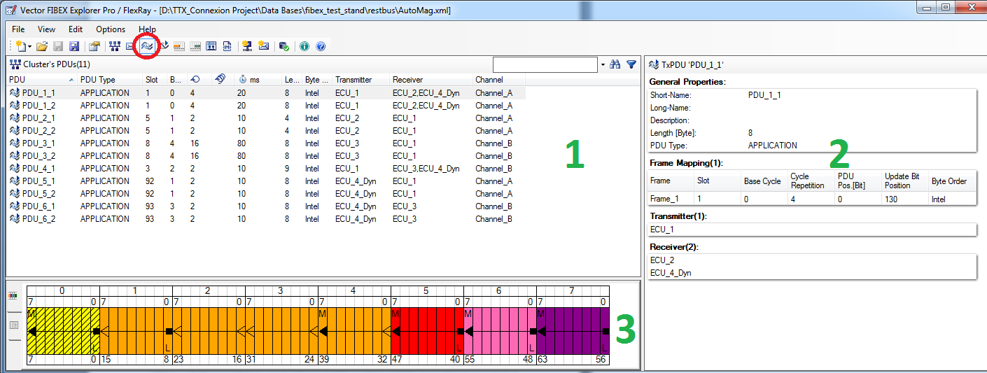
Vector FIBEX Explorer PRO
Selecting the “Cluster’s PDUs” button from the tools bar, the view as described in the picture will present:
All available PDUs
Selected PDUs property
Layout

Slide 14
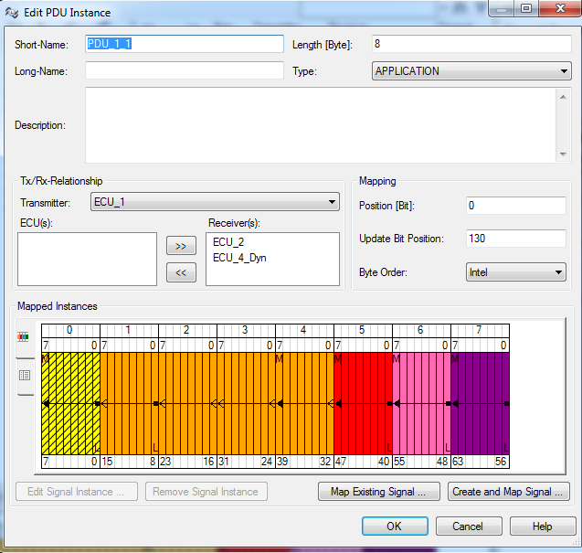
Vector FIBEX Explorer PRO
Double-clicking on the selected frame, the new window will pop up:
Short Name
Long Name
Length [Byte]
Type
Transmitter
Mapping
Layout options

Slide 15
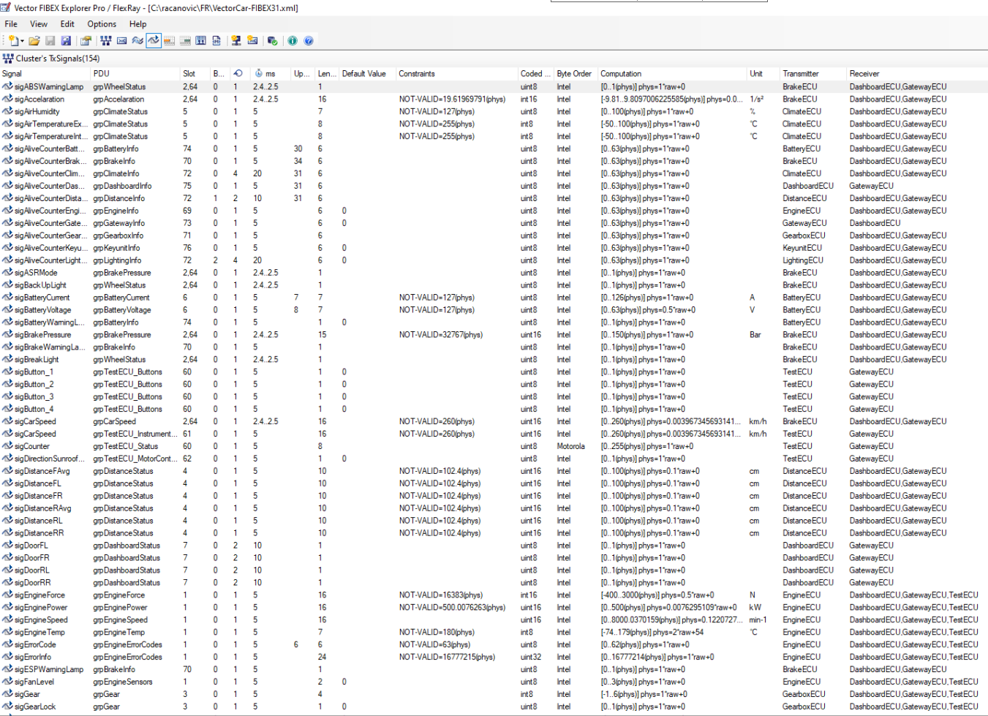
Vector FIBEX Explorer PRO
Selecting the “Cluster’s TX signals” button from the tools bar, the view as described in the picture will present:
Name
PDU
Sending slot
…
Transmitter
Reiever

Slide 16
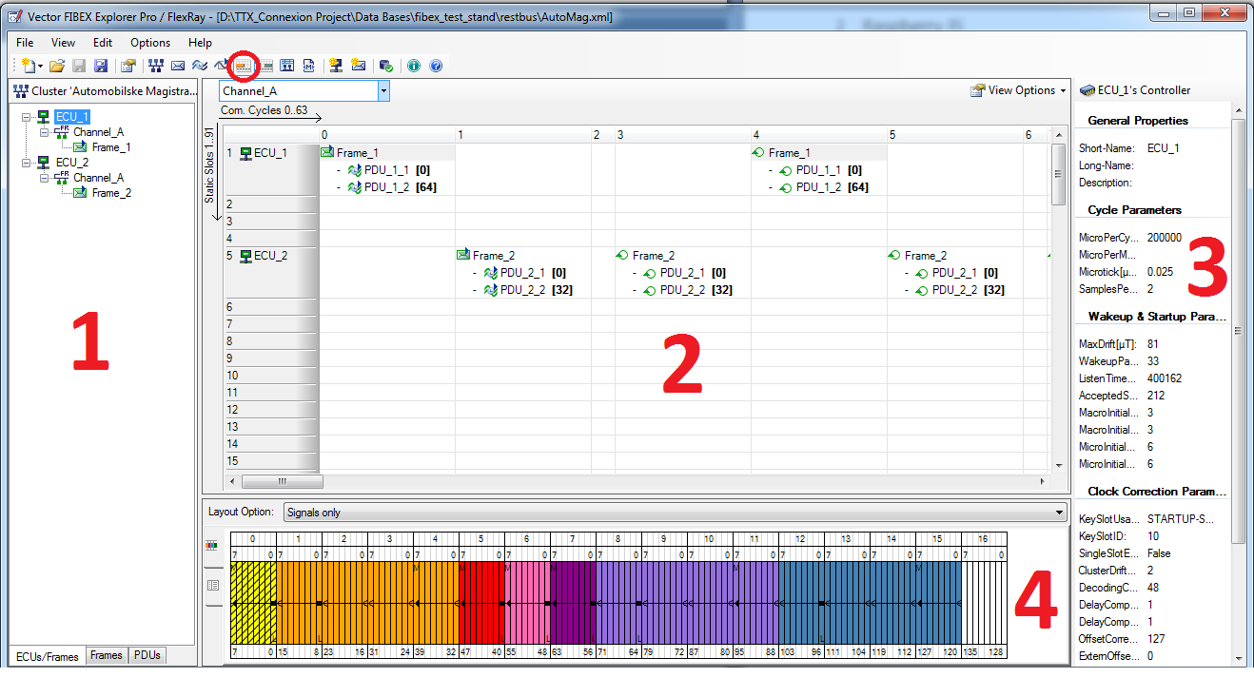
Vector FIBEX Explorer PRO
Selecting the “Static segment of schedule” or “Dynamic segment of schedule” buttons from the tools bar, the view as described in the picture will present:
The list of all available ECUs
Tx scheduler in the selected segment
Property of ECU/Frame/PDU

