Slide 1
Vehicle networks infrastructure
L08 exercise – FR intermediate

Slide 2
Agenda
FlexRay in restbus
How to create a panel
How to test in CANoe

Slide 3
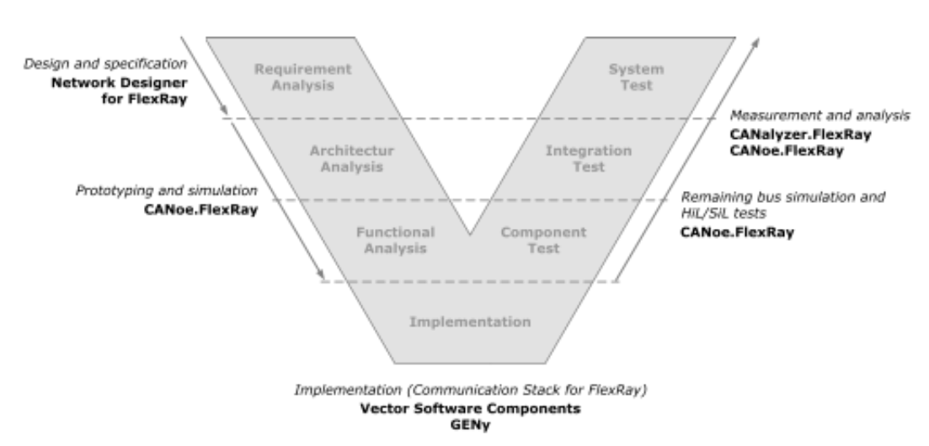
FlexRay in restbus
V model process of development

Slide 4
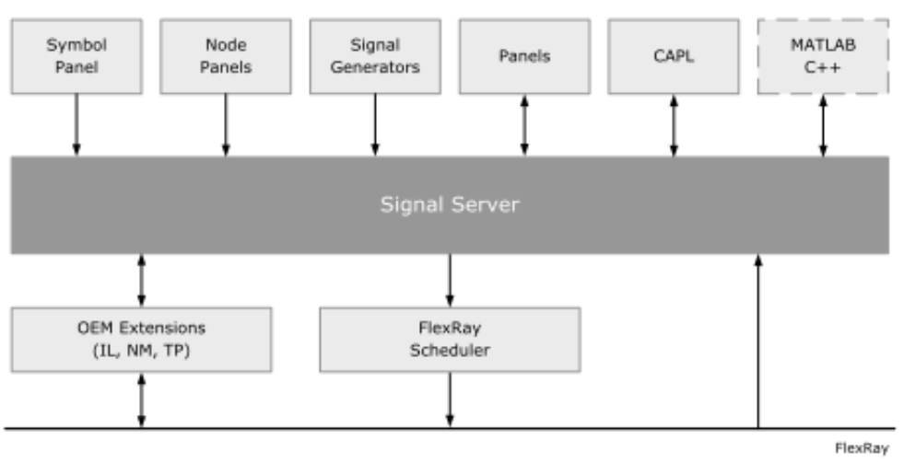
FlexRay in restbus
CANoe signal server concept
Signal server makes all of a network’s signals available
FlexRay Scheduler makes it possible to send out signals in their respective slots

Slide 5
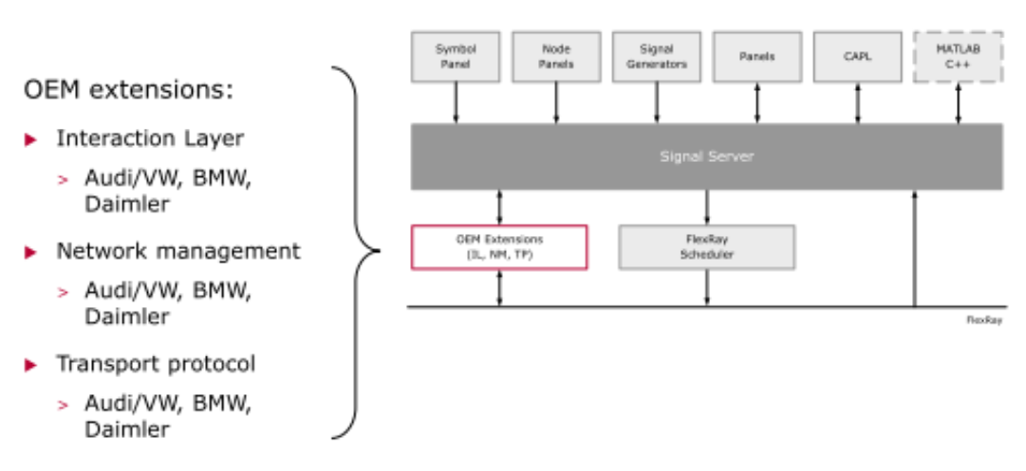
FlexRay in restbus
Extension for OEMs
Interaction layer
Network management
Transport protocol
*The FlexRay scheduler can be supplemented or replaced by OEM extension

Slide 6
FlexRay in restbus
Configuration
Manual configuration
The user must make all settings manually.
FR template is available
Each node must be configured independently and individually
Configuration with wizard
Some settings are made automatically

Slide 7
FlexRay in restbus
Resume: Manual configuration steps
Step: Create a new configuration
2. Step: Associate database
3. Step: Insert network node
4. Step: Make node allocations
5. Step: OEM extensions (optional)
6. Step: Configure network interfaces (optional)
7. Step: Configure messages
8. Step: Define Coldstart nodes
9. Step: Define Wakeup

Slide 8
FlexRay in restbus
Resume: Wizard configuration steps
1. Step: Create new configuration with wizard
2. Step: Associate a database 3. Step: Add ECUS
4. Step: Set hardware channel
5. Step: Complete the configuration
6. Step: Define the Coldstart nodes
7. Step: Define Wakeup

Slide 9
How to test in CANoe
CANoe tests are hierarchically organized:
Uppermost element is a Test setup
Test modules are part of a Test Environment
Test Environments are separately stored and can be used separately
Test Setup
Test Environment
Test Module
Test Folder
Test Case
Test Group
Test Case
Test Step
Test Step
Test Group
Test Module
Test Environment

Slide 10
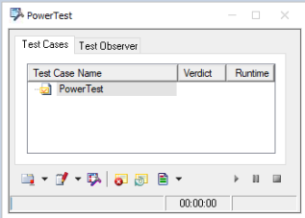
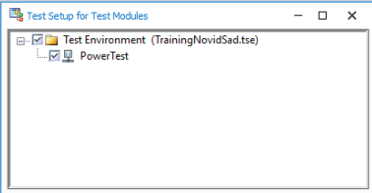
How to test in CANoe
The Test Module is subdivided into:
Test Groups
Test Cases
Test Steps
Every Test Module has a test execution dialog for execution control. It indicates test progress and test results

Slide 11
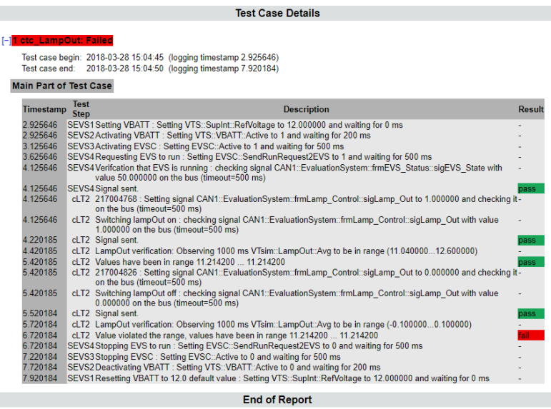
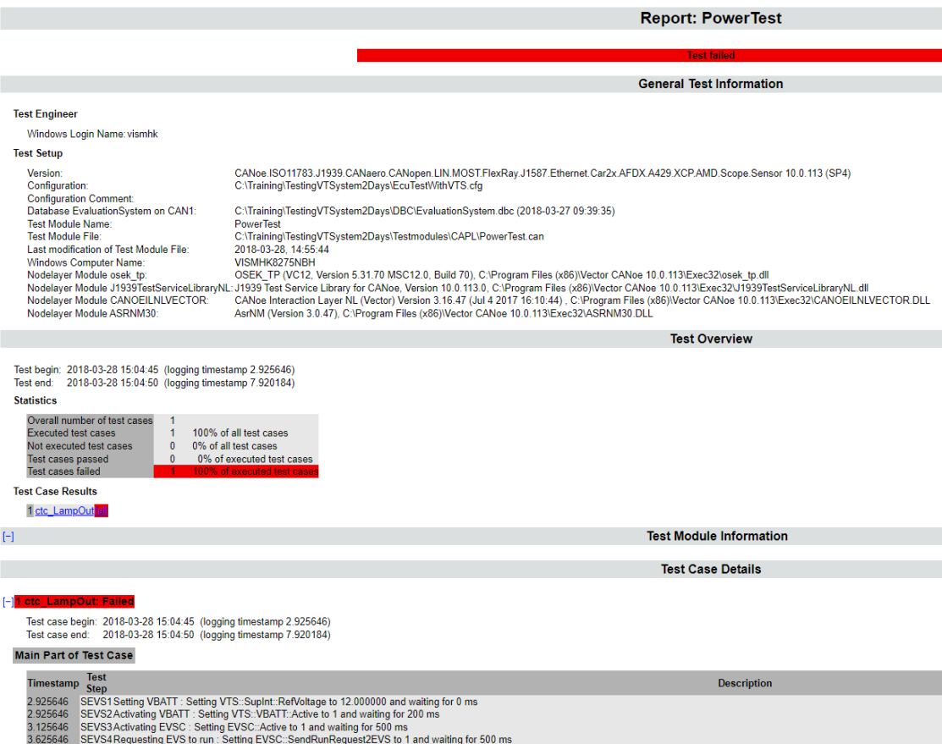
How to test in CANoe
A report is created during test execution
General information about the Test Environment
Versions
Test Cases and Test Steps documentation
Verdicts
Comments

Slide 12
How to test in CANoe
Test Setup configuration
New or existing one
CAPL Test Module configuration
Define CAPL source code
Activate report generation
Define start behaviour
Implementation of:
Test Control
Test Cases
Test Steps

Slide 13
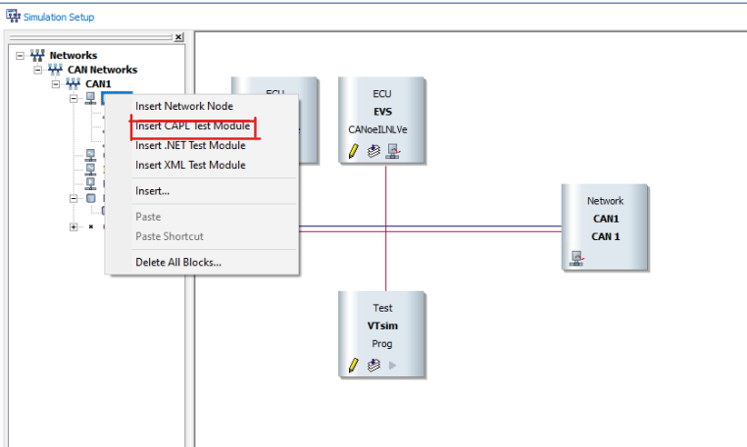
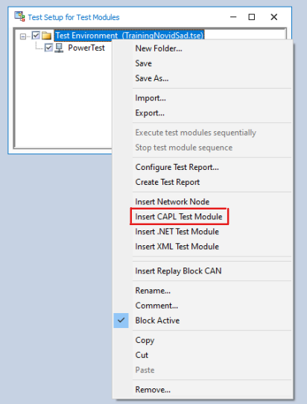
How to test in CANoe
Test Environments contain any number of Test Modules
Test Modules can be implemented in CAPL or .NET
Folders are used to group Test Modules
Test Environment can be extended by:
Generators
Replay blocks
Network nodes

Slide 14
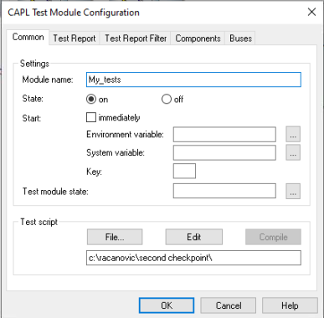
How to test in CANoe
Every Test has its own configuration settings:
Name
Start behavior
Immediately at measurement start
Upon key event
Via environment or system variable
Path and name of the CAPL source code

Slide 15
How to test in CANoe
Test Modules can be started manually with the Test Execution Dialog
All Test Modules in a Test Environment can be executed in sequence

Slide 16
How to test in CANoe
The most common test function
TestModuleTitle ("Functional ")
TestModulesDescription ("Functional Test")
TestModulesDescription ("involves")
testReportAddSUTInfo("Device", "CANister")
testReportAddSUTInfo ("Firmware", "%d", )
testReportAddEngineerInfo("..","..")
testReportAddSetupInfo ("CAN Interface", "")
testReportAddsetupInfo ("Serial Number", "_")
testStepFails("..","..")
testStepPass("..","..")

Slide 17
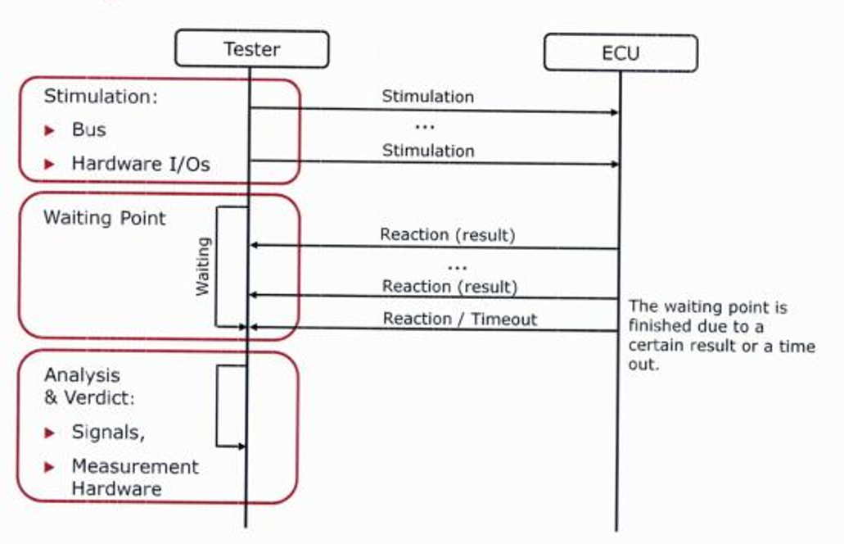
How to test in CANoe

Slide 18
How to test in CANoe
Examples of stimulations for the SUT (DUT)
Sending a message
Setting signals
Setting environment variables
Setting IO ports

Slide 19
Test case workflow – waiting for
For receipt of a message
For a setting of environment variables
For a specific time period
For events of the TSL (Test Service Library)
For user-defined events
Syntax:
long testWaitFor
...Timeout
...SignalIn/OutSideRange
...SignalMatch
...ValueInput
...Message
...Syscall
... TesterConfirmation

