Slide 1
Vehicle networks infrastructure
L08 exercise – FR intermediate

Slide 2
Agenda
FlexRay in restbus
How to create a panel
How to test in CANoe

Slide 3
Exercise feedback
Exercise 1
Create a new configuration
Insert the FIBEX file VectorCar-FIBEX 31.xml
Save your configuration.
Insert the following nodes in your Simulation Setup.
KeyunitECU, Engine ECU, GearboxECU
Your assigned Trainee ECU node (1-8)
Execute a measurement
Switch CANoe to simulate mode
Start your measurement and observe the Trace window
Check whether all messages have been sent correctly.
Check the following properties of the messages
Which messages are sent out as startup/sync frames
Are the signals for the training model available in the messages

Slide 4
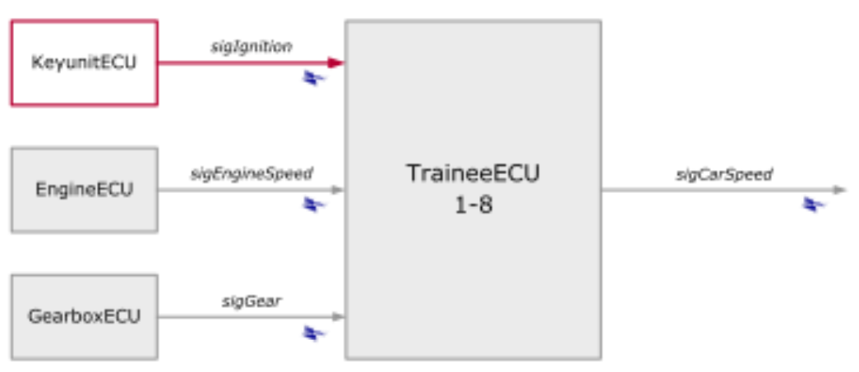
Exercise feedback
Exercise 1 – part 2
The task is to manipulate the sigIgnition signal with the Symbol and Node Panel.
Open the Symbol Panel for the sigIgnition signal.
Open the Node Panel for the KeyunitECU.
Manipulate the signal values from zero to three and observe the changes in the Trace window.

Slide 5
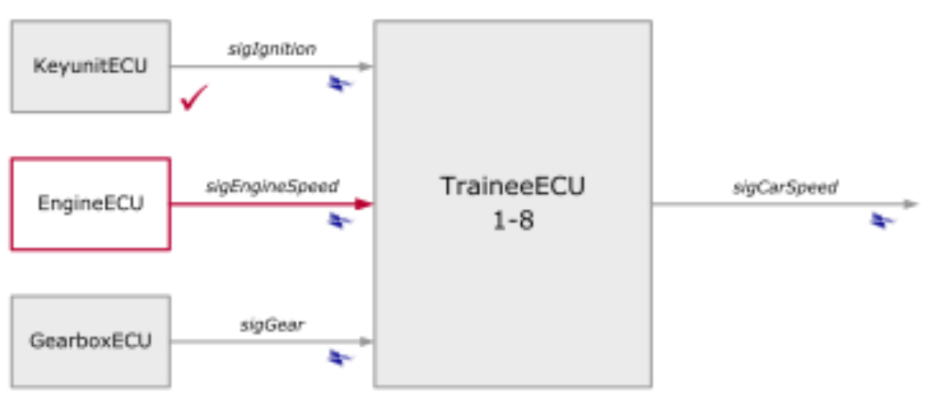
Exercise feedback
Exercise 2
The task is to manipulate the sigEngineSpeed signal with a signal generator.
Configure the signal generator
Open the configuration for the signal generators,
Insert a signal generator for the sigEngineSpeed signal.
Simulate a ramp that has the following properties:
The signal value should rise from 0 to 8000
The period length of the signal is 5 seconds

Slide 6
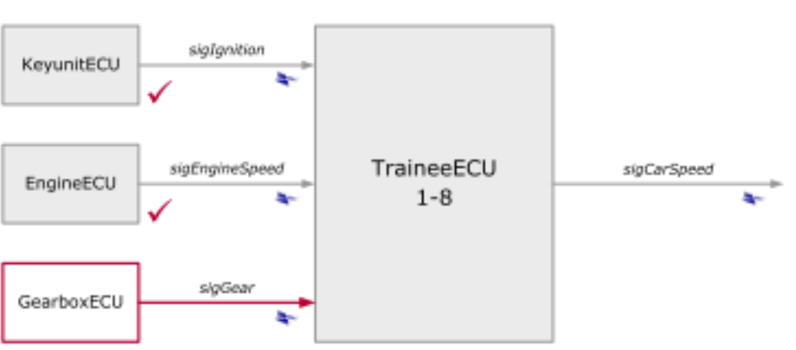
Exercise feedback
Exercise 3
The task is to create a panel that displays the sigEngine Speed signal and enables manipulation of the sigGear signal.
Creating a new Panel
Open the Panel Designer and create a new panel
Save the panel as Exercise3.xvp.

Slide 7
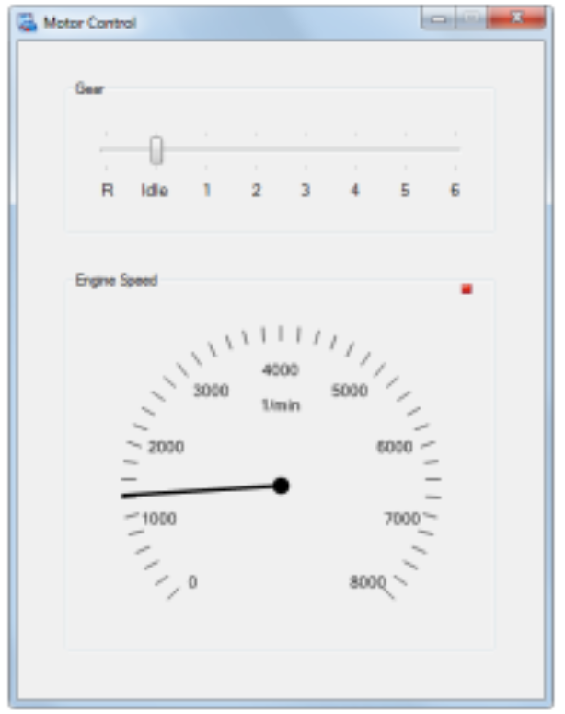
Exercise feedback
Exercise 3 – part 2
Display of sigEngine Speed
Insert a display element for the signal
Assign the signal to the display element
Save the panel and check its functionality
Manipulating sigGear
Insert a slider element for the signal
Assign the signal to the slider element
Save the panel and check its functionality

