Slide 1
Vehicle networks infrastructure
L06 exercise – LIN bus – Advance

Slide 2
CAN bus – Advance
Agenda:
The principle of modeling with CANoe
Usage of Interactive generators
Usage of LIN Network panels
Usage of Signal generator

Slide 3
The principle of modeling with CANoe
What are we going to learn from this?
Example for bus monitoring, sending of frames and signals
Usage of different generators
Structure of LIN frame and schedule tables

Slide 4
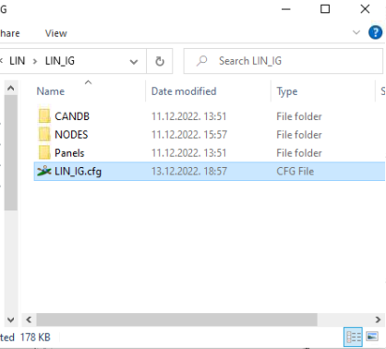
The principle of modeling with CANoe
Simulation setup
Download materials “LIN_IG” from Canvas and save them in your workspace
Open an existing restbus simulation:
Name configuration is “LIN_IG”
Setup operational mode Simulated bus

Slide 5
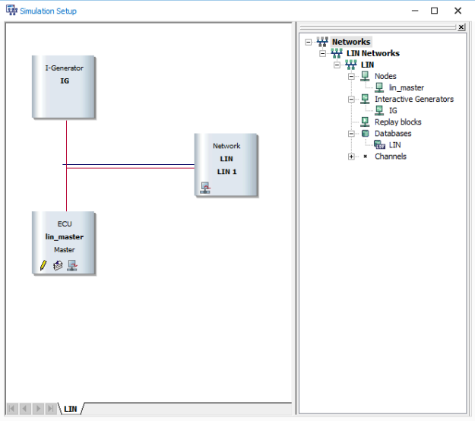
The principle of modeling with CANoe
Simulation setup
Available database “LIN.ldf” is already assigned to the network
Available nodes:
lin_master
I-Generator IG

Slide 6
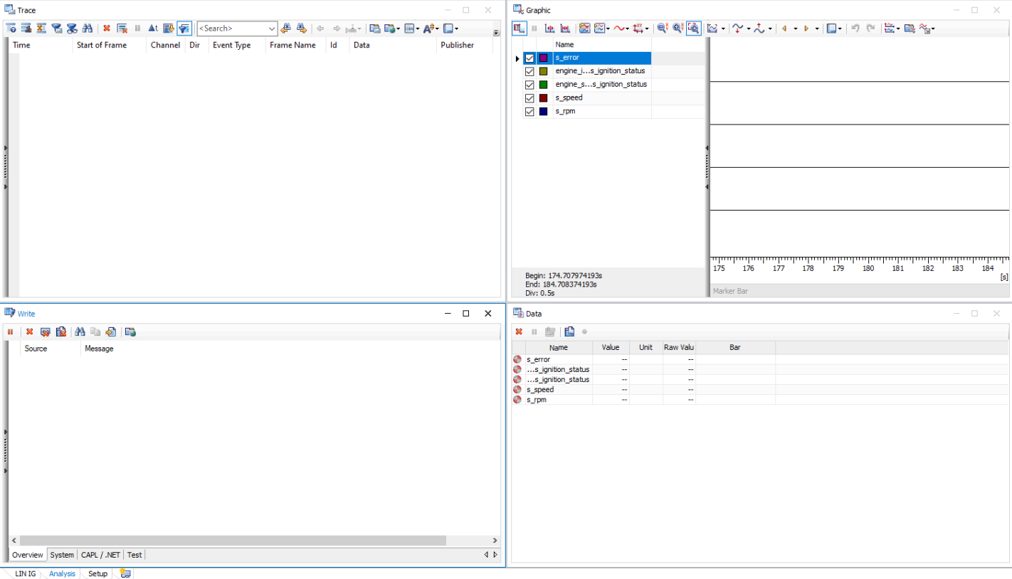
The principle of modeling with CANoe
Measurement setup
Select “Analysis” desktop and open the following windows there:
Trace window
Graphical window
Data window
Write window

Slide 7
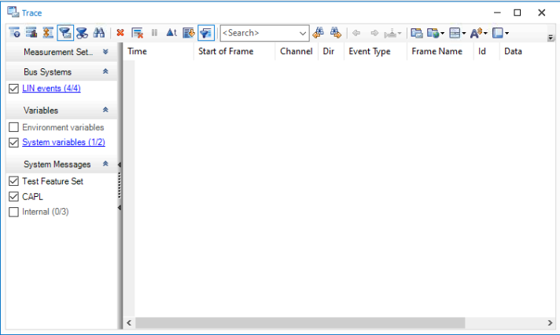
The principle of modeling with CANoe
Measurement setup
Open the trace window and enable the following filters:
LIN events
System Variables

Slide 8
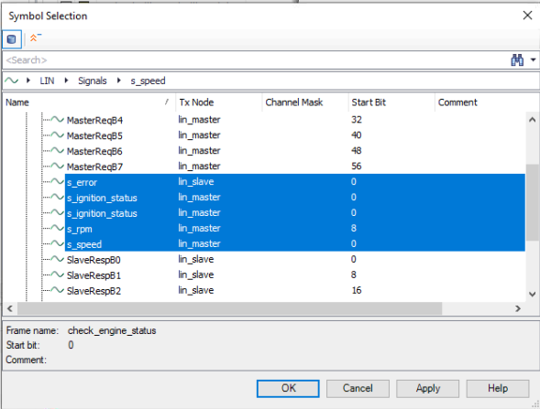
The principle of modeling with CANoe
Measurement setup
Open the graphic window and add the following signals to be tracked:
s_ignition_status from engine_ignition frame
s_ignition_status from engine_status frame
s_speed from engine_speed frame
s_rpm from engine_speed frame
s_error from check_engine_status

Slide 9
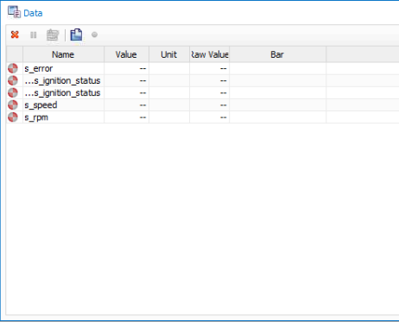
The principle of modeling with CANoe
Measurement setup
Open the data window and add the following signals to be tracked:
s_ignition_status from engine_ignition frame
s_ignition_status from engine_status frame
s_speed from engine_speed frame
s_rpm from engine_speed frame
s_error from check_engine_status

Slide 10
Usage of Interactive generators
With the Interactive Generator is possible to configure and send messages while a measurement is running
Depending on where the generator was linked, it is possible either send messages to the bus or control the analysis without sending messages
Advantages
Quick, improvised way to influence a measurement
No CAPL programming necessary

Slide 11
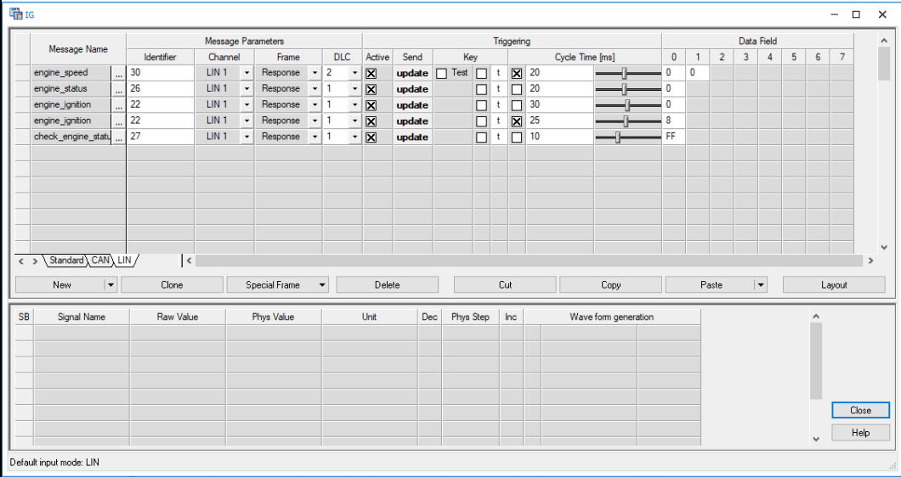
Usage of Interactive generators
Interactive generator IG can be found in:
simulation setup
from LIN IG desktop.

Slide 12
Let’s try it live
The schedule table specifies that two frames “engine_speed” and “engine_status” will be sent with a delay of 30 ms.
The first two entries in the IG allow you to update the response data
Sending a Header frame with the help of the IG
A header and the corresponding responses are configured as “engine_ignition” from lines 3 and 4.
“engine_ignition” header can be sent by clicking on the now button
“engine_ignition” response is updated cyclically
The response data of the “check_engine_status” message can be changed in the data field of the IG and sent via the update button.

