Slide 1
Vehicle networks infrastructure
L06 exercise – LIN bus – Advance

Slide 2
CAN bus – Advance
Agenda:
The principle of modeling with CANoe
Usage of Interactive generators
Usage of LIN Network panels
Usage of Signal generator

Slide 3
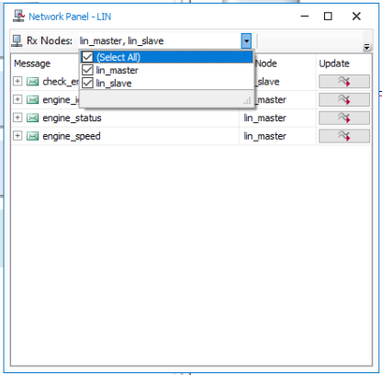
Exercise feedback
Task 1
Using simulation setup, open the network panel
Clicking on the drop-down menu as shown in the picture, bot nodes can be added
Reproduce all traffic described in the database
What cannot be done by this generator?

Slide 4
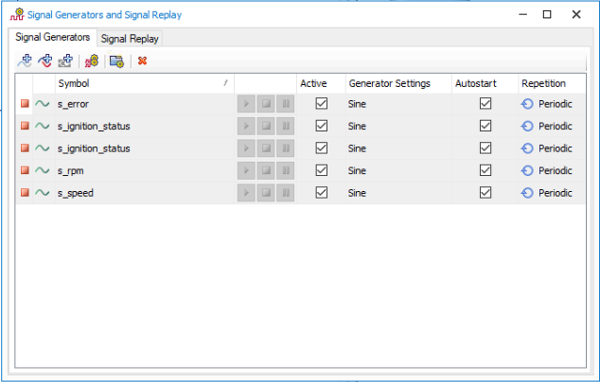
Exercise feedback
Task 2
From the Simulation tab in the Stimulation section, open the signal generator
Add all needed variables needed to reproduce all traffic described in the database
What cannot be done by signal generator?

