Slide 1
Vehicle networks infrastructure
L02 exercise – Tools and Utils advance

Slide 2
Vehicle networks infrastructure
Agenda:
CANoe Advance
CAPL Advance
Restbus simulation Advance

Slide 3
CANoe Advance
Vehicle networks infrastructure

Slide 4
CANoe Advanced
What do we know from the last class?
What is CANoe and what is used for
How to use Trace, Measurement, Simulation and Write windows

Slide 5
CANoe Advanced
Different and additional CANoe options
Home – Options for selection operational mode of working, Start and stop simulation, Panels…
Analysis – Optional windows for analyzing
Simulation – Simulation and generators settings
Test – Test settings
Diagnostic & XCP – Calibration and diagnosis settings
Environment – Environment and system variable settings
Hardware – Settings of connected physical devices available in simulation, settings related to HIL testing
Tools – Group of tools connected with CANoe used for communication databases, writing code for network nodes, panel creation
Layout – Windows manipulation and desktop layout

Slide 6
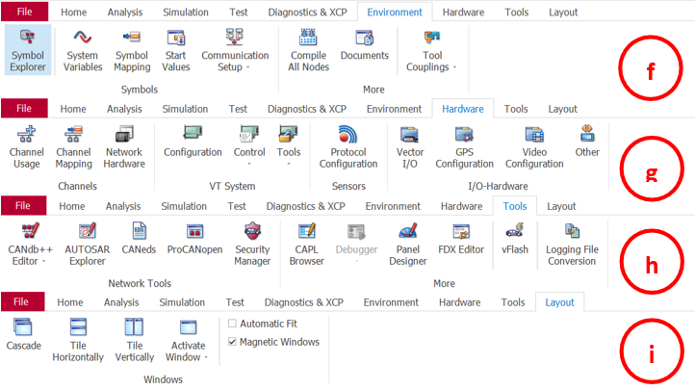
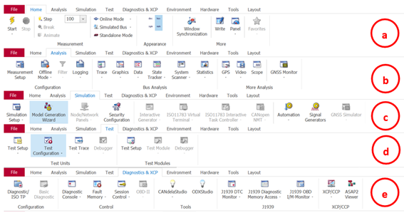
CANoe Advanced
Live demonstration about available options!
Notes:
CANoe has the access to the whole simulated bus. CANalyzer only has one node for accessing message frames that are flowing in and flowing out for that node.
CANoe Supports Multi-Node simulations: if you want to simulate an entire distributed system that is multiple nodes connected and interacting in a CAN environment you can do so using CANoe only. Whereas CANalyser supports simulating a single node, so for a distributed system you can only simulate a single node, and the rest of the nodes must be connected physically.

Slide 7
CANoe Advanced
Additional windows
Graphics Window
Statistics Window
Data Window
State Tracker

Slide 8
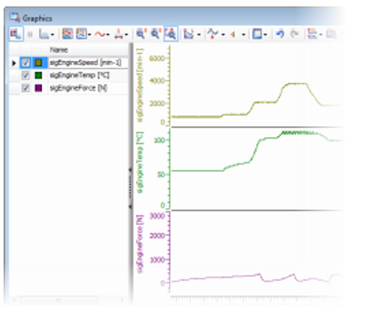
CANoe Advance
Graphical window
Graphical response of physical values or raw values
Measurement and difference markers for signal evaluation
Cursor bar for entering comments in offline analysis
Export/import of signal responses Configurable legend
Syn with Trace window is possible

Slide 9
CANoe Advance
Graphical window - Live demonstration!

Slide 10
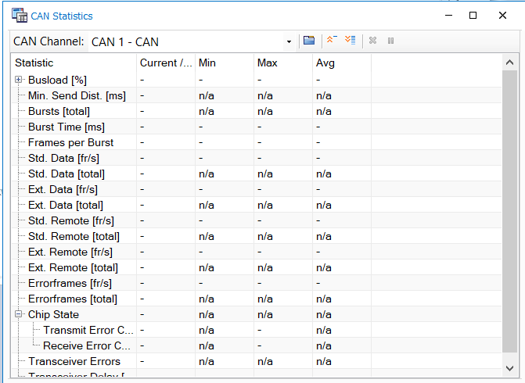
CANoe Advance
Statistic window
Bus statistic
CAN statistic
Flex Ray statistic
Frame histogram
Flex Ray cluster monitor

Slide 11
CANoe Advance
Statistic window - Live demonstration!

Slide 12
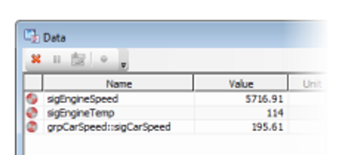
CANoe Advance
Data window
Analysis window for the table-based display of signal value:
Physical and raw value
Physical minimum and maximum since measurement start
Units from the database
Comments from the database
Graphic display of received signals and changes in signal value

Slide 13
CANoe Advance
Data window - Live demonstration!

Slide 14
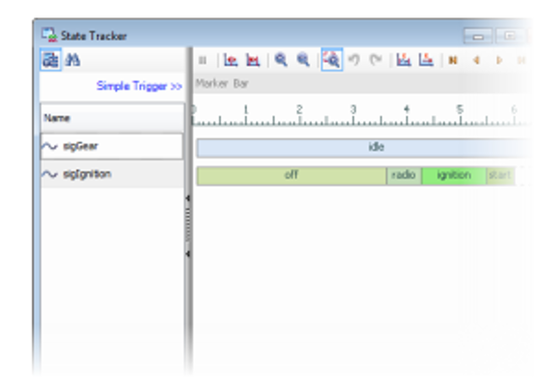
CANoe Advance
State tracker
Graphic response of symbolic values or raw values
Measurement and difference markers for signal evaluation
Cursor bar for entering comments in offline analysis
Trigger for pausing or stopping the measurement

Slide 15
CANoe Advance
State tracker - Live demonstration!

Slide 16
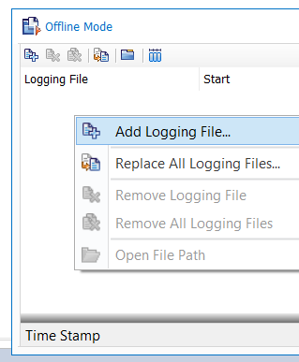
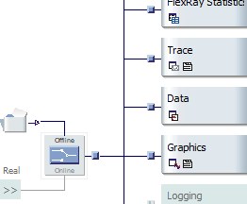
CANoe Advance
Logging and offline analysis
Logged data can be analysed offline
Offline refers to use of the logged data as a data source
Tab: Home/offline mode or using switch in the Measurement setup

Slide 17
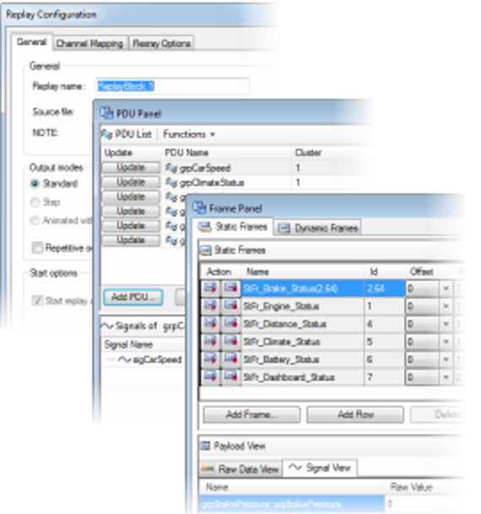
CANoe Advance
Interactive sending
It is possible to send out messages, PDUs, and signals in the Simulation setup:
Replay block – used to replay log files
PDU Panels – send out PDUs or signal values in PDUs
Frame Panel – send out messages or signal values in messages

Slide 18
CAPL Advance
Vehicle networks infrastructure

Slide 19
CAPL Advanced
What do we know from the last class?
What is CAPL and what is used for
How to use or create a new node and start the program
How to use CAPL Browser
Basic data type

Slide 20
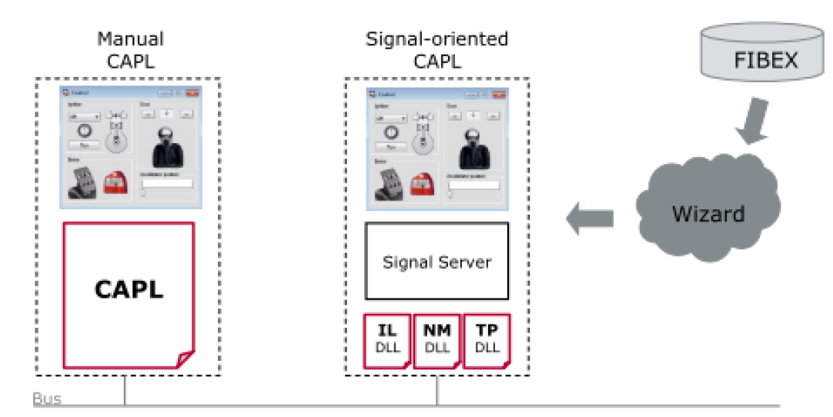
CAPL Advance
Manual or Signal-oriented CAPL
IL – Interaction Layer
NM – Network Management
TP – Transport Protocol
Notes:
Interaction Layer - performs mapping of signals to their send frames and controls the sending of these send frames as a function of the send model. The transmission behavior of frames and signals is described based on attributes in the database.
Network Management - Network Management is a hardware-independent protocol that can only be used on specific protocol (CAN). Its main purpose is to coordinate the transition between normal operation and bus-sleep mode of the network.
Transport Protocol -

Slide 21
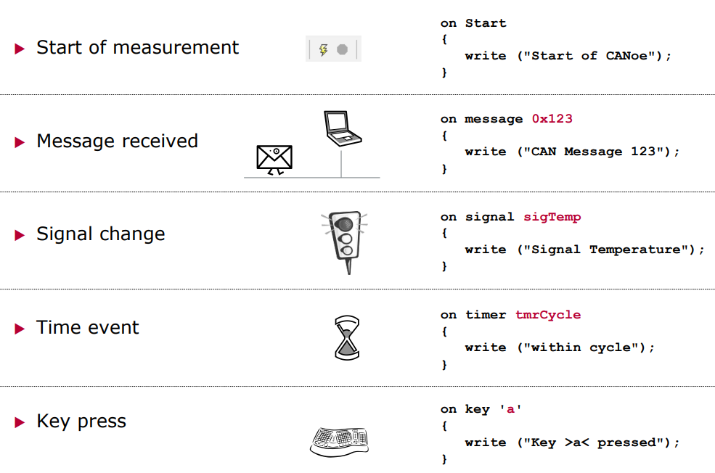
CAPL Advance
Event orientation
An event is only processed if its associated event has occurred
FIFO principle in collision situation
Event procedures are independent and do not exchange any data directly

Slide 22
CAPL Advance
Event Procedures: Overview
AUTOSAR PDU Event Procedures
General Event Procedures
Response to Signal Changes
Events of Measurement System
Diagnostic Event Procedures
FRStress Event Procedures
CAN Event Procedures
LIN Event Procedures
MOST Event Procedures
FlexRay Event Procedures
J1939 Event Procedures
Ethernet Event Procedures
J1587 Event Procedures
Unconditional (Boxed) Event Procedures

Slide 23
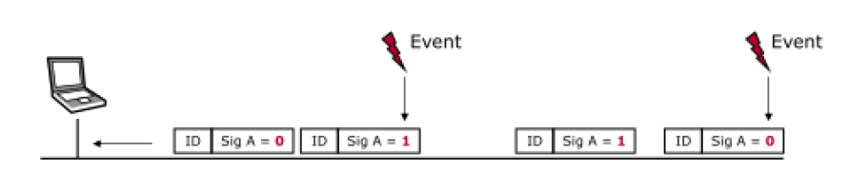
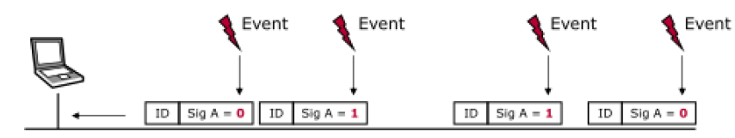
CAPL Advance
On signal <name>
On signal_update <name>

Slide 24
CAPL Advance
System variables
Environment variables
Used for modeling internal parameters and development and testing
Provide the opportunity to change and analyse internal variables and parameters
Used to indicate signals in CANoe which are not defined in a database and which were not received via a network (e.g. I/O signals)
Each variable can only take values of one specific data type.
Describe the behavior of network nodes with regard to external input and output signals
Discrete environment variables may be used to represent switch positions.
Continuous environment variables might be used to represent variables such as temperature or engine speed.
Character string variables can represent whole words or texts of any length.
Binary data can be used to encode entire data fields.

Slide 25
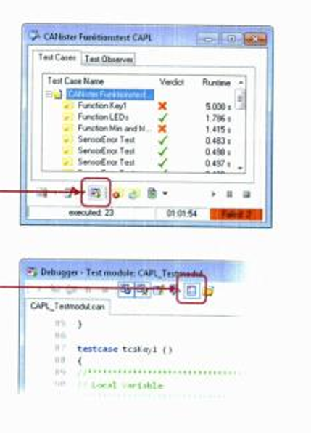
CAPL Advance
Debugging
Nodes can be debugged in simulation and real mode
The debugger is opened before or during the measurement
The debug mode must be activated

Slide 26
Restbus simulation Advance
Vehicle networks infrastructure

Slide 27
Restbus simulation Advance
What do we know from the last class?
What is restbus simulation and what is used for
How to create configuration using wizard

Slide 28
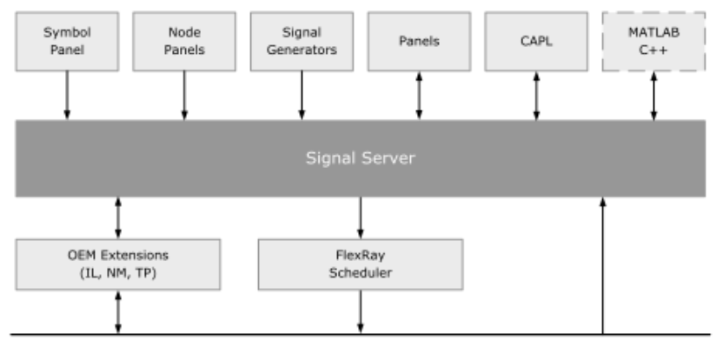
Restbus simulation Basics
Signal server concept
Its purpose is to make all network’s signal from the database available
User can access an individual signal and read them or write to them

Slide 29
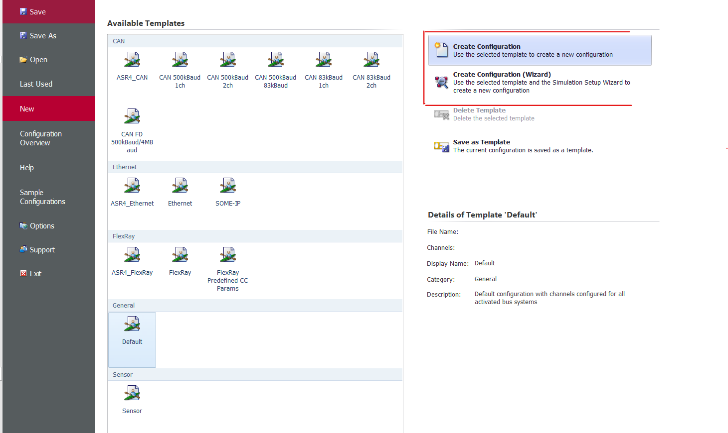
Restbus simulation Advance
How to create CANoe simulation?
Using Wizard
Manually

Slide 30
Restbus simulation Advance
Manual configuration
1. Step: Create a new configuration
2. Step: Associate database
3. Step: Insert network node
4. Step: Make node allocations
5. Step: OEM extensions (optional)
6. Step: Configure network interfaces (optional)
7. Step: Configure messages
8. Step: Define Coldstart nodes
9. Step: Define Wakeup

