Slide 1
Vehicle networks infrastructure
L04 exercise – CAN bus – Advance

Slide 2
CAN bus – Advance
Agenda:
The principle of modeling with CANoe
The initialization of the system variables via CAPL nodes
Modeling with control and display panels
Sending and receiving messages

Slide 3
The principle of modeling with CANoe
What are we going to learn from this?
Example for bus monitoring, sending of messages, and use of panels
The configuration contains an AUTOSAR 4.0 database that contains the network description of a CAN network

Slide 4
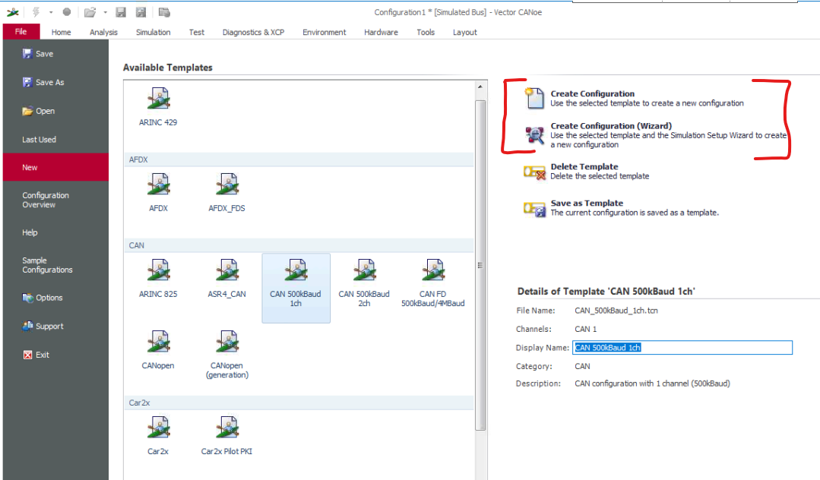
The principle of modeling with CANoe
Simulation setup
Download materials “CAN_Autosar” from Canvas and save them in your workspace
Create a new restbus simulation:
Name configuration as “CAN_Autosar” and save in materials
Use CAN template: “CAN 500kBaud 1ch”
Name CAN network as “Vehicle_control”
Setup operational mode Simulated bus

Slide 5
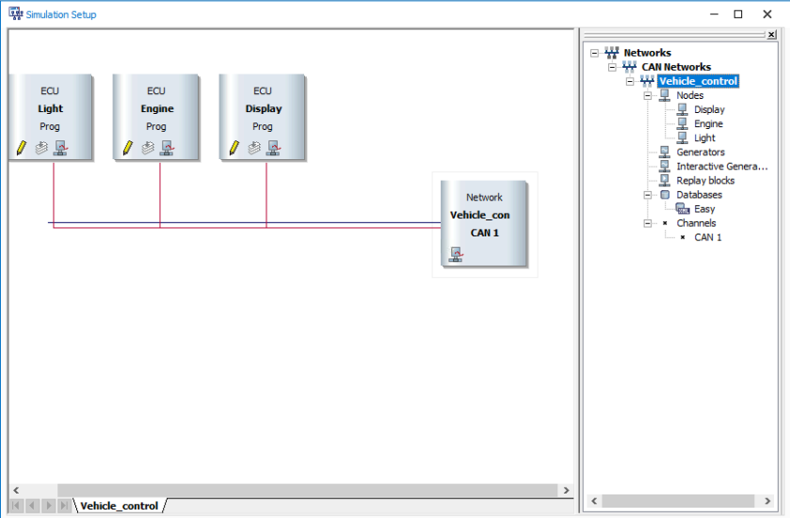
The principle of modeling with CANoe
Simulation setup
Assign database “Easy2.arxml” from materials using the Simulation setup window
Create three network nodes:
Display
Engine
Light

Slide 6
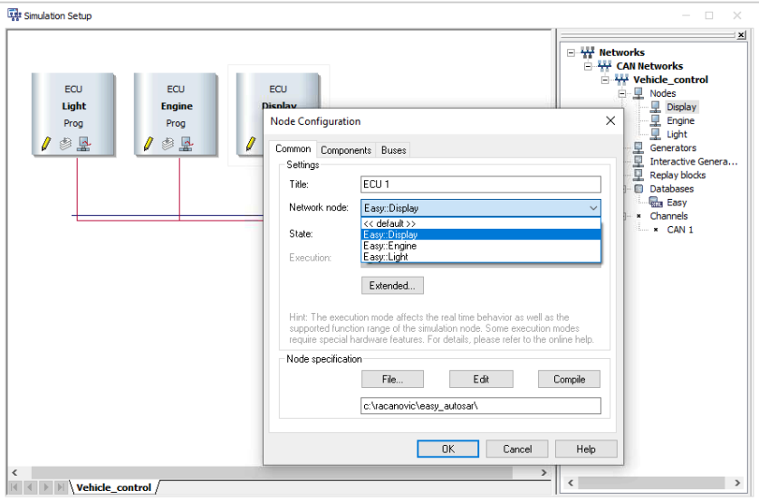
The principle of modeling with CANoe
Simulation setup
The network nodes should inherit the behavior described in the database
The database will be in ARXML format
Why not DBC?

Slide 7
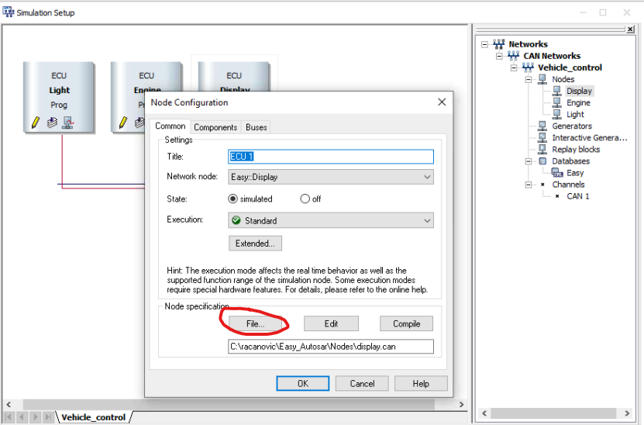
The principle of modeling with CANoe
Simulation setup
All nodes should be assign to corresponding .can files
Load nodes from materials under the “Nodes” folder:
Display.can
Engine.can
Light.can

Slide 8
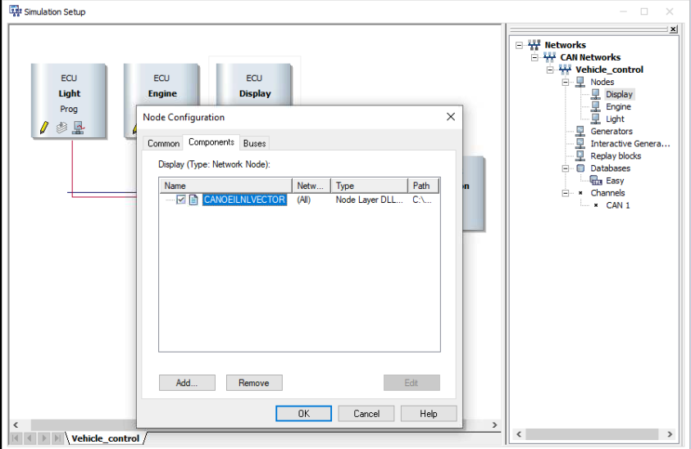
The principle of modeling with CANoe
Simulation setup
Load modeling library for all three nodes from “C:\Program Files\Vector CANoe 11.0\Exec32\CANoeILNLVector.dll”
What is the Interaction Layer?
By using the CANoeILNLVector.dll, a generated or manually created CAPL code is not required to send messages.
The modeling library determines the information required to send the messages directly by reading the database IL parameters (transmission types, cycle times, etc.)

Slide 9
The principle of modeling with CANoe
Measurement setup
Select “Analysis” desktop and open the following windows there:
Trace window
Graphical window
Data window
Write window

Slide 10
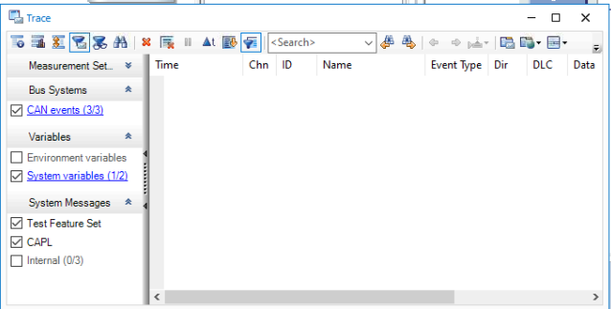
The principle of modeling with CANoe
Measurement setup
Open the trace window and enable the following filters:
CAN events
System Variables

Slide 11
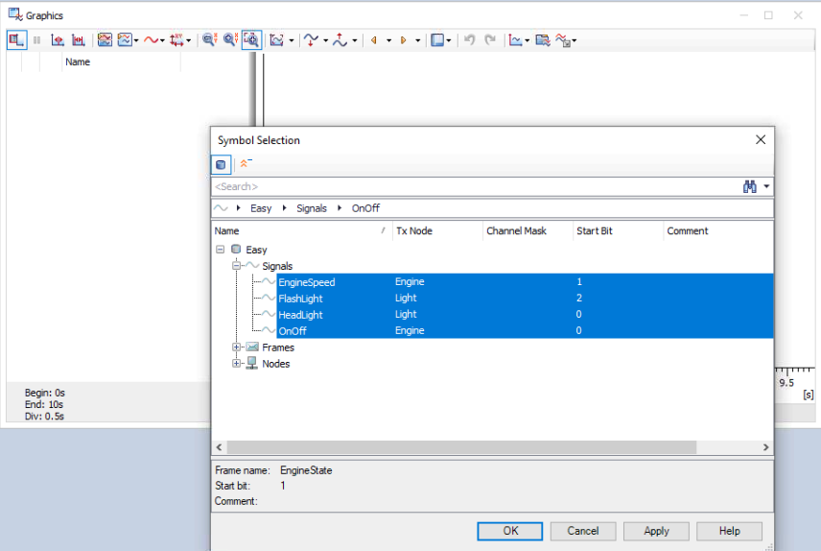
The principle of modeling with CANoe
Measurement setup
Open the graphic window and add the following signals to be tracked:
Easy::Engine::EngineState::EngineSpeed
Easy::Light::LightState::FlashLight
Easy::Light::LightState::HeadLight
Easy::Engine::EngineState::OnOff

Slide 12
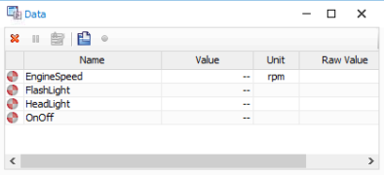
The principle of modeling with CANoe
Measurement setup
Open the data window and add the following signals to be tracked:
Easy::Engine::EngineState::EngineSpeed
Easy::Light::LightState::FlashLight
Easy::Light::LightState::HeadLight
Easy::Engine::EngineState::OnOff

Slide 13
The initialization of the system variables via CAPL nodes
System variables
Environment variables
Used for modelling internal parameters and development and testing
Provide the opportunity to change and analyse internal variables and parameters
Used to indicate signals in CANoe which are not defined in a database and which were not received via a network (e.g. I/O signals)
Each variable can only take values of one specific data type.
Describe the behaviours of network nodes with regard to external input and output signals
Discrete environment variables may be used to represent switch positions.
Continuous environment variables might be used to represent variables such as temperature or engine speed.
Character string variables can represent whole words or texts of any length.
Binary data can be used to encode entire data fields.

Slide 14
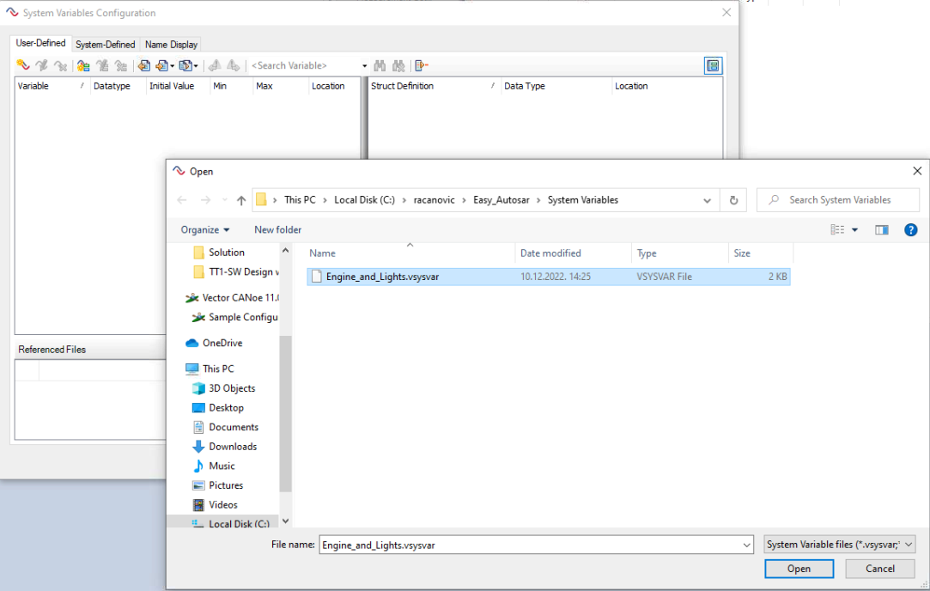
The initialization of the system variables via CAPL nodes
System variables
Open the System Variables Configuration from the tab Environment/Symbol/SystemVariable using import button
Import a file “Engine_and_Lights.vsysvar” from materials under System Variables folder
After successful import additional 5 variables will be visible in 2 different namespaces

Slide 15
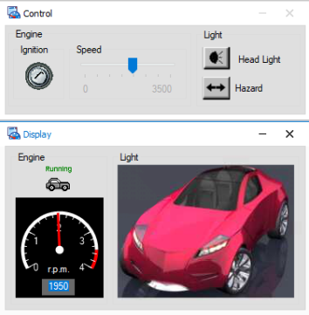
Modeling with control and display panels
Panels
The “Control” panel contains variables and signals from Engine and Light nodes used as an input for the simulation
The "Display“ panel contains variables and signals from Engine and Light nodes used as an output of the simulation

Slide 16
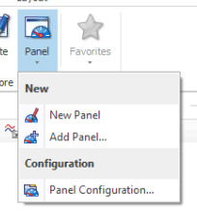
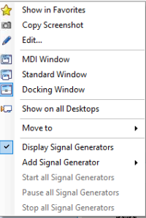
Modeling with control and display panels
Panels
Create a new display “Tracking” and add two panels from materials under the “Panels” folder:
"Control.xvp"
"Display.xvp“
Right click on each panel will offer you the option to use panels as MDI Window

Slide 17
Sending and receiving messages
In our example, the messages can be sent using:
Panels,
Data window
In our example, the messages can be received using:
Panels
Trace window
Graphic window
Data window

Slide 18
Let’s try it live
Start the measurement and turn on the engine or the lights via the associated controls in the "Control" panel.
To see more or less information in the Write window, press the following keys:
Press key 1 to set DbgLevel = 1 for more information
Press key 0 to set DbgLevel = 0 for less information

