Slide 1
Vehicle networks infrastructure
L11 exercise – 1TPCE Advance

Slide 2
Agenda
How to configure Ethernet packets
Dynamic Host Configuration Protocol (DHCP)
Transmission Control Protocol/Internet Protocol (TCP/IP)
User Datagram Protocol/Internet Protocol (UDP/IP)

Slide 3
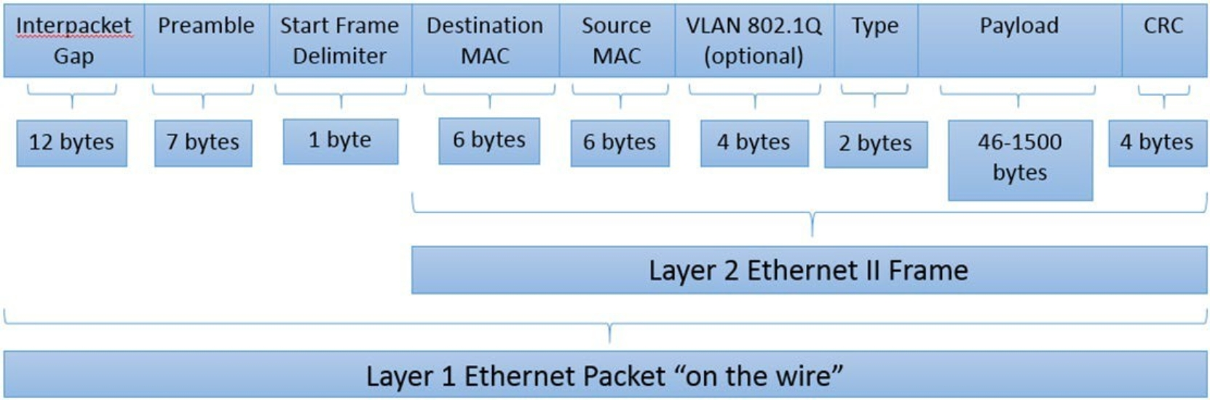
How to configure Ethernet packets

Slide 4
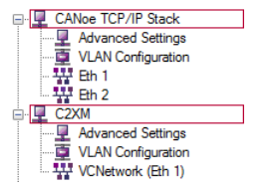
TCP IP Stack
This dialog is only available, if
the option Ethernet is installed
at least one Ethernet channel is configured in the current configuration
For each network stack you can configure the following settings:
Stack Selection
Activate Tcp Delayed Acknowledge
VLAN Configuration
Network Settings for each Ethernet Channel

Slide 5
TCP IP - Stack Selection
Several components use IP communication, e.g. DoIP, XCP, and TCP/IP in CAPL.
On TCP/IP Stack page, is possible to configure the basic settings for IP communication.
This page is available for:
CANoe TCP/IP Stack
Network nodes

Slide 6
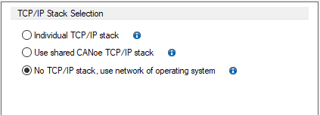
TCP IP - Stack Selection
In this section is possible to select which TCP/IP stack CANoe or a network node uses for communication.
Individual TCP/IP stack
Use shared CANoe TCP/IP stack
No TCP/IP stack, use network of operating system

Slide 7
TCP IP - Stack Selection
Individual TCP/IP stack
A proprietary TCP/IP stack is established for the network node.
This stack is used for the IP communication of the TCP/IP API and DoIP functions in CAPL.
The network node then communicates with an independent TCP/IP stack with its own IP and MAC address.
You have to do these settings in the Ethernet settings for each assigned channel.
Select an individual TCP/IP stack instance for the node if this node should represent a discrete node with its own TCP/IP stack in the network. However it is not possible to directly connect to the localhost of your computer.
If a node from a datavase file is selected for the network node, the use of the individual TCP/IP stack instance is automatically activated and cannot be changed.

Slide 8
TCP IP - Stack Selection
Use shared CANoe TCP/IP stack
The CANoe TCP/IP stack has to be configured separately at CANoe TCP/IP Stack.
CANoe has its own TCP/IP stack instance that can be used offor several network nodes in common.
Nodes which use this instance are visible in the network as one node only. DoIP windows and XCP functions use this stack for the IP communication.
The CANoe TCP/IP stack communicates with its own IP and MAC address. You have to do these settings at CANoe TCP/IP Stack for each channel.
Select the CANoe TCP/IP stack if you want to distribute an distributed application to several simulation nodes and which is visible as a single node in the network.

Slide 9
TCP IP - Stack Selection
No TCP/IP stack, use network of operating system
If the TCP/IP API or DoIP in CAPL is used by this network node, the IP communication is routed via the Windows® network.
In this case the network nodes shares the network resources with the operation system.
Therefore the network settings of Windows have to be correct. In CANoe no more settings are necessary.
This option is also used if no option Ethernet is available or the network node is not assigned to an Ethernet bus.
The network communication is not visible in CANoe.
You can communicate with the localhost of your computer.
In simulation mode the network communication is routed via the real network interface. If the measurement is paused, connection aborts are possible.
Use this setting with vVIRTUALtarget to avoid conflicts with the IP settings of vVIRTUALtarget.

Slide 10
TCP IP – Advanced settings
On this page the Tcp Delayed Acknowledge can be activated/deactivated.
This page is available for:
CANoe TCP/IP Stack with activated Use CANoe internal TCP/IP stack option
Network nodes with activated Individual TCP/IP stack instance option
If this option is activated the TCP/IP Stack tries to send the ACK flag together with a possibly sent response. This should avoid an acknowledgement being sent additionally to the response.
With this behavior, the number of small packets in the network should be reduced.
The delayed acknowledge is activated by default.
This option is available if the following preconditions are complied with:
  The configuration contains at least two networks or a VLAN.
  At CANoe TCP/IP-Stack|TCP/IP Stack Selection you have selected option Use CANoe internal TCP/IP stack.
  At <node>|TCP/IP Stack Selection you have selected Individual TCP/IP stack instance and the node is assigned to two networks at least.
If you activate option Enable routing the TCP/IP stack routes packets from one sub net to the other ones. Each assigned bus must be configured as a proprietary sub net.

Slide 11
TCP IP - VLAN Configuration
On this page VLANs of the network notes aare managed.
The VLANs are sorted by channel and listed in the table with itheir ID and priority.
This page is available for:
CANoe TCP/IP Stack with activated Use CANoe internal TCP/IP stack option
Network nodes with activated Individual TCP/IP stack instance option
VLAN name - Name of the VLAN, is automatically generated from channel number and VLAN ID
VLAN ID - ID of the VLAN, valid values: 1..4094
VLAN Priority - Priority of the VLAN, valid values: 0..7
Use [Add] to add a new VLAN and [Remove] to remove an existing VLAN.
The configuration pages for the IP addresses of the VLAN are shown below the appropriate channel. On these pages you can configure the IPv4 and IPv6 addresses.
The configuration pages are shown only after the TCP/IP Stack dialog is reopened.
If a node from a FIBEX file is selected for the network node, the VLAN settings of the associated network cannot be changed.

Slide 12
TCP IP – Network Settings
On this page you can modify the settings for each Ethernet channel.
The VLANs are sorted by channel and listed in the table with itheir ID and priority.
This page is available for:
CANoe TCP/IP Stack with activated Use CANoe internal TCP/IP stack option
Network nodes with activated Individual TCP/IP stack instance option
Following settings are available:
  Ethernet Settings
  IPv4 Settings
  IPv6 Settings
  Advanced Settings

Slide 13
How to configure Ethernet packets
An Ethernet packet on the wire at Layer 1 is composed of the following fields:
Interpacket Gap: Serves as a gap between each frame, similar to a spacer. The Interpacket gap is only part of Layer 1. The field originates from a time when hubs were common, and collisions were more commonplace.
Preamble: Composed of alternating 1 and 0 bits for receiver clock synchronization. The Preamble is only part of Layer 1.
Start Frame Delimiter: Identifies the start of an Ethernet frame.
Destination MAC: Contains the MAC address of the destination station for which the data is intended.
Source MAC: Contains the MAC address of the sending station.
VLAN 802.1Q: Optional field used if a VLAN is identified.
Type: Also known as the EtherType field, this defines the type of protocol that is encapsulated in the payload. In the preceding example, it is an Ethernet II Frame, the most widely accepted type.
Payload: Spans from 46 to 1,500 bytes and contains user data. If it is smaller than 46 bytes, blank values are entered to bring this up to 46 bytes, which is the minimum value. The Payload consists of protocol data for TCP, UDP, or RTP and IPv4 or IPv6.
CRC: Cyclic Redundancy Check is part of the Frame Check Sequence (FCS) to detect errors within the frame. The CRC code should result in a zero if the data does not contain any error

Slide 14
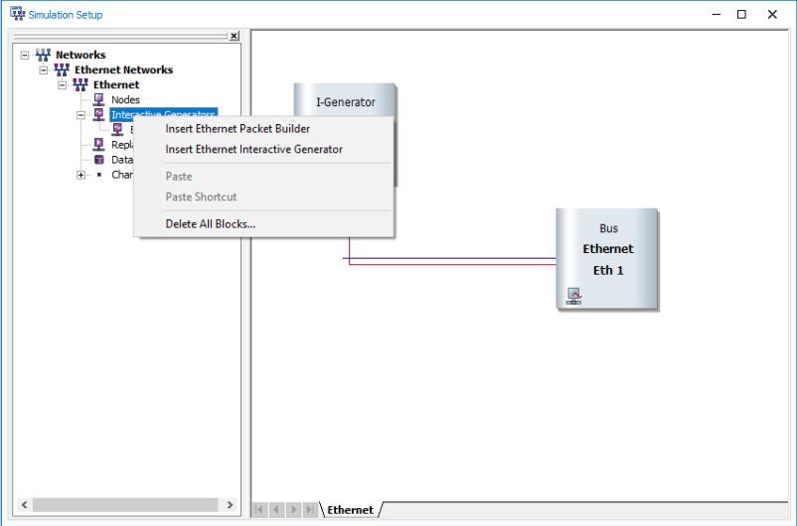
How to configure Ethernet packets
From materials open “EthernetBasicPackageBuilder.cfg”
From the Simulation Setup window insert the Ethernet Package Builder if doesn’t exist

Slide 15
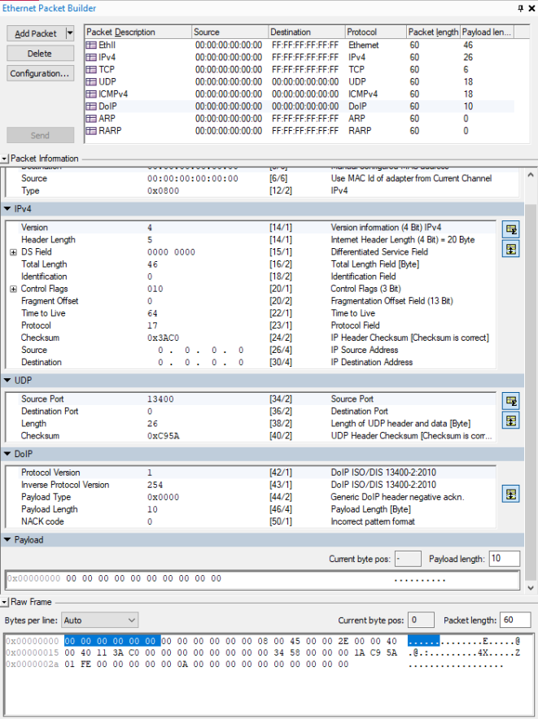
How to configure Ethernet packets
Supported package types:
EthII
IPv4
TCP
UDP
ICMPv4
DoIP
ARP
RARP

Slide 16
How to configure Ethernet packets
Clicking on the desired package, the option for additional information will jump out
After the population Payload and desired content, click on Send button package will appear in the Trace window

Slide 17
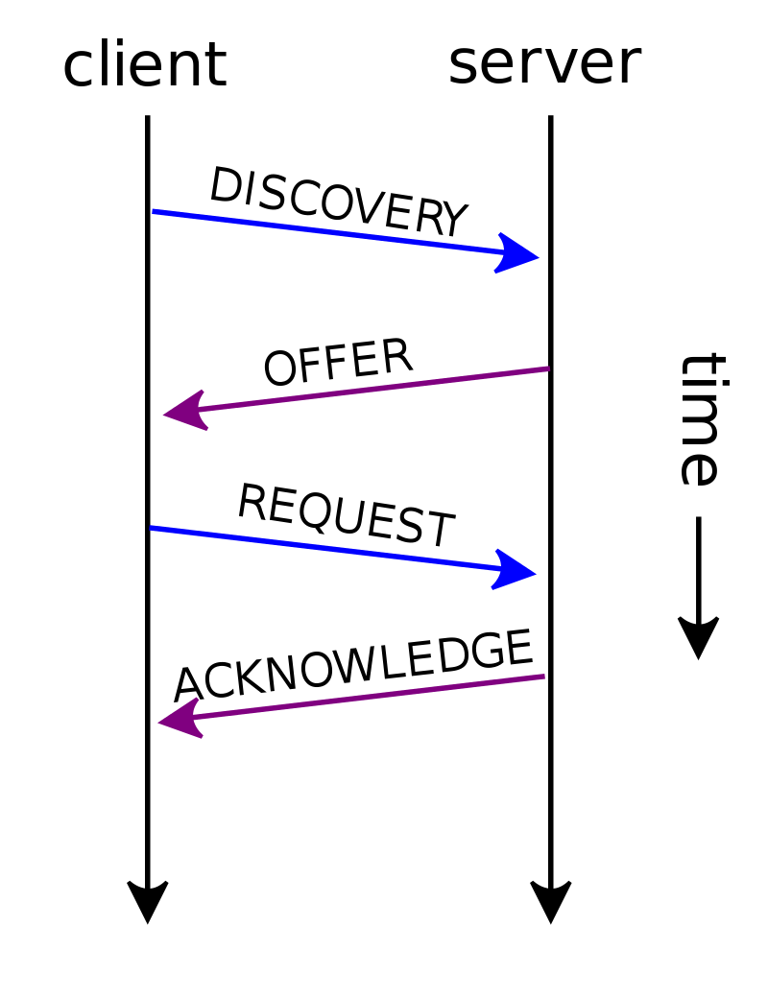
Dynamic Host Configuration Protocol (DHCP)
Dynamic Host Configuration Protocol (DHCP) is a client/server protocol that automatically provides an Internet Protocol (IP) host with its IP address and other related configuration information such as the subnet mask and default gateway.

Slide 18
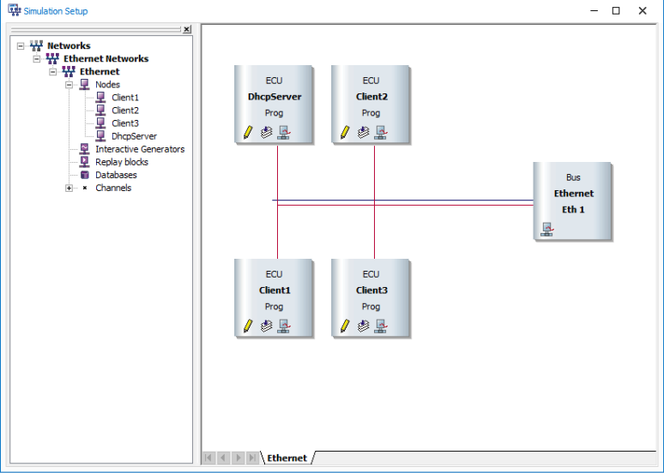
Dynamic Host Configuration Protocol (DHCP)
From materials open “DHCPSimServer.cfg”
The Simulation Setup contains four nodes.
  Three DHCP client nodes
  One DHCP server which manages the address pool and provides the addresses for the clients

Slide 19
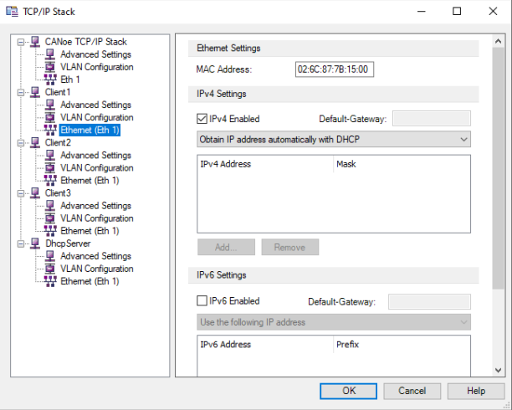
Dynamic Host Configuration Protocol (DHCP)
Ethernet settings about TCP/IP Stack already predefined as shown in the picture
From Simulation tab, select TCP/IP Stack option

Slide 20
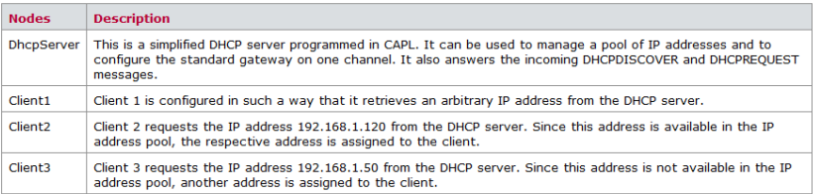
Dynamic Host Configuration Protocol (DHCP)

Slide 21
Dynamic Host Configuration Protocol (DHCP)
The DHCP Server can be managed and configured via the DHCP Server Panel.
The DHCP server can be enabled and disabled using the Enable DHCP Server switch. If the DHCP server is disabled, the validity of the addresses expires and the configuration of the clients will become invalid.
The input boxes IP Address Range Begin and IP Address Range End can be used to specify an IP address range from which the DHCP server can select the IP addresses.
Subnet Mask: This input box is used to set the subnet mask for the assigned IP addresses.
Default Gateway: This option is used to set the standard gateway address for the DHCP server.
Lease Duration: This option is used to set the validity of the assigned IP address in seconds.
After half of the validity period has elapsed, the clients start to refresh their IP address configuration.
The view area shows the assigned addresses and the current validity period.

Slide 22
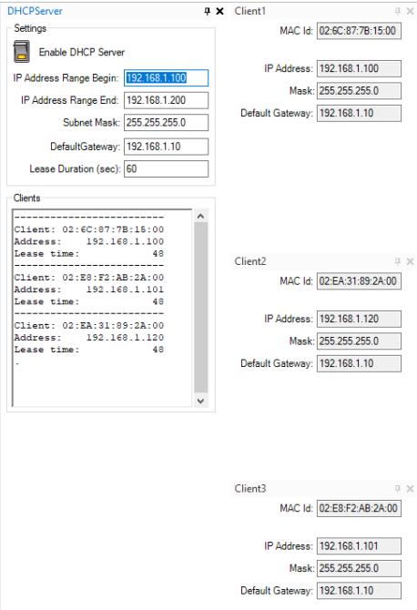
Dynamic Host Configuration Protocol (DHCP)
Each client has a dedicated panel that shows the current IPv4 configuration.
The data traffic concerning the configuration can be monitored in the Trace Window for the client.

Slide 23
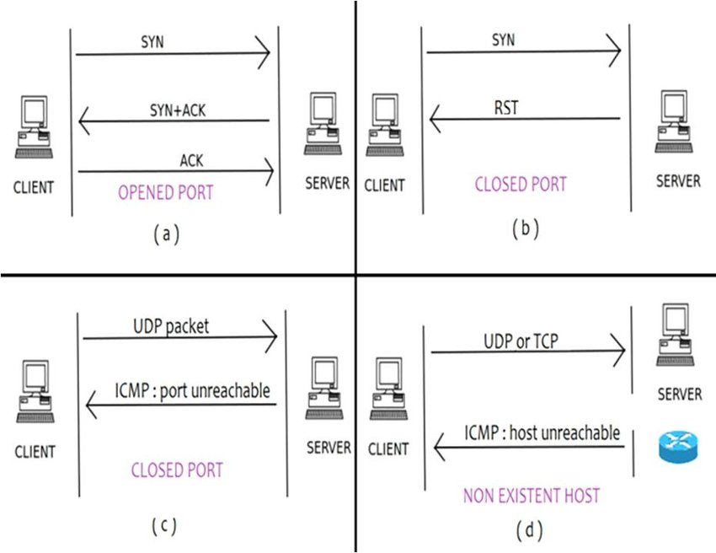
Transmission Control Protocol/Internet Protocol (TCP/IP)
TCP/IP stands for Transmission Control Protocol/Internet Protocol and is a suite of communication protocols used to interconnect network devices on the internet.
TCP/IP is also used as a communications protocol in a private computer network (an intranet or extranet).

Slide 24
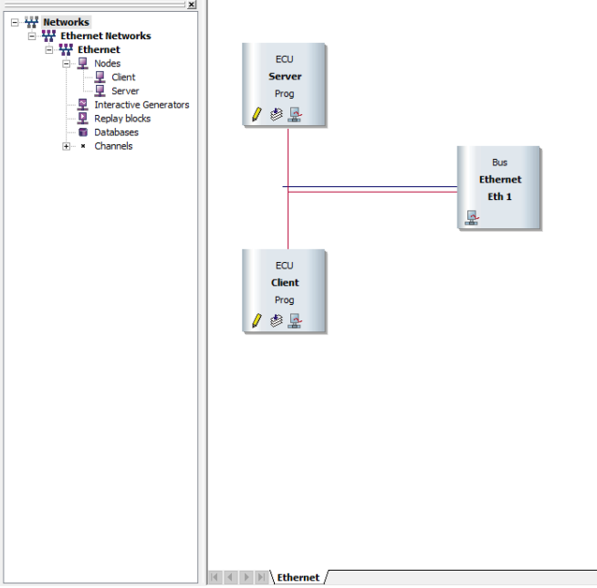
Transmission Control Protocol/Internet Protocol (TCP/IP)
From materials open “TCPBasicCAPL.cfg”
The simulated nodes Server and Client can be seen in the Simulation Setup.
  A double click on the node opens the CAPL Browser.
  The CAPL programs use the TCP/IP API from CAPL to open TCP sockets and exchange data through them.
  The client establishes a TCP connection to the server; the server can then send a text message to the client.
  This is controlled through system variables, which you can influence with the controls on the panels.
The Start Values Window sets the system variables at the start of measurement in such a way that a TCP connection is established by the client.

Slide 25
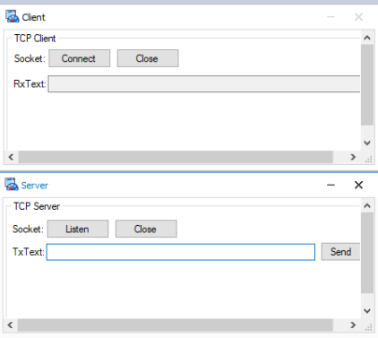
Transmission Control Protocol/Internet Protocol (TCP/IP)
At the start of a measurement, a TCP connection is established between the client and the server.
You can send a text message to the client with the Send button on the TCP Server panel.
The text message transmitted is displayed in the Trace Window.
With the Listen, Connect, and Close buttons you can close or re-establish the TCP connection.

Slide 26
User Datagram Protocol (UDP)
User datagram protocol (UDP) operates on top of the Internet Protocol (IP) to transmit datagrams over a network
UDP does not require the source and destination to establish a three-way handshake before transmission takes place
Additionally, there is no need for an end-to-end connection.

Slide 27
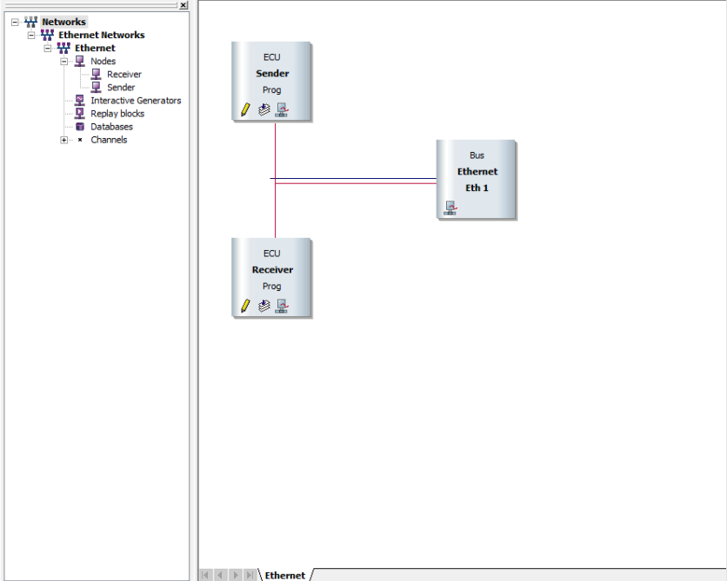
User Datagram Protocol (UDP)
From materials open “UDPBasicCAPL.cfg”
This desktop contains the Simulation Setup, including the two simulated nodes
  Sender
  Receiver

Slide 28
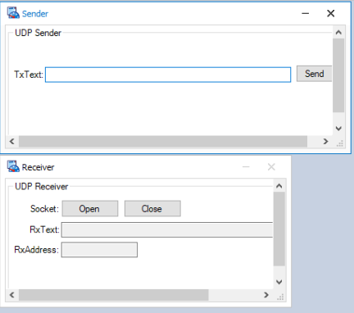
User Datagram Protocol (UDP)
At the start of a measurement, the two simulated nodes open one UDP socket each.
The Sender node opens a UDP socket to start sending.
The Receiver node opens a UDP socket to receive these UDP packets.
Press the Send button on the Sender panel to start the process.

