Slide 1
Vehicle networks infrastructure
L05 exercise – LIN bus - basic

Slide 2
Vehicle networks infrastructure
Agenda:
DBC – Data Base for CAN
LDF – LIN Description File
FIBEX – Field Bus Exchange Format (FlexRay, MOST, CAN, TTCAN, LIN and Ethernet)
ARXML – AutoSAR XML (FlexRay, MOST, CAN, TTCAN, LIN and Ethernet)

Slide 3
LDF format
The configuration of the Local Interconnect Network (LIN) network cluster, i.e. the specification of:
Network publishers and subscribers
Signals
Frames
is managed in the LIN Description File or LDF.
This is an ASCII-text file created by the network designer and provided to vendors who will be developing LIN Master/Slave node hardware/software.
From the LDF, ANSI-C driver code and header files are automatically generated using suitable tools.

Slide 4
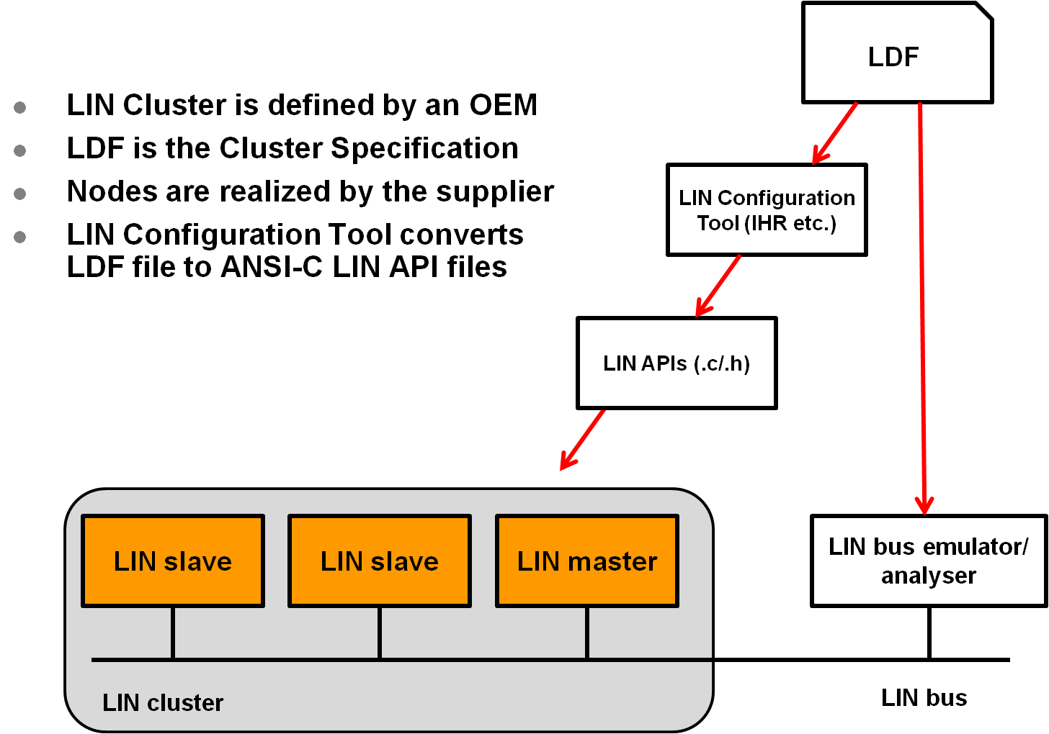
LDF format
Workflow

Slide 5
LDF format
Structure of LDF documents:
Defined by a consortium
Global description language
One single file describes a complete LIN network
Universal file for embedded software, test, validation, and analysis tools
Defines cluster information
Protocol and Language Version
Bus Speed
Node List, Signals &Frames
Schedule Tables

Slide 6
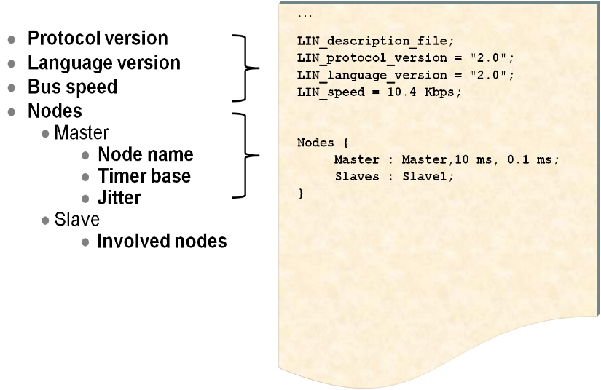
LDF format
LFR document header

Slide 7
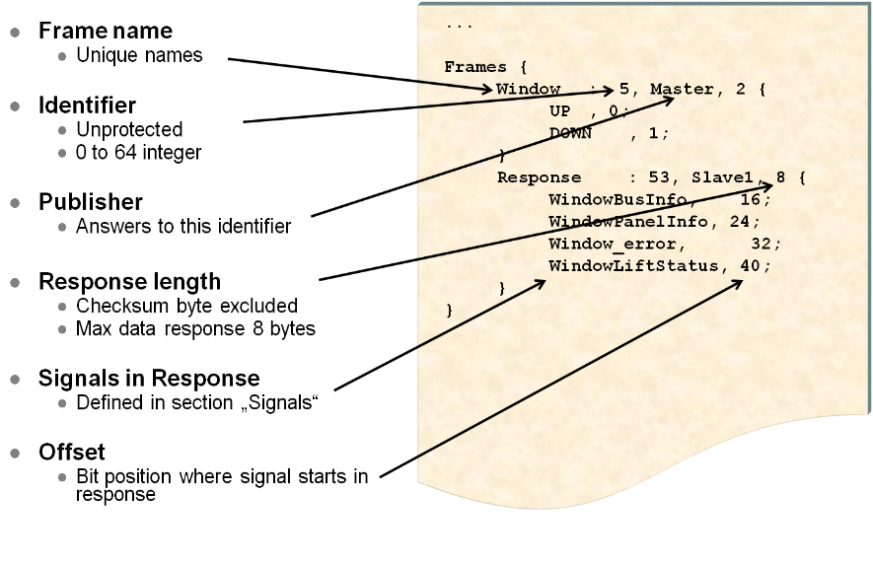
LDF format
Description section

Slide 8
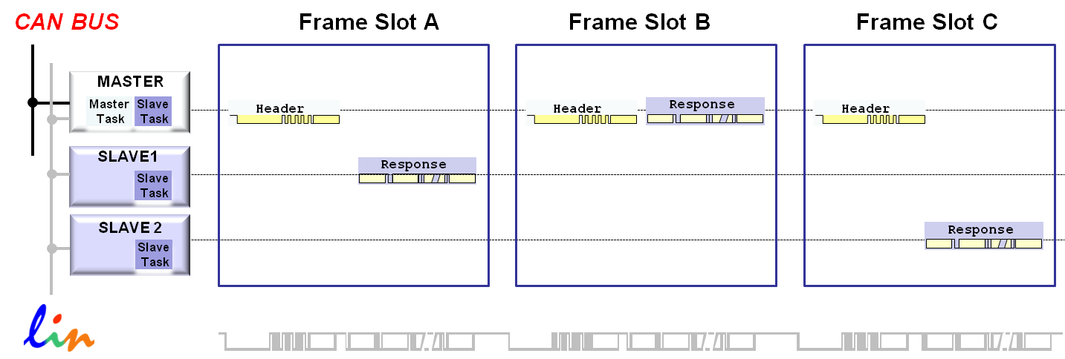
LDF format
Unconditional Frames
This is the “normal” type of LIN communication.
The master sends a frame header in a scheduled frame slot and the designated slave node fills the frame with data.
Unconditional frames carry signals, and their frame identifiers are in the range 0 (zero) to 59 (0x3B).

Slide 9
LDF format
Event Triggered Frames
The purpose of an event triggered frame is to increase the responsivity of the LIN cluster without assigning too much of the bus bandwidth to the polling of multiple slave nodes with seldom occurring events.
Master asks slaves if a certain event has occurred
Only those who have seen the event publish a response
Identifiers 0x00 to 0x3b (0-59)
Collisions are possible - If more than one slave has detected the specified event, all respond simultaneously resulting in a collision
When detected, MASTER reverts to unconditional frames
Can result in better utilization of bandwidth

Slide 10
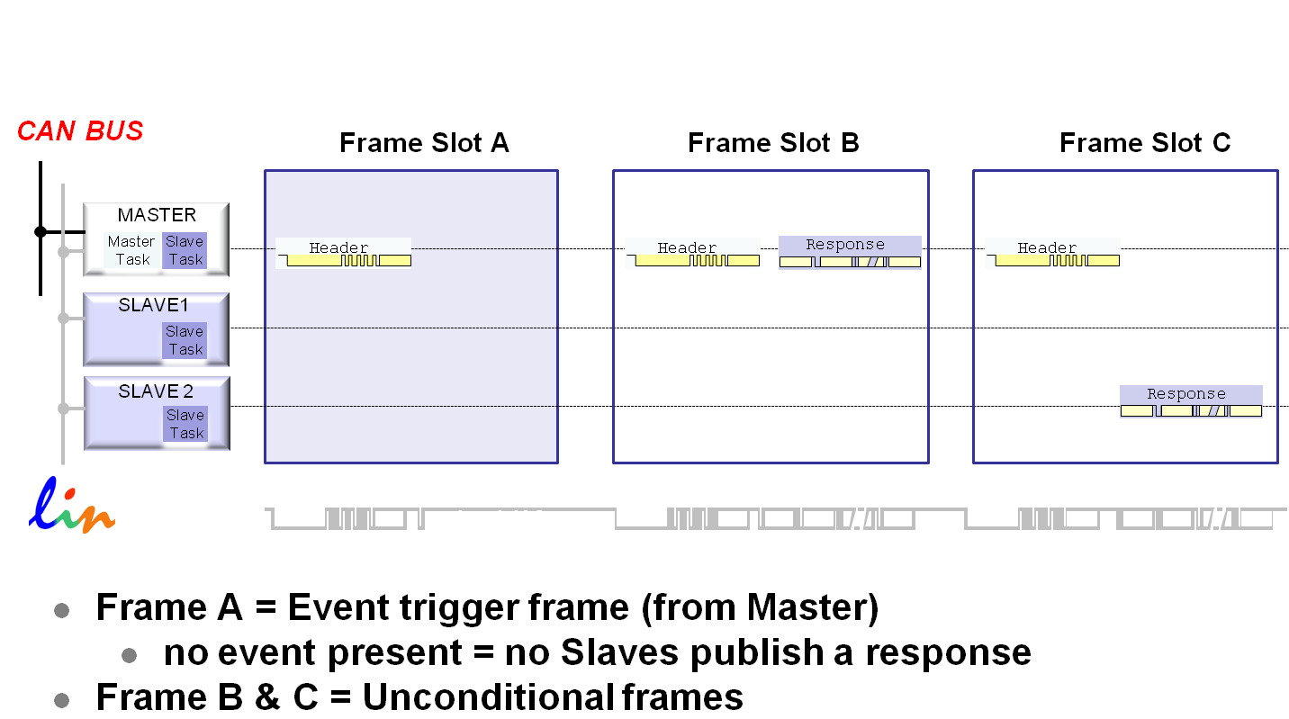
LDF format
Event Triggered Frames
Scenario#1
No slaves have event to report, no one publishes

Slide 11
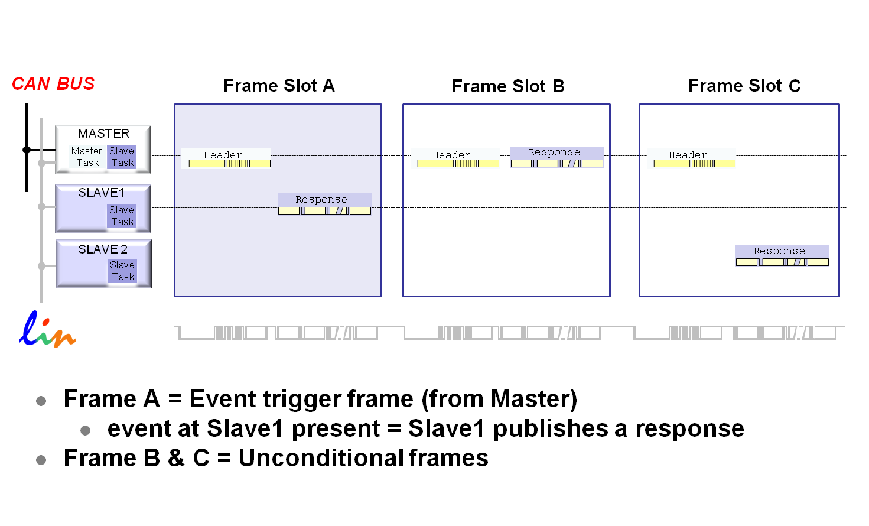
LDF format
Event Triggered Frames
Scenario#2
SLAVE1 has an event to report and publishes a response

Slide 12
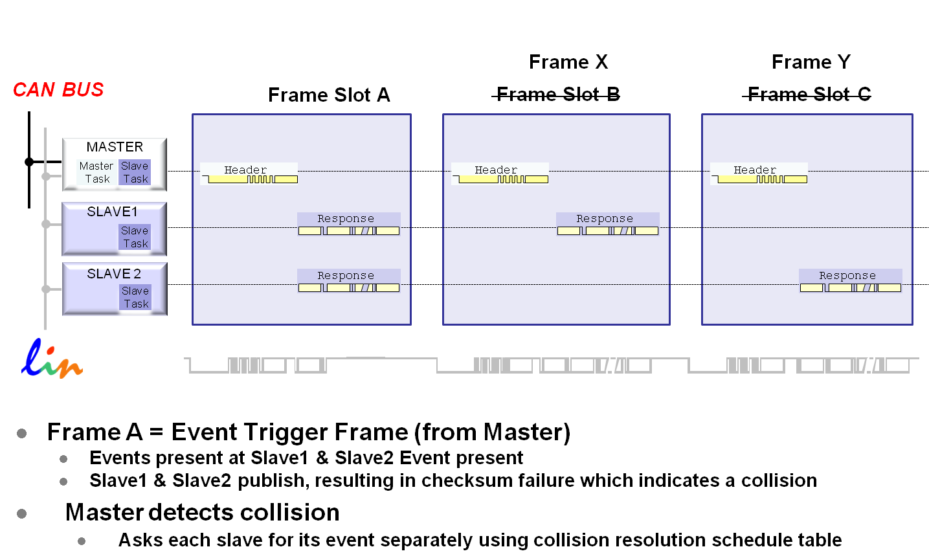
LDF format
Event Triggered Frames
Scenario#3
Two (or more) slaves detect and publish responses

Slide 13
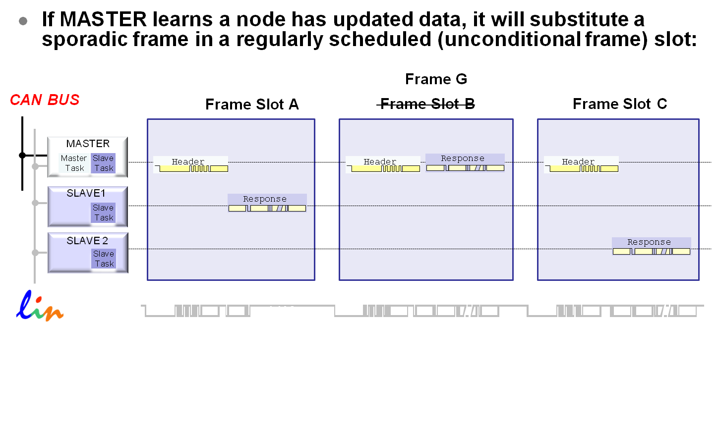
LDF format
Sporadic Frames
The purpose of sporadic frames is to blend some dynamic behavior into the deterministic and real-time focused schedule table without losing the determinism in the rest of the schedule table.

Slide 14
LDF format
Diagnostic Frames
Their primary function is in the area implementing diagnostics and configuration functions on LIN slaves.
Carry diagnostic/configuration data
Always contain 8-byte data payload
Designated Identifiers
0x3C (60) Master Request Frame
0x3D (61) Slave Response Frame

Slide 15
LDF format
Diagnostic Frames
Data Field Definitions
Node Configuration
NAD (Node Address)
Supplier ID
Supplier Identification e.g. 0x0014 = Microchip
Function ID
Function Application e.g. 0xAA55 = Window Lift Switch
Variant
Application Type e.g. 0x3C = Anti Pinch Function

Slide 16
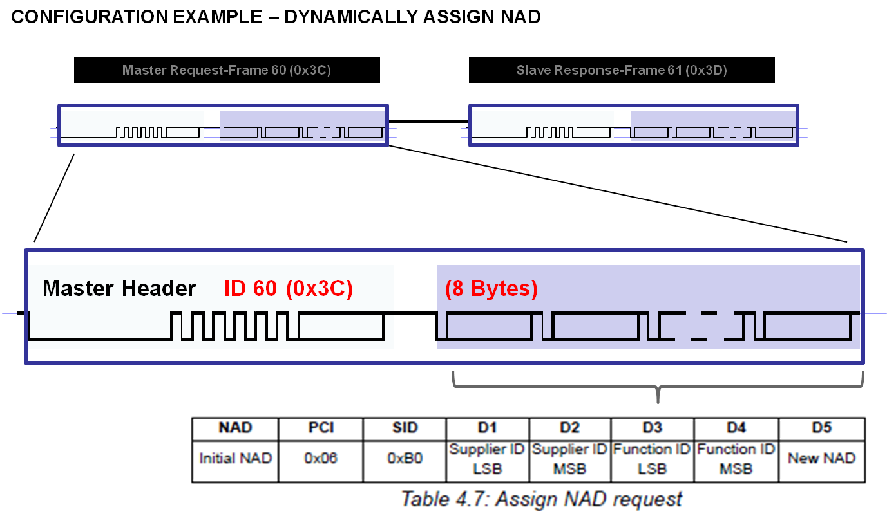
LDF format
Diagnostic Frames
Example (Master Request Frame)

Slide 17
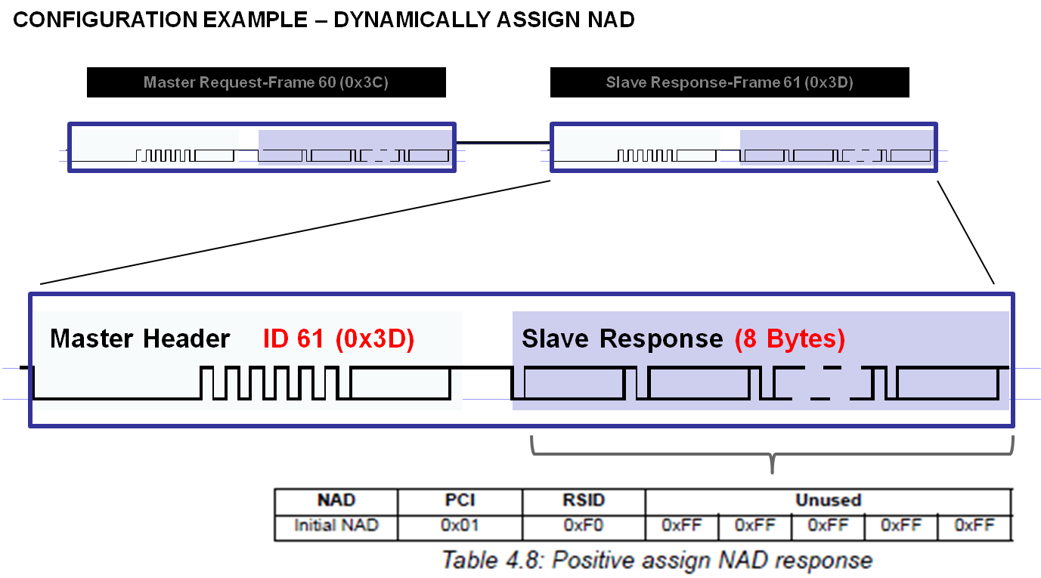
LDF format
Diagnostic Frames
Example (Slave Response Frame)

Slide 18
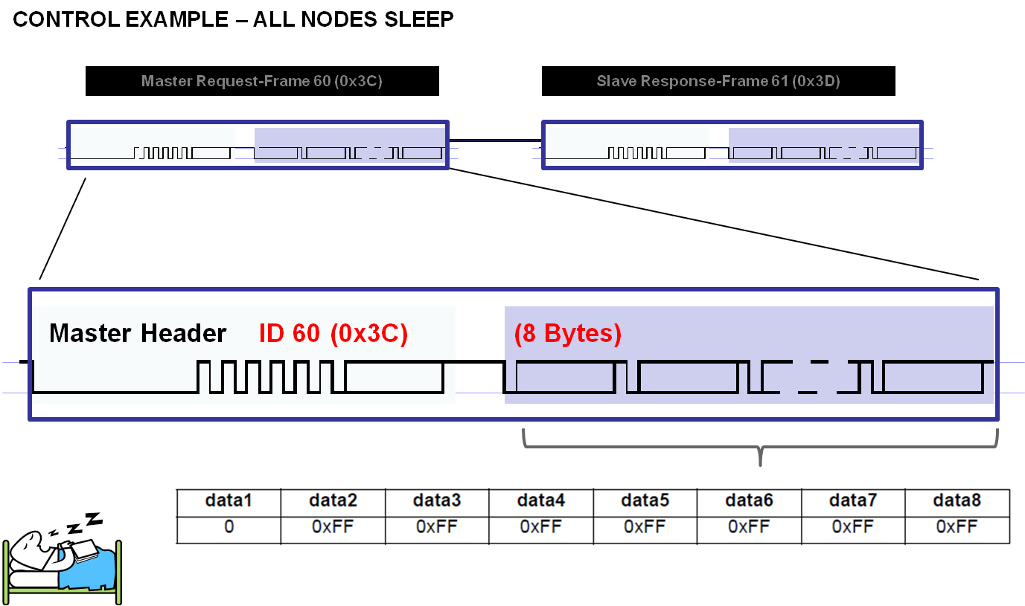
LDF format
Network Management Frames
In a LIN cluster it refers to cluster wake up and go to sleep only.
All Nodes Sleep Command
The go to sleep command is a master request frame with the first data field set to 0 and rest set to 0xFF

Slide 19
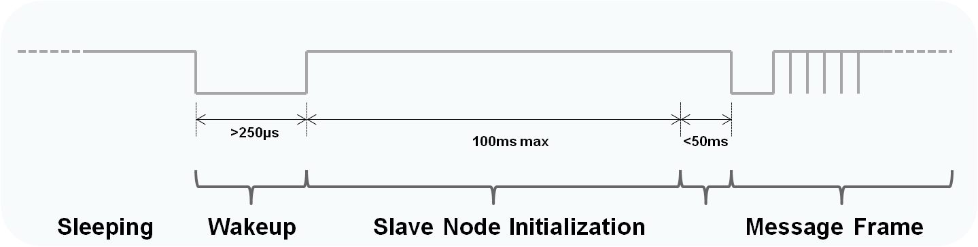
LDF format
Network Management Frames
Wake up
Any node can request a wakeup
Node forces dominant from 250 µs – 5 ms
All nodes should then wakeup within 100 ms from end of wakeup signal
Master node must transmit within 150 ms

Slide 20
LDF format
Signal descrpition
Signal definition
A "signal" is transported in the data field of a LIN frame.
Each signal has exactly one publisher, i.e. it is always written by the same node in the cluster. Zero, one or multiple nodes may subscribe to the signal.
All signals have initial values. The initial value for a published signal is valid until the node writes a new value to this signal. The initial value for a subscribed signal is valid until a new updated value is received from another node.

Slide 21
LDF format
Signal descrpition
Signal types
A scalar signal is between 1 and 16 bits long.
A 1-bit scalar signal is called a boolean signal
Scalar signals in the size of 2 to 16 bits are treated as unsigned integers.
A byte array is an array of between one and eight bytes.

Slide 22
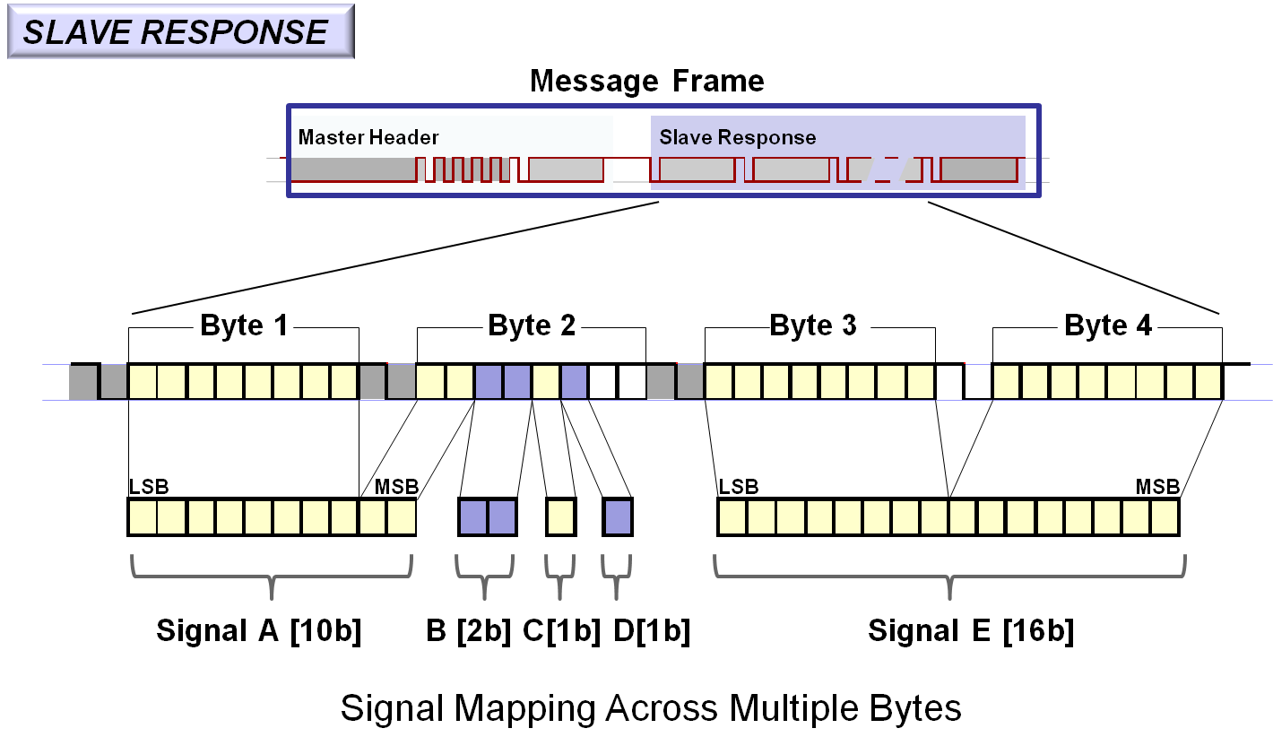
LDF format
Signal descrpition
Example of signal distribution

Slide 23
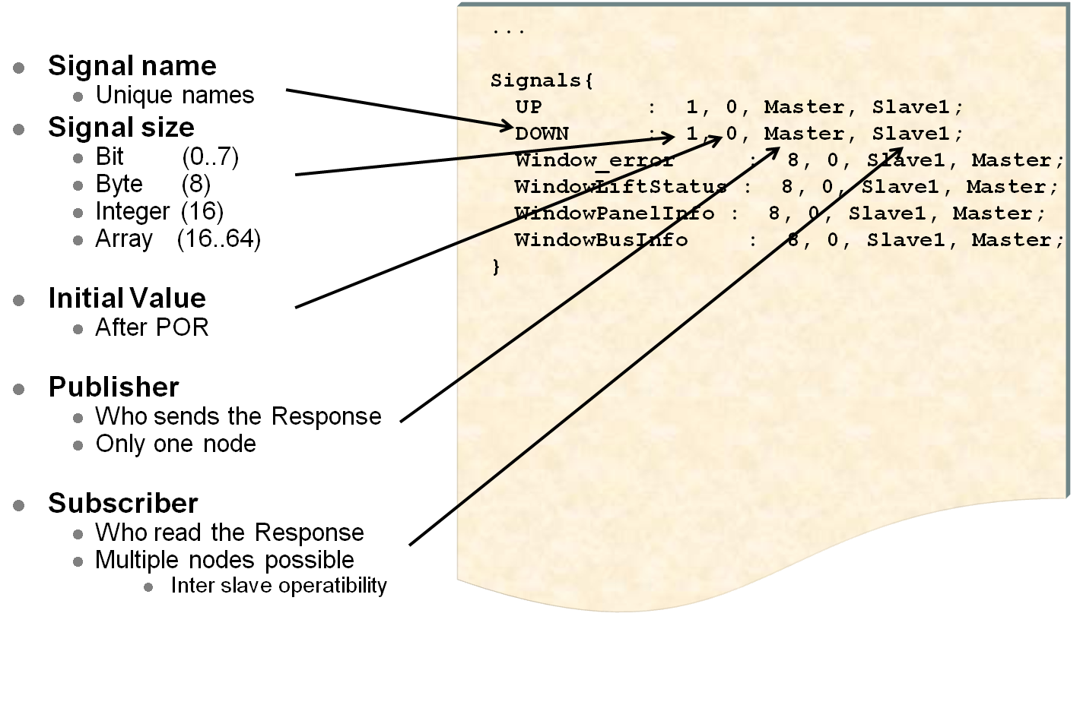
LDF format
Signal descrpition
Format chapter for signal description

Slide 24
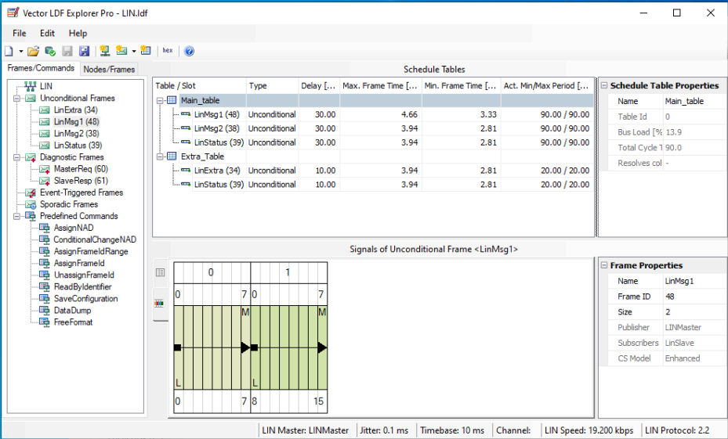
LDF Explorer
LDF Explorer Pro tool
The tool offers a graphical user interface to visually review and modify a text record.
The tool allows an overview by frame type or by network node type.

