Slide 1
Vehicle networks infrastructure
L05 exercise – LIN bus - basic

Slide 2
Vehicle networks infrastructure
Agenda:
DBC – Data Base for CAN
LDF – LIN Description File
FIBEX – Field Bus Exchange Format (FlexRay, MOST, CAN, TTCAN, LIN and Ethernet)
ARXML – AutoSAR XML (FlexRay, MOST, CAN, TTCAN, LIN and Ethernet)

Slide 3
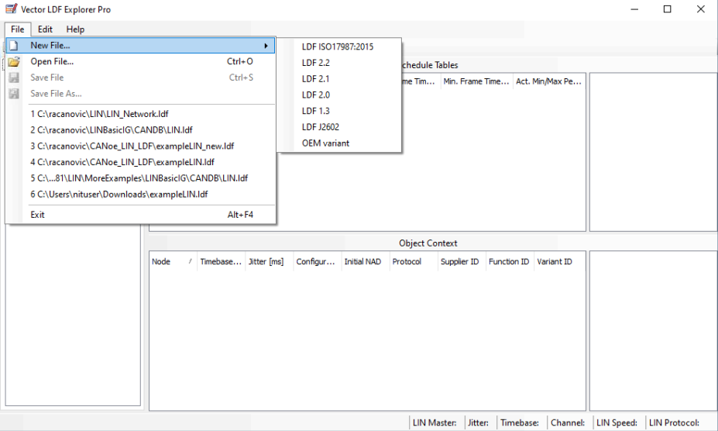
Exercise feedback
Task 1
Open LDF Explored and create a new LDF 2.2 database
Save the configuration as “LIN_Engine.ldf” in your folder on lab PC

Slide 4
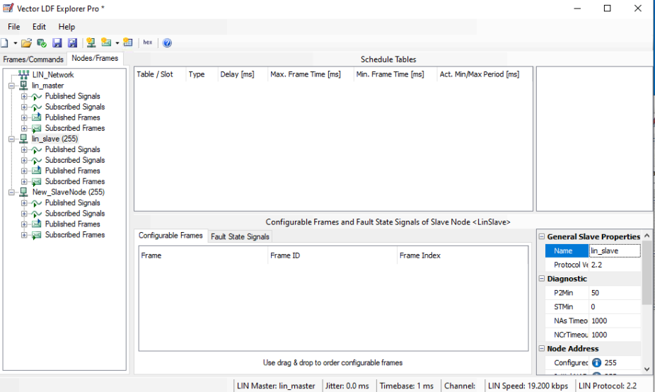
Exercise feedback
Task 1
Rename both, master and slave nodes as “lin_master” and “lin_slave” respectively
For renaming use the name field from the general property of the node as shown in the picture in the bottom-right corner

Slide 5
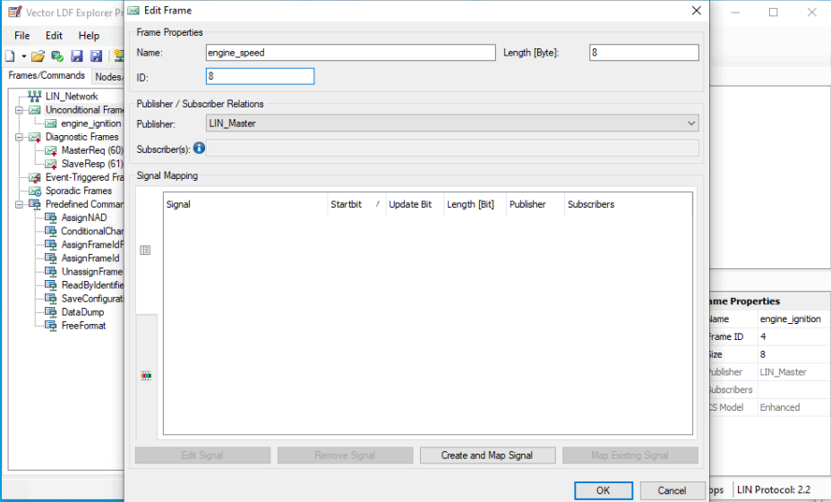
Exercise feedback
Task 1
Using the button “Create frame” from the toolbar, create 4 unconditional frames and name them:
engine_ignition with ID=34
engine_speed with ID=48
engine_status with ID=38
check_engine_status with ID=39

Slide 6
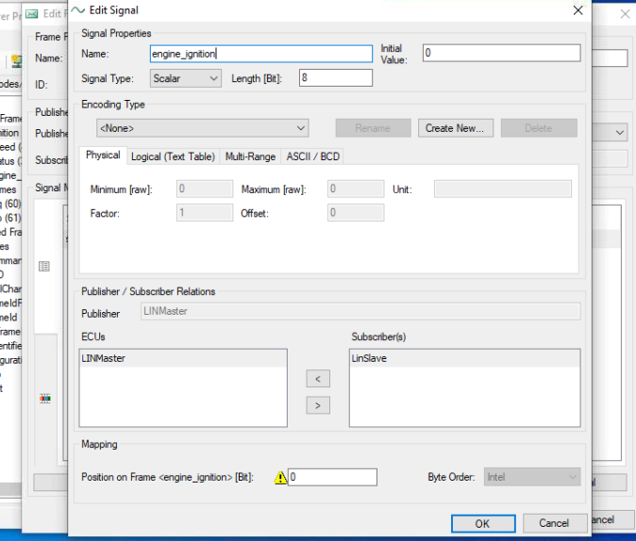
Exercise feedback
Task 2
Using the button “Create and Map Signal” from the bottom of the window, create signals with the further names:
s_ignition_status for engine_ignition frame
s_speed and s_rmp for engine_speed frame
s_error for check_engine_status
All signals should have “lin_slave” as a Subscriber(s)

Slide 7
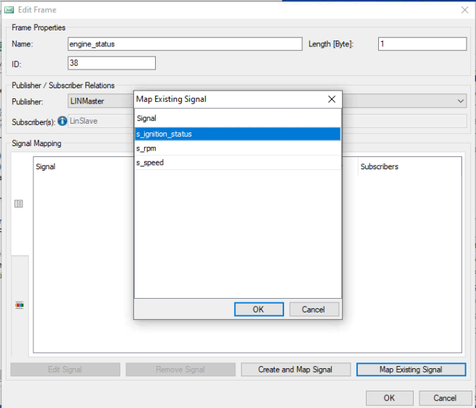
Exercise feedback
Task 2
The only exception to this rule is in frame “engine_status”:
Instead of “Create and Map Signal” button, the “Map Existing Signal” should be used and “s_ignition_status” field should be mapped

Slide 8
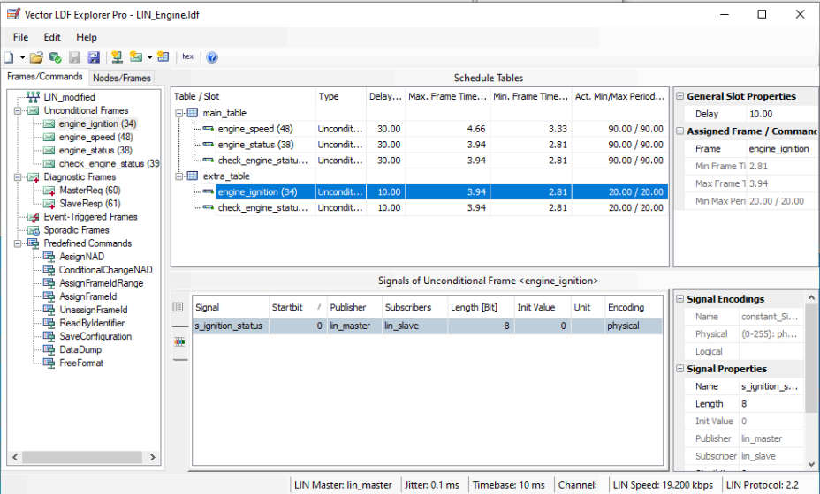
Exercise feedback
Task 3
Using the button “Create schedule table” from the toolbar, create 2 schedule tables and drag and drops proper frames:
main_table
engine_speed
engine_status
check_engine_status
extra_table
engine_ignition
check_engine_status

Slide 9
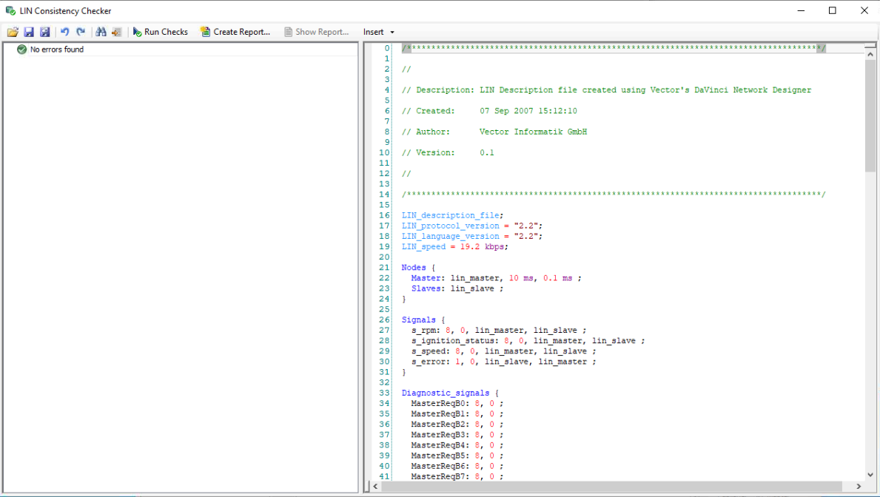
Exercise feedback
Task 3
Run consistency check using “LIN Consistency Checker” button from the toolbar
No error found is expected

