Slide 1
Vehicle networks infrastructure
L10 exercise – 1TPCE Bus - Basic

Slide 2
Vehicle networks infrastructure
Agenda:
What is AUTOSAR?
What is the need of AUTOSAR?
Difference between ARXML and FIBEX format
ARXML – AutoSAR XML

Slide 3
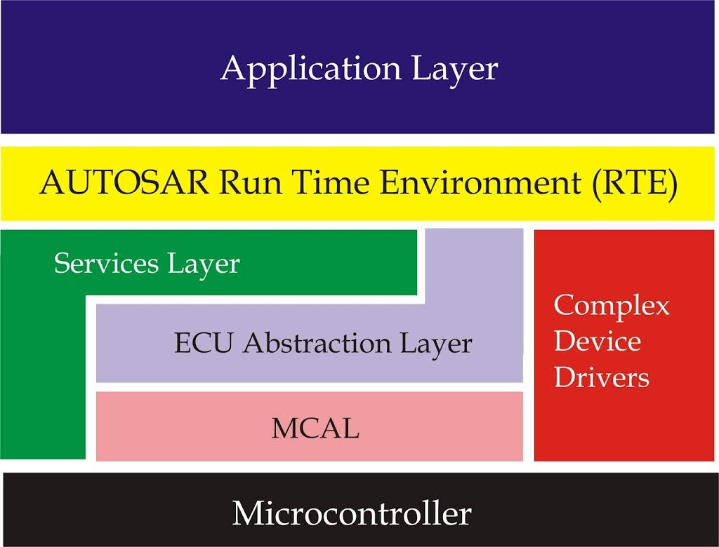
What is AUTOSAR?
Stands for AUTomotive Open System ARchitecture which is a layered architecture with standard specifications founded by a consortium of companies
Has different layers to handle and abstract different operations of code
Is used for micro controllers which targets applications mostly in automotive space which utilizes CAN, Flex Ray, Ethernet etc
Being used in applications based on micro controllers, it is developed with a view to use least memory possible as micro controllers have resource constraints

Slide 4
What is AUTOSAR?
Application Layer: This layer has the application code which resides in top. It can have different application blocks called as Software Components(SWCs) for each feature which the ECU needs to support according to application.
AUTOSAR RTE: This is one of the important layers of AUTOSAR, it provides communication between different SWCs and also between ECUs. Application layer uses this layer while communicating with other layers below using ports.
Services Layer: This layer provides different services for applications to use. Services like: System Services, Memory Services, Crypto Services, Off-board communication services, Communication services.
ECU Abstraction Layer: This layer provides ECU related abstractions. It contains different abstracted layers like I/O Hardware Abstraction layer, On board device abstraction, Memory hardware Abstraction, Crypto hardware abstraction, etc. to make applications hardware independent.
MCAL: This is Micro Controller Abstraction Layer it has drivers using which the above layers communicates with Micro controller hardware peripherals.

Slide 5
What is the need of AUTOSAR?
Listed below are the problems faced in conventional ways of writing software for ECUs:
Embedded systems is a vast field having n number of semiconductor manufacturers, hardware and software platforms which can be selected based on application requirements. Due to such varieties, the development effort is tough, and the portability of code is hard which further increases the development cost.
A automotive is a complex machine which consists of n number of small embedded systems called Electronic control Unit(ECUs) so maintenance and development of code for such controllers is not easy. Further complexity is increased if different ECUs use different MCUs for meeting cost requirements, then each ECU will have different software as hardware platforms will be different.
To partially standardize things, sometimes there is also a need to develop and follow custom created standard ( Custom standard means to develop a protocol for communication which is agreed by all ECUs in network ) to communicate with other ECUs. This is the conventional way of writing software which is very hard to maintain and has very less chance of code portability or reuse ability.
A automobile has n number of parts which are manufactured by different companies called Tier 1 companies which supplies the parts to OEMs like BMW, Volkswagen, etc. Today almost all mechanical parts are becoming intelligent by adding ECU in them to increase control and efficiency. So those ECUs also need to have a common way of communication to communicate with the ECUs of OEM for this again a custom standard needs to be implemented and maintained.

Slide 6
Types of AUTOSAR
There are two types of AUTOSAR architectures named as Classic and Adaptive.
The Classic have all the modules which are generally needed for a application
The Adaptive can be configured and adapted according to application by removing unnecessary modules.
Current Classic release version is 4.4.0 and current adaptive version is 19.03

Slide 7
AUTOSAR XML
AUTOSAR defines a series of steps to create an executable ECU component
XML is relied upon as the interchange format
XML files are based on a schema file derived from the AUTOSAR UML model:
Software Component Template for the definition of individual software components,
Basis Software Module Description Template for the description of all information about a Basis,
Software Component,
ECU Configuration Template for the definition of architecture and interfaces of an ECU
About the system template:
serves to define the overall system
stores information about the bus systems, the signals, the mapping and the topology
has a lot in common with the FIBEX standard.
*As of FIBEX 3.0, even the PDU concept has been taken over from AUTOSAR, in order to achieve further harmonization between the two standards

Slide 8
Difference between ARXML and FIBEX format
The structure of the schema files
In AUTOSAR, all information for all bus systems is stored in one schema file, named autosar.xsd, includes information on the structure of a FlexRay, CAN or LIN cluster.
In FIBEX, there are several schema files. There is a central schema file named fibex.xsd.
If different bus systems are described with one FIBEX file, schema file fibex4multiplatform.xsd must be used.
In this file, besides the central schema file, additional schema files for CAN, LIN, FlexRay, Byteflight, TTCAN and MOST are integrated via import instructions.

Slide 9
Difference between ARXML and FIBEX format
A representation of signals
In AUTOSAR, there is a distinction between an I-Signal and a System Signal.
A System Signal includes information about the signal length and the coding of the signal.
In an I-Signal, reference is made to a System Signal.
The I-Signals are grouped into Signal-I-PDUs
In FIBEX, there is one standard signal
A FIBEX signal has a great similarity to a System Signal
Signals are grouped into PDUs

Slide 10
Difference between ARXML and FIBEX format
The ARXML XML structure
The structure starts with the root element TOP-LEVEL-PACKAGES
Under this element, any number of AR-PACKAGE elements can be entered
An AR-PACKAGE consists of an ELEMENTS or a SUBPACKAGES element
One AR-PACKAGE is usually created for each element type
The FIBEX structure
The root area of the XML structure for the elements is fixed
Starting with ELEMENTS, elements for CLUSTER, CHANNELS, ECUS, etc. can be entered in a specific sequence
Elements for clusters and ECUs can be entered under ELEMENTS
Under SUB-PACKAGES, any number of AR-PACKAGE elements can be entered

Slide 11
Difference between ARXML and FIBEX format
FIBEX
ARXML

Slide 12
Difference between ARXML and FIBEX format
The linking between the elements in a file under AUTOSAR
There are no IDs.
There are UUIDs, but these are not used for linking.
What is referenced is the Short Name of the respective element, the path within the XML structure being prefixed to the Short Name.
It is even possible to link to an external file via the path.
The linking between the elements in a file under FIBEX
linking is via the attributes ID and ID-REF.
Each main element has a unique ID assigned to it.
This ID can then be referenced from other elements.

Slide 13
Difference between ARXML and FIBEX format
The conversion from FIBEX to AUTOSAR
Elements with the same name are expressed in different units
Particularly in the case of the FlexRay parameters, can be a problem
Many of the FlexRay parameters that are defined in seconds in AUTOSAR are defined in microseconds in FIBEX.
This should be noted in the case of the parameters CYCLE, MAX-INITIALISATION-ERROR and OFFSET-CORRECTION-MAX, among others.

Slide 14
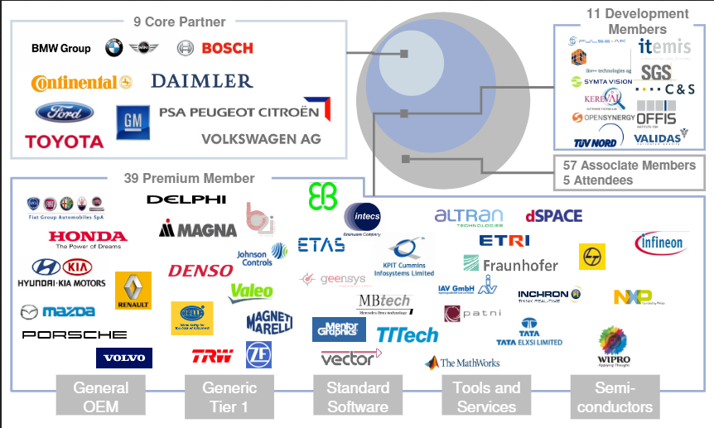
AUTOSAR System Description Network Explorer
The AUTOSAR System Description Network Explorer is a file editor that supports visualizing and editing the communication aspects of AUTOSAR system description files and ECU extracts of system descriptions.
It supports Schema version: 4.0.3, 4.1.2, 4.2.1, 4.2.2 and 4.3.0.
Schema versions up to and including 3.2.2 can be investigated by using the previous version AUTOSAR System Description Network Explorer (Windows Start Menu|Vector AUTOSAR Explorer).
The AUTOSAR system description is a XML based file format. The elements describing the network communication are based on the AUTOSAR system template. A
AUTOSAR System Description Network Explorer 2.0 visualizes the communication aspects in a user-friendly way and hides format details as far as possible.

Slide 15
Signals in AUTOSAR
AUTOSAR implements signal-based communication.
A signal is the smallest amount of information that a CAN message can have.
A signal can be of any size from 1- bit to all 64 bits of CAN message (considering the CAN message is 8-Bytes), in other words the CAN message is divided in bits called signals.
Signals can be also there for Ethernet or another bus, the only change is the maximum number of signals it can hold.

Slide 16
PDUs in AUTOSAR
In AUTOSAR, roughly a message is called PDU (Protocol Data Unit)
PDU contains information other than our data which is used or extracted by below or upper layers in transmission or reception respectively. There can be n number of PDUs with varying sizes.
The PDU is basically group of packed signals along with lower-layer information.
AUTOSAR COM performs the packing or unpacking of signals in or from PDU while transmission or reception respectively. Every PDU has a unique identifier associated with it.

Slide 17
PDUs in AUTOSAR
PDU contains SDU and PCI.
SDU is the abbreviation of Service Data Unit
PCI is the Protocol Control Information.
SDU is the data that needs to be transmitted. While transmission, SDU is passed from upper layers to lower layers along with PCI. During the reception, SDU is the data extracted from the below layers and passed on to the upper layers.
PCI contains the information which indicates the next destination of the SDU. Basically, it contains the source and destination of the SDU. The source and destination in this case is the next layer to which the PDU needs to be passed.

Slide 18
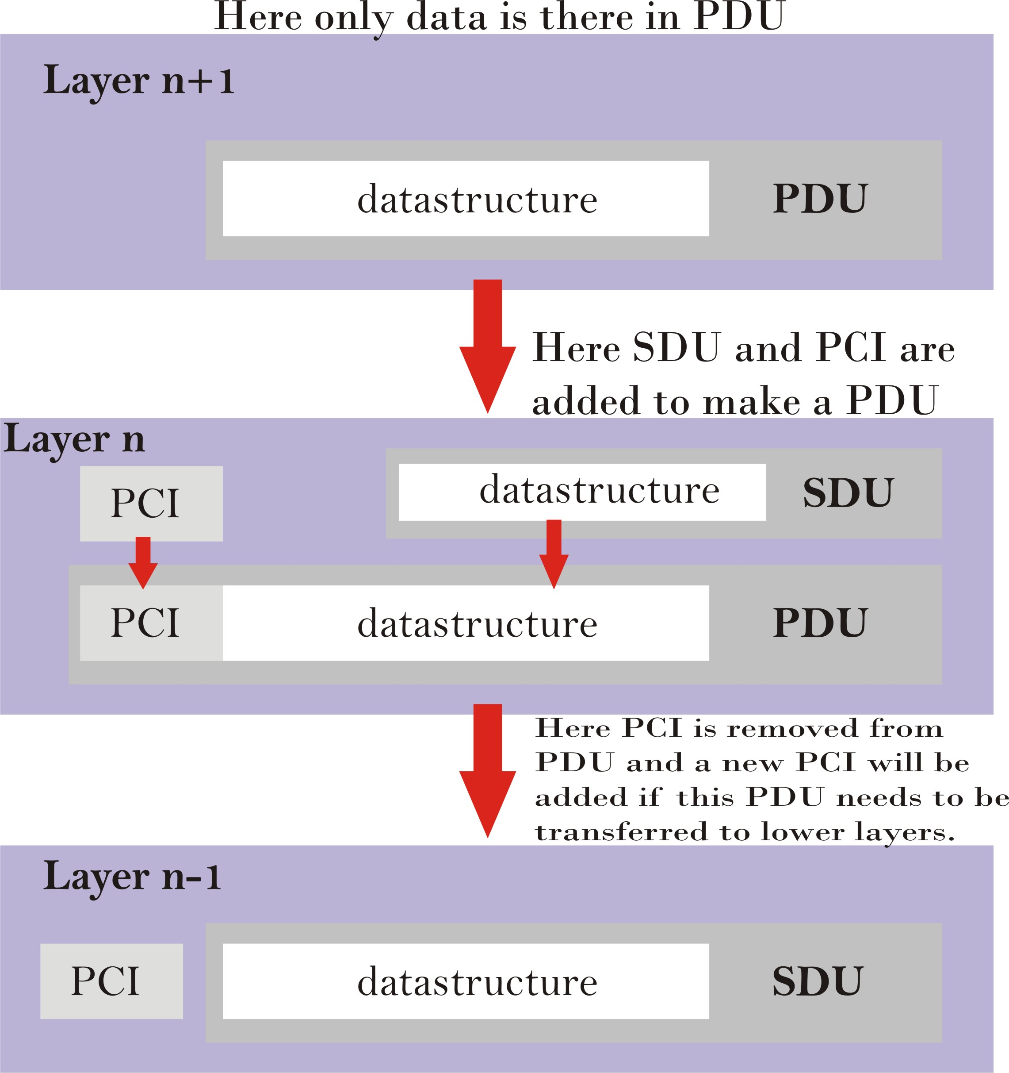
PDUs in AUTOSAR
While transferring PDU from layer to layer it’s called by relevant names based on the layer it is in. The PDUs are named as:
I-PDU (Interaction Layer PDU),
N-PDU (Network Layer PDU),
L-PDU (Data Link Layer PDU).
Whenever the PDU is in layers above Communication Hardware Abstraction layer then it’s called I-PDU.
Whenever the PDU is in layers below PDU-R and above the Communication Drivers layer then it’s called N-PDU.
Whenever the PDU is below Communication Hardware Abstraction then it’s called L-PDU.

Slide 19
PDUs in AUTOSAR
Computation method or compu method in short is used to transform the fixed point values in software into physical values which can be floating point values.
Compu method defines the relationship of converting internal values of SWC to real/physical values. Compu method is defined for a signal.
There are mainly three categories of compu methods:
Linear: This type of Compu method is used when value to be converted is of linear type. During configuration, we have to give ranges of raw values. Like minimum this value can be, maximum this value can go,Factor (which is the multiplication factor or its also called gain),Offset value.
Text Table: It is most simple type of compu method. It is a table of numerical values which represent some text which has some meaning.
Scale-Linear: It is a table of linear compu methods.

Slide 20
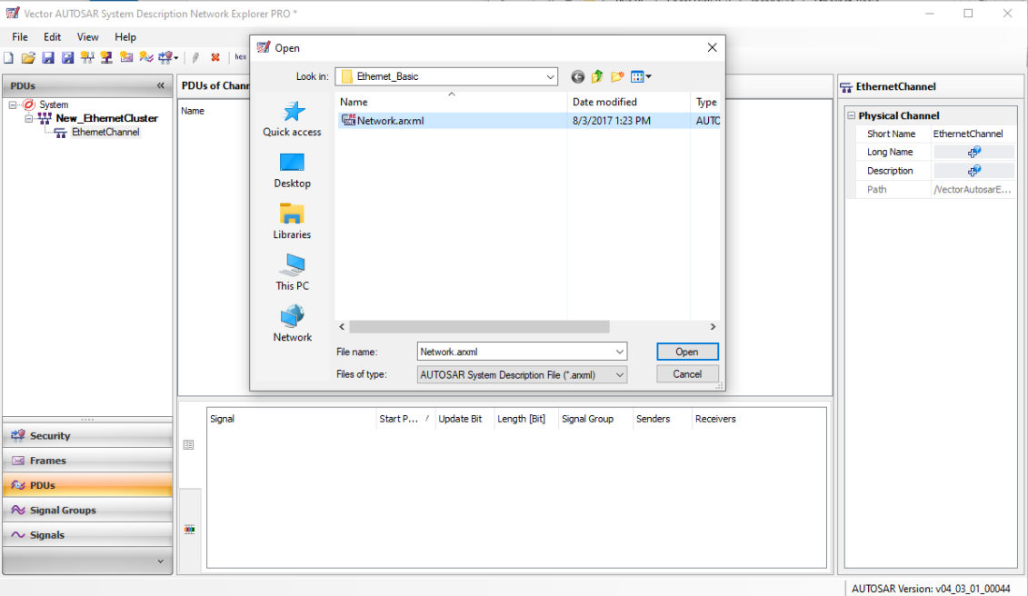
Vector FIBEX Explorer PRO
Download materials “Ethernet_Basic” from Canvas and save them in your workspace
Open an existing ARXML database as shown in the picture (select File/Open)
Name of the database is “Network.arxml”

Slide 21
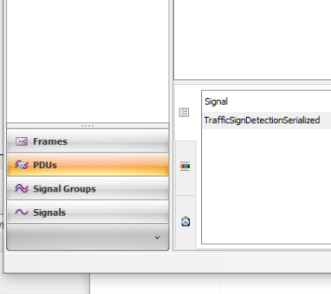
Vector FIBEX Explorer PRO
Utilization of the content view can be done by:
Frames
PDUs
Signal Groups
Signals

Slide 22
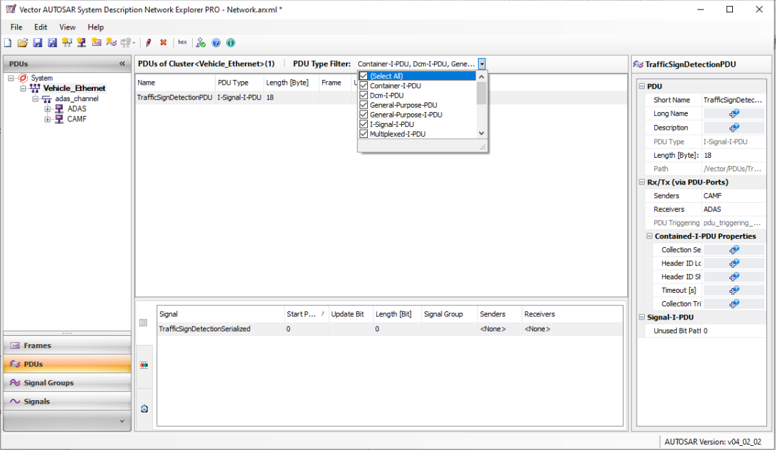
Vector FIBEX Explorer PRO
The tool is easy to use
Looks similar to FIBEX Explorer
PDUs view:
As shown in the picture PDUs can be filtered by following types:
Container I-PDU
DCM I-PDU
General Purpose PDU
General Purpose I-PDU
I-Signal-I-PDU
…
NM-PDU

Slide 23
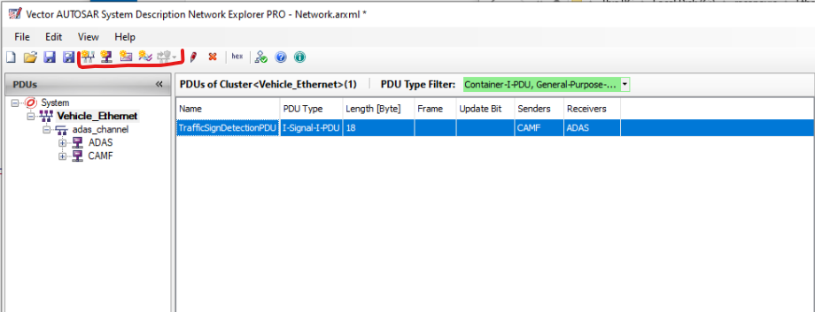
Vector FIBEX Explorer PRO
How to extend the database
Options in the toolbar
Create Cluster
Create ECU
Create Frame
Create (unmapped) DCM-I-PDU

