Slide 1
‘AliBaba’ website UI and Performance testing
https://github.com/nikolaStanojkovski/AliBaba_Testing
Made by:
Tashko Pavlov (181104)
Nikola Stanojkovski (181076)

Slide 2
UI (User Interface) Testing

Slide 3
UI (User Interface) Testing
Goals & Objectives
Testing the overall website quality
Testing the integrity of the website
Testing the security of the website
Verifying whether the UI elements and structure meets the main user requirements
Verifying whether the website meets the required general known UI compliance & standards

Slide 4
UI (User Interface) Testing
Tools
Selenium WebDriver - testing framework used for the cross browser-tests
Java - programming language
Maven - project management software
Git - version control system
JUnit - unit testing framework

Slide 5
UI (User Interface) Testing
Coverage
Registration Page
Login Page
Home Page
Categories Page
Subcategories page
Search/Filter options
Product List page
Specific Product page
Help page
Regional Settings page

Slide 6
UI (User Interface) Testing
108 Tests
Registration page - 14 tests
Test 1: Successful registration with valid credentials
Test 2: Unsuccessful registration with invalid trade role
Test 3: Unsuccessful registration with empty email address
Test 4: Unsuccessful registration with incorrect email address format (correct email address format: test@test.com)
Test 5: Unsuccessful registration with empty password
Test 6: Unsuccessful registration with incorrect login password with unsatisfied requirements (Requirements: 6 to 20 characters and combination of letters, numbers and symbols)
Test 7: Unsuccessful registration with empty confirm password
Test 8: Unsuccessful registration with unmatched password and confirm password
Test 9: Unsuccessful registration with empty company name
Test 10: Unsuccessful registration with empty username
Test 11: Unsuccessful registration with incorrect username format
Test 12: Unsuccessful registration with incorrect phone number (phone number should be valid and have less than 14 digits)
Test 13: Unsuccessful registration with unverified slider bar
Test 14: Unsuccessful registration with unchecked license agreement

Slide 7
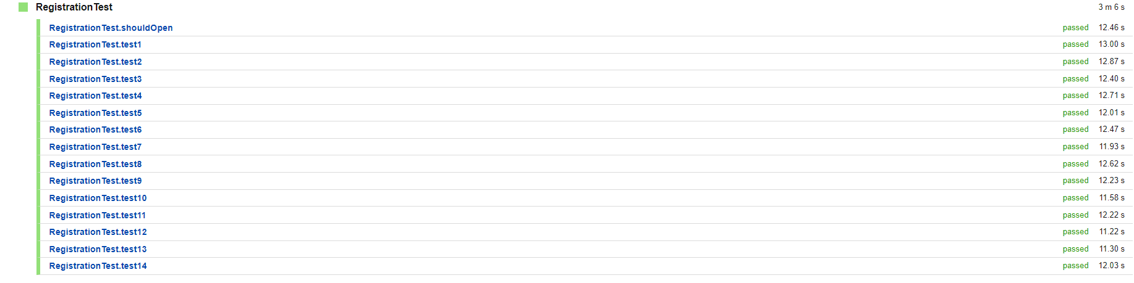
UI (User Interface) Testing
108 Tests

Slide 8
UI (User Interface) Testing
108 Tests
Login page - 4 tests
Test 1: Successful login with valid credentials
Test 2: Unsuccessful login with invalid email address
Test 3: Unsuccessful login with invalid password
Test 4: Unsuccessful login with invalid credentials
Categories page – 7 tests
Test 1: Main categories list existence
Test 2: Main specific categories listing check
Test 3: Main specific categories in the page existence
Test 4: Subcategories listing existence
Test 5: Navigation to the specific category on the page
Test 6: Navigation to a specific category page
Test 7: Navigation to a specific subcategory page

Slide 9
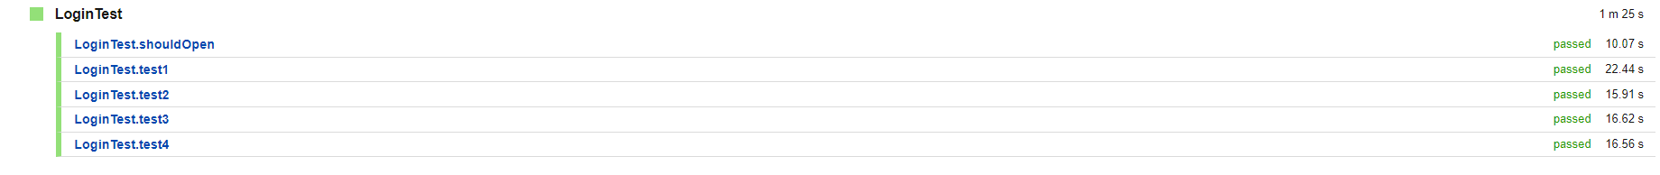
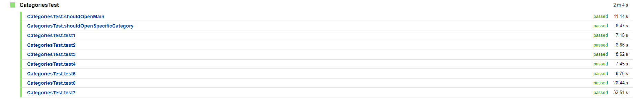
UI (User Interface) Testing
108 Tests

Slide 10
UI (User Interface) Testing
108 Tests
Subcategories page - 6 tests
Test 1: Subcategory list existence
Test 2: Subcategories list check
Test 3: Image navigation list existence
Test 4: Image navigation list check
Test 5: 3D Reality Showroom section check
Test 6: Product recommendations section check
Regional Settings - 5 tests
Test 1: Language change check on Home Page
Test 2: Language change check on Login Page
Test 3: Language change check on Registration Page
Test 4: Language change check on Product Listing Page
Test 5: Language change check on Specific Product Page

Slide 11
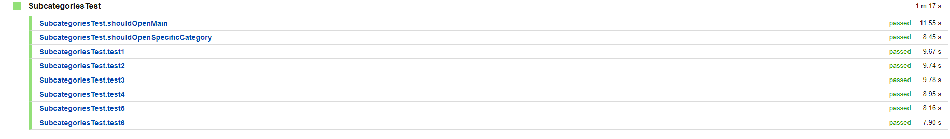
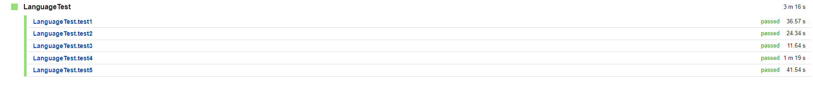
UI (User Interface) Testing
108 Tests

Slide 12
UI (User Interface) Testing
108 Tests
Home page - 12 tests
Test 1: Navigation existence
Test 2: Search bar existence
Test 3: Account widget icons without logged in user existence
Test 4: Important navigation items existence
Test 5: Important category listing
Test 6: Trending products listing
Test 7: Customized category product listing
Test 8: Ready to Ship category product listing
Test 9: Personalized category listing
Test 10: Weekly market listing
Test 11: Request for quotation form existence
Test 12: Recommendations and personalization products existence

Slide 13
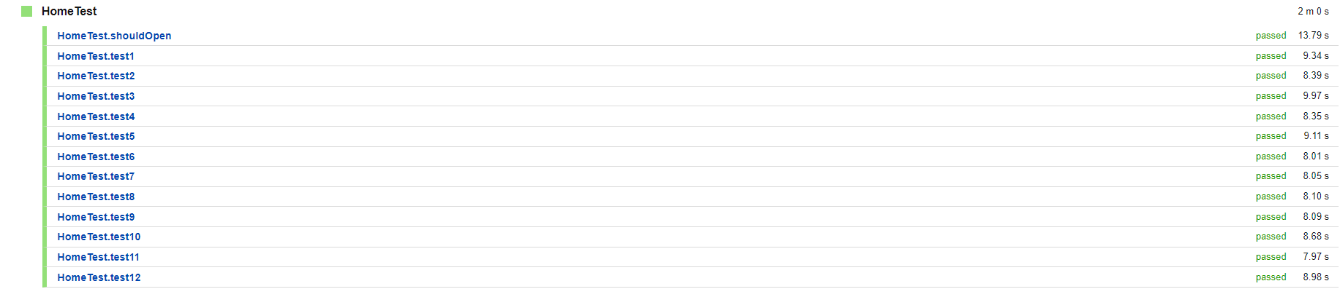
UI (User Interface) Testing
108 Tests

Slide 14
UI (User Interface) Testing
108 Tests
Search/Filter options - 14 tests
Test 1: Search for a product
Test 2: Main filters list existence
Test 3: Main filters items check
Test 4: Category filter check
Test 5: Supplier types filter check
Test 6: Product types filter check
Test 7: Minimal order quantity filter check
Test 8: Minimal price filter check
Test 9: Maximum price filter check
Test 10: Minimal and maximum price filter check
Test 11: Supplier country/region filter check
Test 12: Past export country/region filter check
Test 13: Management certification filter check
Test 14: Product certification filter check

Slide 15
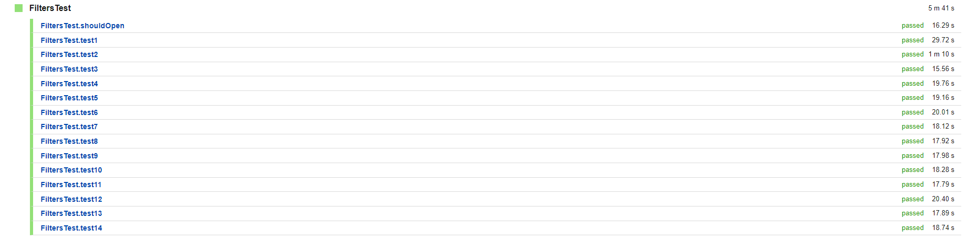
UI (User Interface) Testing
108 Tests

Slide 16
UI (User Interface) Testing
108 Tests
Products List page - 9 tests
Test 1: List of products type/category/subcategory title
Test 2: Products list existence
Test 3: Product image existence
Test 4: Product title existence
Test 5: Product price existence
Test 6: Product minimum order quantity (MOQ) existence
Test 7: Product link to detailed information existence
Test 8: ‘About products and suppliers’ section existence
Test 9: ‘Related products’ section existence

Slide 17
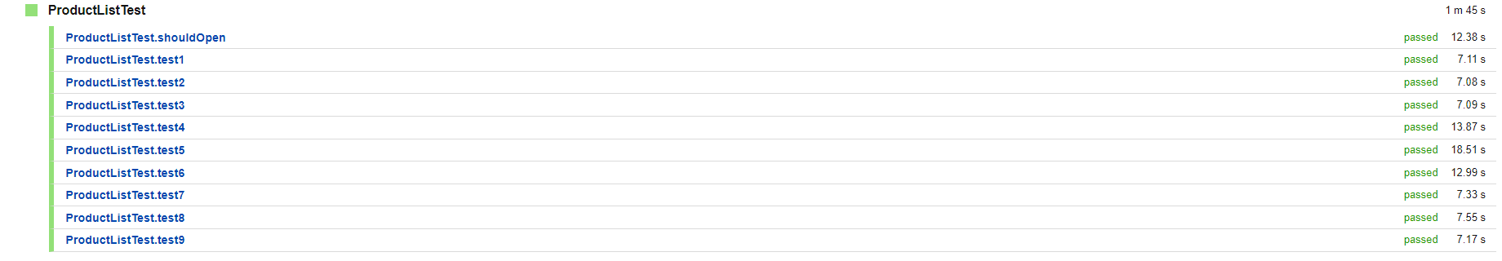
UI (User Interface) Testing
108 Tests

Slide 18
UI (User Interface) Testing
108 Tests
Specific Product page - 27 tests
Test 1: Product appearance check
Test 2: Product image check
Test 3: Product image list check
Test 4: Product title check
Test 5: Product tags check
Test 6: Product overall review check
Test 7: Product quantity sold check
Test 8: Product price check
Test 9: Product minimum order quantity (MOQ) check
Test 10: Product quantity check
Test 11: Product description check
Test 12: Product company profile check
Test 13: Product buyer reviews check
Test 14: Product feedback form existence

Slide 19
UI (User Interface) Testing
108 Tests
Specific Product page - 27 tests
Test 15: Product feedback form elements check
Test 16: Product feedback form functionality
Test 17: Total product price check
Test 18: Shipping price check
Test 19: Shipping information check
Test 20: Total price check
Test 21: 'Order' button check
Test 22: 'Contact' button check
Test 23: 'Call Us' button check
Test 24: 'Add to cart' button check
Test 25: 'Favourite' button check
Test 26: Recommendations section check
Test 27: Recommendations section items check

Slide 20
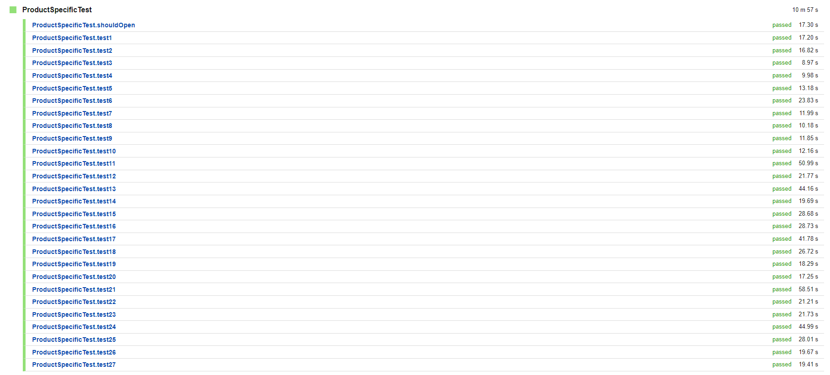
UI (User Interface) Testing
108 Tests

Slide 21
UI (User Interface) Testing
108 Tests
Help page - 10 tests
Test 1: 'Help' section existence check
Test 2: 'Help' section links check
Test 3: 'For Buyers' link check
Test 4: 'For Buyers' page check
Test 5: 'For Suppliers' link check
Test 6: 'For Suppliers' page check
Test 7: 'Submit a Dispute' check
Test 8: 'Report IPR Infringement' link check
Test 9: 'Report IPR Infringement' page check
Test 10: 'Report Abuse' check

Slide 22
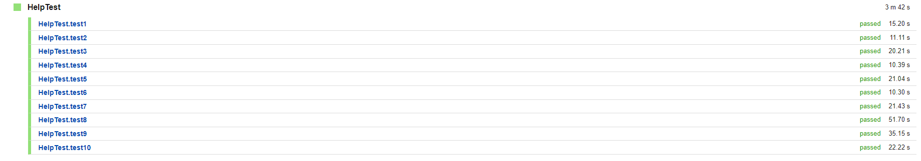
UI (User Interface) Testing
108 Tests

Slide 23
UI (User Interface) Testing
Conclusion
AliBaba has a very secure user-management
AliBaba has the most important functionalities and they are really optimized and available all the time
AliBaba has UI features and shopping features which separates it from the competition
Alibaba is a very reliable website

Slide 24
Performance Testing

Slide 25
Goals & Objectives
Test the performance of Alibaba website compared to Amazon
Test the performance of logging in, loading home page and searching term in the search bar
Try each of these three functionalities with different number of users
Comparing response times and other valuable metrics such as throughput

Slide 26
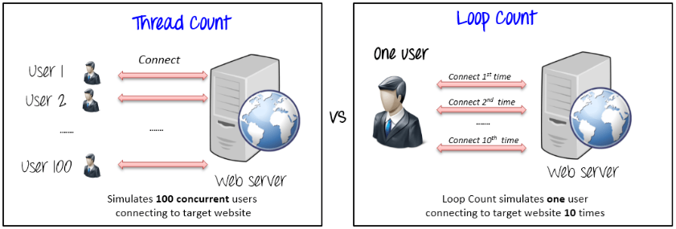
Tools
Apache jMeter - performance testing tool which includes Stress and Load Testing. It simulates multiple users who are using the target web application.

Slide 27
Test: Loading Home Page
1 User
Alibaba.com
Amazon.de

Slide 28
Test: Loading Home Page
10 Users
Alibaba.com
Amazon.de

Slide 29
Test: Loading Home Page
100 Users
Alibaba.com
Amazon.de

Slide 30
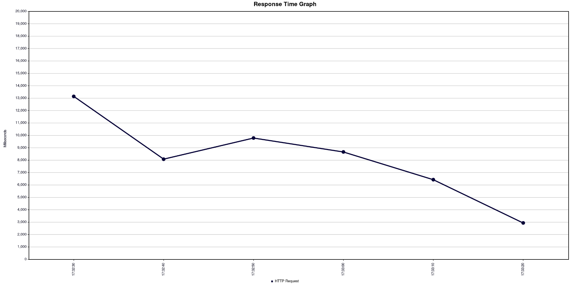
Test: Loading Home Page 100 Users
Response Times
Alibaba.com

Slide 31
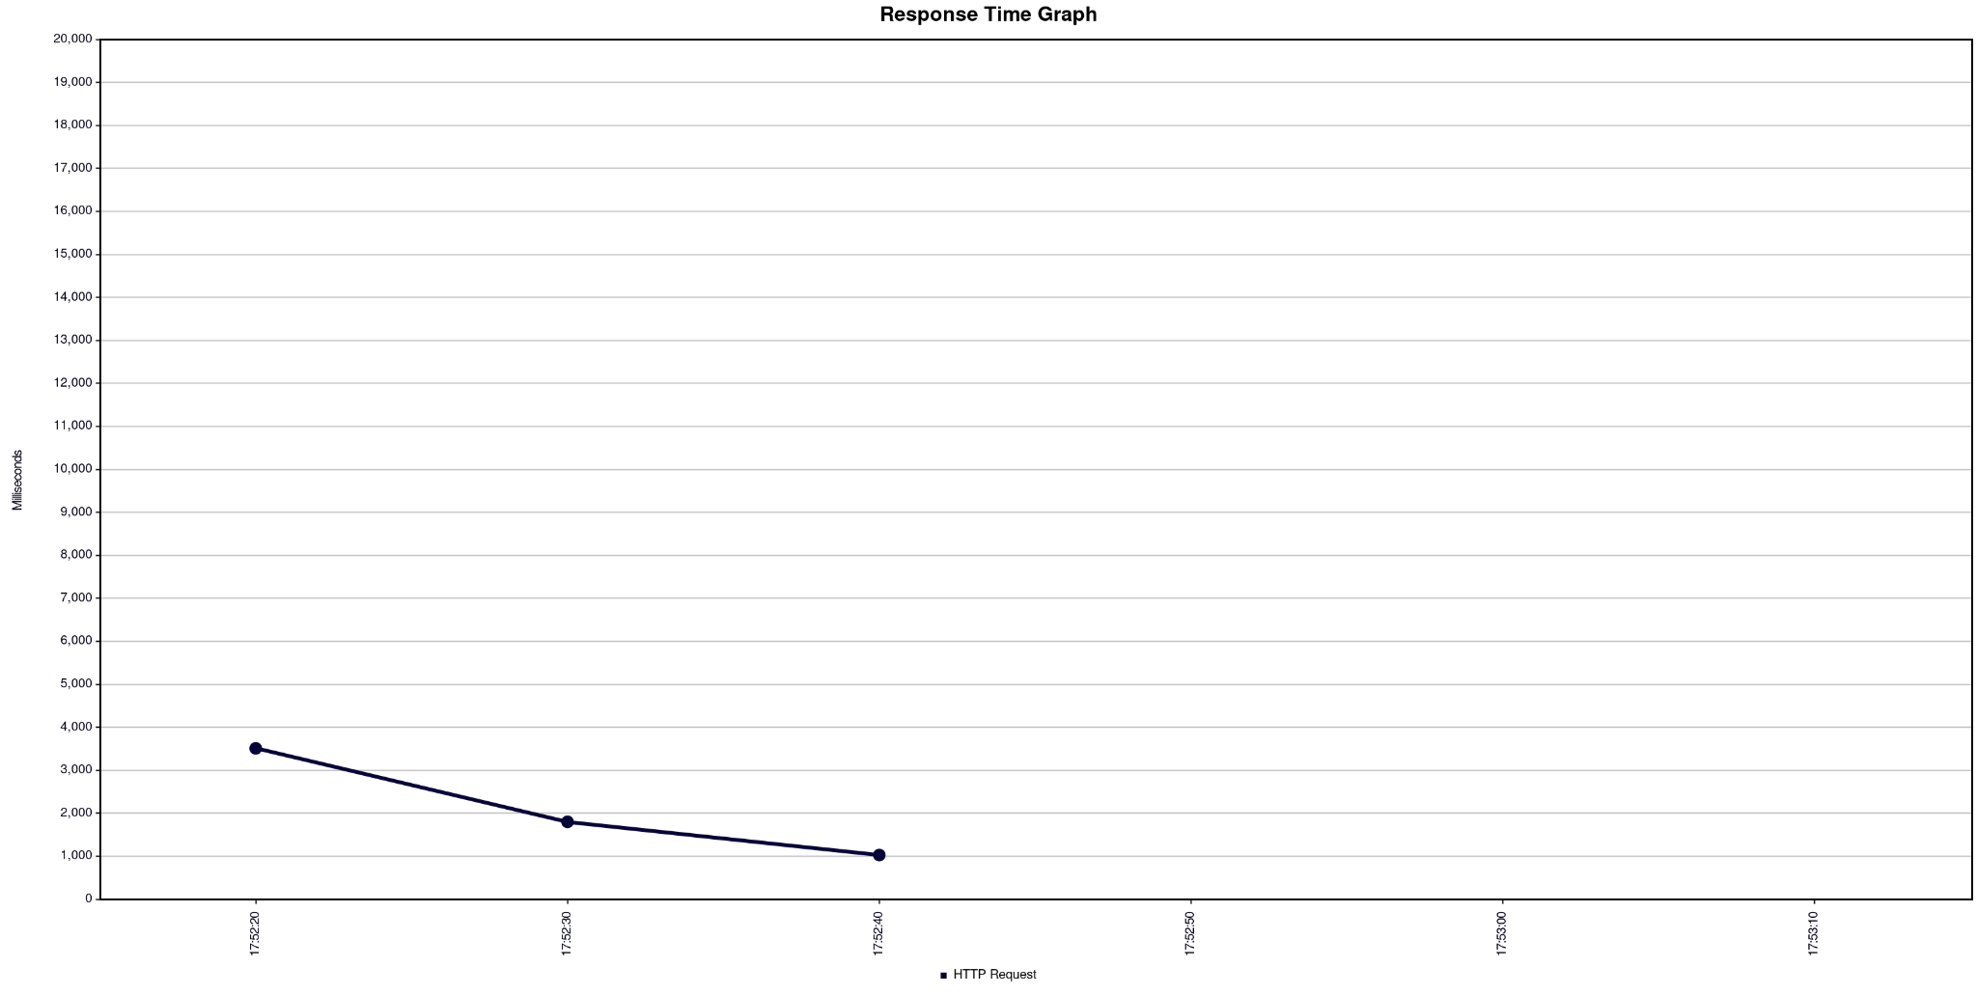
Test: Loading Home Page 100 Users
Response Times
Amazon.de

Slide 32
Test: Loading Home Page
1000 User
Alibaba.com
Amazon.de

Slide 33
Conclusion
The best data that we could get was from 1000 simultaneous users
Errors started to occur
Reached maximum load capacity - stress test
Drastic difference in throughput
Based on the data from 1000 users, we can safely say that Amazon.de is performing better under more simultaneous users compared to Alibaba.com
But Alibaba.com is performing better when it comes to less simultaneous users than Amazon.de

Slide 34
Test: Search Term - table
1 User
Alibaba.com
Amazon.de

Slide 35
Test: Search Term - table
10 Users
Alibaba.com
Amazon.de

Slide 36
Test: Search Term - table
100 Users
Alibaba.com
Amazon.de

Slide 37
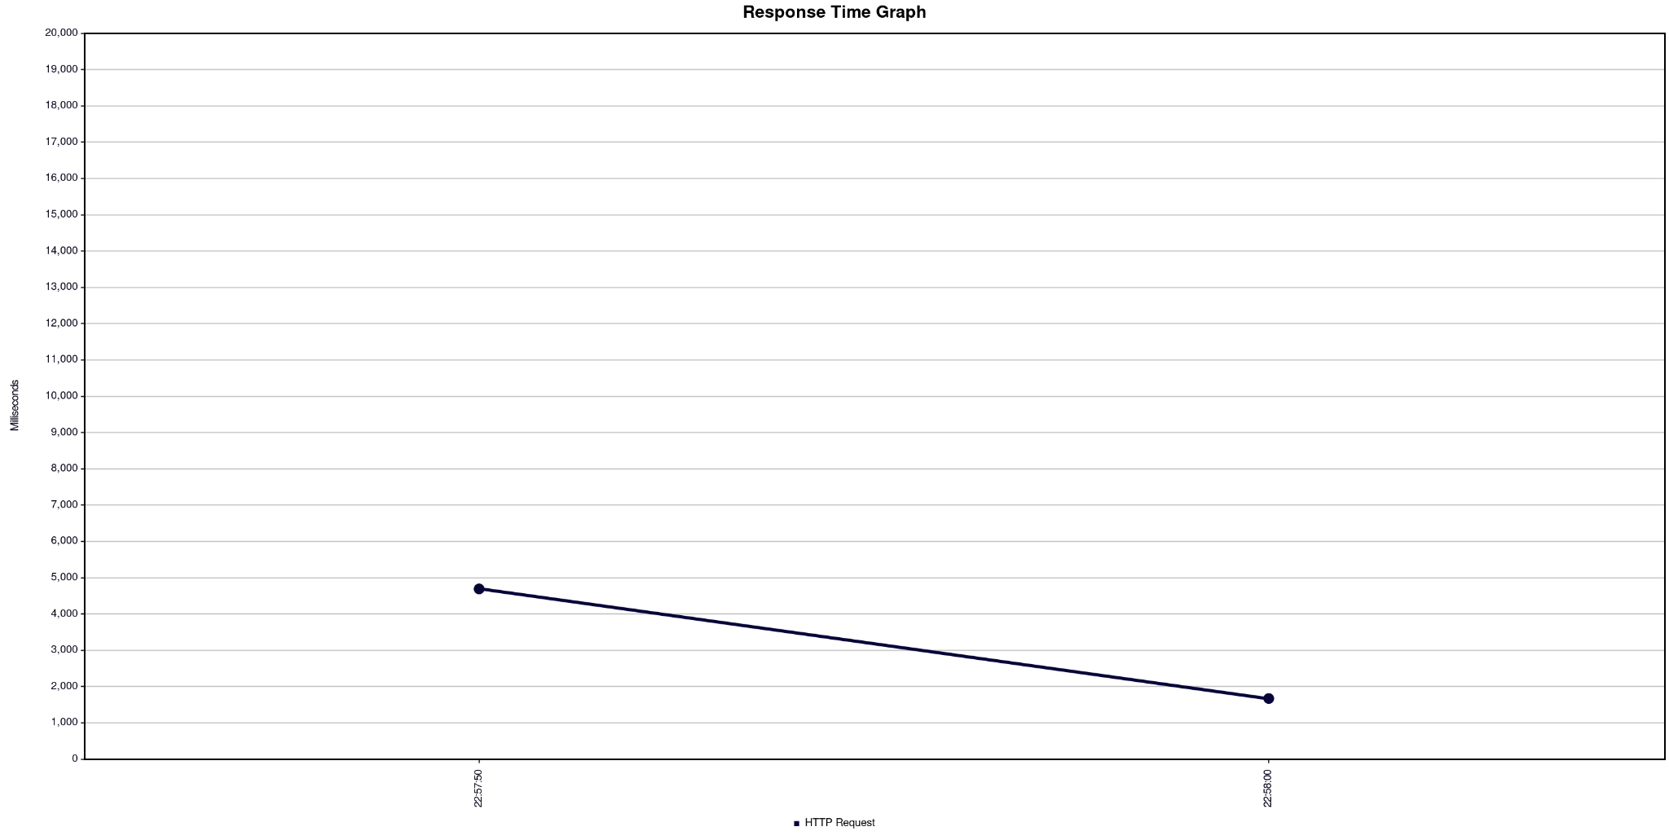
Test: Loading Home Page 100 Users
Response Times
Alibaba.com

Slide 38
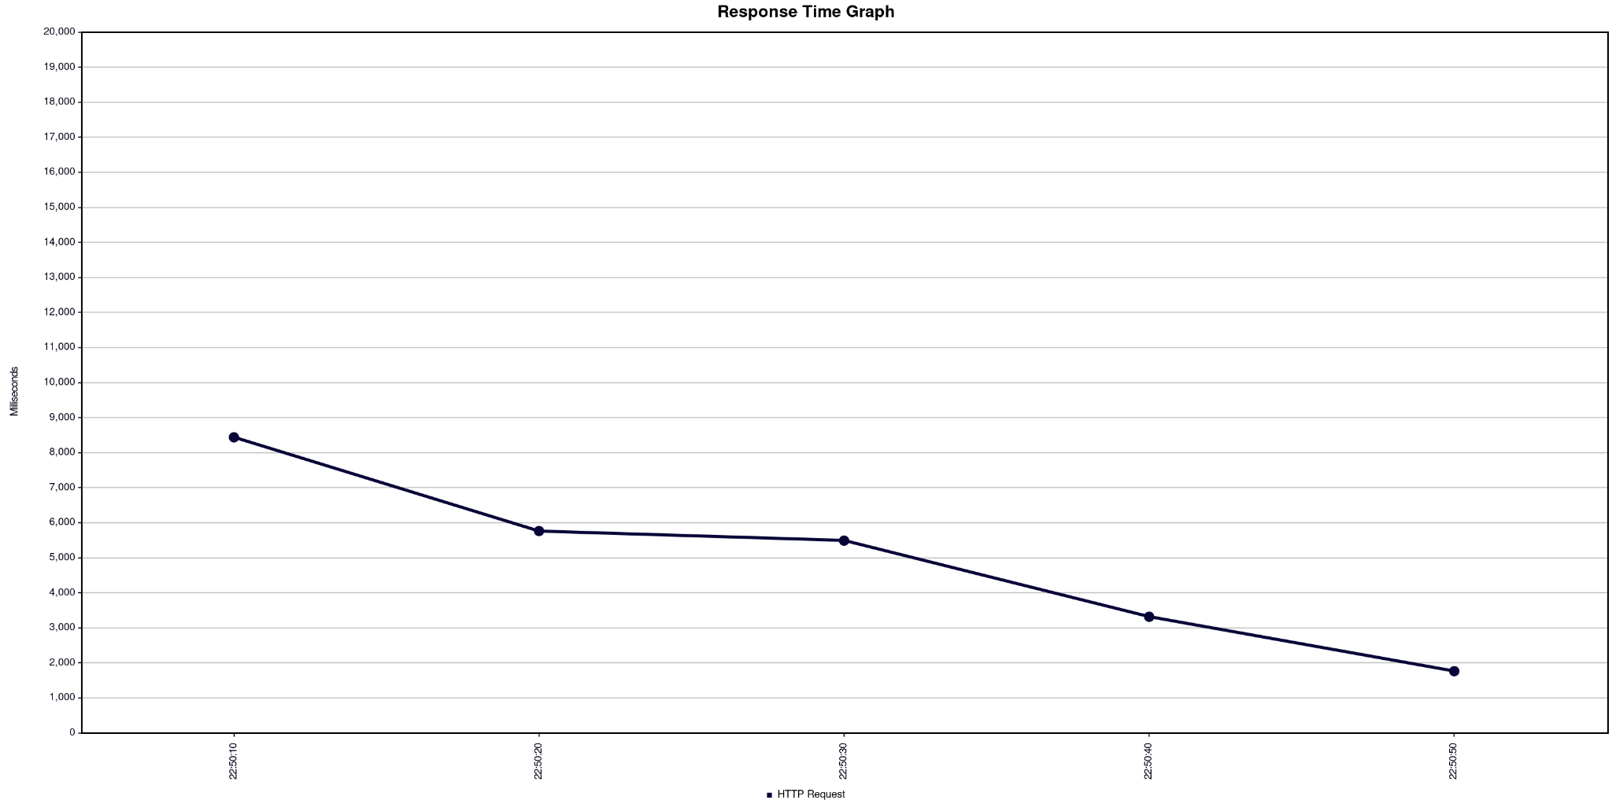
Test: Loading Home Page 100 Users
Response Times
Amazon.de

Slide 39
Test: Search Term - table
1000 Users
Alibaba.com
Amazon.de

Slide 40
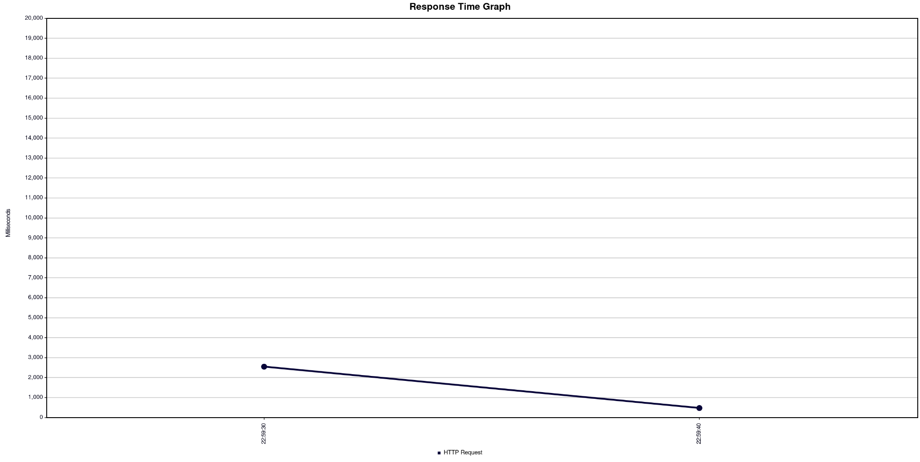
Test: Loading Home Page 1000 Users
Response Times
Alibaba.com

Slide 41
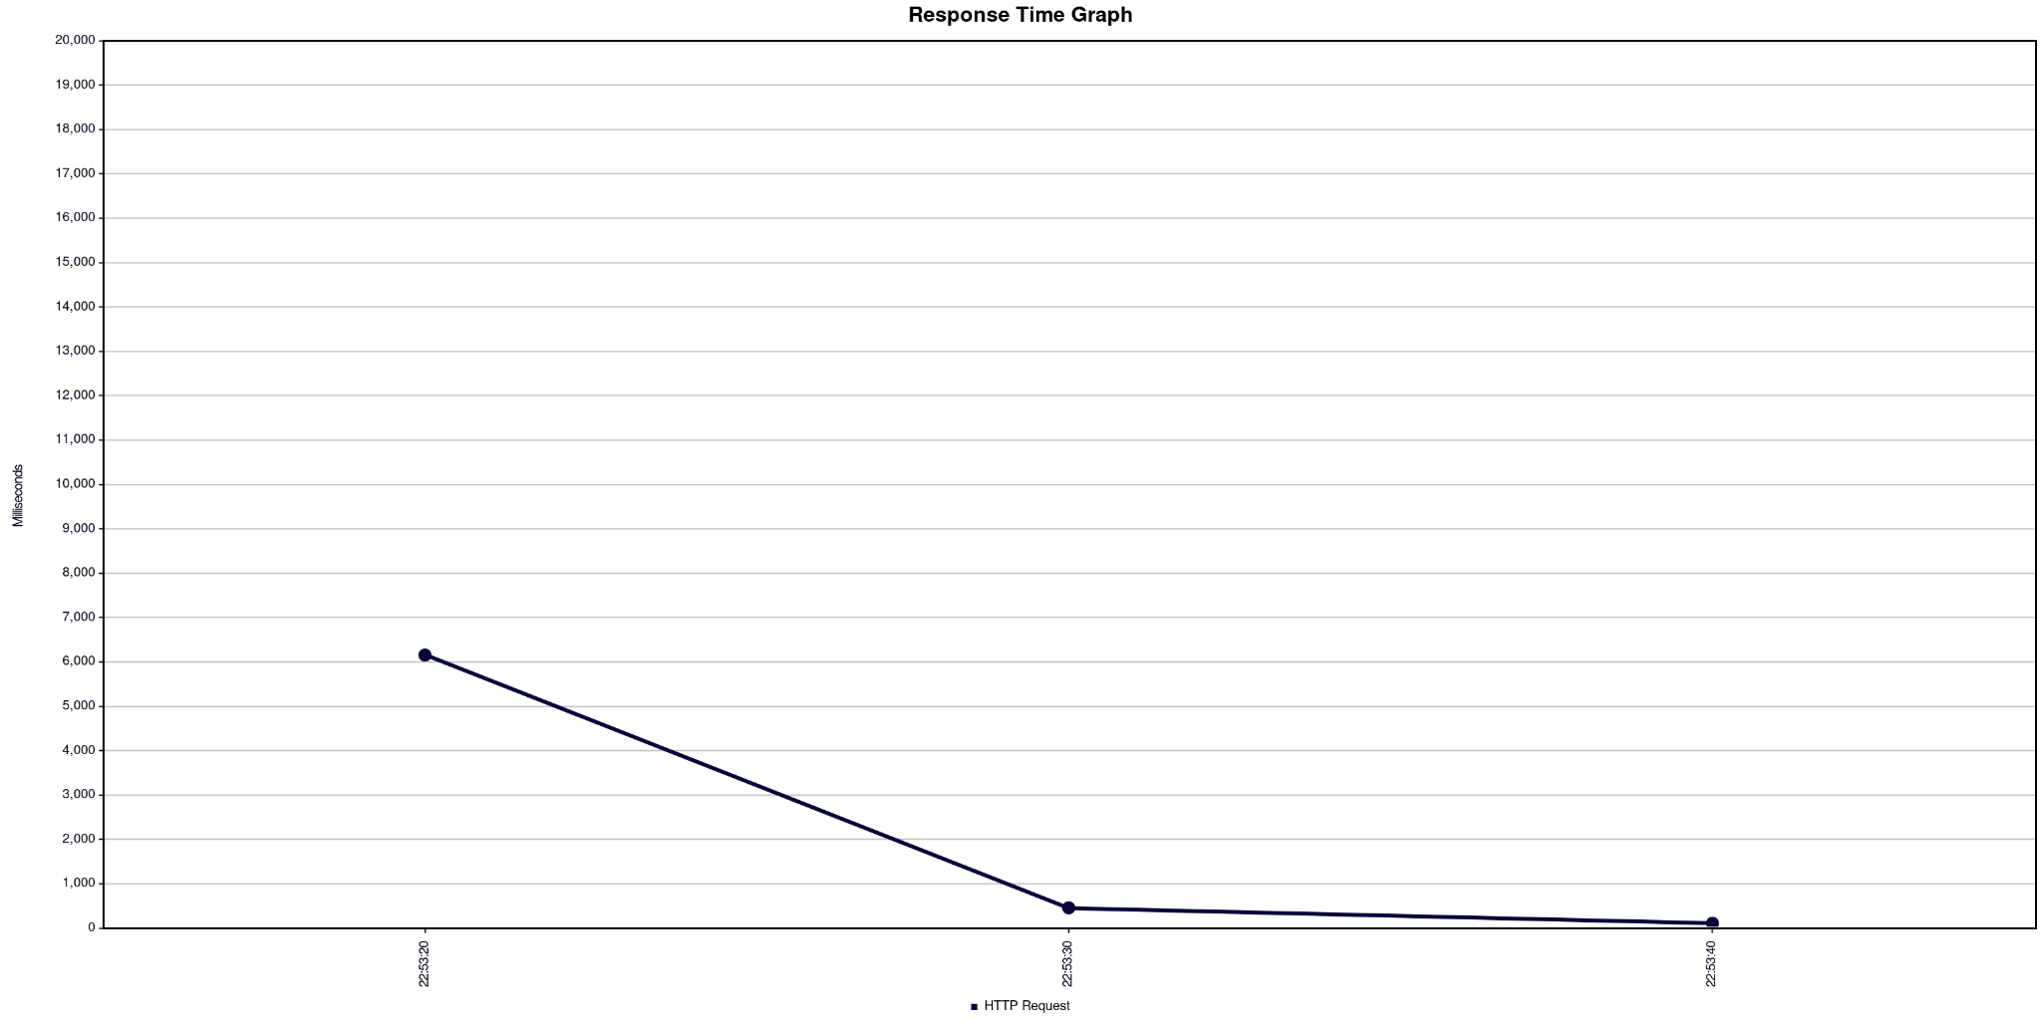
Test: Loading Home Page 1000 Users
Response Times
Amazon.de

Slide 42
Conclusion
Things change when it comes to searching term in Alibaba.com and Amazon.de
The tables are turned
Alibaba.com beats Amazon.de in almost every measured metric
Especially when it comes to a lot of simultaneous users accessing the website
But these results depend on a lot of other unpredictable and predictable factors, such as if there is a lot of traffic currently on the website or it even depends on the machine that I am using to send the requests or my internet speed.

Slide 43
Test: Logging in with
1 User
Alibaba.com
Amazon.de

Slide 44
Test: Logging in with
10 Users
Alibaba.com
Amazon.de

Slide 45
Test: Logging in with
100 User
Alibaba.com
Amazon.de

Slide 46
Conclusion
It is hard to compare both websites
For the logging in they use many redirections
It is not as the previous test examples where we tested only access to a specific resource
But comparing only the throughput (our main comparison metric) the Amazon.de website is taking the lead
In every scenario it has a higher throughput
But it also has a lot of errors which means it failed to response to some of the requests because it was overloaded where on the other hand Alibaba.com website is handling the logging in without that much error responses (it provides errors only for 100 users)
Generally speaking we can not declare a winner but we can surely see the different performances in both websites
NOTE: The performance testing was done following this article: https://www.guru99.com/jmeter-performance-testing.html

Slide 47

Thank you for your attention!

