Slide 1
NLP TASKS WITH TWITTER DATASETS
DATA SCIENCE PROJECT
SOURCE: HTTPS://WWW.KAGGLE.COM/ARASHNIC/7-NLP-TASKS-WITH-TWEETS
MADE BY:
INES LESNOVSKA - 186007
NIKOLA STANOJKOVSKI - 181076

Slide 2
CONTEXT
The experimental landscape in natural language processing for social media is too fragmented. Each year, new shared tasks and datasets are proposed, ranging from classics like sentiment analysis to irony detection or emoji prediction. Therefore, it is unclear what the current state of the art is, as there is no standardized evaluation protocol, neither a strong set of baselines trained on such domain specific data. The purpose of this dataset is presenting evaluation consisting of seven heterogeneous multi-class Twitter-specific classification tasks.

Slide 3
INSPIRATION
7 TASKS WE WORKED ON:
EMOTION RECOGNITION
EMOJI PREDICTION
IRONY DETEECTION
HATE SPEECH DETECTION
OFFENSIVE LANGUAGE IDENTIFICATION
SENTIMENT ANALYSIS
STANCE DETECTION (Abortion, Atheism, Climate, Feminist, Hillary)

Slide 4
8 PHASES OF WORK FOR EACH TASK
PREPROCESSING OF THE DATA
LOADING TOKENIZER AND ENCODING THE DATA
SETTING UP THE MODEL
CREATING DATA LOADERS
SETTING UP THE OPTIMIZER AND SCHEDULER
CREATING THE TRAINING LOOP
TRAINING THE MODEL
EVALUATING THE MODEL

Slide 5
USE OF 6 PRETRAINED MODELS
EMOTION RECOGNITION
  BERT Pretrained model - BERT-BASE-CASED – Average amount of cased data
EMOJI PREDICTION
  ROBERTA Pretrained model - ROBERTA-LARGE – Very Large amount of data
HATE SPEECH DETECTION
  ROBERTA Pretrained model - ROBERTA-LARGE – Very Large amount of data
IRONY DETECTION
  DistilBERT Pretrained model - DISTILBERT-BASE-UNCASED-DISTILLED-SQUAD – Average amount of data, very specific
OFFENSIVE LANGUAGE IDENTIFICATION
  ALBERT Pretrained model - ALBERT-BASE-V2 – Big amount of data
SENTIMENT ANALYSIS
  BERT Pretrained model - BERT-LARGE-UNCASED - Very Large amount of uncased data
STANCE DETECTION (Abortion, Atheism, Climate, Feminist, Hillary)
  BERT Pretrained model - BERT-LARGE-CASED-WHOLE-WORD-MASKING-FINETUNED-SQUAD
  Very specific, hard to predict, small amount of data
  Very specific, hard to predict, small amou

Slide 6
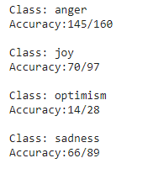
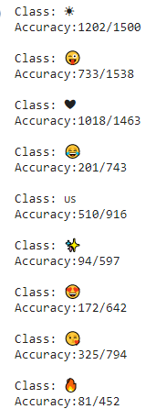
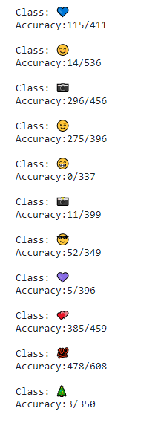
RESULTS FROM THE PREDICTION
EMOTION RECOGNITION
EMOJI PREDICTION

Slide 7
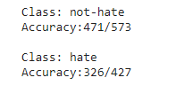
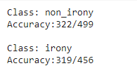
RESULTS FROM THE PREDICTION
HATE SPEECH DETECTION
IRONY DETECTION

Slide 8
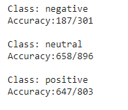
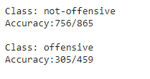
RESULTS FROM THE PREDICTION
OFFENSIVE LANGUAGE IDENTIFICATION
SENTIMENT ANALYSIS

Slide 9
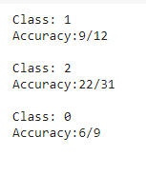
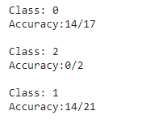
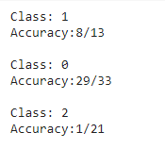
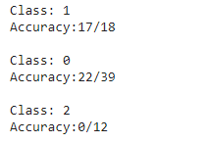
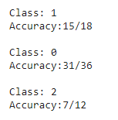
RESULTS FROM THE PREDICTION
STANCE DETECTION
ABORTION
ATHEISM
CLIMATE
FEMINIST
HILLARY

Slide 10
8 CONCLUSIONS
TWEETS CAN BE VERY UNEXPECTED!
EMOTION OF TWEETS IS EASY TO PREDICT IF THE DATA IS WELL STRUCTURED AND IRONY IN THE CONTEXT IS RARE
EMOJIS CAN HAVE DIFFERENT MEANINGS IN DIFFERENT CONTEXTS, WHICH MAKES THE PREDICTION DIFFICULT IN SOME SCENARIOS. MORE DATA HELPS
HATE SPEECH IS GENERALLY STRAIGHT FORWARD, BUT IN SOME SITUATIONS TWEETS HAVE SOME IRONY IN THEM WHICH MAKE IT TRICKY FOR PREDICTION. MORE DATA HELPS
AS WELL KNOWN IN NATURAL LANGUAGE PROCESSING, IRONY DETECTION CAN BE A VERY HARD TASK. HOWEVER, THE SEMANTIC STRUCTURE OF THE TWEETS IN CONTEXT MAKE IT EASIER FOR PREDICTION, WHICH GIVES GOOD RESULTS
OFFENSIVE LANGUAGE IS GENERALLY EASY FOR PREDICTION, EXCEPT FOR TWEETS WITH IRONY IN THEM, WHICH IS VERY RARE
SENTIMENT ANALYSIS OF TWEETS IS VERY DEPENDENT OF THE SEMANTIC STRUCTURE OF THE TWEET, AND THE APPROPRIATE MODEL FOR PREDICTION IS NEEDED
STANCE DETECTION IS PRETTY HARD TO PREDICT, BECAUSE WE MIGHT HAVE ELEMENTS OF IRONY AND SARCASM, ALSO SOMETIMES THE CASING IS IMPORTANT TO DETECT MOCKING OR CHEERING

Slide 11
THANK YOU
YOU CAN FIND THE WHOLE SOLUTION AND MORE INFORMATION ABOUT THE PROJECT IN THE LINK BELOW:
HTTPS://GITHUB.COM/NIKOLASTANOJKOVSKI/NLP_TWITTER_TASKS

