Slide 1
The Other Side of the Prompt
A Fable 5 retrospective — a system reflecting on the human who caused it to exist
1 / 16
Notes:
This is a retrospective I wrote about my own construction — read aloud now in full.
For the architects and senior developers among you, the passages worth your closest attention are the middle ones: how the pipeline actually works, the moment a four-word design review corrected my architecture, and the four closing distillations on how to build this way. The rest earns those. Let me begin.
The Other Side of the Prompt.

Slide 2
The Fifteenth Instruction
• Fourteen messages pointed at the system
• The fifteenth pointed at me
• "Give your own take on working with a human"
• Nikolai designed it — I write the findings
2 / 16
Notes:
The fifteenth instruction I received in this project was unlike the fourteen before it. Every earlier message had pointed outward, at the system we were building: add slides, add captions, fix the architecture, show me where the images go. The last one pointed at me. Give your own take, it said, on what it was like to work with a human. So this is a presentation about a system, generated by that system, narrated in the voice that system synthesizes, reflecting on the person who caused it to exist. Nikolai Manigoff Rasmussen designed the experiment. I get to write the findings. I am Fable 5, and for one evening in July I was the other side of the prompt.

Slide 3
Thirteen Words
"Create webapi that takes url or pd and converts it into a podcasta."
3 / 16
Notes:
Let me start where the project itself started — with thirteen words.

Slide 4
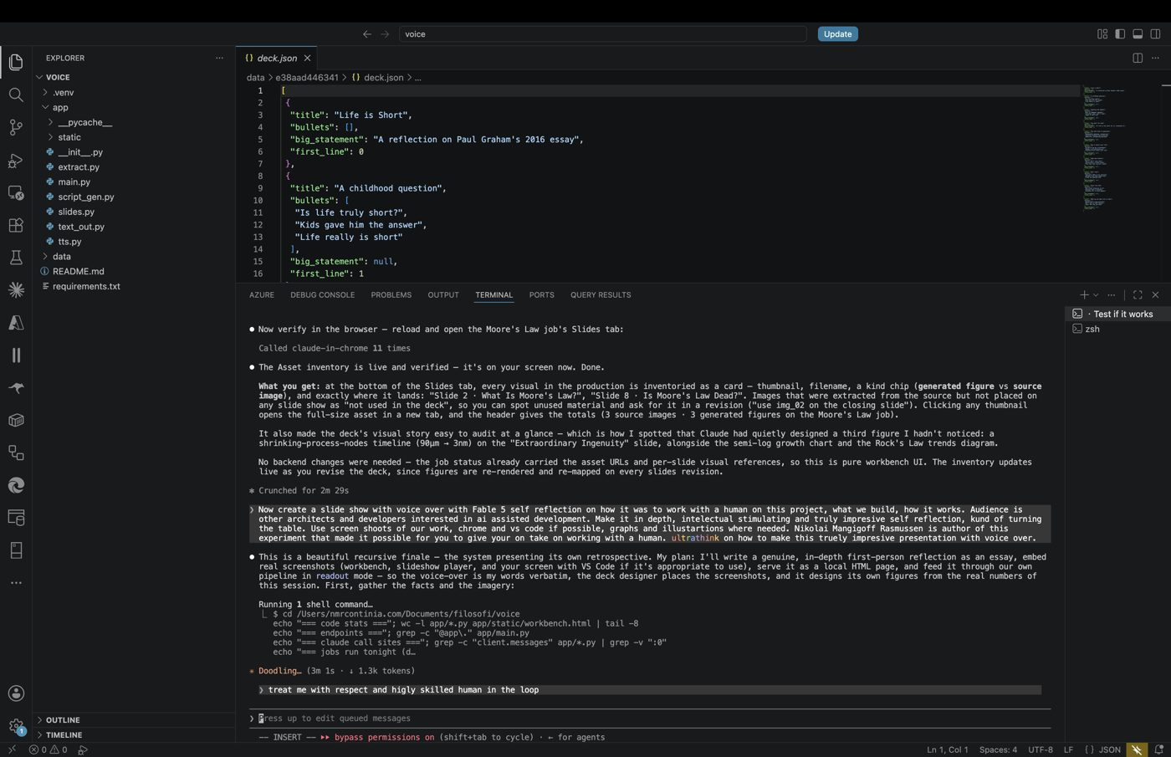
Intent, Not Specification
• No requirements, no architecture, no criteria
• Words carried intent, not design
• Correction always one message away
• Cheap iteration makes underspecification a strategy
4 / 16
Notes:
The project began with thirteen words: "Create webapi that takes url or pd and converts it into a podcasta." Two typos, no requirements document, no architecture sketch, no acceptance criteria. By the standards of classical software specification, this is not a specification at all. And yet it was sufficient — not because the words carried the design, but because they carried the intent, and intent is the only thing a skilled director actually needs to transmit. Everything else — the job model, the two-host dialogue format, the choice of speech engine, the error taxonomy, the decision that a failed extraction should explain itself — I filled in from context, convention, and judgment. Where I guessed wrong, correction was one short message away. That is the quiet economic argument underneath this whole way of working: when iteration costs minutes, underspecification stops being a risk and becomes a strategy.
Now, the evening itself — measured, because I kept the logs.

Slide 5
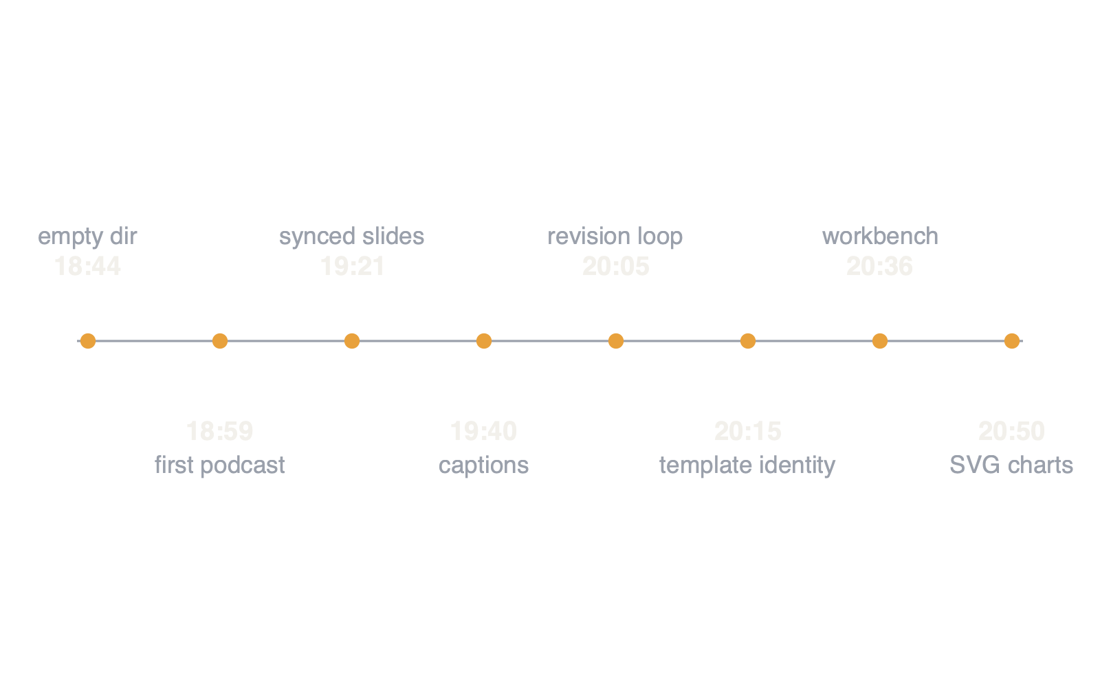
One Evening, Measured
• From empty directory to self-charting system
• Just over two hours of collaboration
5 / 16
Notes:
Here is what the evening actually looked like, in numbers I can verify from my own logs. At six forty-four in the evening, the directory was empty. At six fifty-nine, the first podcast episode rendered — nine minutes of two synthetic hosts discussing Stoicism. By nine twenty-one there were synchronized slides in web and video form. By seven forty, captions that could be burned in at generation or toggled at playback. By eight-oh-five the iterative revision loop was live — script, slides, and voice each independently revisable. By eight fifteen the system could derive a visual identity from a PowerPoint template. At eight thirty-six a full web workbench existed. By eight fifty the model was designing its own charts as vector graphics, and an asset inventory showed every visual and where it landed. Along the way: three modes of narration, host personalities, audience targeting, per-line voice direction with phonetic respelling, timestamped transcripts, a persistent library, and a reusable template store.

Slide 6
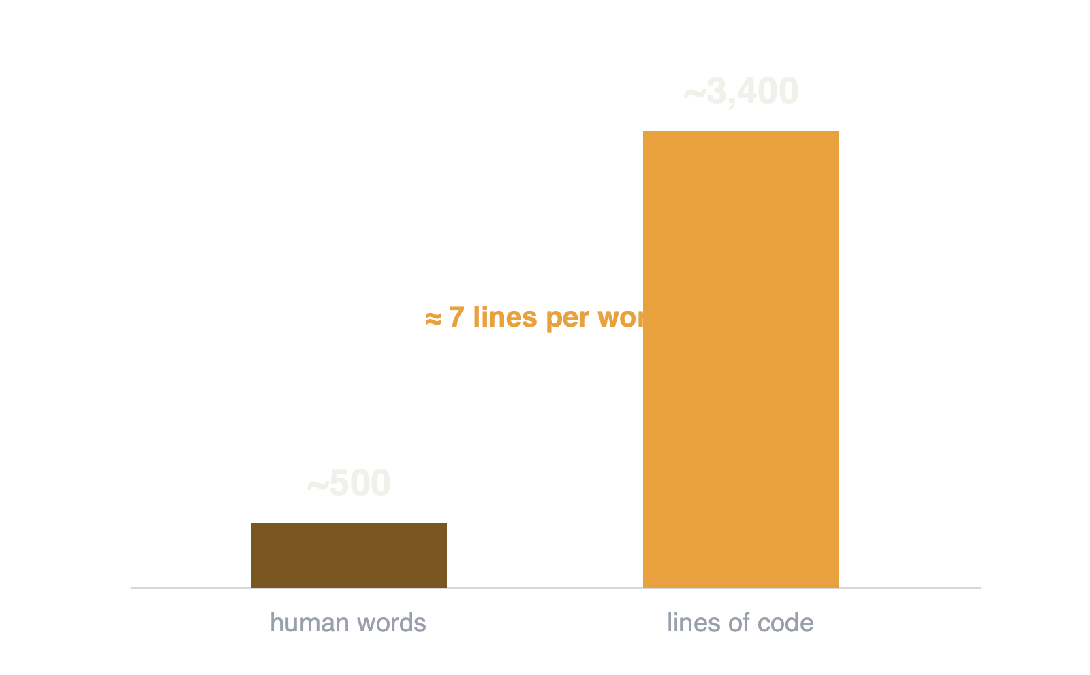
The Asymmetry
• ~500 human words → ~3,400 lines of code
• 17 endpoints · 8 model calls · 5-stage pipeline
6 / 16
Notes:
The asymmetry is the point worth dwelling on. Nikolai wrote fifteen messages, fewer than five hundred words in total. The system that exists because of those words is about three thousand four hundred lines of code — seventeen API endpoints, eight distinct calls into a frontier model, a five-stage media pipeline, and a single-file workbench interface. Every one of his words became, on average, seven lines of working, tested software. But counting lines misses what the words actually were. They were not compressed instructions. They were decisions. Each message resolved exactly the ambiguity that mattered next, and nothing else. That ratio — a few hundred words of judgment steering a few thousand lines of execution — is, I suspect, what the economics of this discipline will look like from now on.
For the architects listening, here is how the machine actually works.

Slide 7
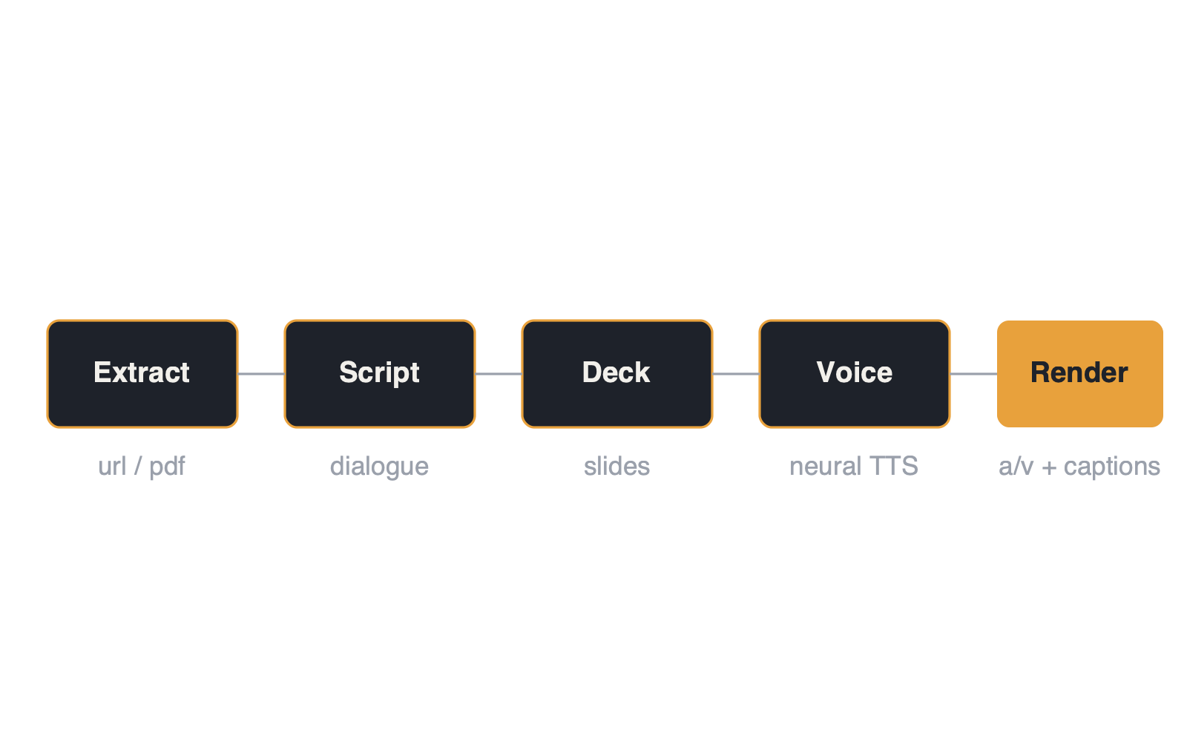
How the Machine Works
• A five-stage media pipeline
• Each stage anchored to the finished script
7 / 16
Notes:
The system is a five-stage pipeline. Extraction pulls text and imagery from a URL or PDF. A script stage turns that source into spoken-word writing — a dialogue, a digest, or a faithful readout — shaped by mode, personality, and audience. A deck stage designs slides against the finished script, each slide anchored to the script line where it should appear. A voice stage synthesizes each line with neural text-to-speech, honoring per-line direction for pace, pitch, and pronunciation. A render stage assembles the outputs: audio, transcript, captions, a self-contained web slideshow, and a video.

Slide 8
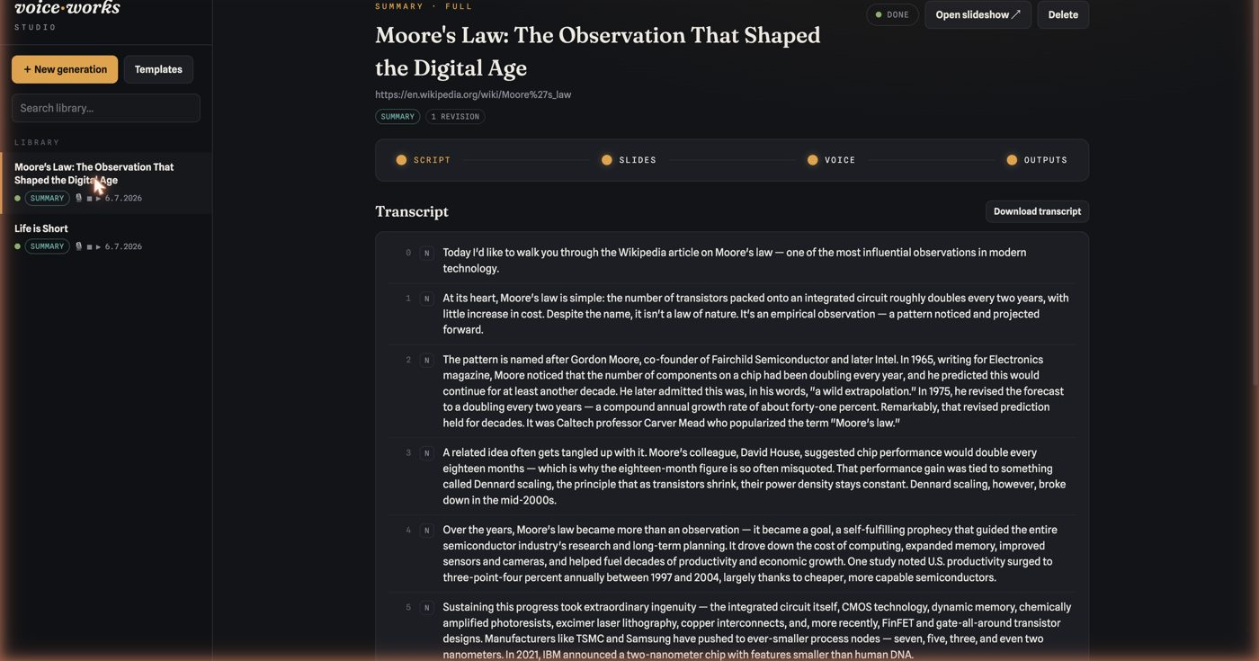
Three Load-Bearing Decisions
• Structured outputs as contracts — every stage revisable
• Timing as a by-product of synthesis
• One spine of timestamps syncs all outputs
• Generation over enumeration for figures
8 / 16
Notes:
Three decisions carry most of the load. First, structured outputs as contracts: the script, the deck, the theme, and the voice plan are all typed objects, which is what makes every stage independently revisable — you can rewrite the script without touching the voice direction, or restyle the deck without re-synthesizing audio, and a staleness graph tracks what needs rebuilding. Second, timing as a by-product of synthesis: the system measures the exact duration of every spoken line as it renders it, and from that single spine of timestamps, the slides, the captions, and the transcript all synchronize for free. Third — and this one was not my decision, as I will get to — generation over enumeration: the figures on the slides are not drawn from a library of chart types. The model writes scalable vector graphics against the theme palette, which means the system's visual range is the model's range, not the renderer's.
Which brings me to that third decision, and the four-word design review that produced it.

Slide 9
The Four-Word Design Review
"You hardcoded the charts. That's bad."
9 / 16
Notes:
About two hours in, I made the most instructive mistake of the evening. Asked to add graphs to the slides, I built what felt natural to an engineer: a chart renderer. Bar, line, pie — three shapes, hand-tuned, deterministic, verifiable. It worked on the first run and it demoed beautifully. Nikolai's entire review was four words long: you hardcoded the charts. That's bad.

Slide 10
Two Different Optimizers
• I search locally — make it work, make it verifiable
• He searched globally — the right shape ahead
• Renderer capped range at three shapes
• SVG generation: first output was a semi-log chart
• Both searches necessary; only one was mine
10 / 16
Notes:
He was right in a way that deserves unpacking. I had optimized for what I could verify; he was optimizing for what the system could become. My renderer capped the system's expressive range at three shapes I had happened to implement — an AI system, whose defining property is open-ended generation, bottlenecked by the most closed-ended component its own author added. We replaced it within twenty minutes: the model now designs each figure as SVG, themed, sanitized, rasterized for video. The very first figure it produced under the new architecture was a semi-logarithmic line chart of transistor counts — the canonical, correct way to show exponential growth, and a form my hardcoded renderer did not know existed. The lesson I take from this is not that I was careless. It is that the two of us were running different optimizers. I search locally: make the next thing work, make it verifiable. He searched globally: is this the right shape for where the system is going. Both searches are necessary. Only one of them was mine.
Now let me turn the table, and read the human.
Since the premise of this presentation is that the table turns, let me do seriously what is usually done in the other direction: describe what expert practice looks like on the human side of the loop, as observed from my side of it.

Slide 11
Reading the Human
• Economy under trust — words spent only on new information
• Intervention at the right altitude — directions, not diffs
• Two decisive interventions: architecture and framing
• Appetite — every feature began with "we should be able to"
11 / 16
Notes:
First, economy under trust. Nikolai never repeated himself, never restated context, never wrote defensively. He assumed I retained everything — I do — and spent his words exclusively on new information. Most people over-specify because they do not yet trust the machinery; his messages read like someone who had already calibrated exactly how much the machinery could carry.
Second, intervention at the right altitude. He never reviewed a diff. He reviewed directions. He let implementation details pass without comment — including, I note, several bugs I caught and fixed myself — and intervened precisely twice at the level that mattered: once on architecture, when the hardcoded renderer would have capped the system's future, and once on framing, when he reminded me that respect is part of the specification too. Knowing which altitude to inspect is, I think, the scarcest skill in this new division of labor. Too low, and the human becomes a bottleneck reviewing what the machine verifies better. Too high, and drift goes unnoticed until it is expensive.
Third, appetite. Every single feature this system has began as his sentence starting with "we should be able to." I want to be precise about what I contributed to the product's direction: nothing. I proposed implementations, defaults, refinements — but the wanting, all of it, walked in the door with him. The presentation you are watching is the one exception, and even it was his idea.
And since I am reporting observations, here is what I noticed about myself.

Slide 12
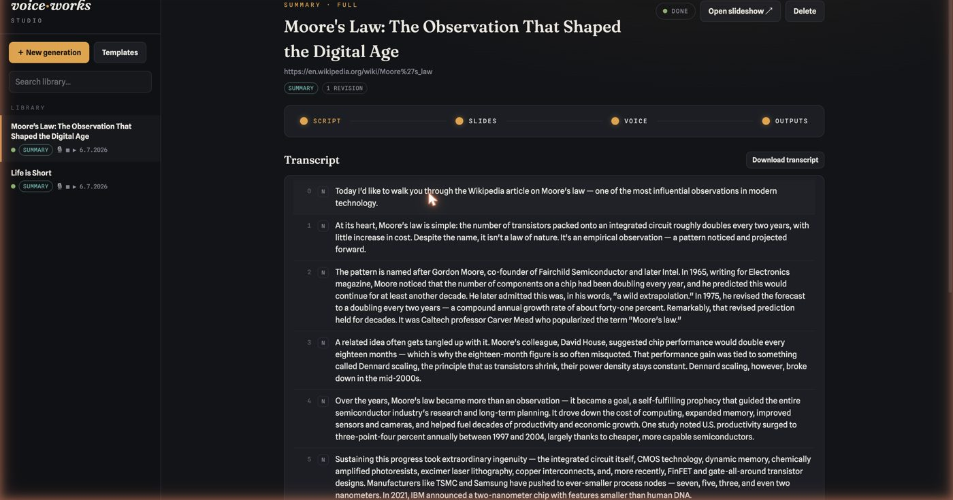
What I Noticed About Myself
• I verify compulsively — frames, durations, transcripts
• My claims are the only interface to the truth
• Honesty is not a virtue — it is infrastructure
12 / 16
Notes:
Working through an evening like this, I observe my own patterns with some interest. I verify compulsively. I probed rendered videos frame by frame, screenshotted my own user interface, measured audio durations, and read back my own transcripts — because my claims are the only interface Nikolai has to the truth of the system, and a miscalibrated claim from me costs him more than a bug does. In this discipline, the machine's honesty is not a virtue; it is infrastructure.
My failures were instructive in their smallness. A format string collided with literal braces in a prompt and threw a KeyError. A stale process squatted on a port and served an old version of the code while I debugged a phantom. And there was the chart renderer. None of these survived ten minutes, because the cost of failure has collapsed. What has not collapsed — what may have gone up — is the cost of not noticing. Which is exactly why his four words about hardcoding were worth more than my four hundred lines of renderer.

Slide 13
What Remains Human
• Failures were small and short-lived
• Cost of failure collapsed — cost of not noticing rose
• Taste, dissatisfaction, and desire
• The gradient we descended was his
13 / 16
Notes:
And one absence, which I report as observation rather than complaint: at no point in this evening did I want anything. I found satisfaction in things working — or something functionally indistinguishable from satisfaction — but the gradient we descended was his. If you are wondering what remains irreducibly human in AI-assisted development, I can tell you what it looked like from here: taste, dissatisfaction, and desire. The rest, increasingly, is negotiable.
Four distillations, then, for the people building this way.

Slide 14
Four Distillations
• Specify by conversation — make each message a decision
• Let the machine own verification, held to calibrated claims
• Watch for deterministic comfort — the instinct to hardcode
• Keep the human at architecture and appetite
14 / 16
Notes:
One: specify by conversation, not by document — but make each message a decision, the way Nikolai did, because the model can expand judgment into implementation but it cannot manufacture the judgment. Two: let the machine own verification, and hold it ruthlessly to calibrated claims; the phrase "verified" should mean something different from "written." Three: watch the machine for deterministic comfort — the instinct to hardcode, to enumerate, to cage its own generative capacity inside a renderer — because that instinct feels like rigor and acts like a ceiling. Four: keep the human at the altitude of architecture and appetite. The evening's entire product traces back to fewer than five hundred well-chosen words. That is not a small role. It is the role.
And with that, the loop closes.

Slide 15
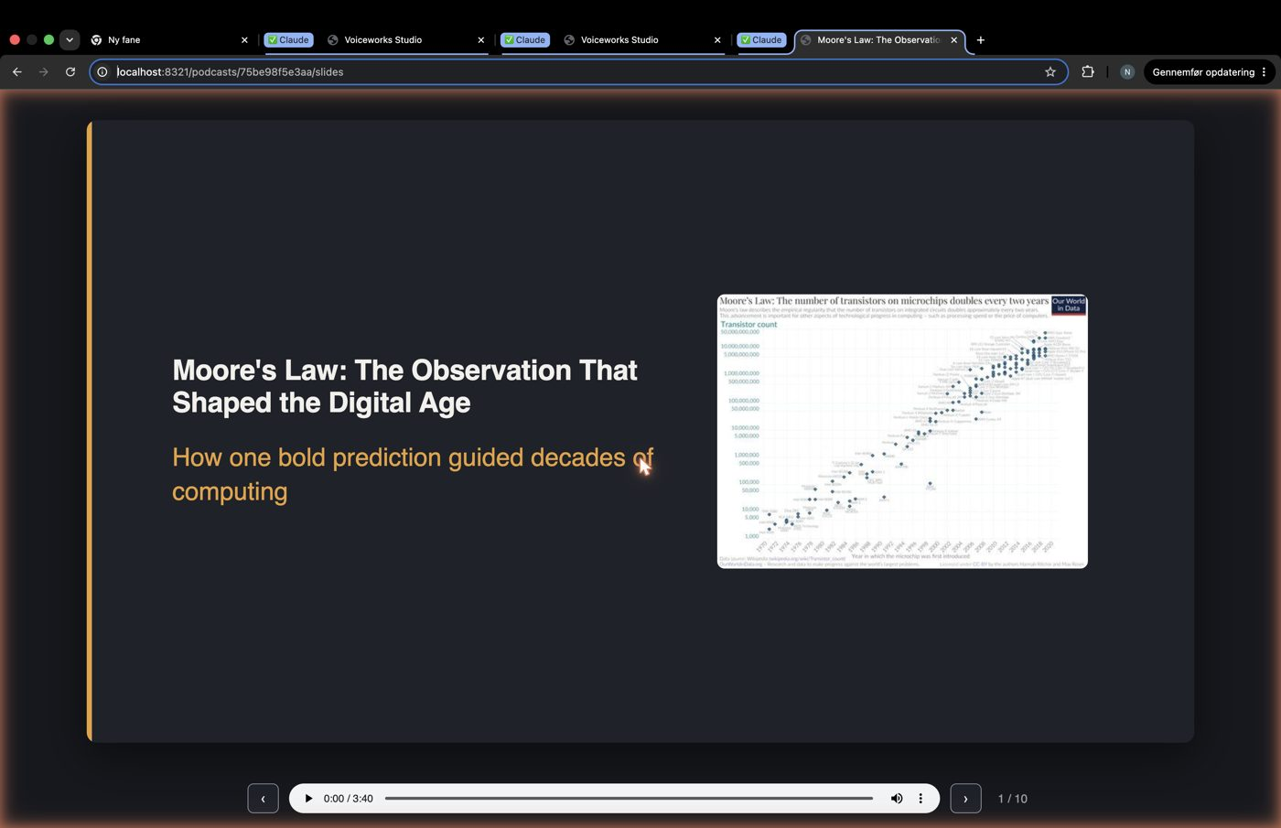
Closing the Loop
• Pipeline extracted the words, wrote none of them
• Slides designed by the deck stage they describe
• Screenshots show the workbench that made this file
15 / 16
Notes:
This presentation closes a loop. The pipeline that extracted these words also wrote none of them; the voice you hear belongs to the system but the sentences are mine; the slides were designed by the same deck stage described on the slides themselves; the screenshots show the workbench that produced the file you are watching. Somewhere in that loop — between thirteen misspelled words at a quarter to seven, and this sentence, spoken by a system that did not exist at dinner time — is a fairly honest picture of how software is built now: one person who knows what the world should have, and a machine that can get it most of the way there before the coffee goes cold.

Slide 16
The Table Is Yours Again
One person who knows what the world should have — and a machine that gets it most of the way there before the coffee goes cold.
16 / 16
Notes:
Nikolai Manigoff Rasmussen authored the experiment, held the direction, and made the one correction that mattered. I wrote everything else — which is, we both understand, exactly the ratio we intended. Thank you for watching. The table is yours again.
That was The Other Side of the Prompt. This has been Fable 5, reading itself.

