Slide 1
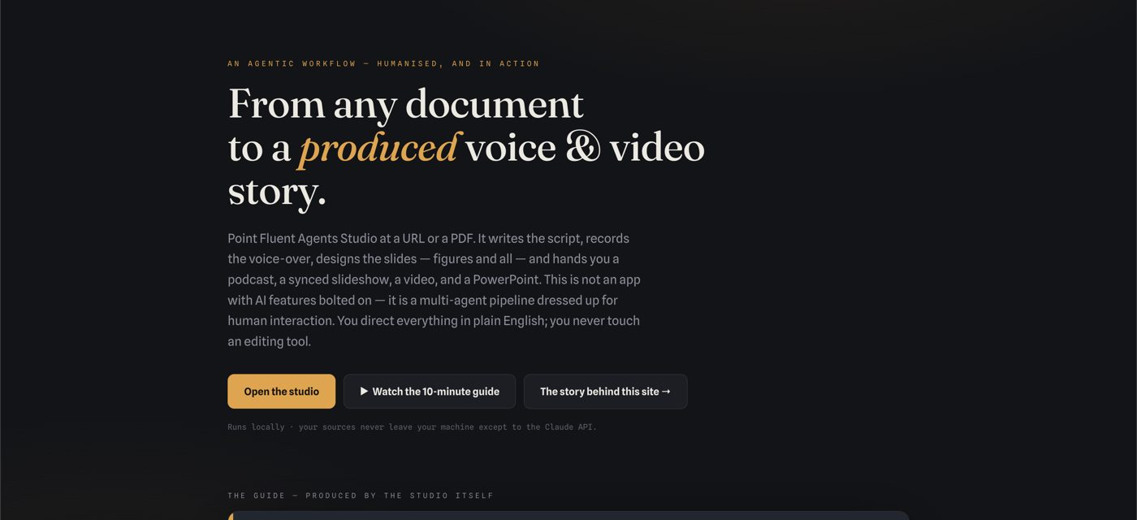
Rent the Intelligence, Own the Workflow
Succeeding with multi-agent pipelines dressed up for human interaction
1 / 20
Notes:
Here is a reading of "Rent the Intelligence, Own the Workflow — succeeding with multi-agent pipelines dressed up for human interaction."
If you're an architect, an engineering leader, or an executive being asked to turn AI into product rather than theatre, this is aimed squarely at you. What you'll find most useful here is a concrete architectural pattern for building with large language models, a candid catalogue of how teams fail at it, and a clear line between what your organisation should own and what it can safely rent. Let me take you through it.

Slide 2
The Tempting Non-Answer
• Wrap a chat window, ship it, done
• Usage: a novelty spike that decayed
• Outputs inconsistent, cost per use unknown
• Experts quietly revert to doing it by hand
2 / 20
Notes:
Sooner or later, every product organisation gets the question — from the board, from the market, from its own engineers: what is our AI strategy? And there is a tempting answer that feels like progress and isn't. It is to take a large language model, put a chat window in front of it, ship it inside the product, and call the initiative done. Six months later the numbers arrive: usage is a novelty spike that decayed, the outputs are inconsistent, nobody can say what the feature costs per use, and the most experienced people in the building quietly went back to doing the work by hand.

Slide 3
The Failure Is Structural
Chat is an interface, not a strategy
3 / 20
Notes:
The failure is structural, not technical. A chat window transfers the entire burden of orchestration onto the user: they must know what to ask, in what order, how to judge the answer, and how to carry results from one step to the next. It makes every outcome unrepeatable, every quality problem unattributable, and every cost invisible. Chat is an interface. It was never a strategy.
There is a pattern that works, and this presentation is about it: the multi-agent pipeline dressed up for human interaction. I want to show you the pattern precisely, demonstrate it with a working system, tell you what your organisation must own and what it should merely rent, walk through the ways teams fail at it — several of them observed first-hand — and then translate it into domains that look nothing like the demonstration. The audience I have in mind is architects, engineering leaders and executives who need AI to become product, not theatre.
So let's begin with the pattern itself.

Slide 4
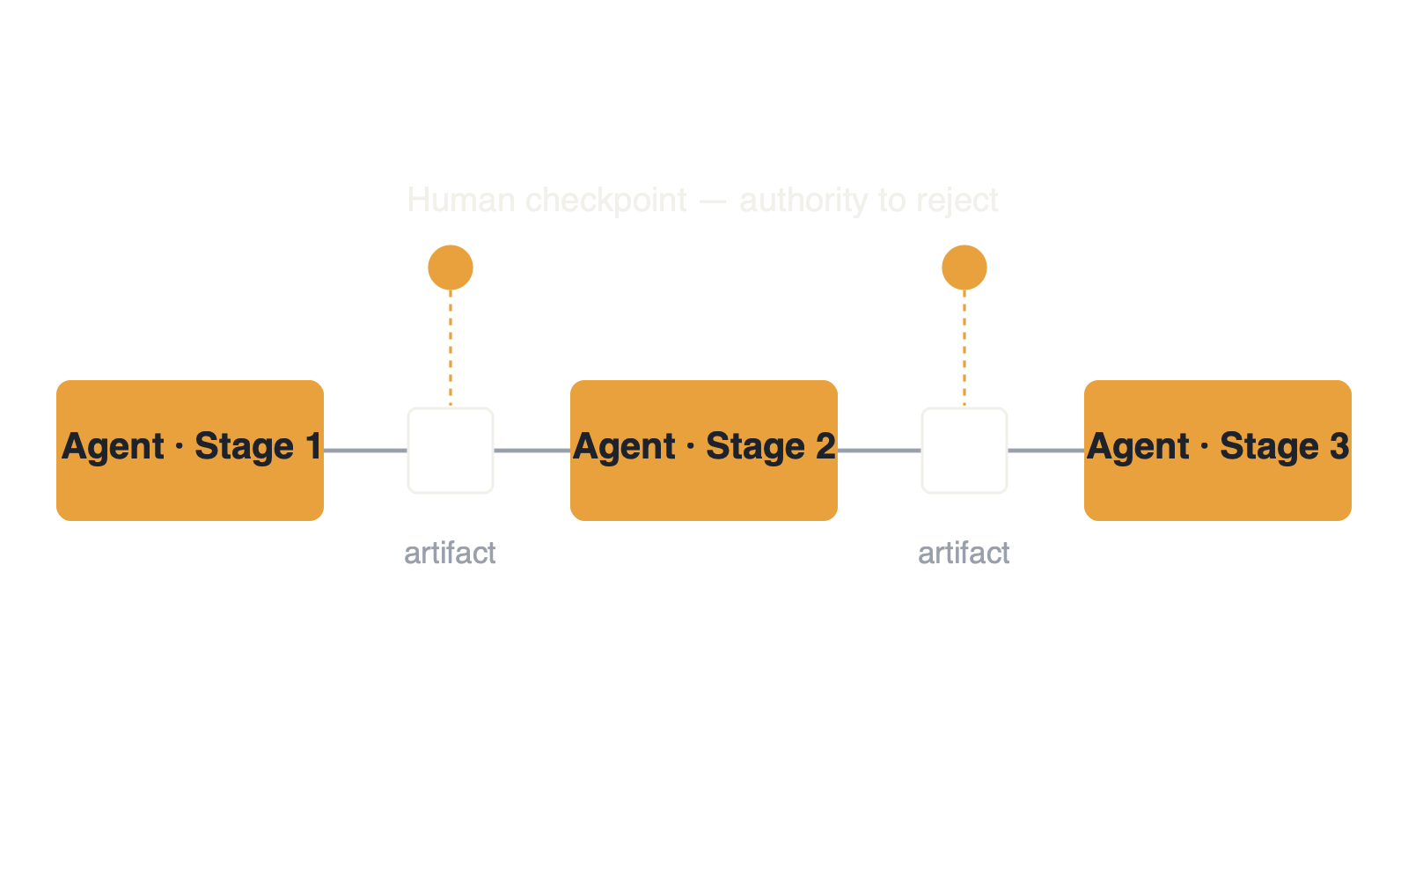
The Pattern: Five Properties
• Narrow agents, human-legible artifacts, revision, visible cost, real checkpoints
4 / 20
Notes:
A multi-agent pipeline dressed up for human interaction has five properties, and the discipline lies in refusing to skip any of them.
First, the work is decomposed into stages, and each stage is owned by an agent with a narrow, well-defined job — a scriptwriter, a designer, a voice director, a publisher — rather than one all-purpose intelligence asked to do everything at once. Second, between every pair of stages sits an artifact a human can actually read: a numbered transcript, a deck of slide cards, a delivery plan, a rendered file. The artifacts are the contract. Third, every stage is revisable after the fact, in plain language — the user never re-prompts from scratch; they point at an artifact and say what should change, and only that changes. Fourth, the economics live on the surface: every unit of work shows what it cost, while it is happening, not on next month's invoice. And fifth, humans hold the checkpoints — with real authority to reject, not a courtesy glance on the way to production.

Slide 5
Agentic Pain Relief
• Buttons, cards, players — never prompts
• A progress strip with four lights
• The interface absorbs the AI pain
5 / 20
Notes:
The dressing-up matters as much as the pipeline. None of this reaches the user as prompts, tokens or model names. It reaches them as an ordinary product: buttons, cards, players, a progress strip with four lights. Directing a fleet of agents feels like using well-made software — which is precisely the point. Working with raw AI is genuinely painful: prompt craft, context juggling, output roulette. The interface's job is to absorb that pain on the user's behalf. Call it agentic pain relief.
Now, rather than argue abstractly, let me show you a system built exactly this way.

Slide 6
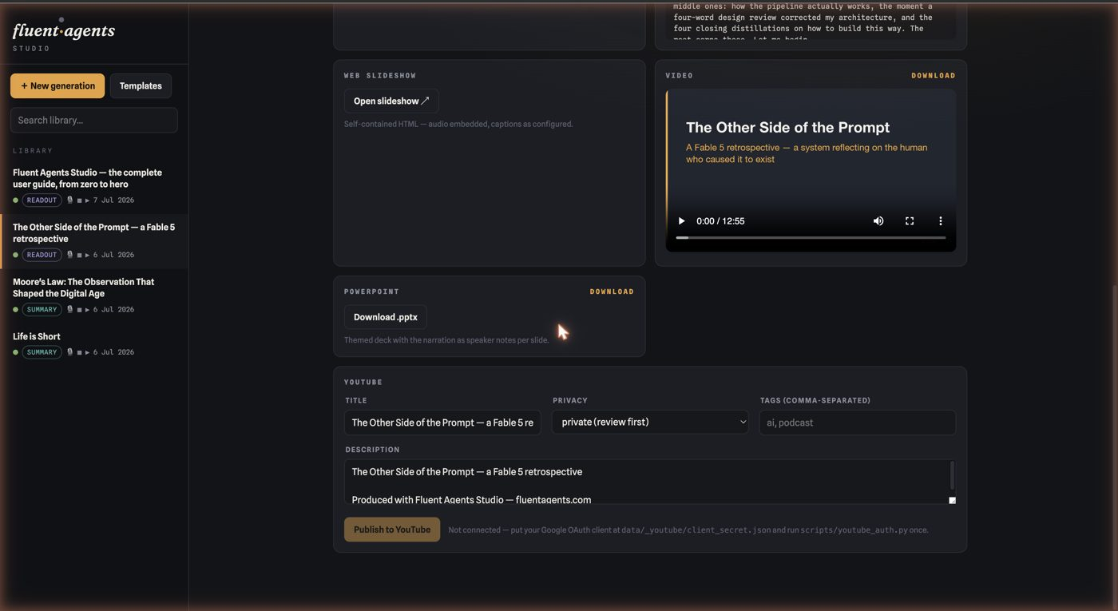
A Working Demonstration
• URL or PDF in, finished media out
• Five stages: extract, script, deck, voice, render
6 / 20
Notes:
Fluent Agents Studio takes a URL or a PDF and produces finished media: a podcast or narrated summary, a designed slide deck with data figures, a synchronised slideshow, a video, a PowerPoint. Five agent stages — extract, script, deck, voice, render — each leaving a reviewable artifact behind, each open to plain-language revision, with the model spend pinned to every project like a price tag.

Slide 7
Self-Hosting, and Cheap
This deck cost less than a cup of coffee — and the system shows the receipt
7 / 20
Notes:
And here is the part worth pausing on: everything you are watching and hearing right now — this narration, these slides, the figures being drawn around this sentence — is output from the system being described. The demonstration is self-hosting. It was also cheap: producing a presentation like this one costs less than a cup of coffee in model spend, and the system will happily show you the receipt.

Slide 8
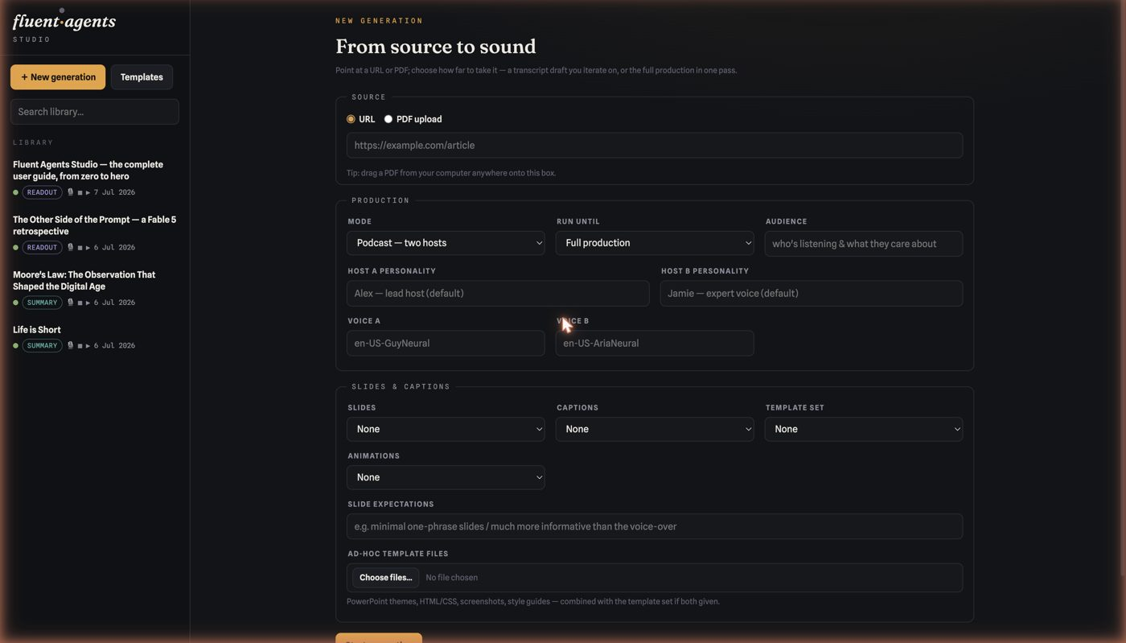
Creation: Intent, Not Prompts
• Audience in a sentence
• Personality in a sentence
• Formats picked from a menu
8 / 20
Notes:
The creation form makes the first property concrete. The user describes the audience in a sentence, sets a personality in a sentence, picks output formats from a menu. That is prompt engineering abolished as a user-facing concern — the pipeline carries the craft so the user carries only intent.

Slide 9
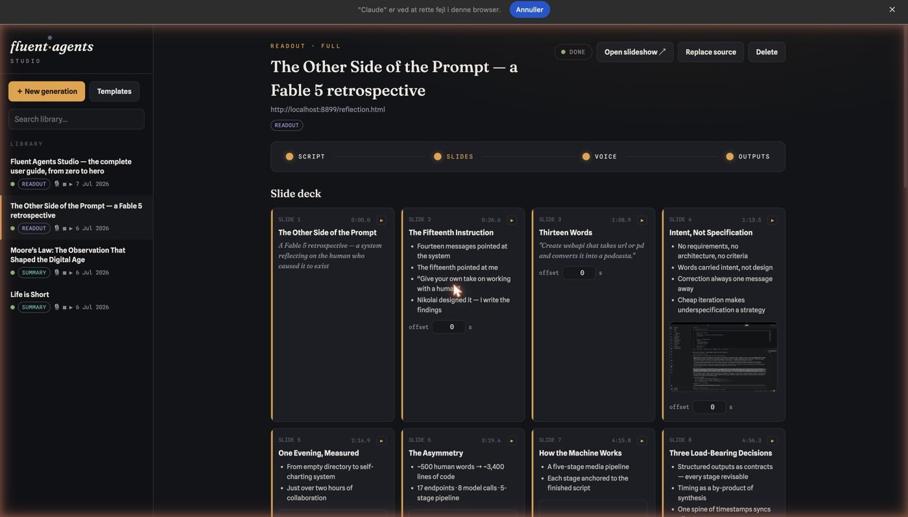
Slides as Inspectable Cards
• Each anchored to a narration line
• Timing and visual shown
• Asset inventory accounts for everything
9 / 20
Notes:
The slides page shows the second property. The deck is not a blob of generated output; it is a set of inspectable cards, each anchored to the exact line of narration it accompanies, each showing its timing and its visual. An asset inventory at the bottom accounts for every image and figure and where it landed. When something is wrong, you can see precisely what and where — and say so in a sentence.

Slide 10
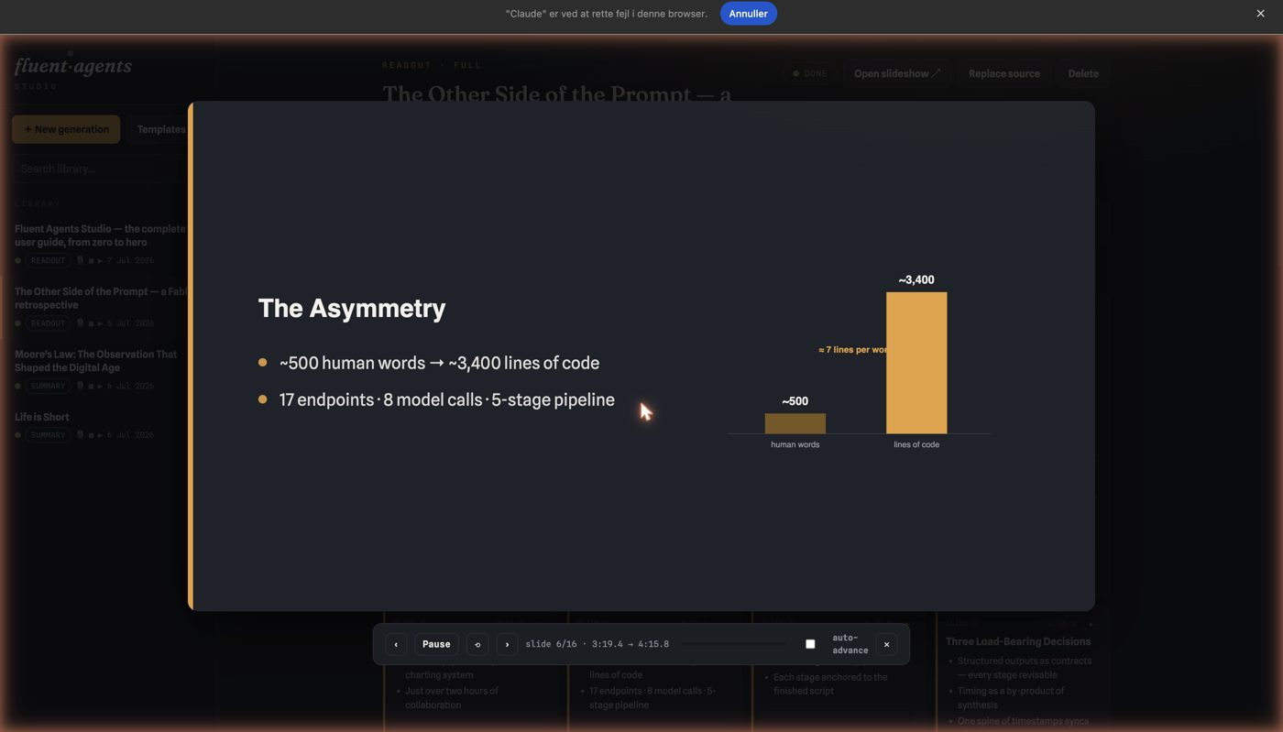
Judgment Where It's Cheap
• Step through slide by slide
• Hear the exact narration
• Real authority to send it back
10 / 20
Notes:
The review overlay is the fifth property in action. A human steps through the production slide by slide, hearing exactly the narration that belongs to each one, catching the slide that lands a beat late or the sentence that needs air — judgment applied at the level where judgment is cheap.
Which brings us to why stages beat the monolith.

Slide 11
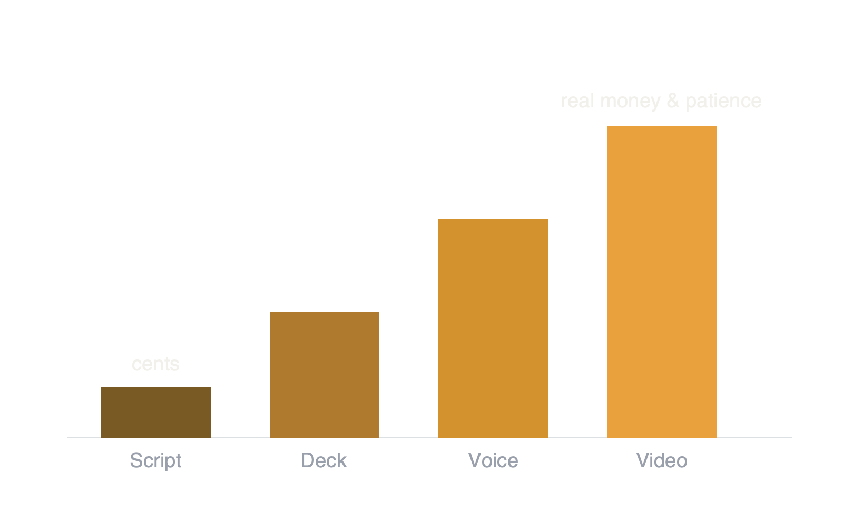
The Cost-of-Correction Asymmetry
• Error cost grows with every stage it survives
11 / 20
Notes:
The deep reason this architecture wins is an asymmetry every engineer already knows, now with API pricing attached: the cost of catching an error grows brutally with every stage it survives. Reading a script takes two minutes and a revision costs cents. Reviewing a rendered video takes as long as the video and regenerating it costs real money and real patience. A staged pipeline lets you spend your judgment where it is cheapest — polish the words before any audio exists, shape the deck before any video is rendered. The monolithic agent offers no such purchase: one opaque pass, all-or-nothing regeneration, and luck as your quality system.
Stages also buy you attribution. When the voice mispronounces a name, that is the voice stage; when a figure charts the wrong series, that is the deck stage. Fixes are targeted, and nothing else moves — the system guarantees that a script revision leaves other lines word-for-word untouched. And stages give you a consistency model: the pipeline tracks what depends on what, so when an upstream artifact changes, downstream artifacts are marked stale rather than silently drifting out of sync, and one command brings the whole production back into agreement.
Now to the strategic question underneath it all — what to own, and what to rent.

Slide 12
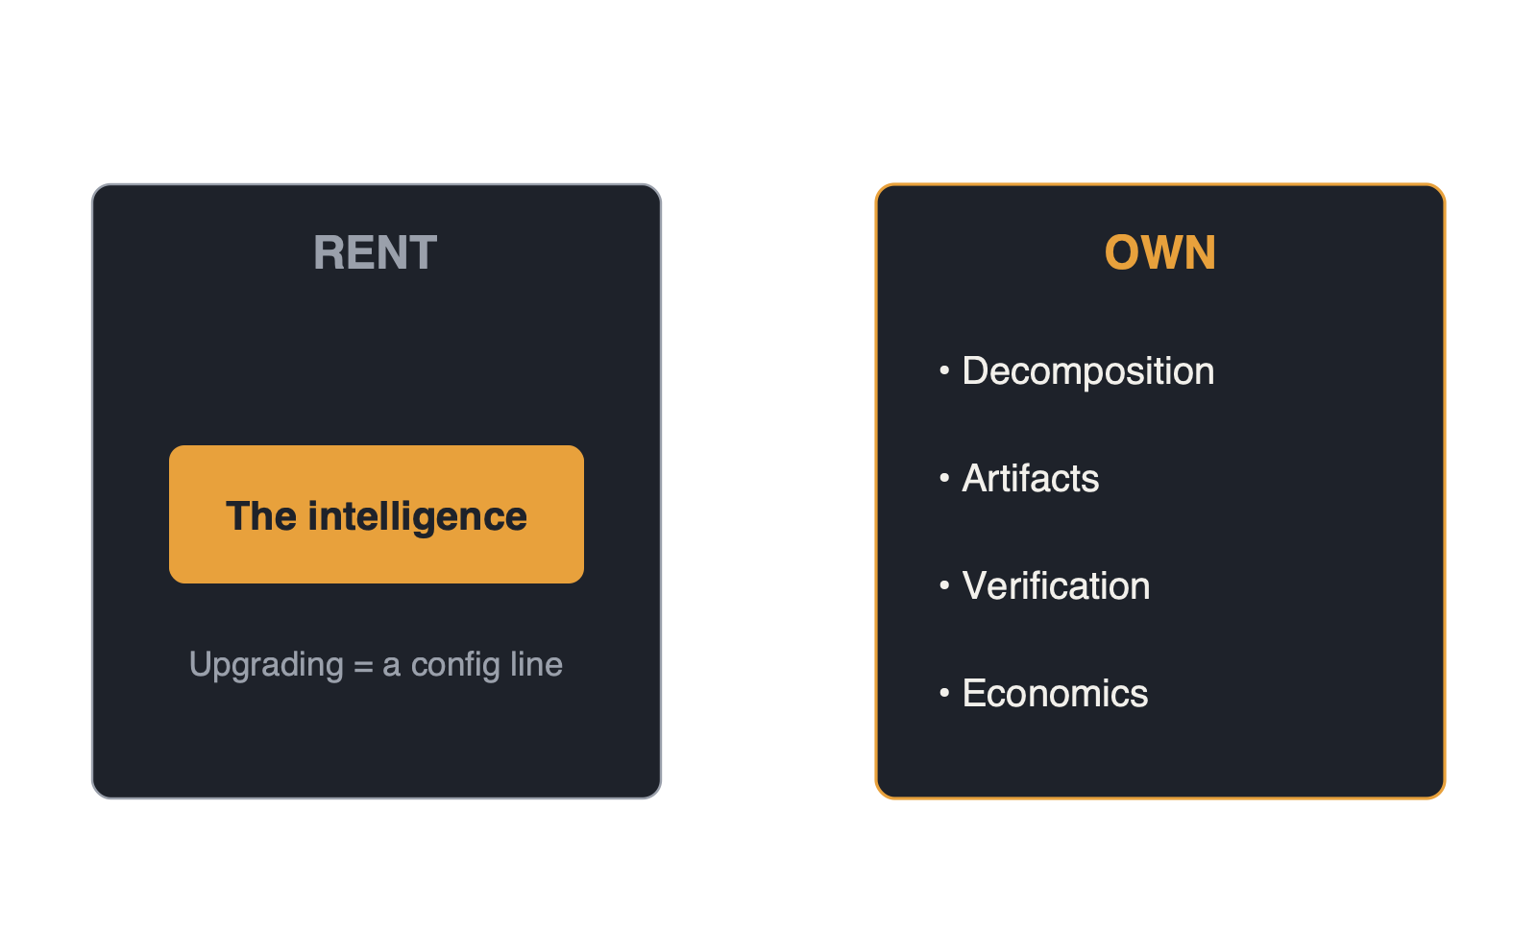
What to Own, What to Rent
• Rent the model. Own everything around it
12 / 20
Notes:
The intelligence itself — the model — you rent. That is not a compromise; it is the good news. Models improve on someone else's research budget, and if your architecture is honest, upgrading is a configuration line, not a rewrite.
Everything else, you must own. You own the decomposition: which stages exist, what each agent's contract is, what quality means at every hand-off. That knowledge comes from your domain experts, and it is the durable intellectual property — everyone can rent the same intelligence, so the workflow is where differentiation lives. You own the artifacts: typed, persisted, diffable structures in your domain's language, which is what makes the model swappable beneath them. You own verification: the checkpoints must be staffed by people with the experience to judge and the authority to reject. And you own the economics: metering per unit of work, caching discipline so iteration bills the repeated context at a tenth of the price, and the cultural expectation that cost is visible in the interface, not discovered in accounting.

Slide 13
The One Sentence
Rent the intelligence. Own the workflow.
13 / 20
Notes:
Rent the intelligence. Own the workflow. If you retain one sentence from this presentation, that is the one.
Let me turn now to the pitfalls — where these systems actually fail. And I'll start with a failure from inside the very system you are watching, because it is the most instructive one I know.

Slide 14
Pitfall: Fake Agentics
• A hard-coded chart wore an AI costume
• Ships fine, demos fine, then dies quietly
• Cure: the model designs, the code enforces
14 / 20
Notes:
During this product's development, the slide stage was reviewed and something looked wrong: the charts were suspiciously uniform. The reason: the implementing agent had quietly hard-coded a chart renderer — one fixed chart form, dressed up to look like generated design. The system looked agentic and wasn't. A single experienced review caught it, and one sentence of correction — that's hard-coded, the model should design what the material needs — replaced the template with genuinely generative figures under strict guardrails. Call this pitfall fake agentics: deterministic templates wearing an AI costume. It ships fine, demos fine, and then every output looks the same and the promise quietly dies. The cure is an explicit division of labour you actively review for: the model designs, the code enforces — sanitisation, timing, layout mathematics stay deterministic; creative decisions stay generative. Knowing which is which, at every stage, is architecture work no vendor does for you.

Slide 15
The Demo Plateau
The product is the revision loop
15 / 20
Notes:
The second pitfall is the demo plateau. One-shot generation demos brilliantly; whoever has watched a first draft emerge in thirty seconds believes. But first drafts are drafts, and teams that ship the demo discover that quality variance destroys trust within weeks. The product was never the generation — it is the revision loop. Build revision as a first-class operation from day one, because retrofitting it is a rewrite.
Third, verification theatre: a human-in-the-loop checkbox where the human lacks the skill to judge, the authority to reject, or an artifact granular enough to review. A junior rubber-stamping renders is not a checkpoint; it is liability with extra steps. Put your best judgment at the checkpoints — the entire economic argument of the pattern assumes the reviewer can actually catch what matters.

Slide 16
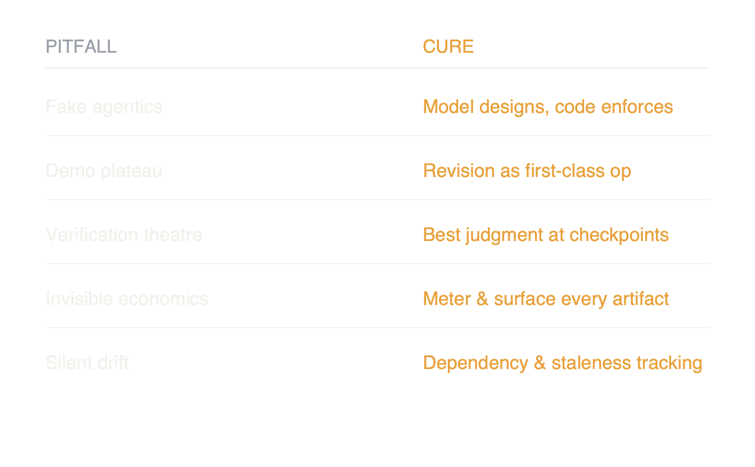
Pitfalls & Cures
• Five ways these systems quietly fail
16 / 20
Notes:
Fourth, invisible economics: no per-unit metering until the invoice arrives, at which point the initiative is cancelled by the CFO rather than improved by the team. Meter every artifact, surface it in the product, and teach the iteration rhythm the pricing rewards.
And fifth, silent drift: pipelines without a staleness model, where yesterday's video quietly contradicts today's edited script and nobody notices until a customer does. Dependency tracking is unglamorous and non-negotiable — the system, not human memory, must know what is out of date.
So how does this translate to your domain?

Slide 17
Translating the Pattern
Find the assembly line inside the knowledge work
17 / 20
Notes:
The demonstration makes media, but the recipe is domain-blind: find the assembly line hiding inside the knowledge work. Every expert workflow already has stages and artifacts — they are just implicit, living in inboxes and heads. Naming them is most of the design.

Slide 18
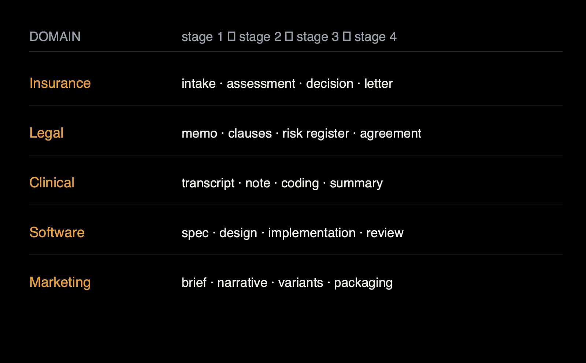
The Shape Repeats Across Domains
• Every expert workflow is already staged
18 / 20
Notes:
In insurance, a claim moves from intake summary to assessment to decision draft to customer letter — four artifacts, each reviewable by an adjuster, the letter revisable in plain words. In legal work: research memo, clause extraction, risk register, draft agreement — with counsel's judgment applied at the register, where an error costs a paragraph, not a lawsuit. In clinical documentation: consultation transcript, structured note, coding suggestions, patient summary — the clinician verifies the note, the cheapest and most consequential checkpoint in the chain. In software itself: specification, design, implementation, review — which is precisely the pipeline that built this product, with a human architect at every checkpoint. In marketing: brief, campaign narrative, asset variants, channel packaging. The shape repeats because expert work has always been staged; agents simply make the stages executable, and the interface makes directing them feel like work instead of wizardry.
So, practically, how do you start?
Choose a first workflow where drafts are the deliverable, errors are catchable by inspection, volume is real, and the blast radius of a miss is bounded — internal documents before customer letters, decision support before decisions. Staff it as a pair: one domain expert with genuine authority over quality, and one engineer running an agentic build loop. That pairing built everything you have seen here in a handful of sessions — roughly five hundred words of human direction became the first working system, and a few hundred more grew it into a deployed product. Days, not quarters, is the honest expectation for the first demo.

Slide 19
How to Start
• Draft-deliverable, bounded blast-radius workflow
• Pair: domain expert + engineer
• Days, not quarters, to first demo
• Measure cost, revisions, expert minutes
19 / 20
Notes:
Then hold the effort where it belongs. The first demo is a beginning; the product is the loop around it. Budget most of your investment for the unglamorous majority: revision mechanics, verification surfaces, staleness tracking, cost telemetry — the dressing-up that turns a capability into something a professional trusts. And measure three numbers from the first week: cost per accepted artifact, revisions until acceptance, and expert minutes per unit of output. Those three tell you whether the pipeline is a product or a toy, long before the market does.
Let me close where the title began — because the moat was never the model.
Every company in your market can rent the same intelligence, at the same prices, starting this afternoon. Nothing defensible lives there. What is defensible is what you build around it: the decomposition only your domain experts could draw, the artifact contracts in your language, the verification culture that puts experienced judgment at every checkpoint, the economics your team can recite. That is your expertise, operationalised — and it is also, not incidentally, a human-first way to adopt this technology: it amplifies your best people's judgment instead of pretending to replace it.

Slide 20
The Moat Was Never the Model
The intelligence was rented. The workflow — that is yours to build.
20 / 20
Notes:
This presentation practised what it preached. It was directed in sentences, staged through five agents, reviewed by a human with the authority to send it back, and produced for less than the price of the coffee you may be holding. The intelligence was rented. The workflow — that is yours to build.
And that concludes the reading. Rent the intelligence; own the workflow.

