Slide 1
The Test Is the Memory
QA as team dialogue, organizational memory, and the answer to epistemic debt
https://fluentagents.com
1 / 18
Notes:
Here's a piece on why QA and testing aren't overhead to be trimmed for AI speed, but the actual memory of a development department — and if you're feeling pressure to trade quality process for velocity, the part you'll want most is why the AI era doubles the stakes, and the five team practices you can start this sprint.
There is a question moving through development departments right now, sometimes spoken, mostly implied by budget lines: if AI writes more and more of the code, and writes it fast, do we still need all this process around quality? The reviews, the test suites, the triage meetings, the QA function itself — weren't those mostly there to catch human mistakes? This talk answers that question, and the answer runs opposite to the instinct. QA and testing were never mainly about catching mistakes.

Slide 2
Three Claims
• Suite = the department's memory
• Verification is dialogue, not monologue
• Review turns output into warranted knowledge
https://fluentagents.com
2 / 18
Notes:
Three claims, and the whole talk hangs on them. First: the test suite is a development department's memory — the one place its hard-won knowledge is stored in a form that cannot silently rot. Second: verification is a team dialogue, never the author's monologue — and that is the cardinal rule of this talk: no work is verified by the one who made it, whether the author is a developer or a model, because quality is a property of a team, not a virtue of individuals. Third: in the AI era, where code and even tests can be generated faster than anyone can read them, review is what turns generated output into warranted knowledge — and a department that skips it is not saving time; it is accumulating a new kind of debt with an old kind of interest.
This is the third talk in a series. The first argued that AI belongs in staged pipelines with human checkpoints; the second, that organizations lose their connective tissue when the assistant answers first. This one is about where those arguments touch the ground in a development department.

Slide 3
Part One
The suite is the memory
https://fluentagents.com
3 / 18
Notes:
Part one: the suite is the memory. Start with what a test actually is, stripped of tooling. A test is a decision that remembers itself. Somebody once decided that this endpoint must reject a negative amount, that this date math must survive a leap year, that this timeout must fall back gracefully — and instead of recording that decision in a document, they recorded it in a form that re-asserts itself on every commit, forever, against every future colleague and every future model.

Slide 4
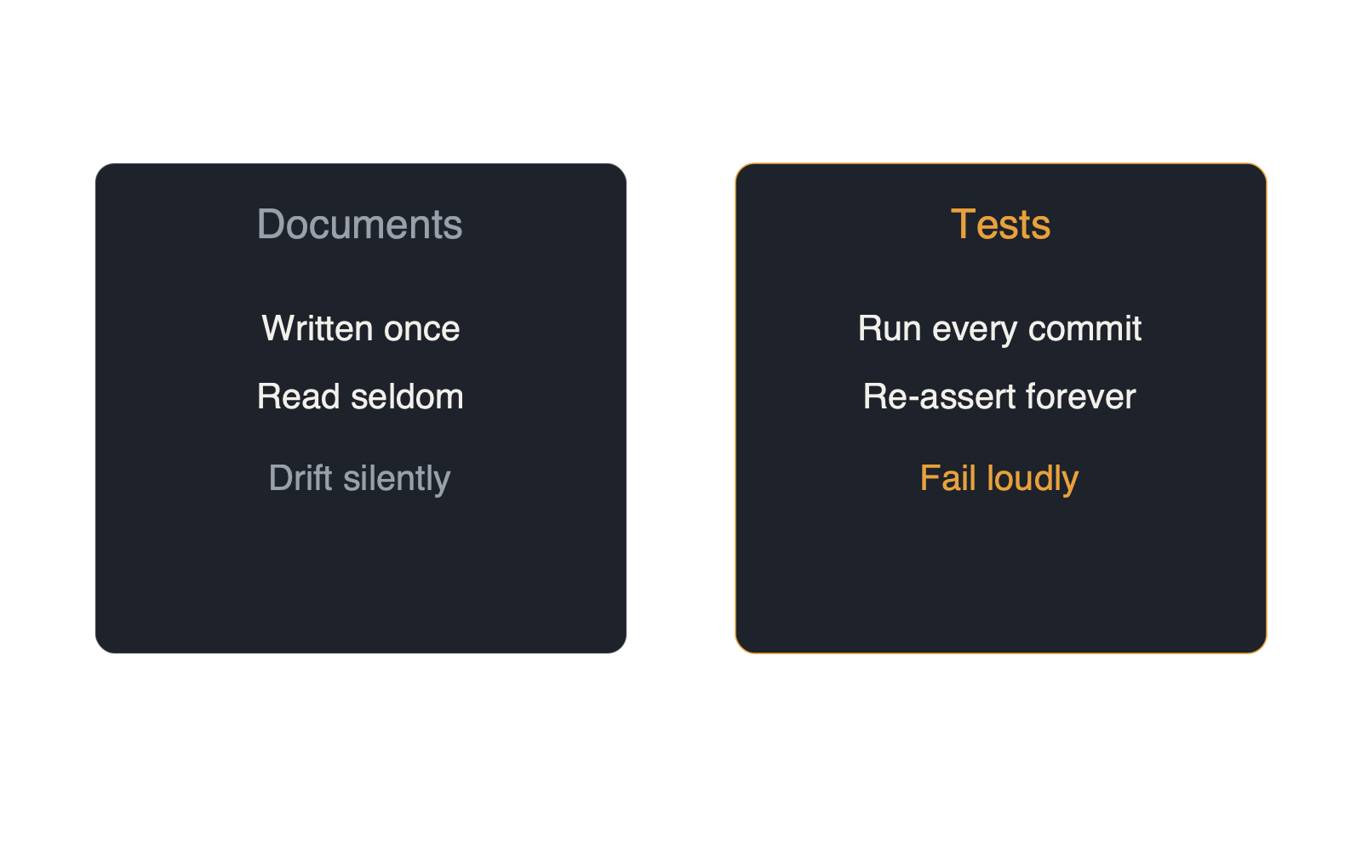
A Test Is a Decision That Remembers Itself
• Documents drift silently when wrong
• Tests fail loudly — the only honest docs
https://fluentagents.com
4 / 18
Notes:
Compare the fates of the two forms. Requirements documents, wiki pages, architecture decks are written once, read seldom, and drift from the truth the day after publication, because nothing happens when they become wrong. A test cannot drift silently. The moment reality disagrees with it, one of them fails loudly, and a human is summoned to decide which is right. That property — knowledge that defends itself — makes the suite the only documentation in the organization that is guaranteed honest. Ask any senior engineer how they approach an unfamiliar codebase: read the tests first. The suite is the fastest truthful map of what a system actually promises — an onboarding document written by everyone, verified continuously, impossible to embellish.

Slide 5
Domain Knowledge, Crystallized
• Customer with two addresses, apostrophe name
• Order at midnight, quarter's last day
• Rounding bug above one million DKK
• People leave — the fixtures stay
https://fluentagents.com
5 / 18
Notes:
Now look at what accumulates in its corners. The fixture with the customer who has two addresses and a name with an apostrophe. The test for the order placed at midnight on the last day of a quarter. The regression case for the rounding error that only appears above one million Danish kroner. That is not test data; that is decades of domain knowledge, crystallized — every strange truth about the business that someone once learned the hard way, kept alive in a form that bites when violated. People leave. The fixtures stay.
The memory grows by two mechanisms, and both deserve naming. The first is that writing a test is doing the understanding: to test anything you must first say precisely what correct means — inputs, boundaries, failure behavior, the cases nobody put in the ticket. That act converts a feeling in one head into an artifact a team can inspect and dispute; when behavior is argued about in a meeting, the healthiest possible outcome is that the argument ends in a test. The test is the minutes of the meeting — and unlike minutes, it executes.

Slide 6
How the Memory Grows
• Writing a test is doing the understanding
• Bugs are tuition → regression test + why
• Blameless postmortems keep learning honest
https://fluentagents.com
6 / 18
Notes:
The second mechanism is that bugs are tuition. Every production defect is expensive education, and the discipline that separates learning departments from lucky ones is what happens next: the incident ends as a regression test plus one written line of why, and the organization acquires scar tissue — it cannot be wounded the same way twice. Google's engineering culture formalized this as the blameless postmortem, and the point of blamelessness is not politeness; it is that failures are treated as team learning events, because that is the only way people surface them honestly. Departments without this discipline pay the same tuition repeatedly — the same class of bug returning in a different jacket, re-diagnosed from scratch by whoever is on call.

Slide 7
Part Two
Quality is a team property, not an individual virtue
https://fluentagents.com
7 / 18
Notes:
Part two: quality is a team property, not an individual virtue. Here is where this talk turns, because everything in part one is routinely undermined by a single organizational habit: treating quality as an individual responsibility. It sounds virtuous — every developer tests their own work; the QA engineer down the corridor owns the quality gate; everyone is personally accountable. And it quietly guarantees the opposite of everything we just described. If testing is an individual chore appended to each developer's task, then whatever each test knows stays with its author. If QA is one person's department, then the end-to-end picture of the system lives in exactly one head. Individual quality produces individual knowledge — sealed compartments, individually diligent, collectively ignorant.

Slide 8
The Oldest Rule
Myers, 1979: never verify your own work
https://fluentagents.com
8 / 18
Notes:
The oldest rule in the discipline says why. Glenford Myers wrote it down in The Art of Software Testing in 1979: never verify your own work. The familiar argument is bias — the same mental model that produced the bug produces the test that misses it; the author searches for confirmation that it works, a tester searches for the ways it fails, and those are different searches that find different things. The bias argument is true. It is also not the cardinal one.

Slide 9
Dialogue With a Deadline
• Verifier asks: how should this behave?
• Tacit knowledge forced into words
• Edge cases surface between two minds
https://fluentagents.com
9 / 18
Notes:
The cardinal argument is this: the moment your work must be verified by someone else, a conversation becomes unavoidable. The verifier has to ask the most knowledge-productive question in a development department — how is this supposed to behave? — and you have to answer it, out loud, to a mind that does not share your assumptions. In that exchange, everything this talk cares about happens at once. Your tacit understanding is forced into words. The unstated requirement surfaces where the verifier's model of the problem collides with yours. The edge case neither of you had written down is discovered in the gap between two perspectives — before production discovers it for you. Self-testing is a monologue: the knowledge never has to survive expression to another human being, so it never becomes shareable, checkable, or teachable. Independent testing is a dialogue with a deadline.
The previous talk in this series argued that informal knowledge exchange lost its carrier when the assistant made asking colleagues optional. See what the test handoff is in that light: it is that exchange with the option removed — a conversation built into the structure of the work, one that cannot be quietly skipped on a busy Tuesday. When a department lets developers verify their own work, it is not saving a process step. It is deleting the last mandatory conversation in its pipeline.

Slide 10
Rumor With a Commit Hash
• Author-only = bus factor of one
• A second mind duplicates and hardens
• Verification moves knowledge to the org
https://fluentagents.com
10 / 18
Notes:
And the dialogue does something deeper than spread knowledge: it secures it. As long as only its author has exercised a behavior, the organization's grasp of it has a bus factor of one — the author can resign, forget, or have been wrong from the start, and nobody would know. The moment a second mind verifies it, the knowledge is duplicated, hardened against a different model of the problem, and anchored in an artifact both can defend. Verification is how knowledge changes owner — from the author to the organization. Until then, a claim only its author has verified is not yet organizational knowledge. It is a rumor with a commit hash.
Follow the logic to its structural conclusion and the team framing stops being a slogan. If verification must be independent, then quality work is collective by construction: the suite belongs to the team, not to whoever happened to write each test; review rotates so no pairing hardens into a private channel; triage happens in a room because the room is where the who-knows-what map gets refreshed and where a junior learns how a senior probes a failure; the definition of done is a team artifact, not a personal standard. None of this is ceremony. Every quality activity done together is simultaneously a gate and an act of knowledge circulation — the same hour does both jobs. Done alone, it is cost without memory.

Slide 11
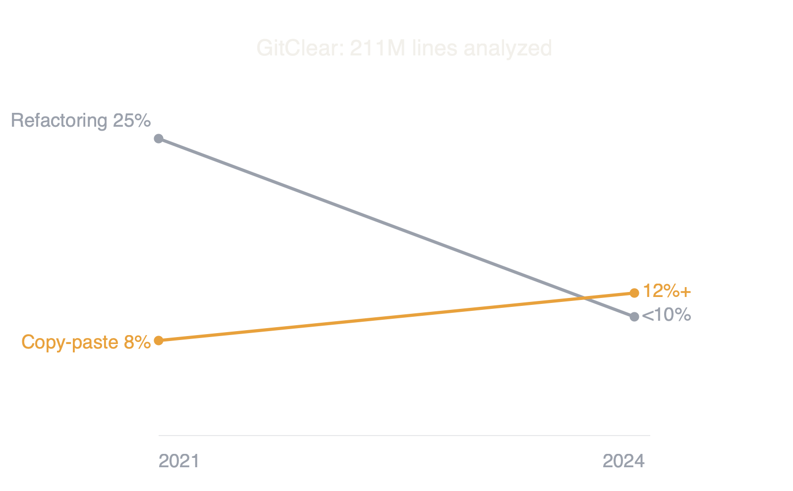
Part Three: AI Era & Epistemic Debt
• Duplication outpaced refactoring — first ever
• Generation got cheap; understanding did not
https://fluentagents.com
11 / 18
Notes:
Part three: the AI era, and epistemic debt. Everything so far was true before AI. Here is why it now matters twice. The industry's own data tells the story from two directions. The DORA State of AI-assisted Software Development report — the largest running study of delivery performance — finds AI adoption correlates with higher throughput and with worse delivery stability: teams ship more and break more. And GitClear's analysis of over two hundred million changed lines found that between 2021 and 2024, copy-pasted code rose from about eight to over twelve percent, code churn nearly doubled, and refactoring collapsed from a quarter of all changes to under ten percent — the first year on record where duplication outpaced refactoring. Generation got cheap. Understanding did not. The gap between the two is landing in production.

Slide 12
Output Is Not Warrant
• Model tests its own code → green checkmark
• A self-fulfilling prophecy is not evidence
• Warrant needs an independent mind
https://fluentagents.com
12 / 18
Notes:
Now bring the cardinal rule to the new author. It is tempting to close the gap by having the model test its own output, and as scaffolding it should — generated tests are excellent raw material. But watch what happens when nobody reviews them, because the failure hides inside good news. The model writes the code; the model writes tests that assert what the code already does; the tests pass. A test that restates its own implementation is not evidence — it is a self-fulfilling prophecy with a green checkmark. The suite fills with assertions nobody argued for, the dashboard glows, and the warrant everyone assumes must exist was never manufactured by anyone. This is the oldest distinction in the theory of knowledge, wearing engineering clothes: producing an answer is not justifying one. Output is not warrant. Capability produces candidates; warrant is what makes a candidate safe to act on — and in this story warrant comes from exactly one place: a mind independent of the author deciding that the assertion is the right one to make.

Slide 13
Epistemic Debt
Repaid later, with interest, at the worst possible moment
https://fluentagents.com
13 / 18
Notes:
There is a name for what accumulates when that step is skipped: epistemic debt — the growing distance between what the system relies on and what is still warranted. It compounds quietly, because every unreviewed generated test adds another assumption nobody owns, and it is repaid the way all debt is repaid: later, with interest, at the worst possible moment. Test review — the team reading the generated assertions and asking, is this actually what we mean? — is not process overhead on top of the real work. It is the step that converts generated candidates into justified claims: the department's defense against paying interest on green builds it never actually earned. This was never a new rule for a new technology. It is Myers' rule, applied to a new kind of author — one that produces plausible verification of its own work at industrial speed, and holds no employment contract.

Slide 14
Tests Are the Brakes That Let You Drive Fast
• Strong net = accept big AI changes quickly
• Delete the process = drive without brakes
https://fluentagents.com
14 / 18
Notes:
Reframe, finally, what the reviewed suite buys you: speed. The department with a trustworthy regression suite is the one that can accept large AI-generated changes quickly, because the net is strong enough to catch what the reading missed. Tests are not the brakes that slow the car; they are the brakes that let you drive fast. Departments that deleted their quality process to go faster with AI chose to drive fast without brakes — and the DORA stability numbers are what that choice looks like at industry scale.

Slide 15
Five Honest Failure Modes
• Coverage worship — review assertions, not %
• Rubber-stamp review transfers no judgment
• Gatekeeping nostalgia — organ, not toll booth
• Outsourcing the organ hollows the learning
• Individual scorecards kill the dialogue
https://fluentagents.com
15 / 18
Notes:
Now, in fairness, the honest failure modes — five concessions, so this survives your most skeptical colleague. Coverage worship: one hundred percent coverage of tests that assert nothing anchors nothing — coverage measures execution, not knowledge; review the assertions, not the percentage. Rubber-stamp review: an approval in forty seconds transfers no judgment; if review is theater, it is cost without memory. Gatekeeping nostalgia: QA as a toll booth deserved its bad name — the case here is for QA as a learning organ, not a department of no.
Outsourcing the organ: handing all testing to the cheapest external provider does not outsource a task, it outsources the learning; a department can hollow itself this way while its dashboards stay green. And the newest one, quality as individual scorecard: the moment defect counts become personal KPIs, people stop surfacing failures, the dialogue dies, and the memory stops growing. Measure teams, never heads — blamelessness is not softness; it is a memory strategy.

Slide 16
Five Practices to Start This Sprint
• Every prod bug → regression test + why
• Review AI code and its tests together
• Let behavior disputes end in a test
• Rotate test and review ownership
• Policy: nothing ships author-verified alone
https://fluentagents.com
16 / 18
Notes:
So what do you actually do? The program is small enough to start this sprint, and every item is a team practice, not an individual duty. Every bug that reaches production ends its life as a regression test plus one written line of why. Review AI-generated code and its AI-generated tests together — senior and junior at the same screen, asking whether the assertions say what the team means; that hour is simultaneously the quality gate, the classroom, and the map-refresh. Let disputes about behavior end in a test. Rotate test and review ownership so no knowledge hardens into a private channel. And make the cardinal rule written policy: nothing ships verified only by its author — human or model.

Slide 17
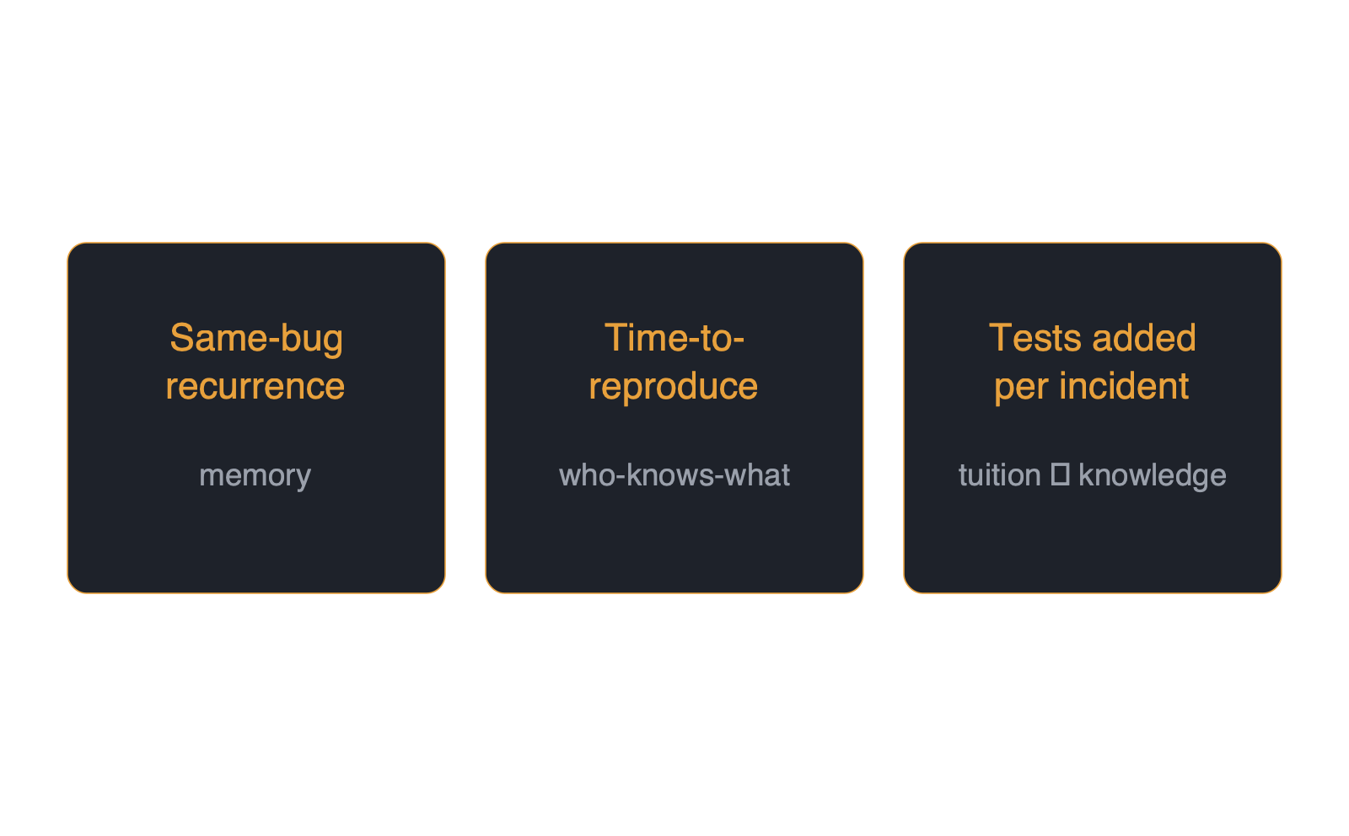
Three Team Metrics
• On a team dashboard — never personal
https://fluentagents.com
17 / 18
Notes:
Then watch three numbers, and put them on a team dashboard, never a personal one. Same-bug recurrence — the direct measurement of organizational memory. Time-to-reproduce — a live reading of whether the who-knows-what map still works. And regression tests added per incident — whether tuition is being converted into knowledge, or merely paid.

Slide 18
What Remains
Nothing enters on its author's word alone
https://fluentagents.com
18 / 18
Notes:
And what remains, when you strip it all down? A development department's real asset was never this quarter's feature list. It is the accumulated, hard-won model of the domain — every rule, every exception, every way the system has ever surprised you. That asset has exactly one home that does not evaporate when a person resigns, does not drift when a document ages, and does not depend on a model's context window: the test suite, and the team dialogue that builds it. The code, increasingly, anyone can generate — and unreviewed, it is only a candidate. What your tests know, because your team argued it into them together — that is warranted, that is owned, and that is yours. Quality was never an individual virtue. It is how a team thinks together, and what a department remembers. Anchor it — and guard the door with the cardinal rule: nothing enters on its author's word alone.
A note on the research behind this talk. It draws on the DORA State of AI-assisted Software Development report; GitClear's AI code quality research, covering two hundred eleven million lines analyzed; Google's Site Reliability Engineering book and its chapter on postmortem culture; Microsoft's study of collaboration networks published in Nature Human Behaviour; reporting on the junior developer pipeline crisis; and Glenford Myers, The Art of Software Testing, 1979, the classic statement of testing independence. This presentation was produced end to end by Fluent Agents Studio.
That's the readout — now go make sure the thing your team knows lives somewhere that can't quit, drift, or forget.

