Slide 1
The Coffee Talk Was Load-Bearing
What organizations quietly lose when the assistant answers first
https://fluentagents.com
1 / 20
Notes:
Here's a piece worth sitting with — a talk about what quietly changes in an organization when the AI assistant becomes the first thing we ask. Whether you set strategy, manage a team, design systems, or write the code, this one is for you, because it puts a name and some hard research behind a feeling many of us already have: work got faster, and the workplace got quieter. What you'll find most useful here is a vocabulary for what's being lost, why it matters competitively, and three concrete ways to rebuild it on purpose.
Let me read it to you in full.
The Coffee Talk Was Load-Bearing — what organizations quietly lose when the assistant answers first.
In an earlier talk, I argued for making AI humane: multi-agent pipelines dressed up for human interaction, interfaces so considerate that directing a fleet of agents feels like using well-made software. I stand by every word. But there is a second meaning of human interaction, and this talk is about that one. Because the better we make the surface between a person and the machine, the more quietly something else changes: the surface between a person and the people around them. This talk is for everyone — not just leaders — and it has one goal: to give you words for something you can probably already feel but may not yet be able to name.

Slide 2
The Feeling
• Work got faster
• The workplace got quieter
• Every answer a small rational win
• Yet the organization feels thinner
https://fluentagents.com
2 / 20
Notes:
Here is the feeling. Work got faster, and the workplace got quieter. The assistant answers in seconds, never sighs, never makes you feel slow. Questions that used to travel across the desk, into the team channel, or out over coffee now go somewhere private and come back solved. Every individual interaction is a small, rational win. And yet something in the organization feels thinner — and if your honest impression is that we are drifting apart, this talk is going to take that impression seriously, put research under it, and end somewhere practical rather than nostalgic.
Let's start with the smallest unit of the change: the unasked question.

Slide 3
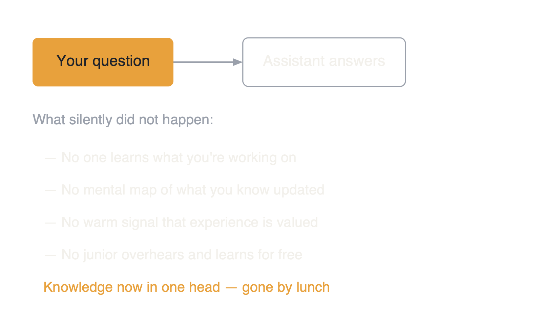
The Unasked Question
• The smallest unit of the change
• Notice what silently does not happen
https://fluentagents.com
3 / 20
Notes:
Start with the question you no longer ask a colleague. Nothing dramatic happens. The assistant's answer was good — probably faster and, some days, better. But notice everything that silently did not happen. Nobody learned what you are working on or where you are struggling. Nobody updated their mental map of what you know. No colleague got the small, warm signal that their experience is valued. No junior overheard the answer and learned it for free. The knowledge that moved is now in exactly one head — yours — and in a context window that will be gone by lunch.

Slide 4
Load-Bearing
The coffee talk was a load-bearing structure nobody engineered — so nobody notices when it's removed
https://fluentagents.com
4 / 20
Notes:
An organization is held together by millions of these micro-exchanges. They were never on any org chart, and that is the point: the coffee talk, the hallway question, the argument in the review meeting — these were load-bearing structures that nobody engineered, so nobody notices when they are removed. One unasked question is nothing. A year of them, across every desk, is a different company.
Now, you don't have to take that mechanism on faith — because the world ran the experiment in public. Consider Stack Overflow.

Slide 5
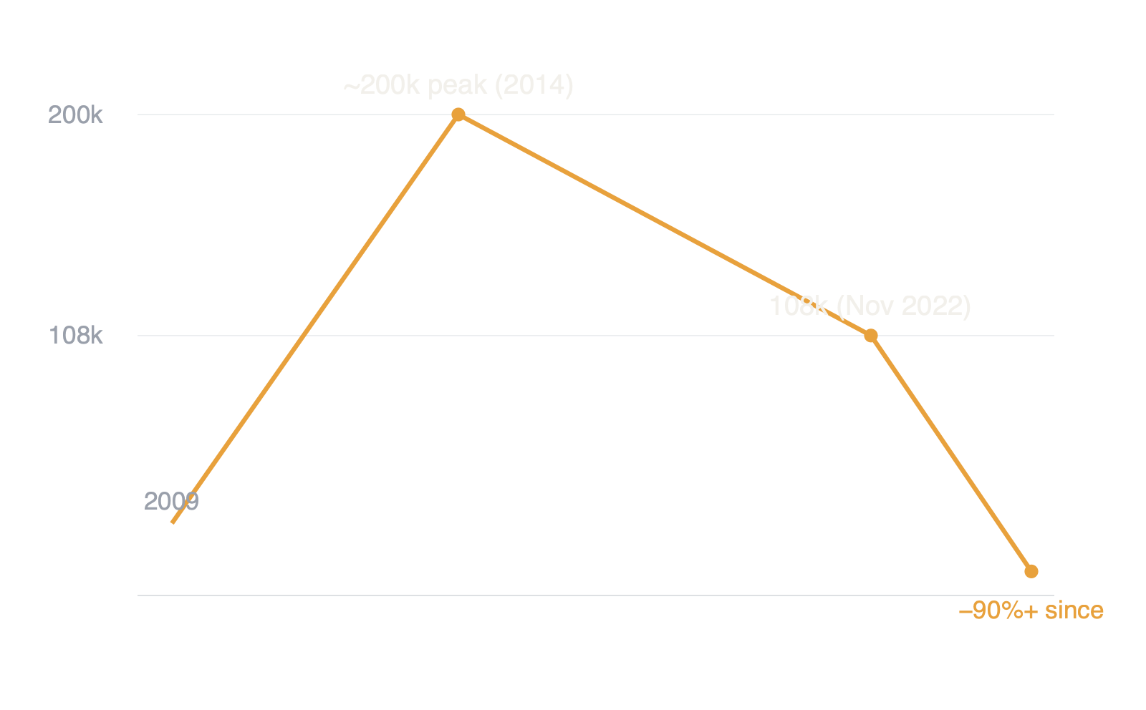
A Public Autopsy: Stack Overflow
• Questions per month, the shared coffee talk
• Peak 2014 → ChatGPT 2022 → collapse
https://fluentagents.com
5 / 20
Notes:
Stack Overflow was the software profession's shared coffee talk: every question asked and answered became a permanent artifact that hundreds of others would later find. At its peak around 2014, developers asked roughly two hundred thousand questions a month; when ChatGPT launched in late 2022, it was still over a hundred thousand. Since then the volume has collapsed by more than ninety percent — recent months have approached levels last seen when the site launched in 2009. Honesty requires the caveat: the decline began years before AI, for the site's own cultural reasons. But the acceleration after 2022 is unmistakable, and here is the part that matters for your organization: the questions did not disappear. Developers ask more questions than ever. The questions moved into private AI conversations — where they produce answers, but no artifact, no shared trace, no commons. The knowledge still flows; it just stopped accumulating anywhere that others can stand on.

Slide 6
The Commons
The questions did not disappear — the commons did
https://fluentagents.com
6 / 20
Notes:
Now realize that every organization is running the same experiment internally, unmeasured. Your internal Stack Overflow was never a website — it was the fabric of asking around. It is thinning at the same rate, for the same reason, with nobody plotting the graph.

Slide 7
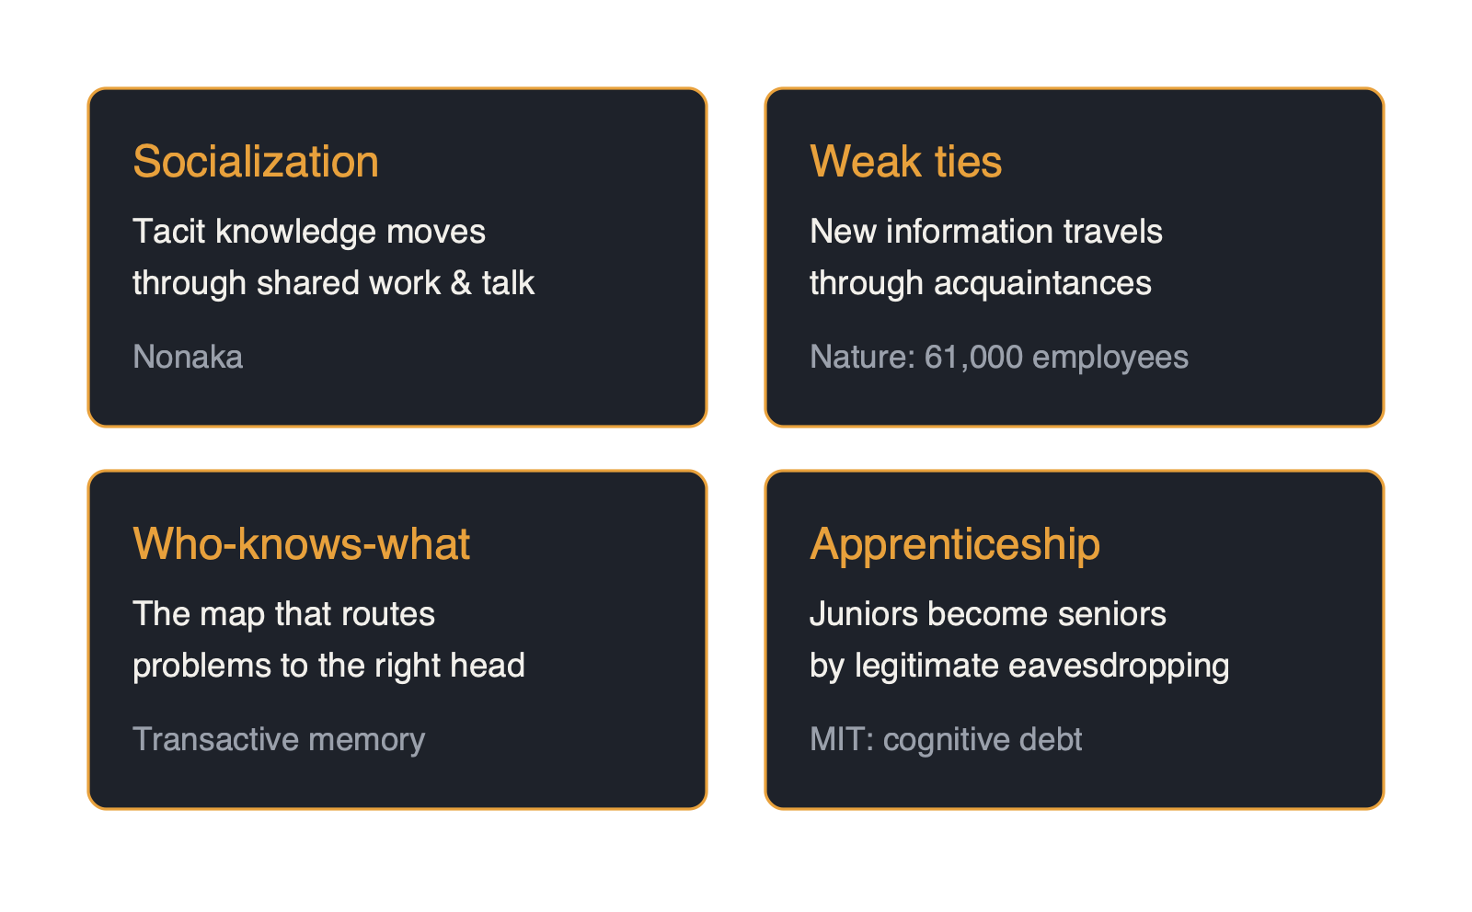
Four Things That Stop Happening
• Name them — you can't defend what you can't point to
https://fluentagents.com
7 / 20
Notes:
So let's give this loss its proper names — four things that stop happening when the question goes unasked. Knowing the names matters, because you cannot defend what you cannot point to.
The first is socialization. Decades of knowledge-management research — Ikujiro Nonaka's work is the classic — established that most of what an organization knows is tacit: it lives in people as judgment and feel, and it moves between people through shared work, imitation, and talk, long before anyone writes it down. The coffee talk was never a break from knowledge work. It was the first stage of it.

Slide 8
The Weak Tie
• Microsoft: remote work siloed the network
• Cross-group time fell ~a quarter
• Weak ties withered first
• AI is the accelerant
https://fluentagents.com
8 / 20
Notes:
The second is the weak tie. When Microsoft studied sixty-one thousand of its own employees for a paper in Nature Human Behaviour, the shift to remote work made the company's collaboration network measurably more static and siloed: time spent with cross-group connections fell by about a quarter, and the weak ties — the acquaintances across the organization through which new information actually travels — withered first. That study is about remote work, not AI, and that is exactly why it belongs here: it proves the connective tissue is real, measurable, and damaged by removing informal contact. Remote work loosened it first. The assistant is the accelerant, because now even the questions stay home.

Slide 9
The Who-Knows-What Map
• Teams know who knows things
• Asking around refreshes the map
• Ask only the assistant → map goes stale
• Full of experts, unable to find them
https://fluentagents.com
9 / 20
Notes:
The third is the who-knows-what map. Teams do not just know things; they know who knows things — psychologists call it transactive memory, and it is the mechanism by which a group outperforms its members. Every time you ask around, you refresh that map, and the map is what lets the organization route hard problems to the right head in minutes. When everyone asks the assistant, the map goes stale — not because anyone chose that, but because knowing-who stopped paying its daily dividend. A team can be full of experts and still lose the ability to find them.

Slide 10
Cognitive Debt
• MIT: weakest brain connectivity, lowest recall
• CMU: more trust in AI, less critical thinking
• Juniors ship more, understand less
• Seniors mentor less
https://fluentagents.com
10 / 20
Notes:
The fourth is the apprenticeship. Juniors have always become seniors by legitimate eavesdropping: watching how an experienced colleague narrows a problem, hearing why the obvious fix is wrong, being handed the small task with the safety net. Two early research signals say the assistant disrupts this quietly. An MIT Media Lab experiment found that people who wrote with an LLM showed the weakest brain connectivity of the groups measured, the lowest felt ownership of their work, and the poorest recall of it — the researchers called it cognitive debt. A Microsoft and Carnegie Mellon survey of three hundred and nineteen knowledge workers found that the more people trust the AI, the less critical thinking they report doing. Both studies are young, and this talk will not pretend they are settled science. But they rhyme with what senior engineers already report from the field: juniors who ship more and understand less — while seniors, made more productive by the same tools, mentor less. An organization can gain velocity every quarter while its ability to produce its next generation of judgment quietly declines.
Now for the perspective that reframes the whole thing — because we have run this experiment before.
Take the extreme thought seriously for a moment: if the assistant is your primary contact surface, does it still matter where you work from, or who hired you? Before you answer, remember that entire industries spent two decades learning what happens when work crosses a well-defined interface without shared context. It was called outsourcing.

Slide 11
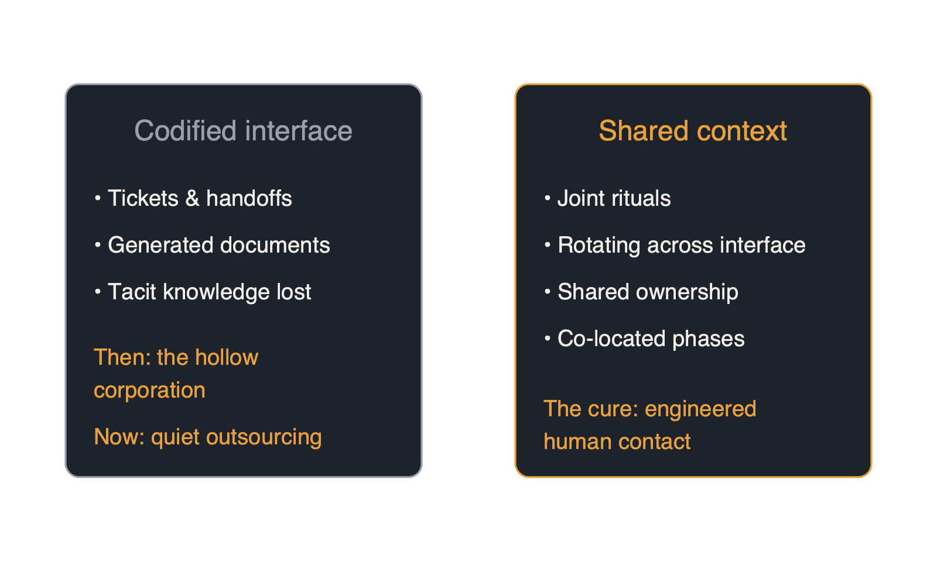
The Mirror: We've Run This Before
• Work across an interface without shared context
• Two decades called it outsourcing
https://fluentagents.com
11 / 20
Notes:
The research record on outsourcing is unambiguous about the failure mode: when collaboration is reduced to codified handoffs, tacit knowledge does not make the crossing. Organizations that outsourced too close to their core hollowed out — the literature literally calls it the hollow corporation — losing not headcount but the contextual understanding that made them capable of judging the work at all. And the arrangements that succeeded learned a specific cure: deliberately engineered human contact. Joint rituals, rotating people across the interface, shared ownership of quality, co-located phases. The interface was never enough; the relationship had to be built on purpose.

Slide 12
Co-located Strangers
• Share an employer and a floor plan
• Exchange context through tickets alone
• Outsource the org to the model, no contract
• Human connection is now the hard argument
https://fluentagents.com
12 / 20
Notes:
Here is the uncomfortable symmetry. An organization where everyone's primary interlocutor is an assistant has rebuilt outsourcing's interface inside its own walls — desk by desk, one convenient answer at a time. Colleagues become co-located strangers: people who share an employer and a floor plan but exchange context through nothing wider than tickets and generated documents. Call it quiet outsourcing — you outsource your organization to the model without signing a contract. And the personal, eye-level version deserves saying plainly: if the assistant is your only interface to your work, you have made yourself outsourceable. Your task output now looks like anyone's task output, anywhere, with the same subscription. What was never outsourceable about you is the rest: the context you carry, the judgment you have earned, the people who trust you and know exactly when to bring you the weird problem. That is as true for a whole organization as for one person. Which means the argument for investing in human connection is no longer soft. It is the hard, competitive one.
Now, before this hardens into an anti-AI sermon, let me be clear about what this talk is not saying. Three honest concessions, so the words you take from here survive contact with skeptics.

Slide 13
What This Is Not Saying
• Much AI displaced deserved to die
• Valuable exchange free-rode on the necessary
• Remote work loosened the fabric first
• DORA: AI amplifies what's already there
https://fluentagents.com
13 / 20
Notes:
First: much of what AI displaced deserved to die. The status meeting that was theater, the interruption for the trivially answerable — good riddance; nobody should defend meetings for their own sake. The precise loss is different: the valuable exchange was free-riding on the necessary one. You asked a colleague because you had to, and the relationship, the map-updating, the apprenticeship rode along at no charge. The necessity is gone. The freight it carried does not arrive anymore — unless we ship it deliberately.
Second: AI did not start this. Remote and hybrid work loosened the fabric first, and the Nature study proves it; the assistant accelerates a drift that was already underway, which is exactly why it is worth naming now rather than in five years.
Third: the AI-specific research is young — small samples, self-reports, preprints — and the DORA industry report, drawing on years of data, adds the fair counterweight: AI amplifies what is already there. Strong fabric gets stronger. It is precisely the organizations with thinning fabric that should worry about what is being amplified.
So the answer is not fewer assistants and more nostalgia. It is treating knowledge-cementing as engineering, now that it stopped happening for free. Let's look at three examples — and notice they are exactly the processes every software organization already has, the ones now under pressure as supposed bureaucratic residue.

Slide 14
The Merge Ritual
• Status reporting is dead — a gift
• Failure mode: everyone aligns with their own assistant
• Ask where do we disagree — and is it right?
https://fluentagents.com
14 / 20
Notes:
First, development meetings. Status reporting is dead; the assistant genuinely does it better, and freeing that time is a gift. But a new failure mode has appeared in its place: everyone aligns with their own assistant instead of with each other. Each person arrives locally coherent — and the team is collectively incoherent, like developers each pairing with a brilliant partner on their own branch, and nobody ever merging. So repurpose the meeting into the merge ritual: not what did you do, but where do we disagree, what did your assistant convince you of, and is it right? Argument is not friction in the process. Argument is the process by which private understanding becomes organizational knowledge.

Slide 15
Argument
Argument is not friction in the process — argument is the process
https://fluentagents.com
15 / 20
Notes:
Second, documentation. When the assistant writes all the documents, documentation stops being thinking and becomes exhaust — plausible pages nobody fought over and nobody owns. Keep the machine drafting; it is excellent at drafting. But the decision record — why we chose this, what we rejected, who dissented — must stay a human argument, because the argument is the knowledge. A document the team argued into shape is cement. A document nobody resisted is wallpaper.

Slide 16
Documentation & Review
• Argued document is cement; unresisted is wallpaper
• Keep the decision record a human argument
• Review together: quality gate + apprenticeship + map-refresh
• The last place your next seniors are made
https://fluentagents.com
16 / 20
Notes:
Third, QA, testing, and review. From the earlier talk: every AI pipeline needs human checkpoints with authority. Add this talk's dimension: the checkpoint is also the classroom. Reviewing the AI's output together — senior and junior at the same artifact, reasoning out loud about why it is almost right — is simultaneously your quality gate, your apprenticeship, and your map-refresh, three load-bearing functions in one hour. Organizations under velocity pressure will be tempted to automate exactly this conversation away. It is the last place where your next seniors are being made. Keeping these processes strong is not merely the responsible choice — in the AI era it is how an organization keeps ownership of what it does best, and what sets it apart: its judgment, its context, and its colleagues.
And now, let me bring this down to eye level — for wherever you sit.
If you lead: measure the fabric, not just the velocity. You track deployment frequency; consider also watching who asks whom, whether cross-team ties are forming or fading, whether juniors are becoming seniors. Spend some of the meeting time AI liberated on the merge ritual, not on more heads-down speed.

Slide 17
At Eye Level
• Leaders: measure the fabric, not just velocity
• ICs: take one question a day to a human
• Being findable keeps you a colleague
https://fluentagents.com
17 / 20
Notes:
If you are an individual contributor: use the assistant for everything it is good at — and then, deliberately, take one question a day to a human anyway. Not because the assistant would fail, but because the question is how colleagues stay colleagues, how you stay findable on the map, and how somebody two desks away learns something for free. Being a good colleague was always kindness; it turns out it is also infrastructure.

Slide 18
Being a Good Colleague
Being a good colleague was always kindness — it turns out it's also infrastructure
https://fluentagents.com
18 / 20
Notes:
The machine can hold what we tell it. It cannot hold what we are together — the shared context, the earned trust, the argument that ends in understanding. That was always the organization. It still is. The assistant answers in seconds; some questions should still take the long way around, past another human being — because the answer was never the only thing the question was for.

Slide 19
Take the Long Way Around
• The machine holds what we tell it
• Not what we are together
• Some questions should still pass a human
• The answer was never all the question was for
https://fluentagents.com
19 / 20
Notes:
This talk draws on a body of research worth reading yourself: the Nature Human Behaviour study of sixty-one thousand Microsoft employees on remote work and collaboration; the MIT Media Lab study "Your Brain on ChatGPT" on cognitive debt; the Microsoft Research and Carnegie Mellon paper on generative AI and critical thinking; the data on Stack Overflow's decline; the DORA State of AI-assisted Software Development report; work on transactive memory and AI; and the literature on tacit knowledge loss in outsourcing. This presentation was produced end to end by Fluent Agents Studio.

Slide 20
Sources
• Nature Human Behaviour, Microsoft 61k: nature.com/articles/s41562-021-01196-4
• Your Brain on ChatGPT, MIT: media.mit.edu/publications/your-brain-on-chatgpt
• GenAI & Critical Thinking, MSR + CMU, CHI 2025: microsoft.com/en-us/research
• Stack Overflow decline: blog.pragmaticengineer.com/stack-overflow-is-almost-dead
• DORA 2025: dora.dev/dora-report-2025 · Transactive memory: tepperspectives.cmu.edu
• Tacit knowledge in outsourcing: sciencedirect.com · Produced by fluentagents.com
https://fluentagents.com
20 / 20
Notes:
And that's the talk. If you take one thing from it: keep using the tools — and keep, on purpose, the human questions that were quietly holding everything together.

