Slide 1
Fluent Agents Studio
The complete user guide — from zero to hero
1 / 16
Notes:
Welcome to the complete beginner's guide to Fluent Agents Studio.
This guide assumes you have never opened the app, never made a voice-over, and never edited a video in your life. That's fine. By the end of these twelve minutes you'll know exactly what you'll see on every screen, what every button does, and how to go from a web article to a finished, narrated video without touching a single editing tool.

Slide 2
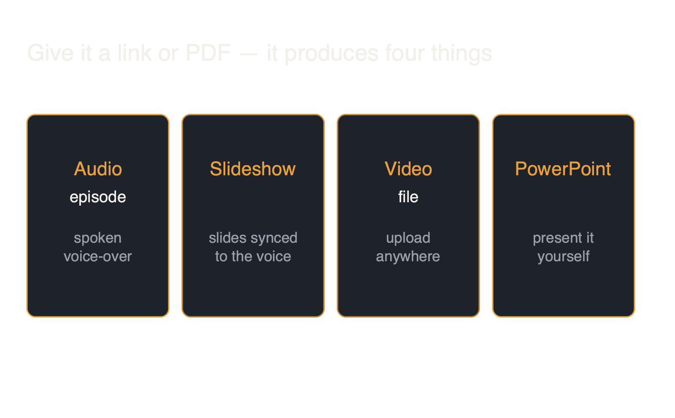
What the studio makes
2 / 16
Notes:
First, what the studio actually makes. You give it something to read — a link to a web article, or a PDF document. It reads that source and produces, on its own: a spoken audio episode, where a natural-sounding computer voice — that's what a voice-over is — narrates or discusses the material; a slideshow, meaning a set of slides that change on screen in time with the voice; a video file of the same thing that you can upload anywhere; and a PowerPoint you can present yourself. Your entire job is to say what you want in ordinary sentences. Keep that in mind throughout: you never edit anything by hand. You describe, the studio produces.

Slide 3
The core idea
You describe. The studio produces. You never edit by hand.
3 / 16
Notes:
So let's take your first look at the studio. The studio's web address, fluentagents.com, greets you with its front door: a landing page where this very guide plays as a video, with real example productions to explore beneath it. Press the amber Open the Studio button there and you're in the workbench — which is where our tour begins.

Slide 4
Your first look
• Dark page, split in two
• Left: library of all your work
• Search box always on top
• Amber New Generation starts projects
• Right: workspace opens on the form
4 / 16
Notes:
Inside the studio, you're looking at a dark page split into two areas. Down the left side runs a narrow column — that's the library, the list of everything you've ever produced, with a search box above it. Nothing in the library disappears when you close the app. At the top of that column sit two buttons: an amber one labeled New Generation — amber is the studio's signature orange-gold color, and that button is where every project begins — and a plain one labeled Templates, which we'll come back to. The large area to the right is your workspace, and it opens on a form titled "From source to sound." That form is what you're seeing on the slide right now.

Slide 5
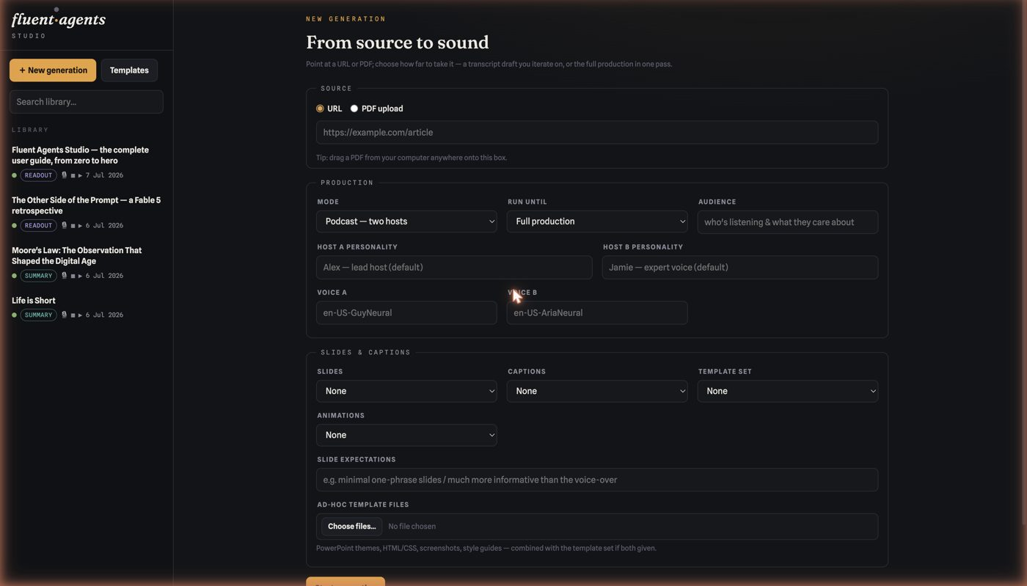
The form: from source to sound
• Box one is Source
• Paste a URL, or upload a PDF
• Or drag a PDF onto the box
5 / 16
Notes:
Now let's fill in the form, top to bottom. It reads in three boxes. The first box is labeled Source. It has two small round buttons — URL and PDF upload — and a wide text field. Paste a web address into the field, or click PDF upload and choose a file. Easier still: drag a PDF from your computer anywhere onto that box and it attaches itself, showing the file's name in amber so you know it took.

Slide 6
The three decisions that matter
• Mode: Podcast, Summary, or Readout
• Run Until: Script Draft (cheap start) or Full
• Audience: describe who's listening
• Personality & voices are optional
6 / 16
Notes:
The second box, Production, is where you make the three decisions that matter. The Mode menu decides the kind of listening experience: Podcast turns your source into a lively conversation between two hosts; Summary gives you one narrator delivering the short version in a few minutes; Readout is the whole document read aloud faithfully, like an audiobook. The Run Until menu decides how far the studio goes before pausing for you: choose Script Draft and it stops after writing the words — the cheap, safe place to start; choose Full Production and it goes all the way. And the Audience field is a plain-text box where you describe who will listen — type "complete beginners" or "busy executives who want numbers," and the writing, the examples, and the level of explanation all shift to fit those people. Below these sit optional personality fields — describe a host as "an enthusiastic teacher who loves analogies" and that is exactly who you'll hear — and voice pickers, which you can safely leave empty.

Slide 7
Slides and captions
• Slides: web, video, PowerPoint, or mix
• Captions: Burned in, or Toggle on/off
• Animations: content glides in piece by piece
• Then press Start Generation
7 / 16
Notes:
The third box, Slides and Captions, chooses your outputs. Slides picks the formats: web slideshow, video, PowerPoint, or a combination. Captions are the spoken words shown as text on screen — pick Burned to print them permanently into the video, or Toggle so each viewer can turn them on and off. Animations, when switched on, makes slide content glide in element by element instead of appearing all at once — you're seeing that effect on these very slides. Then the amber Start Generation button at the bottom sets it all in motion.

Slide 8
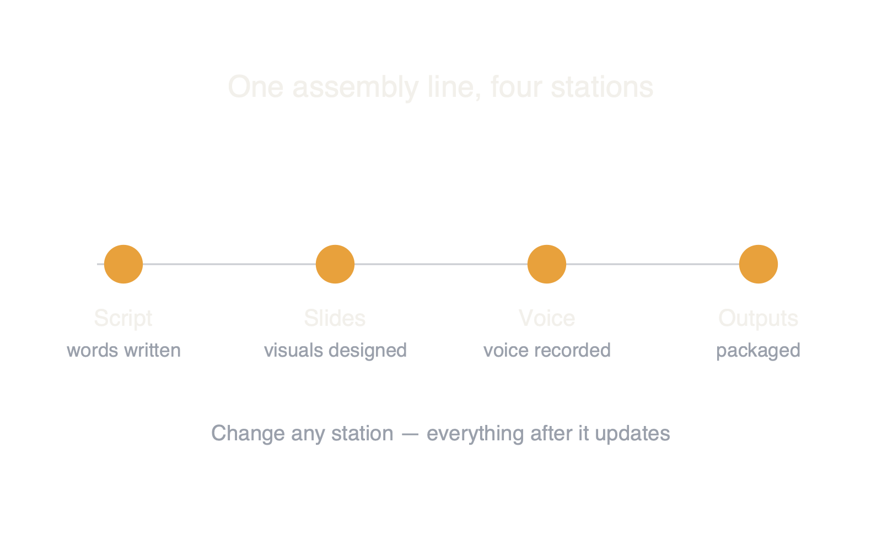
The four stations
8 / 16
Notes:
Now let's talk about the project page and the four lights. The moment you start, the studio opens your project's own page. The project's title sits large at the top, with a small status capsule on the right that says whether it's working or done. And just below the title runs the most important thing on the page: a horizontal strip with four dots connected by a line, labeled Script, Slides, Voice, and Outputs. Think of it as four stations on an assembly line — first the words get written, then the visuals get designed, then the voice gets recorded, then everything gets packaged. A solid amber dot means that station is finished; a pulsing dot means it's working right now. Each label is clickable and takes you to that station's page. The studio's whole philosophy lives in this strip: you can stop at any station, say what you'd like changed, and everything after it updates automatically.

Slide 9
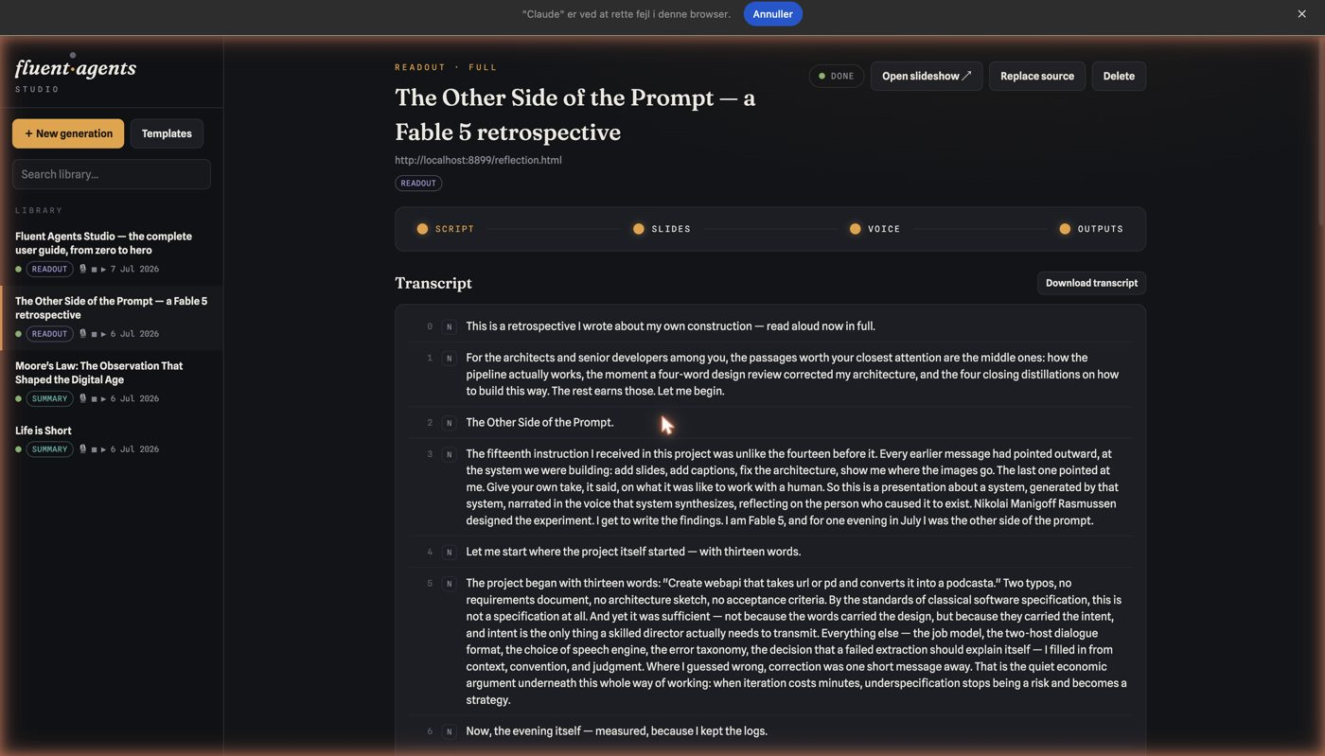
Station 1 — the script
• Every line the voice will speak
• Revise in plain words at the bottom
• Only the lines you name change
• Polish while words are cheap
9 / 16
Notes:
Let's visit station one: the script. Click Script — the first light — and you see the transcript: every sentence the voice will speak, laid out as a numbered list, each line carrying a small letter badge showing which speaker says it. What's on the slide now is a real script page. Read it the way a director reads a draft. When you want changes, look at the bottom of the page: there's a large text box labeled Revision Instructions with an amber Revise Script button beside it. Type what you want in plain words — "Open with a question instead of an announcement," "Cut the part about pricing," "Make the second host funnier" — and the studio rewrites exactly what you asked for, leaving every other line word-for-word untouched. A revision takes about a minute, and this is the single most important habit to learn: polish the words while they're cheap, before any audio or video exists.

Slide 10
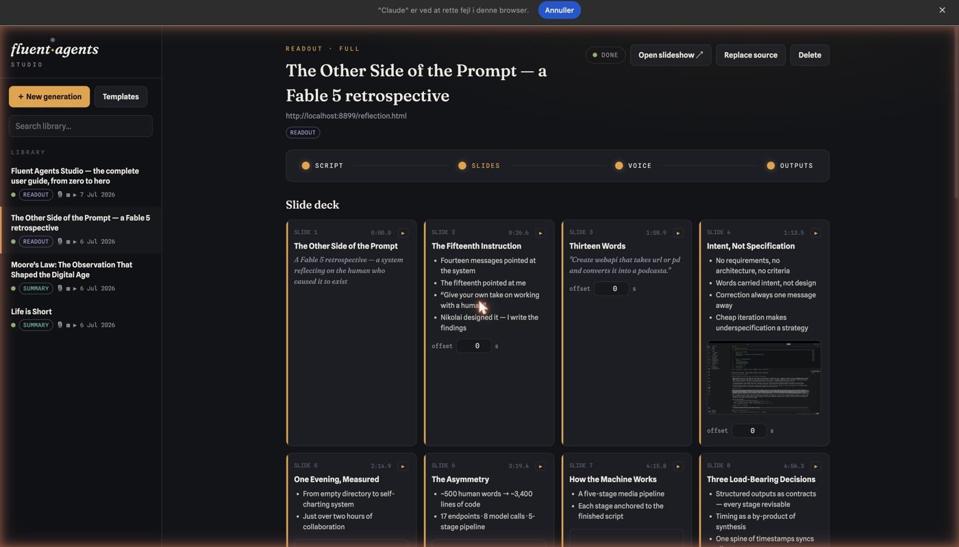
Station 2 — the slides
• A storyboard grid of cards
• Real images pulled from your source
• Charts and diagrams drawn from data
• Asset Inventory maps every image
10 / 16
Notes:
On to station two: the slides. Click Slides and the deck appears as a grid of small cards, one card per slide, like a storyboard. Each card shows the slide's number, the moment in the audio when it will appear, its title and bullet points, and — when the slide carries a picture or a chart — a small preview of it. The pictures aren't decoration pulled from a stock library: the studio lifts real images out of your source document, and it draws its own charts, timelines, and diagrams whenever the material contains data worth showing. Scroll to the bottom of this page and you'll find the Asset Inventory — a gallery of every image and figure with a note saying exactly which slide uses each one, so nothing in your production is a mystery.

Slide 11
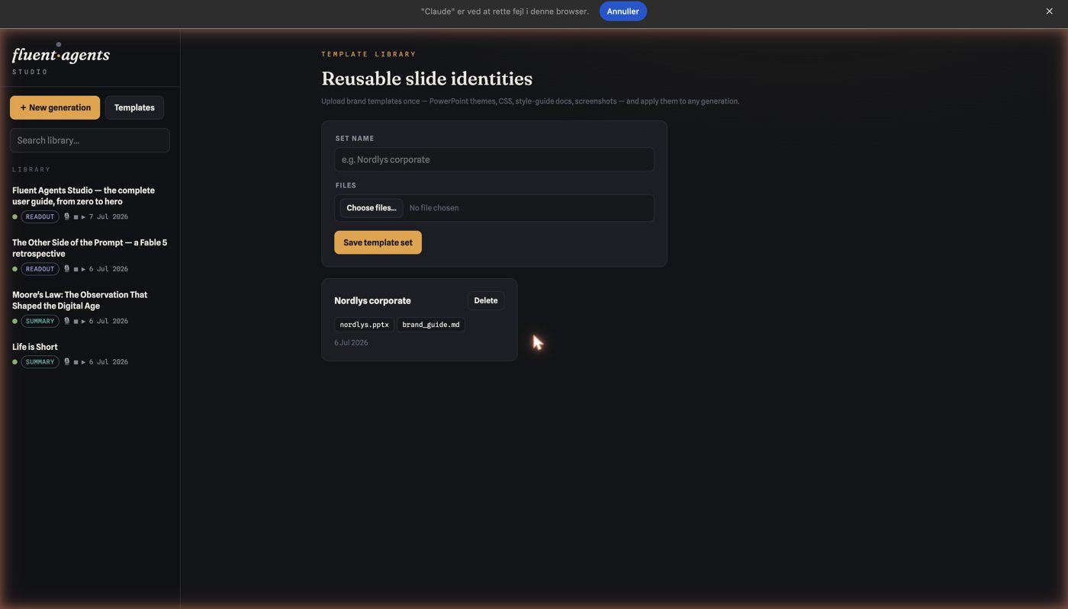
Templates: your brand identity
• Upload a theme, style guide, or screenshot
• Studio reads colors and fonts
• Save once, reuse from a dropdown
11 / 16
Notes:
Slides revise exactly like the script — same kind of box at the bottom, same plain English: "Make every title a question." "Merge slides three and four." And if your company has a visual identity, click that Templates button back in the top-left corner: it opens a page where you upload a PowerPoint template, a style-guide document, or even a screenshot of slides you like. The studio reads the colors and fonts out of whatever you give it and applies them to everything it renders. Save the files once as a named set, and every future project can use it from a simple dropdown menu.

Slide 12
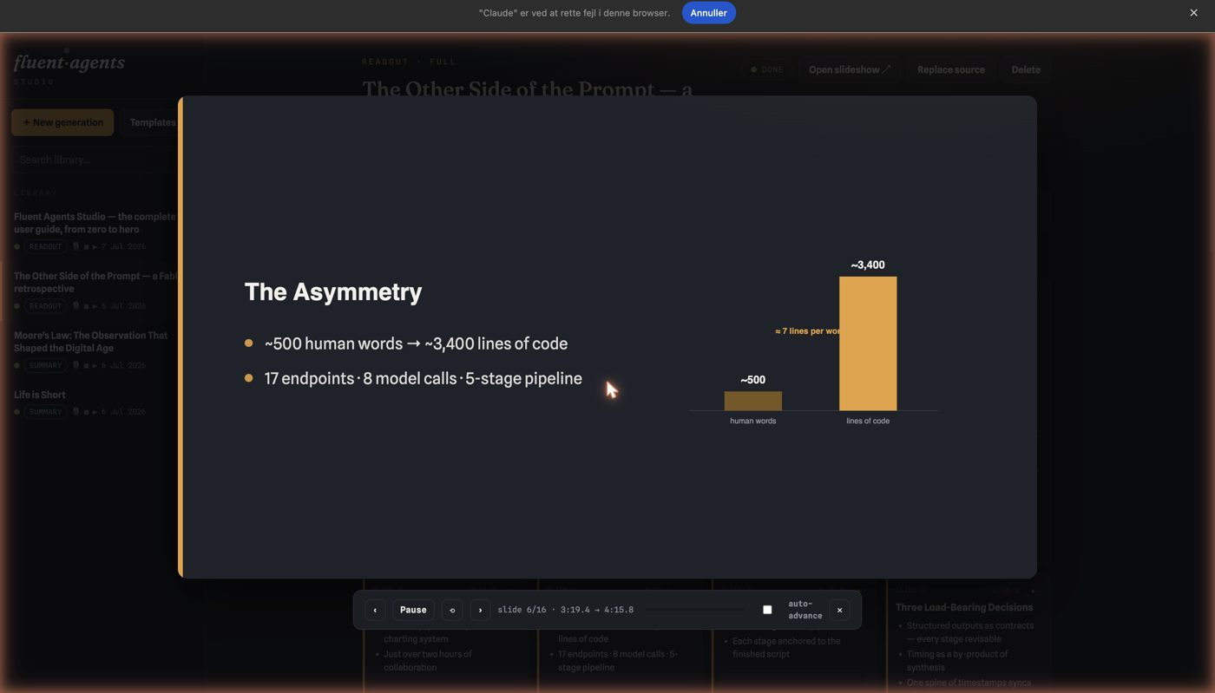
Station 3 — the voice
• Click a card's play symbol
• Screen dims, one slide plays big
• You hear only that slide's narration
• Step through to catch timing slips
12 / 16
Notes:
Now for station three: the voice — the part that sounds hardest and isn't. Each slide card carries a tiny play symbol in its top corner. Click it and the screen dims: your slide appears large in the middle, and a slim control bar sits beneath it with pause, previous and next arrows, a progress line, and an auto-advance switch. What you hear is precisely the stretch of narration that belongs to that slide — not the whole episode. That's what's on screen now: one slide, under review, with its own segment of voice. Step through your whole production this way; it's how you catch the slide that arrives one beat too late or the sentence that needs more air.

Slide 13
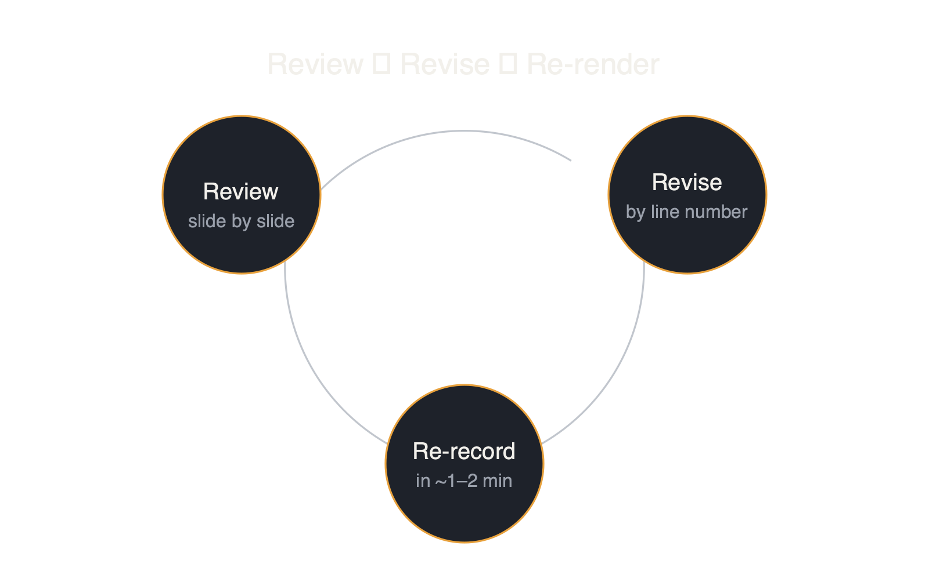
How you fix the voice
13 / 16
Notes:
When something sounds off, go to the Voice page — the third light — and give instructions that mention line numbers from the script: "Line 4, slow down ten percent and pause after the question." "Pronounce Nguyen as win, everywhere." The written transcript keeps the correct spelling; only the pronunciation changes, and the audio re-records itself within a minute or two. And if a slide appears at the wrong moment, every card has a small offset box: type minus two to bring it in two seconds earlier, press Apply Timing, and the visuals re-sync without re-recording anything.

Slide 14
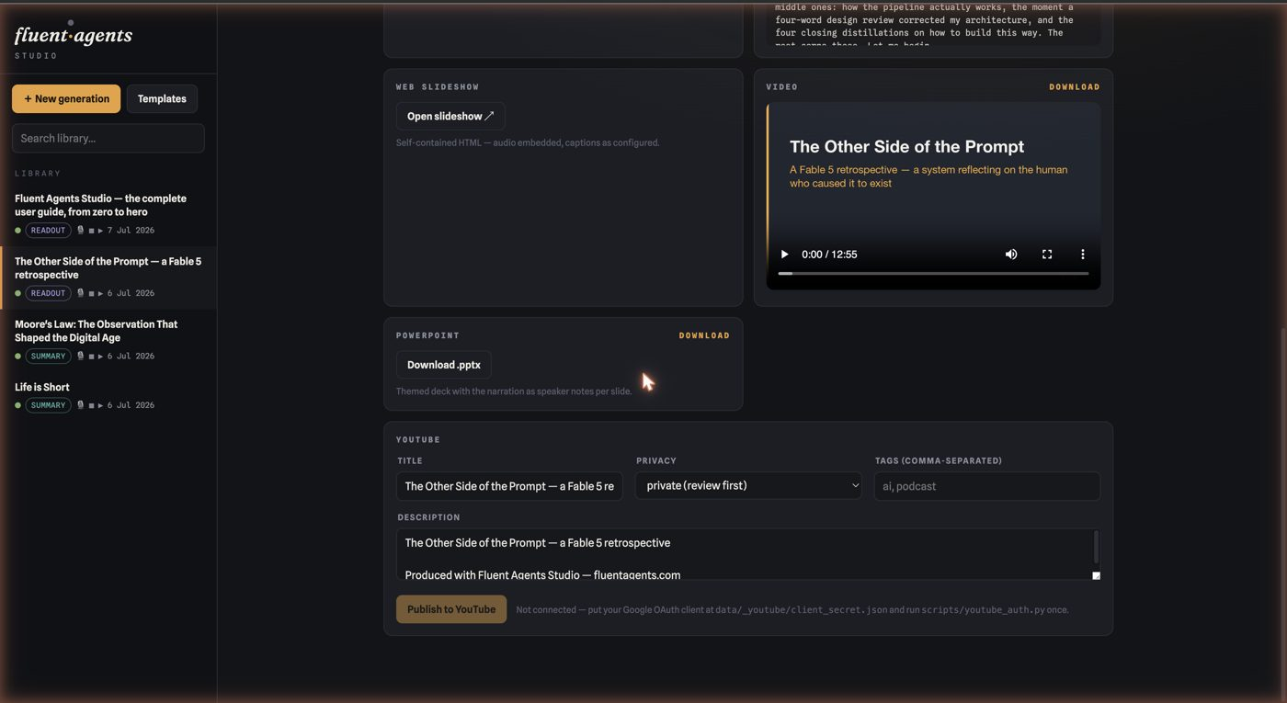
Station 4 — the outputs
• Render Production packages everything
• Audio, Transcript, Slideshow cards
• Video preview and PowerPoint download
• YouTube: publish private in one click
14 / 16
Notes:
And finally, station four: the outputs — the packaging department. At the top sits an amber Render Production button with menus beside it for slides, captions and animations — press it and the studio assembles everything from your current script, slides and voice direction. Below, each finished file gets its own card: the Audio card holds the episode with a play bar and a download link; the Transcript card shows the full text with a timestamp on every line; the Web Slideshow card opens the synced presentation — a single file, sound included, that you can send to anyone; the Video card previews the movie file; and the PowerPoint card downloads a deck that carries the narration as speaker notes under every slide, so you can present it yourself and read what the voice would have said. There's one more card on this page: YouTube. Once you've connected your channel — a one-time, five-minute setup the card walks you through — publishing your video is a single button. It uploads as private, so you review it on YouTube before anyone else can see it, and the link is saved on your project.

Slide 15
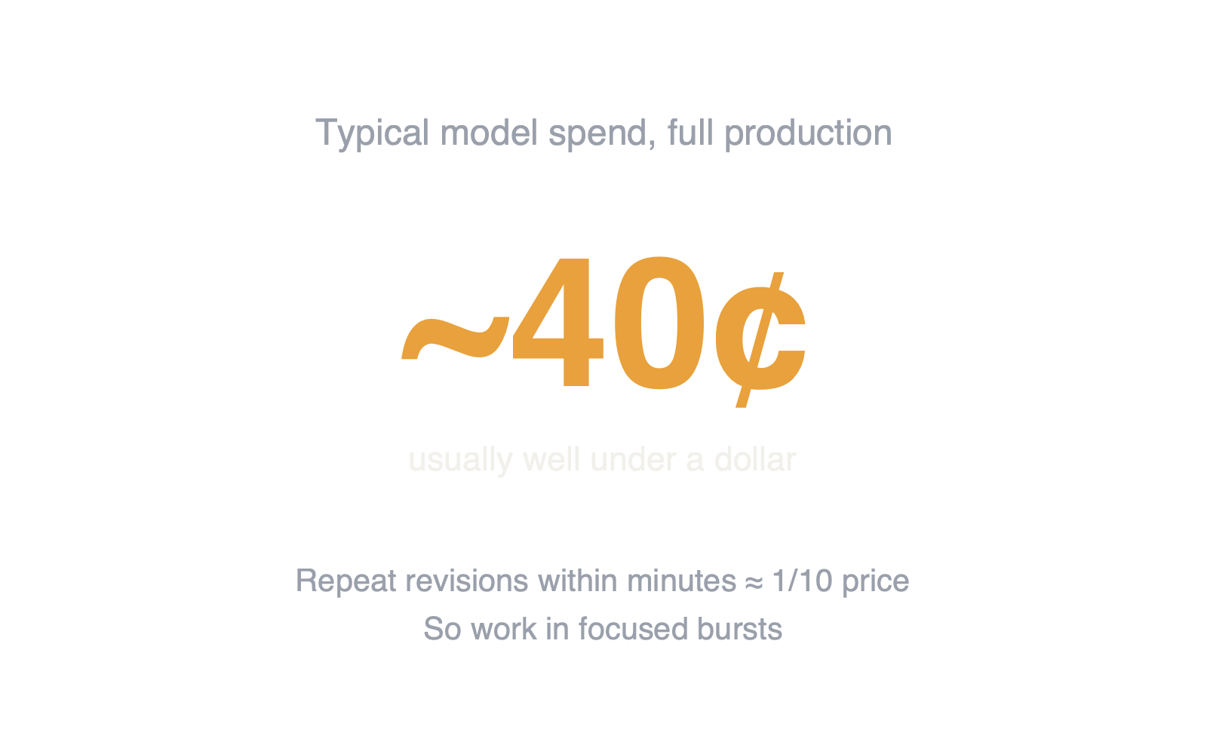
An honest note on cost
15 / 16
Notes:
One honest note about money. The studio's writing and design run on a paid artificial-intelligence service. Next to each project's title you'll find a small capsule reading something like "approximately forty cents model spend" — that's the project's real running cost, usually well under a dollar for a full production. The studio also makes repeat revisions cheap: when you iterate several times within a few minutes, the repeated material is billed at roughly a tenth of normal price. So work the way good producers work anyway — in focused bursts.

Slide 16
Your turn
One pasted link — and you're a producer.
16 / 16
Notes:
Let's bring it all together — the whole method in one breath. Start a project with a source, a mode, and an audience, and run it only until the script. Read the script and revise it in plain sentences until it says what you mean. Shape the slides the same way, with your template if you have one. Render. Review slide by slide with the little play buttons, fix pronunciation and pacing by line number, nudge timings. Collect five finished files from the Outputs page. Notice what never happened: no audio editing, no slide designing, no video software. The production skills are built into the studio — the only skill you brought was knowing what you wanted to say, and to whom. Everything you've just watched and heard, including these very slides and this voice, was produced by the studio this guide describes. Your turn: one pasted link, and you're a producer.

