Slide 1
Of Battleships and Battlecruisers
A data driven analysis

Slide 2
Introduction
Some topics can start arguments in every niche
Such as Battlecruisers and Battlecruisers
A few weeks ago, I decided I could solve this once and for all
  Using a bit of C# and Regex
  And the arrogance of a physicist looking at a field they don’t know about

Slide 3
Ok, but what is a battleship/battlecruiser
A big capital ship, with big guns, a lot of armour
A battlecruiser sacrifices armour for speed
  Wins race with battleship, kills cruisers
A battleship does not
  wins fight with battlecruiser, can’t catch cruisers

Slide 4
Is HMS Hood a Battlecruiser or Fast Battleship
One of the most beautiful ships ever built
The fastest, largest warship of her day
Officially a battle-cruiser
But the Yankees considered her equal to some of their battleships

Slide 5
Did the Japanese turn the Kongo Battlecruiser into a fast battleship
The Japanese took a ship everyone agreed was a battlecruiser
Slapped more armour, better engines in, and called it a fast battleship
Is that even legal!?

Slide 6
USS Iowa (and Class)
Officially a fast battleship
But not as heavily armed/armoured for the sake of speed

Slide 7
Dunkerque and Richelieu class
French fast battleship, also very beautiful
Fast, but undergunned (13’) and underarmoured

Slide 8
German Scharnhorst and Gneissenau
Hillariously undergunned with 11’ guns

Slide 9
American … ship … Alaska
What even is that thing, seriously
A cruiser with 12 inch guns

Slide 10
What definition do other people use
Battleships are capital ships armoured against own guns, battlecruisers are not
Not really good, as many battlecruisers are armoured against own guns, and some battleships are not. Check out Drachinifels video on hood and Iowa

Slide 11
Drachinifel’s definition
A battlecruiser is what you get if you
  Take a contemporary battleship, make it 4 to 5 knots faster
  Remove some firepower (fewer or smaller) and armour
So if the USS Montana was build, Iowa would be a battlecruiser
Hood is a fast battleship, because no contemporary battleship exists, if the G3s were built Hood would be a cruiser
I don’t like the dependence on other ships

Slide 12
Dr Alex Clarke’s definition
Look at the internal structure, the armour coverage, bulkheads, not just the thickness
Battleships have a “honeycomb” structure, battlecruisers have large open engine spaces
There is a spectrum, Battle Cruisers → Battlecruisers → fast battleship → battleships
I like this, only, I don’t like having to look at the drawings

Slide 13
My definition
If it is armour coverage and internal bulkheads, versus machinery, surely we can just look at shaft horsepower/displacement
My idea:
  Download shaft horsepower and displacement for all battleships and battlecruisers on Wikipedia
  Plot everything, look for a good definition
  spoiler, there is none

Slide 14
I actually asked Dr Alex if horsepower per tonne was a good dividing line in a youtube comment, and he said:
Yes, this is a good idea, with no problems or pitfalls at all, this is definitely, actually what he wrote, please don’t check this against his reply on screen
(Text on screen Ok in all seriousness, he predicted it wouldn’t work, and spoiler: it doesn’t but it is fun anyway)

Slide 15
Wikipedia API
Wikipedia is famously unreliable, but easy to access, and has articles for every ship
Show wiki list, and click Arpad, This is human readable, but there are too many for me to read.
As in 315 battleships, and that is before we get to the cruisers
Wikipedia has a “consistent” api, (show it), if you edit wikipedia (show that), this is what you see
I will download this, find this list, download every ship, find the infobox, and find the displacement, and the shaft horsepower for all

Slide 16
Ok, but how do we download Wikipedia
Downloading Wikipedia is easy, show C# code.
Yep, I used AI to scaffold it, but improved it
So, this is the url you need to use to get the page, just insert the page title here…
Then you get a JSON response which contains all pages (in practice only one)
Ok, now we have the wikitext as one giant string, (flip back to page) how do we get the list of ships

Slide 17
Regex magic
We know what a line in the table looks like, and we can use a regex, a regular expression, which is really an advanced search and replace function
And here it is (show code) scroll, this is a perfectly normal regex, which searches for ships in this list
Yeah, I need to explain this

Slide 18
Explanation is in text document
Go through explanation in text document on the whiteboard
We can use the name of the ship, including the disambiguation, to find the Wikipedia article. But I am going to skip over that
We need disambiguation because people use the same names A LOT
Suffice it to say, show Ship = new Ship(…), we can make a list of ships, and each ship can download its own wikipedia page (show download command)

Slide 19
Each ship downloads own data
Show ship download code, this is the same as we saw before, we can get the entire wikipedia text for this ship.
Oh yeah, sometimes the names are a bit… inconsistent... thats why I try two different names from the same ship
There are still some cases where I downloaded the wrong ship with the same name, I had to manually delete them

Slide 20
The infobox
The Wikipedia infobox for technical stats is easy to find. It looks like this (show for arpad)
It starts with Infobox Ship Characteristics, and inside there are a bunch of information.
I want to find the displacement, the shaft horsepower, and I would also like the speed
conveniently that is the only thing measured in tonnes, horsepower or kilowatt, and knots
And Wikipedia wants all that to be inside a “convert” template

Slide 21
The annoying convert statement
So, in theory, we just want to search for anything inside a convert statement.
Let us just look at the power
We can do the same to get speed and displacement
Alas, power can both be shaft horsepower, or indicated horsepower.
The former is after there has been losses in the machinery. I am just ASSUMING that shaft = 90% indicated before 1904, then 95% (bc. turbines)
Displacement is harder

Slide 22
Displacement is a lie
What is the displacement of the ship?
Is it the displacement of the empty hull with nothing in it?
Is it the displacement when maximally loaded with people, fuel, water, shells, ammunition and all the panoply of war?
Or just loaded to some “normal” operational limit?
Or is it how much it “normally” weighs, minus reserve feed-water for the steam boilers for some reason?
The answer is yes… well apart from the empty case, all these are measures of displacement.

Slide 23
Normal, Standard, and deep displacement
For most ships, Wikipedia lists their “normal” displacement, for some it lists “deep-load”, for some it lists “standard”
Standard displacement is a weird category created for the Washington naval treaty, it is normal minus boiler feed water
Essentially, the imperial powers France and britain didn’t want to count feed water, because they need more for cruising around the empire

Slide 24
Finding displacement
Sometimes, Wikipedia only lists a single type of displacement, sometimes it lists more.
I can test which displacement is which, by searching for words like “standard, treaty, normal, deep, full” and then I simply save as many displacements for the same ship
Then, every time a ship has more than one, I save the ratio betwixt them on a national basis (Show Vanguard example)
Then I can find the average conversion ratio for each nation, and hopefully convert everything to normal displacement

Slide 25
There are still problems
Alas, Wikipedia is written by humans, and humans make mistakes
Sometimes humans do not use the correct format, show King George the V, here the humans just wrote t in plain text, and did not write if it is standard, normal, or deep.
And sometimes my code makes mistake. Like how it read the article for the 1914 dreadnought Imperator Alexandre III, instead of the 1904 pre-dreadnought of the same name
So I have had to manually go through the data and correct it, delete wrong information, and insert missing information
And sometimes wikipedia is just plain lying
Still, it is better than manually having to write everything
Oh and New Jersey has 4 50000 horsepower boilers ...

Slide 26
Battlecruisers
I just manually wrote down the data for every battlecruiser on Wikipedia, there are not that many anyway
Now what did I get … well
So, now I have all the normal displacements, speed, and shaft horsepower of every battleship and battlecruiser ever built. Lets plot this thing!

Slide 27
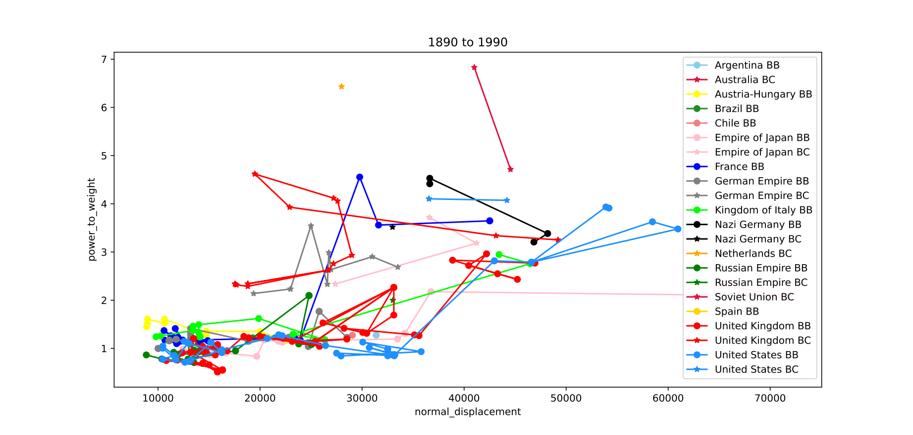
This is our finished data… It is horrible!

Slide 28
Let’s start from the beginning
Yeah, that is not super clear. After some playing around, I believe

Slide 29
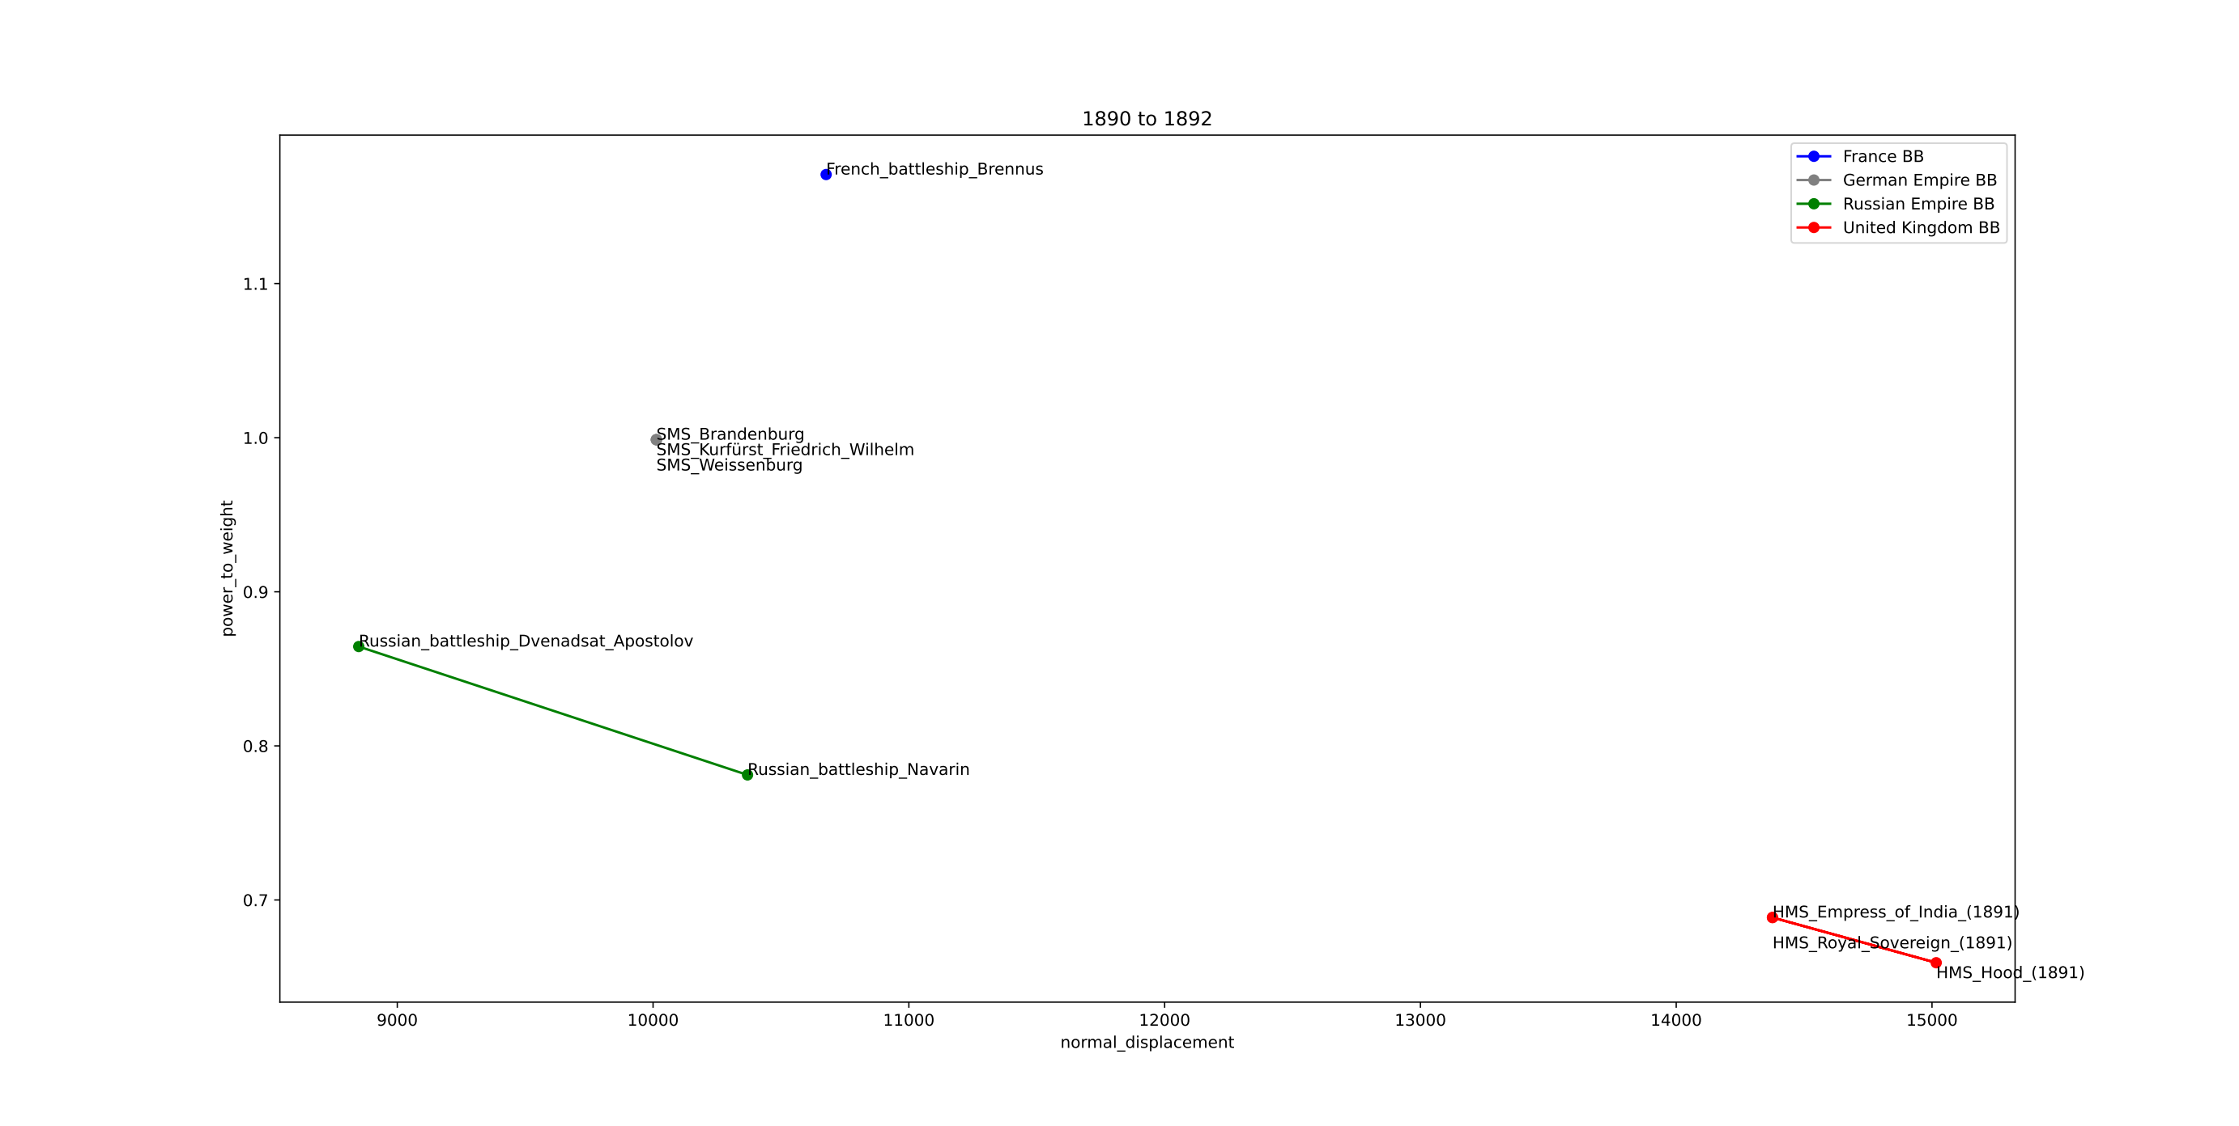

Slide 30
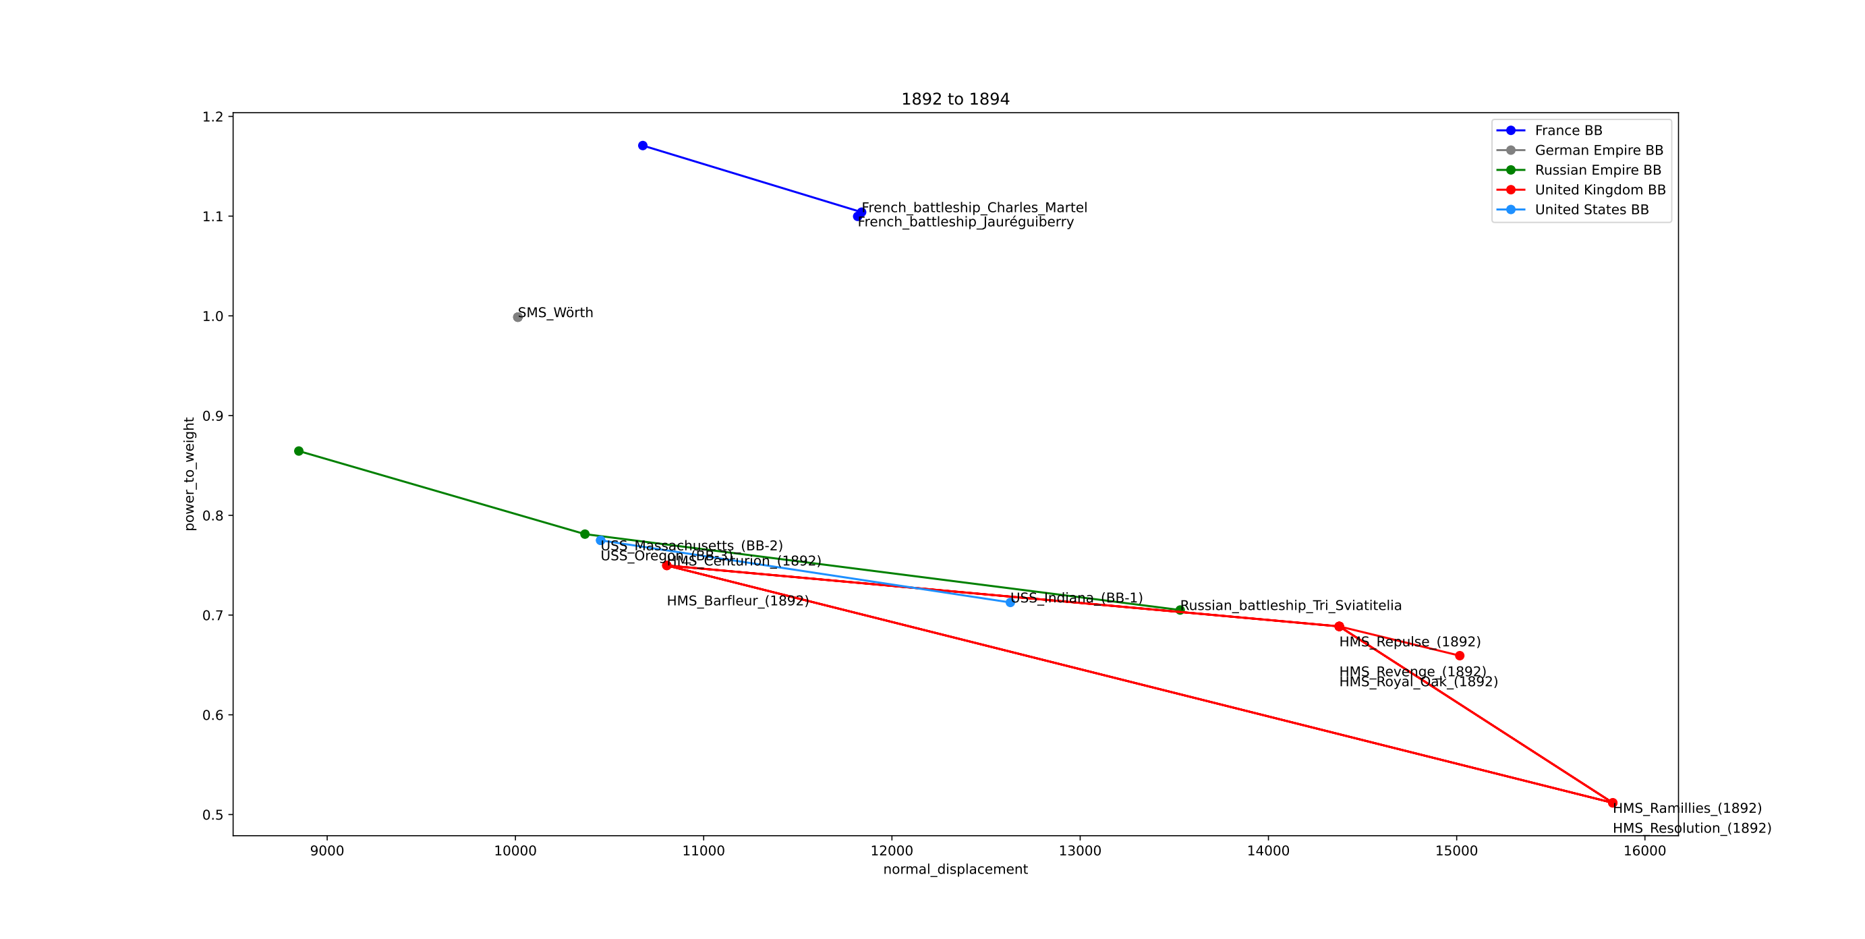

Slide 31
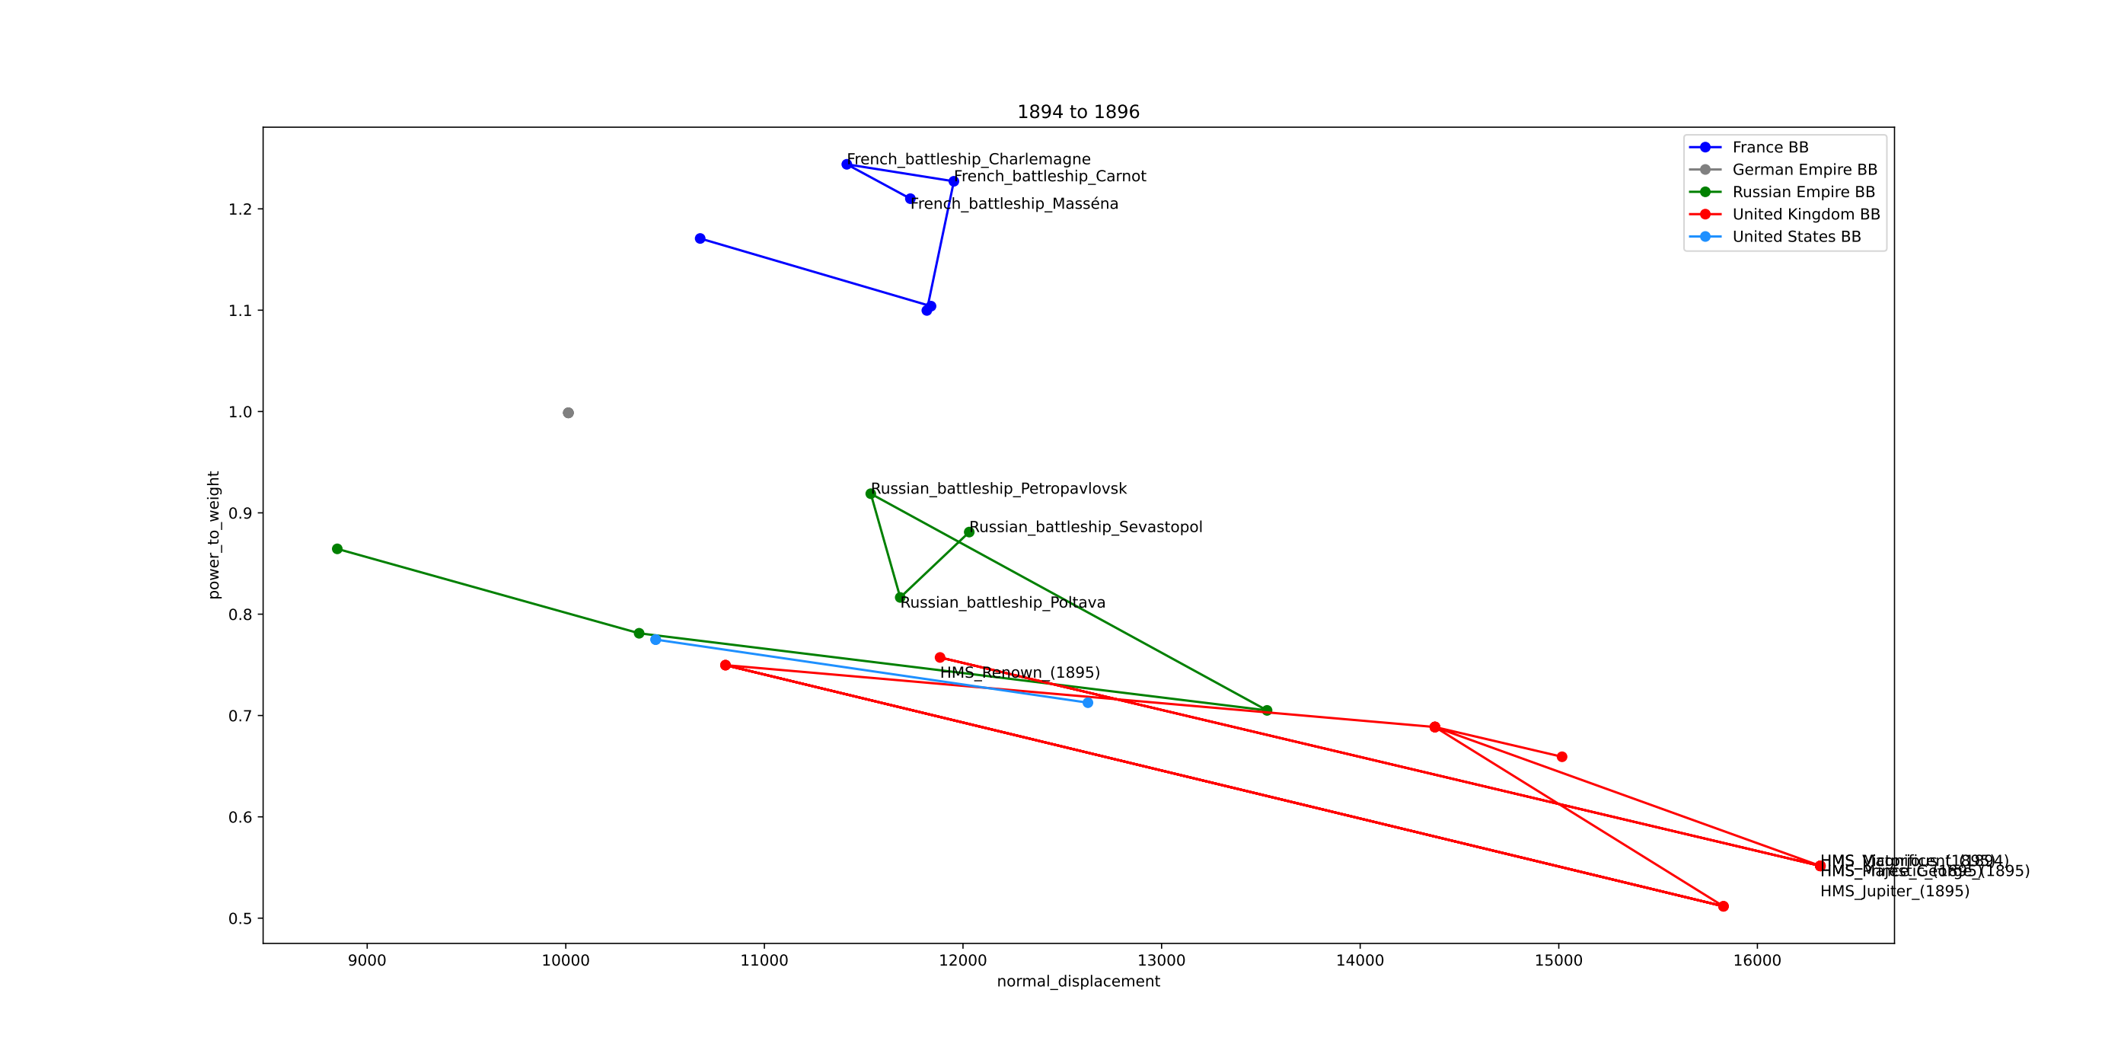

Slide 32
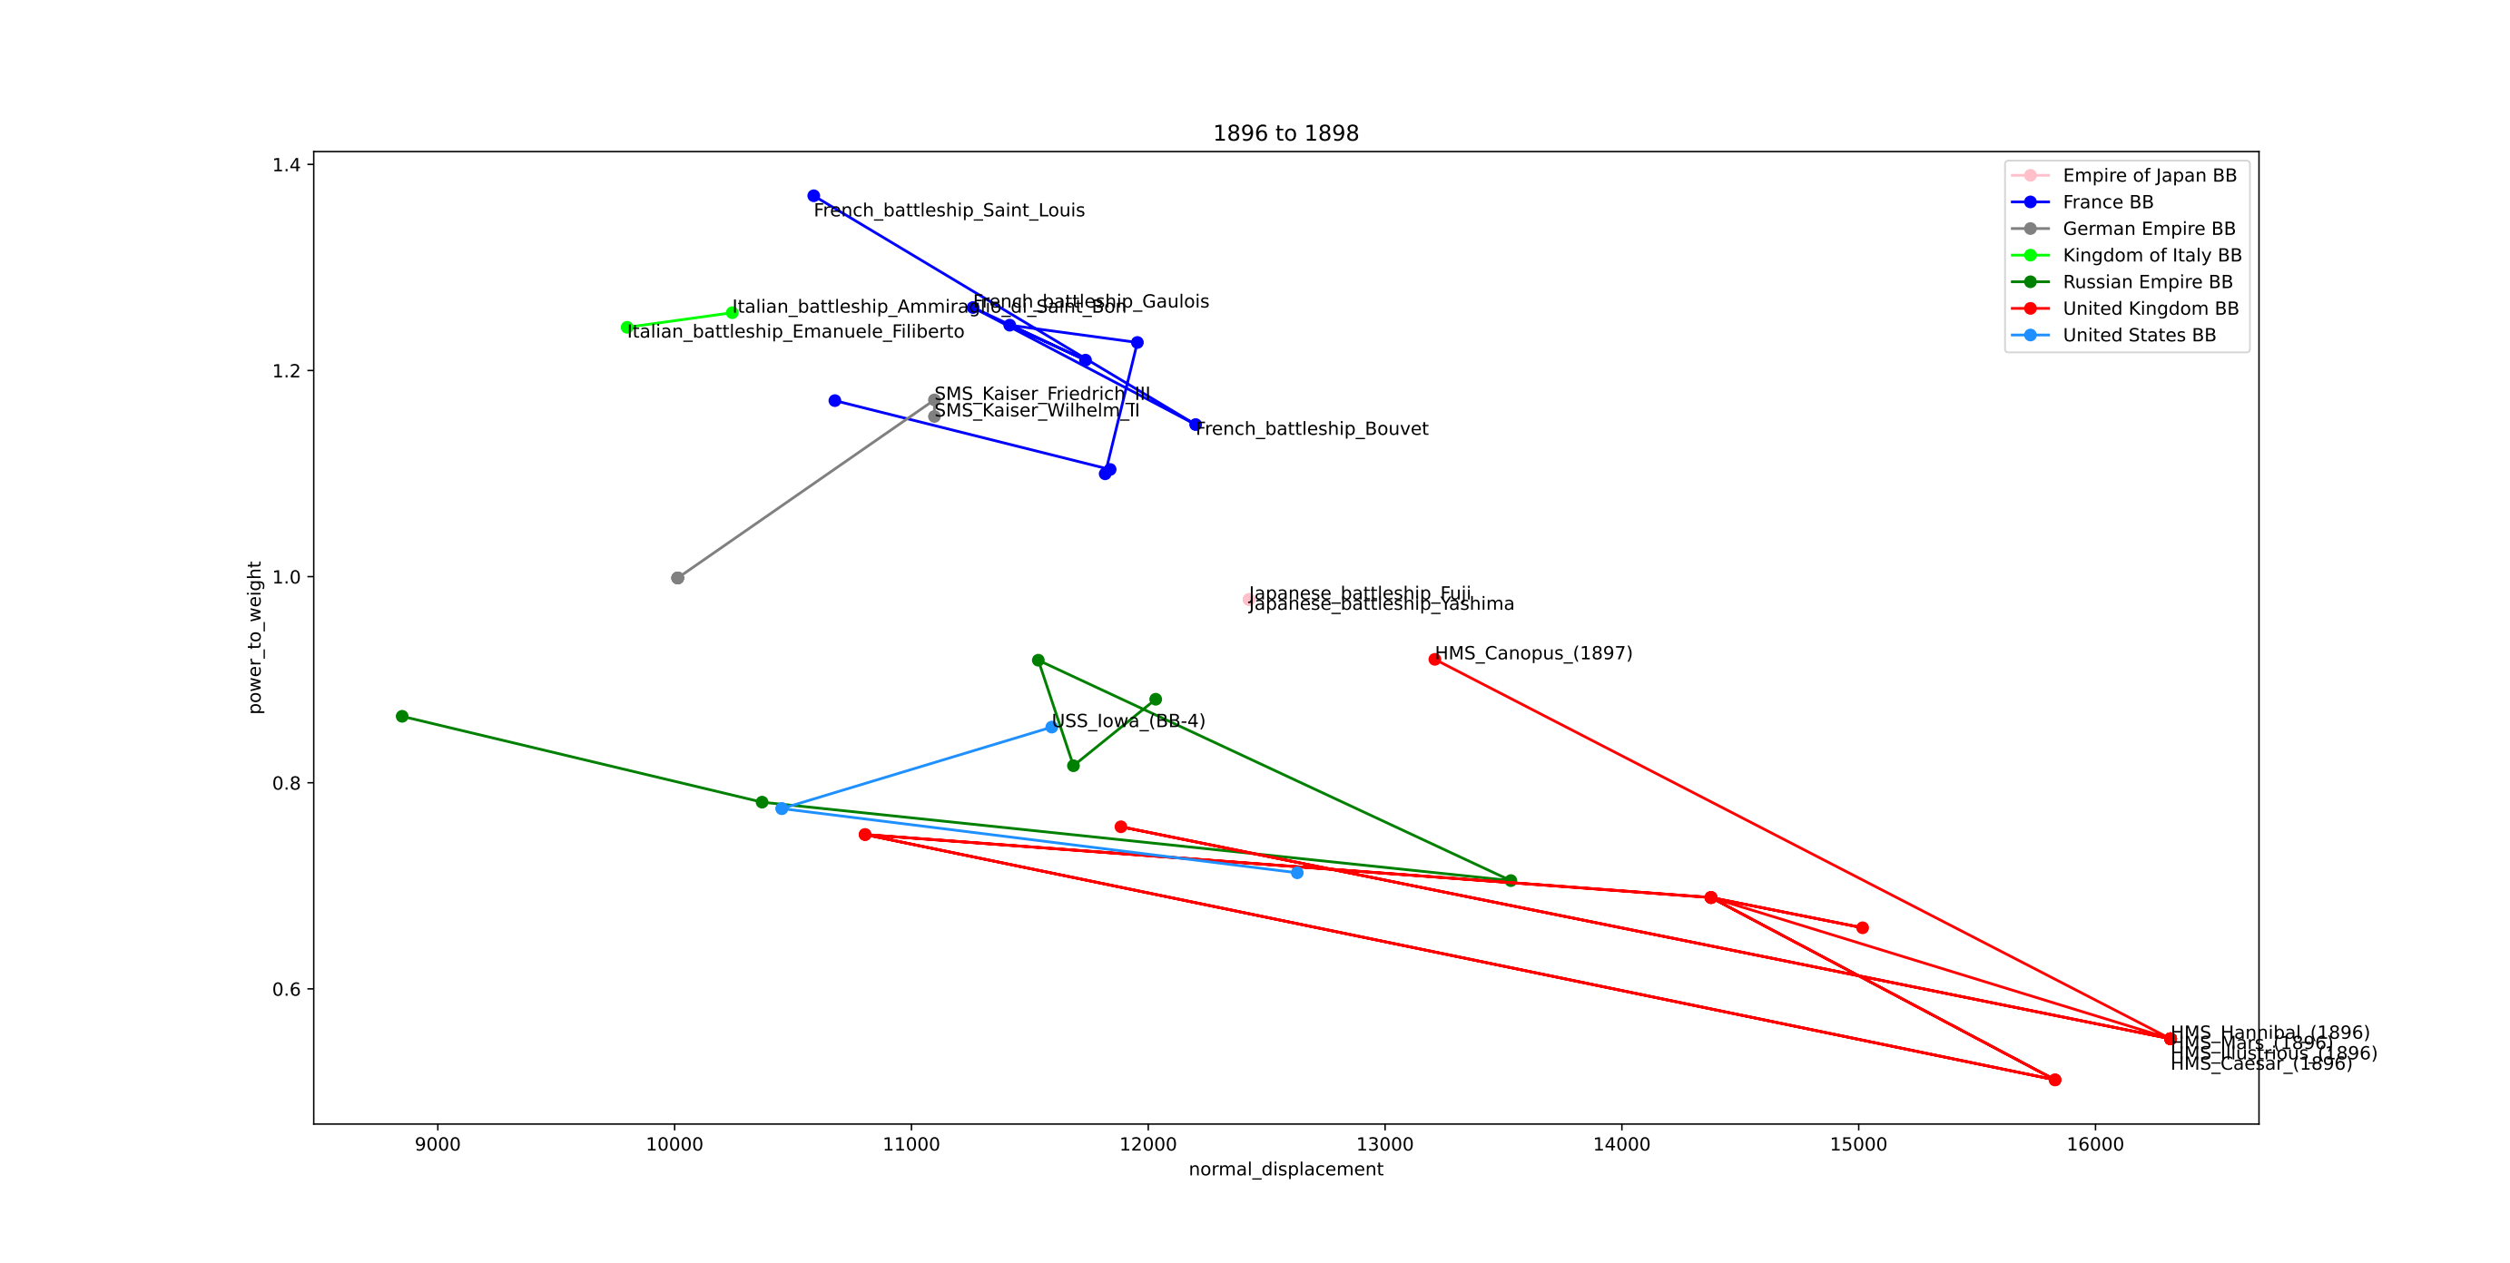

Slide 33
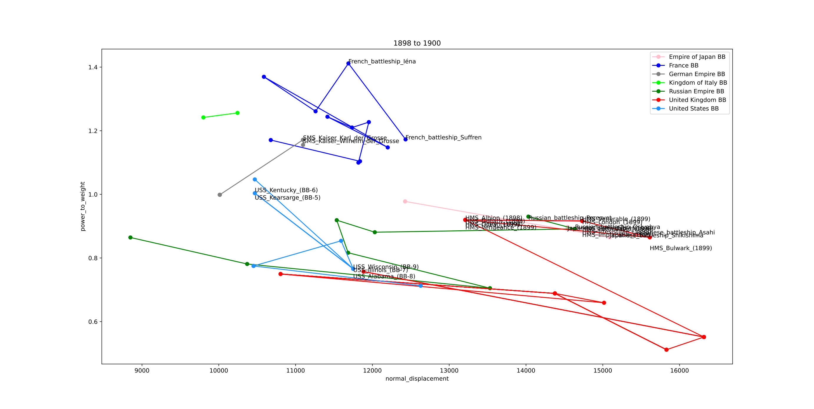

Slide 34
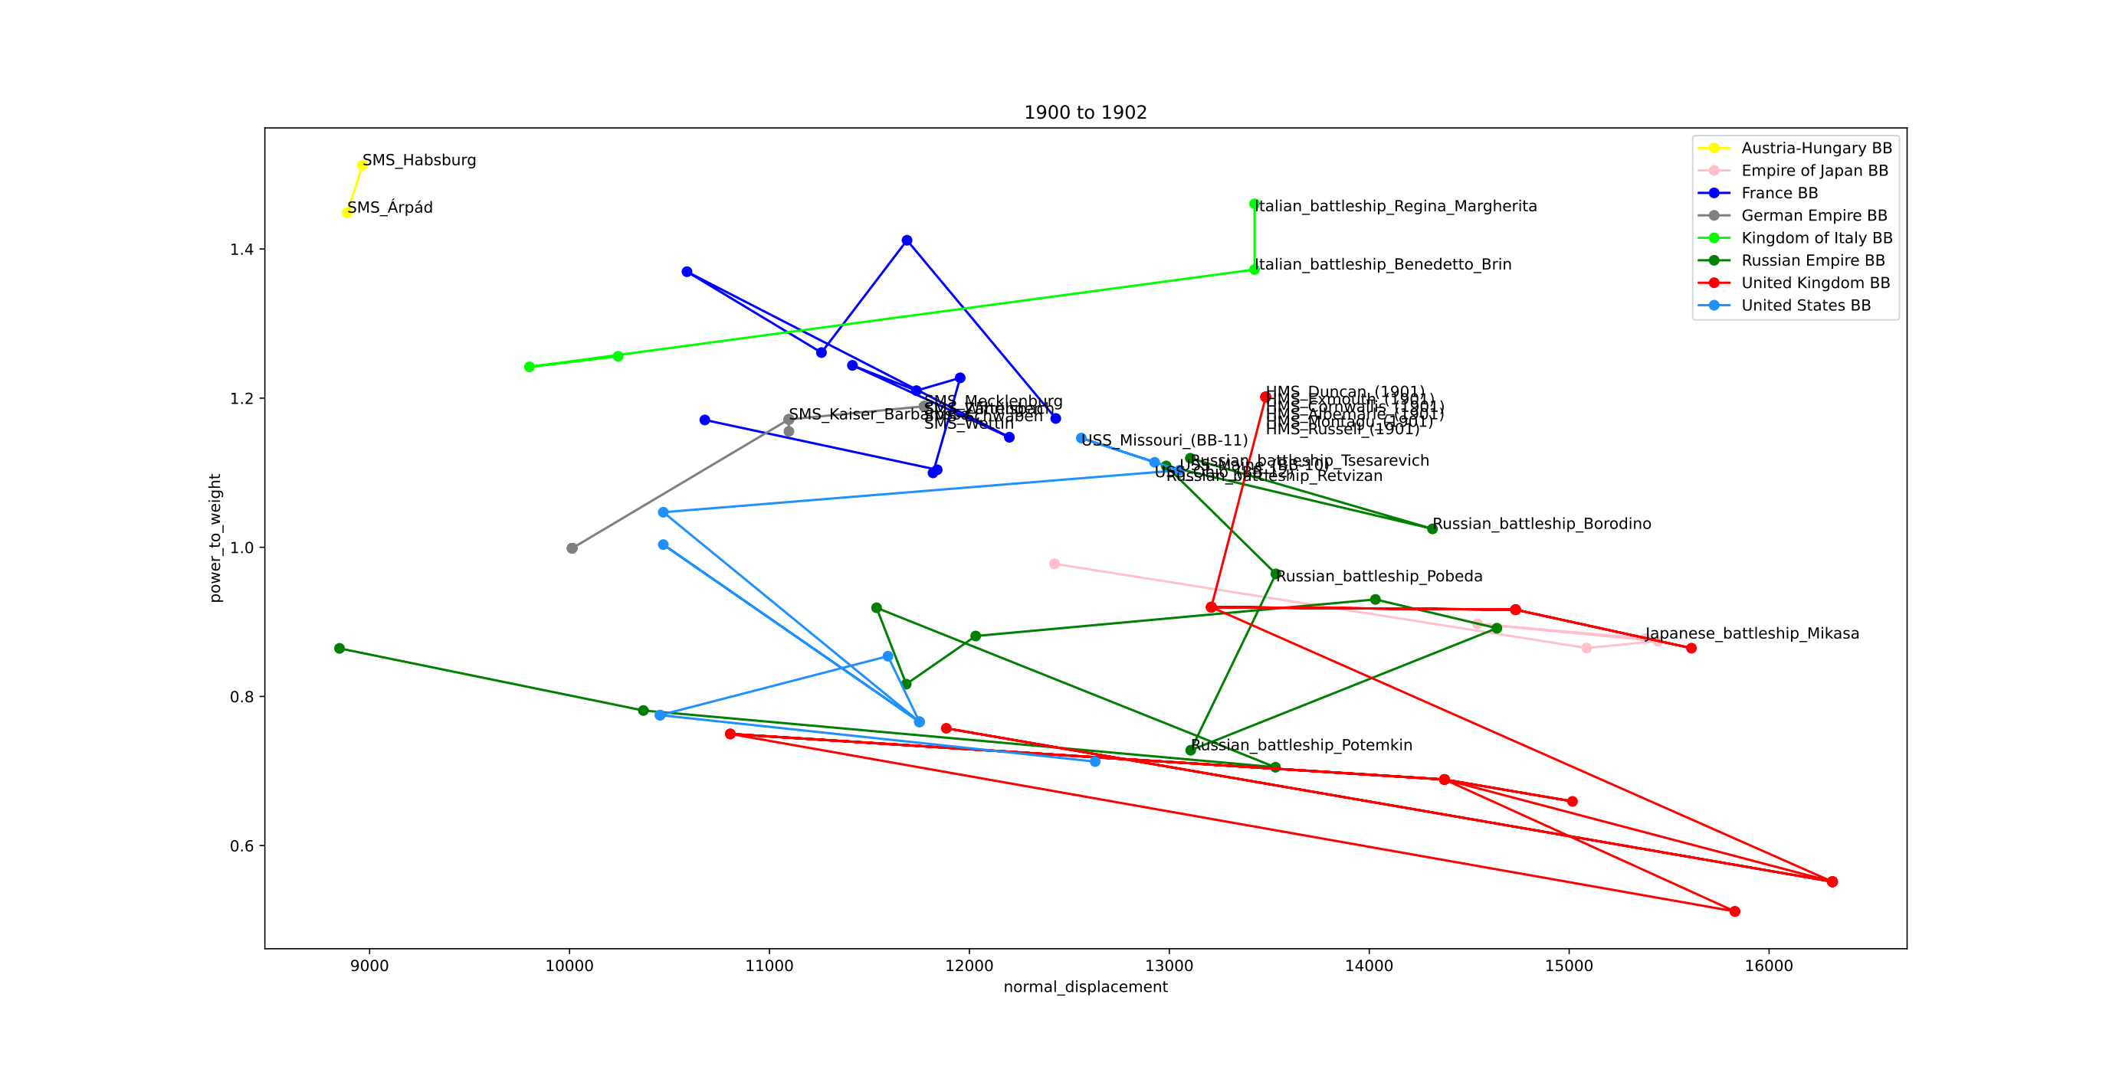

Slide 35
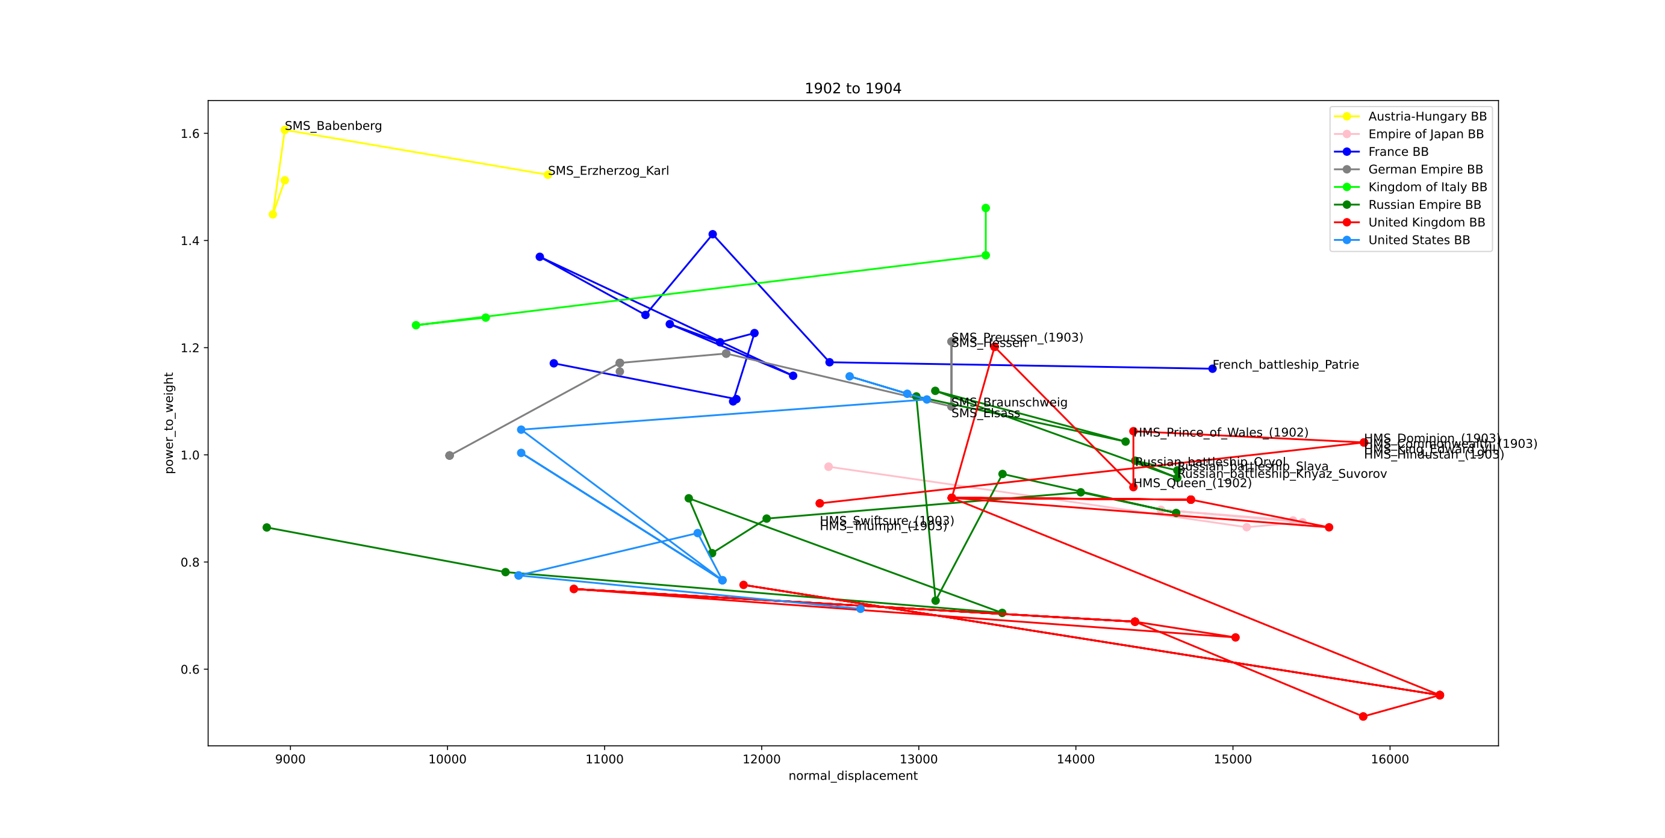

Slide 36
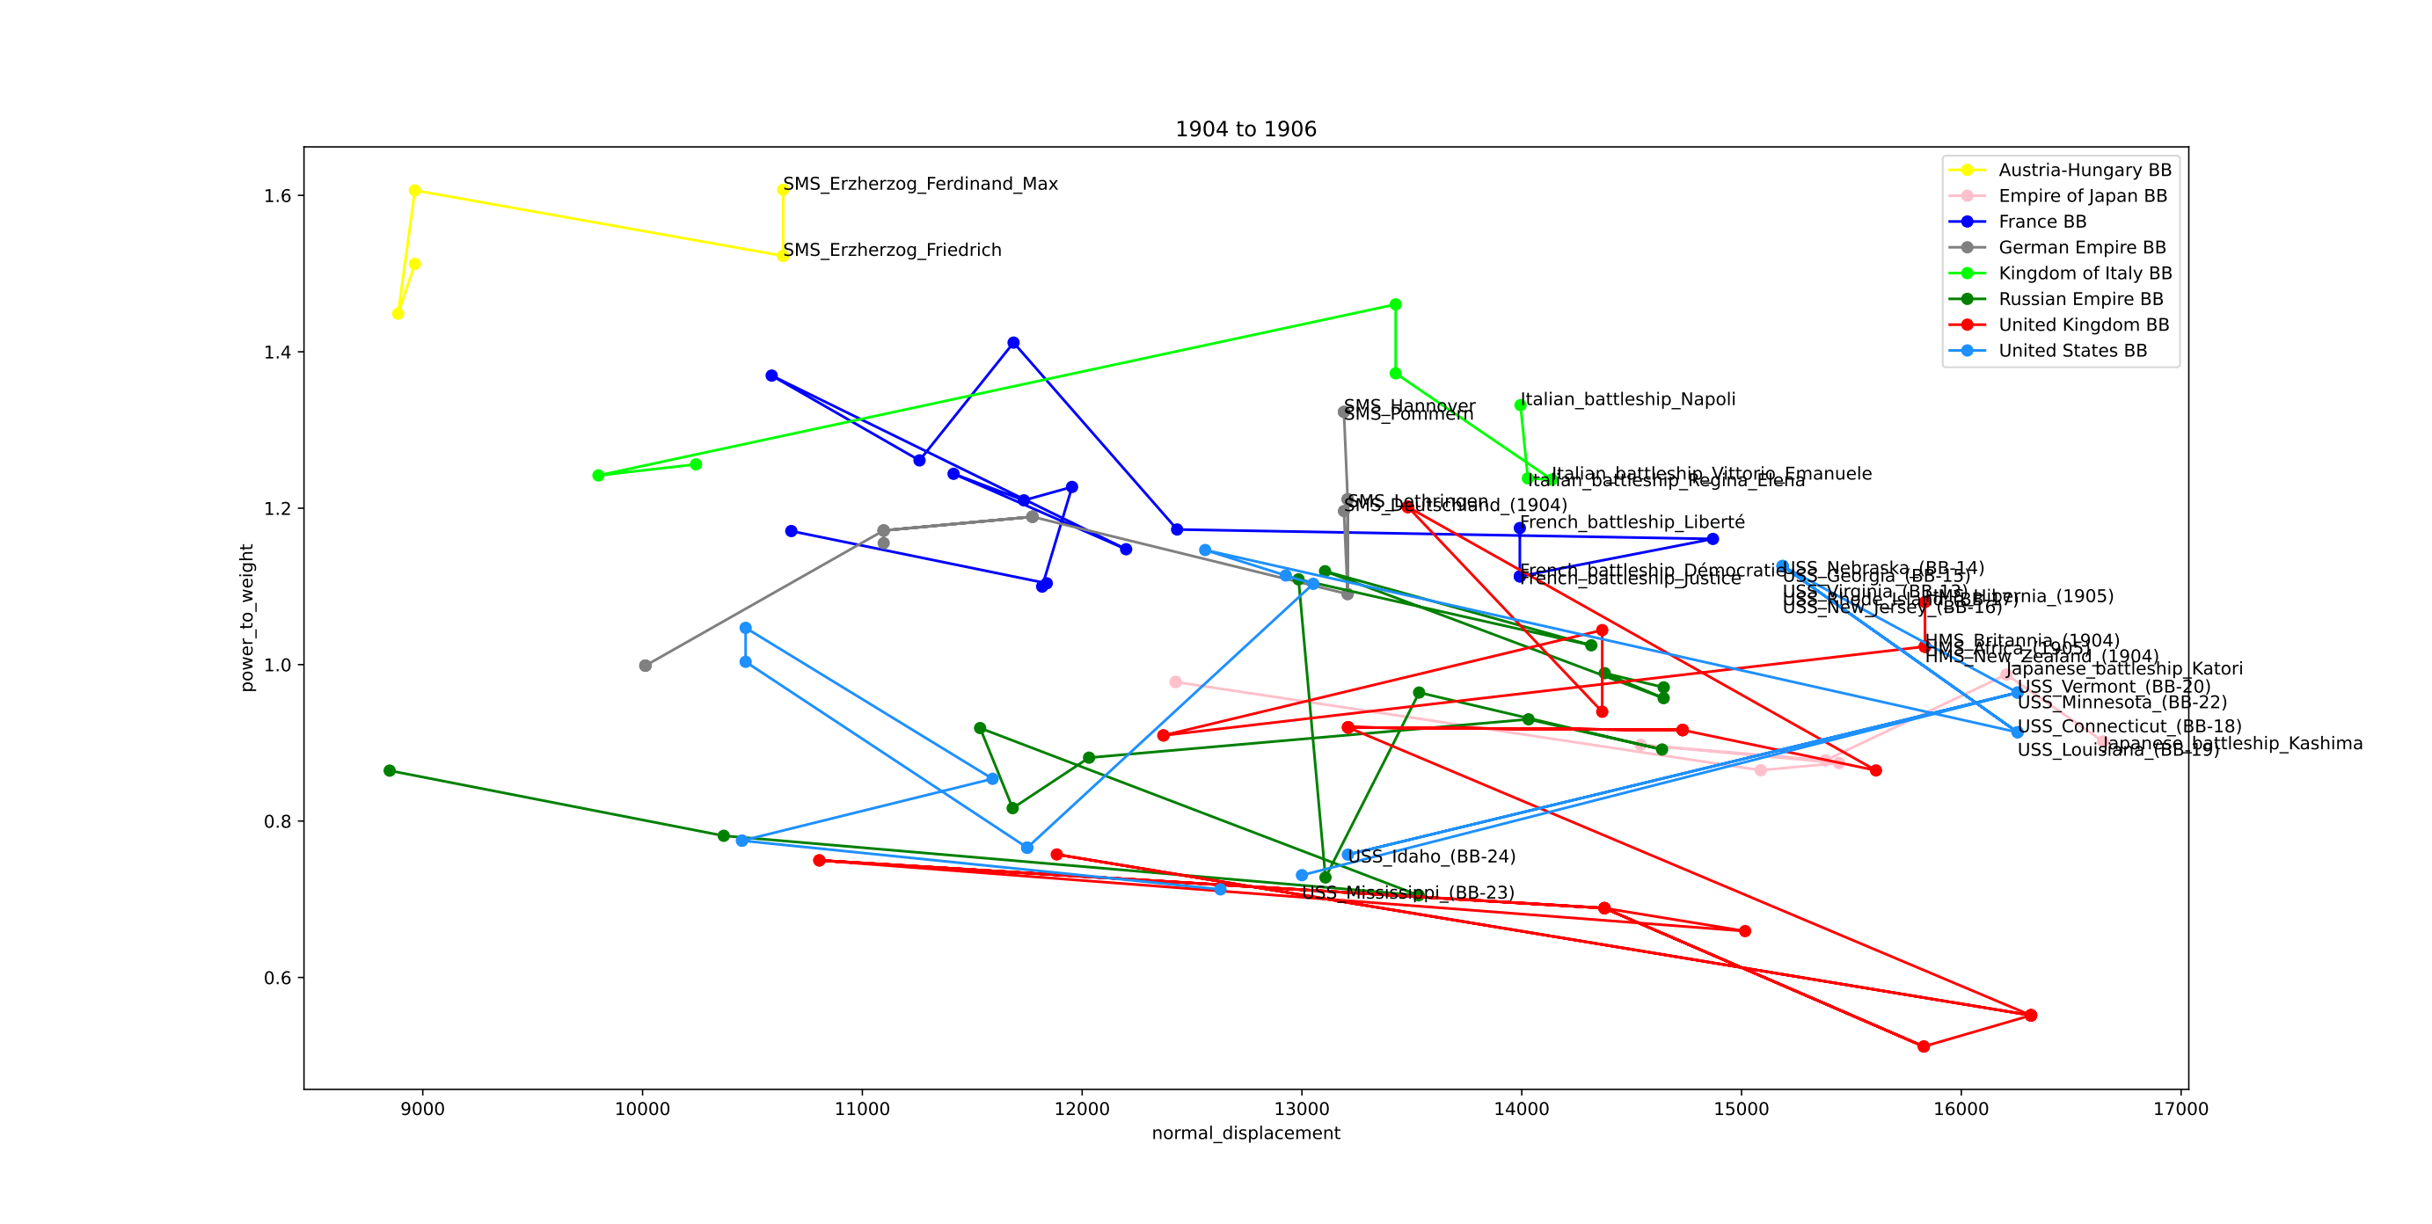

Slide 37
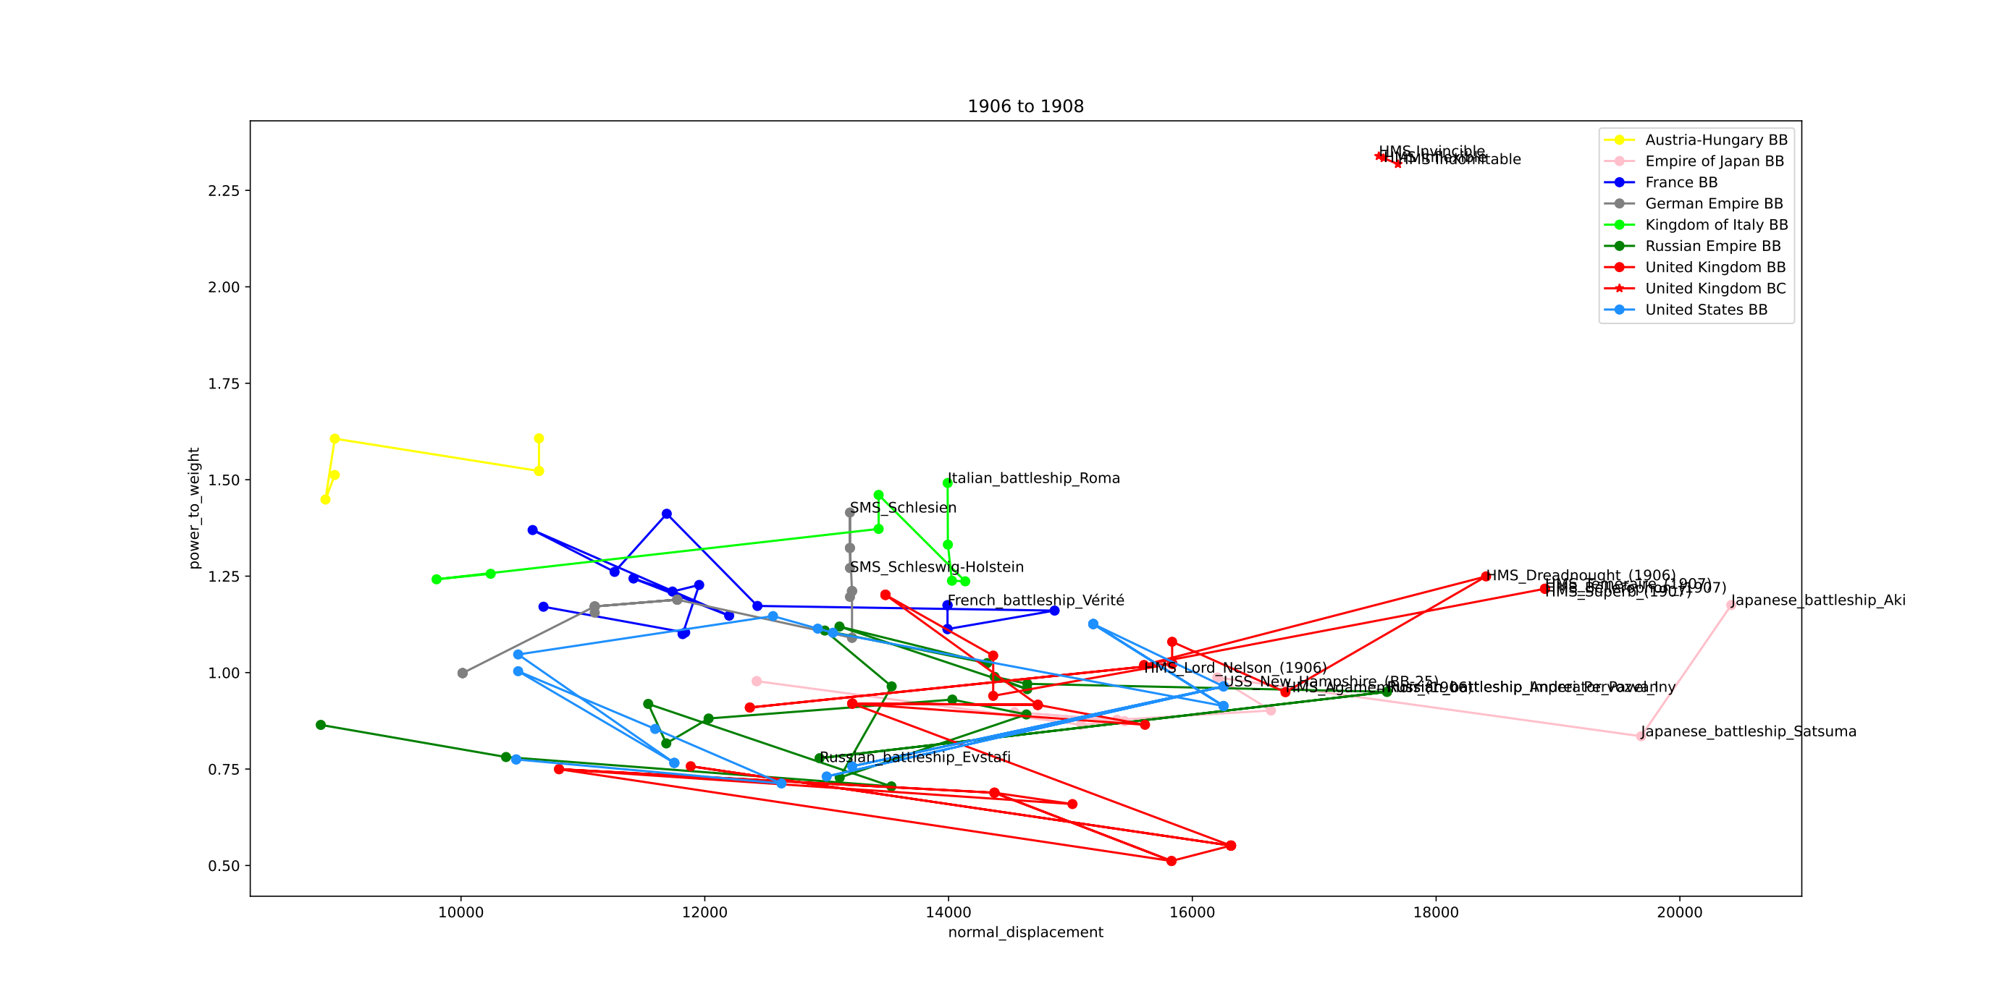

Slide 38
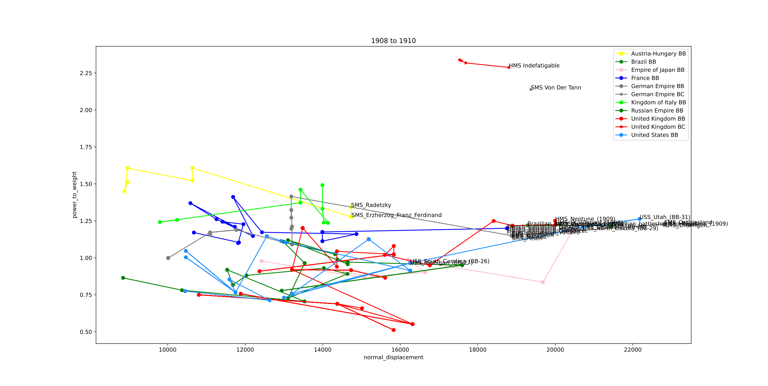

Slide 39
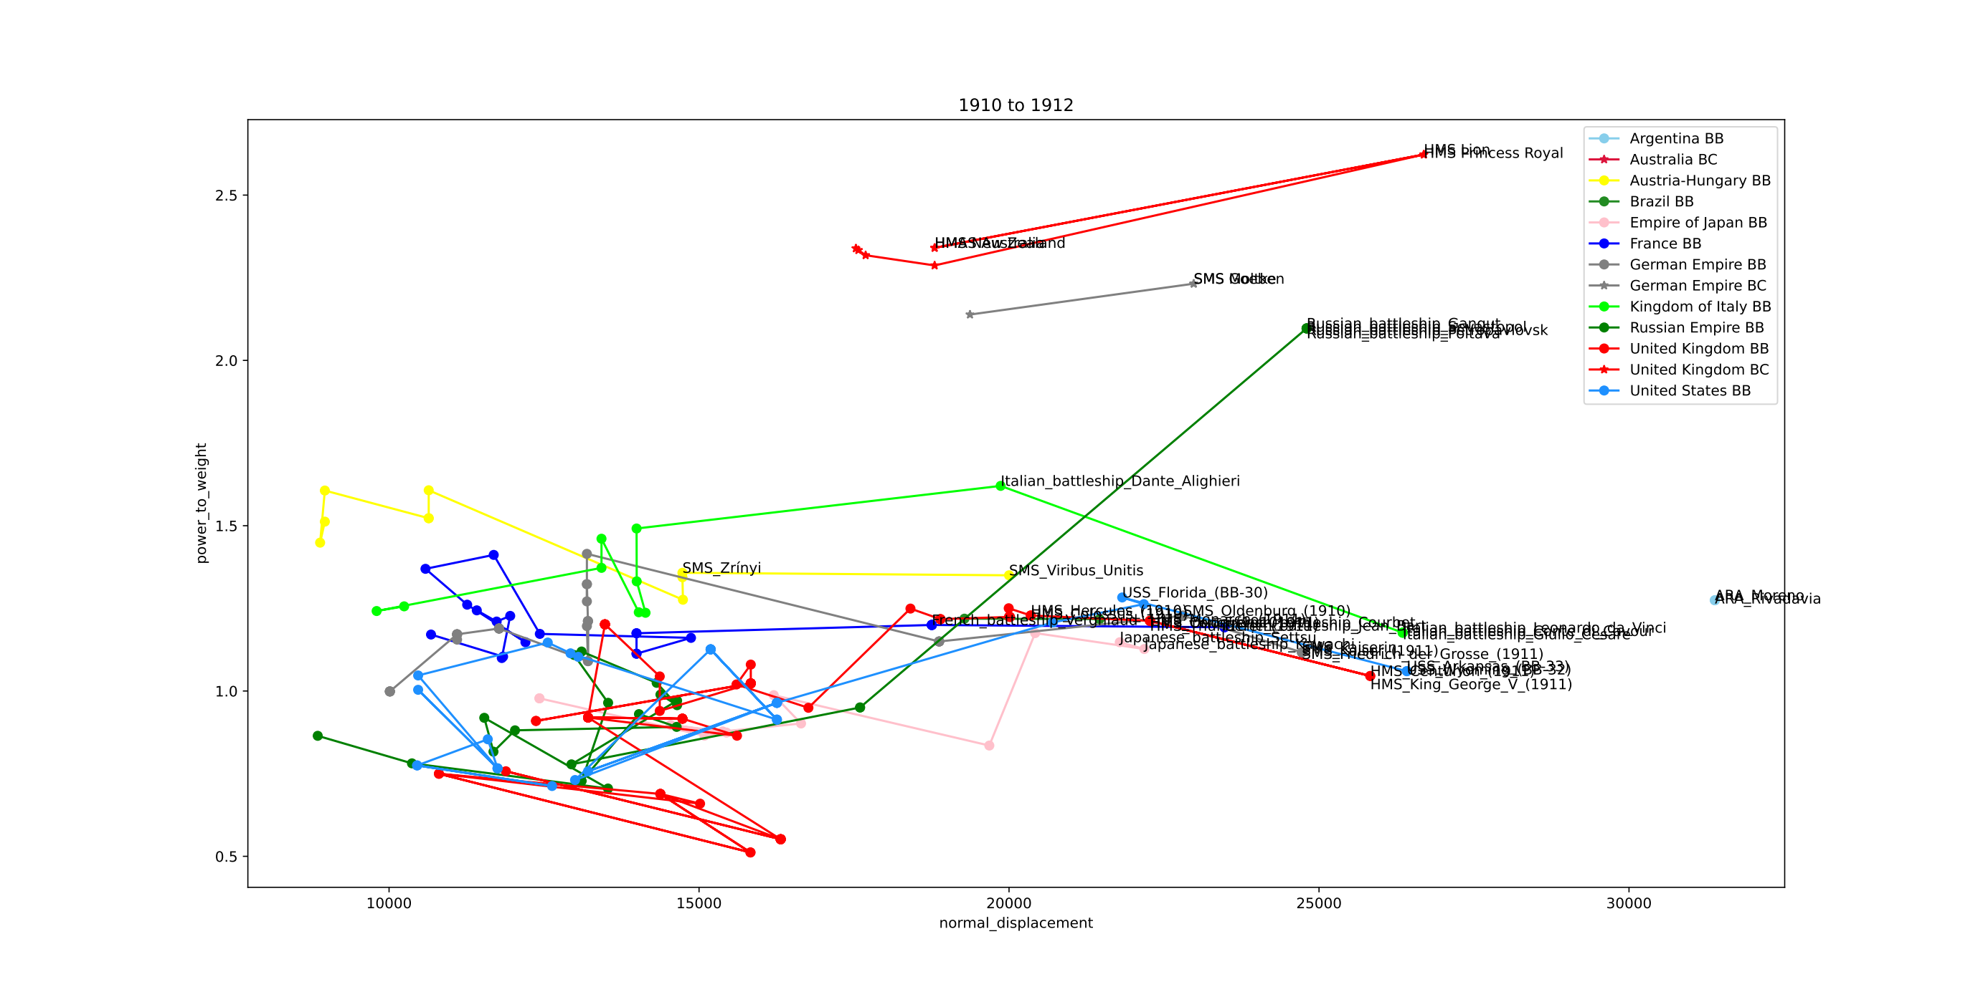

Slide 40
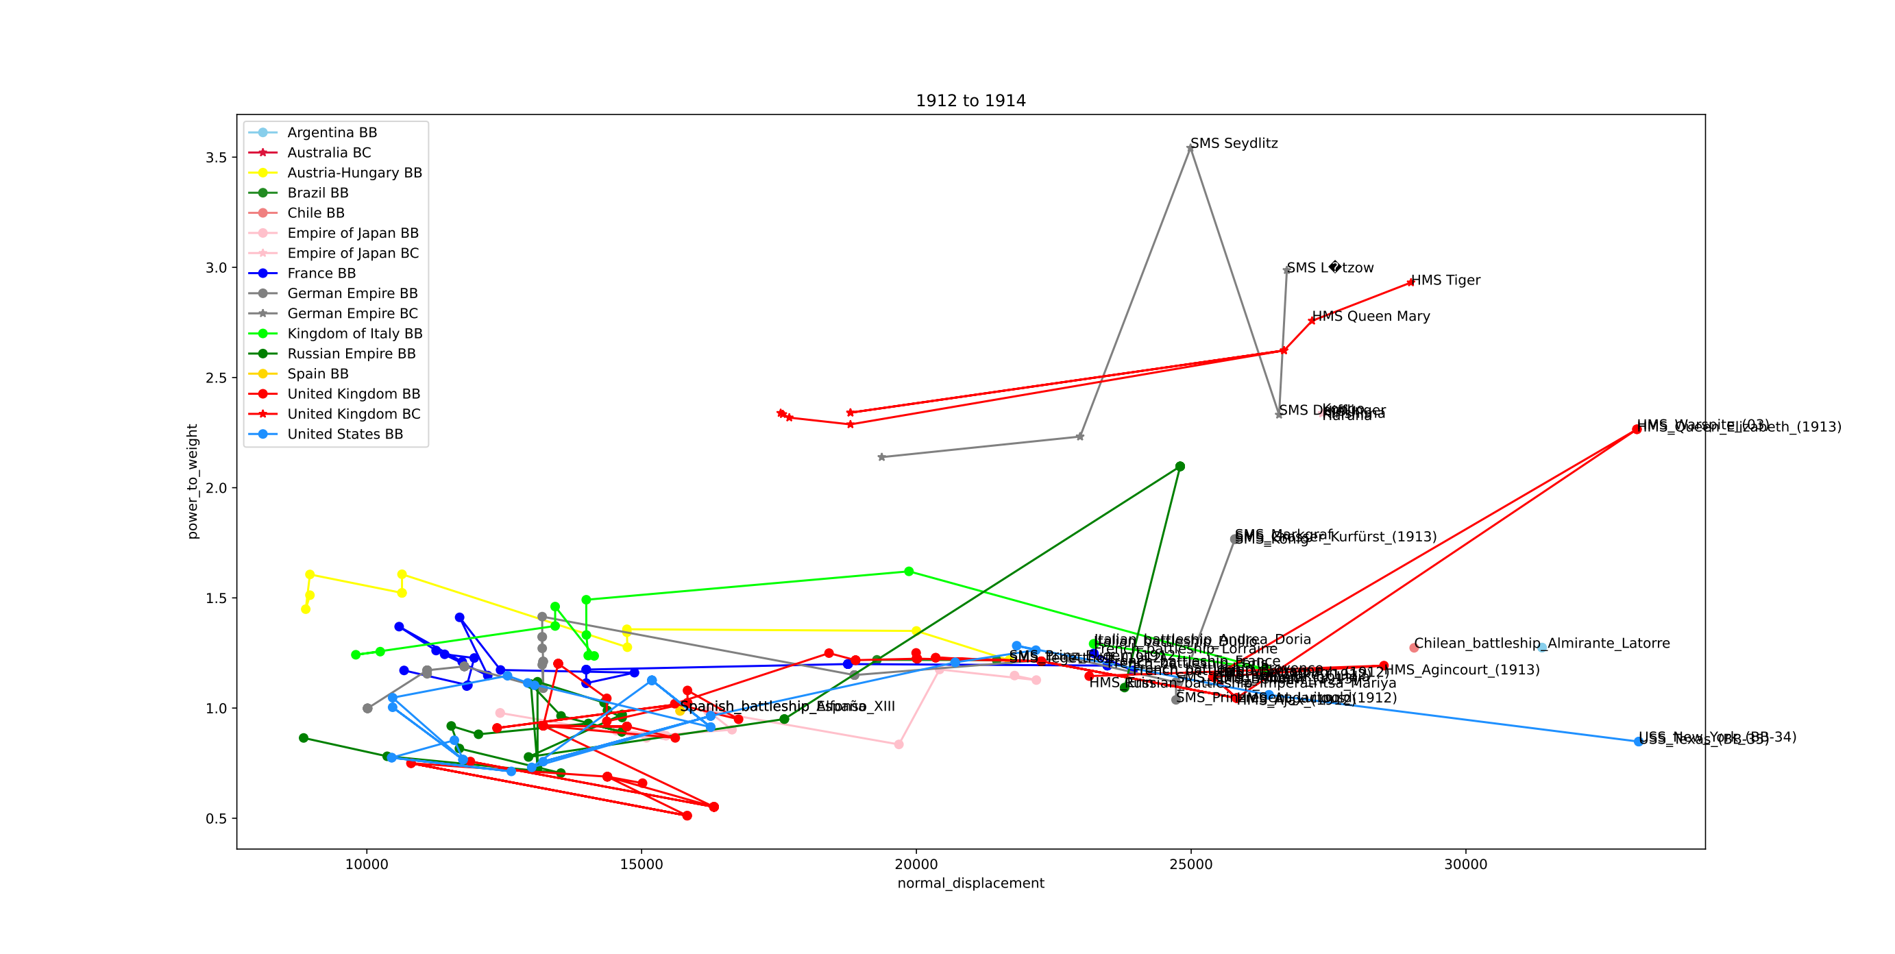

Slide 41
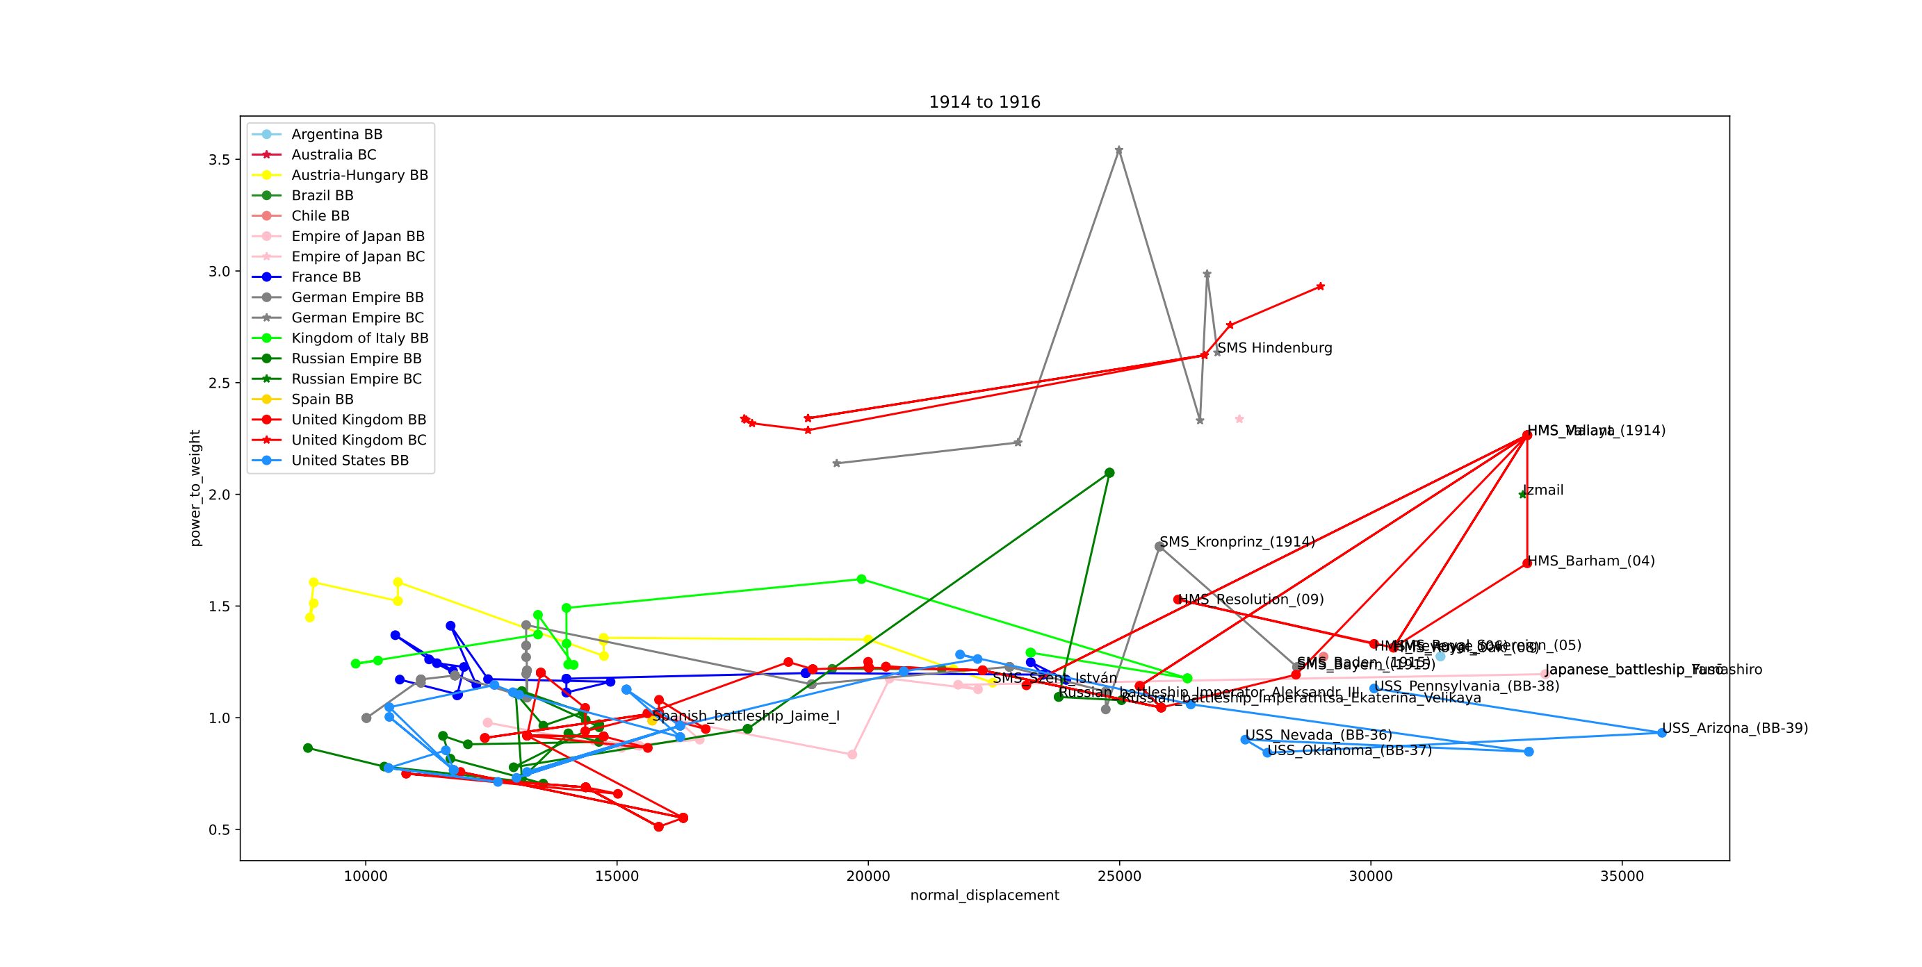

Slide 42
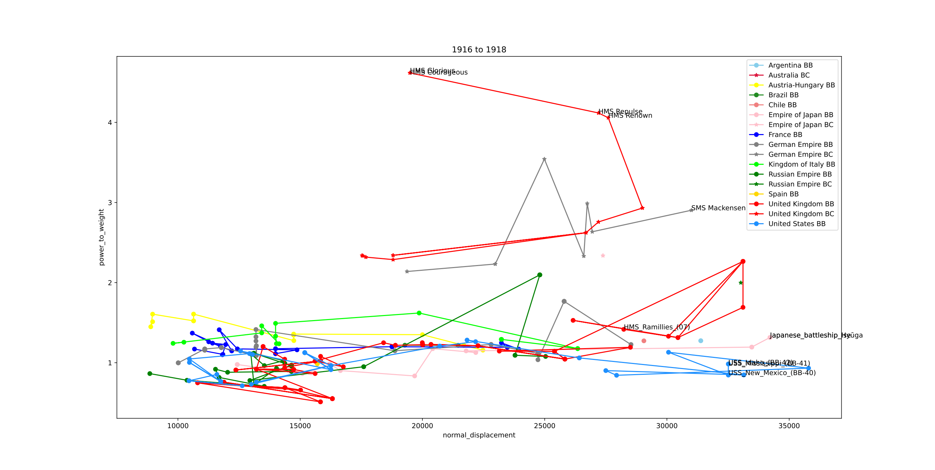

Slide 43
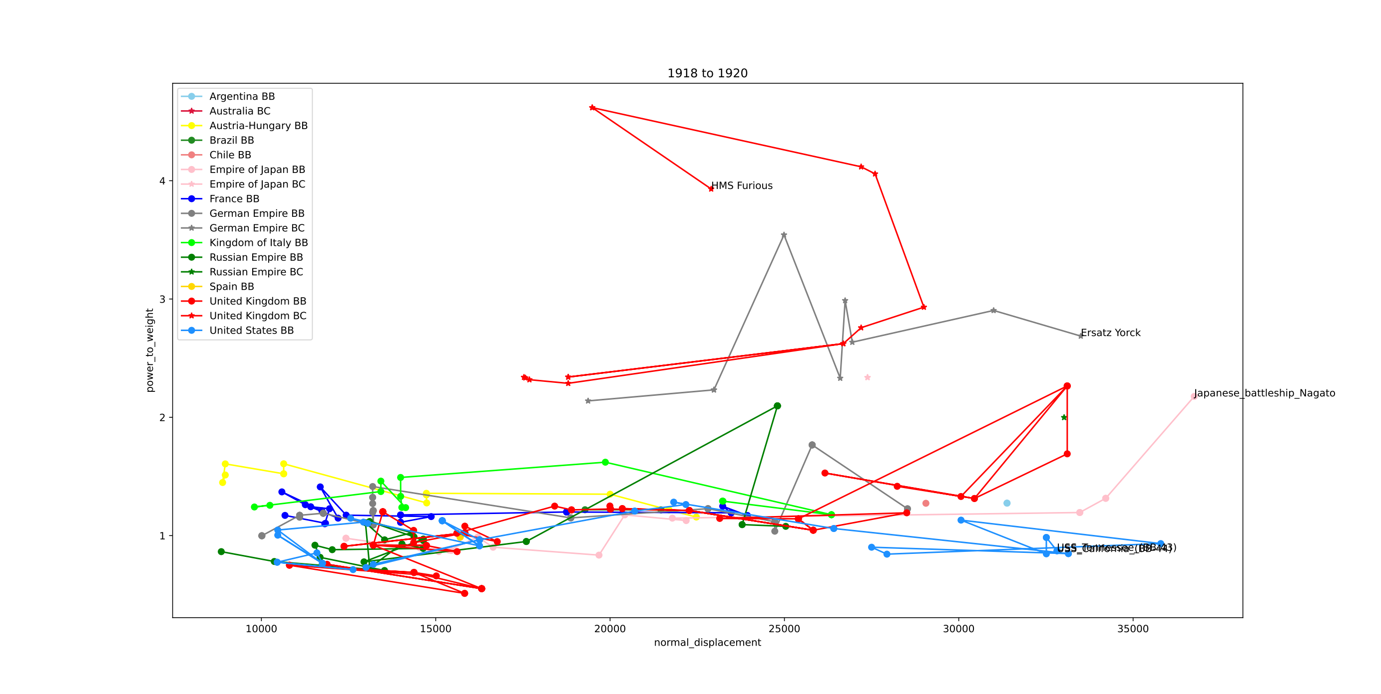

Slide 44
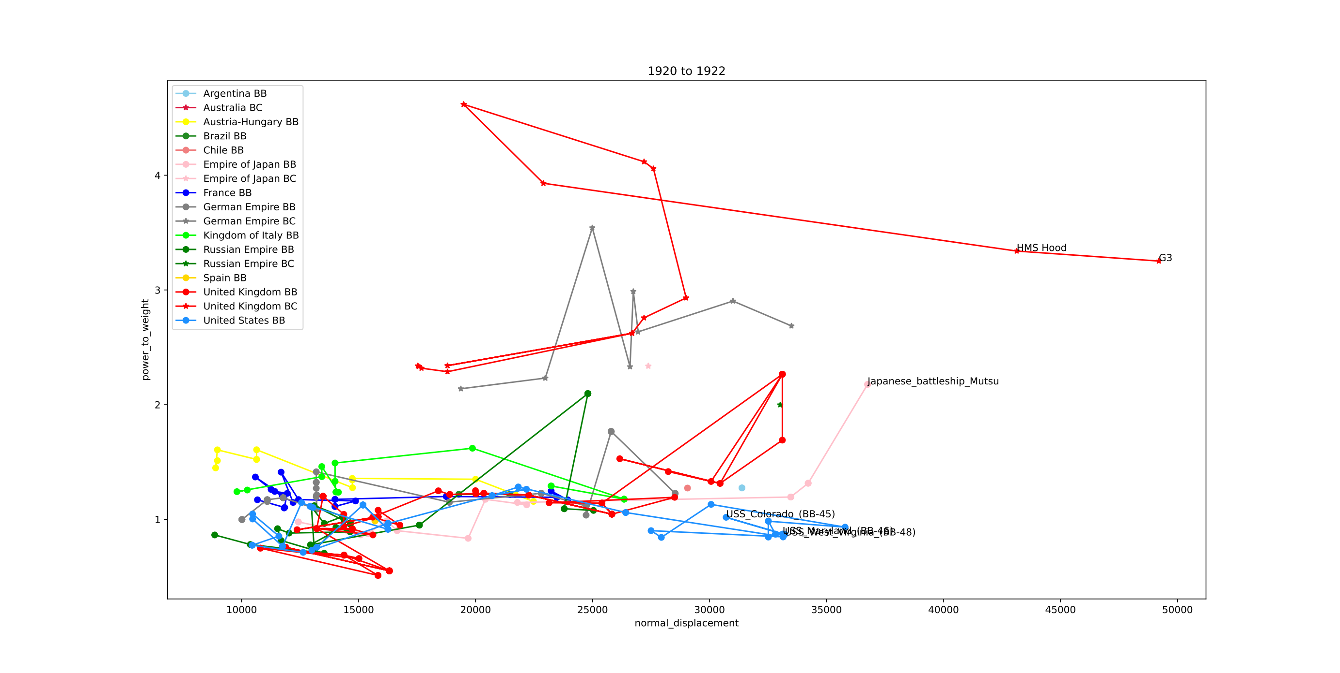

Slide 45
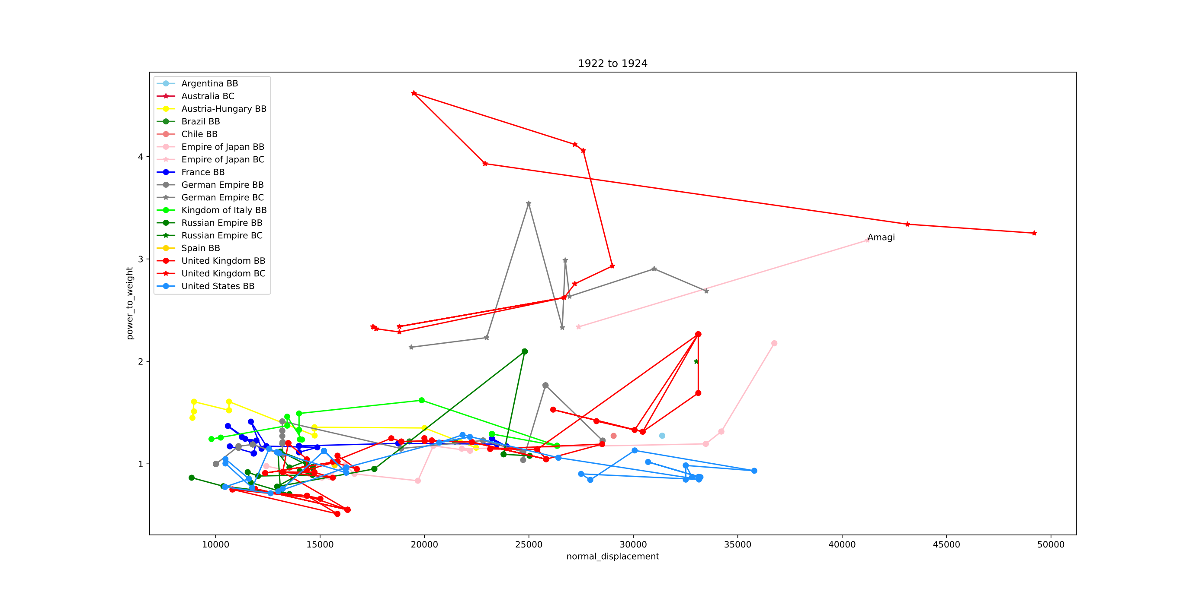

Slide 46
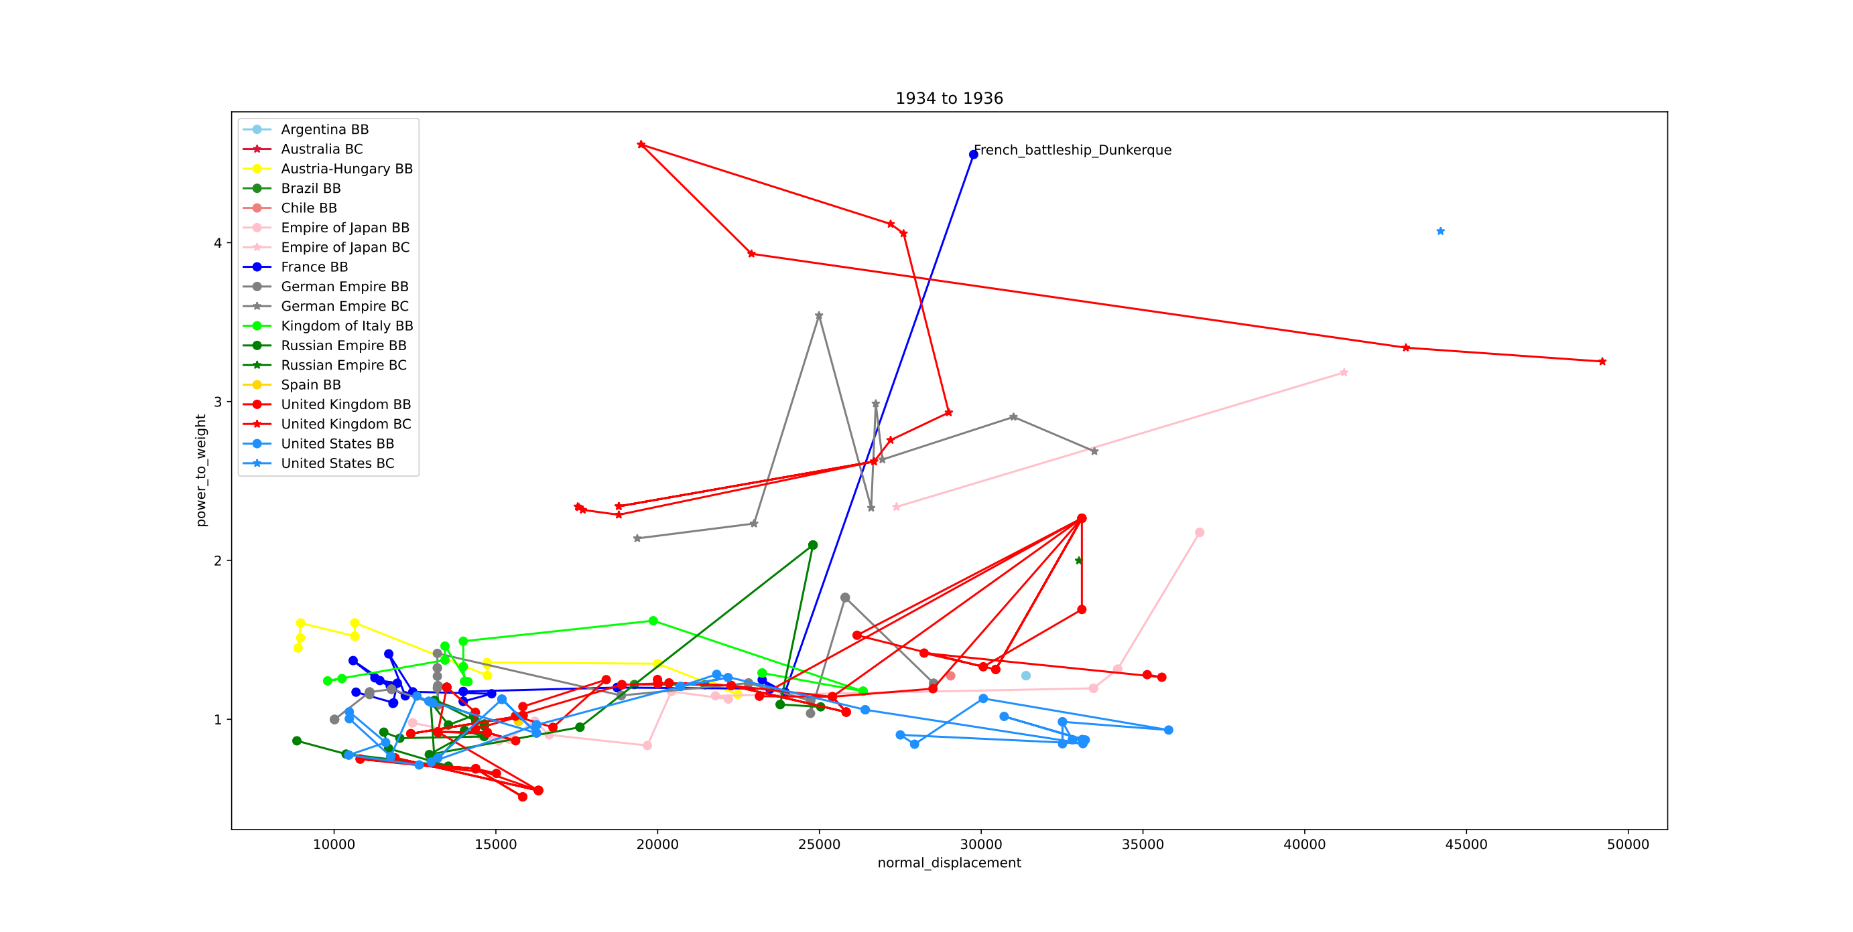

Slide 47
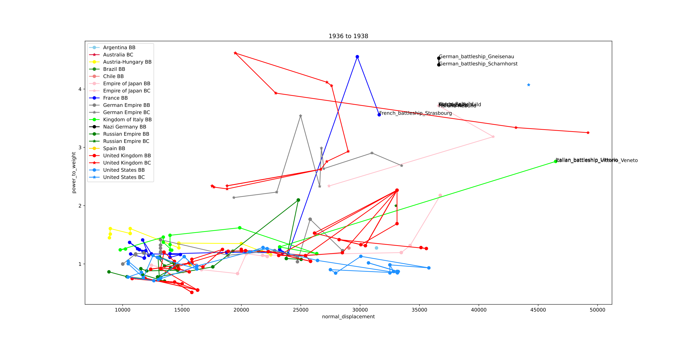

Slide 48
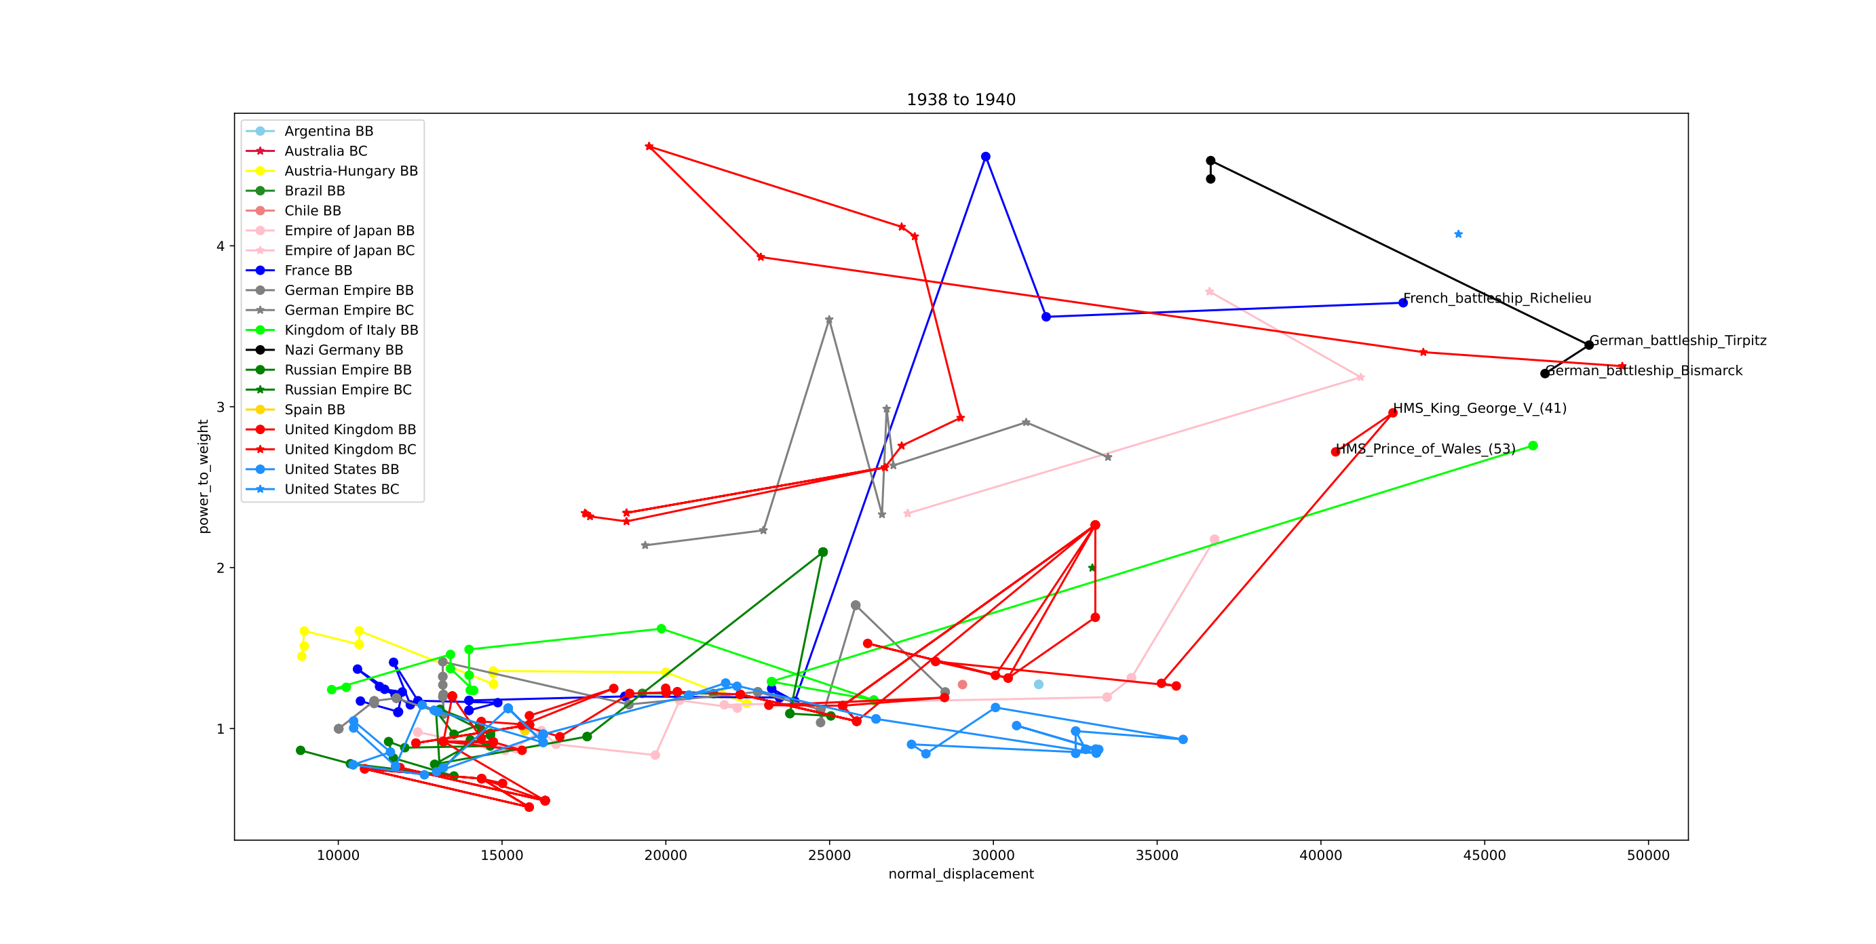

Slide 49


