Slide 1
{papaja}

Slide 2
Learning Objectives
Understand how to render R Markdown documents into APA manuscripts using the {papaja} package
Understand how to include citations in an R Markdown document
Render an R Markdown document as an APA manuscript

Slide 3
papaja
{papaja} has been around for several years now, but is still not on CRAN
Some evidence that great packages do not have to live on CRAN
The package is seemingly perpetually under development. What does this mean?
Re-install regularly
Not everything may work perfect - don't worry though, most things do
You may want to peruse the current issues
If you run into one (and you're sure it's an issue) consider opening one yourself
Bonus - the developer is very kind, so even if you open up a silly issue, he's likely to be understanding

Slide 4
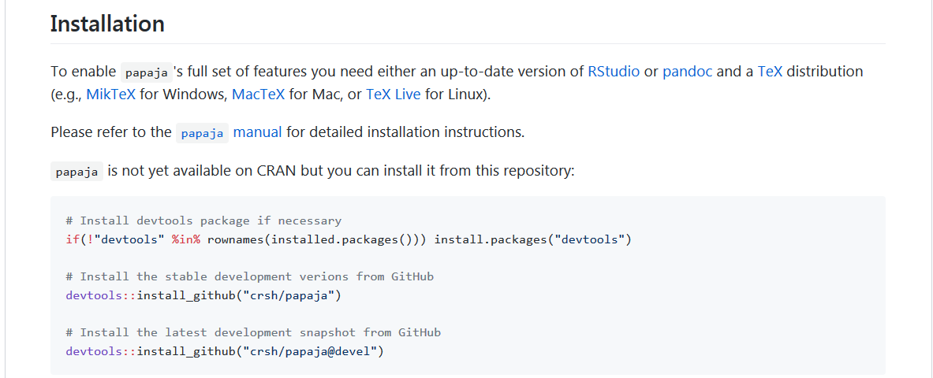
papaja

Slide 5
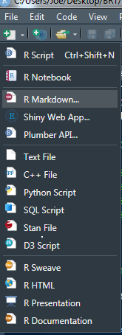
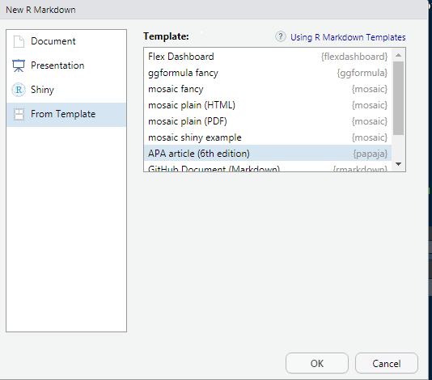
Use the template

Slide 6
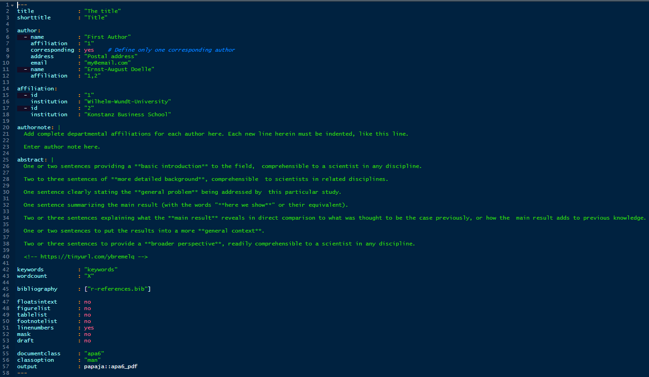
YAML (64 lines!)

Slide 7
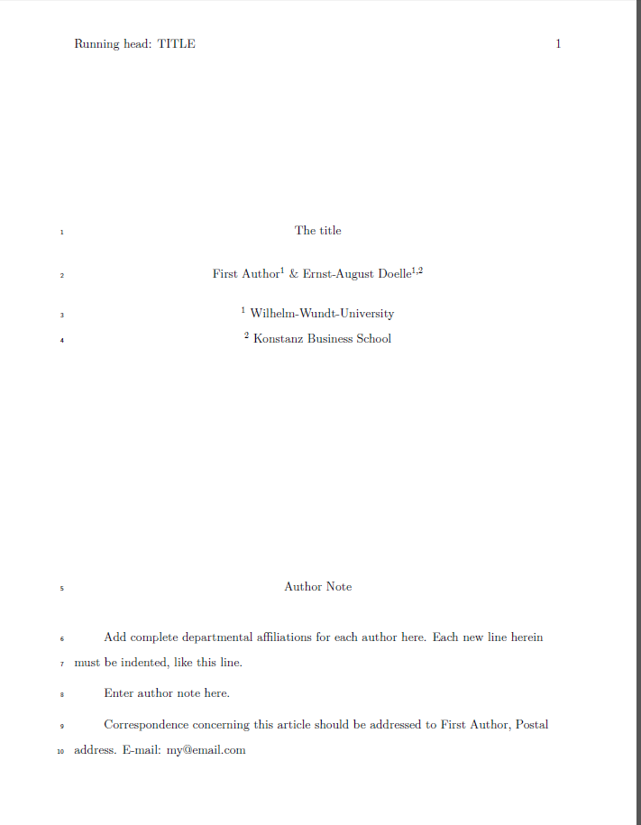
First thing – Render!
First render might take a LONG time

Slide 8
Trouble rendering?
Be sure to install tinyTex
install.packages(“tinytex”)
tinytex::install_tinytex()
Still having trouble?
tinytex::reinstall_tinytex()
Still having trouble?
Ugh…

Slide 9
Modifications
title
author & author info
abstract
keywords
Be careful with copying/pasting the default YAML options

Slide 10
Modifications
shorttitle – running head
authornote (can fully delete or modify)
wordcount (probably useless at this point)
bibliography (we'll talk more about this)
linenumbers – lines continuously numbered throughout the manuscript
floatsintext – figures & tables positioned at the end of the document (APA) or included in the body
mask – removes author names, affiliations, and author note from the title page (for blind peer-review)
classoption – style of the document (man, doc , jou)
output – papaja::apa6_pdf or papaja::apa6_word

Slide 11
Modify some stuff!
Modify some of the options on the previous slide
Specifically, try changing classoption from man to jou
Try other things, too

Slide 12
Citations
To include references in your paper, you must:
Create an external .bib file using LaTeX formatting (we'll get to this)
Include
bibliography: nameOfYourBibFile.bib in your YAML
Refer to the citations in text using @
Open up the r-references.bib file that was automatically created when you rendered the default papaja Rmd document

Slide 13
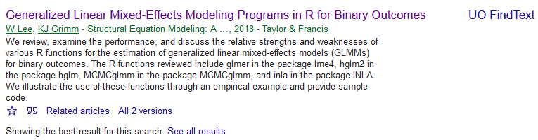
Creating a .bib doc
Using Google Scholar is perhaps the simplest

Slide 14
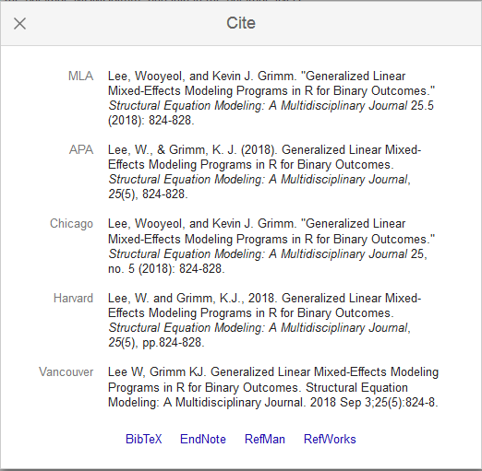
Creating a .bib doc

Slide 15
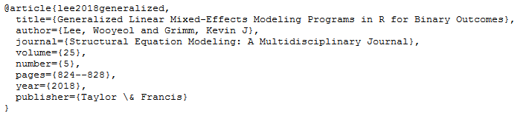
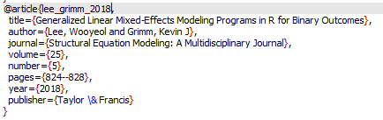
Creating a .bib doc
Copy the result
Paste it into your .bib file
Edit the tag (for in-text reference) as desired

Slide 16
In text citations
Citation Style (using the tag) | Output
@Briggs11 | Briggs and Weeks (2011)
[see @Baldwin2014; @Caruso2000] | (see Baldwin et al. 2014; Caruso 2000)
[@Linn02, p. 9] | (Linn and Haug 2002, p. 9)
[-@Goldhaber08] | (2008)
In papaja, references are included automatically at the end of the document
This is not true of Rmd documents (we’ll get to this)

Slide 17
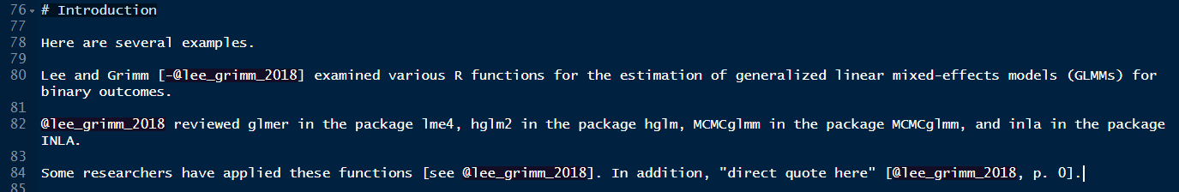
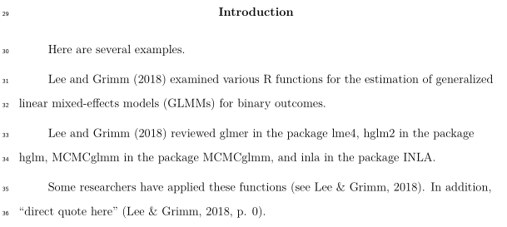
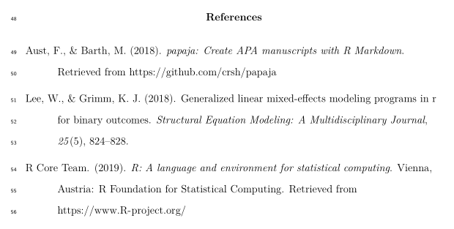
An example

Slide 18
Trouble rendering?
Be sure to install tinyTex
install.packages(“tinytex”)
tinytex::install_tinytex()
Still having trouble?
tinytex::reinstall_tinytex()
Still having trouble?
Ugh…

Slide 19
Modifications
title
author & author info
abstract
keywords
Be careful with copying/pasting the default YAML options

Slide 20
Modifications
shorttitle – running head
authornote (can fully delete or modify)
wordcount (probably useless at this point)
bibliography (we'll talk more about this)
linenumbers – lines continuously numbered throughout the manuscript
floatsintext – figures & tables positioned at the end of the document (APA) or included in the body
mask – removes author names, affiliations, and author note from the title page (for blind peer-review)
classoption – style of the document (man, doc , jou)
output – papaja::apa6_pdf or papaja::apa6_word

Slide 21
Your Turn
Modify some of the YAML options!
Change:
classoption from man to jou
Under author:
include your name, address, and email
Under affiliation:
change the first institution to “University of Oregon”
Render again!
this might take some time, too

Slide 22
Citations {papaja}

Slide 23
papaja references
Use the r-references.bib generated automatically
Paste in your BibTex references there
Remember to cite the R packages that you use!
citation(“package_name”)
[demo]

Slide 24
Citations
Open up the r-references.bib file that was automatically created when you rendered the default papaja Rmd document
You can also use a text editor instead of RStudio
[demo]

Slide 25
Adding a reference
Using Google Scholar is perhaps the simplest

Slide 26
Adding a reference

Slide 27
Adding a reference
Copy the result
Paste it into your .bib file
Edit the tag (for in-text reference) as desired

Slide 28
Your Turn
Use scholar.google.com/
Find two references
They can be your own!
Your favorite article
An article you are reading for another class
An article written by your advisor
Open your r-references.bib file in RMarkdown
Add two BibTex references to the r-references.bib file
make sure you note the tag
Save the r-references.bib file

Slide 29
In text citations
Citation Style (using the tag) | Output
@Briggs11 | Briggs and Weeks (2011)
[see @Baldwin2014; @Caruso2000] | (see Baldwin et al. 2014; Caruso 2000)
[@Linn02, p. 9] | (Linn and Haug 2002, p. 9)
[-@Goldhaber08] | (2008)
In papaja, references are included automatically at the end of the document
This is not true of Rmd documents

Slide 30
An example

Slide 31
Your Turn
In your papaja document, add in text citations for each of the two references you just added to r-references.bib
Start a sentence with one citation
Include the second citation at the end of a sentence in parentheses

