Slide 1


Exploratory Data Analysis in Movies dataset
Project Team B
Nikolas Karapas
Athina Tsani
Nikoletta Tounta

Slide 2

This dataset is an ensemble of data collected from TMDB and Group Lens. Contains information on 45,000 movies featured in the Full Movie Lens dataset.

Slide 3
What makes a profitable movie?

Slide 4
Lets find a predictor!

Slide 5
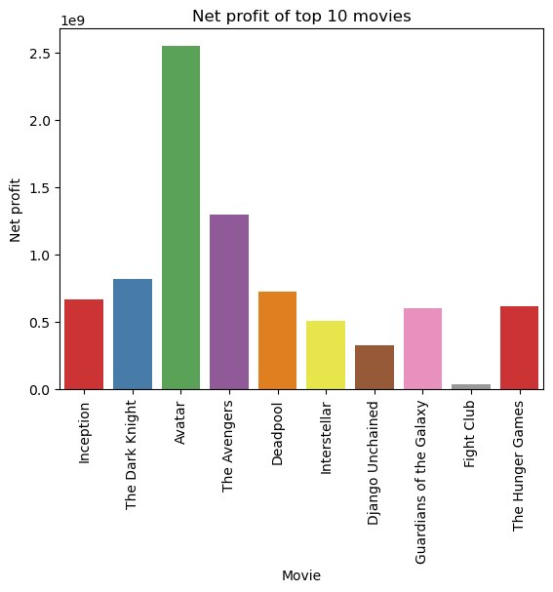
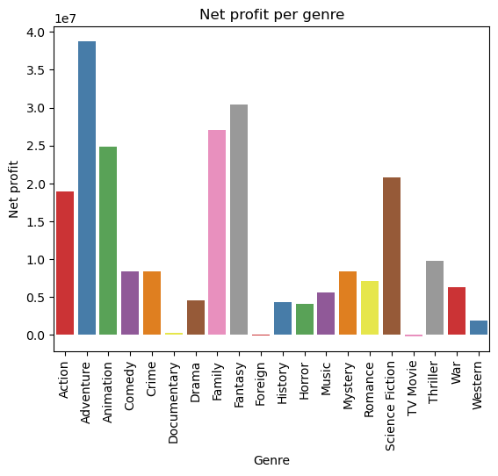
Genres are a good predictor!
1)Just make an adventure movie
2) Forget about Foreign, Documentaries, TV Mo

Slide 6
Fight Club is a masterpiece! But is it profitable?

Slide 7
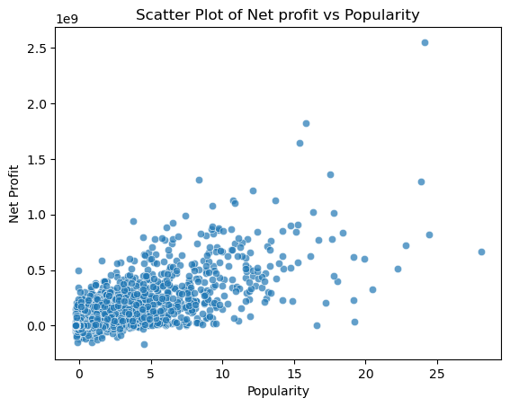
Popular does not mean a Box Office success?

Slide 8
The Jackpots!

Slide 9
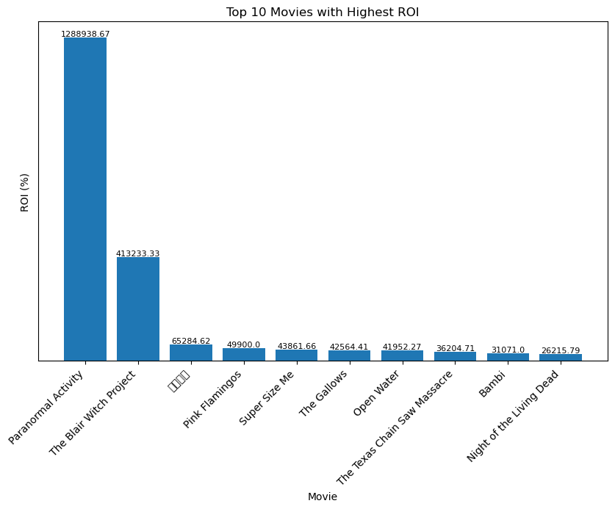
ROI, or Return on Investment, is a financial metric used to measure the profitability of an investment. It is calculated by dividing the net profit of an investment by the cost of the investment and expressing the result as a percentage.

Slide 10
Make an adventure film or just hit the jackpot!

