Slide 1
Inventory Management System
Nikolett Bajna

Slide 2
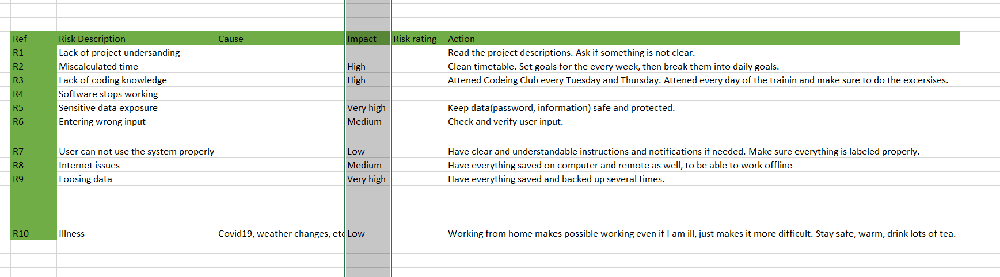
Risk assesment

Slide 3
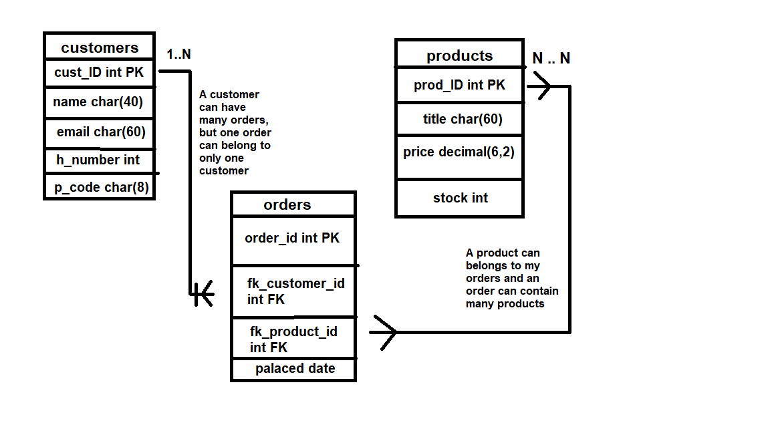
ERD
products
OrderItem
orders

Slide 4
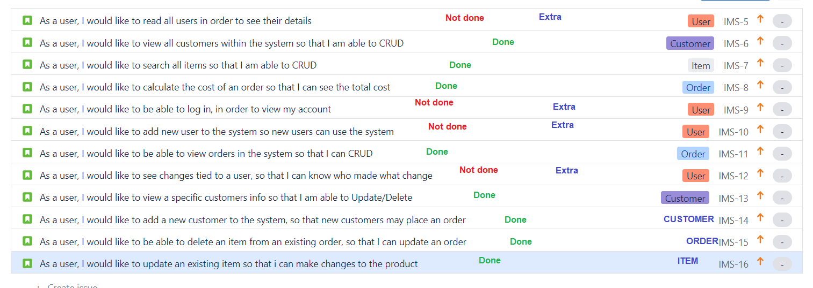
User Stories

Slide 5
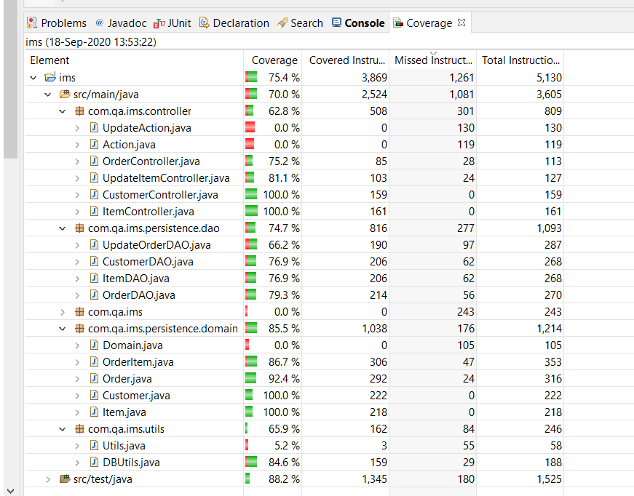
Testing

Slide 6
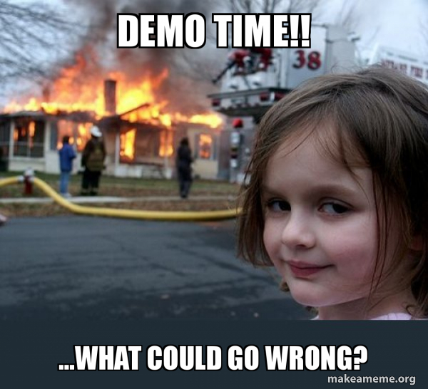
Please let me show you a little demo of my IMS project!

