Slide 1

To-Do List Web Application
Nikolett Bajna

Slide 2

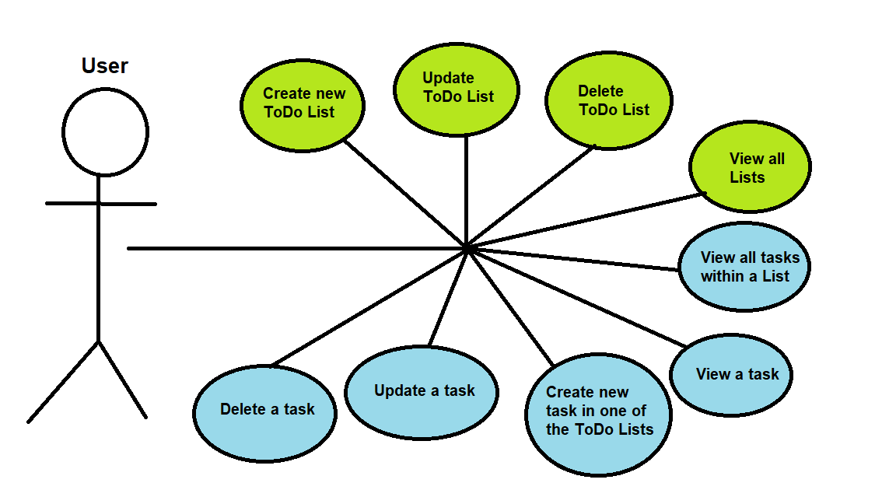
What can the user do?

Slide 3

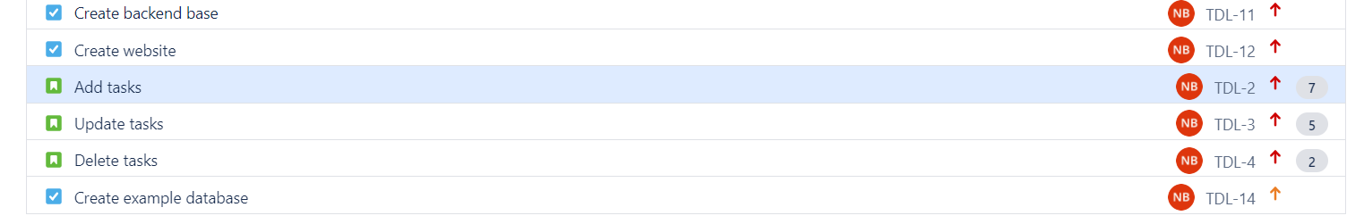
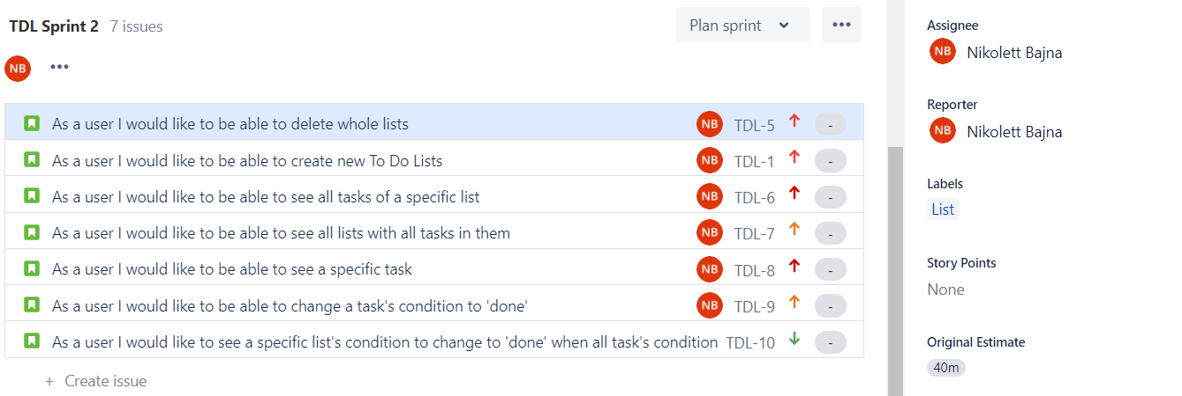
User stories and planning

Slide 4
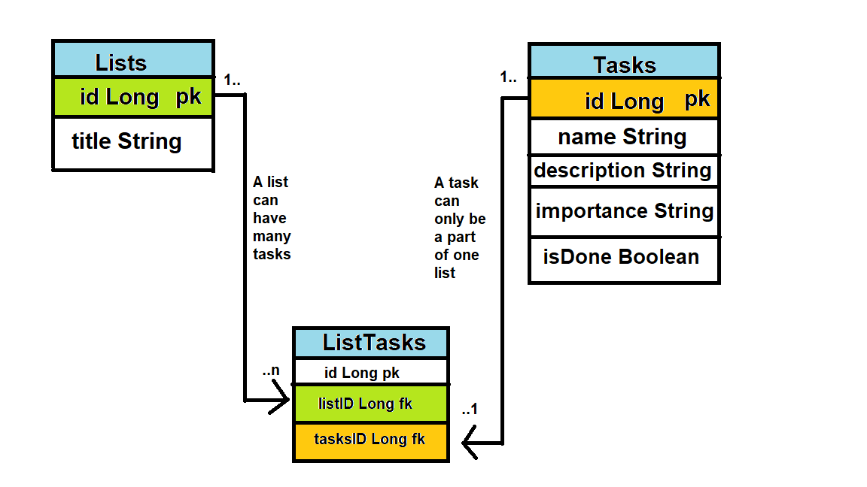
ERD

Slide 5
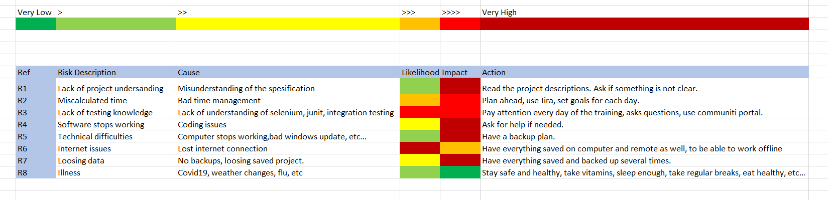
Risk Assessment

Slide 6


Slide 7
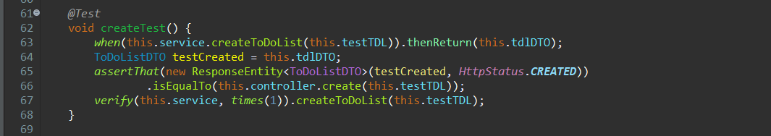
To-Do List Unit Test
Set up the test
Check if the expected outcome is equals to the actual outcome
Verify if the method is running.

Slide 8
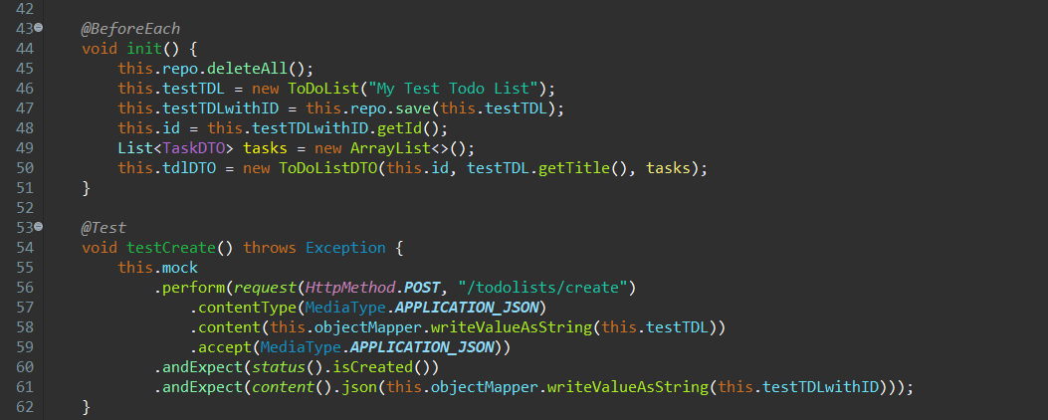
To-Do list controller integration test
Set up test environment
Test for creating to-do lists
MockMVC mock -> creates a mock http request
Set the content Type of the request to application/json
With the Object Mapper convert the test Object into json string
Set the response to accept only json
Check the status of the response
Check the result

Slide 9
Thank you!
Any question?

