Slide 1
Latent Dirichlet Allocation
Nikhilkumar Jadhav

Slide 2
Outline
Parameter Estimation
Conjugate Distributions
Modeling Text
Bayesian networks and generative models
Latent Dirichlet Allocation
Gibbs Sampling
Collapsed Gibbs Sampling for LDA

Slide 3
Outline
Parameter Estimation
Conjugate Distributions
Modeling Text
Bayesian networks and generative models
Latent Dirichlet Allocation
Gibbs Sampling
Collapsed Gibbs Sampling for LDA

Slide 4
Outline
Parameter Estimation
Maximum likelihood estimation (ML)
Maximum a posteriori estimation (MAP)
Bayesian estimation

Slide 5
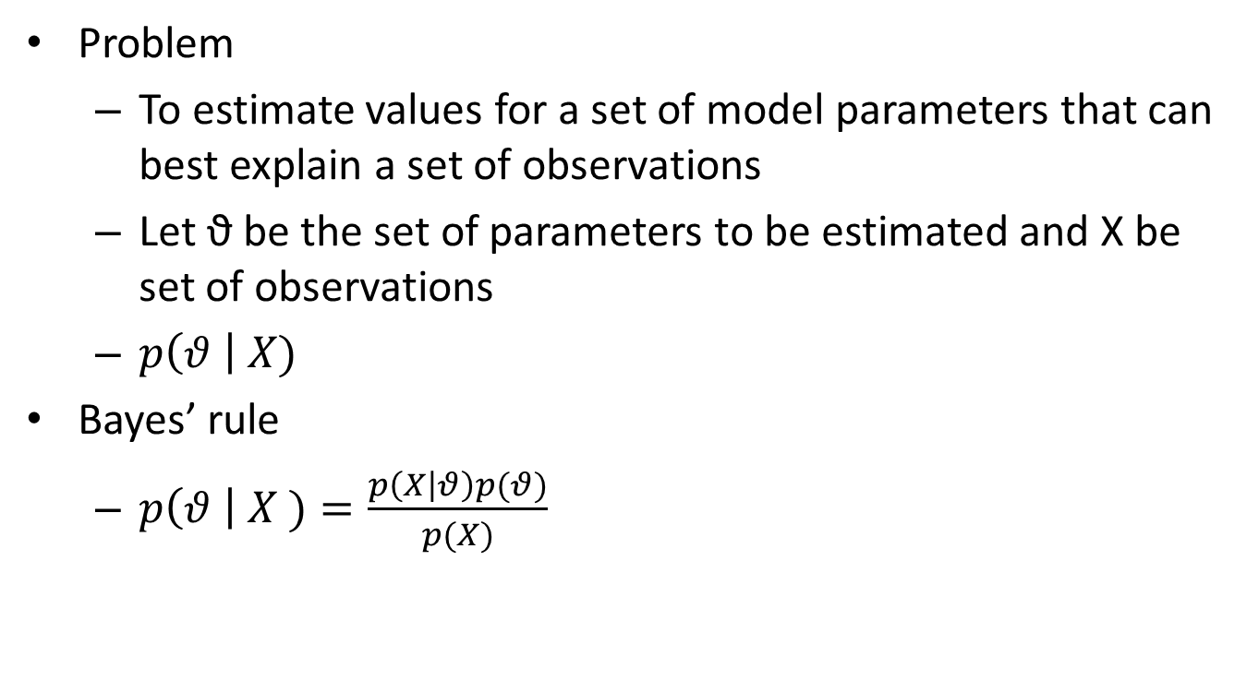
Parameter Estimation
Problem
To estimate values for a set of model parameters that can best explain a set of observations
Let ϑ be the set of parameters to be estimated and X be set of observations
$p\left(θ \right| X)$
Bayes’ rule
$p\left(θ \right| X )=\frac{p\left(X | θ\right)p(θ)}{p(X)}$

Slide 6

Parameter Estimation
Different view of Bayes’ rule
$posterior= \frac{likelihood.prior}{evidence}$

Slide 7
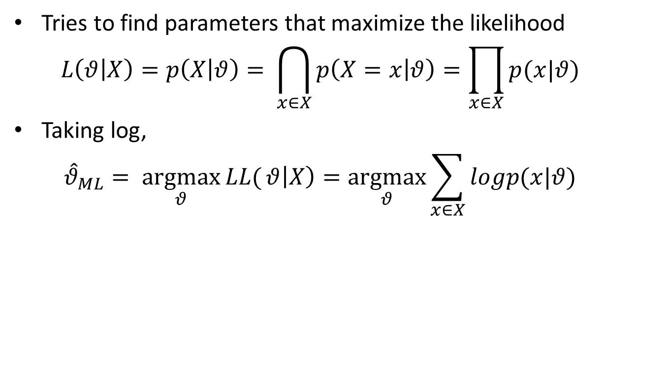
Maximum Likelihood estimation (ML)
Tries to find parameters that maximize the likelihood
$$L\left(θ | X\right)=p\left(X | θ\right)= \bigcap_{x∈X}{p\left(X=x | θ\right)}=\prod_{x∈X}{p(x|θ)}$$
Taking log,
$${\hat{θ}}_{ML}= \underset{θ}{argmax}{LL(}θ\left|X\right)=\underset{θ}{argmax}{\sum_{x∈X}{logp(x|θ)}}$$

Slide 8
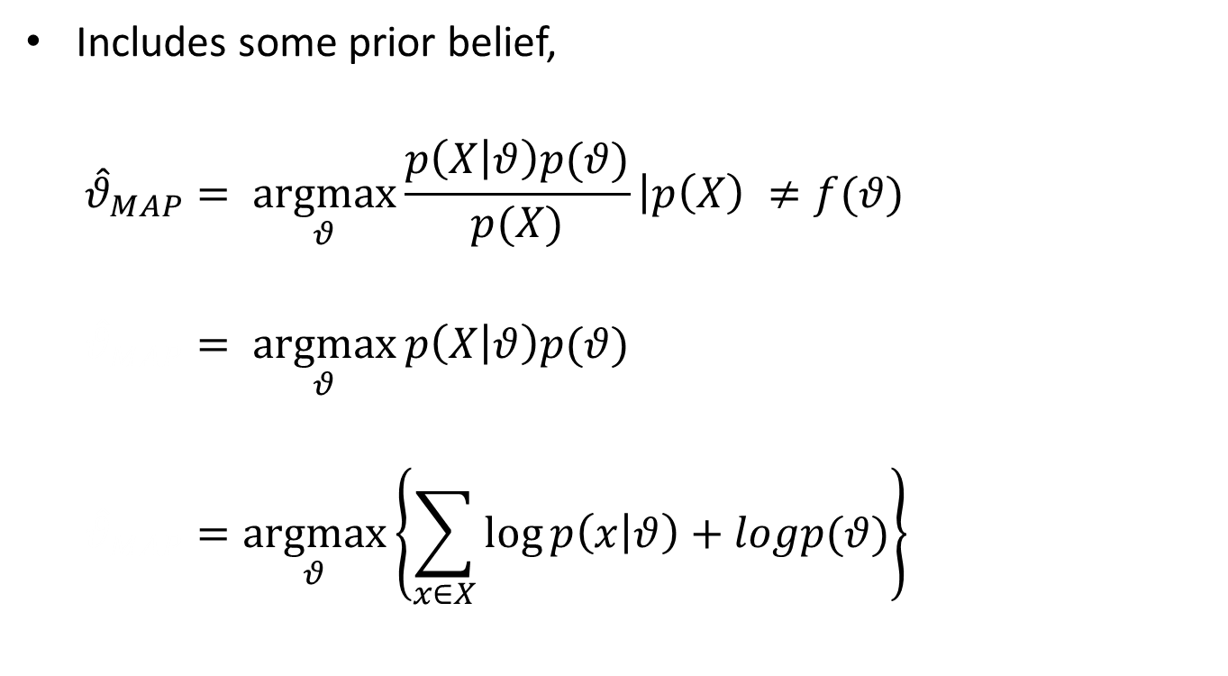
Maximum a posteriori estimation
Includes some prior belief,
$${\hat{θ}}_{MAP}= \underset{θ}{argmax}{\frac{p\left(X | θ\right)p(θ)}{p(X)}}\left|p\left(X\right) ≠f(θ)\right.$$
$${\hat{θ}}_{MAP}= \underset{θ}{argmax}{p\left(X | θ\right)p(θ)}$$
$${\hat{θ}}_{MAP}=\underset{θ}{argmax}\left\{\sum_{x∈X}{\log{p\left(x | θ\right)+logp(θ)}}\right\}$$

Slide 9
Bayesian Estimation
Allows a distribution over the parameter set ϑ instead of making a direct estimate
Calculation of posterior according to Bayes’ rule

Slide 10
Outline
Parameter Estimation
Conjugate Distributions
Modeling Text
Bayesian networks and generative models
Latent Dirichlet Allocation
Gibbs Sampling
Collapsed Gibbs Sampling for LDA

Slide 11
Outline
Conjugate Distributions
Conjugacy
Coin Tossing
Bernoulli likelihood
Beta Distribution
Multivariate case
Multinomial likelihood
Dirichlet distribution
Modeling text

Slide 12
Conjugate Distributions
Calculation of Bayesian models often becomes quite difficult
Summation or integrals of marginal likelihood (evidence) are intractable or there are unknown variables
Advantage of Bayesian estimation
Freedom while encoding prior belief
Conjugate prior distributions are used to facilitate model inference

Slide 13
Conjugacy
A conjugate prior, p(ϑ) of a likelihood, p(X|ϑ) is a distribution that results in a posterior, p(ϑ|X) of the same form

Slide 14
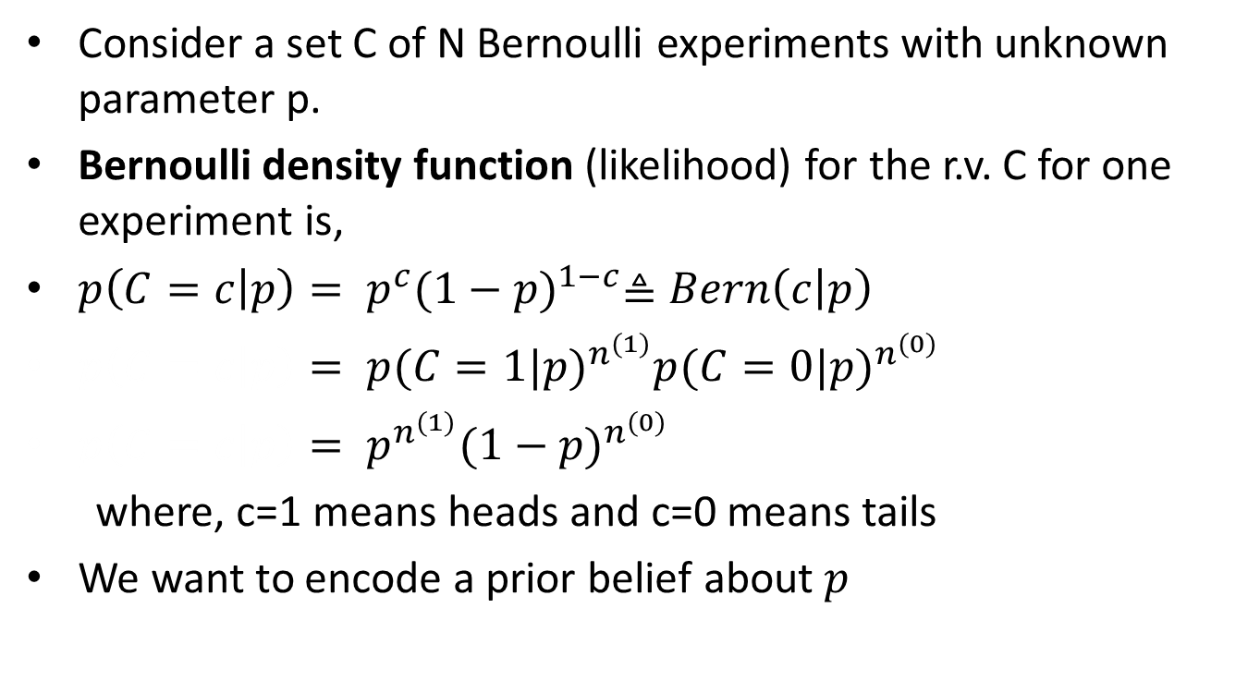
Coin Tossing
Consider a set C of N Bernoulli experiments with unknown parameter p.
Bernoulli density function (likelihood) for the r.v. C for one experiment is,
$p\left(C=c | p\right)= p^{c}{(1−p)}^{1−c}≜Bern\left(c | p\right)$
$p\left(C=c | p\right)={{ p(C=1|p)}^{n^{(1)}}p(C=0|p)}^{n^{(0)}}$
$p\left(C=c | p\right)= p^{n^{(1)}}{(1−p)}^{n^{(0)}}$
where, c=1 means heads and c=0 means tails
We want to encode a prior belief about $p$

Slide 15
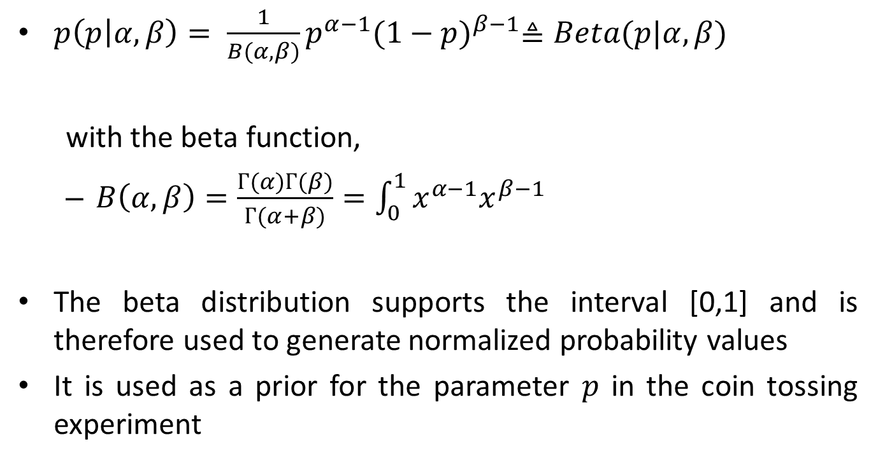
Beta Distribution
$p\left(p | α,β\right)= \frac{1}{B(α,β)}p^{α−1}{(1−p)}^{β−1}≜Beta(p|α,β)$
with the beta function,
$B\left(α,β\right)=\frac{Г(α)Г(β)}{Г(α+β)}=\int_{0}^{1}{x^{α−1}x^{β−1}}$
The beta distribution supports the interval [0,1] and is therefore used to generate normalized probability values
It is used as a prior for the parameter $p$ in the coin tossing experiment

Slide 16

Beta-Bernoulli case
$p\left(C | α,β\right)=\int_{0}^{1}{p\left(C | p\right)p\left(p | α,β\right)dp}$
$p\left(C | α,β\right)= \int_{0}^{1}{p^{n^{(1)}}{(1−p)}^{n^{(0)}}\frac{1}{B(α,β)}p^{α−1}{(1−p)}^{β−1}}$
$p\left(C | α,β\right)=\frac{1}{B(α,β)}\int_{0}^{1}{p^{n^{\left(1\right)+α−1}}{(1−p)}^{n^{(0)}+β−1}}$
$p\left(C | α,β\right)=\frac{B(n^{\left(1\right)}+α,n^{(0)}+β)}{B(α,β)}$

Slide 17
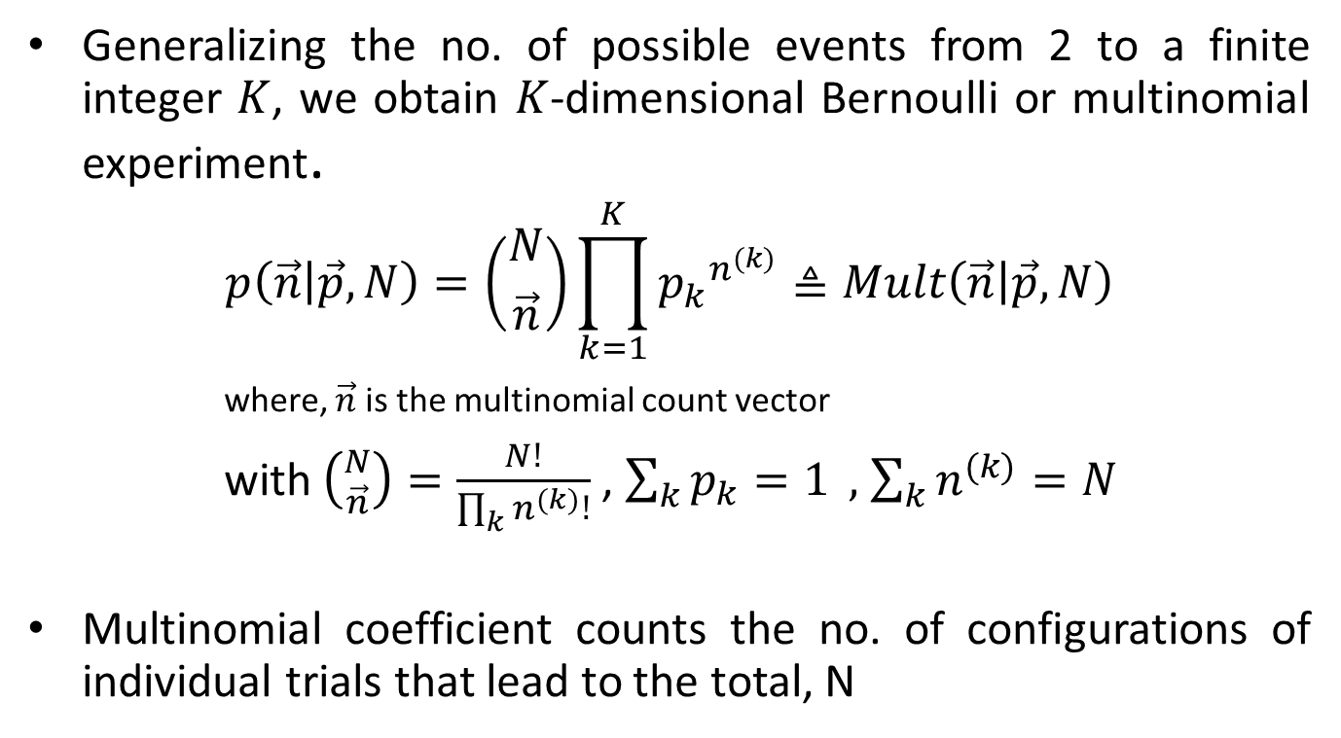
Multivariate case
Generalizing the no. of possible events from 2 to a finite integer $K$, we obtain $K$-dimensional Bernoulli or multinomial experiment.
$$p\left(\vec{n} | \vec{p},N\right)=\left({N \atop \vec{n}}\right)\prod_{k=1}^{K}{{p_{k}}^{n^{(k)}}≜Mult\left(\vec{n} | \vec{p},N\right)}$$
where, $\vec{n}$ is the multinomial count vector
with $\left({N \atop \vec{n}}\right)=\frac{N!}{\prod_{k}{n^{(k)}!}}$ , $\sum_{k}{p_{k}=1} ,$ $\sum_{k}{n^{(k)}=N}$
Multinomial coefficient counts the no. of configurations of individual trials that lead to the total, N

Slide 18
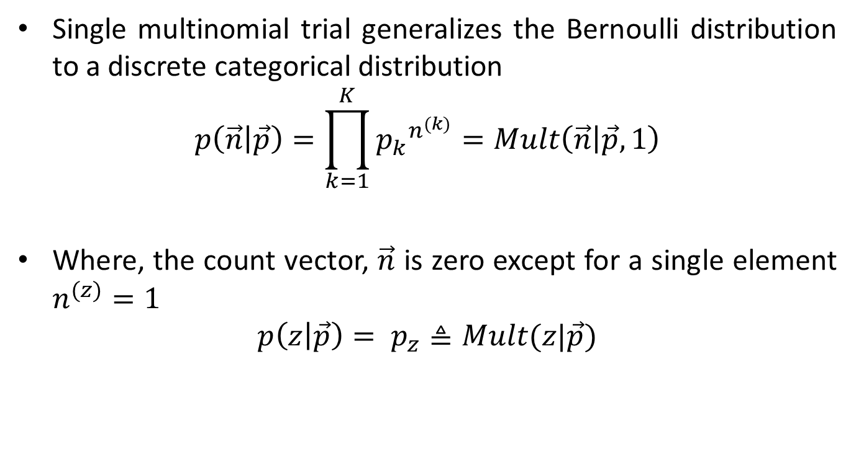
Multivariate case
Single multinomial trial generalizes the Bernoulli distribution to a discrete categorical distribution
$$p\left(\vec{n} | \vec{p}\right)=\prod_{k=1}^{K}{{p_{k}}^{n^{(k)}}}=Mult\left(\vec{n} | \vec{p},1\right)$$
Where, the count vector, $\vec{n}$ is zero except for a single element $n^{(z)}=1$
$$p\left(z | \vec{p}\right)= p_{z}≜Mult(z|\vec{p})$$

Slide 19
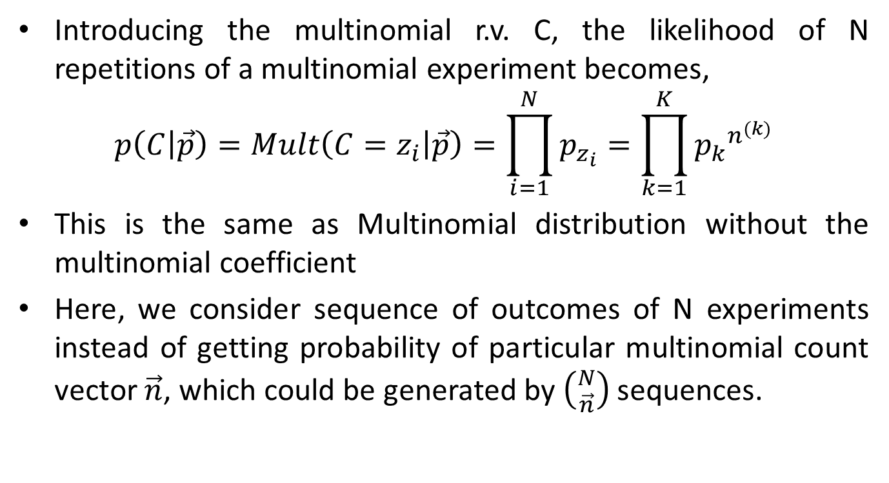
Multinomial Likelihood
Introducing the multinomial r.v. C, the likelihood of N repetitions of a multinomial experiment becomes,
$$p\left(C | \vec{p}\right)=Mult\left(C=z_{i} | \vec{p}\right)=\prod_{i=1}^{N}{p_{z_{i}}}=\prod_{k=1}^{K}{{p_{k}}^{n^{(k)}}}$$
This is the same as Multinomial distribution without the multinomial coefficient
Here, we consider sequence of outcomes of N experiments instead of getting probability of particular multinomial count vector $\vec{n}$, which could be generated by $\left({N \atop \vec{n}}\right)$ sequences.

Slide 20
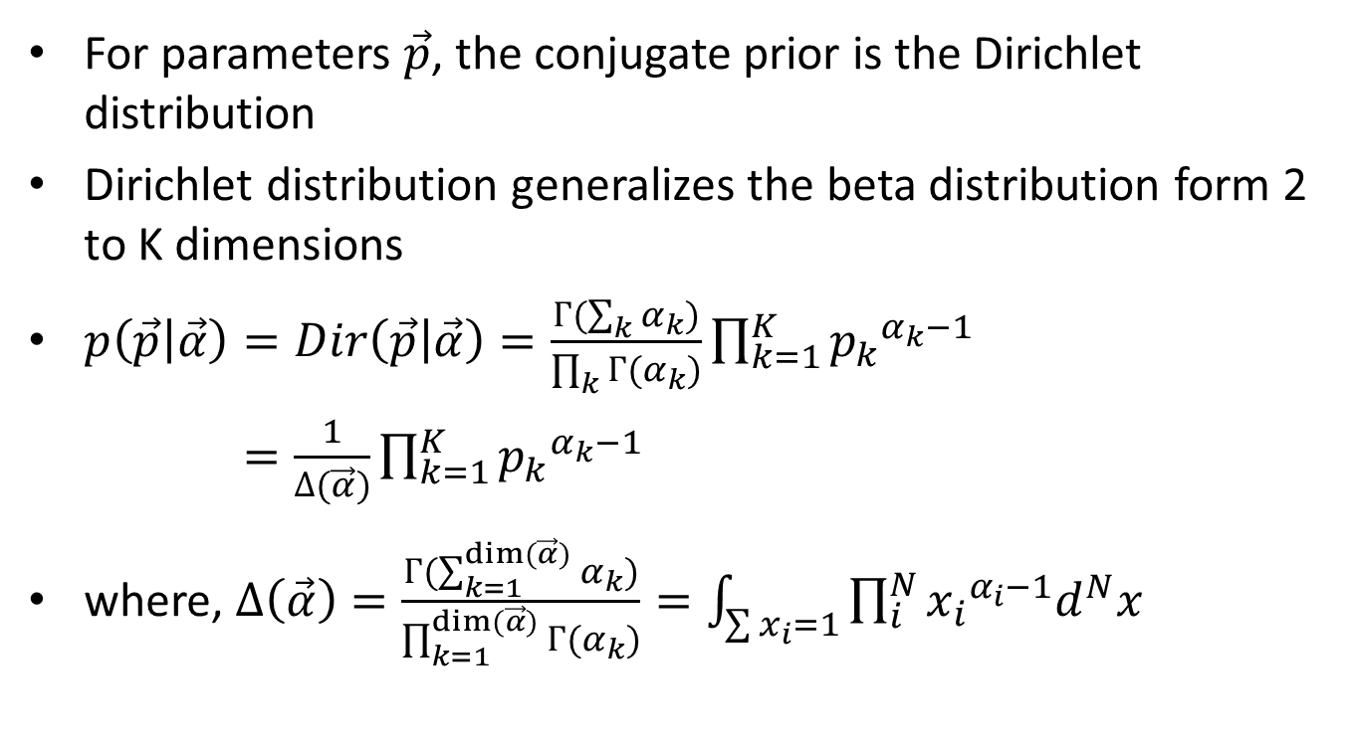
Dirichlet distribution
For parameters $\vec{p}$, the conjugate prior is the Dirichlet distribution
Dirichlet distribution generalizes the beta distribution form 2 to K dimensions
$p\left(\vec{p} | \vec{α}\right)=Dir\left(\vec{p} | \vec{α}\right)=\frac{Г(\sum_{k}{α_{k}})}{\prod_{k}{Г(α_{k}})}\prod_{k=1}^{K}{{p_{k}}^{α_{k}−1}}$
$p\left(\vec{p} | \vec{α}\right)=\frac{1}{∆(\vec{α})}\prod_{k=1}^{K}{{p_{k}}^{α_{k}−1}}$
where, $∆\left(\vec{α}\right)=\frac{Г(\sum_{k=1}^{dim⁡(\vec{α})}{α_{k}})}{\prod_{k=1}^{dim⁡(\vec{α})}{Г(α_{k})}}=\int_{\sum{x_{i}=1}}{\prod_{i}^{N}{{x_{i}}^{α_{i}−1}d^{N}x}}$

Slide 21
Outline
Parameter Estimation
Conjugate Distributions
Modeling Text
Bayesian networks and generative models
Latent Dirichlet Allocation
Gibbs Sampling
Collapsed Gibbs Sampling for LDA

Slide 22
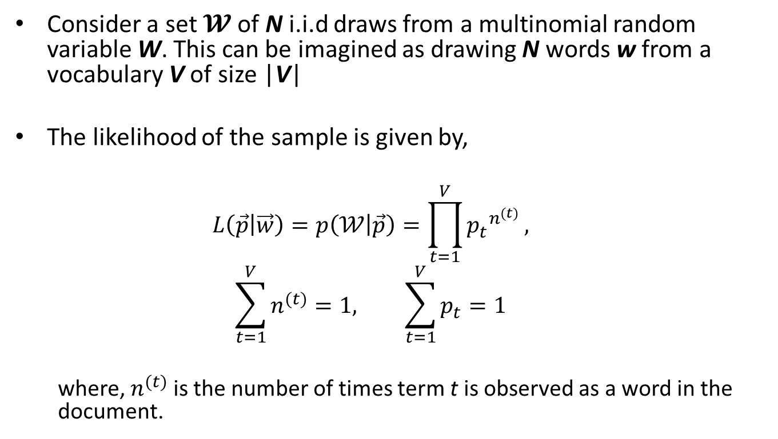
Modelling Text
Consider a set $𝓦$ of N i.i.d draws from a multinomial random variable W. This can be imagined as drawing N words w from a vocabulary V of size |V|
The likelihood of the sample is given by,
$$L\left(\vec{p} | \vec{w}\right)=p\left(𝒲 | \vec{p}\right)=\prod_{t=1}^{V}{{p_{t}}^{n^{(t)}}},$$
$$\sum_{t=1}^{V}{n^{(t)}}=1, \sum_{t=1}^{V}{p_{t}}=1$$
where, $n^{(t)}$ is the number of times term t is observed as a word in the document.

Slide 23
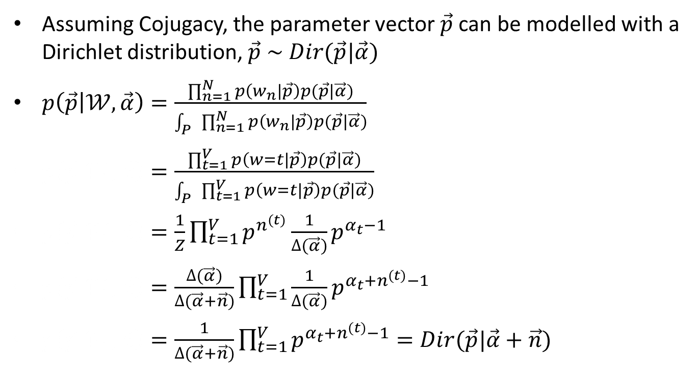
Modelling Text
Assuming Cojugacy, the parameter vector $\vec{p}$ can be modelled with a Dirichlet distribution, $\vec{p} \sim Dir(\vec{p}|\vec{α})$
$p\left(\vec{p} | 𝒲,\vec{α}\right)=\frac{\prod_{n=1}^{N}{p\left(w_{n} | \vec{p}\right)p(\vec{p}|\vec{α})}}{\int_{P}{\prod_{n=1}^{N}{p\left(w_{n} | \vec{p}\right)p(\vec{p}|\vec{α})}}}$
$p\left(\vec{p} | 𝒲,\vec{α}\right)=\frac{\prod_{t=1}^{V}{p\left(w=t | \vec{p}\right)p(\vec{p}|\vec{α})}}{\int_{P}{\prod_{t=1}^{V}{p\left(w=t | \vec{p}\right)p(\vec{p}|\vec{α})}}}$
$p\left(\vec{p} | 𝒲,\vec{α}\right)=\frac{1}{Z}\prod_{t=1}^{V}{p^{n^{(t)}}}\frac{1}{∆(\vec{α})}p^{α_{t}−1}$
$p\left(\vec{p} | 𝒲,\vec{α}\right)=\frac{∆(\vec{α})}{∆(\vec{α}+\vec{n})}\prod_{t=1}^{V}{\frac{1}{∆(\vec{α})}p^{α_{t}+n^{(t)}−1}}$
$p\left(\vec{p} | 𝒲,\vec{α}\right)=\frac{1}{∆(\vec{α}+\vec{n})}\prod_{t=1}^{V}{p^{α_{t}+n^{(t)}−1}}=Dir(\vec{p}|\vec{α}+\vec{n})$

Slide 24
Outline
Parameter Estimation
Conjugate Distributions
Modeling Text
Bayesian networks and generative models
Latent Dirichlet Allocation
Gibbs Sampling
Collapsed Gibbs Sampling for LDA

