Slide 1
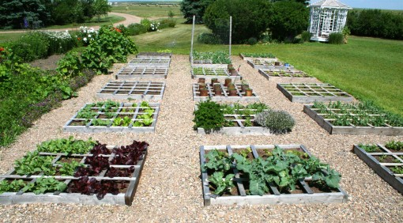
Garden Planner
by Nathalie Desrosiers
& Nikolay Nikolov

Slide 2
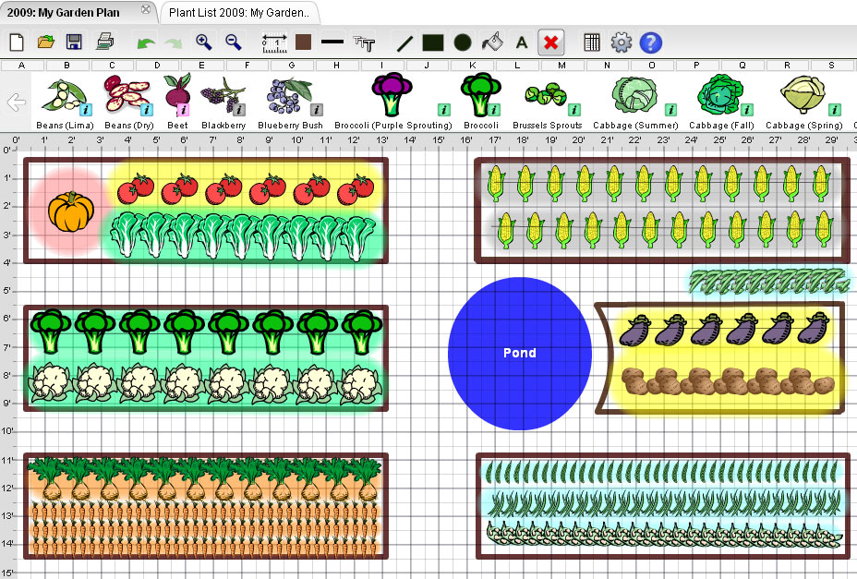

Slide 3
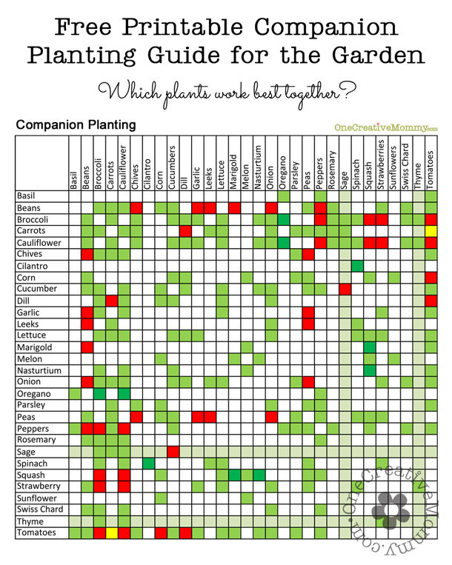

Slide 4
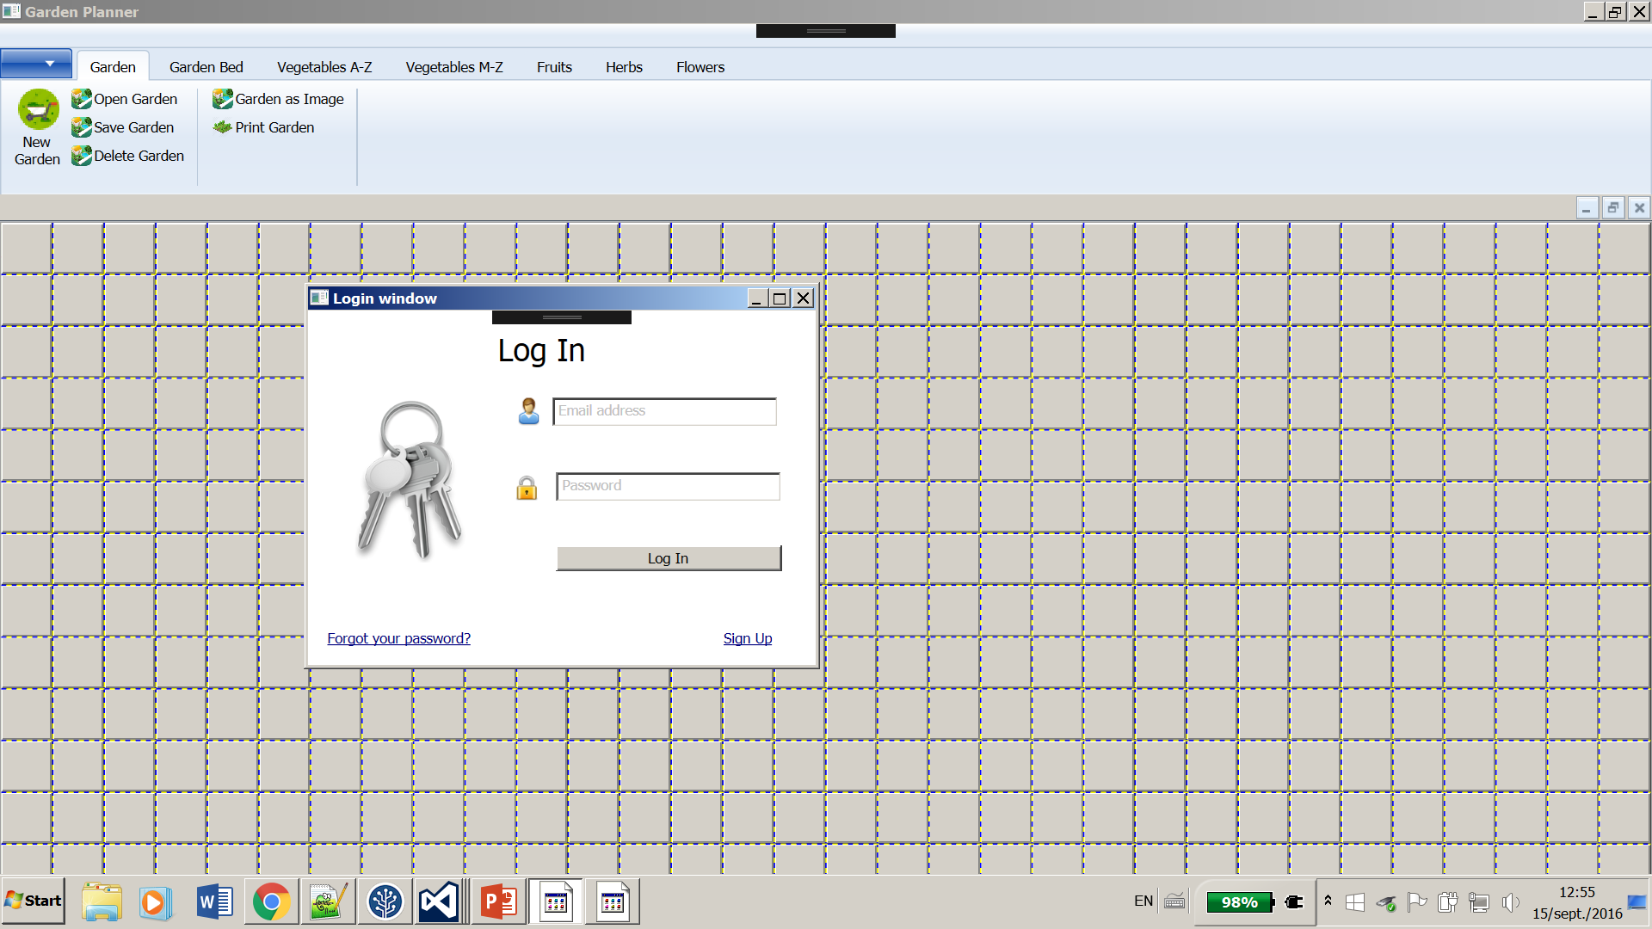

Slide 5
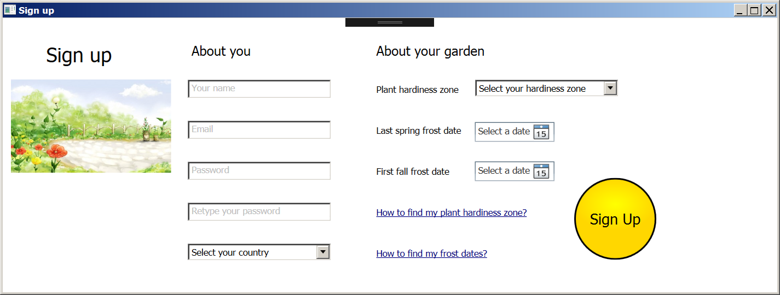

Slide 6
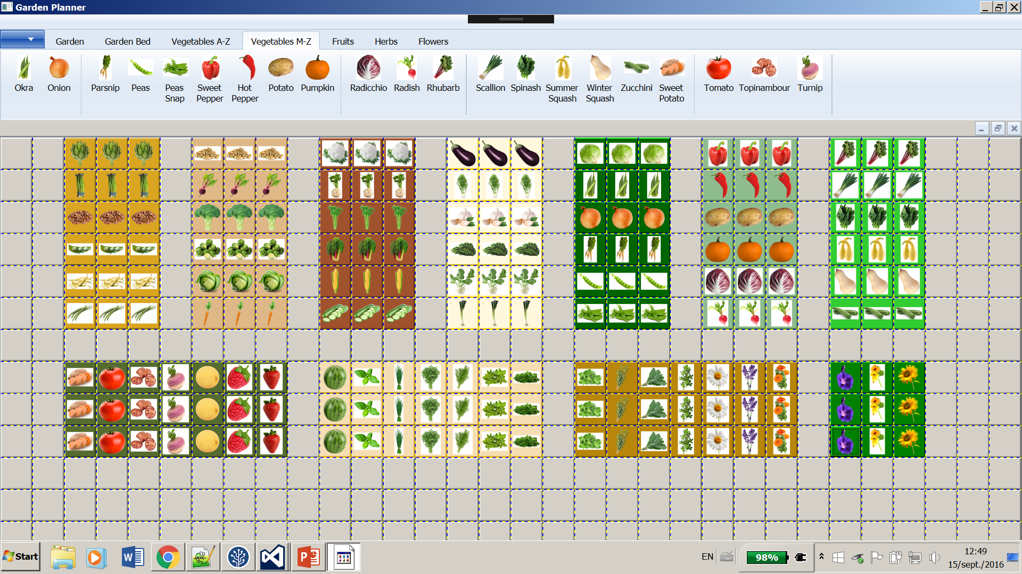

Slide 7
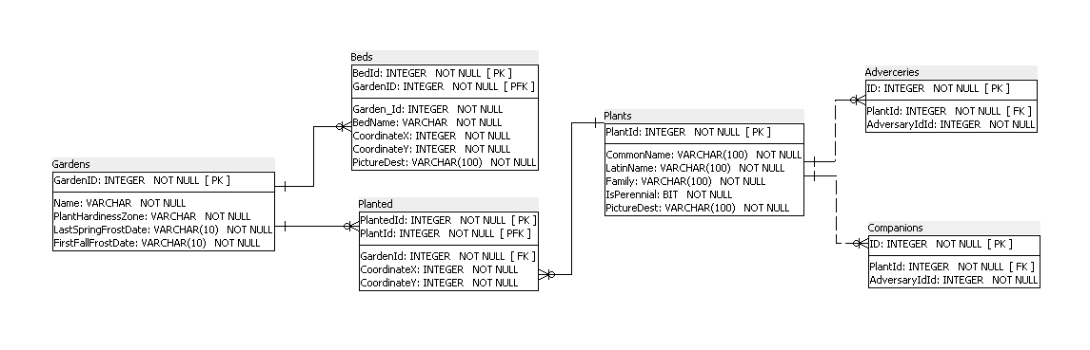
Solution
Data Model

Slide 8
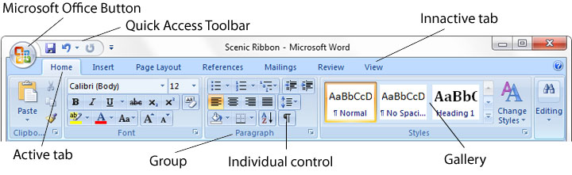
Solution
Ribbon
Not included in WPF
Needs additional installation
Appears in XAML as custom control

Slide 9
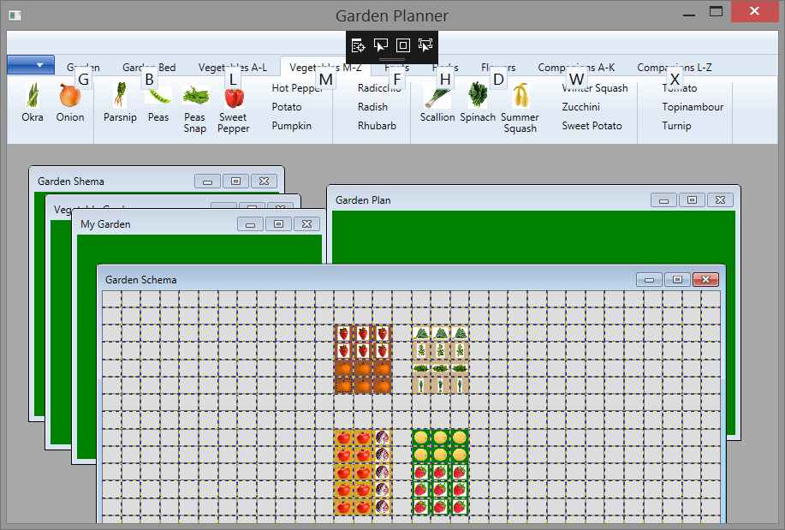
Solution
MDI
WPF.MDI
External Library
Container made to look like window
Grid in it – controls all kind of resizing,
scaling, margins etc.

Slide 10
Solution
Three Layers Application
Database – shown in previous slides
Mid layer – current statuses in arrays and lists
Visualization – mostly done in XAML with no or very little programming

Slide 11
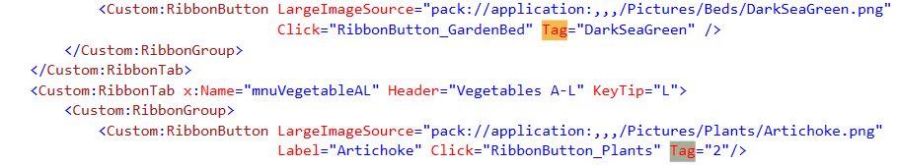
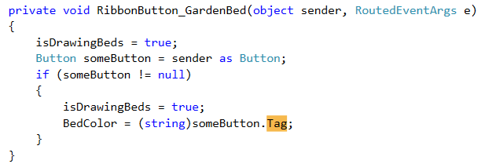
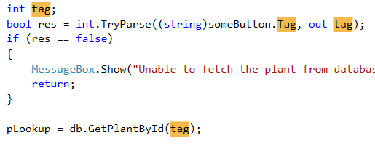
Tips and Tricks
Passing extra parameters to an event handler

Slide 12
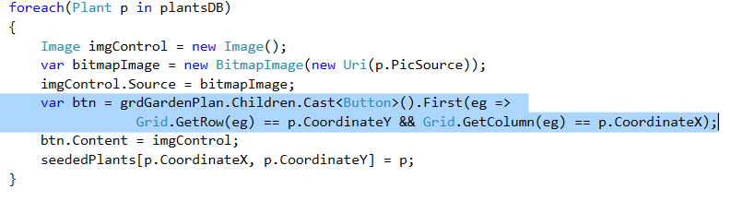
Tips and Tricks
Accessing control through its parent element

