Slide 1
CRUD on REST API using Axios
Saba Turdzeladze
Boris Badashvili
Mariam Kitsmarishvili
Nikoloz Asatiani

Slide 2
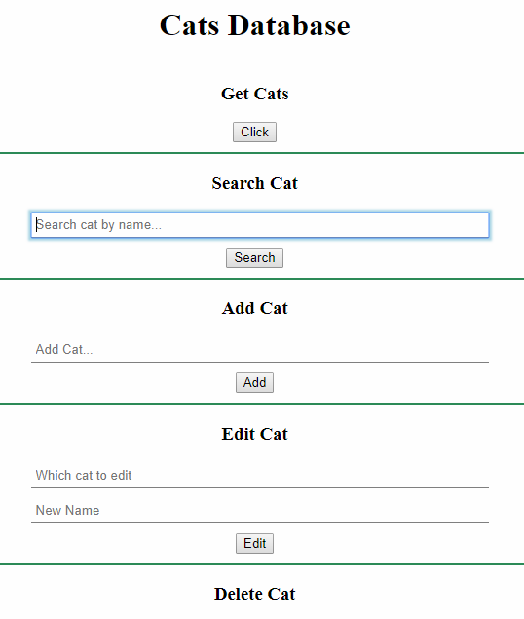

What will we be Building?
Cat Database (because cats are cool)
Code on Github:
https://github.com/nikoloz110/Cats-repo.git

Slide 3
API Structure
Operation | Method | Endpoint | Code on Endpoint
Create | Post | /cats | cats.push(cat);
Read | Get | /cats /cats/:name | res.json(cats); res.json(cat);
Update | Put | /cats/:name | cat.name = newName;
Delete | Delete | /cats/:name | cats.splice(index, 1);

Slide 4


Axios 101
What is axios? – Promise based HTTP client for the browser and node.js
Installing : $ npm install axios || $ bower install axios || https://github.com/mzabriskie/axios/tree/master/dist
Run axios in node:
Run axios in browser:
Axios features:
Make XMLHttpRequests from the browser
Make http requests from node.js
Supports the Promise API
Intercept request and response
Transform request and response data
Cancel requests
Automatic transforms for JSON data
Client side support for protecting against XSRF

Slide 5
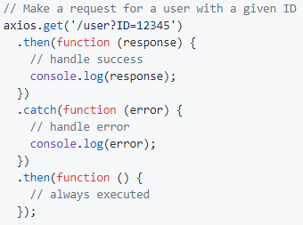
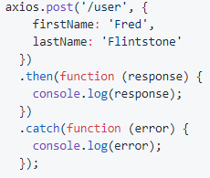
Axios 101
Send request via axios

Slide 6
Summary
GET
POST
Server.js
Index.html
Server.js
Index.html
1. axios.get('/cats')
1. axios.post(`/cats`, { name })
3. Update element with data
2. res.json(cats);
2. cats.push(cat);
Index.html
Server.js
1. axios.put(`/cats/${name}`, { name, newName })
2. cat = cats.find( c => c.name === name );
PUT
3. cat.name = newName;

Slide 7
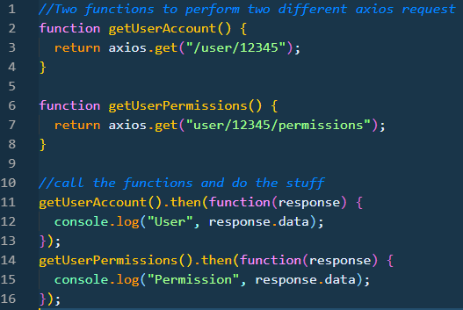
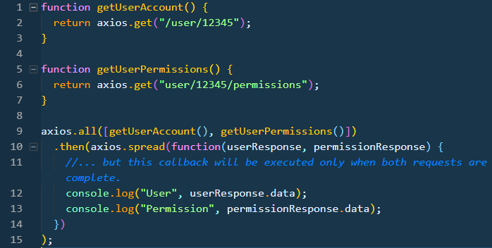
Multiple Requests simultaneously

Slide 8
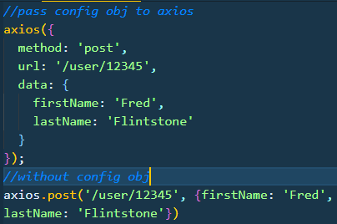
Axios Config Object

Slide 9
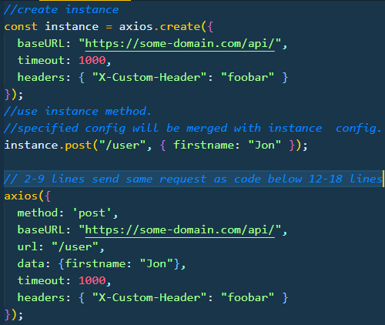
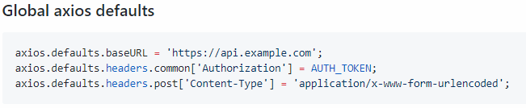
Creating instance & Defaults

Slide 10
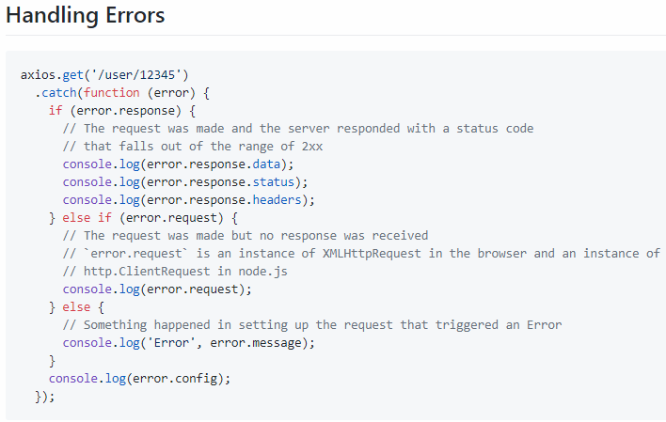

Slide 11
Thanks !

