Slide 1
Real Time Binaural Audio Spatialization Using MAX/MSP
BSc Thesis Presentation
By Nikoloz Kapanadze

Slide 2
Motivation
Stereo Hearing allows us to pinpoint the sound sources
Magnitude based panning methods do not preserve spatial cues
Binaural Spatialization usually used as a post processing technique
Can be used to increase immersion levels in applications such as VR, Telepresence
Audio based orientation for the visually impaired

Slide 3
State of the art
Modern computers have the capacity to perform complex DSP operations
Several DAWs have static spatial panners built in
High end audio-cards use HRTFs to optimize audio for 3D applications
No good solution for adapting the audio environment to changes in listeners orientation in real time

Slide 4
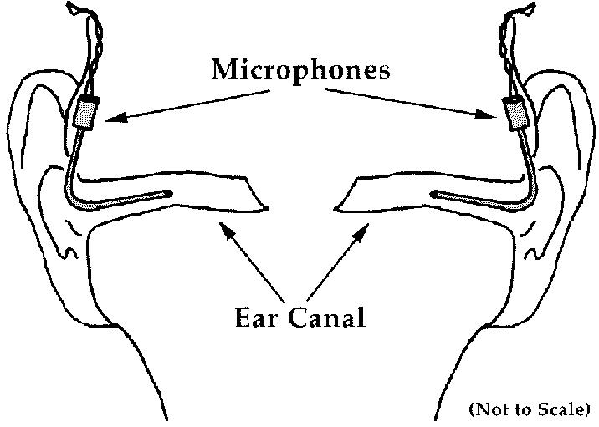
A bit of theory
Binaural recording can capture a particular auditory scene
Binaural processing can map sounds to arbitrary locations in space
HRTF – Head Related Transfer Function
Binaural recording/HRTF
measurement setup

Slide 5
Binaural Processing
Uses HRTFs (Head Related Transfer Functions) to model the listeners had.
Filters audio based on the model
Accounts for the low pass filtering a human head introduces between left and right ears
Accounts for IDT(Interaural Delay Time) - Difference in ToA od signals

Slide 6
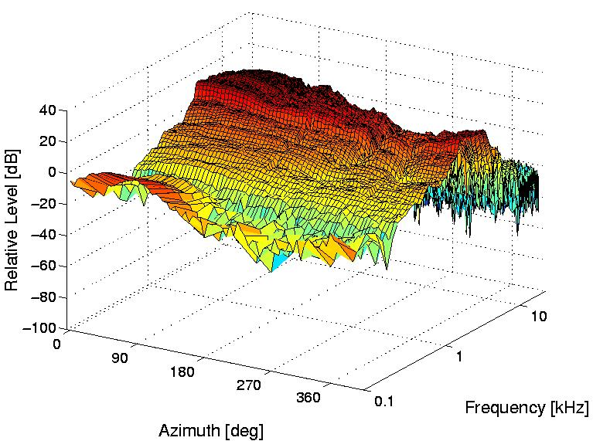
CIPIC HRTF Database
Measurements performed by the Department of Electrical and Computer Engineering at the UCDavis
Public domain database
Defined for 25 azimuth points, 50 elevation points and 200 samples
IDT values for the 25*50 points
HRTFs plotted against azimuth
elevation and time
The CIPIC HRTF Database

Slide 7
Tech&Hardware
Max/MSP 7 + Max SDK 6.0.4 - Modular graphical programming language.
Arduino UNO R3 – Atmega 328p based AVR microprocessor dev board
Invensense MPU 6050 – 6DoF Accelerometer/Gyro breakout board

Slide 8
Max / MSP
PureData(PD) based GUI programming language
Modular design: Easily extensible through a thoroughly documented SDK for C programming language. Compiles into shared libraries
Good wrapper for audio I/O and driver communications
Allows changing the patcher while audio is running
Multiple DSP chains can run in parallel, takes care of concurency

Slide 9
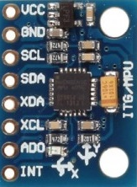
Invensense MPU 6050
Combination of an accelerometer and a gyroscope
Uses the common I2C serial protocol
Can be extended with a magnetometer over slave I2C pins
Easy to interface
6DoF for low drift over time

Slide 10
Arduino
Good alternative for dedicated I2C adapter
Easy to program
Good support for a wide range of peripheral
Good libraries for working with I2C and MPU line of motion sensors in particular
Available through Embedded Systems lab

Slide 11
Implementation
Can be split into two sections:
DSP - Audio Processing
Head-tracking – Generates control signals for the DSP objects.

Slide 12
Convolver
MSP family of Max Externals
The main method of the object is called within the callback of an audio driver
Picks appropriate HRIR based on control input
Does fixed size convolution
Overlap add to merge consecutive buffers

Slide 13
IDT
Shares the common structure with Convolver object
Simple two channel delay line
Picks delay time based on control input

Slide 14
Serial communication
Arduino(with custom firmware) + MPU 6050 for orientation sensing
Talk to PC over virtual COM port
Generates output in the form of quaternion
arduino_accel_gyro Max external polls Arduino for updated vales at regular specifiable intervals

Slide 15
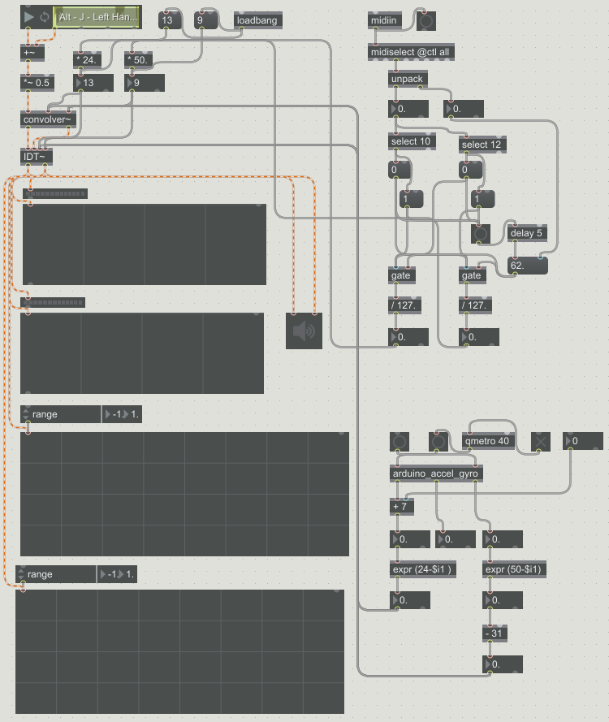
Patcher
The sections discussed above come together in the patcher
Spectroscope and Osciloscope for audio monitoring
Takes input from an audio file
Can be reconfigured to accept audio from elementary signal generators

Slide 16
Testing and Evaluation
Precision of head-tracking:
Average Deviation - 3.7°
Maximum Deviation - 10°
Drift Accumulation:
5° Over 15 minutes of “intended” use
Precision of localization:
Average Deviation - 4.6°
Maximum Deviation - 10°

Slide 17
Q&A
Questions?

