Slide 1

Off-Grid Innovation

Slide 2



What is a Fabship? … no it’s not a boat
Fabship is an off-grid Fab Lab, powered by renewable energy and Earthship-inspired design and systems.
+
=
EARTHSHIP

Slide 3
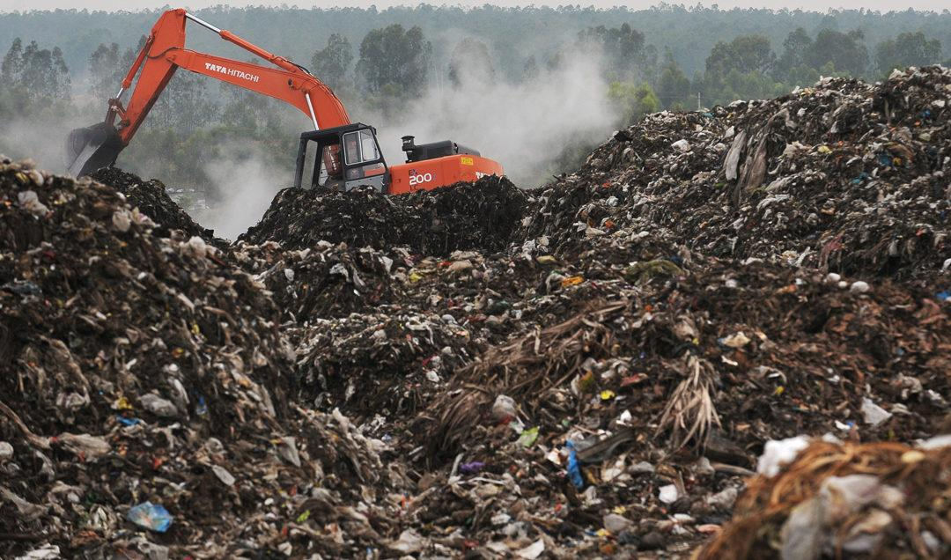
What seems to be the problem?
We are facing a global ecological crisis
We produce more trash per capita than we can sustainably dispose of. This ends up here.
In 2007 alone, the US produced a record 254 million tons of garbage.

Slide 4
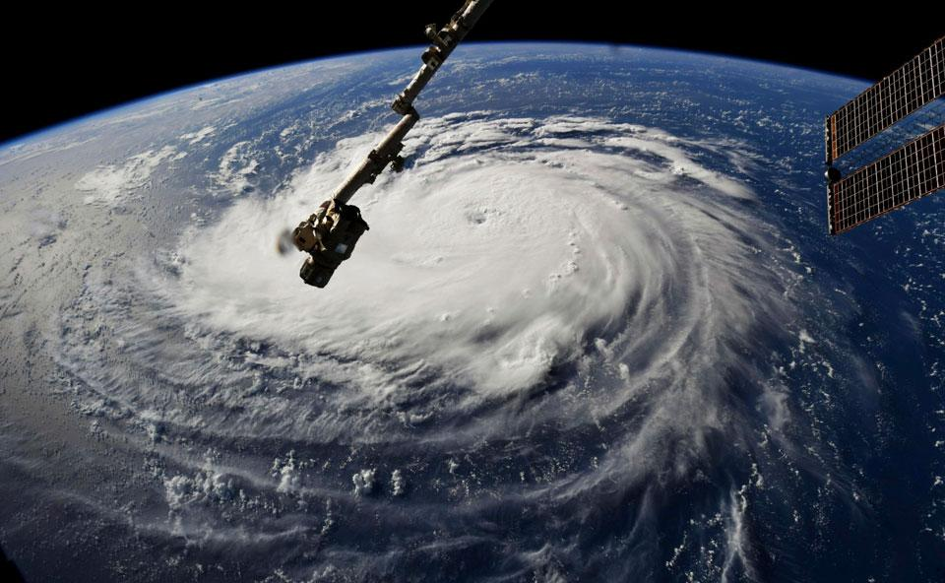
Tropical storm Michael seen from space (2018)
Human induced climate change is a scientifically proven reality. Ignorance is no longer an excuse.
With a rapidly warming planet is leading to rising sea levels and melting ice sheets, but also more super storms, wildfires and droughts.
These natural disasters are disproportionately affecting parts of the planet and people who have least contributed to climate change.

Slide 5
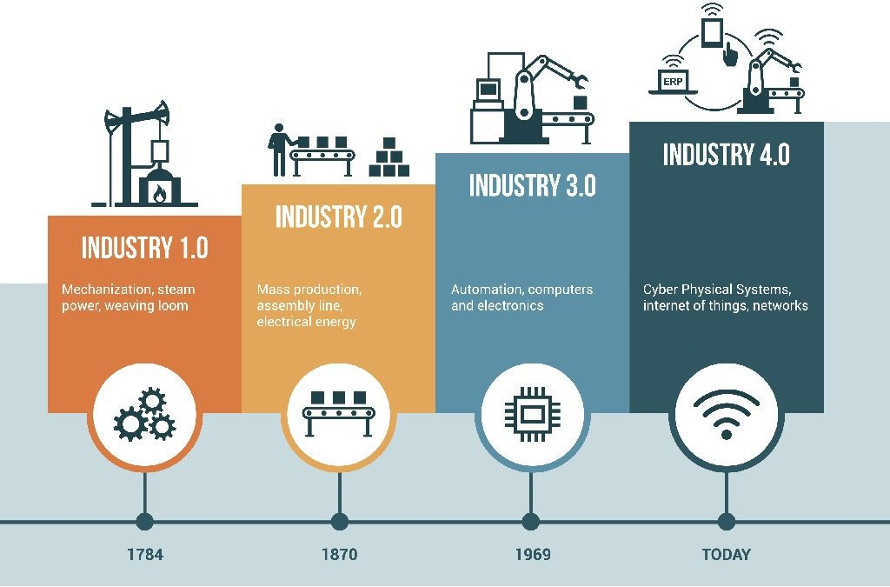
Industrial Revolution 4.0
Mechanization
Mass production
Automation
Networked economy

Slide 6
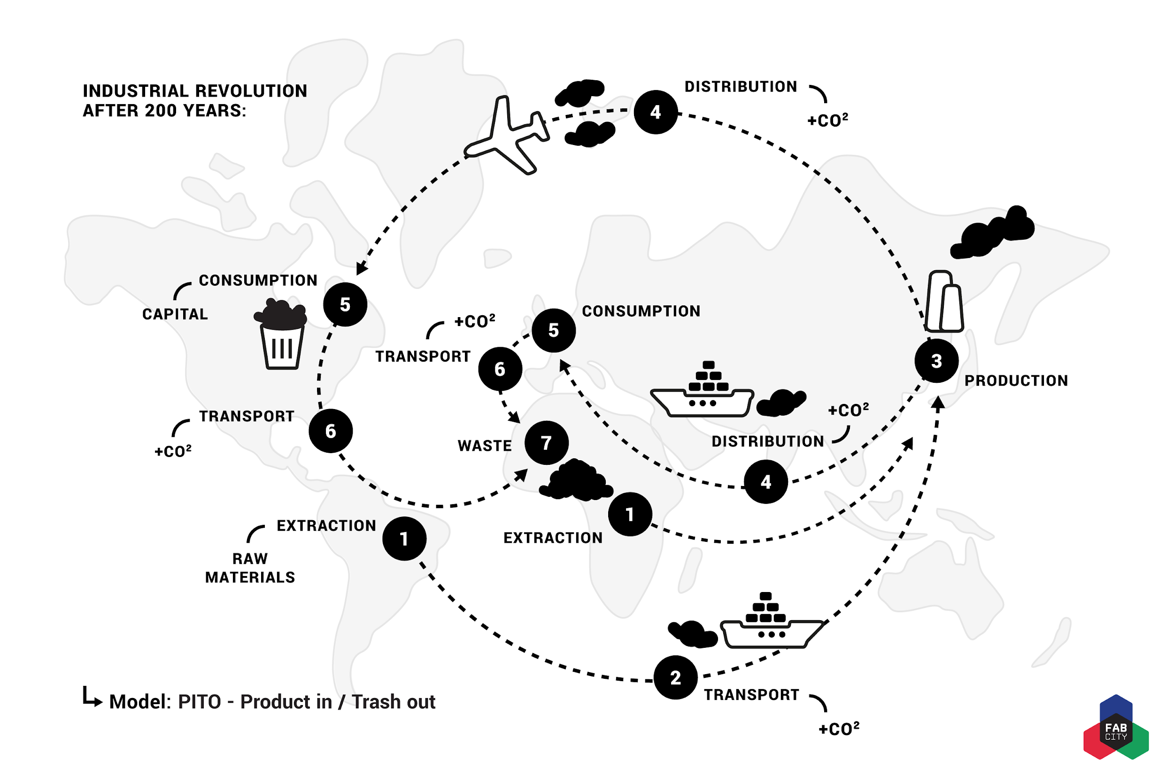

Slide 7
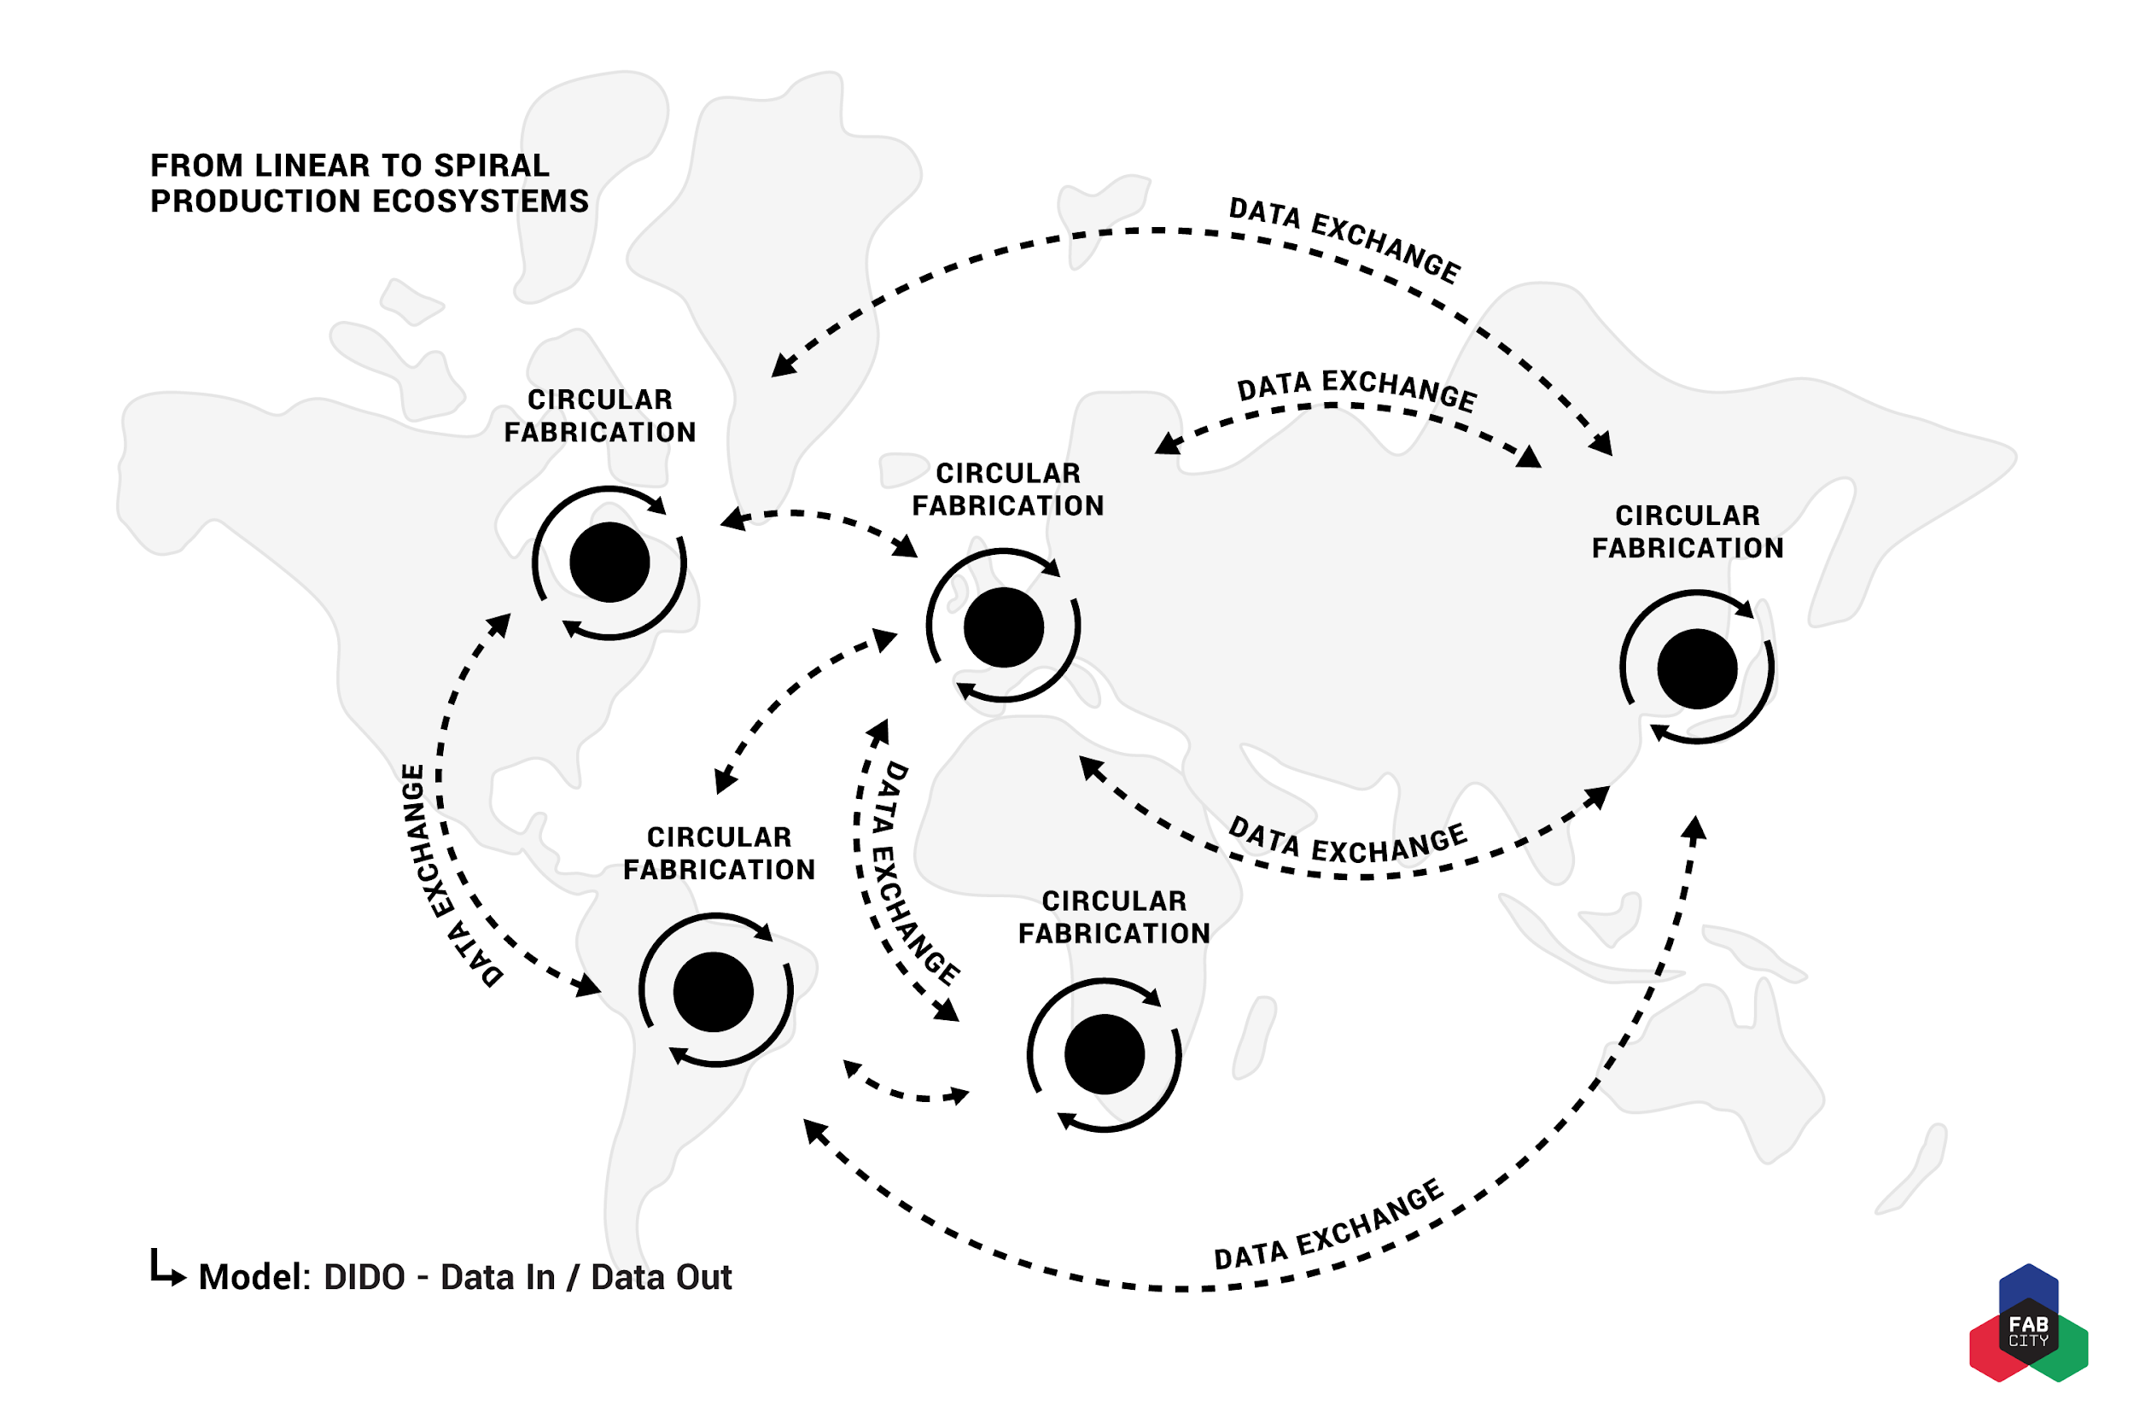

Slide 8
The parallel histories of two movements
Romanticism to ecological awareness
Counter-culture
Back to the land and communes
The Whole Earth Network
Permaculture and the 1 straw revolution
Eco-building + Earthships
Babbage, Ada Lovelace and the first algorithm.
Turing, Shannon & Von Neumann analogue to digital computing.
MIT and the tech model railroad club
Homebrew computing, silicon valley and cyberculture
Hackerspaces, hacklabs and Fablabs

Slide 9
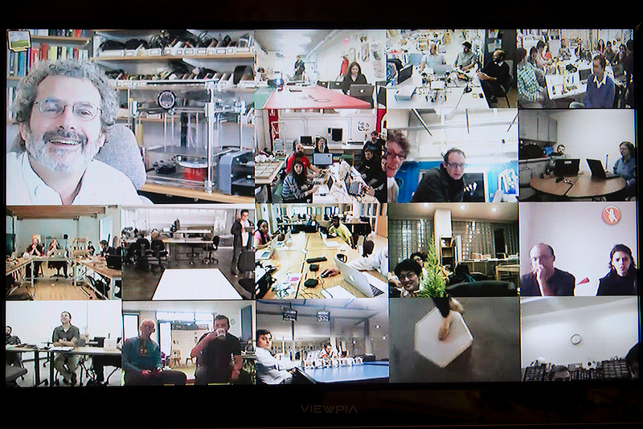
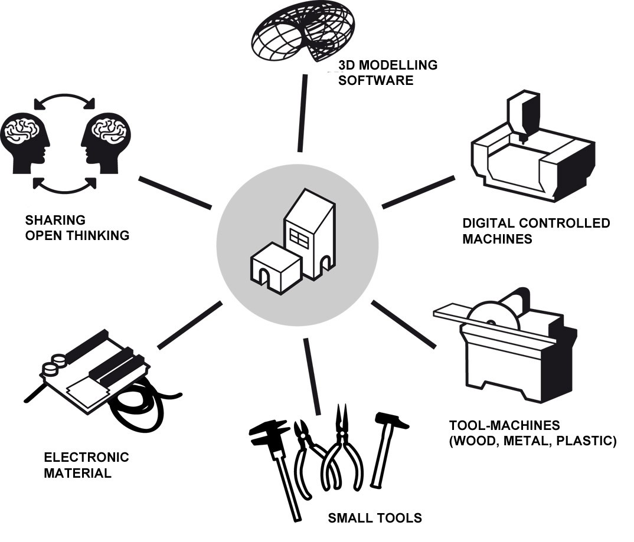
FAB LABS = SHARING KNOWLEDGE & OPEN LEARNING
Circular Economy does not mean a closed economy

Slide 10
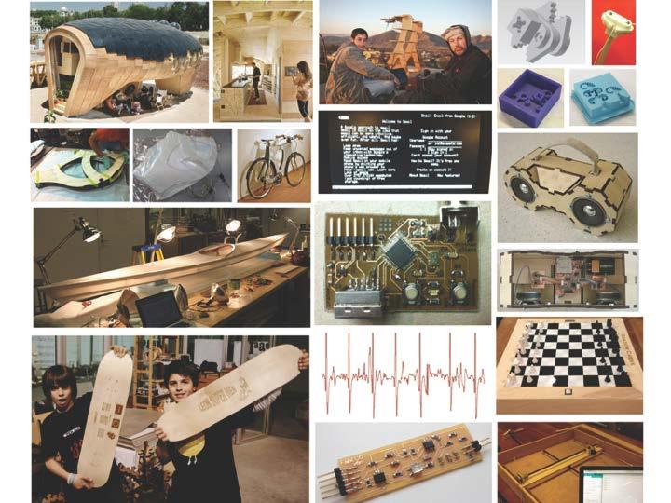
How to Make (Almost) Anything?
WHY to Make (Almost) Anything?

