Slide 2
Windows 12

Slide 3

Windows 12

Slide 4
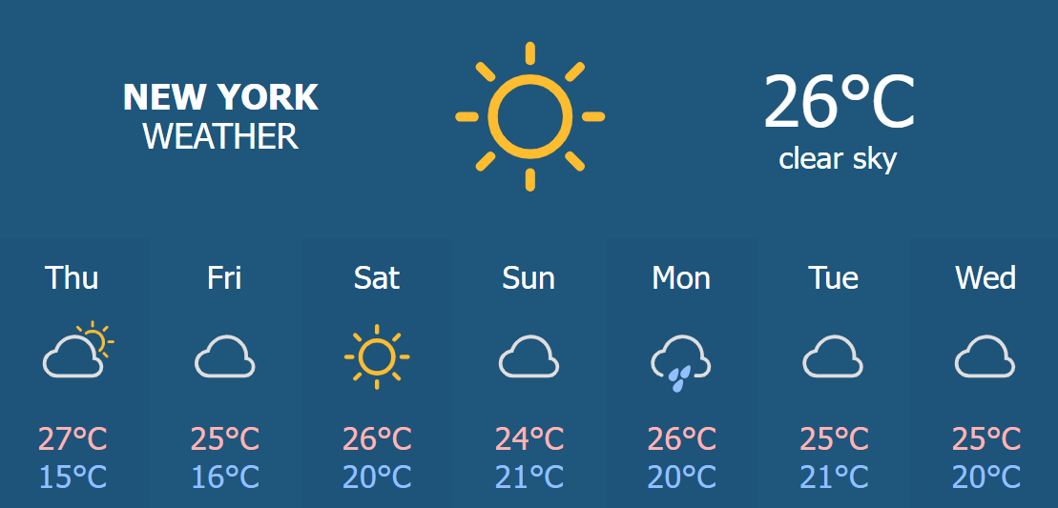
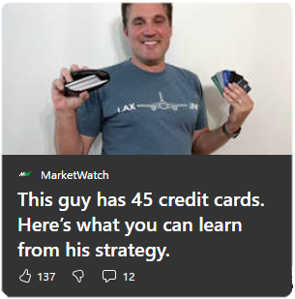



12:55
9/11/25
Joseph Lo Casto
Please enter your password.
Guest Mode
Light Breeze – 75°

Slide 5
12:55
9/11/25
Joseph Lo Casto
Please enter your password.
Guest Mode
Light Breeze – 75°

