Slide 1
Data Mining
Classification: Alternative Techniques
Lecture Notes for Chapter 5
Introduction to Data Mining
by
Tan, Steinbach, Kumar
© Tan,Steinbach, Kumar Introduction to Data Mining 4/18/2004 <number>

Slide 2
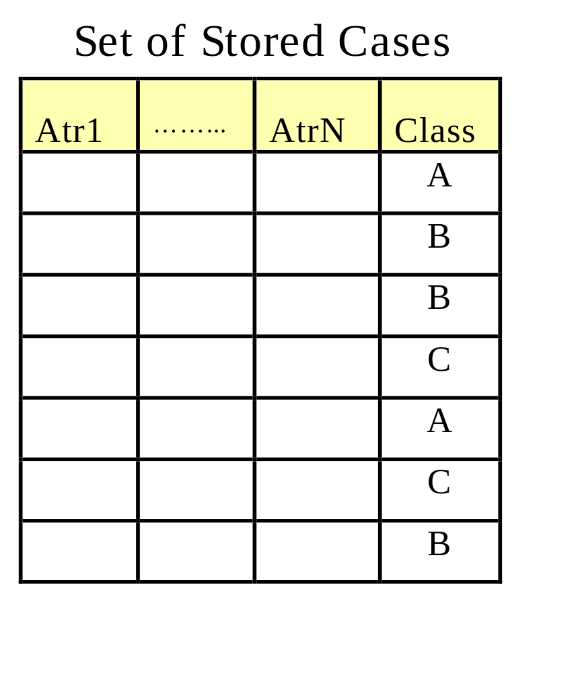
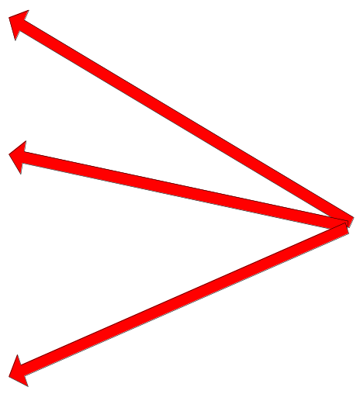
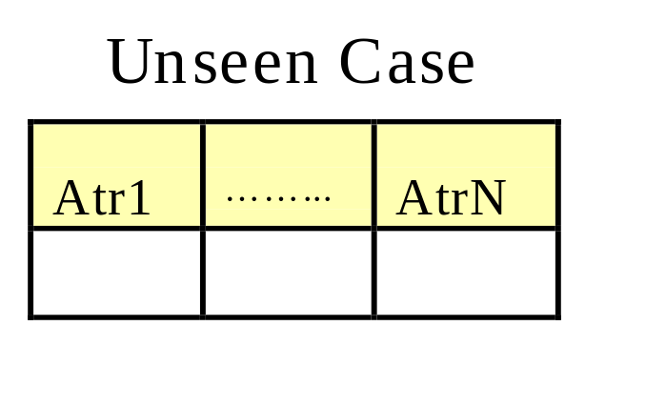
Instance-Based Classifiers
Store the training records
Use training records to
predict the class label of
unseen cases

Slide 3
Instance Based Classifiers
Examples:
  Rote-learner
    Memorizes entire training data and performs classification only if attributes of record match one of the training examples exactly
  Nearest neighbor
    Uses k “closest” points (nearest neighbors) for performing classification

Slide 4






Nearest Neighbor Classifiers
Basic idea:
  If it walks like a duck, quacks like a duck, then it’s probably a duck
Compute Distance
Test Record
Training Records
Choose k of the “nearest” records

Slide 5
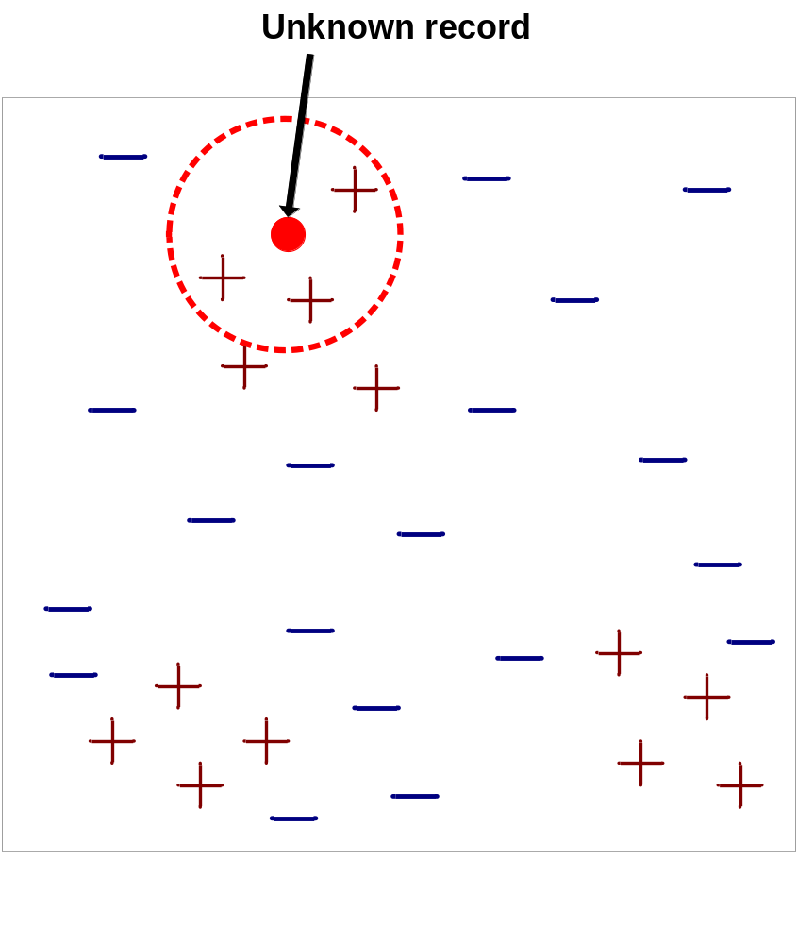
Nearest-Neighbor Classifiers
Requires three things
  The set of stored records
  Distance Metric to compute distance between records
  The value of k, the number of nearest neighbors to retrieve
To classify an unknown record:
  Compute distance to other training records
  Identify k nearest neighbors
  Use class labels of nearest neighbors to determine the class label of unknown record (e.g., by taking majority vote)

Slide 6

Definition of Nearest Neighbor
K-nearest neighbors of a record x are data points that have the k smallest distance to x

Slide 7
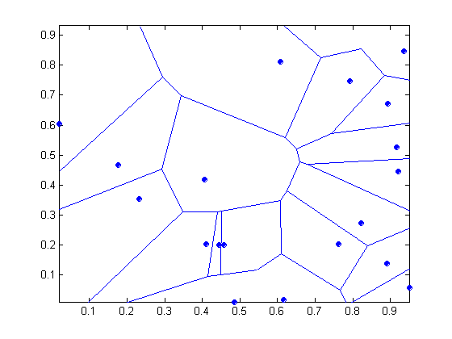
1 nearest-neighbor
Voronoi Diagram

Slide 8
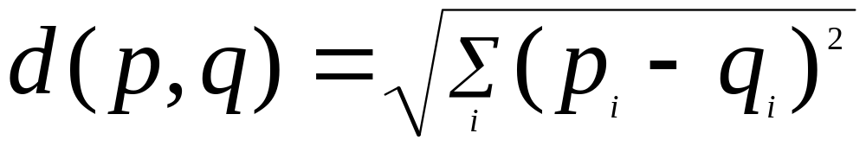
Nearest Neighbor Classification
Compute distance between two points:
  Euclidean distance
Determine the class from nearest neighbor list
  take the majority vote of class labels among the k-nearest neighbors
  Weigh the vote according to distance
    weight factor, w = 1/d²

Slide 9
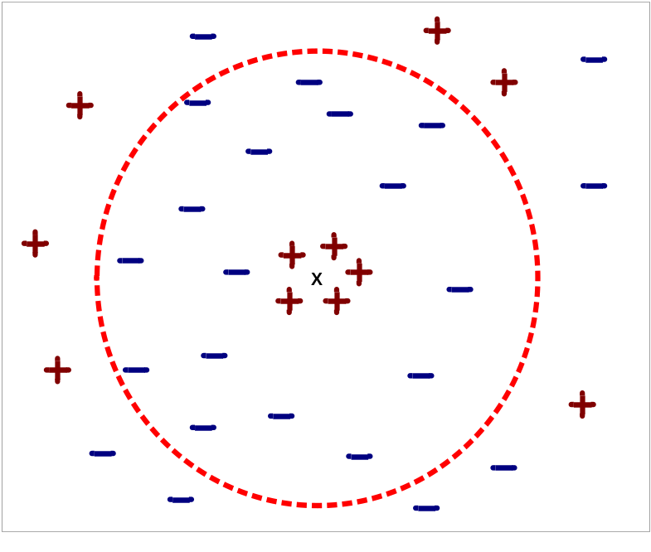
Nearest Neighbor Classification…
Choosing the value of k:
  If k is too small, sensitive to noise points
  If k is too large, neighborhood may include points from other classes

Slide 10
Nearest Neighbor Classification…
Scaling issues
  Attributes may have to be scaled to prevent distance measures from being dominated by one of the attributes
  Example:
    height of a person may vary from 1.5m to 1.8m
    weight of a person may vary from 90lb to 300lb
    income of a person may vary from $10K to $1M
Issues with data dimensionality
  Curse of dimensionality

Slide 11
Nearest neighbor Classification…
k-NN classifiers are lazy learners
  It does not build models explicitly
  Unlike eager learners such as decision tree induction
  Classifying unknown records are relatively expensive

Slide 12
Example: PEBLS
PEBLS: Parallel Examplar-Based Learning System (Cost & Salzberg)
  Works with both continuous and nominal features
    For nominal features, distance between two nominal values is computed using modified value difference metric (MVDM)
  Each record is assigned a weight factor
  Number of nearest neighbor, k = 1

Slide 13

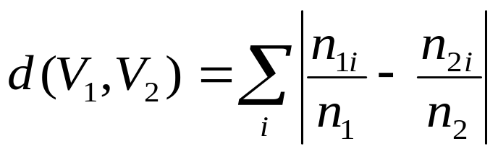
Example: PEBLS
Distance between nominal attribute values:
d(Single,Married)
= | 2/4 – 0/4 | + | 2/4 – 4/4 | = 1
d(Single,Divorced)
= | 2/4 – 1/2 | + | 2/4 – 1/2 | = 0
d(Married,Divorced)
= | 0/4 – 1/2 | + | 4/4 – 1/2 | = 1
d(Refund=Yes,Refund=No)
= | 0/3 – 3/7 | + | 3/3 – 4/7 | = 6/7
Class | Marital Status
 | Single | Married | Divorced
Yes | 2 | 0 | 1
No | 2 | 4 | 1
Class | Refund
 | Yes | No
Yes | 0 | 3
No | 3 | 4

Slide 14
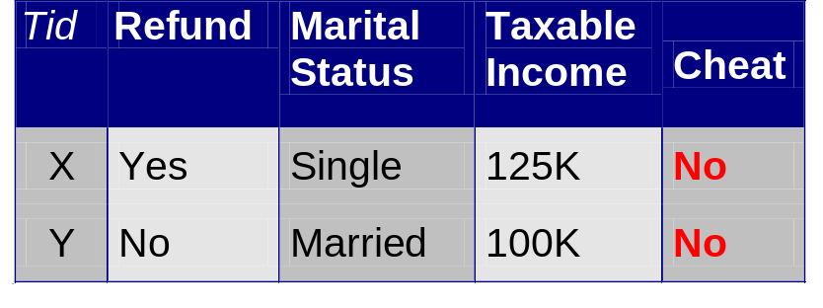
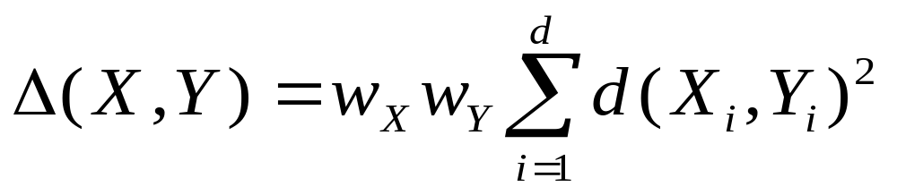
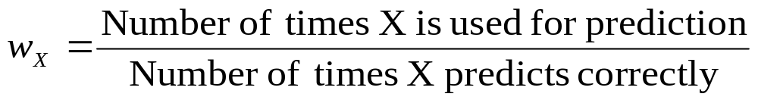
Example: PEBLS
Distance between record X and record Y:
where:
w_{X} ≅ 1 if X makes accurate prediction most of the time
w_{X} > 1 if X is not reliable for making predictions

Slide 15
Bayes Classifier
A probabilistic framework for solving classification problems
An experiment produces exactly one out of several possible outcomes
The set of all possible outcomes is called the Sample Space of the experiment
A subset of the sample space (a collection of possible outcomes) is called an event
Example: throwing two fair dice is an experiment. The sample space contains 36 elements {(1,1), (1,2),…. (6,6)}. Obtaining a sum of 7 in the throws is an event

Slide 16
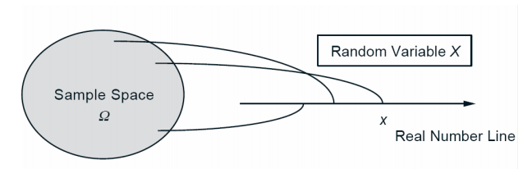
Bayes Classifier
Random Variables
Given an experiment and the corresponding sample space, a random variable associates a particular number with each outcome
This number is referred to as the numerical value of the random variable
A random variable can be discrete or continuous
A discrete random variable has a countable number of possible values
Example: Let X be the random variable denoting the sum of scores in throwing two fair dice. X is a discrete random variable, which can take on values from the set {2,3,4,5,6,7,8,9,10,11,12}
A continuous random variable can assume an infinite number of values in a given range
Example: Let X be the random variable denoting the height of a student in a class

Slide 17
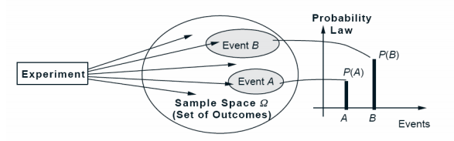
Bayes Classifier
Probability
With every event A, we associate a non-negative number P(A) (called the probability of event A), which encodes our knowledge or belief about the likelihood of occurrence of event A
Example: in throwing two fair dice, consider the event of obtaining a sum of 7. The probability of that event is 6/36 = 1/6
Properties
Non-negativity: P(A) >= 0, for every event A
Additivity: P(A U B) = P(A) + P(B), for two disjoint events A and B
Normalization: the probability of the entire sample space (all possible outcomes) is 1, that is P(S) = 1

Slide 18
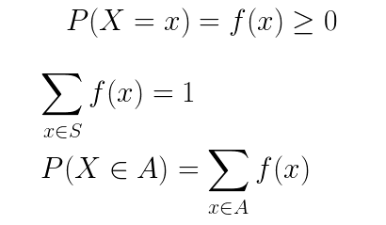
Bayes Classifier
Probability Mass Function (PMF)
A discrete random variable X has an associated probability mass function (PMF) p_{X}(x), which denotes the probability that the random variable X can assume a value x.
Example: Suppose S is the sample space of all outcomes of a single toss of a fair coin and X is the random variable defined on S assigning 0 to “tails” and 1 to “heads”. The pmf is given by:
p_{X}(x) = ½ , if x ϵ {0,1}
= 0 otherwise
The PMF of a discrete random variable X satisfies the following properties:

Slide 19
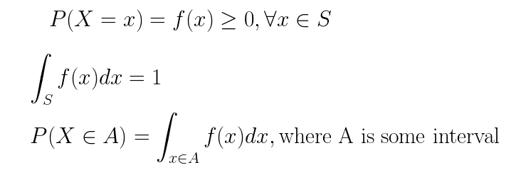
Bayes Classifier
Probability Density Function (PDF)
A continuous random variable X has an associated probability density function (PDF) p_{X}(x), which denotes the probability that the random variable X can assume a value within a given interval.
The PDF of a continuous random variable X is an integrable function f(x) that satisfies the following properties:
S is called the support, that is the domain over which f(x) is defined

Slide 20
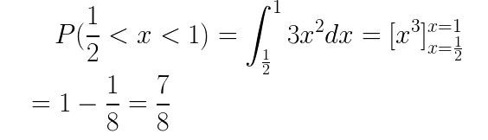
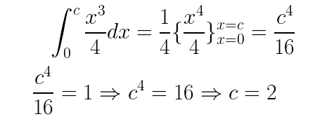
Bayes Classifier
Probability Density Function (PDF)
Example: Let X be a continuous random variable whose PDF is given by f(x) = 3x² for 0<x<1. What is the probability that x falls between ½ and 1.
Example: Let X be a continuous random variable whose PDF is given by f(x) = x³/4, for 0<x<c. What value of c makes f(x) a valid PDF?
Valid PDF
Negative 2 is not possible as x³/4 will not be positive for c = -2

Slide 21
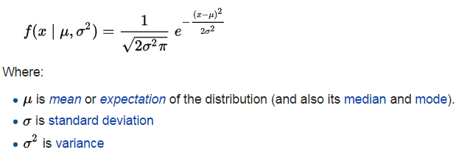
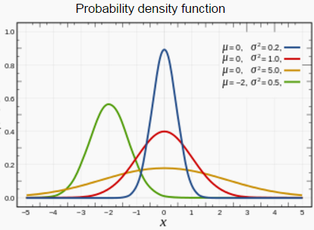
Bayes Classifier
The Normal Distribution
A very commonly used continuous probability distribution
The probability density function of a normal distribution is:
f(x)

Slide 22
Bayes Classifier
Prior Probability / Marginal Probability
Prior knowledge about an event occurring
It is not conditioned on another event
Example: the probability that a card drawn at random from a fair deck of cards is red = p(red) = 0.5
Example: the probability that a card drawn at random from a fair deck is a 4 = p(4) = 4/52 = 1/13
Joint Probability
The probability that two (or more) events occur simultaneously
It is the probability of the intersection of two or more events
For two random variables A and B, the joint probability is denotes by p(A,B)
p(A,B) is interpreted as p(A=a, B=b): probability that the random variable A takes up a value a and the random variable B takes up a value b
Example: the probability that a card drawn at random from a fair deck is a 4 and red = p(4 and red) = 2 / 52 = 1/26
Conditional Probability
The probability of an event A occurring, given that an event B has already occurred
Denoted by p(A|B) – probability of event A conditioned on event B
p(A|B) is interpreted as p(A=a | B=b): probability that the random variable A takes a value a given that the random variable B has already taken the value b
Example: the probability that a card drawn at random from a fair deck is 4 given it is a red card = p(4|red) = 2/26 = 1/13

Slide 23


Bayes Classifier
Let X and Y be two random variables. The joint probability P(X=x, Y=y) refers to the probability that the variable X will take on the value x and the variable Y will take on the value y
The conditional probability P(Y=y | X=x) refers to the probability that the variable Y will take on the value y, given that the variable X is observed to have the value x
The joint and conditional probabilities are related in the following way:
Prior Probability
Conditional Probability
Prior Probability
Joint Probability
Conditional Probability
Rearranging the terms leads to the following formula, known as the Bayes theorem

Slide 24
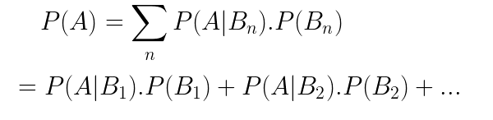

Bayes Classifier
Law of Total Probability
It is a fundamental rule relating marginal probabilities to conditional probabilities
If B1, B2, B3… is a finite partition of a sample space (in other words, a set of pairwise disjoint events whose union is the entire sample space), then for any event A,
Bayes theorem

Slide 25
Bayes Classifier
Law of Total Probability
Suppose that two factories supply light bulbs to the market. Factory X's bulbs work for over 5000 hours in 99% of cases, whereas factory Y's bulbs work for over 5000 hours in 95% of cases. It is known that factory X supplies 60% of the total bulbs available. What is the probability that a purchased bulb will work for longer than 5000 hours?
Let B be the random variable denoting the factory manufacturing the bulb and A be the random variable denoting whether or not it lasts for more than 5000 hours.
P(B = x) = 6/10, P(B = y) = 4/10
P(A|B=x) = 0.99, P(A|B=y) = 0.95
We need to compute:
P(A) = P(A|B=x). P(B = x) + P(A|B=y). P(B = y)
= 0.99*0.6 + 0.95*0.4
= 0.974

Slide 26
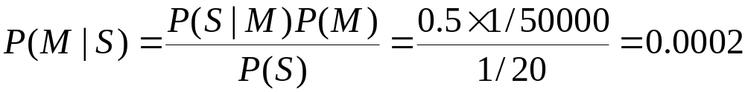
Example of Bayes Theorem
Given:
  A doctor knows that meningitis causes stiff neck 50% of the time
  Prior probability of any patient having meningitis is 1/50,000
  Prior probability of any patient having stiff neck is 1/20
If a patient has stiff neck, what’s the probability he/she has meningitis?
Let S be the random variable denoting whether the patient has stiff neck and M be the random variable denoting whether he/she has meningitis.
Prior probability of S, P(S) = 1/20
Prior probability of M, P(M) = 1/50,000
Conditional probability of having stiff neck given the patient has meningitis, P(S|M) = ½
Therefore, conditional probability that the patient has meningitis, given he/she has stiff neck is:

Slide 27
Example of Bayes Theorem
Bowl A contains 2 red chips; bowl B contains two white chips; and bowl C contains 1 red chip and 1 white chip. A bowl is selected at random, and one chip is taken at random from that bowl. What is the probability of selecting a white chip?
Let A be the event that Bowl A is randomly selected; let B be the event that Bowl B is randomly selected; and let C be the event that Bowl C is randomly selected. Because there are three bowls that are equally likely to be selected, P(A) = P(B) = P(C) = 1/3. Let W be the event that a white chip is randomly selected. The probability of selecting a white chip from a bowl depends on the bowl from which the chip is selected:
P(W | A) = 0
P(W | B) = 1
P(W | C) = ½
By the law of total probability:
P(W)=P(W|A)P(A)+P(W|B)P(B)+P(W|C)P(C) = 0.1/3 + 1.1/3 + ½.1/3 = ½

Slide 28
Example of Bayes Theorem
Consider a football match being played between two rival teams: Team 0 and Team 1. Suppose Team 0 wins 65% of the time and Team 1 wins the remaining matches. Among the games won by Team 0, only 30% come from playing in Team 1’s football field. On the other hand, 75% of the victories for Team 1 are obtained while playing at home. If Team 1 is to host the next match between the two teams, which team is most likely to win?
Let X be the random variable denoting the team which hosts the match and Y be the random variable denoting the team that wins the match
Prior probability that team 0 wins, P(Y = 0) = 0.65
Prior probability that team 1 wins, P(Y = 1) = 1 – P(Y=0) = 0.35
Conditional probability that team 1 hosted the match it won is P(X=1 | Y =1) = 0.75
Conditional probability that team 1 hosted the match won by team 0 is P(X=1 | Y = 0) 0.3
Our objective is to compute P(Y=1 | X=1)

Slide 29
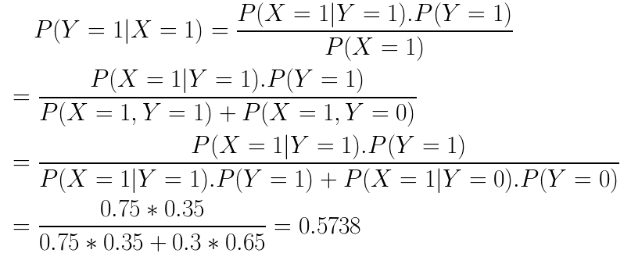

Example of Bayes Theorem
Law of total probability
Bayes theorem
Further,
Thus, team 1 has a better chance of winning the next match

Slide 30
Bayesian Classifiers
Conditional Independence
Let X, Y and Z denote three random variables. X is said to be conditionally independent of Y given Z, if the following condition holds:
P(X|Y,Z) = P(X|Z)
Example
Relationship between a person’s arm length and reading skills
One might observe that people with longer arms tend to have higher levels of reading skills
Can be explained by the presence of the confounding factor, age
A young child tends to have shorter arms and lacks the reading skills of an adult
If the age of a person is fixed, then the observed relationship between arm length and reading skills disappears
Thus, the arm length and reading skills are conditionally independent, when the age is fixed

Slide 31
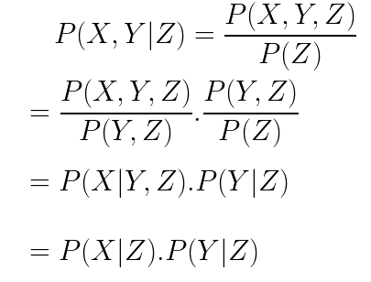
Bayesian Classifiers
Consider three random variables X, Y and Z such that X is conditionally independent of Y given Z. We then have the following:
Bayes theorem
Bayes theorem
Conditional Independence
Thus, the conditional independence X and Y given Z implies the following:
P(X,Y|Z) = P(X|Z).P(Y|Z)

Slide 32
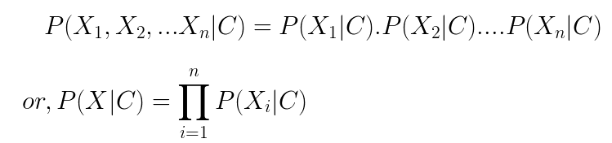
Bayesian Classifiers
Consider each attribute and class label as random variables
Given a record with attributes (X₁, X₂,…,X_{n})
  Goal is to predict class C
  Specifically, we want to find the value of C that maximizes P(C| X₁, X₂,…,X_{n} )
  Compute P(C| X₁, X₂,…,X_{n} ) for all the possible classes – predict the class furnishing the maximum value of the probability
  Direct computation of this probability is difficult as we would have to do it for every combination of X – requires huge amounts of training data
A naïve Bayes classifier assumes that the attributes are conditionally independent given the class
This can be formally stated as follows:
Notes:
Change continuous data to discrete to find probability distributions. This can be done by making a histogram of the data.

Slide 33
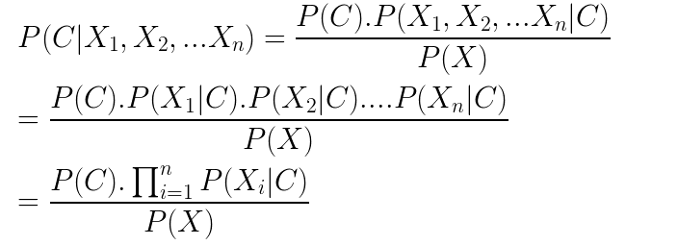
Bayesian Classifiers
With the conditional independence assumption, we have
Since P(X) is constant, it is sufficient to select the class that maximizes the numerator term
We evaluate the numerator term for all possible classes C and predict the class producing the maximum value of the term
P(X_{i}|C) is much easier to evaluate
Separate techniques for categorical and continuous attributes

Slide 34
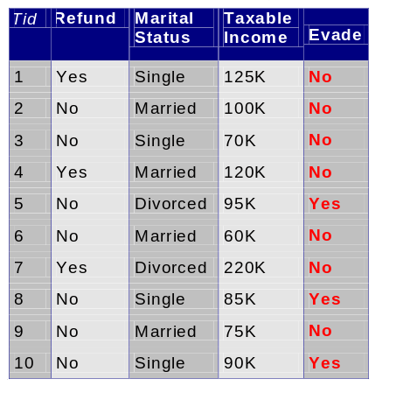
How to Estimate Probabilities from Data?
Class: P(C) = N_{c}/N
  e.g., P(No) = 7/10,
  P(Yes) = 3/10
For discrete attributes:
P(A_{i} | C_{k}) = |A_{ik}|/ N_{c}
  where |A_{ik}| is number of instances having attribute A_{i} and belongs to class C_{k}
  Examples:
  P(Status=Married|No) = 4/7
  P(Refund=Yes|Yes)=0
k

Slide 35
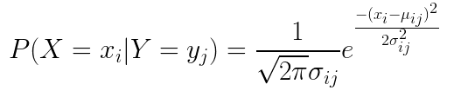
How to Estimate Probabilities from Data?
For continuous attributes
We can discretize each continuous attribute and then replace the continuous attribute value with its corresponding discrete interval. The conditional probability P(X_{i}|Y = y) is estimated by computing the fraction of training records belonging to class y that falls within the corresponding interval for X_{i.} The estimation error depends on the discretization strategy and also on the number of discrete intervals. If the number of intervals is too large, there are too few training records in each interval to provide a reliable estimate of P(X_{i}|Y). If the number of intervals is too small, some intervals may aggregate records from different classes and we may miss the correct decision boundary
We can assume a certain form of probability distribution for the continuous variable and estimate the parameters of the distribution from the training data. A Gaussian distribution is usually chosen to represent the class conditional probability for continuous attributes. For the class y_{j} the class conditional probability for attribute X_{i} is:
Mean
Estimate from Training Data
Variance

Slide 36
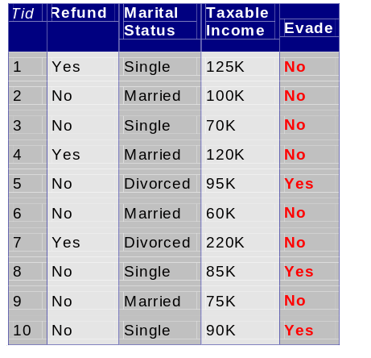
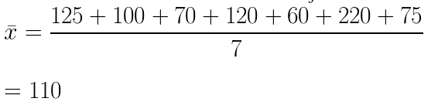
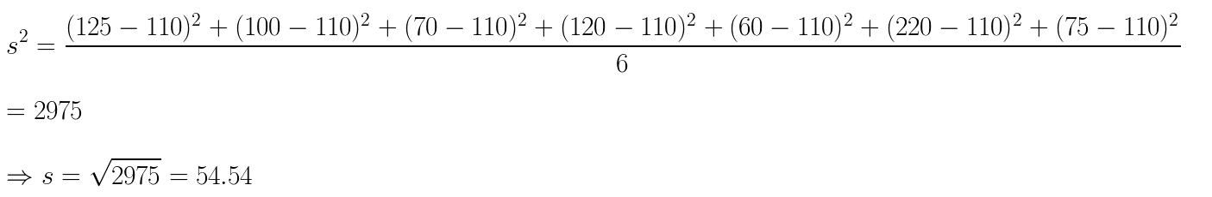
How to Estimate Probabilities from Data?
Let us say, we want to compute P(Income = 120|No) for this data
Let us first compute the mean and variance of the Taxable Income attribute for the class No

Slide 37
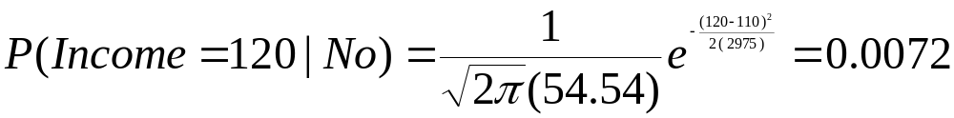
How to Estimate Probabilities from Data?
To compute P(Income = 120|No) for this data, substitute the values of the mean, standard deviation and x = 120 in the equation of the normal distribution

Slide 38
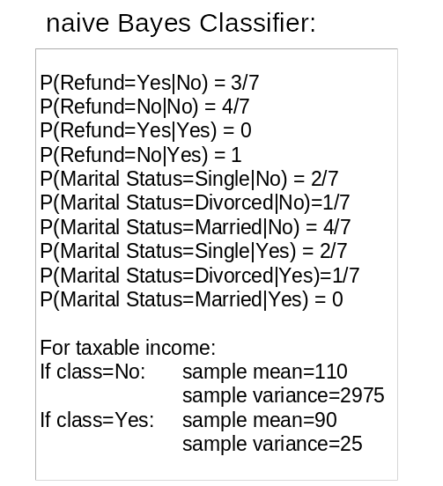
Example of Naïve Bayes Classifier
Given a Test Record to Classify:
P(X|Class=No) = P(Refund=No|Class=No)
× P(Married| Class=No)
× P(Income=120K| Class=No)
= 4/7 × 4/7 × 0.0072 = 0.0024
P(X|Class=Yes) = P(Refund=No| Class=Yes)
× P(Married| Class=Yes)
× P(Income=120K| Class=Yes)
= 1 × 0 × 1.2 × 10⁻⁹ = 0
P(No|X) = P(X|No).P(No)/P(X) = 0.0024*0.7 / P(X)
P(Yes|X) = P(X|Yes).P(Yes)/P(X) = 0
Therefore P(No|X) > P(Yes|X)
=> Class = No

Slide 39
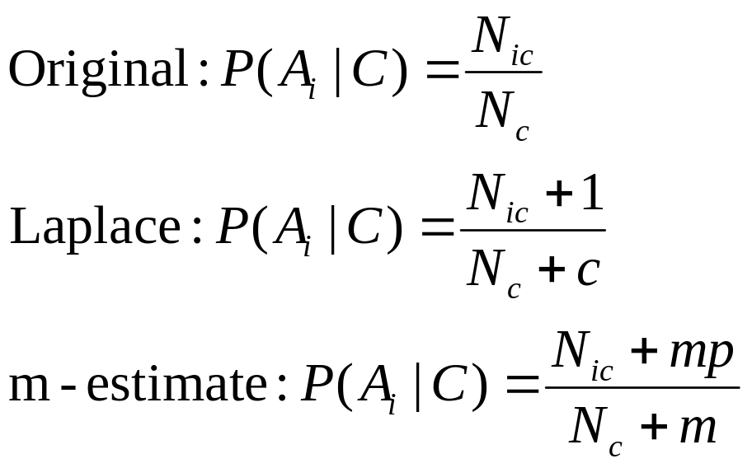
Naïve Bayes Classifier
If one of the conditional probability is zero, then the entire expression becomes zero
Probability estimation:
c: number of classes
p: prior probability
m: parameter

Slide 40
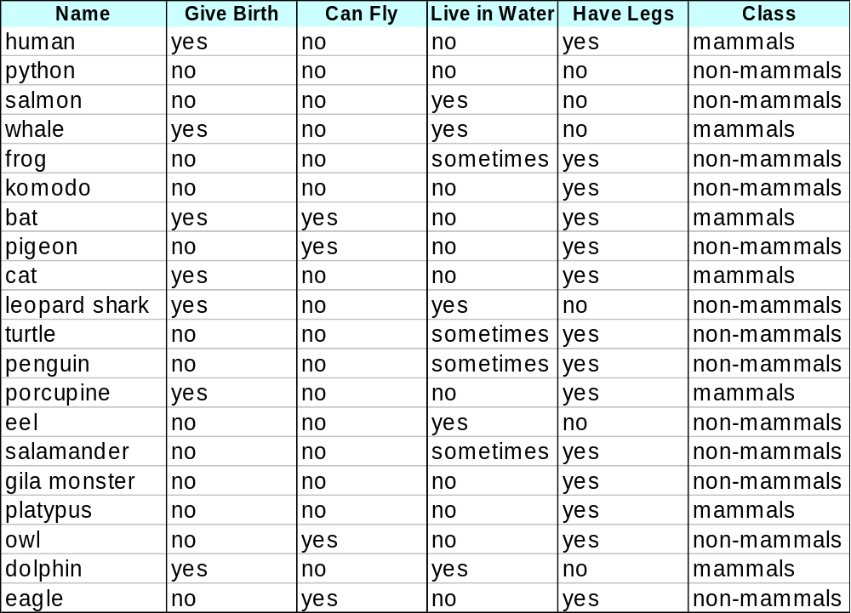
Example of Naïve Bayes Classifier
Training Data
Test sample X

Slide 41
Example of Naïve Bayes Classifier
Prior probability of mammals P(M) = 7/20
Prior probability of non-mammals P(N) = 13/20
Define the random variables:
G -> gives birth, F -> can fly, W -> live in water, L -> has legs
Compute the conditional probability of class mammal given the test sample X:
P(M|X) = P(X|M).P(M) / P(X) = P(G = yes, F = no, W = yes, L = no |M).P(M) / P(X)
= P(G=yes|M).P(F=no|M).P(W=yes|M).P(L=no|M).P(M) / P(X)
= 6/7 * 6/7 * 2/7 * 2/7 * 7/20 / P(X)
= 0.021 / P(X)
Compute the conditional probability of class non-mammal given the test sample X:
P(N|X) = P(X|N).P(N) / P(X) = P(G = yes, F = no, W = yes, L = no |N).P(N) / P(X)
= P(G=yes|N).P(F=no|N).P(W=yes|N).P(L=no|N).P(N) / P(X)
= 1/13 * 10/13 * 3/13 * 4/13 * 13/20 / P(X)
= 0.0027 / P(X)
Since P(M|X) > P(N|X), the test sample is predicted to be of class mammal

Slide 42
Naïve Bayes (Summary)
Robust to isolated noise points as such points are averaged out when estimating conditional probabilities from the data
Handle missing values by ignoring the instance during probability estimate calculations
Robust to irrelevant attributes
Correlated attributes can degrade the performance of naïve Bayes classifiers as the conditional independence assumption no longer holds for such attributes

Slide 43
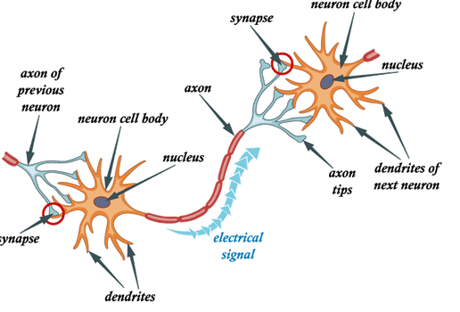
Artificial Neural Networks (ANN)
Human brain consist primarily of nerve cells called neurons
Neurons are linked together with other neurons via strands of fiber called axons. They are used to transmit nerve impulses from one neuron to another whenever the neurons are stimulated
A neuron is connected to the axons of other neurons via dendrites, which are extensions from the cell body of the neuron
The contact point between a dendrite and an axon is called a synapse. Neurologists have discovered that the human brain learns by changing the strength of the synaptic connection between neurons upon repeated stimulation by the same impulse
Analogous to human brain structure, an Artificial Neural Network (ANN) is composed of an inter-connected assembly of nodes and directed links

Slide 44
Perceptron
Perceptron is a supervised learning algorithm of binary classifiers (two class classification problems)
It is a linear classifier; that is a classification algorithm that makes its predictions based on a linear predictor function combining a set of weights with the feature vector
The algorithm allows for online learning, in that it processes elements in the training set one at a time
The perceptron algorithm dates back to the late 1950s; its first implementation, in custom hardware, was one of the first artificial neural networks to be produced

Slide 45
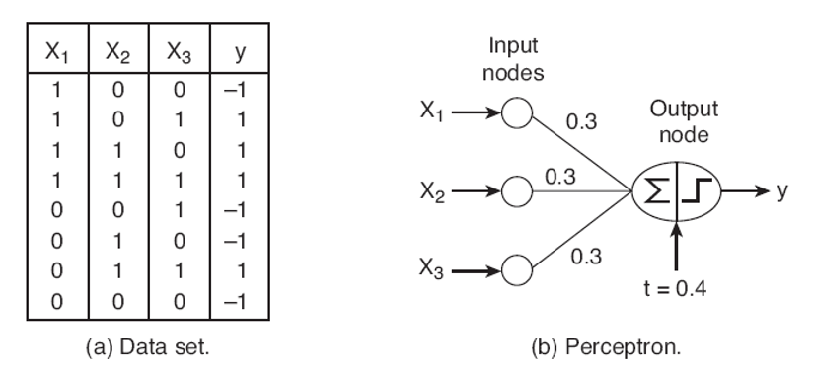
Perceptron
x1, x2 and x3 are three Boolean variables (features); y is an output variable (class label)
y takes a value -1 if at least 2 of three features are 0 and +1 if at least two of the three features are 1
The perceptron consists of two types of nodes: input nodes to represent the input attributes and an output node to represent the model output
Each input node is connected via a weighted link to the output node; the weighted link is used to emulate the strength of synaptic connection between the neurons
Training a perceptron model amounts to adapting the weights of the links until they fit the input-output relationships of the underlying data
An input node simply transmits the value it receives to the outgoing link, without performing any mathematical operation.
The output node is a mathematical device that computes the weighted sum of the inputs, subtracts the bias term and produces an output depending on the sign of the result

Slide 46
Perceptron
A perceptron computes its output y* by performing a weighted sum on its inputs, subtracting a bias factor t from the sum and then examining the sign of the result
The model shown has three input nodes, each having a weight of 0.3 to the output node and a bias factor of t = 0.4
The output of the node (denoted by y* or y_hat) is computed by
y* = 1, if 0.3*x1 + 0.3*x2 + 0.3*x3 – 0.4 >=0
= -1, if 0.3*x1 + 0.3*x2 + 0.3*x3 – 0.4 <0
Example: if x1 = 1, x2 = 1, x3 = 0, then y* = +1. If x1 = 0, x2 = 1, x3 = 0, y* = -1
More specifically, the output of the perceptron model can be expressed as follows:
y* = sign(w_{d}x_{d} + w_{d-1}x_{d-1} + … w₂x₂ + w₁x₁ - t)
where w_{1,} w_{2,….} w_{d} are the weights of the input links and x_{1,} x_{2,….} x_{d} are the input attribute values
The sign function acts as an activation function for the output neuron and outputs a value +1 if its argument is positive and -1 if its argument is negative
The perceptron model can be written in a more compact form as follows:
y* = sign(w_{d}x_{d} + w_{d-1}x_{d-1} + … w₂x₂ + w₁x₁ + w₀x₀) = sign(w.x)
where w₀ = -t and x₀ = 1 and w.x is the dot product between the weight vector w and the input attribute vector x

Slide 47
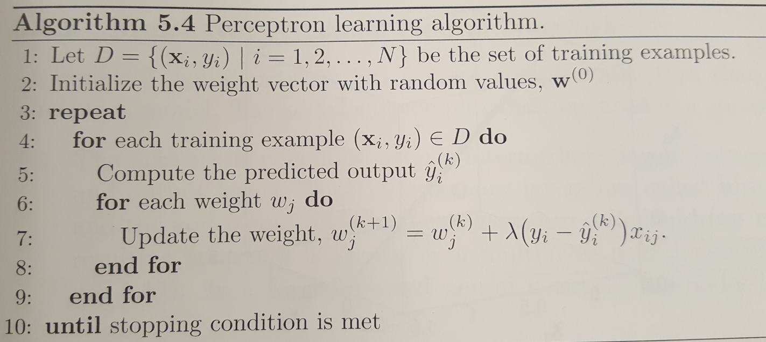
Learning Perceptron Model
During the training phase of the perceptron model, the weight parameters w are adjusted until the outputs of the perceptron become consistent with the true outputs of the training examples
The perceptron learning algorithm is outlined below:

Slide 48

Learning Perceptron Model
The key computation for this algorithm is the weight update formula in Step 7 of the algorithm (k denotes the current iteration and k+1 denotes the next iteration:
Learning Rate
Value of j^{th} attribute of training example x_{i}
Weight of the j^{th} attribute in the next iteration
Prediction Error
Weight of the j^{th} attribute in the current iteration
The new weight is a combination of the old weight and a term proportional to the prediction error
If y = y(hat), the prediction is correct and the weights need not be updated
If y = 1 and y(hat) = -1, then the prediction error is 2. To compensate for the error, we need to increase the value of the predicted output by increasing the weights of all links with positive inputs and decreasing the weights of all links with negative inputs
If y = -1 and y(hat) = 1, the prediction error is -2. To compensate for the error, we need to decrease the value of the predicted output by decreasing the weights of all links with positive inputs and increasing the weights of all links with negative inputs

Slide 49
Learning Perceptron Model
In the weight update formula, the weights should not be changed too drastically between one iteration and the next.
This is because the error term is computed only for the current training example
Otherwise, the adjustments made in earlier iterations will be undone
The learning rate (lambda) ha a value between 0 and 1 and is used to control the amount of adjustment made in each iteration
If lambda is close to 0, then the new weight is mostly influenced by the value of the old weight
If lambda is close to 1, then the new weight is sensitive to the amount of adjustment performed in the current iteration
In some cases, an adaptive value of lambda can be used; initially, lambda is moderately large during the first few iterations and then gradually decreases in the subsequent iterations

Slide 50
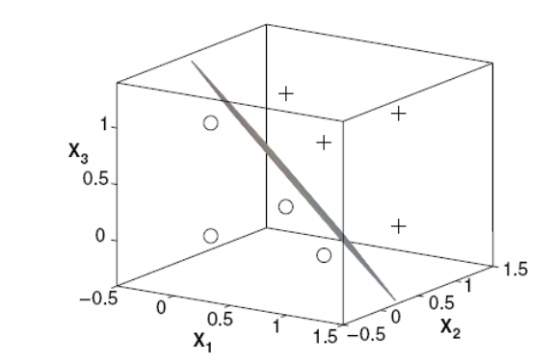
Perceptron
The perceptron model is linear in its parameters w and attributes x
The decision boundary of a perceptron is a linear hyperplane that separates the data into two classes +1 and -1
The following figure shows the decision boundary obtained by applying the perceptron learning algorithm to the three dimensional dataset shown in the example
Perceptron decision boundary for the three dimensional data shown in the example

Slide 51
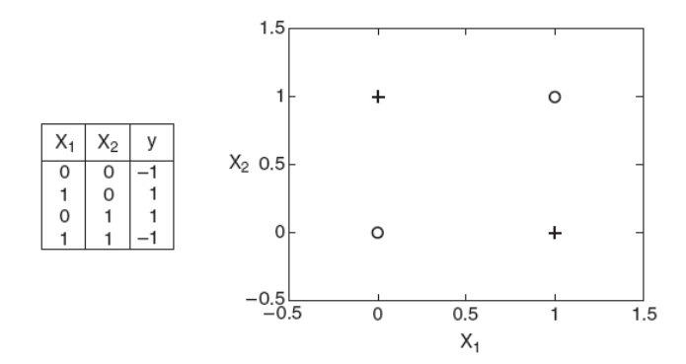
Perceptron
The perceptron learning algorithm is guaranteed to converge to an optimal solution (as long as the learning rate is sufficiently small) for linearly separable classification problems
If the problem is not linearly separable, the algorithm fails to converge
The following figure shows an example of non-linearly separable data given by the XOR function
Perceptron cannot find the right solution for this data because there is no linear hyperplane that can perfectly separate the training instances
XOR classification problem; no linear hyperplane can separate the two classes

Slide 52
Multilayer Artificial Neural Network
An artificial neural network (ANN) has a more complex structure than that of a perceptron model
The network may contain several intermediary layers between its input and output layers. Such intermediary layers are called hidden layers and the nodes embedded in them are called hidden nodes. The resulting structure is called a multi-layer neural network.
In a feed-forward neural network, the nodes in one layer are connected only to the nodes in the next layer. The perceptron is a single layer feed-forward neural network as it has only one layer of nodes - the output layer – that performs complex mathematical operations.
In a recurrent neural network, the links may connect nodes within the same layer or nodes from one layer to the previous layer.
The network can use activation functions other than the sign function. Examples include linear, sigmoid and hyperbolic tangent functions. These activation functions allow the hidden and output nodes to produce output values that are non-linear in their input parameters.
These additional complexities allow multi-layer neural networks to model more complex relationships between the input and output variables.

Slide 53
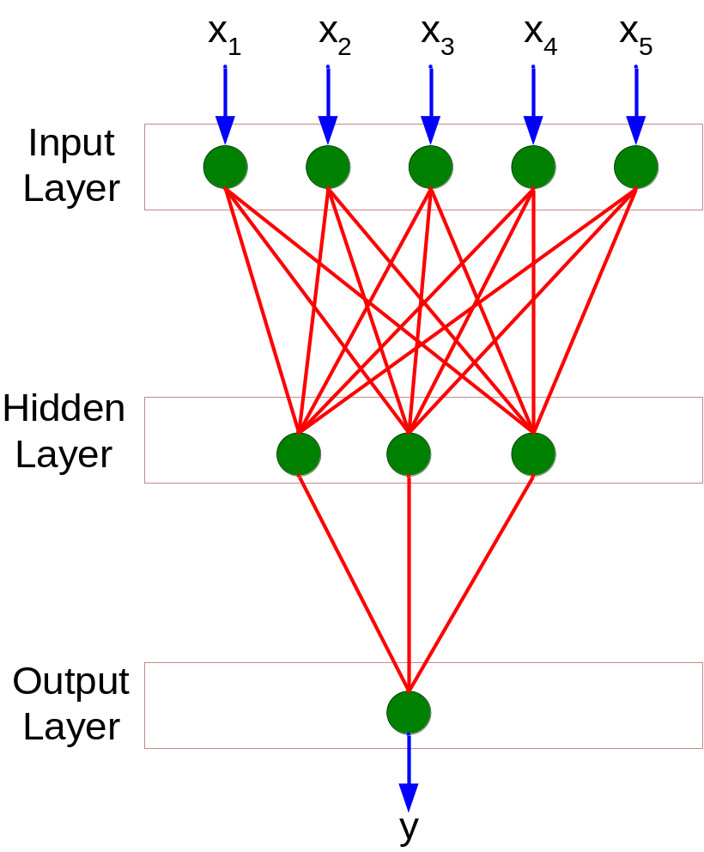
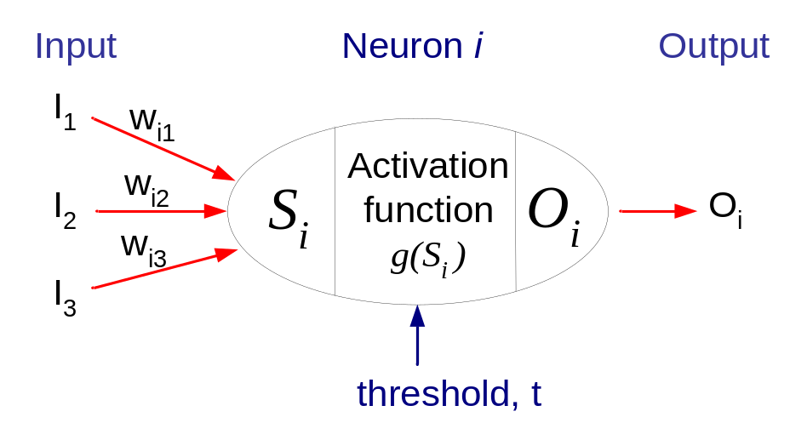
General Structure of ANN
Training ANN means learning the weights of the neurons

Slide 54
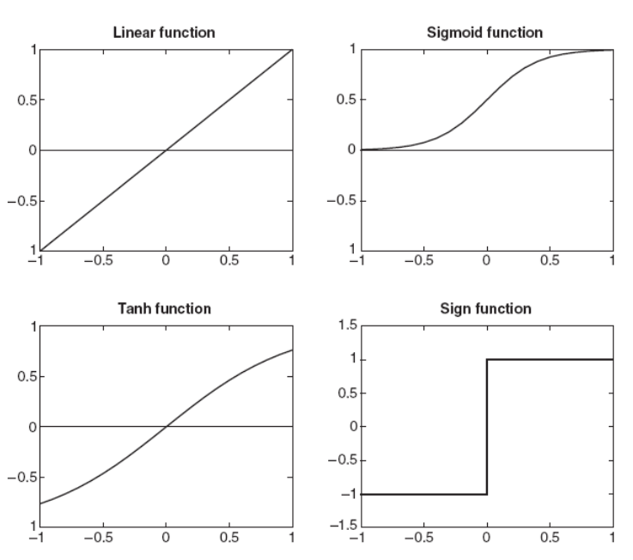


Multilayer Artificial Neural Network
Common types of activation functions

Slide 55
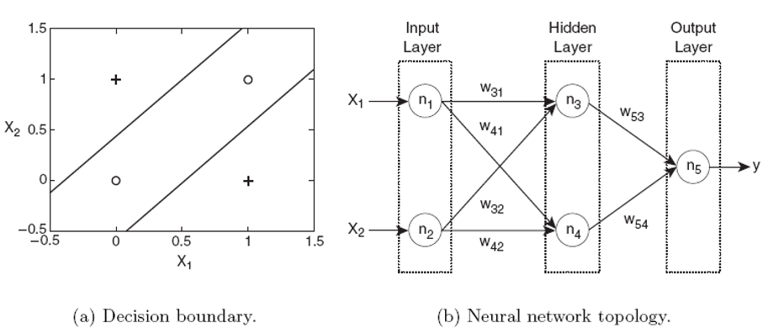
Multilayer Artificial Neural Network
Consider the XOR problem in the previous example. The instances can be classified using two hyperplanes that partition the input space into their respective classes, as shown in Figure (a)
A perceptron can create only one hyperplane and so it cannot find the optimal solution.
This problem can be addressed using a two-layer feed-forward neural network , as shown in Figure (b).
Intuitively, we can think of each hidden node as a perceptron that tries to construct one of the two hyperplanes, while the output node simply combines the results of the perceptrons to yield the decision boundary shown in Figure (a)

Slide 56
Learning the ANN model
To learn the weights of an ANN model, we need an efficient algorithm that converges to the right solution when sufficient training data is provided
On approach is to treat each hidden node or output node in the network as an independent perceptron and apply the same weight update formula
This approach will not work as we do not have any knowledge about the true outputs of the hidden nodes
Thus, it is difficult to determine the error term (y - y*) associated with each hidden node
The weights of an ANN are learned based on the gradient descent approach

Slide 57
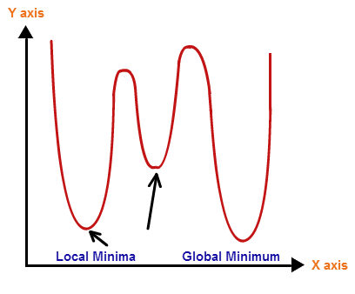
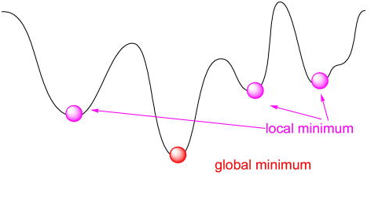
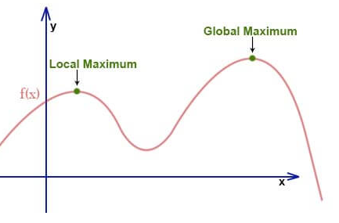
Learning the ANN model
A real-valued function f defined on a domain X has a global (or absolute) minimum at a point x* if f(x*) <= f(x) for all x in X
A real-valued function f defined on a domain X has a local (or relative) minimum at a point x* if f(x*) <= f(x) for all x in X within a local neighborhood of x*
Analogous definitions hold for global and local maximum

Slide 58

Learning the ANN model
Gradient Descent Algorithm
A first order iterative algorithm to find the local optimum (minimum or maximum) of a function
To find the minimum value of a function using gradient descent, we proceed as follows:
  Start with a random initialization point
  Compute the derivative (gradient) of the function at that point
  Take steps proportional to the negative of the gradient of the function at that point
  Repeat the steps until a local minimum is reached
The gradient denotes the direction in which the function changes at the maximum rate
The final minimum value obtained depends on the starting point (local vs global)
To find the maximum value, take steps proportional to the positive gradient
The gradient descent equation is given by:
Updated value
Function we are trying to minimize
Old value
Learning rate / step size
Selecting the right step size is important – if it is too large, you can overstep the minimum. If it is too small, the process will take a lot of time to converge, increasing the training time

Slide 59
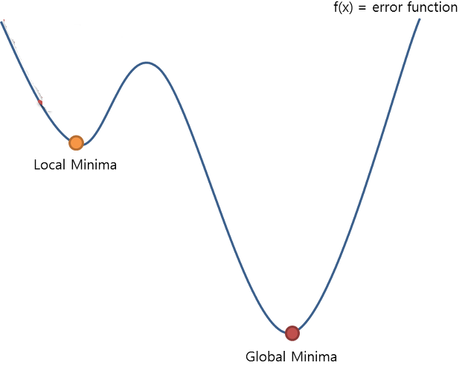
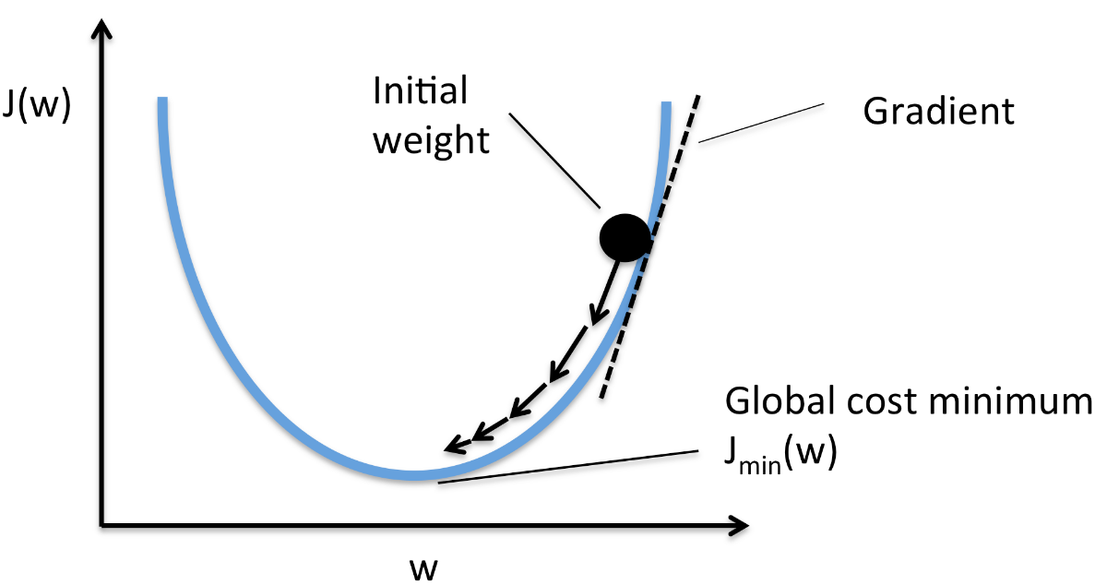
Learning the ANN model
Gradient Descent Examples
Initial guess
Initial guess

Slide 60
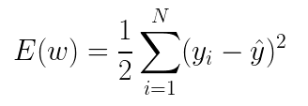

Learning the ANN model
The goal of the ANN learning algorithm is to determine a set of weights w that minimize the total sum of squared errors:
Note that the sum of squared errors depends on w as the predicted class y(hat) is a function of the weights assigned to the hidden and output nodes
If we replace y(hat) = w.x in the equation, then the error function becomes quadratic in its parameters and a global minimum solution can be found
In most cases, the output of an ANN is a nonlinear function of its parameters because of the choice of the activation functions (sigmoid or hyperbolic tangent)
Thus, it is not straightforward to derive a solution for w that is guaranteed to be globally optimal
Algorithms based on gradient descent method have been developed to efficiently solve the optimization problem
The weight update formula used by gradient descent is given by:
Learning Rate

Slide 61
Learning the ANN model
The gradient descent method can be used to learn the weights of the output and hidden nodes of a neural network
For hidden nodes, the computation is challenging as it is difficult to assess their error term without knowing what the true output values should be
A technique known as backpropagation is used to address this problem
There are two phases in each iteration of the algorithm – the forward phase and backward phase
We start with a random initialization of the weights of the nodes
During the forward phase, the weights obtained from the previous iterations are used to compute the output value of each neuron in the network. The computation progresses in the forward direction, that is outputs of the neurons at level k are computed prior to computing the outputs at level k+1
During the backward phase, the weight update formula is applied in the reverse direction. The weights at level k+1 are updated before the weights at level k are updated. The backpropagation approach allows us to use the errors for neurons at layer k+1 to estimate the errors for neurons at layer k

Slide 62
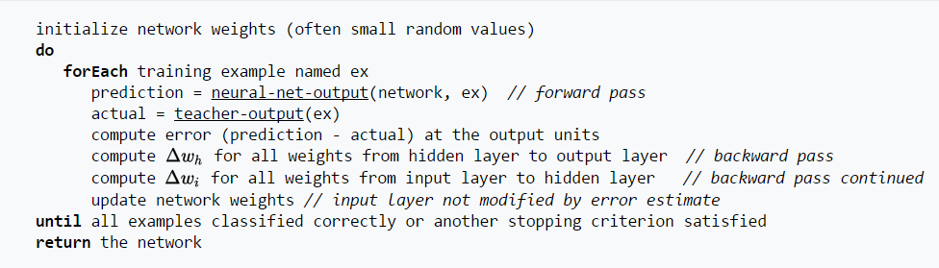
Learning the ANN model

Slide 63

Learning the ANN model
Forward Phase
We know the input vector x and the weights of all the nodes
Find the outputs of all the nodes (weighted summation of the inputs received from the previous layer, followed by a sigmoid activation) in the network
Starting from the input layer, proceed layer by layer and continue all the way to the output node and note the output value
Compute the error, as we know the actual label of this example

Slide 64

Learning the ANN model
Backward Phase
The error tells us whether the output of the network should be higher or lower
We push the error back and try to understand how the output of the h layer nodes should change to achieve this
We then adjust the weights of the connections between the g and the h layers to achieve the desired output

Slide 65
Learning the ANN model
Backward Phase
Next, we adjust the weights of the connections between the g and f layers to achieve the desired output
Like this, we propagate the error all the way back and keep updating the weights

Slide 66
Design Issues in ANN Learning
The number of nodes in the input layer should be determined. Assign an input node to each of the input features
The number of nodes in the output layer should be established. For a two-class problem, it is sufficient to use a single output node. For a k-class problem, there are k output nodes.
The network topology (number of hidden layers, number of hidden nodes in each layer etc.) must be selected. Finding the right topology is challenging. One option is to try out different topologies and select the best one based on performance on a held out validation set
The weights and biases need to be initialized. Random initialization is usually performed.
Training examples with missing values should be removed or replaced with most likely values.

Slide 67
Characteristics of ANN
Multilayer neural networks with at least one hidden layer are universal approximators; that is, they can be used to approximate any target functions. Since ANNs are very expressive, it is important to select the appropriate network topology for a given problem to avoid model overfitting
ANNs can handle redundant features as the weights are automatically learned during the training step. The weights for redundant features tend to be very small.
Neural networks are quite sensitive to the presence of noise in the training data. One approach to handle noise is to use a validation set to determine the generalization error of the model
The gradient descent method used for learning the weights of an ANN often converges to some local optimum
Training an ANN is a time consuming process, especially when the number of hidden nodes is large. However, test examples can be classified rapidly

