Slide 1
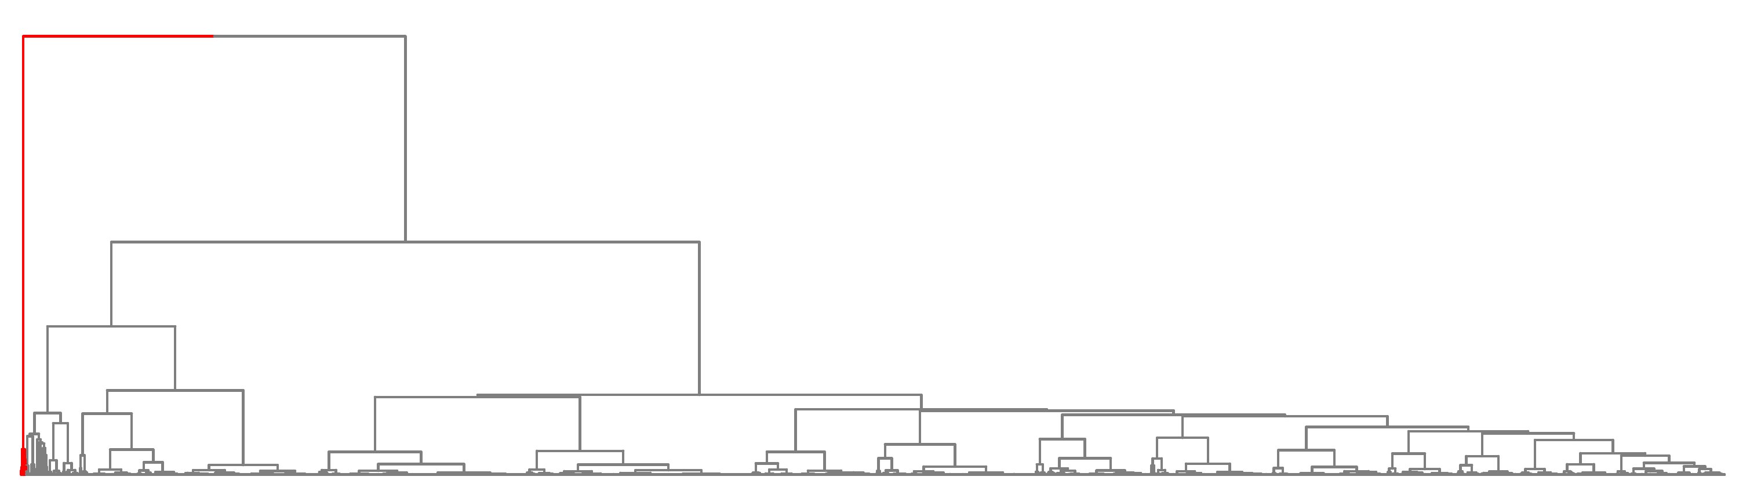
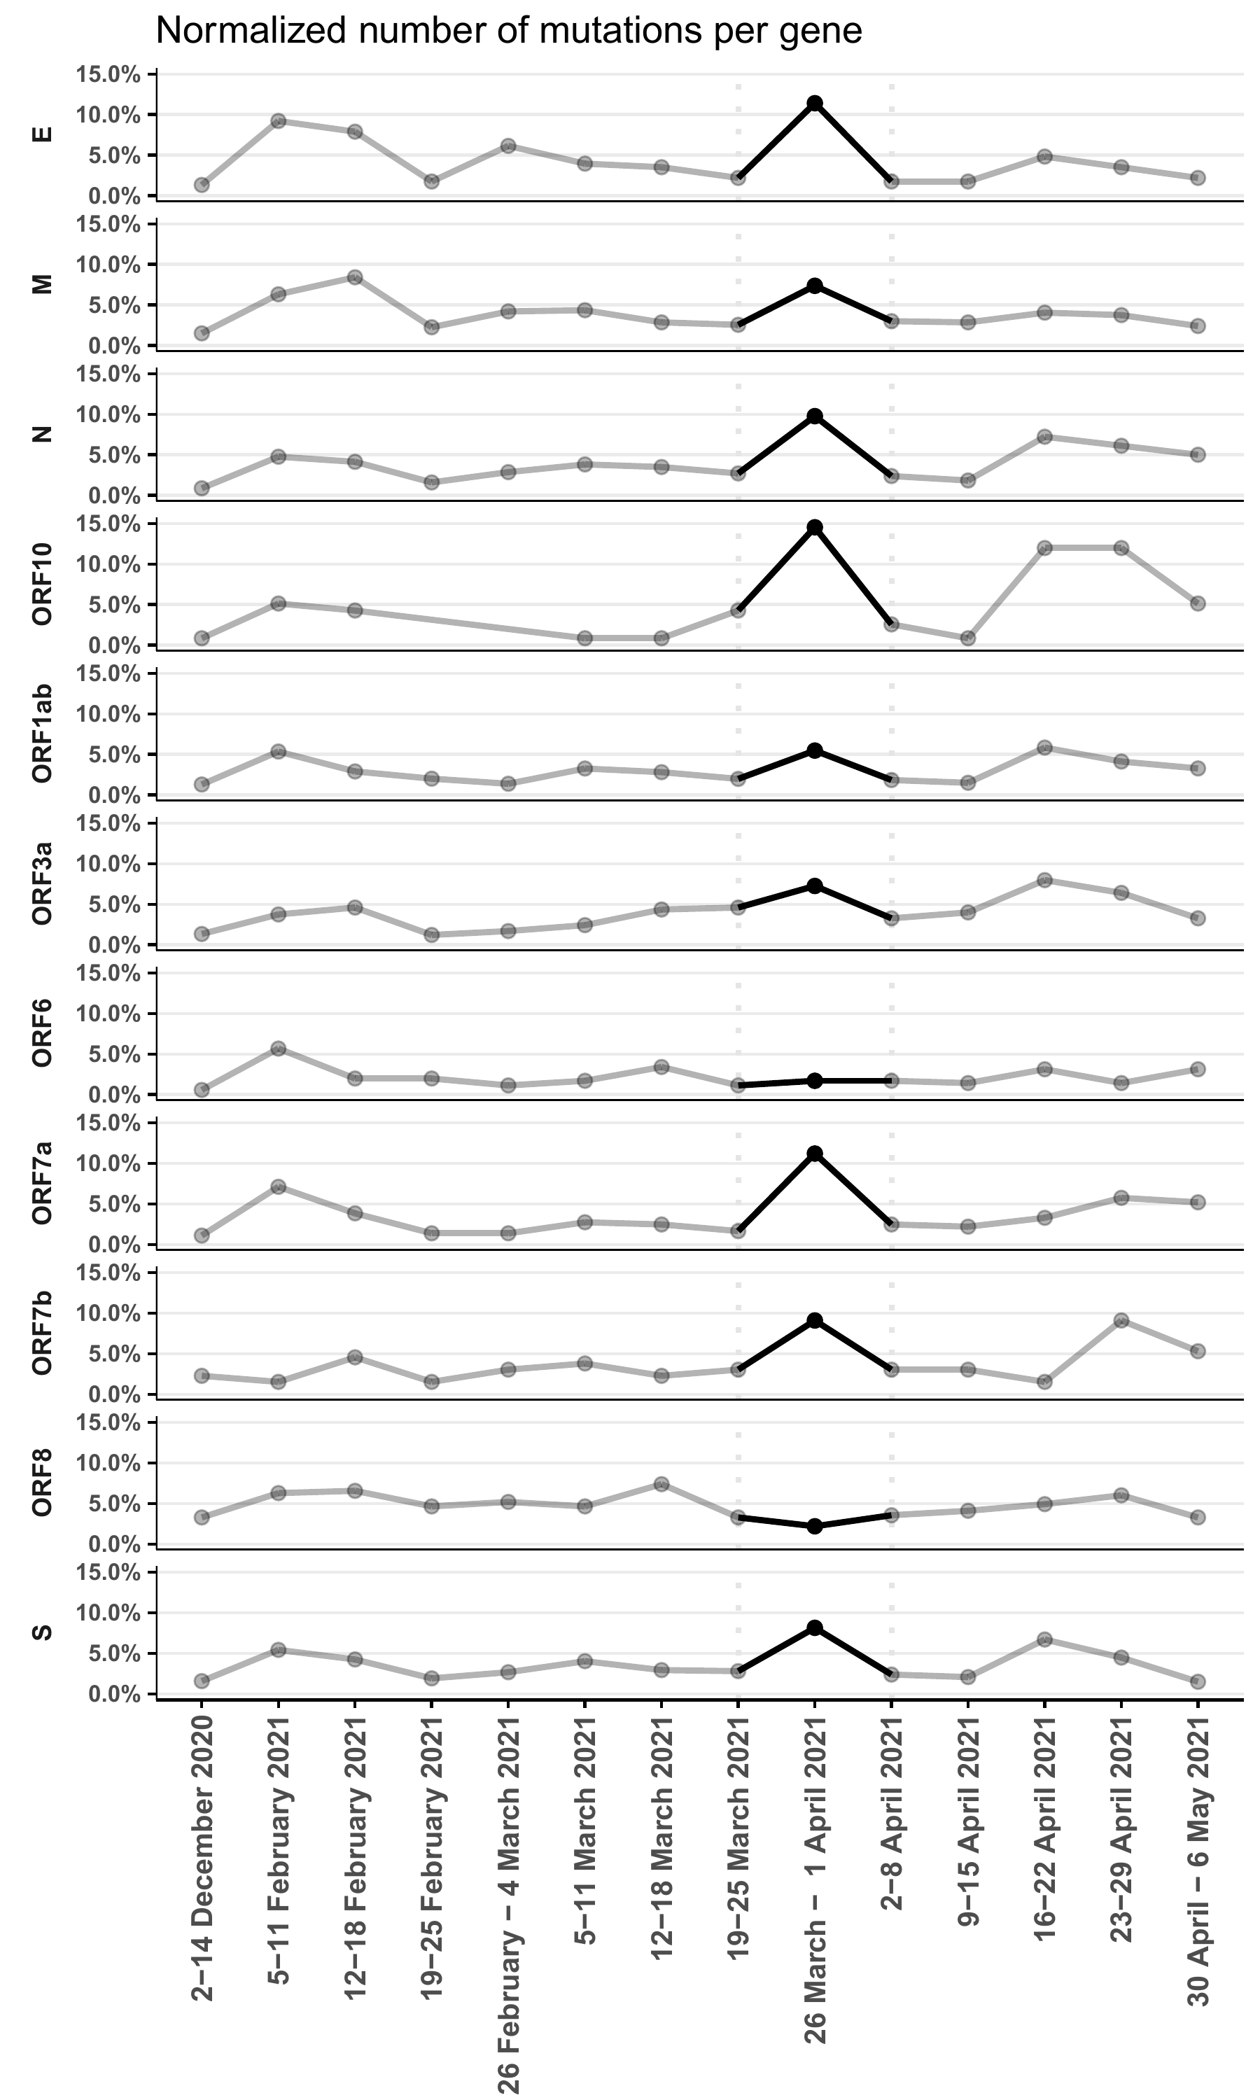
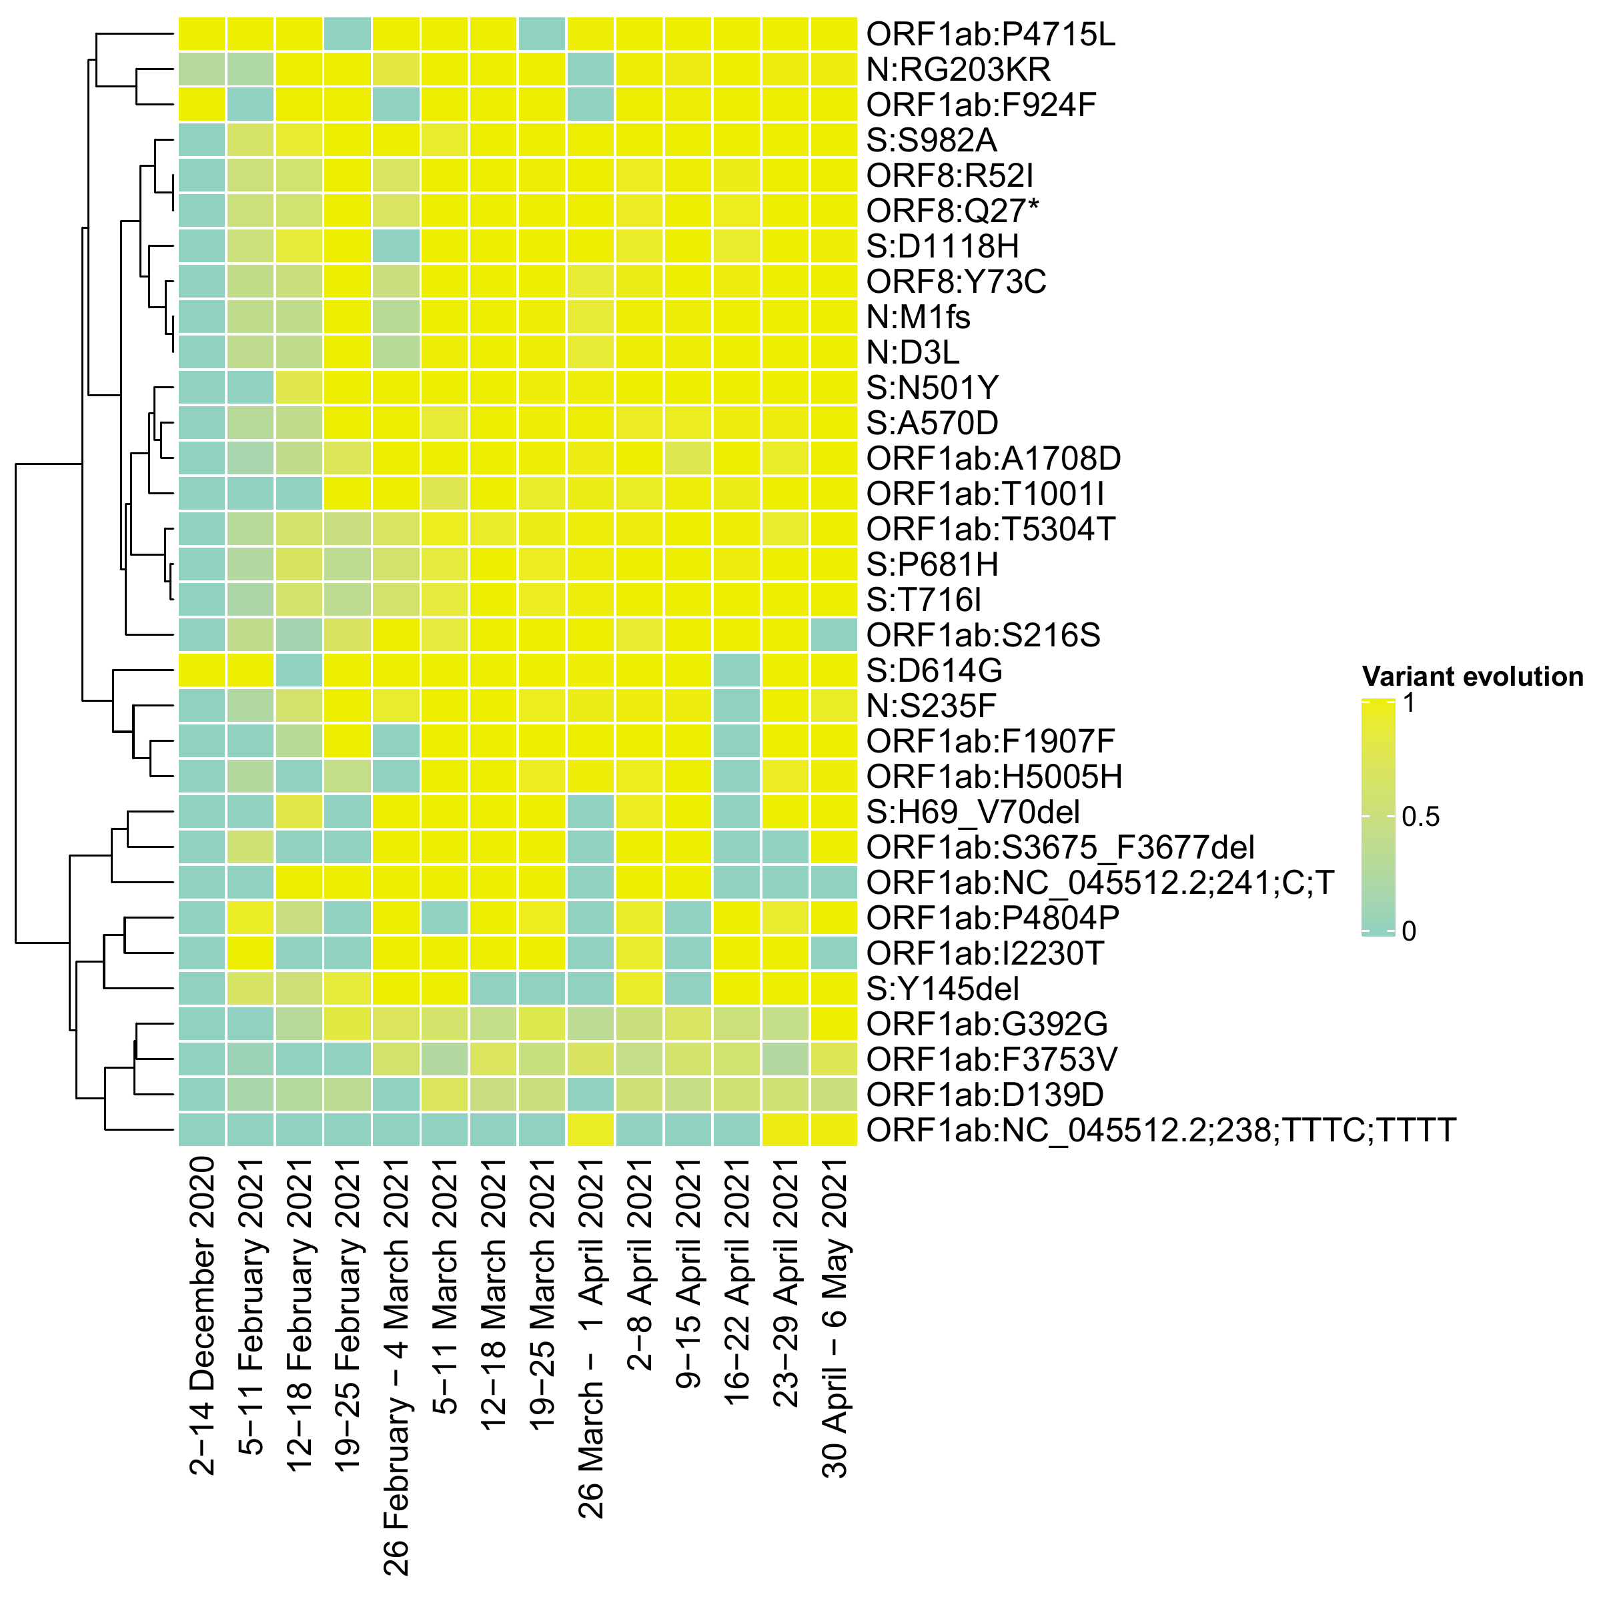
A
B
C

Slide 2
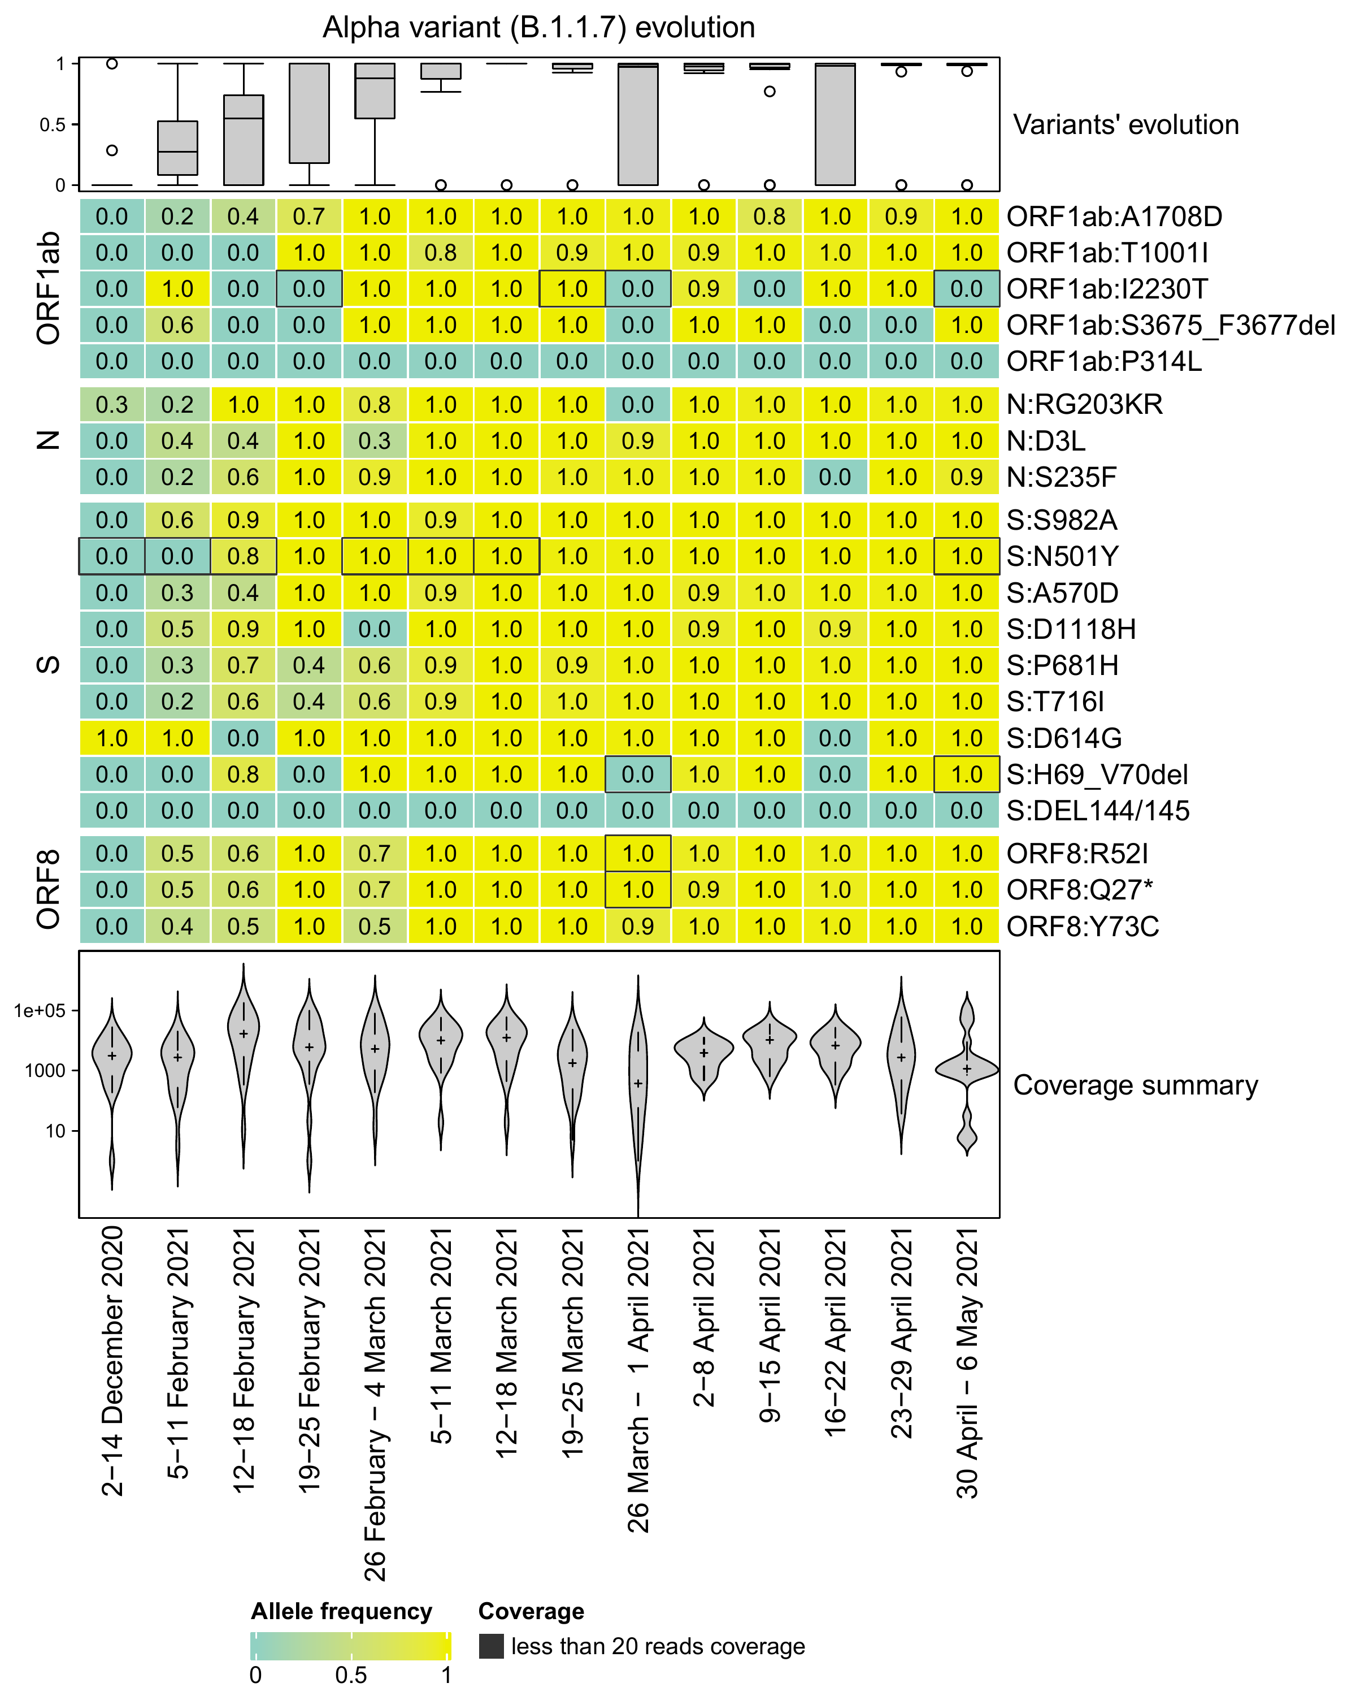
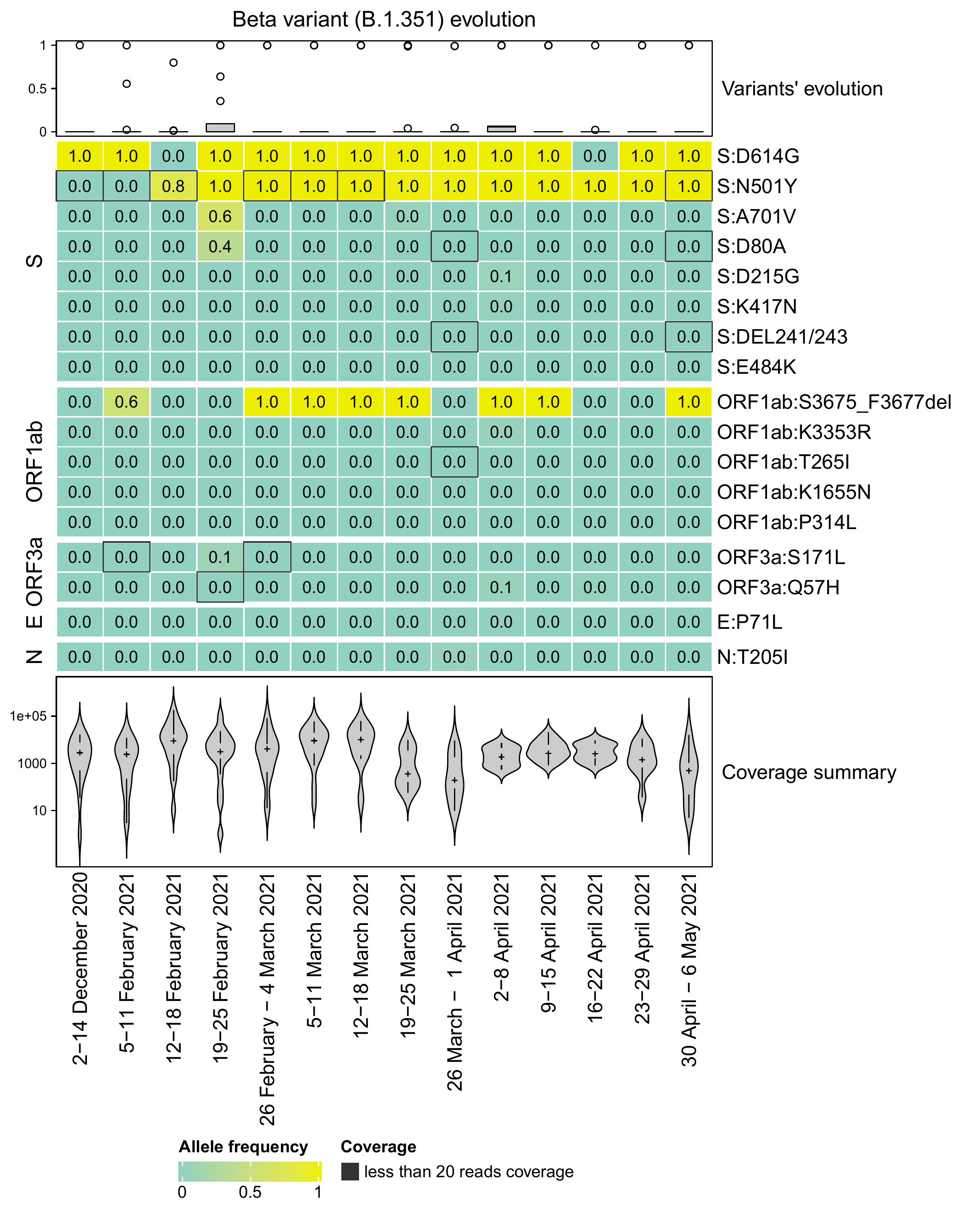
A
B

Slide 3
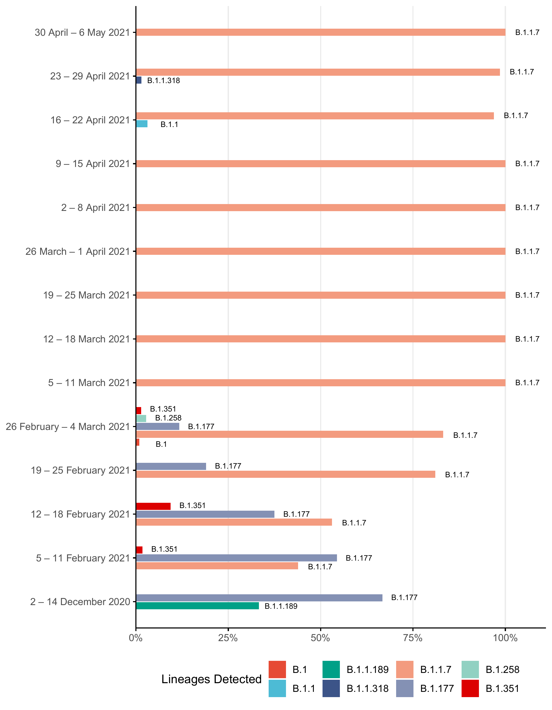
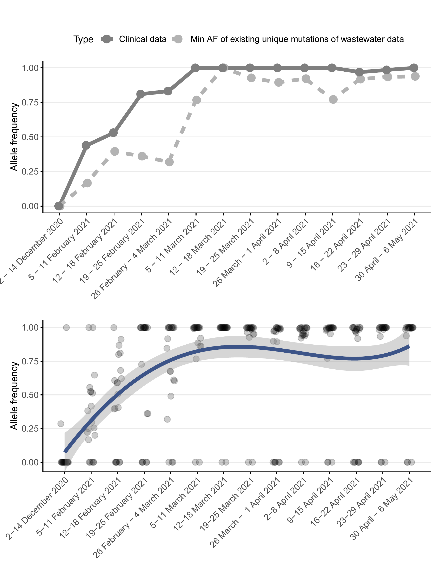
A
B
C

Slide 4
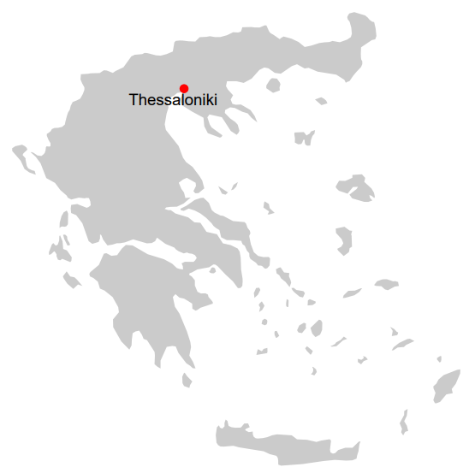

A
RNA extraction
SARS-CoV-2 Quantification
x14 wastewater samples
Library preparation
Process
Sequencing
Raw data analysis
lineagespot
B
CHROM | POS | ID | REF | ALT | QUAL | FILTER | INFO
NC_045512.2 | 326 | . | T | A | 0.0001 | . | DP=6;I16=6,0,0,0,187,5875,0,0,360,21600,0,0,19,73,0,0;QS=1,0;MQ0F=0
NC_045512.2 | 378 | . | T | C | 1.3e-06 | . | DP=7;I16=6,0,1,0,197,6591,18,324,360,21600,60,3600,20,92,5,25;QS=0.916279,0.0837209,0;SGB=-0.379885;RPB=1;MQB=1;BQB=1;MQ0F=0
NC_045512.2 | 408 | . | A | T | 2.5e-06 | . | DP=8;I16=8,0,0,0,268,9088,0,0,480,28800,0,0,32,174,0,0;QS=1,0;MQ0F=0
NC_045512.2 | 433 | . | T | C | 0.0048 | . | DP=9;I16=9,0,0,0,296,10046,0,0,540,32400,0,0,40,246,0,0;QS=1,0;MQ0F=0
Characteristic mutations of Alpha variant
C
gene | amino acid
ORF1a | T1001I
ORF1a | A1708D
… | …
N | G204R
N | S235F
Lineage definitions
Outbreak.info
Pangolin
D
Lineage | Total | N. substitutions satisfied | Total Sum AD | Total Sum DP | Avg.AF
B.1.177 | 17 | 6.6 | 33 | 95 | 0.347
B.1.1.7 | 21 | 2 | 2 | 9 | 0.222
B.1.351 | 13 | 2 | 2 | 9 | 0.222

