Slide 1
Eyeriss v2
A Flexible Accelerator for Emerging Deep Neural Networks on Mobile Devices
AuthorS:
Yu-Hsin Chen, Tien-Ju Yang, Joel Emer, Vivienne Sze
TeaM Presenting :
The Convuluted

Slide 2
Table of Contents
Motivation/Background
Proposed Architecture
Performance and Results
Conclusion
Q/A?

Slide 3
Motivations For EYERISS V2
Resource Constraints on Mobile Devices
Limitations of Current DNN Accelerators

Slide 4
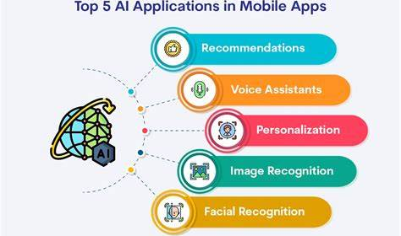
Resource Constraints on Mobile Devices
Deep learning applications are moving to resource- and energy-constrained Mobile platforms.
This has led to the development of smaller, more compact models (Compact DNN’s/Sparse DNN’s) that depend on specialized hardware(Accelerators) to perform efficiently

Slide 5

Limitations of Current DNN Accelerators
Traditional DNN accelerators designed for large DNNs struggle with the compact and sparse models used in mobile platforms due to the variations in layer shapes, sizes, and data sparsity.
Compact DNNs: These networks, characterized by diverse layer shapes and sizes (e.g., MobileNet), challenge traditional accelerators that rely on fixed data dimensions and data reuse patterns.
Sparse DNNs: DNNs with sparse weights and activations (often exceeding 90% sparsity) offer energy and speed improvements but introduce irregular access patterns, making efficient hardware design challenging.

Slide 6

The OBjective
The motivation is to design a DNN accelerator, Eyeriss v2, which can process both sparse and compact DNNs directly in the compressed domain to achieve significant gains in both processing speed and energy efficiency, particularly on mobile devices

Slide 7
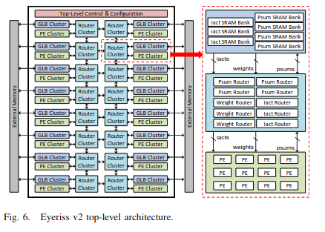
Accelerator Architecture
Special configurable Network-on-Chip (NoC) design
Flexible to handle a variety of compact DNNs
Two level hierarchy to reduce wiring, space, and power
Can route between PEs, GLB Buffer, and external memory
Has different routing modes

Slide 8
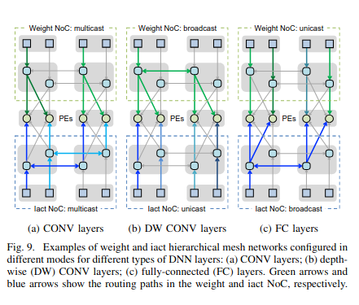
Accelerator Routing
Purpose of Routing
To control how data flows between PEs and memory
Most accelerator routing is fixed and not flexible
Unicast (one connected source to one connected destination)
Multicast (one source to multiple destinations or multiple sources to one destination)
Broadcast (one source to all connected destinations)
Configurable Routing Design
Eyeriss V2 can do unicast and multicast routing
Clusters are connected together in a 2D mesh topology globally and each local cluster has different topology

Slide 9
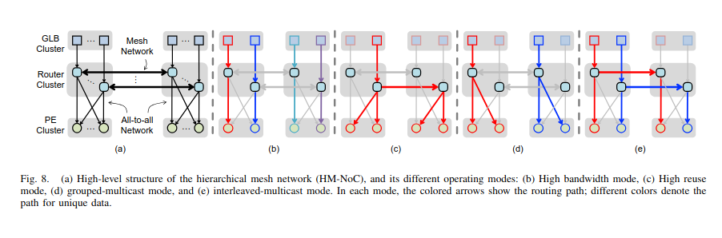
Examples of Routing Configurations

Slide 10
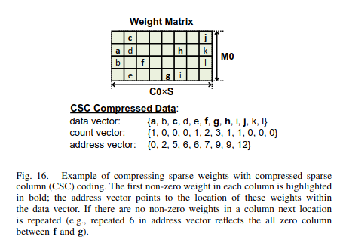
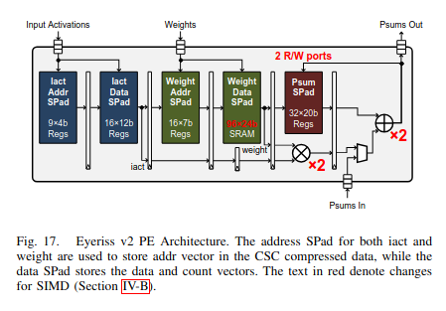
Accelerator Processing Elements
PEs Split into Clusters
Allows memory and routing to be split into separate clusters
All PEs take iacts, weights, and psums as input
Extra Logic for Handling Sparsity
Uses special hardware logic to skip over 0s in PEs
Hardware logic based on special sparsity format
PEs pipelined to handle increased logic requirements
Single Instruction Multiple Data (SIMD) processing
Each PE can process two instructions per cycle

Slide 11
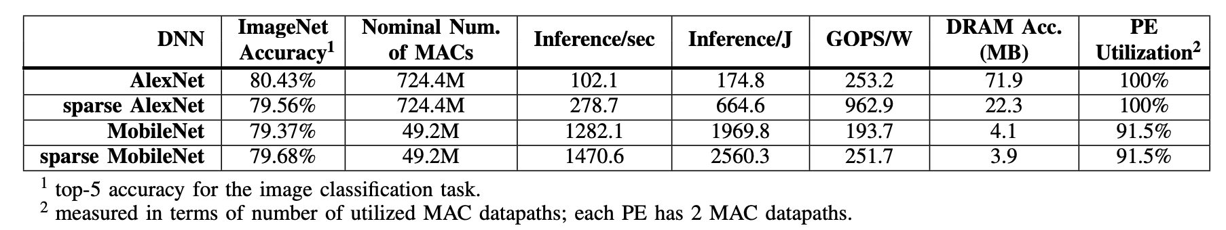
Overall results

Slide 12
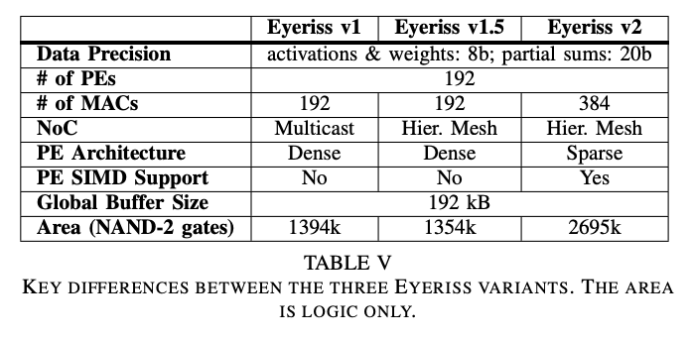
Assessing Performance – v1 vs. v1.5 vs. v2
Eyeriss v1 retains original architecture but scaled to match v1.5 and v2 specs (storage capacity, number of PEs, and data precision)

Slide 13
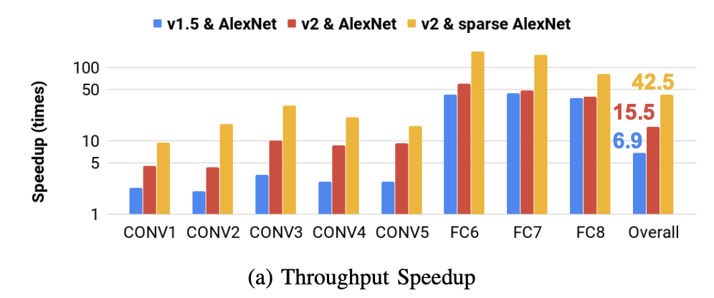
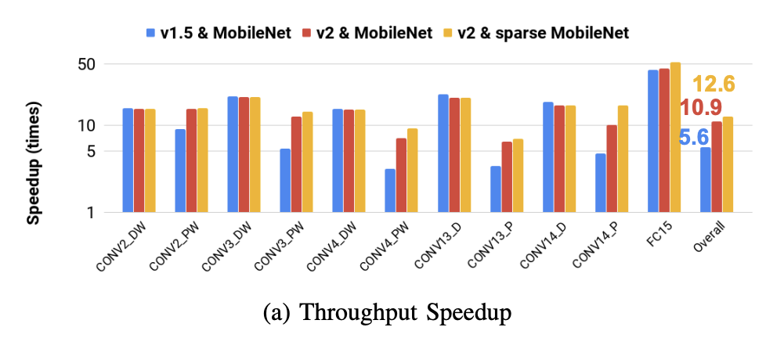
Comparative results

Slide 14
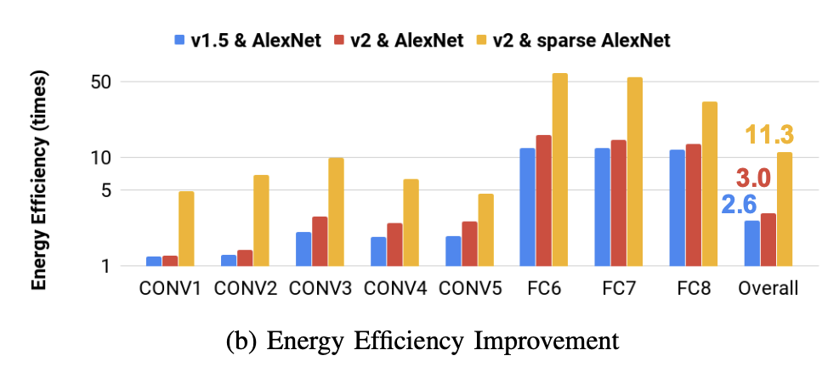
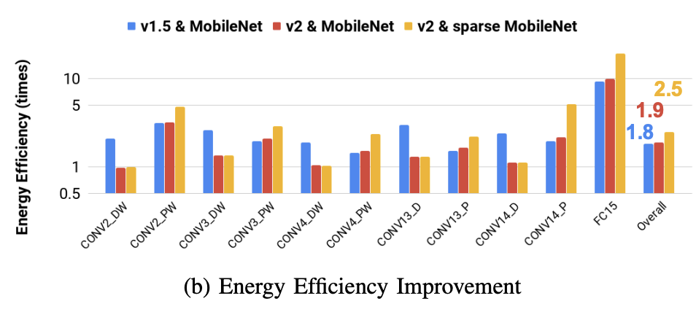
Comparative results

Slide 15
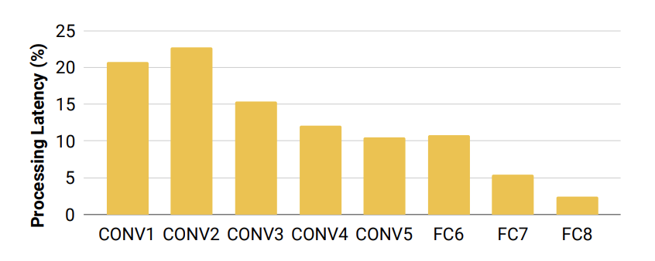
Comparative results
Layer-by-Layer Latency of Sparse AlexNet on Eyeriss v2 vs. v1

Slide 16
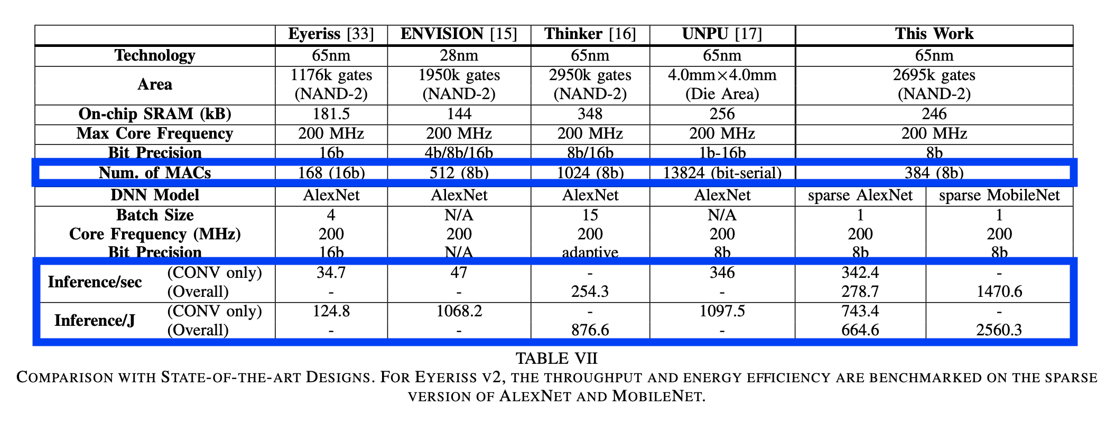
Comparisons to other designs
Similar amount of resources with significantly fewer MACs
Logic to process sparsity
Achieves comparable throughput & energy efficiency

Slide 17
Conclusion
Flexibility & Efficiency
Reconfigurable with programmable PEs
Support for many DNN models & layer types
Memory Management
Hierarchical on-chip memory network
Buffers to reduce off-chip access
Minimizes energy consumption, maximizes data reuse
Support for Sparsity
Reduces model size and increases performance
Scalability
Configurable number of PEs for variable throughput
Energy and performance modes
Incredibly Promising for Edge Computing

Slide 18
The END
Q/A

Slide 19
THANK You
Niko Pedraza
nikopedraza@u.boisestate.edu
Carson Keller
carsonkeller@u.boisestate.edu
Adam Torek
adamtorek@u.boisestate.edu

