Slide 1


NYU Summer Machine Learning Program
Presenter Name Here
Date Here

Slide 2

Neural Networks
Day 6

Slide 3
Learning Objectives
Mathematically describe a neural network with a single hidden layer
  Describe mappings for the hidden and output units
Manually compute output regions for very simple networks
Select the loss function based on the problem type
Build and train a simple neural network in Keras
Write the formulas for gradients using backpropagation
Describe mini-batches in stochastic gradient descent

Slide 4
Outline
Motivating Idea: Nonlinear classifiers from linear features
Neural Networks
Neural Network Loss Function
Building and Training a Network in Keras
  MNIST
Backpropagation Training

Slide 5
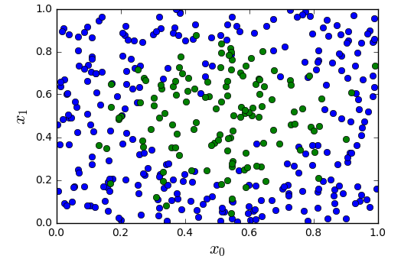
Module 1
Motivation - Most Datasets are not Linearly Separable
Consider simple synthetic data
  See figure to the right
  2D features
  Binary class label
Not separated linearly

Slide 6
Module 1
Motivation - From Linear to Nonlinear
Idea: Build nonlinear region from linear decisions
Possible form for a classifier:
  Step 1: Classify into small number of linear regions
  Step 2: Predict class label from step 1 decisions

Slide 7
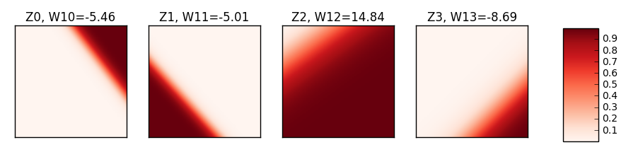
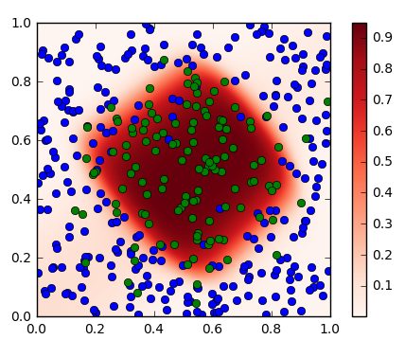
Module 1
Step 1 Outputs and Step 2 Outputs
Each output from step 1 is from a linear classifier with soft decision
  Like logistic regression
Final output is a weighted average of step 1 outputs using the weights
  Weights are indicated on top of the figures

Slide 8
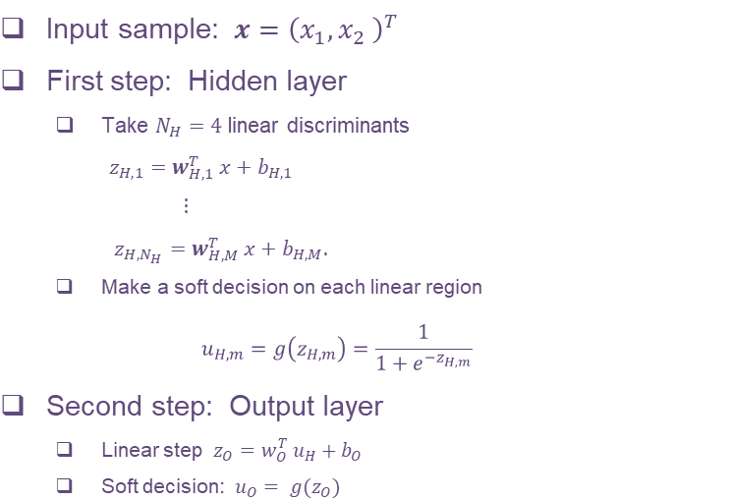
Module 1
A Possible Two Stage Classifier

Slide 9
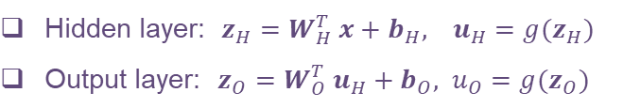
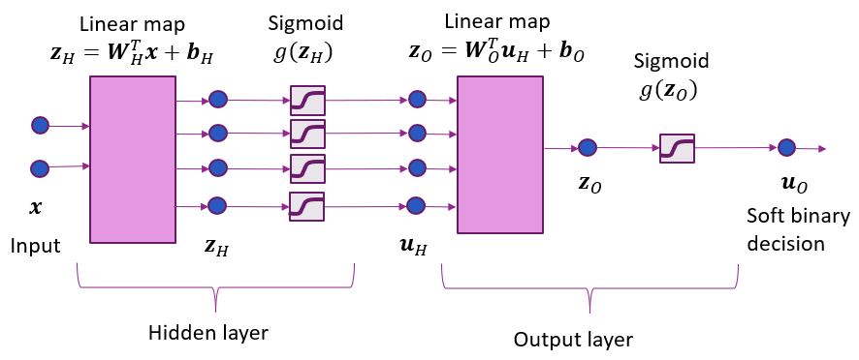
Module 1
Model Block Diagram
Each hidden node is a linear classifier with soft decision (Logistic regression)
Final output is a weighted average of step 1 outputs using the weights indicated on top of the figures

Slide 10
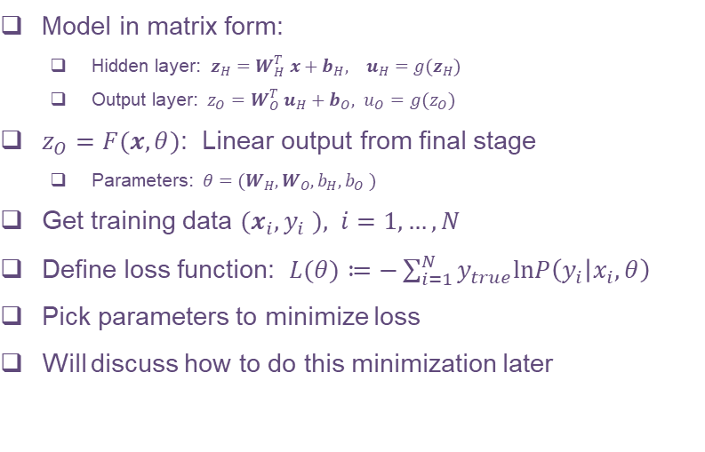
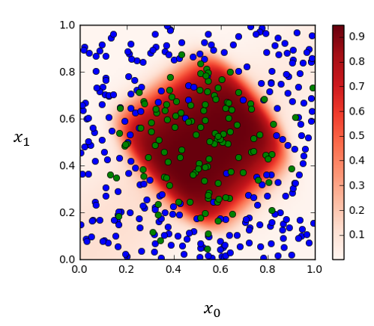
Module 1
Training the Model

Slide 11
Outline
Motivating Idea: Nonlinear classifiers from linear features
Neural Networks
Neural Network Loss Function
Building and Training a Network in Keras
  MNIST
Backpropagation Training

Slide 12
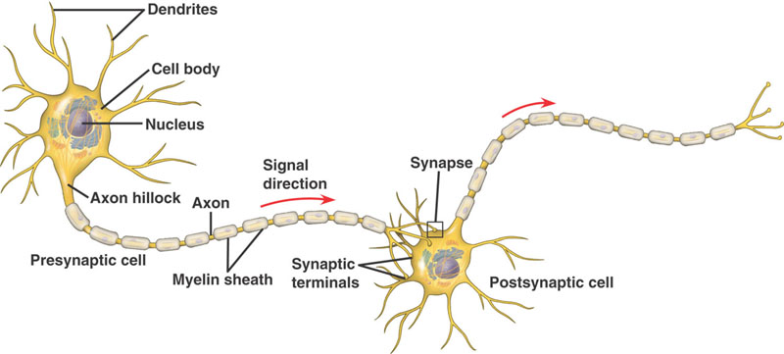
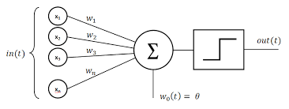
Module 2
Neural Networks - Inspiration from Biology
Simple model of neurons
  Dendrites: Input currents from other neurons
  Soma: Cell body, accumulation of charge
  Axon: Outputs to other neurons
  Synapse: Junction between neurons
Operation:
  Take weighted sum of input current
  Outputs when sum reaches a threshold
Each neuron is like one unit in neural network

Slide 13
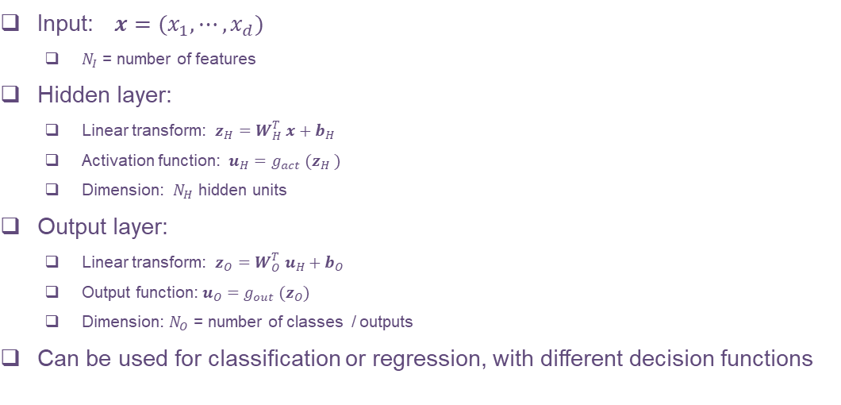
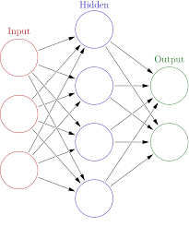
Module 2
General Structure

Slide 14
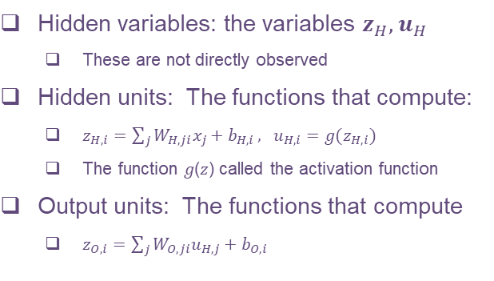
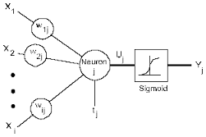
Module 2
Terminology

Slide 15
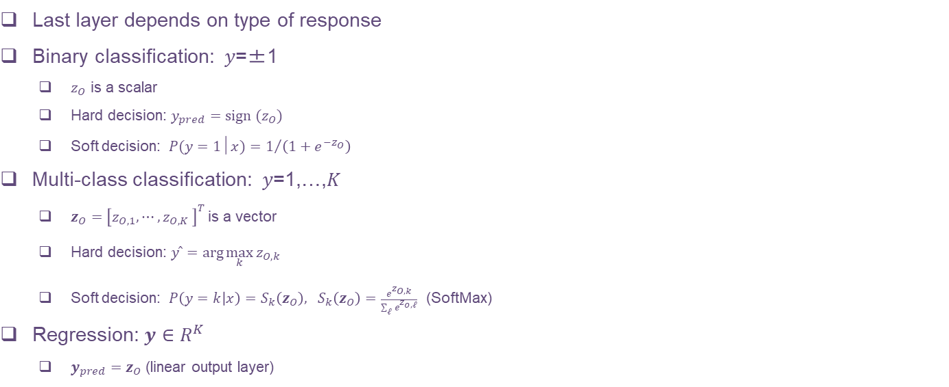
Module 2
Response Map or Output Activation

Slide 16
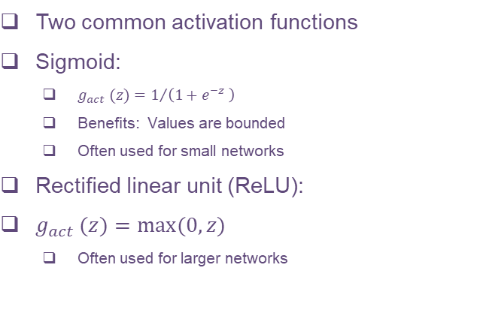
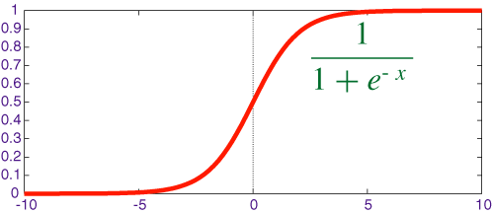
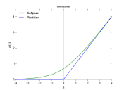
Module 2
Hidden Activation Function

Slide 17
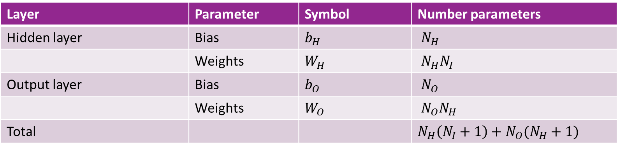
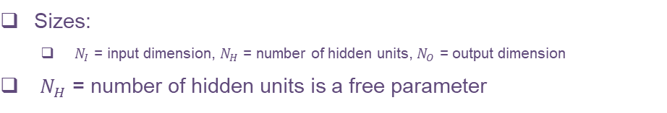
Module 2
Number of Parameters

Slide 18
Outline
Motivating Idea: Nonlinear classifiers from linear features
Neural Networks
Neural Network Loss Function
Building and Training a Network in Keras
  MNIST
Backpropagation Training

Slide 19
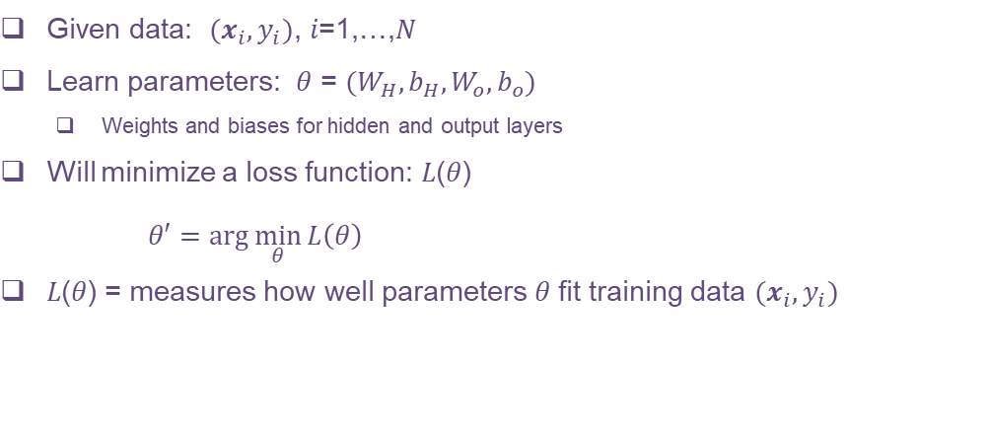
Module 2
Training a Neural Network

Slide 20
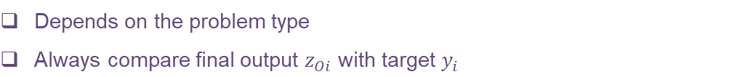
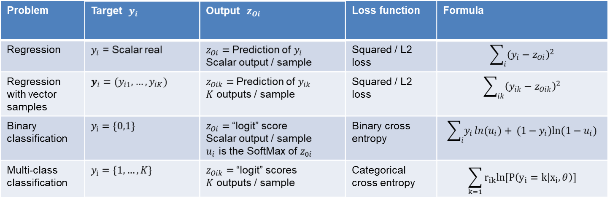
Module 2
Selecting the Right Loss Function

Slide 21
Outline
Motivating Idea: Nonlinear classifiers from linear features
Neural Networks
Neural Network Loss Function
Building and Training a Network in Keras
  MNIST
Backpropagation Training

Slide 22
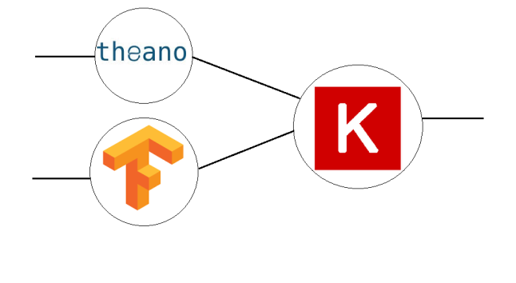
Module 2
Python Deep Learning Library - Keras
High-level neural network language in Python
Runs on top of a backend
  Much simpler than raw backend language
  Very fast coding
  Uniform language for all backend
Keras has been incorporated into TF
But…
  Slightly less flexible
  Not as fast sometimes
In this class, we use Keras

Slide 23
Module 2
Keras Recipe
Step 1. Describe model architecture
  Number of hidden units, output units, activations, …
Step 2. Select an optimizer
Step 3. Select a loss function and compile the model
Step 4. Fit the model
Step 5. Test / use the model

Slide 24
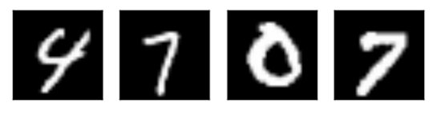
Module 2
Example: MNIST data
Classic MNIST problem:
  Detect hand-written digits
  Each image is 28 x 28 = 784 pixels
Dataset size:
  50,000 training digits
  10,000 test
  10,000 validation (not used here)
Can be loaded with sklearn and many other packages

Slide 25
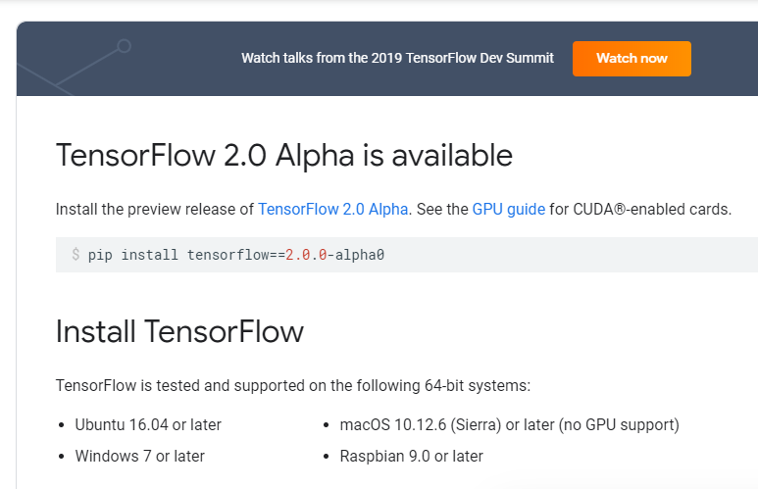
Module 2
Step 0: Import the Packages
https://www.tensorflow.org/install
Install TensorFlow
For this lab, you can use the CPU version
If you are using Google Collaboratory, TF is pre-installed

Slide 26


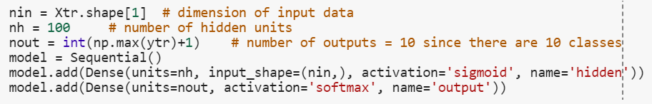
Module 2
Step 1: Define Model
Load modules for layers
Clear graph (extremely important!)
Build model
  This example: dense layers
  Give each layer a dimension, name & activation

Slide 27
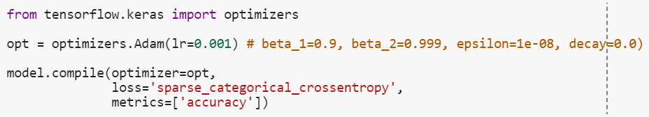
Module 2
Step 2, 3: Select an Optimizer & Compile
Adam optimizer generally works well for most problems
  In this case, had to manually set learning rate
  You often need to play with this.
Use binary cross-entropy loss
Metrics indicate what will be printed in each epoch

Slide 28
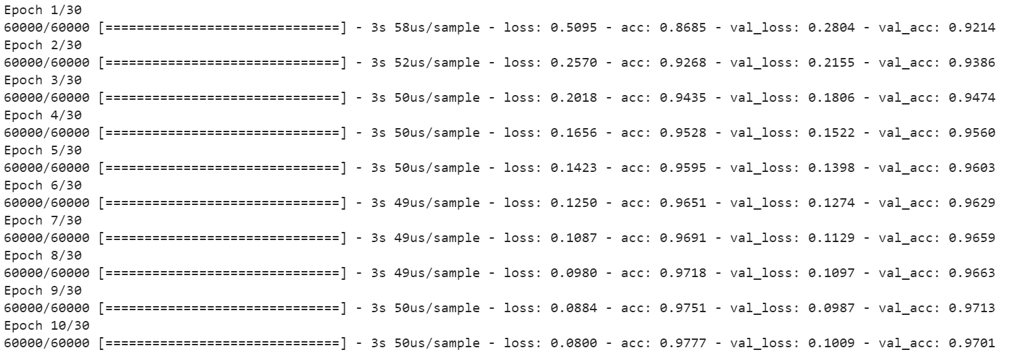
Module 2
Step 4: Fit the Model
Use Keras fit function
  Specify number of epoch & batch size
Prints progress after each epoch
  Loss = loss on training data
  Acc = accuracy on training data

Slide 29
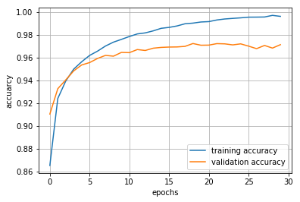
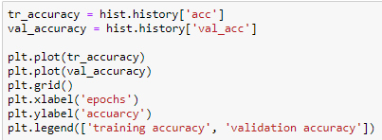
Module 2
Training and Validation Accuracy
Training accuracy continues to increase
Validation accuracy eventually flattens and sometimes starts to decrease.
Should stop when the validation accuracy starts to decrease.
This indicates overfitting.

Slide 30
Outline
Motivating Idea: Nonlinear classifiers from linear features
Neural Networks
Neural Network Loss Function
Building and Training a Network in Keras
  MNIST
Backpropagation Training

Slide 31
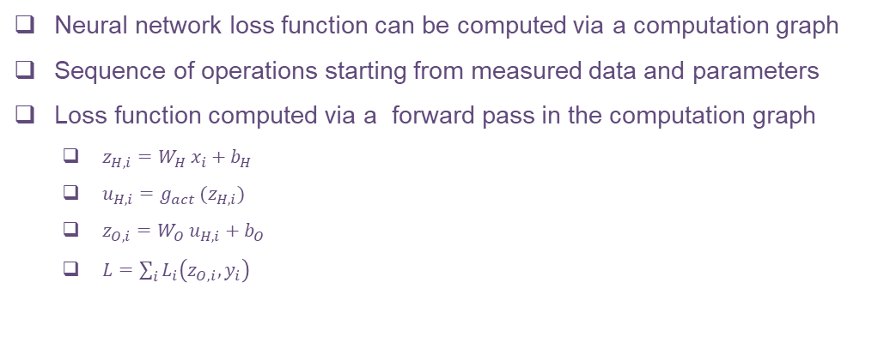
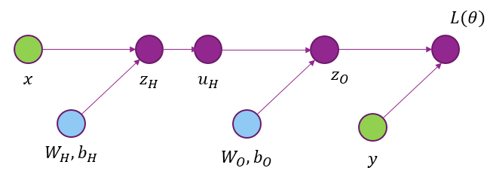
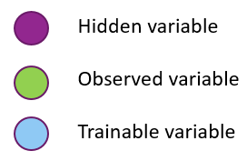
Module 2
Computation Graph & Forward Pass

Slide 32
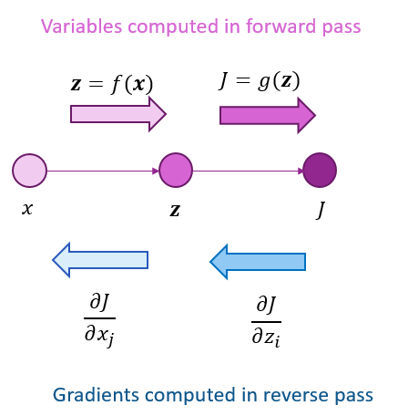
Module 2
Back-Propagation on A Two Node Graph

Slide 33
Module 2
Back-Propagation on A Two Node Graph

Slide 34
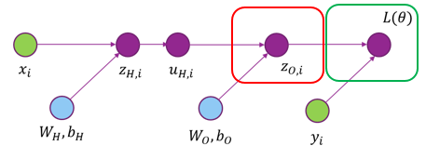
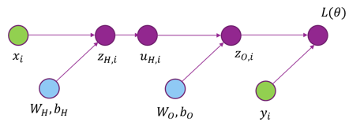
Module 2
Back-Prop on a General Computation Graph

Slide 35
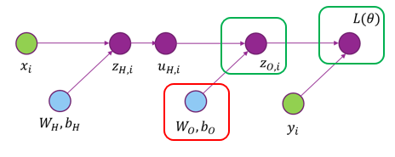
Module 2
Back-Prop on a General Computation Graph

Slide 36
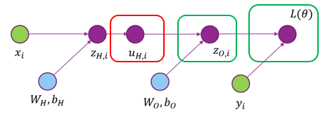
Module 2
Back-Prop on a General Computation Graph

Slide 37
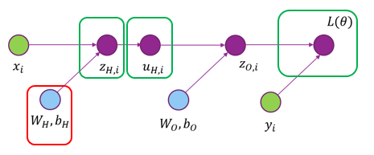
Module 2
Back-Prop on a General Computation Graph

Slide 38
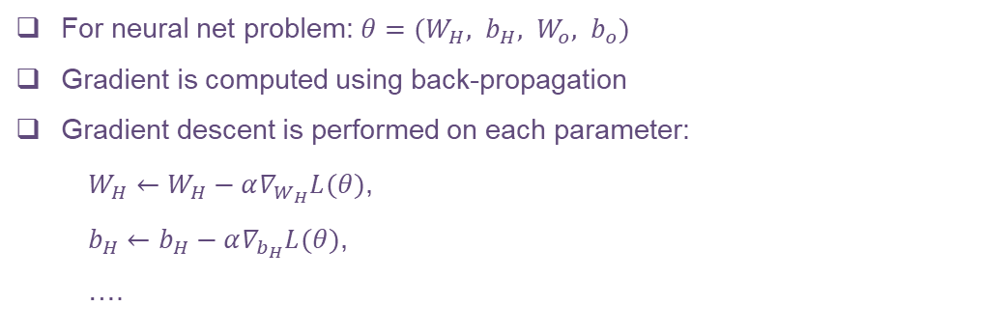
Module 2
Gradients Descent

Slide 39
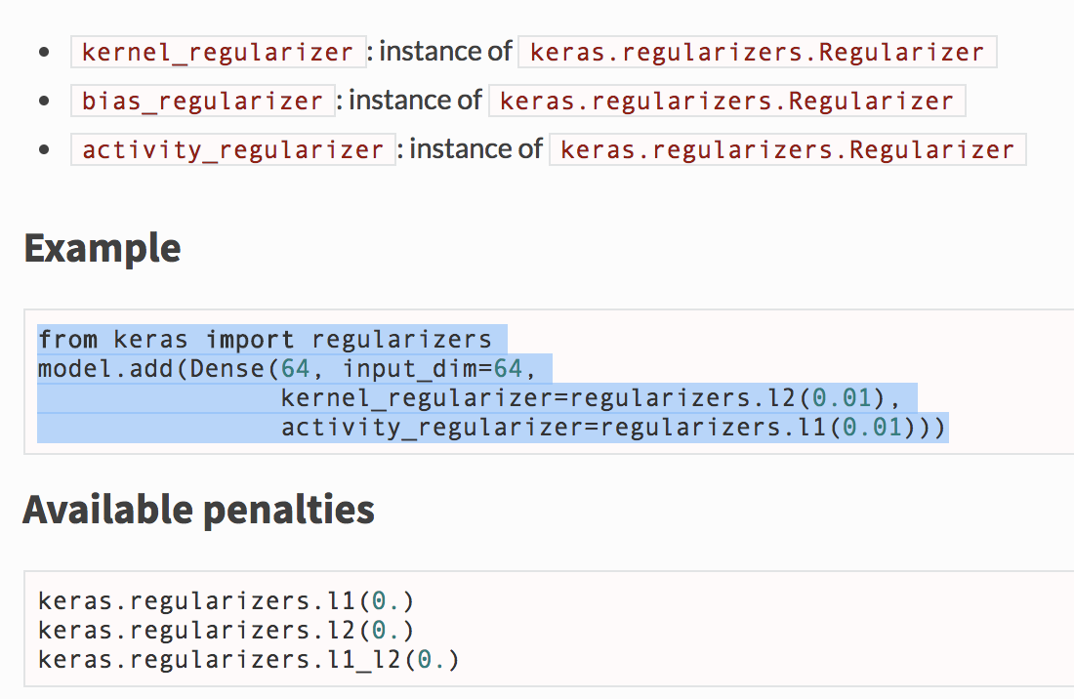
Module 2
Regularization in Keras
Activity regularization tries to make the output at each layer small or sparse.

Slide 40
Module 2
Choice of network parameters
Number of layers (typically not more than 2)
Number of hidden units in the hidden layer
Regularization level
Learning rate
Determined by maximizing the cross-validation error through typically exhaustive search

Slide 41
Module 2
Learning Objectives
Mathematically describe a neural network with a single hidden layer
  Describe mappings for the hidden and output units
Manually compute output regions for very simple networks
Select the loss function based on the problem type
Build and train a simple neural network in Keras
Describe mini-batches in stochastic gradient descent
Importance of regularization
Hyperparameter optimization

Slide 42
Why the hype today?
Thank You!

