Slide 2
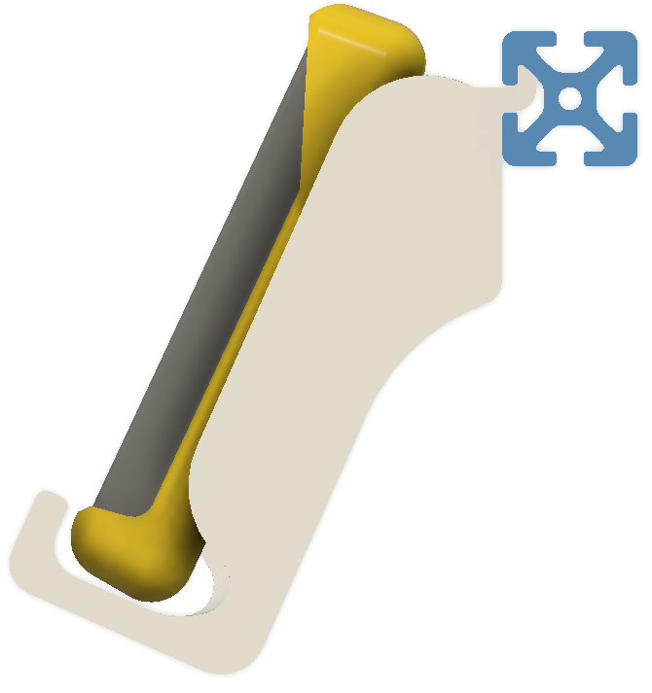
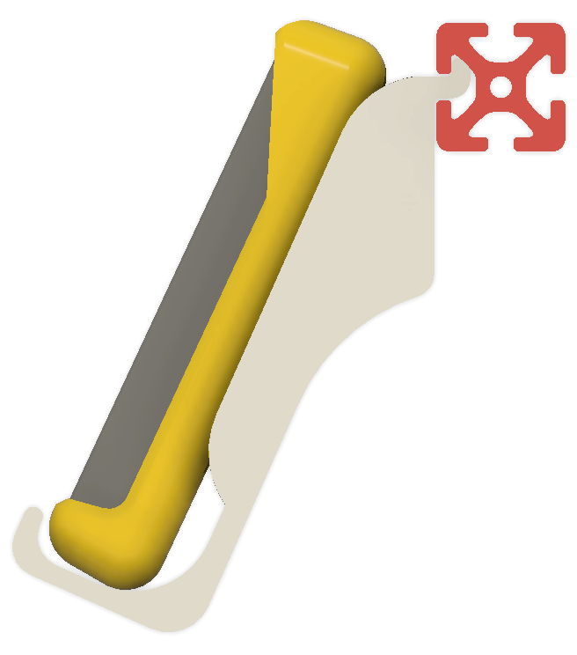
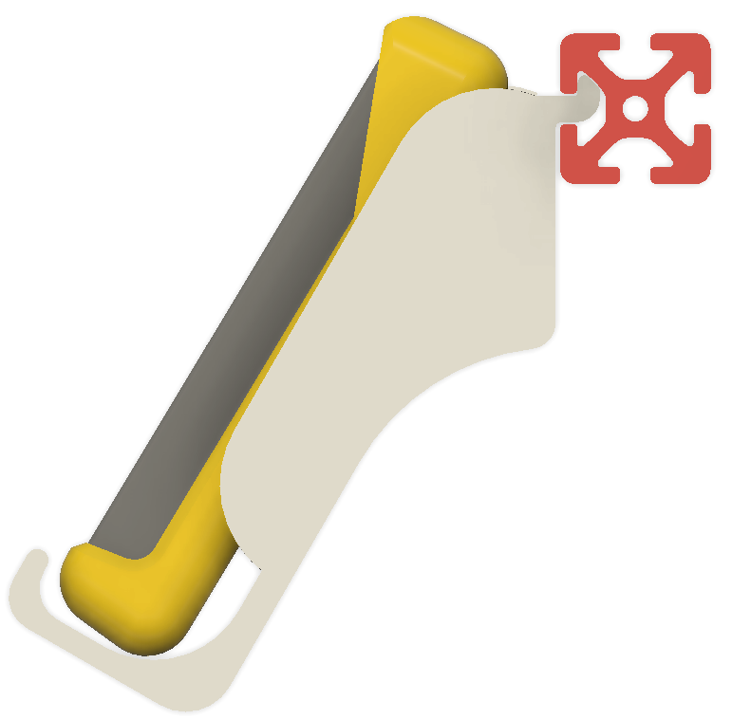
3 options for multimeter4040 design
multimeter4040-Early
multimeter4040-01
multimeter4040-02

Slide 3
3 options for multimeter4040 design
multimeter4040-Early
multimeter4040-01
multimeter4040-02

