Slide 2
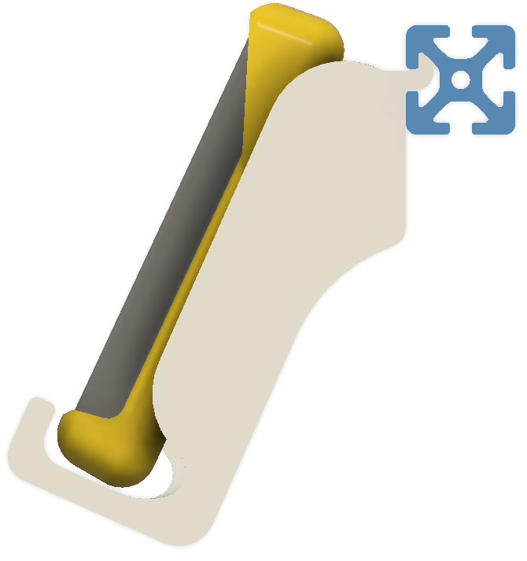
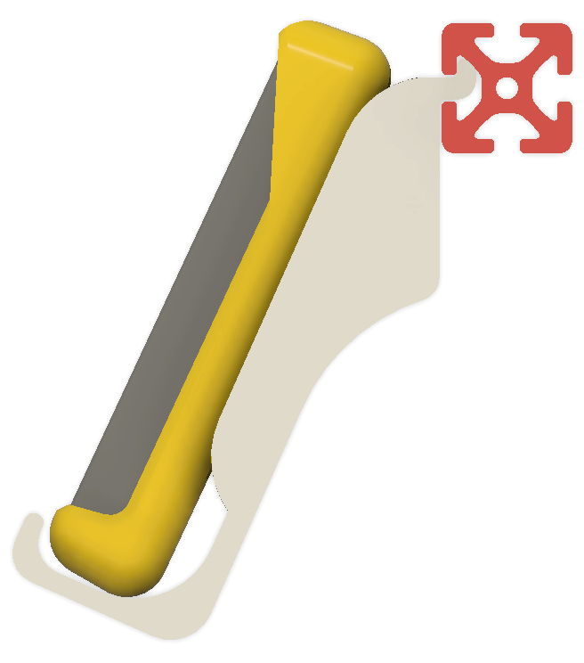
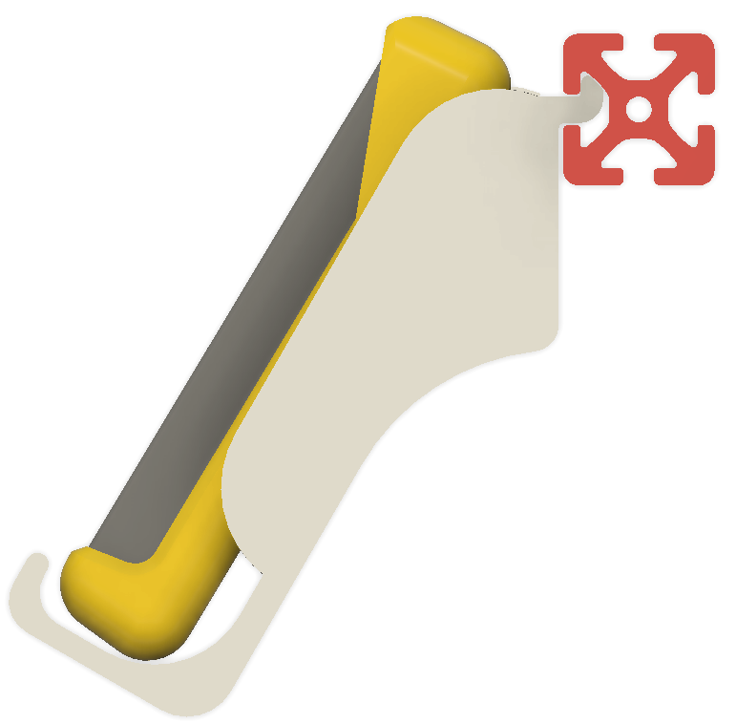
3 options for multimeter4040 design, side view
multimeter4040-Early
multimeter4040-01
multimeter4040-02

Slide 3
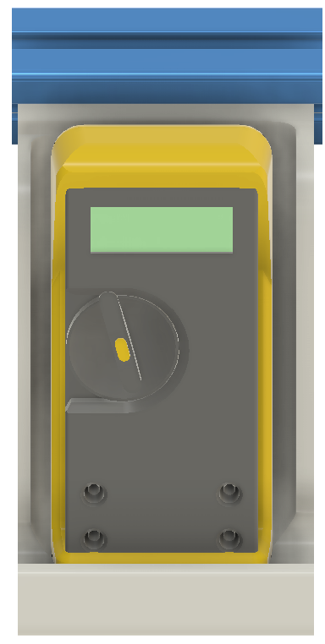
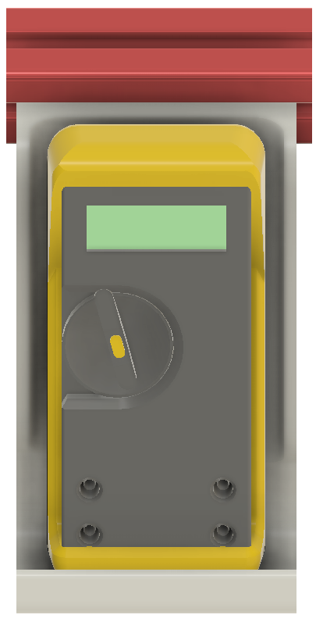
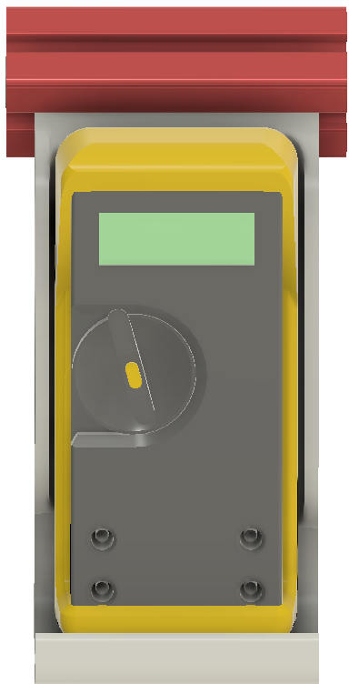
3 options for multimeter4040 design, front view
multimeter4040-Early
multimeter4040-01
multimeter4040-02

