Slide 2
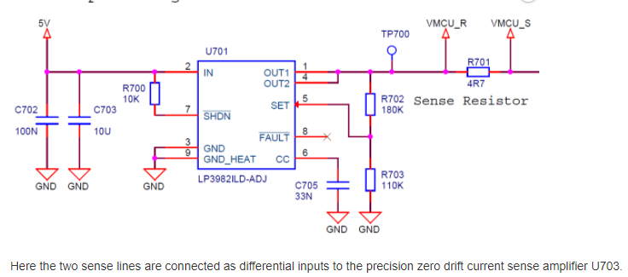
EFM32 Zero Gecko Starter Kit w/ Sensor Card
https://www.eevblog.com/forum/testgear/measuring-current-on-a-low-power-iot-device/25/
https://www.element14.com/community/roadTestReviews/1918
https://www.ti.com/lit/ds/symlink/lp3982.pdf?ts=1609503972847&ref_url=https%253A%252F%252Fwww.google.com%252F
https://www.analog.com/media/en/technical-documentation/data-sheets/6102fe.pdf
https://www.analog.com/media/en/technical-documentation/data-sheets/AD8655_8656.pdf

Slide 3
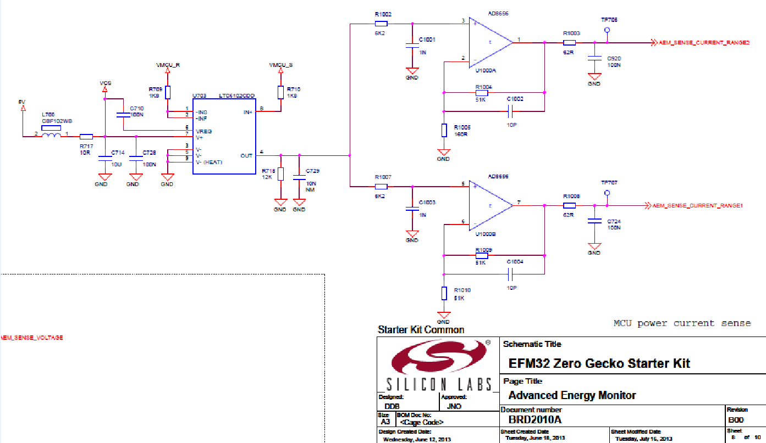
EFM32 Zero Gecko Starter Kit w/ Sensor Card
https://www.element14.com/community/roadTestReviews/1918

Slide 4
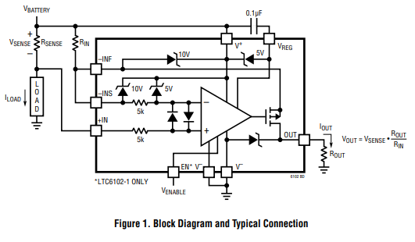
LTC6102 Precision Zero Drift Current Sense Amplifier
https://www.analog.com/media/en/technical-documentation/data-sheets/6102fe.pdf

Slide 5
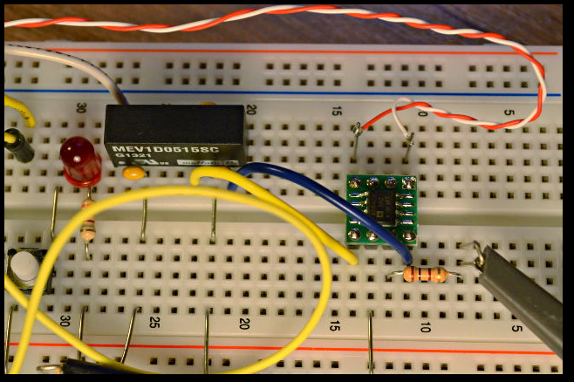
Measuring microamps & milliamps at 3 MHz bandwidth
The AD8428 is perfect. It's so very easy! Of course, such amazing performance costs money: about $20. Here's that expensive little amplifier, and a 5V to +/- 15V power supply (about $10) to power it.
https://www.eevblog.com/forum/testgear/measuring-current-on-a-low-power-iot-device/25/
https://dorkbotpdx.org/blog/paul/measuring_microamps_milliamps_at_3_mhz_bandwidth/

Slide 6
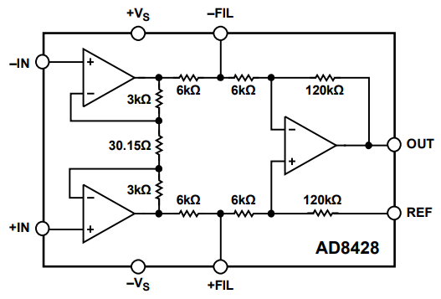
@ $20 : AD8428 Low Noise, Low Gain Drift, G = 2000 Instrumentation Amplifier
https://www.analog.com/media/en/technical-documentation/data-sheets/AD8428.PDF

Slide 7
@ $20 : AD8428 rough estimation
0.5 Ohm 10mA 5mV x2000= 10V
1mA 0.5mV 1V
100uA 50uV 100mV
10uA 5uV 10mV
1uA 0.5uV 1mV
0.01Ohm 500mA 5mV x2000= 10V
Conclusion:
Using 2 AD8428 and 2 series resistors can cover the range from 1uA to 500mA

