Slide 1
Plugin Sonar Icode CNES
Sonar Plugin for the code analysis tool: Icode CNES

Slide 2

Get started with Sonar Plugin Icode CNES
Sonar Server (OPS)
VirtualBox and VMs
Sonar configuration
Deploy & run
Development environment (DEV)
Java JdK
Eclipse

Slide 3
Plugin architecture
languages: Specific Plug-in language
measures: Metrics and computed measures definitions
report: Parse a ICode output report
rules: ICode rules definition
sensor: Sensor executed by sonar-scanner into ICode projects
settings: Plug-in preference

Slide 4
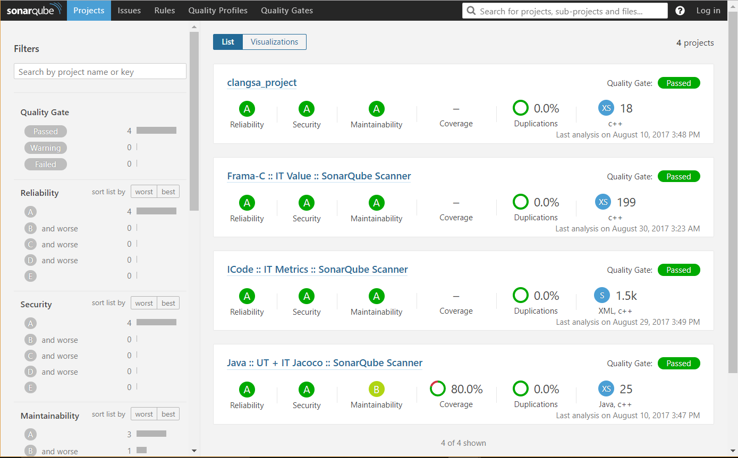
Prepare ICode CNES project
Source files:
File name: *.f, *.f77, *.f90, *.sh
Sonar.properties
Report directory:/icode-reports
Report files:
Into the report directory
Same name as source file

Slide 5
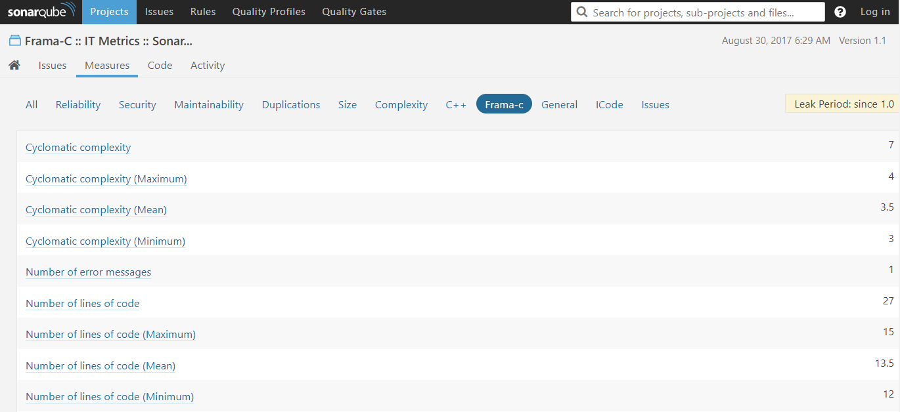
Analyse a ICode CNES project
Sonar scanner
Metrics:
Cyclomatic complexity (Sum, Mean, Min, Max)
Line of codes: SLOC (Sum, Mean, Min, Max)
Sonar web

Slide 6

DeVOPS
From a new plugin revision
To a new project analysis into Sonar
=> deploy-plugin.sh

Slide 7

Quality Profiles & Rules
ICode default Quality Profile without rules
Create a new Quality Profile
Pattern matching

Slide 8
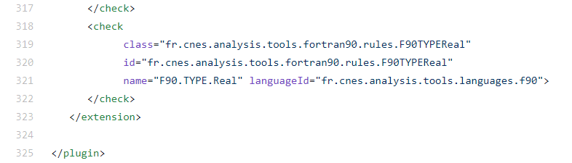
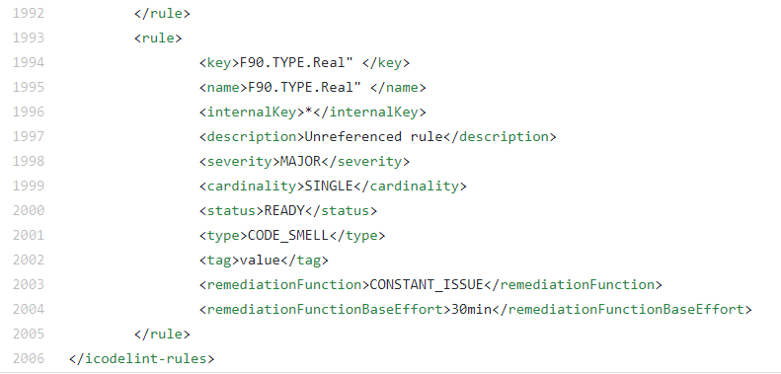
ICode CNES rules & issues
Plug-in resources: icode-rules.xml
Sonar issues
From Icode CNES plugins.xml file to icode-rules.xml…

Slide 9
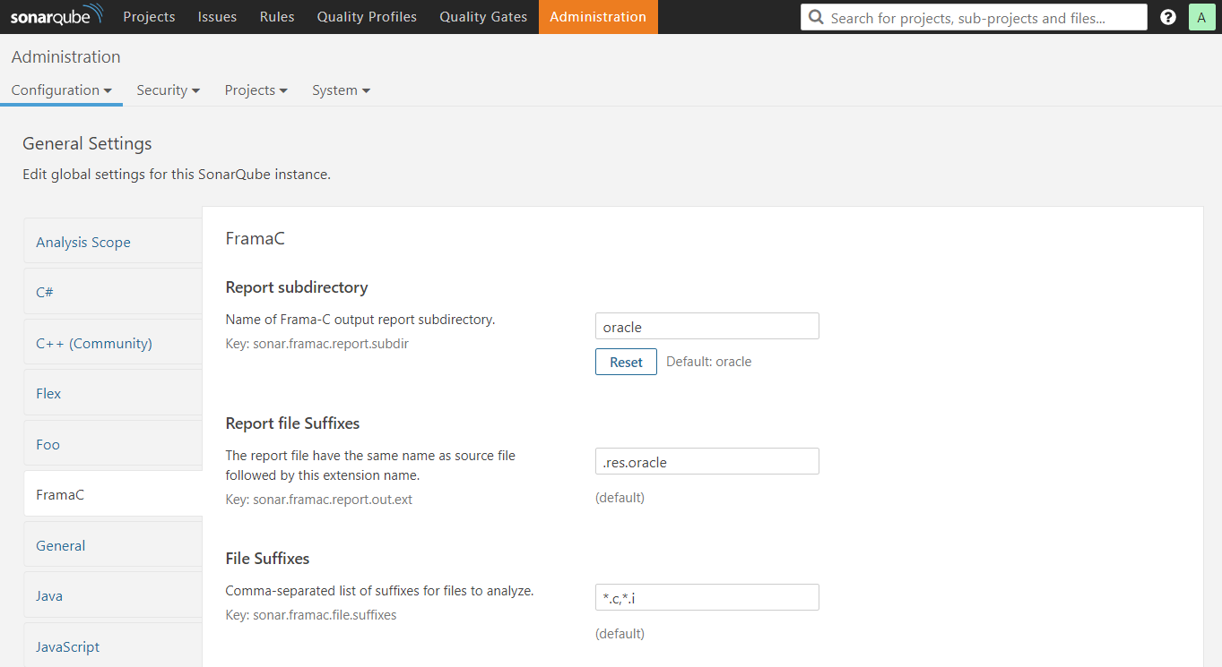
Plugin ICode CNES preferences
File suffixes for ICodeLanguage
Report file suffixes:
Replace the source file extension
Report sub-directory
Plugin metrics:
Number of error messages
Report files error

Slide 10

Continuous Integration (CI)
Github -> Travis -> sounar.cloud
Create Travis and sonar.cloud account
Configure Travis into Github project
Add sonar.cloud key to .travis.yml
Demo & CNES Github/Travis/etc settings

Slide 11
Conclusion
Generic architecture
ICode CNES rules definition with properties file
Simples plug-in preferences
Ready to DevOps & CI
Compliant with ICode CNES requirements (from ICode CNES plugins.xml files)
Warning some rules are defined several times into different plugins.xml files

