Slide 2
Presentation Structure
Introduction
System Components
System Presentation
Experimental Evaluation
Summary

Slide 3
Presentation Structure
Introduction
System Components
System Presentation
Experimental Evaluation
Summary

Slide 4
Examples of parallelly evolving time-series
Financial/Social indicators
Weather data
Software development data
Why do we care?
Recognition of good/bad entity features
Entity behavior pattern mining
Future forecasts
Notes:
Μετοχές
GitHub
Δείκτες Πληθυσμός, κατώτατος μισθός, παιδί/ γυναίκα

Slide 5
Στόχος Εργασίας
Επανασχεδιασμός και υλοποίηση από την αρχή μίας νέας γενικευμένης έκδοσης του εργαλείου.
  Διάγραμμα Παράλληλων Ζωών
  Δημιουργία περιλήψεων των δεδομένων
  Εύκολη επεκτασιμότητα
Έλεγχος ορθής λειτουργίας του εργαλείου.
Πειραματική αξιολόγηση της απόδοσης του εργαλείου.
Notes:
Υλοποίηση ενός εργαλείου από την αρχή που χρησιμοποιεί το διάγραμμα παράλληλων ζωών χωρίς να έχει περιορισμούς συμβατότητας
Προσφέρει την δυνατότητα δημιουργίας περιλήψεων των δεδομένων
Είναι ευκολα επεκτασιμη

Slide 6
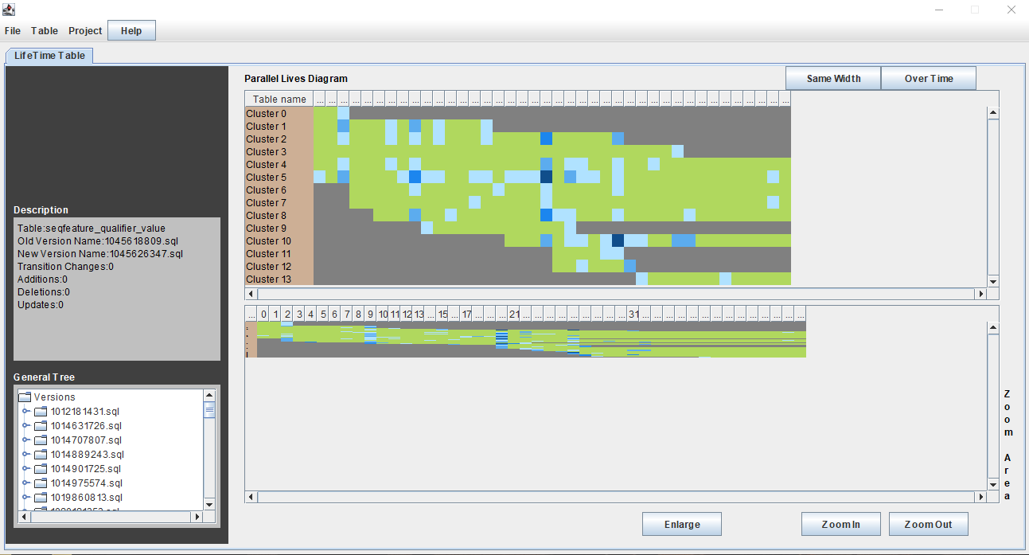
Plutarch Parallel Lives[Giac15]
Schema Evo
Problem:
Supports only DB evolution data.
Notes:
Ισχυρό εργαλείο οπτικοποίησης χρονοσειρών.
Διάγραμμα παράλληλων ζωών
Δημιουργία περιλήψεων των δεδομένων

Slide 7
Presentation Structure
Introduction
System Components
System Presentation
Experimental Evaluation
Summary

Slide 8
How we expand the compatibility?
We introduce a generalized language of parallelly evolving time-series representation, that breaks the direct relation between the system and the data.
Convert the data to intermediate representation.
Schema Evo
GapMinder
Intermediate Representation
System
Other

Slide 9
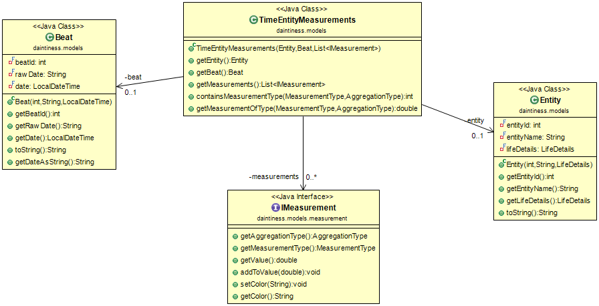
Intermediate Representation
TimeEntityMeasurement(TEM)
is the key ingredient of the representation. It consists of three elements:
Beat
Entity
Measurement
Notes:
Χρονική στιγμή (στήλη)
Οντότητα (γραμμή)
Μέτρηση (κελί)

Slide 10
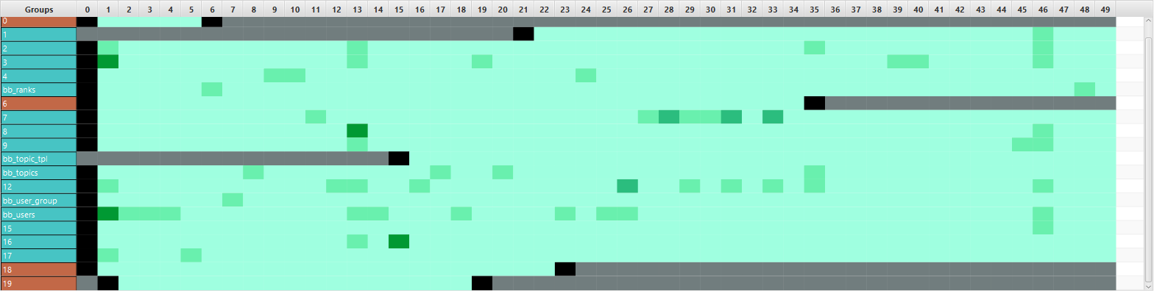
Parallel Lives Diagram
Space problem for big data.
Columns: Time (Beats)
Rows: Entities
Cell color: Measurements

Slide 11
Summarize the data
Use of agglomerative clustering:
On time axis. The similar time moments (Beats) are getting clustered to create Phases.
On entity axis. The similar Entities are getting clustered to create EntityGroups.

Slide 12
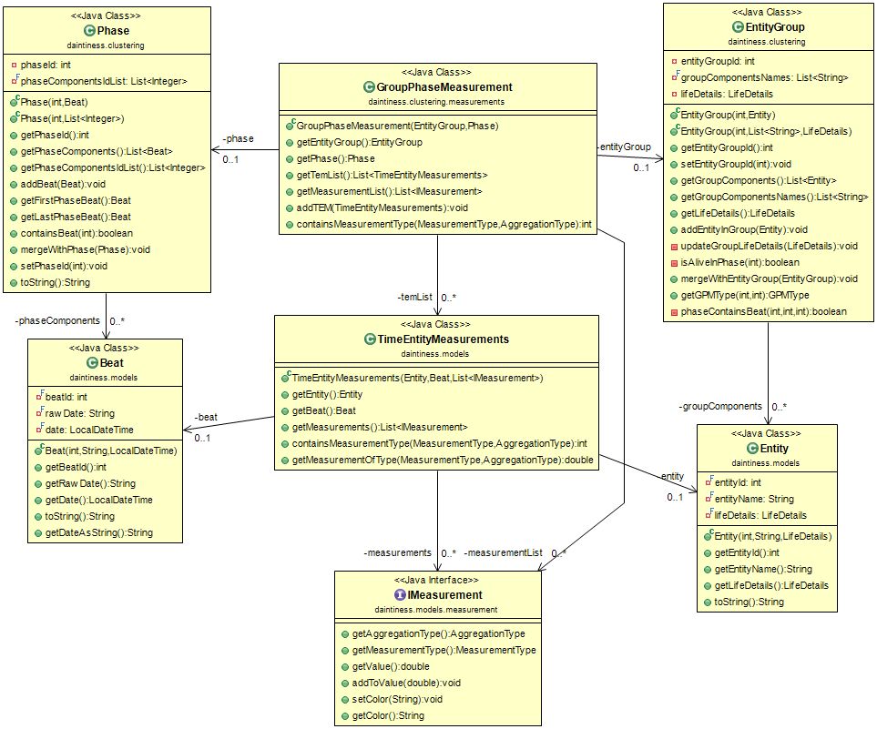
Summary Representation
GroupPhaseMeasurement(GPM) is the key ingredient of the summary representation. It consists of three elements:
Phase
EntityGroup
Measurement

Slide 13
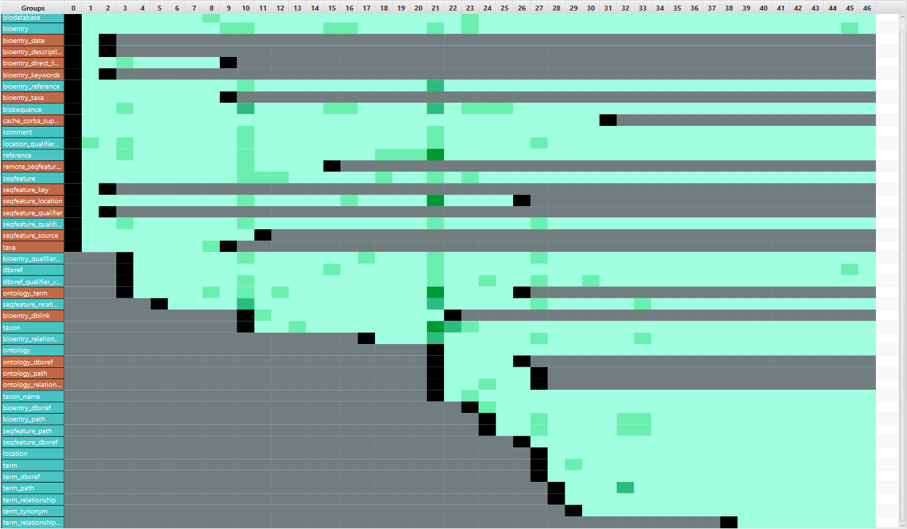
Clustering Examples
Phase
Grouped
Measurements
EntityGroup

Slide 14
Biosql (without clustering)

Slide 15
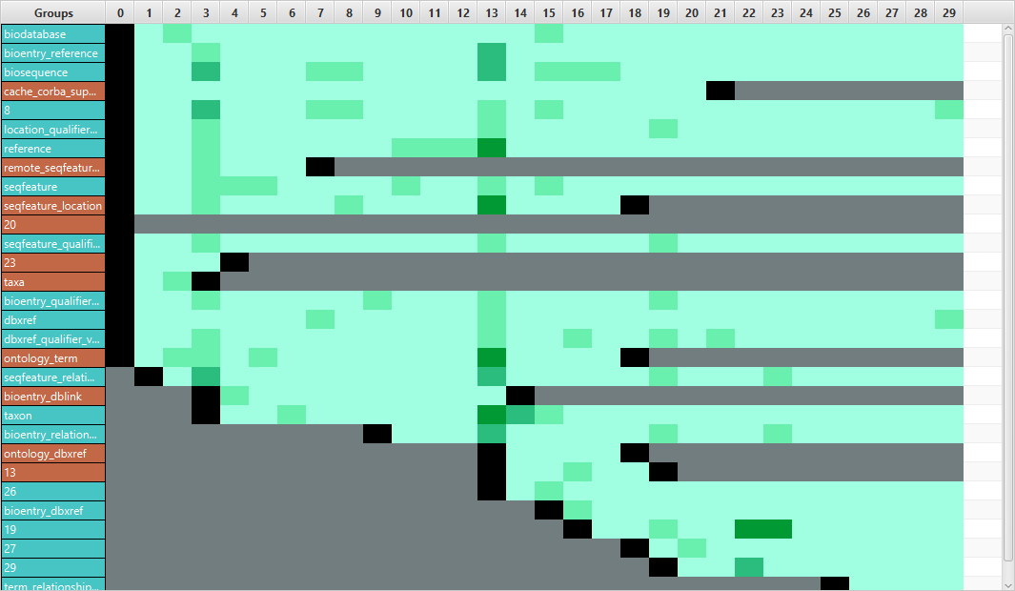
Biosql (Clustering 30-30)

Slide 16
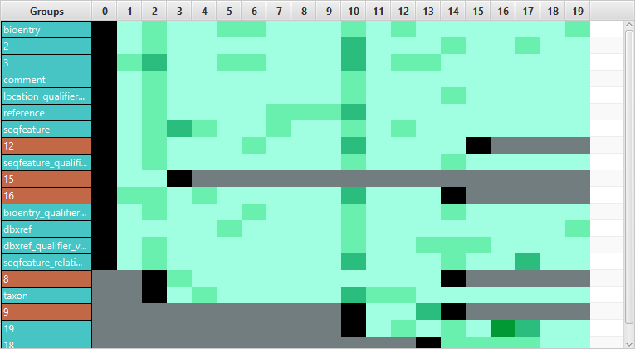
Biosql (Clustering 20-20)

Slide 17
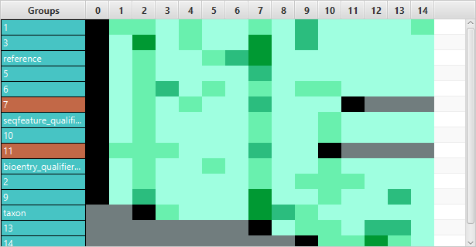
Biosql (Clustering 15-15)

Slide 18
Architecture
FileHandler: handles the data loading and converting.
DataHandler: handles the intermediate representation.
ClusteringHandler: creates and handles the data summary.
MainController: Backend API
MainController
FileHandler
DataHandler
ClusteringHandler
Notes:
3 συστατικά στοιχεία του προγράμματος

Slide 19
Architecture
GUI
CL Converter
The applications that we developed communicate with the backend only through the API.
Τhrough this separation we succeed easier maintenance and scalability for our system.
MainController
FileHandler
DataHandler
ClusteringHandler

Slide 20
Presentation Structure
Introduction
System Components
System Presentation
Experimental Evaluation
Summary

Slide 21
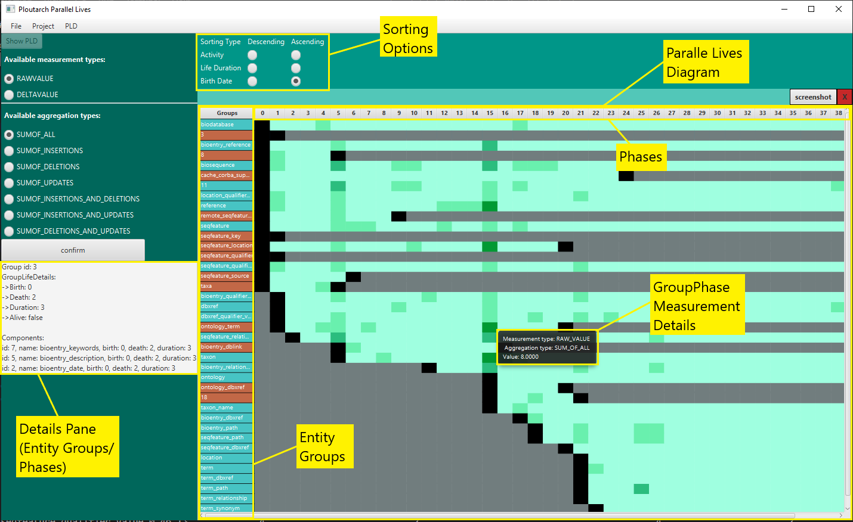
System Features
Load/Save data
Summarize data
Display data in Parallel Lives Diagram
Sort lines
Zoom in/out
Save diagram as an image

Slide 22
Presentation Structure
Introduction
System Components
System Presentation
Experimental Evaluation
Summary

Slide 23
System performance experimental evaluation
We timed 196 DB evolution datasets, on the following task flow:
Data Loading
Converting to intermediate representation
Save intermediate representation in a file
Goal: Find what affects the runtime.

Slide 24
Results (top-20)
Notes:
Κατώφλι στις 100 οντότητες/ χρονικές στιγμές

Slide 25
Results (top-20)
Notes:
Κρατήσαμε τα 20 σετ με τους μεγαλυτερους χρόνους εκτέλεσης

Slide 26
Presentation Structure
Introduction
System Components
System Presentation
Experimental Evaluation
Summary

Slide 27
Summary
We created a new generalized language to represent the parallallly evolving time-series
We developed from scratch a visualization system. With the following main features:
  It has no particular compatibility restrictions
  Offers visual representation through the Parallel Lives Chart.
  It offers the possibility of creating a summary of the data.
We tested the correct operation of the system.
We did an experimental evaluation of its performance.

Slide 28
Future Extensions
Add support for data from Git.
Add more clustering options.
Add data filtering options.
UI/UX improvements.

Slide 29
Thank you for your attention

Slide 30
Additional Slides
System architecture diagrams
Examples of data summarization

Slide 31
Additional Slides
System architecture diagrams
Examples of data summarization

Slide 32
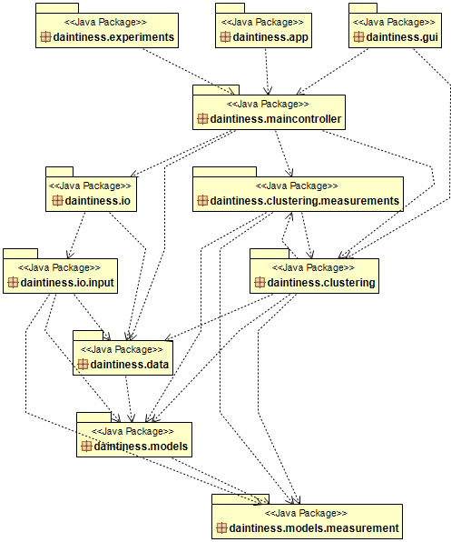
Packet Diagram

Slide 33
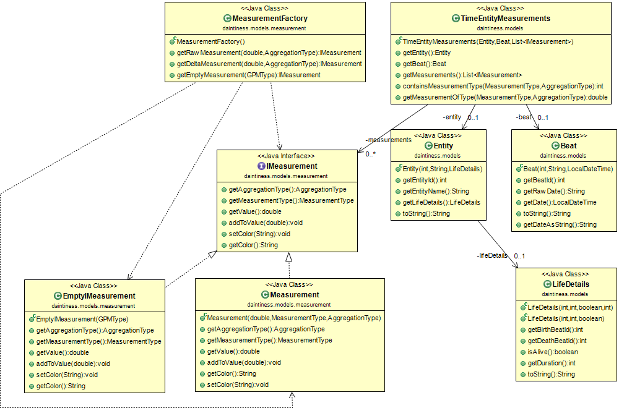
Main Model Class Diagram

Slide 34
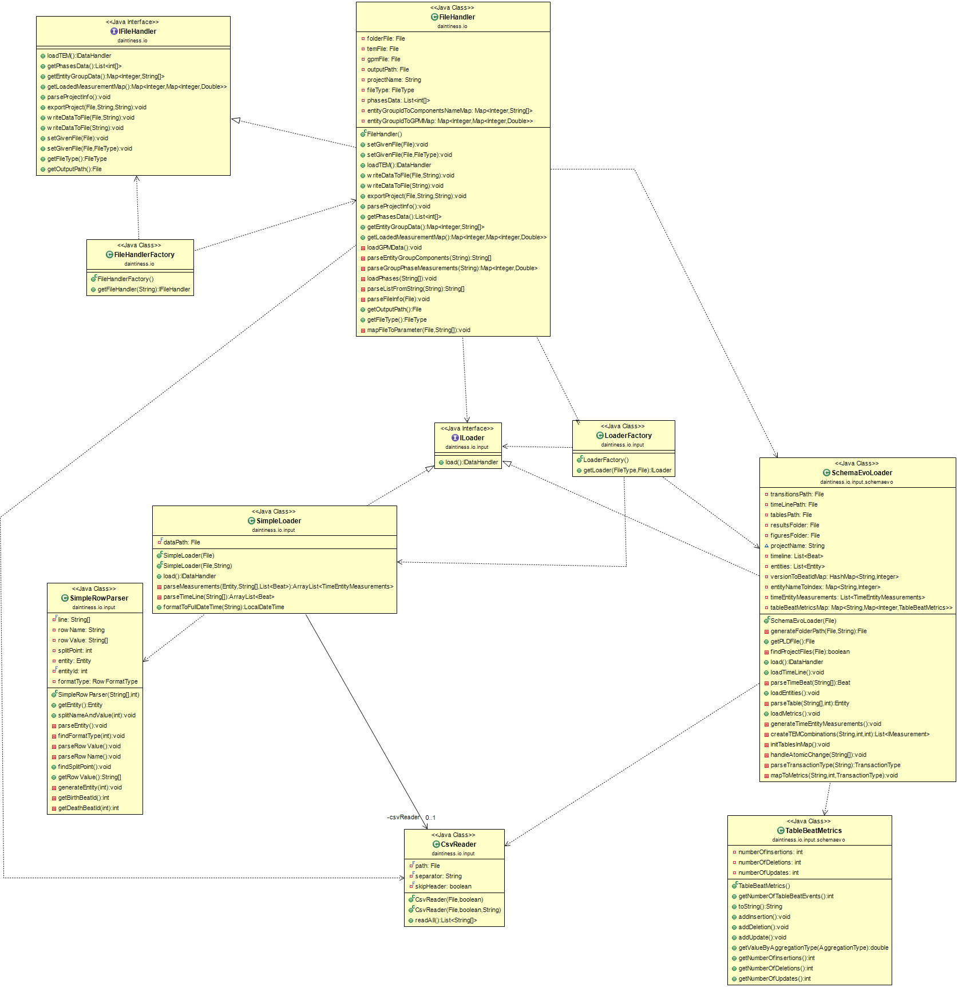
FileHandler Class Diagram

Slide 35
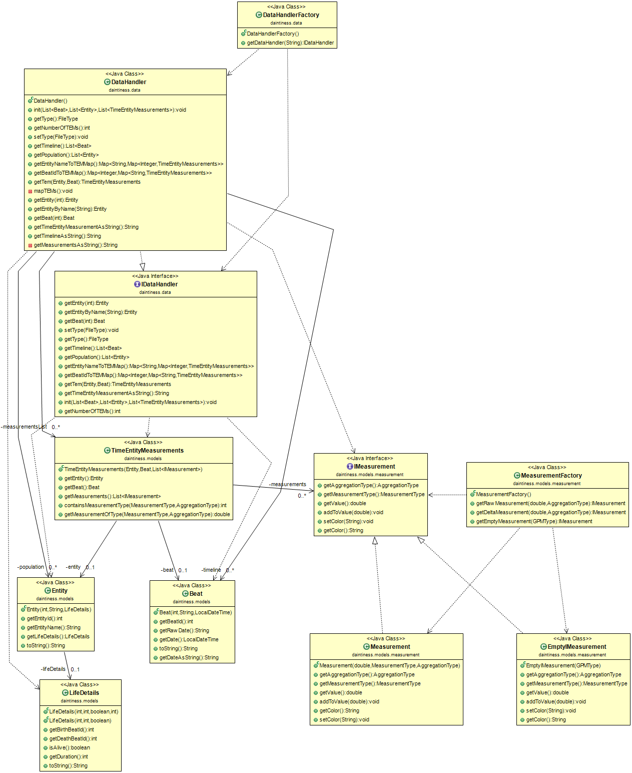
Intermediate Representation Class Diagram

Slide 36
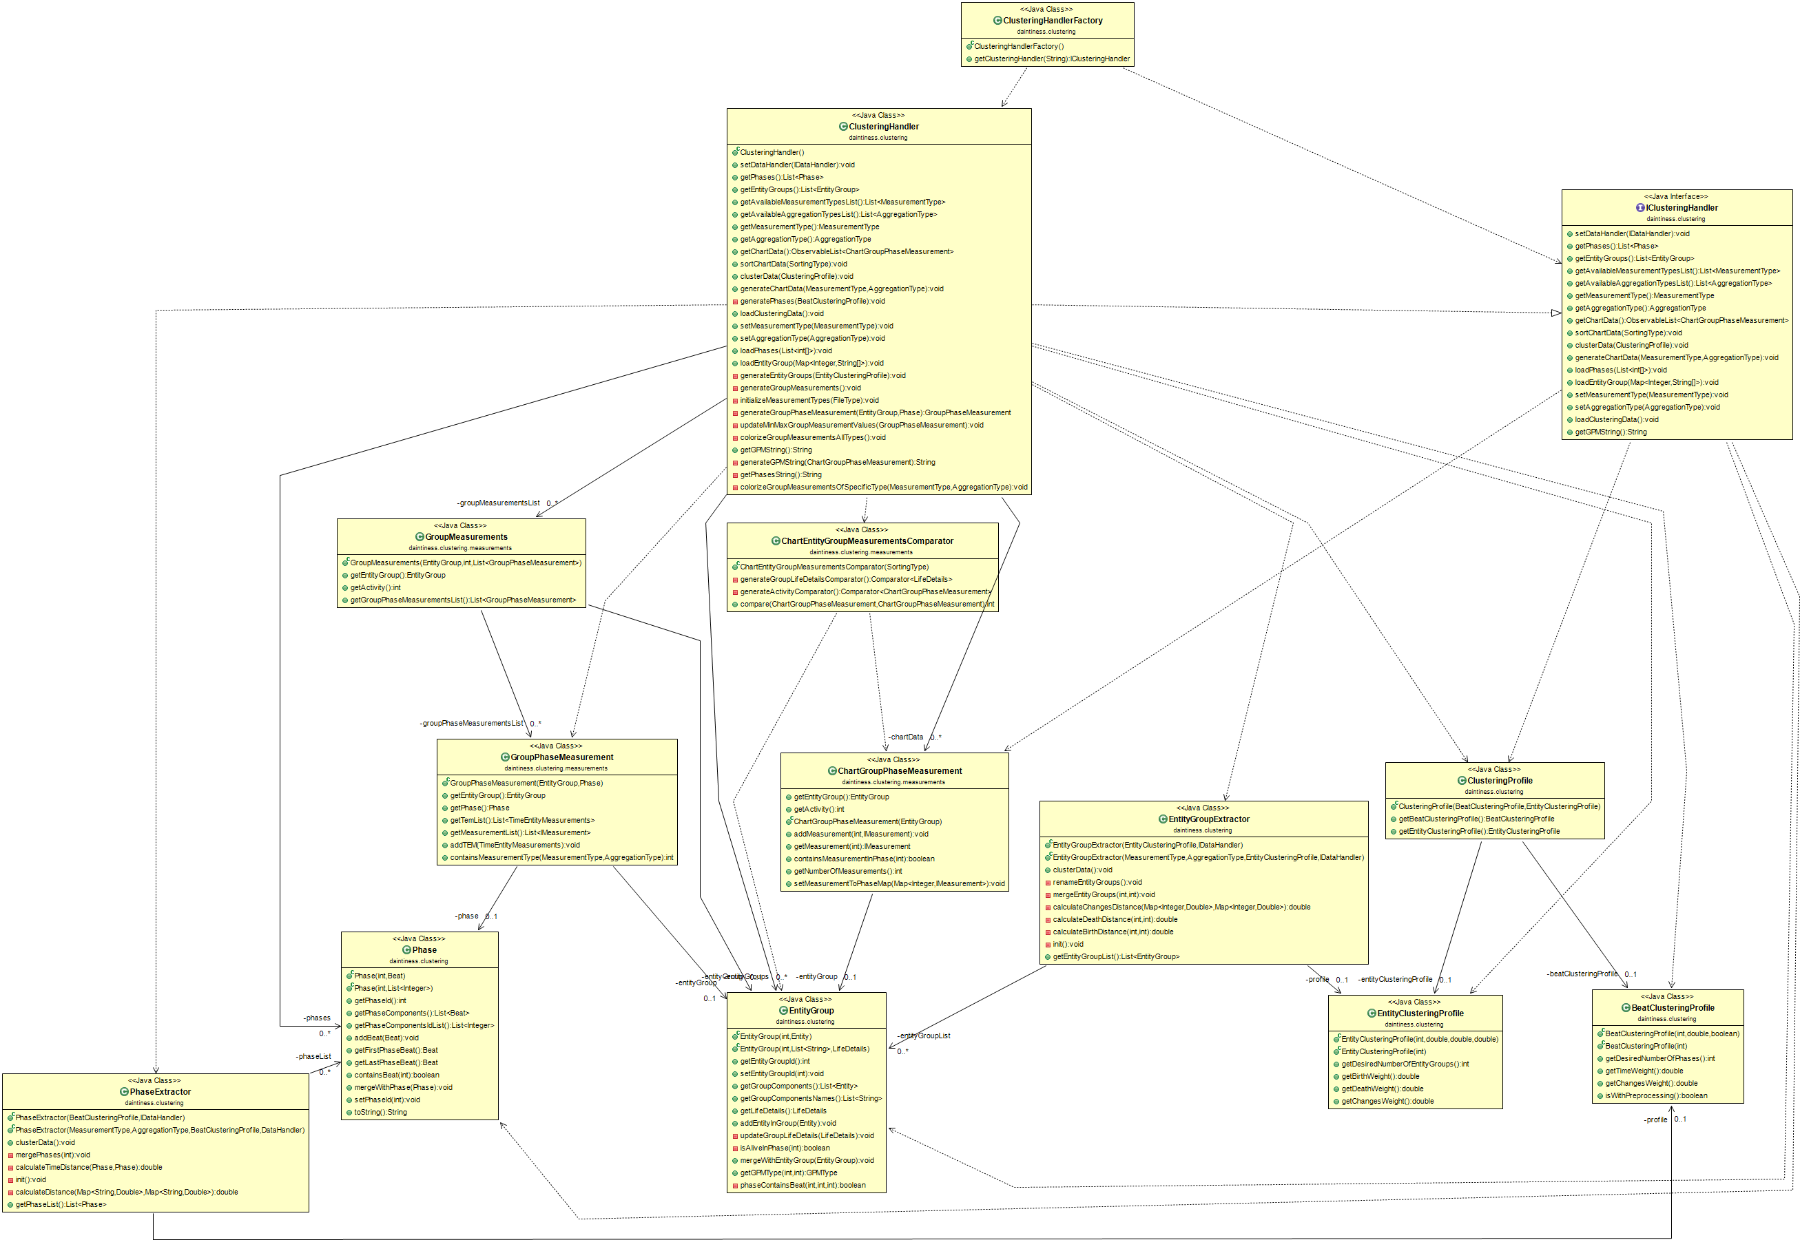
Data Summarization Class Diagram

Slide 37
Additional Slides
System architecture diagrams
Examples of data summarization

Slide 38
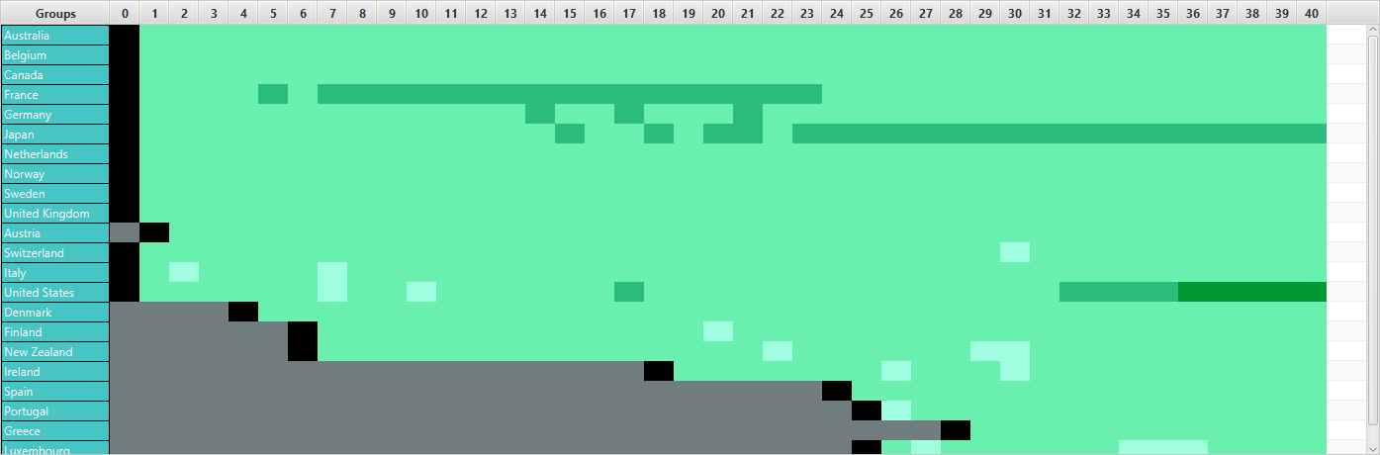
Aid given (without clustering)

Slide 39
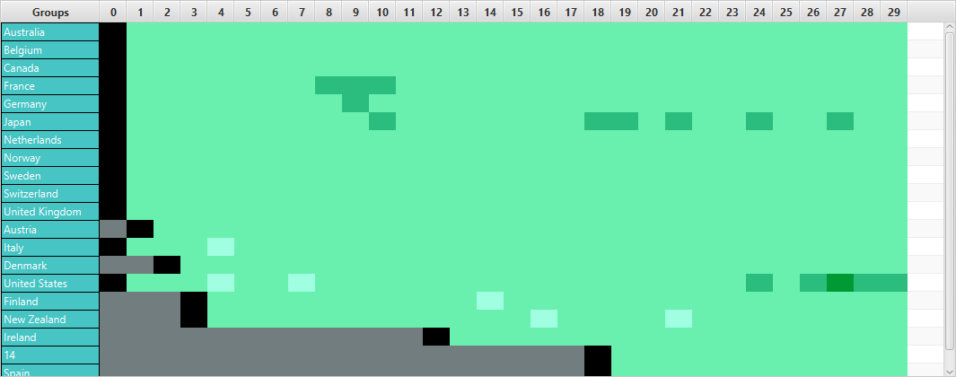
Aid given (clustering 30-20)

Slide 40
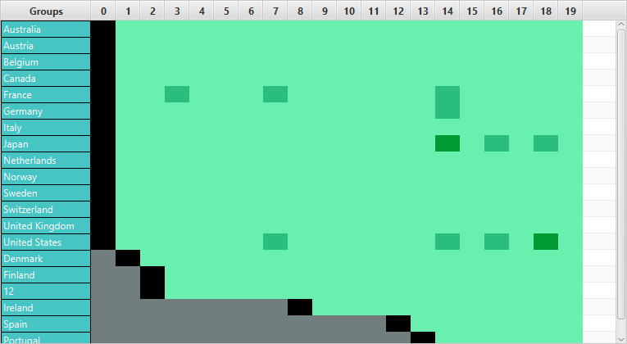
Aid given (clustering 20-20)

Slide 41
Results

Slide 42
What are the time-series?
The term time series refers to the measurements of an entity at specific times.
What are the parallelly evolving time-series?
Parallelly evolving time series are a set of time series that have a common type of entities, use the same time system, and their measurements involve the same quantities.

