Slide 1

Architectural exploration of low-pass FIR filters using MATLAB HDL Coder
Course: ECE 494 – Processor Design | Nikos Stylianou
Date: 28/06/2023

Slide 2
CONTENTS
Introduction | Explanation of goals to achieve and specific filter terms
Filter Creation | Explanation of the filter creation process
Filter Synthesis & Simulation | Overview of the RTL synthesis & simulation flow
Comparison | Illustration of differences found in those architectures
Overall utilization | Quick view of utilization per architecture

Slide 3
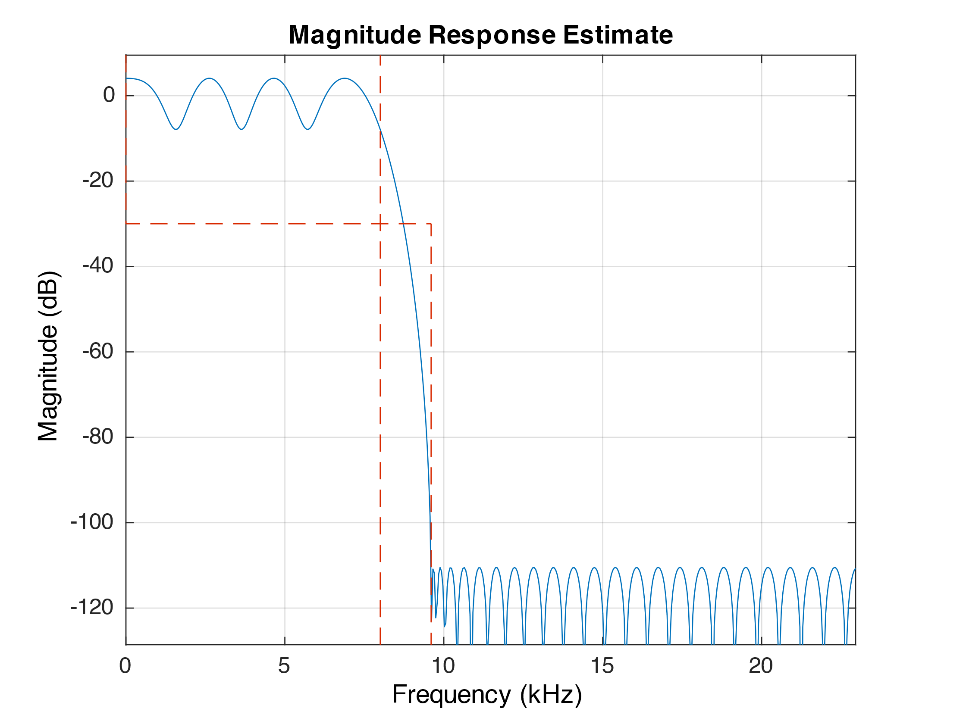
INTRODUCTION
Low-pass FIR filters are digital filters used to remove or attenuate high-frequency components from a digital signal.
FIR filters are characterized by their impulse response, which is a finite duration sequence of coefficients.
Filter’s coefficients determine its frequency response.
Figure 1: FIR low-pass filter with the specifications needed for this project in MATLAB

Slide 4
INTRODUCTION
The filter that had to be implemented has the following characteristics:
Sampling frequency: 46 kHz
Pass frequency: 8 kHz
Stop frequency: 9.6kHz
The filter had to be implanted using different number of coefficients, specifically:
Minimum coefficients possible
20 coefficients
30 coefficients
The filter was tested around different arithmetic:
Single precision floating point arithmetic
Fixed point arithmetic 24 bits
Fixed point arithmetic 16 bits
Fixed point arithmetic 8 bits
Also, several optimizations were added:
1-stage multiplier pipelining
2-stage multiplier pipelining
Multiplier-less arithmetic using factored-CSD
Distributed arithmetic
Notes:
CSD is canonic signed digit. CSD representation expresses a number as a sum of powers of 2, with the coefficients restricted to the set {-1, 0, 1}.

Slide 5
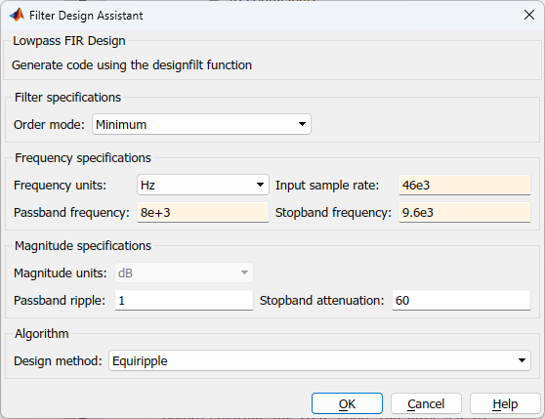
FILTER CREATION
Before creating any HDL code, each filter must be implemented in MATLAB using designfilt().
After successful inspection of the created filters using fvtool, each filter is re-calculated using fdesign.lowpass() and design() functions.
The last two functions return the filter specs and support HDL exporting as well as every optimization we want to apply.
Operates in CLI in contrast to designfilt which operates in GUI.
Figure 2: MATLAB’s designfilt function which is used to create digital filters inside MATLAB.

Slide 6
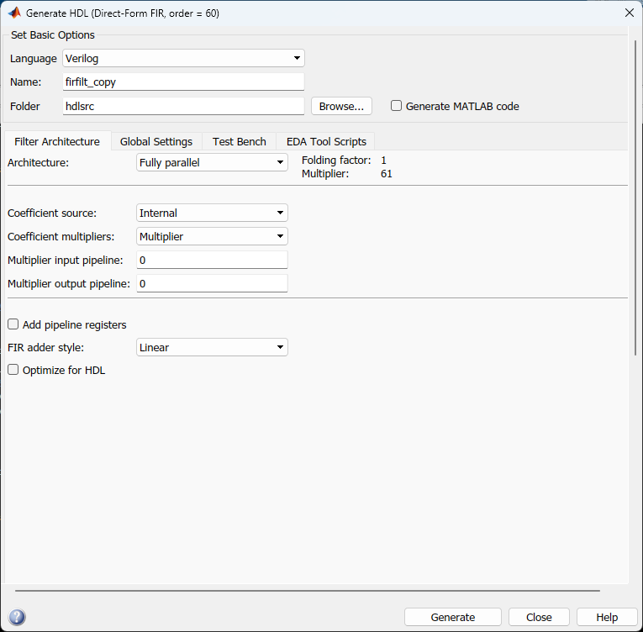
FILTER CREATION
Lastly, fdhdltool function is called with arguments each filter’s specs and numeric type.
Inside this function, optimizations can be enabled such as multiplier-less architectures.
Also, test-benches are created with the filter RTL source files with various stimuli.
Automates the procedure of RTL verification by providing custom scripts for Vivado.
Figure 3: MATLAB’s fdhdltool function which is used to export RTL files of digital filters.
Notes:
Numeric type = το πόσα bits θέλουμε να χρησιμοποιούν τα coefficients

Slide 7
FILTER SYNTHESIS & SIMULATION
Importing RTL files in Vivado
Target device: Zedboard
Pre-synthesis behavioral sim
Adding constraints for the utilization to be accurate
Simulation for filter compliance
Synthesis to obtain filter utilization
Implementation for more accurate results
Post-implementation simulations for actual filter output
Filter utilization is acquired after synthesis.
Simulations were conducted inside Vivado program
Pre-synthesis, to validate correctness of the exported filter.
Post-implementation, to capture filter’s output as this simulation is closer to reality.
Figure 4: Vivado flow for simulation and synthesis for each filter

Slide 8
FILTER COMPARISON
Multiplier architecture 1
Multiplier architecture 2
The output is obtained by summing the products of the coefficients and input samples. 1-stage pipeline used.
Same as the one in the left, uses 2-stage pipeline in multiplier.
Factored CSD
Distributed Arithmetic
Coefficients are decomposed into sum of powers of 2. Uses shift registers and adders to implement multiplication.
Uses pre-computed coefficients stored in LUTs, meaning no multiplication at all.
Notes:
Τα utilizations βγήκαν κατευθείαν από τα Post-implementation reports του Vivado.
Για τα SNR, είχα την κανονική έξοδο του φίλτρου και την expected και μέσω MATLAB υπολογίστηκαν.
Τα latencies per sample έβγαιναν από το MATLAB HDL
Exec. Time = (Latency per sample)*(Number of Samples)/(Clock Frequency)

Slide 9
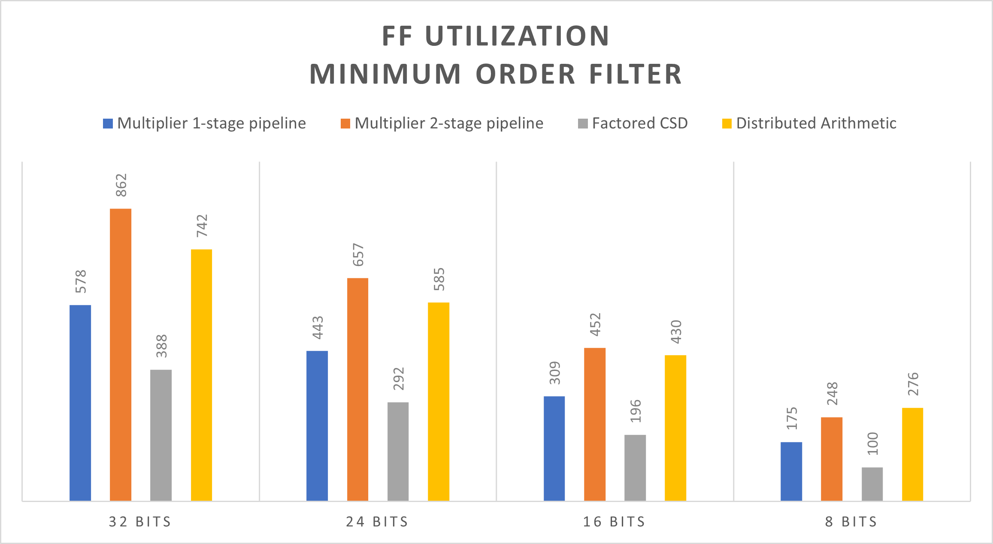
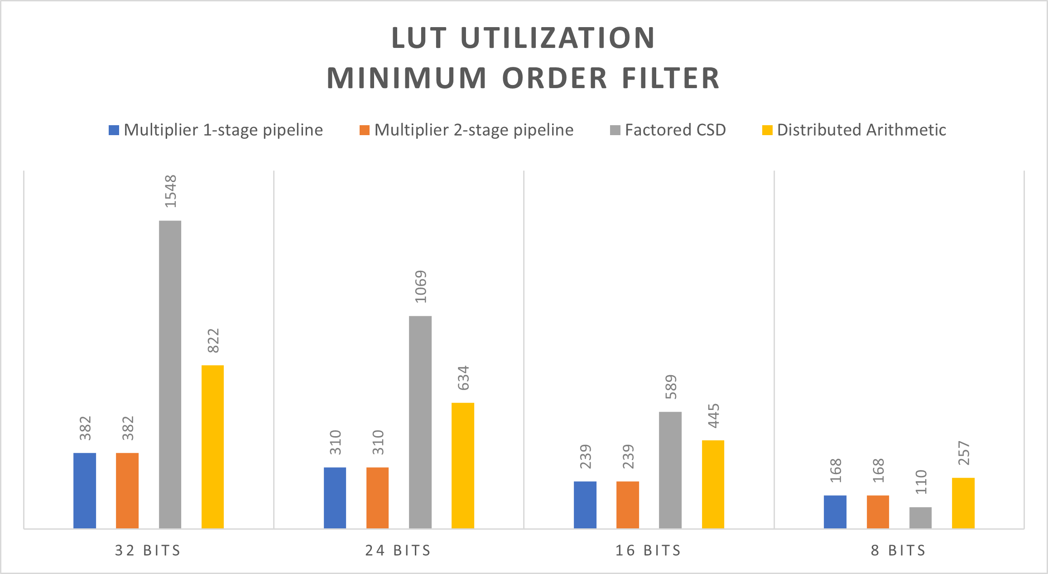
COMPARISON | MIN ORDER FILTER

Slide 10
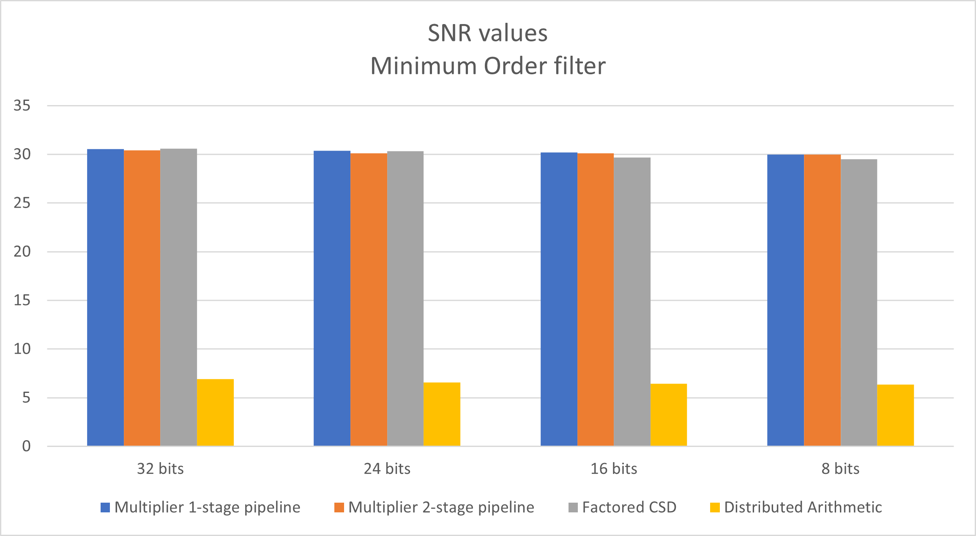
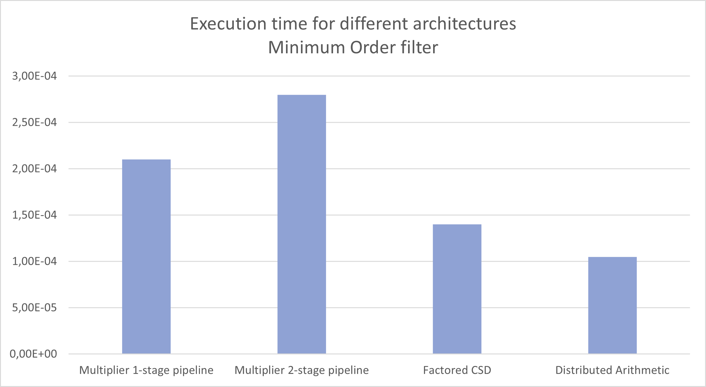
COMPARISON | MIN ORDER FILTER
Note: Sample set consists of 3499 samples.

Slide 11
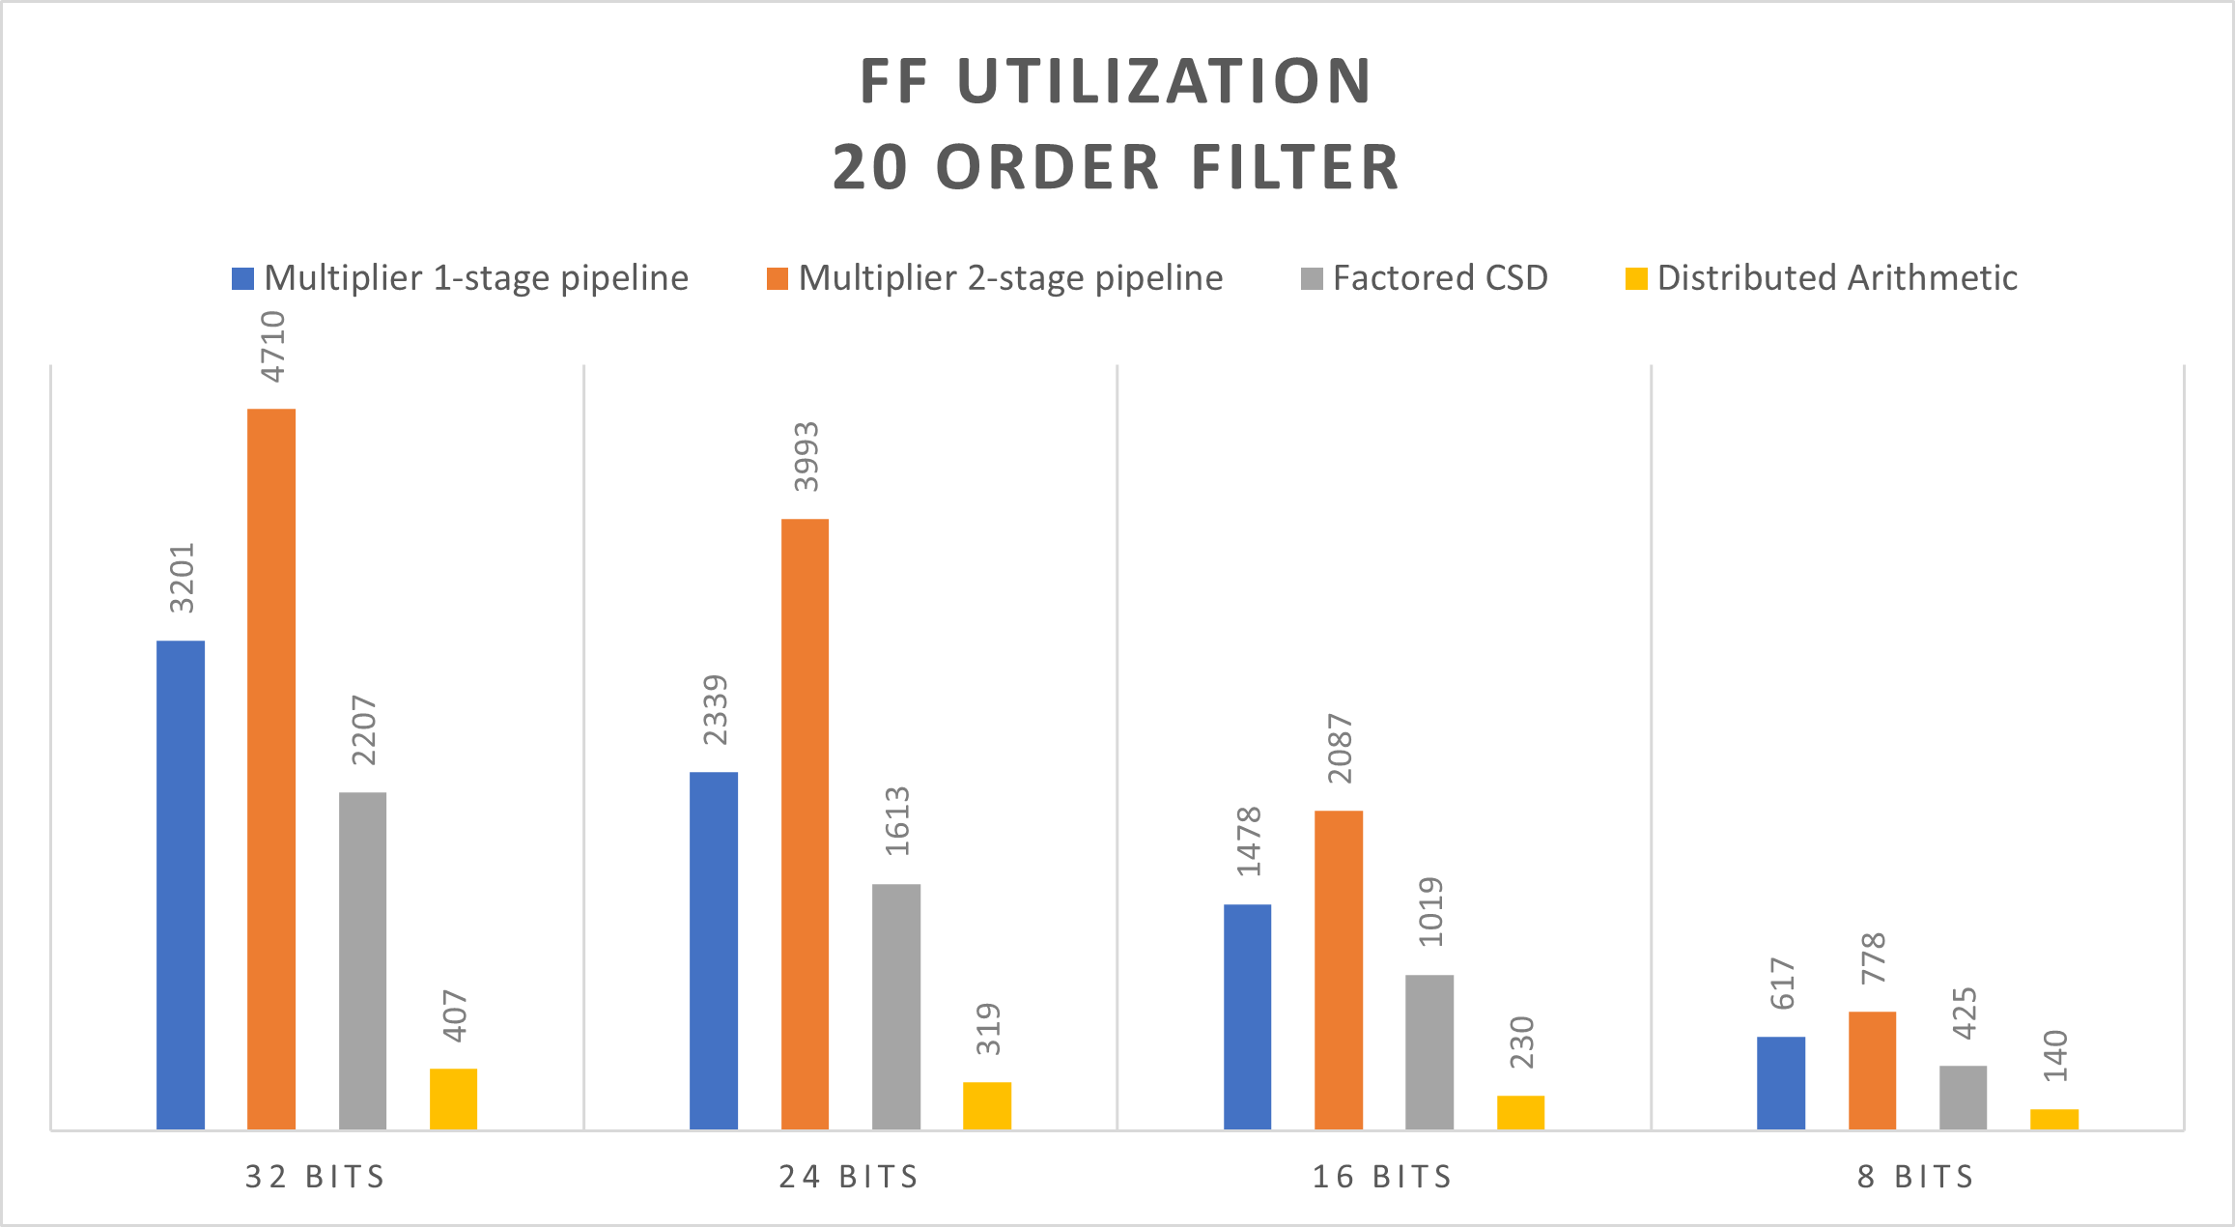
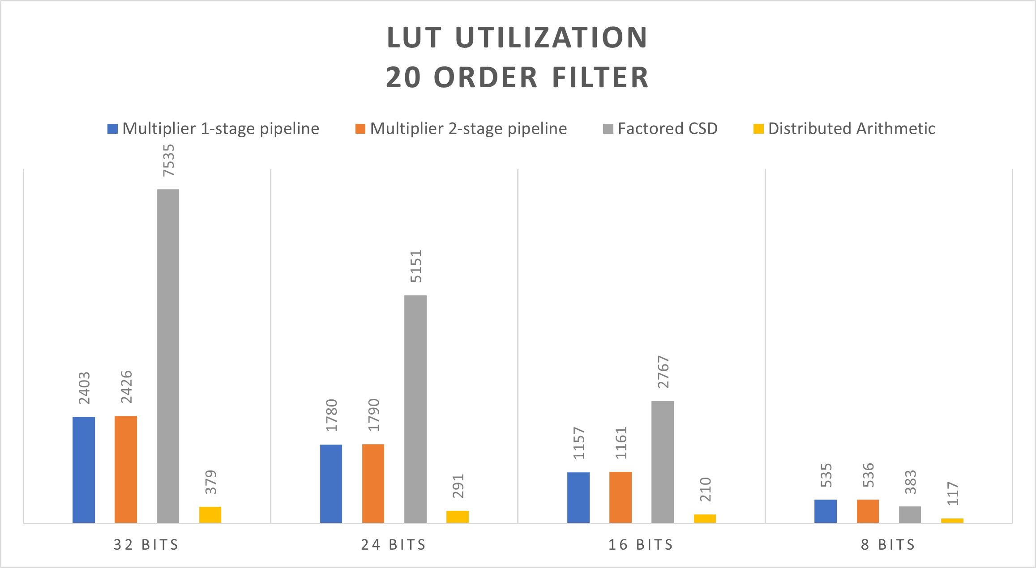
COMPARISON | 20th ORDER FILTER

Slide 12
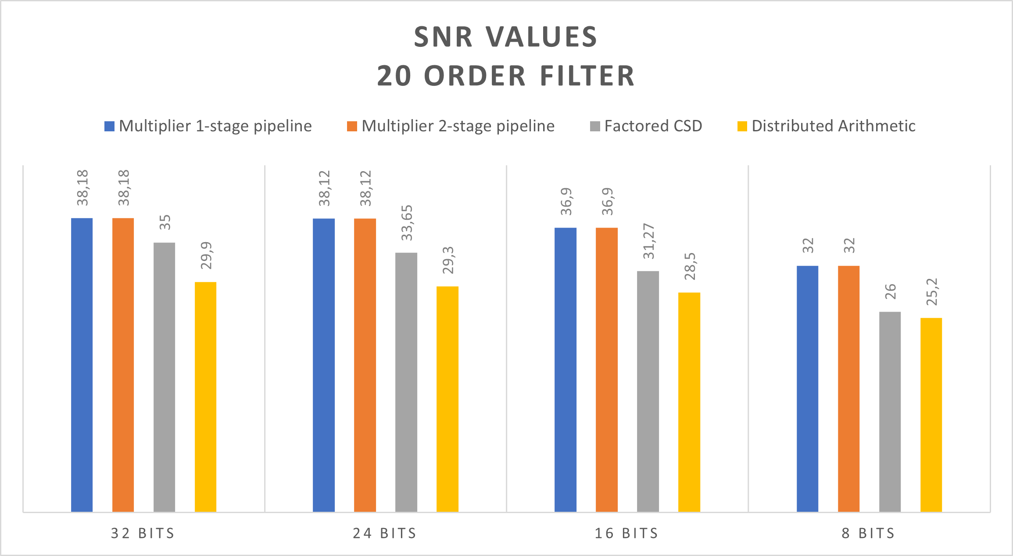
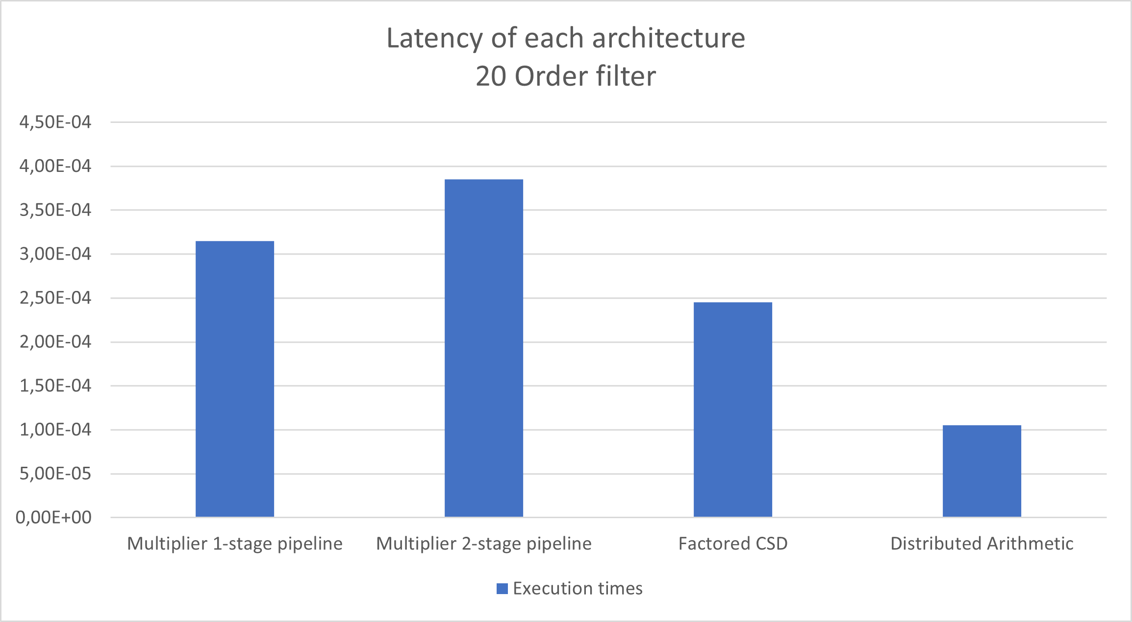
COMPARISON | 20th ORDER FILTER
Note: Sample set consists of 3499 samples.

Slide 13
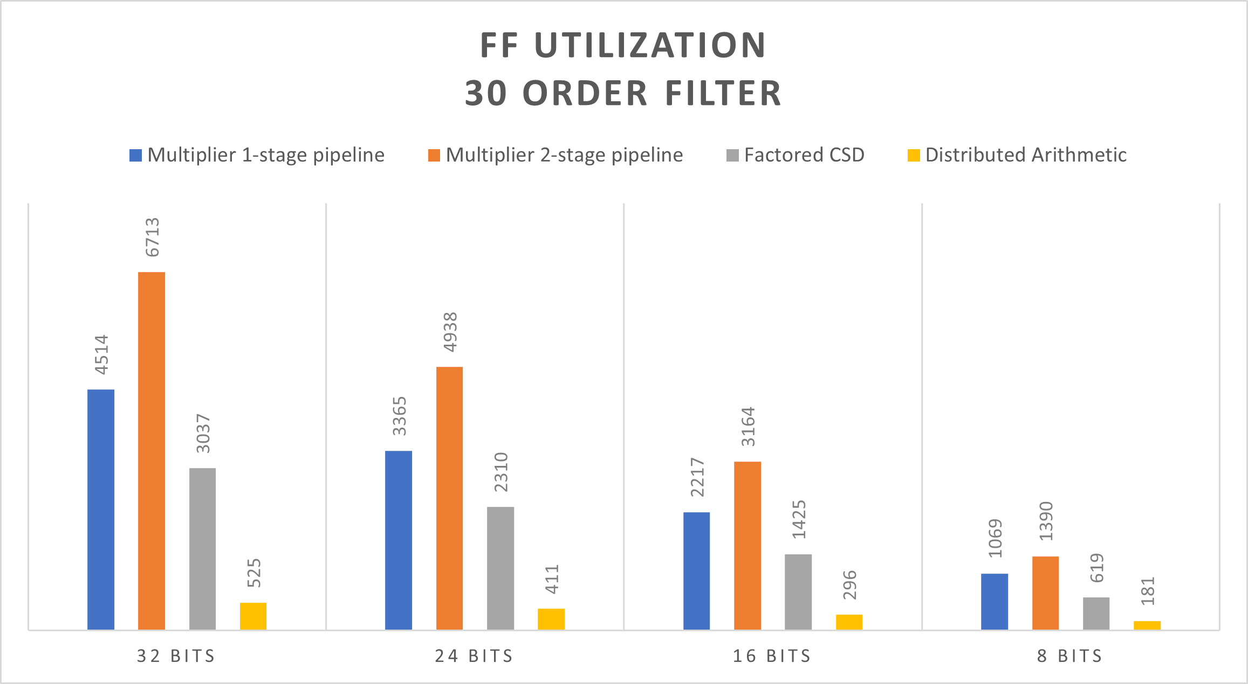

COMPARISON | 30th ORDER FILTER

Slide 14
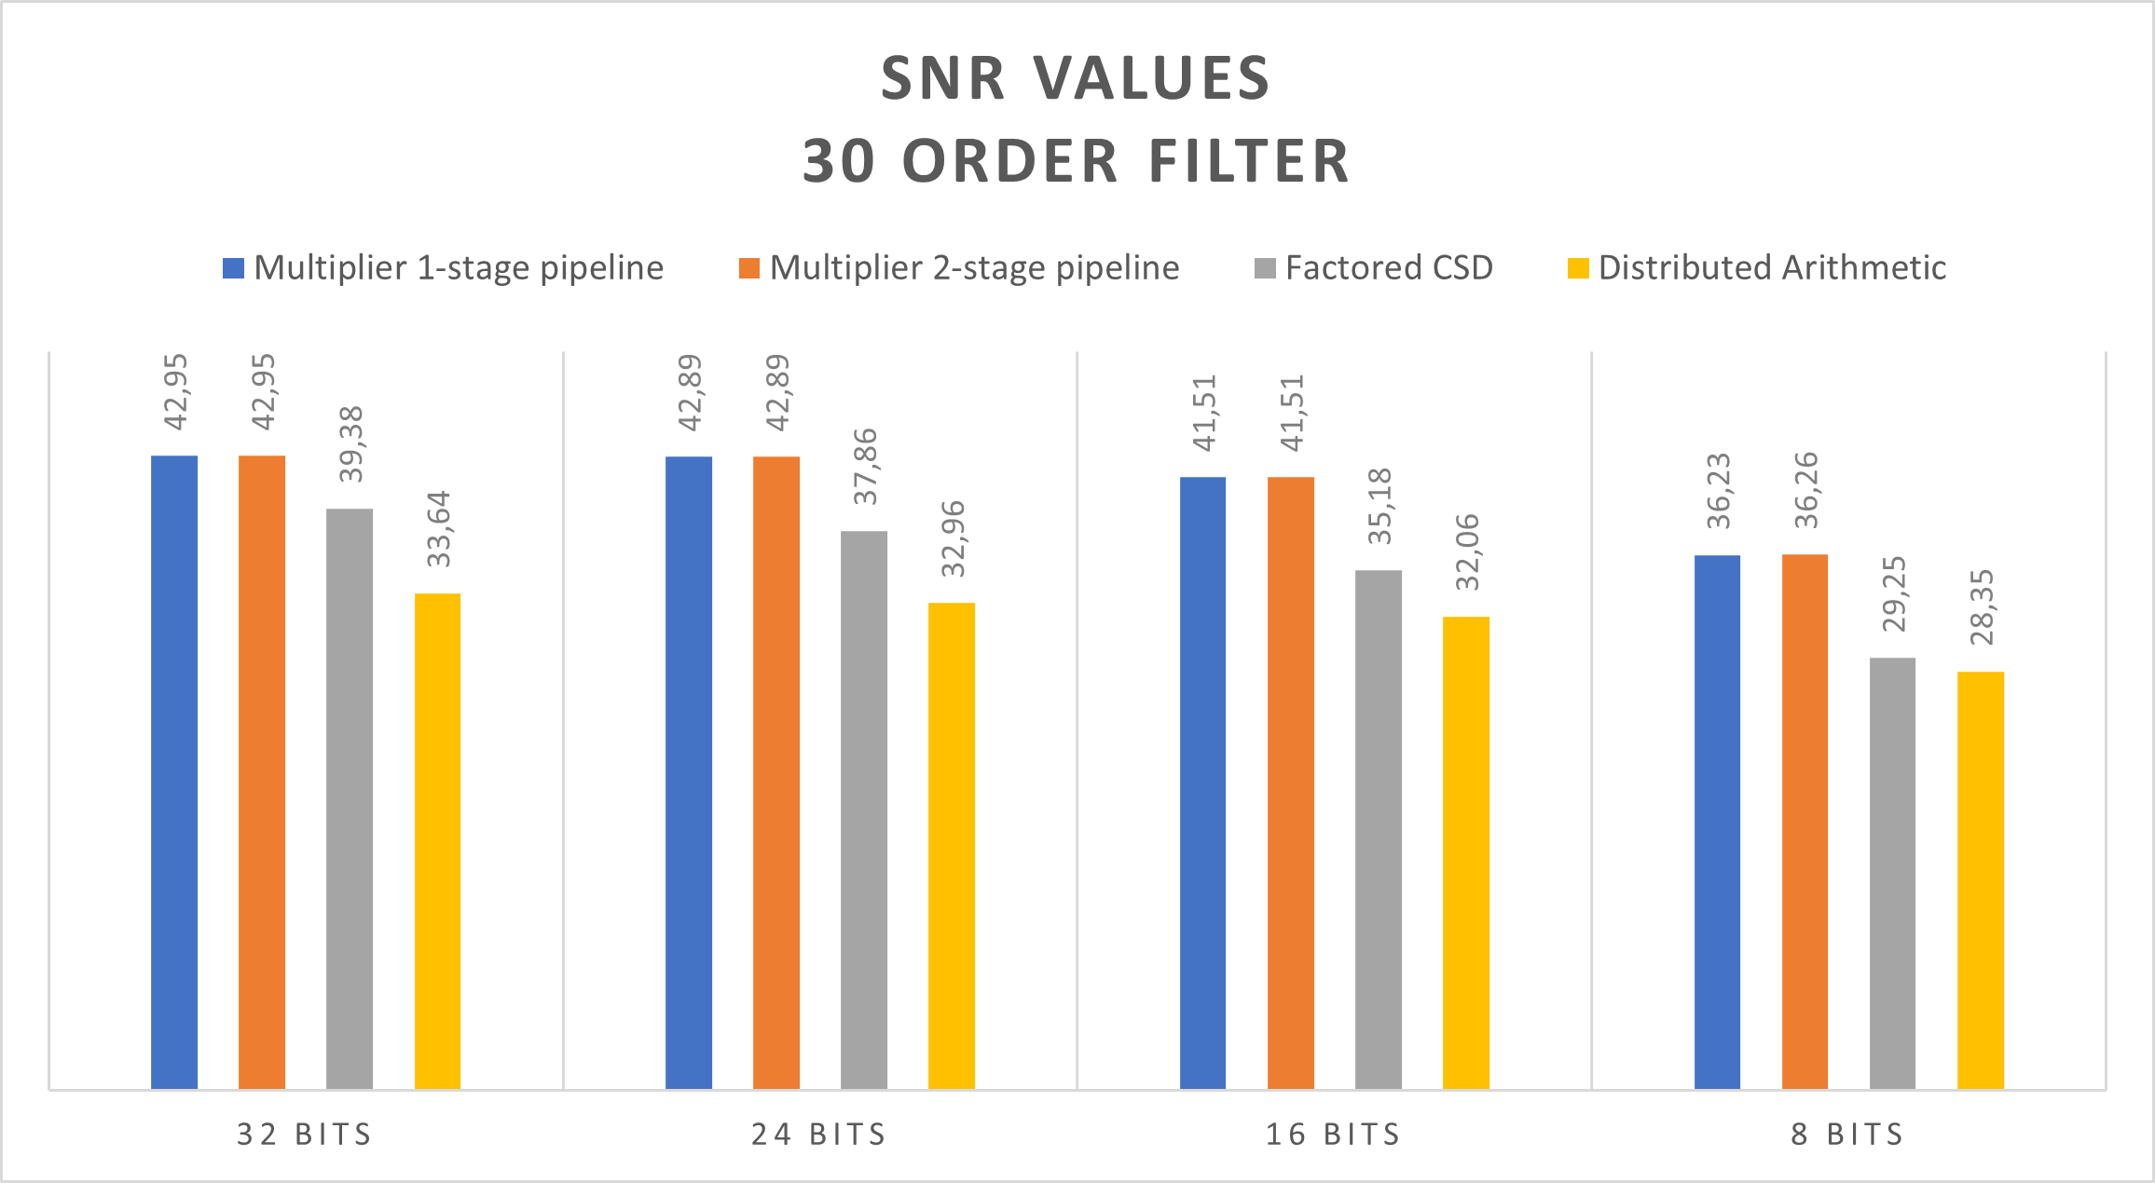
COMPARISON | 30th ORDER FILTER
Note: Sample set consists of 3499 samples. Latency per sample of 30th order filter is the same as the 20th one.

Slide 15
Thank you for your time
Any questions?

