Slide 1
Conversing verses -
Haiku generation using GRU-based
auto-encoder matching model
Luka Ernestini, Niko Uremovic

Slide 2
NLP with RNN
Text summarization
Image captioning
Machine translation
… poem generation?

Slide 3
Motivation
Gaiku
Dialogue generation (chatbot); auto-encoder matching model
LSTM / GRU

Slide 4
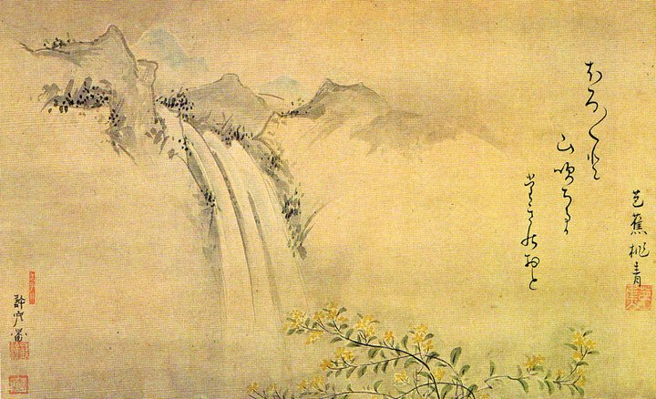
Haiku
Traditional
Dataset

Slide 5
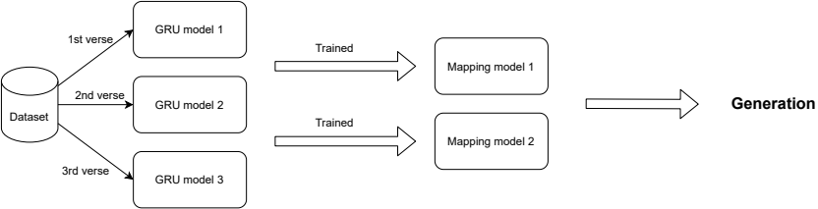
Methodology

Slide 6
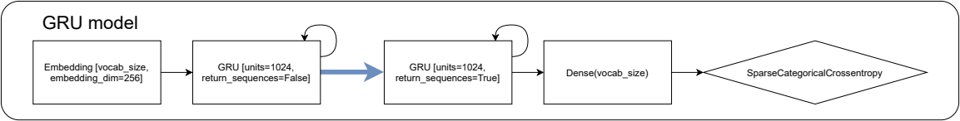
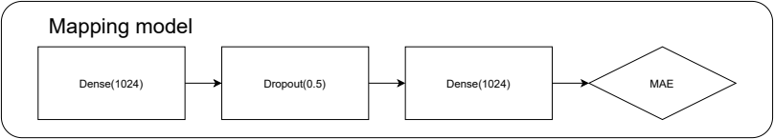
Auto-encoder
Auto-encoder
Mapping model

Slide 7
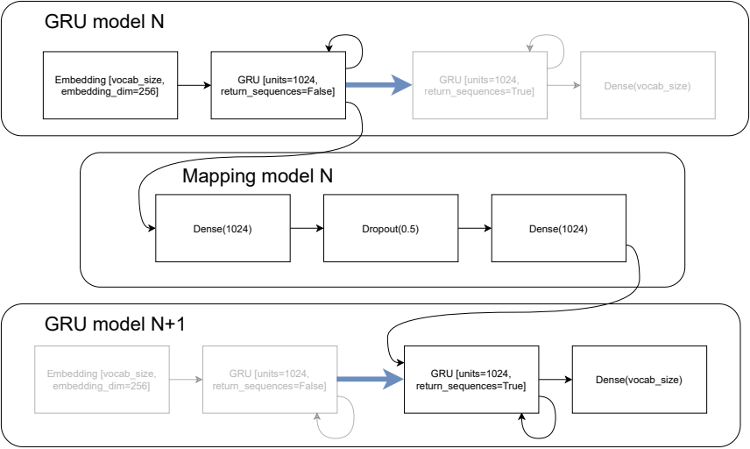
Poem generation

Slide 8
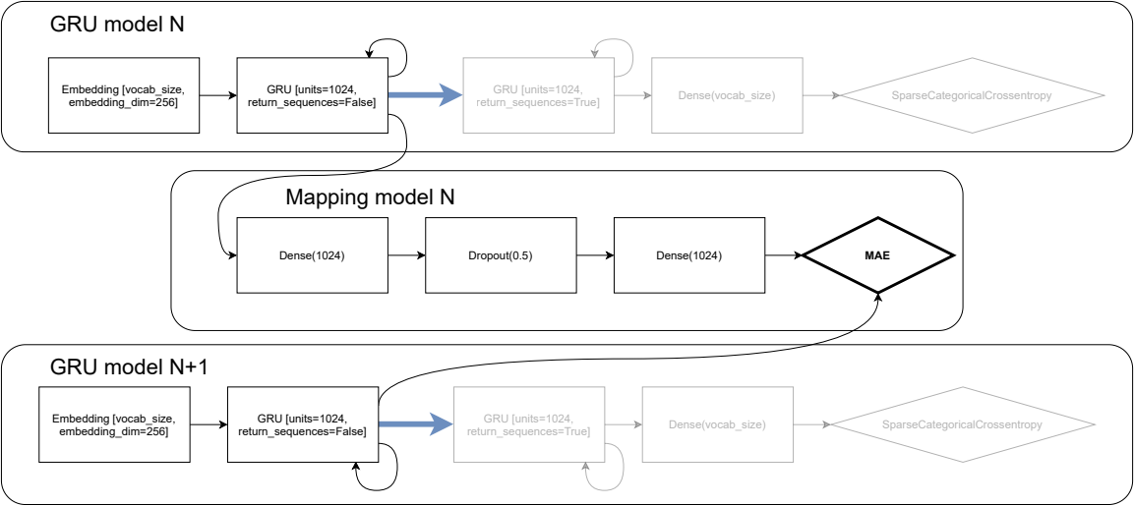
Training
Computationally difficult → optimization (at the cost of exactness)

Slide 9
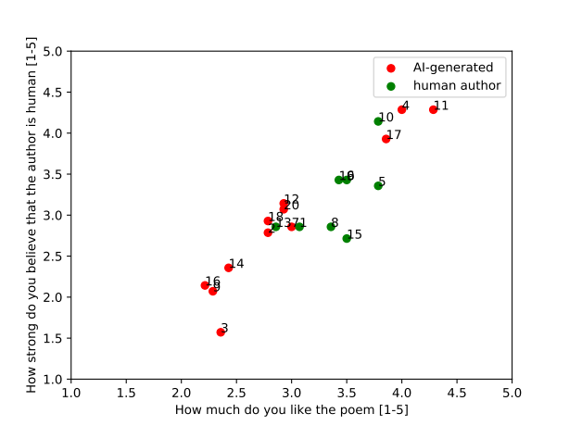
Results
Turing
experiment
evening coffee
the chalkboard scent
belly
early storm warning
I stand next to a tree
coloured into darkness

