Slide 1
THESIS DEFENSE
CHORDLENS
Real-Time Guitar Chord Recognition from Hand Landmarks
Using Classical Machine Learning
PRESENTED BY
ARBOLEDA, Nicolas Angelo T.
ANDAM, Jamir Dwayne C.
NARAWA, Ryu A.
Introduction · Conclusion
Methodology
Results · Limitations
BSCS 3-A · Data Analytics · 12 November 2026
Notes:
Nicolas opens. Title, the three of us, and what the system does in one line: it watches the fretting hand through a normal webcam and names the chord, with no audio.

Slide 2
THE PROBLEM
WHAT A BEGINNER CANNOT CHECK ALONE
A chord is a precise arrangement of fingers across six strings. Put one finger on the wrong string and the guitar tells you something is wrong — but not what.
Sound is ambiguous
Audio arrives too late
The usual fix is a teacher
A wrong shape, too little pressure and a sloppy strum all sound much the same to someone still learning.
Existing recognition systems listen. They stay silent while the hand is still forming the shape — which is when help is needed.
Which is precisely the resource a self-taught learner does not have.
Notes:
Nicolas. Frame the problem as verification, not transcription. The learner's question is not 'what chord was that' — it is 'is my hand right'. Nobody answers that without a teacher.

Slide 3
OBJECTIVES
WHAT WE SET OUT TO BUILD
General
Specific
Determine, from a single webcam frame and in real time, which guitar chord the fretting hand is forming — without audio and without specialised hardware.
Represent the fretting hand as geometry, never as pixels.
Cover all seven natural-note roots, A through G.
Compare classical classifiers under an evaluation that resists near-duplicate leakage.
Run in real time on a laptop CPU, with no GPU.
Notes:
Nicolas. The coverage requirement — every letter A to G — is the one Prof. Lee set, and we meet it. Flag the last bullet: real time on a CPU is a constraint, and it drove the modelling choice.

Slide 4
WHY VISION
TWO DECISIONS THAT SHAPED EVERYTHING
Why not audio?
Why not raw pixels?
Audio chord recognition is mature, but it answers what was played, not whether the hand is right. It is silent until the strings are struck, and it degrades in exactly the noisy rooms where people practise.
A convolutional network trained on twelve thousand frames from two people would learn our rooms, our shirts and our guitars. MediaPipe already solved hand detection on millions of images; we add 85 numbers on top of it.
We watch the hand instead.
Smaller data, explainable errors, no GPU.
Notes:
Nicolas. This is the 'why not a CNN' question answered before it is asked. Three reasons: our dataset is far too small for pixels, the errors stay explainable, and it runs on a laptop. Hand off to Jamir after this slide.

Slide 5
THE PIPELINE
FROM FRAME TO CHORD IN FIVE STAGES
Webcam frame
MediaPipe Hands
Feature extraction
Logistic regression
Majority vote
>
>
>
>
1280 x 720
21 landmarks
85 features
9 probabilities
7-frame window
No pixel data passes beyond MediaPipe. From the third box onward the model sees 85 numbers and nothing else.
train.py reads only the landmark CSV. It never opens an image — which is what makes this a feature-engineering project rather than computer vision on pixels.
Notes:
Jamir takes over here. Walk the five boxes left to right. The sentence that matters is the one in italics: the classifier never sees a photograph. If asked why the vote window is seven — frames arrive about every 0.7 s, and seven smooths the transition between shapes without lag.

Slide 6
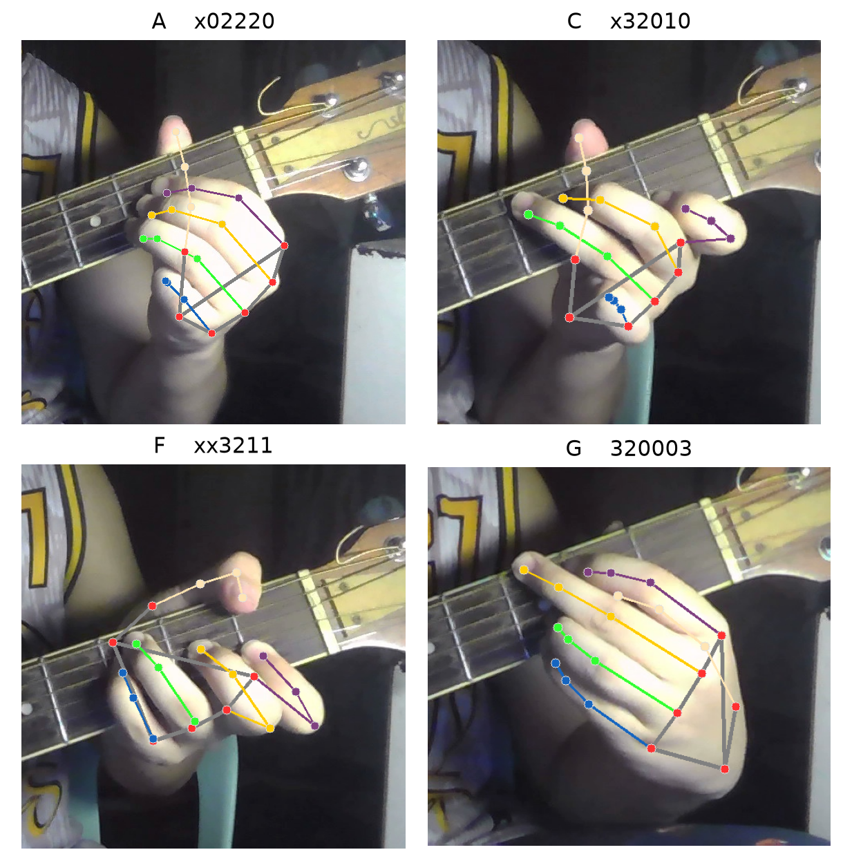
THE FEATURES
85 NUMBERS THAT DESCRIBE A HAND
60
Normalised coordinates
20 landmarks in x, y and z. The wrist is dropped — after centring it is always zero.
10
Fingertip distances
Every pair among the five fingertips.
15
Joint angles
The flexion angle at each finger joint.
Invariant to where the hand sits in the frame and to how big it is. Deliberately NOT invariant to rotation, to mirroring — or to position along the neck.
Notes:
Jamir. Two normalisations: everything measured from the wrist (so position in frame stops mattering), everything divided by the wrist-to-knuckle distance (so hand size and camera distance stop mattering). The last line is the one to land — leaving out neck position is a choice, and slide 13 is the bill for it.

Slide 7
THE DATASET
RECORDED BY US, ON ORDINARY LAPTOP WEBCAMS
13,890
22
2
92.3%
frames captured
recording sessions
players
hand detection rate
MediaPipe found a hand in 12,823 of them. Every frame carries the id of the session it came from — one continuous sitting at the camera. That single column is what makes the evaluation on the next slide possible.
Captured under uncontrolled domestic lighting, which is the condition the system has to survive.
Notes:
Jamir. If asked about the gap between frames captured and rows used: MediaPipe has to actually find a hand, and in poor light it sometimes does not. We report the detection rate rather than hide it. Two players is our biggest limitation and we say so on slide 14.

Slide 8
EVALUATION
WHY WE DID NOT REPORT 95 PER CENT
The trap we avoided
Our recorder saves a frame every 0.7 seconds, so consecutive frames are near-identical. A random train-test split puts near-duplicates on both sides and the model is scored on what it has already seen. That reads around 95 per cent and means nothing.
Leave-one-session-out
Held-out player
A whole sitting is always entirely in training or entirely in test, never split. 22 folds, one per session.
One player's sessions are removed before any training happens. This answers the question that actually matters: does it work on someone we have never recorded?
Accuracies are also reported as a multiple of chance, so schemes with different numbers of chords stay comparable.
Notes:
Jamir — this is the methodological heart of the talk; do not rush it. If a panellist says 79 per cent sounds low, the answer is here: we could have shown them 95 and it would have been fiction. We chose the harder, honest measurement, and the textbook's usability threshold is 70.

Slide 9
ALGORITHMS
ELEVEN COMPARED — THE TWO SIMPLEST WON
The two linear models led
Logistic regression and the linear SVM both beat the RBF support vector machine and the multilayer perceptron — and varied less from session to session.
Why the simple ones win
The 85 features have already done the hard work; by then the classes are nearly linearly separable. Spare capacity goes into memorising one room's light and one person's camera angle.
Notes:
Jamir. This table ranks algorithms under one identical protocol — the numbers here are not the deployed system's accuracy, which is on the next slide. We ship logistic regression rather than the linear SVM because it gives calibrated probabilities, which the live demo needs, and it was better on the held-out player. Hand off to Ryu.

Slide 10
RESULTS
THE TWO NUMBERS THAT MATTER
79.4%
68.9%
6.20x
on an unseen recording session
leave-one-session-out, 22 folds, sd 7.8
on a player held out entirely
all 9 chords, nothing of theirs in training
the 11.1% chance level
how the two compare across schemes
Worst session 60.1%. Best 91.9%. The course textbook puts practical usability at 70 per cent — we clear it on both tests, and the floor sits only ten points under the mean.
Notes:
Ryu opens the results. Quote these two numbers and no others for overall accuracy. If asked about the 85.2 per cent that appears in the paper: that is a five-class model on sessions that only contained five chords — a real number answering an easier question. The deployed nine-chord figure is 68.9. This is also the natural point to run the live demo.

Slide 11
CHORD BY CHORD
WHERE IT IS STRONG, AND WHERE IT IS NOT
Strong
B (.906) and F (.900) are recognised reliably; E follows at .818.
Weak
Em (.649) and C (.676) are the two that cost us.
What it confuses
On the held-out player Em reads as A 180 times, C as Dm 148. C and Dm are the closest pair in the whole feature set.
Notes:
Ryu. Em was the honest surprise. It was our worst chord at .576 and we assumed that was structural — then we re-recorded it under better light and it gained seven points, the biggest single-chord jump in the project. The limit was our data, not the representation. C is different: C and Dm sit 2.08 apart in standardised feature space, closer than B and B minor, and that one really is structural.

Slide 12
DIVERSITY WINS
ONE MORE PERSON BEAT FOUR TIMES THE DATA
Configuration | Unseen session | Unseen player
One player, SVM | 74.8% | 66.7%
Two players, SVM | 76.4% | 80.9%
Two players, log. regr. | 78.9% | 85.2%
Then consistency, not mean
Four later sessions moved the average barely at all — 78.9 to 79.4 — but lifted the worst session from 54.9 to 60.1 and narrowed the spread from 9.3 to 7.8.
Cross-player column uses the five chords those sessions contain, so chance there is 20 per cent.
For a live demo, a steadier model matters more than half a point of average accuracy.
+14.2
+4.0
points of cross-player accuracy
from one additional player
points from quadrupling the frames
of a player already recorded
Notes:
Ryu. The most useful finding in the project for anyone repeating the work. Point at the cross-player column: 66.7 to 80.9, fourteen points from one extra person. A more varied dataset is a harder test, not an easier one, so that gain is real. The chords that gained most were the two that had been weakest, C and Dm, about twenty points each: the signature of a model that had been partly memorising one person's hands.

Slide 13
NINE CHORDS
FIVE EXCLUSIONS WE CAN DEFEND
Bm / Cm
x24432 / x35543
same A-shape barre, two frets apart
Scheme | Cls | Session | Player
All chords | 14 | 68.1% | 57.1%
Merge identical pairs | 11 | 80.5% | 67.8%
Nine plus B minor | 10 | 78.4% | 65.0%
Nine chords (adopted) | 9 | 79.1% | 69.1%
Fm / Gm
133111 / 355333
same E-shape barre, two frets apart
Am / E
x02210 / 022100
same three-finger shape, one string over
Our features are deliberately blind to fret position. These pairs are not difficult — they are indistinguishable. No algorithm recovers information that was never in the data.
Merging the identical pairs beats us on unseen sessions. We still chose nine: it has the highest cross-player accuracy, and its answers are unambiguous. “B minor or C minor” is no use to a learner.
All seven letters A to G are still covered, plus D minor and E minor.
Notes:
Ryu. Volunteer the awkward row before the panel finds it: the merged scheme now beats our adopted set on unseen sessions and on multiple of chance. It is a legitimate alternative and pretending otherwise would look worse. We chose nine for cross-player accuracy and for unambiguous output. If asked about B minor specifically, that is the story worth telling — it looked impossible until we found a groupmate had recorded it with the wrong voicing.

Slide 14
LIMITATIONS
WHAT WE WOULD TELL YOU BEFORE YOU ASK
01
Only two players
02
Position-blind features
Going from one player to two gained fourteen points cross-player. A third would very likely help again.
The root cause of every exclusion. The fix is known: encode position along the neck.
03
F uses a reduced voicing
04
Still partly fitting the setup
xx3211 avoids colliding with F minor — which we later excluded. F now reads as D in 113 frames.
The same player's E scored 83% on one session and about 47% on four newer ones.
05
No audio
We classify hand shape, not sound. We cannot say whether the chord was actually strummed.
Twice, data arrived labelled correctly but showing something else — a wrong voicing, then a ukulele. Both were caught by eye. An automatic intake check would have caught both.
Notes:
Ryu. Say all of these out loud. Volunteering them reads as rigour; being caught hiding one reads as the opposite. Number three is the one we found during live testing two days ago — it is a real mistake, honestly reported, and the reasoning behind it is in Section VII of the paper. Hand back to Nicolas.

Slide 15
CONCLUSION
WHAT WE SHOWED, AND WHAT COMES NEXT
Simple beat complex
Diversity beat volume
Limits are by design
Linear classifiers outperformed every non-linear alternative. Good features can make extra capacity unnecessary — or harmful.
One additional player was worth fourteen points cross-player; four times the frames for an existing player was worth about four.
Every failure traces to one explicit decision — omitting neck position — confirmed by measurement, not assumed.
Next
Encode position along the neck — it breaks every collision at once and could restore all five chords.
Recruit more contributors, and validate contributed data at intake.
Revisit F major's voicing now that F minor is gone.
Notes:
Nicolas closes. Three findings, three next steps. The honest headline: guitar chord recognition from hand position works, on a laptop, without a GPU, and we know exactly why it fails where it does.

Slide 16
THANK
YOU
Questions welcome.
79.4% on an unseen session · 68.9% on an unseen player · 9 chords · 6.20x chance
ARBOLEDA · ANDAM · NARAWA BSCS 3-A 12 November 2026
Notes:
Leave this up for questions. The strip of numbers is there so the panel can see the headline figures while they ask. The defense script doc has the prepared answers.

