Slide 1

Google PUB/SUB
Shravan Honade
Dhananjay Ghate
Ritesh Sengar
Nikhil Patil

Slide 2
AGENDA
What is Pub/Sub
Micro-Service Architecture : Shopping App
Problems in Micro-Service Architecture
Solution: Pub/Sub
Pub/Sub Architecture
Pub/Sub Architecture : Shopping App
Streaming Analytics and Ingestion
Spark and Cloud Pub/Sub
Other Use Cases
Similar Messaging Services
Demo

Slide 3
What is PUB/SUB ?
Pub/Sub is an managed, asynchronous and scalable messaging service that decouples services producing messages from services processing those messages.

Slide 4
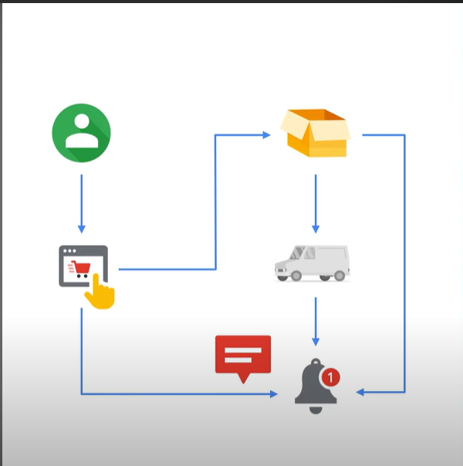
Micro-Service Architecture
Microservices:
Website
Packaging
Shipping
Notification

Slide 5
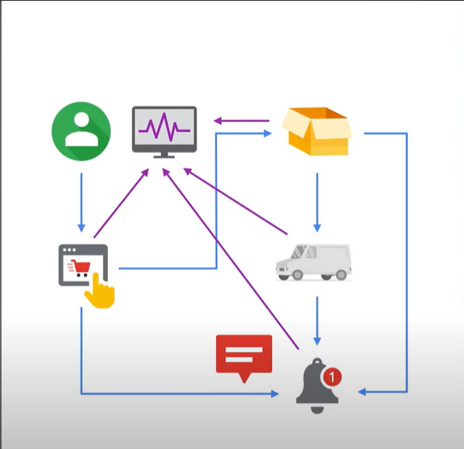
PROBLEMS IN Micro-Service Architecture
Problems :
Complexity
Testing
Scalability
Point of Failure

Slide 6
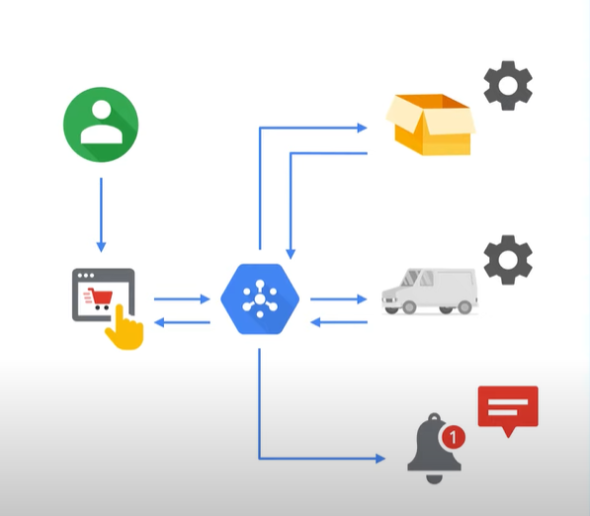
SOLUTION: Pub/SUB
Solutions:
Decoupled and Simplified Workflow
Highly Scalable
Easy addition of new service
Isolated testing of each service.

Slide 7
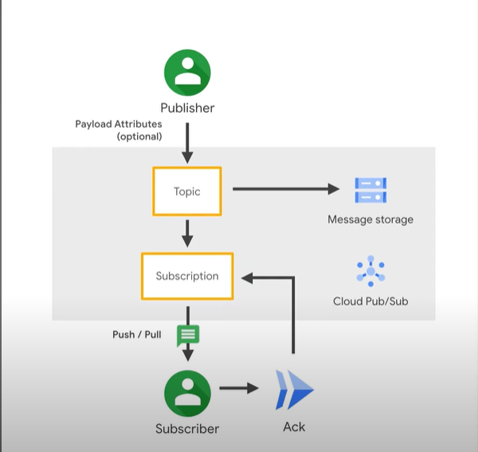
PUB/SUB Architecture
Publisher is an application or service which produces events such as ordering application ,packing service etc.
Topic is a namespace where messages are stored. Isolated testing of each service.
Subscriber is another application which receives messages by creating subscription to a topic.

Slide 8
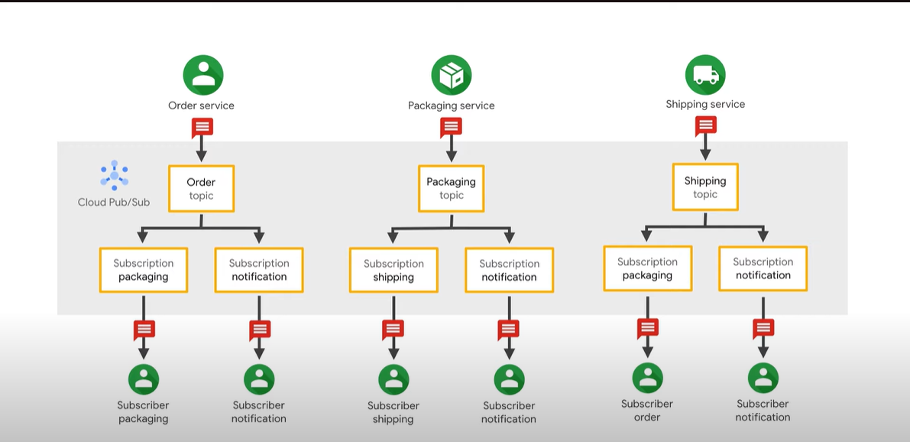
PUB/SUB Architecture: SHOPPING APP

Slide 9
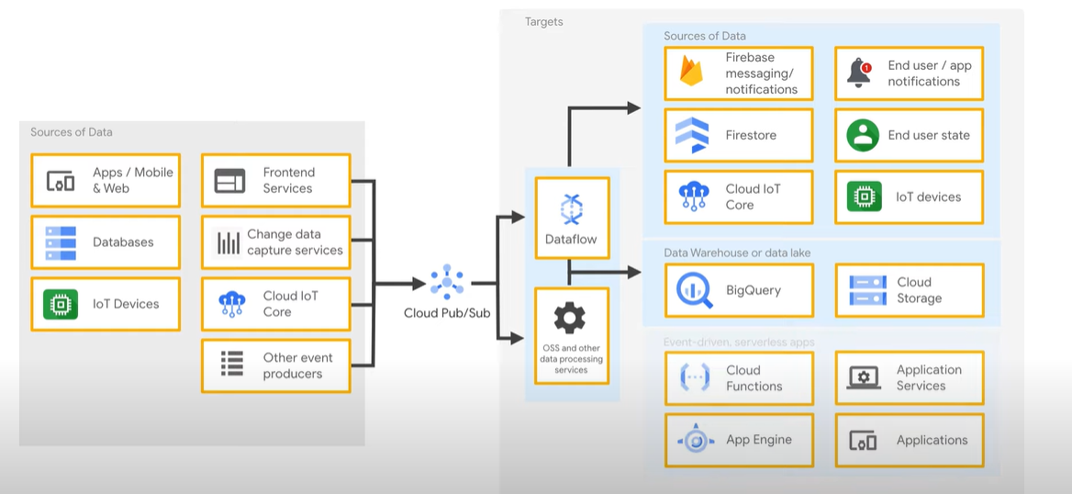
STREAMING ANALYTICS AND INGESTION
Pub/Sub is used for streaming analytics and data integration pipelines to ingest and distribute data.

Slide 10
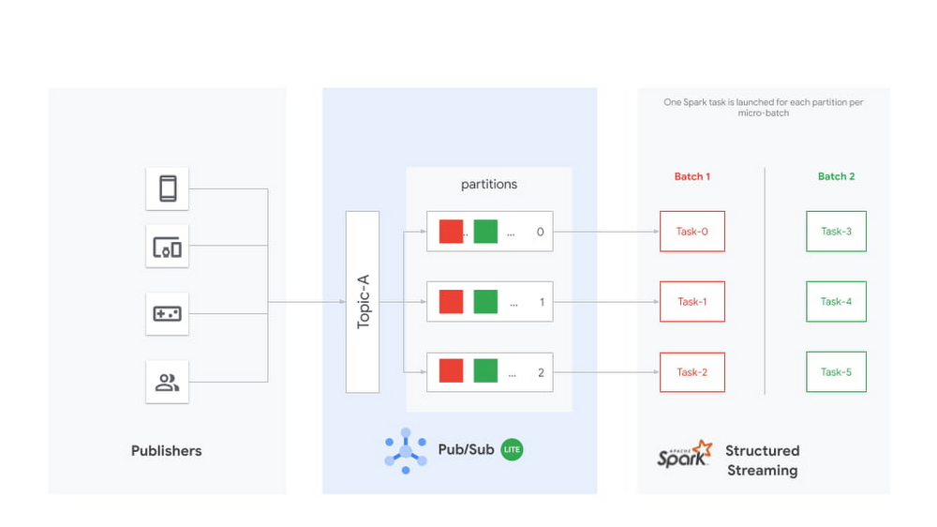
SPARK and CLOUD PUB/SUB

Slide 11
OTHER USE CASES
Ingestion user interaction and server events. To use user interaction events from end-user apps or server events from your system, you might forward them to Pub/Sub. You can then use a stream processing tool, such as Spark, which delivers the events to databases.
Real-time event distribution. Events, raw or processed, may be made available to multiple applications across your team and organization for real- time processing.
Replicating data among databases. Pub/Sub is commonly used to distribute change events from databases. These events can be used to construct a view of the database state and state history in BigQuery and other data storage systems.
Data streaming from applications, services, or IoT devices. For example, a SaaS application can publish a real-time feed of events. Or, a residential sensor can stream data to Pub/Sub for use in other Google Cloud products through a Dataflow or Spark pipeline.

Slide 12



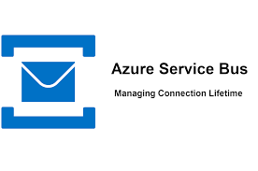
Similar Services

Slide 13
DeMO

