Slide 1
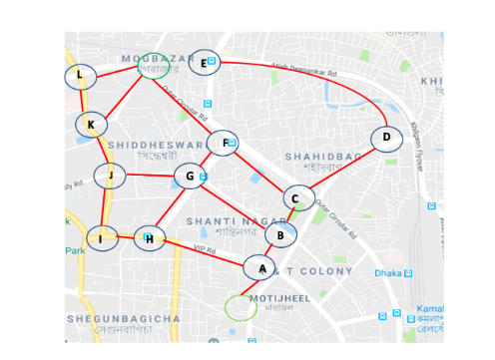

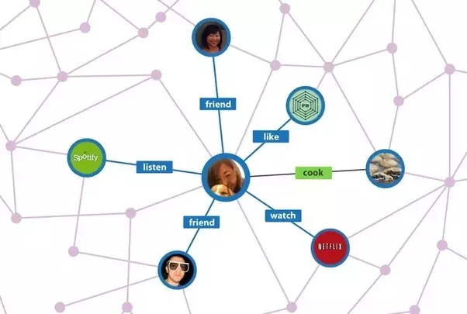
Graph Theory
Graph theory, as a subfield of computer science and mathematics, is used to model relations.
Graph Theory has many real-world applications:
Google Maps
World Wide Web
Social Graph
What’s the Connection?
?
What do these examples have in common? What is being connected to what?
----------------------------------------------------------------------------------------------------------------------------------------------------------
Build your own Network
On Instagram a user can follow other users.
How can you represent these relationships in a clear, structured way?
Tom follows Anna and Steffi
Steffi follows Peter and Diana
Nik follows Tom, Ben, and Anna
Diana follows Emil, Steffi and Kim
Kim follows Emil
What is a Graph ?
Based on what you‘ve built and seen, how would you define a graph?
------------------------------------------------------------------------------------------------------------------------------------------------------------------
Notes:
Google maps: Cities are connected by roads.
Internet / World Wide Web: webpages are connected by links
Sozial graph / Friendship: People are connected to people

Slide 2
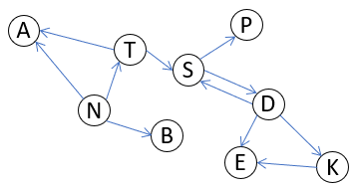
Graph Theory
Graph theory, as a subfield of computer science and mathematics, is used to model relations.
Graph Theory has many real-world applications:
Google Maps
World Wide Web
Social Graph
What’s the Connection?
?
What do these examples have in common? What is being connected to what?
Dots/Circles connected by lines.
Google maps: Cities are connected by roads.
Internet / World Wide Web: webpages are connected by links
Social graph / Friendship graph: People are connected to people
Other examples: airports are connected by flights
Build your own Network
On Instagram a user can follow other users.
How can you represent these relationships in a clear, structured way?
Tom follows Anna and Steffi
Steffi follows Peter and Diana
Nik follows Tom, Ben, and Anna
Diana follows Emil, Steffi and Kim
Kim follows Emil
What is a Graph ?
Based on what you‘ve built and seen, how would you define a graph?
Abstract Definition: “A Graph is a collection of vertices (or nodes ) connected by edges. ”
Notes:
Google maps: Cities are connected by roads.
Internet / World Wide Web: webpages are connected by links
Sozial graph / Friendship: People are connected to people

Slide 3
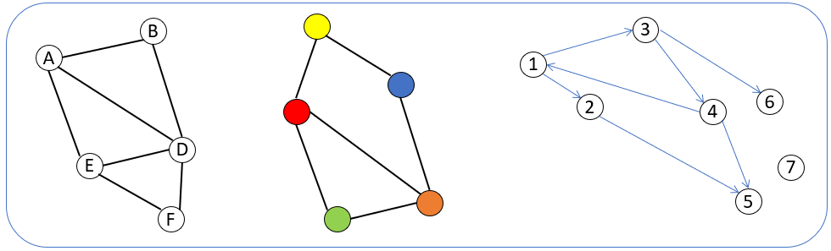

Reflect:
Does your definition of a graph match the following graphs?
Which additional properties of graphs do you notice?
Draw your own graph:
Formal Definition of a Graph: G=(V,E) where
V is a set of nodes
E is a set of edges
Edges
7
4
2
Edges can
have weights
Nodes
Undirected graph
directed graph
A
Path between A and C
is in both directions
Only path from A to D
A
D
B
B
C
C
D
V={A,B,C,D}
E={(A,D),(A,C),(B,A),(C,B),(D,C)}
V={A,B,C,D}
E={{A,B},{A,C},{B,C},{B,D},{C,D}}
adjacent Nodes:
C
Degree of a node: number of adjacent nodes
Share a common edge
„neighbors“
A
B
Degree of node A is 2
Notes:
Deepen Understanding:
Explore variations through more discovery:
Some connections have directions (airline flights). = Directed graphs.
Some connections have numbers/weights (distances, costs). = Weighted graphs.
Some pairs may not be connected at all. = Graphs need not be complete.

Slide 4

Can You Untangle it?
Some messy-looking graphs with edge crossing. Is it possible to make graphs look clean?
Graph messy G1:
Graph K5:
B
Graph messy G2:
B
A
A
F
A
C
E
B
C
G
D
D
D
C
E
Complete Graph: Each node is connected to all others.
F
E
?
What strategies did you try?
A
D
Explore and Discover Patterns
B
E
Count the number of vertices (V), edges (E) and regions (F).
Record your results in the table. (A region is one of the areas restricted by edges)
C
F
Graph K3,3
Graph | V | E | F | V-E+F | planar
Clean G1
Clean G2
Triangle
Square
Clean K4
Create own clean graph with exactly 6 regions
Based on your results, can you formulate a generally valid statement?
------------------------------------------------------------------------------------------------------------------------------------------------------------------
Why does it matter?
Where might planarity be useful or necessary?
------------------------------------------------------------------------------------------------------------------------------------------------------------------
Notes:
Google maps: Cities are connected by roads.
Internet / World Wide Web: webpages are connected by links
Sozial graph / Friendship: People are connected to people

Slide 5
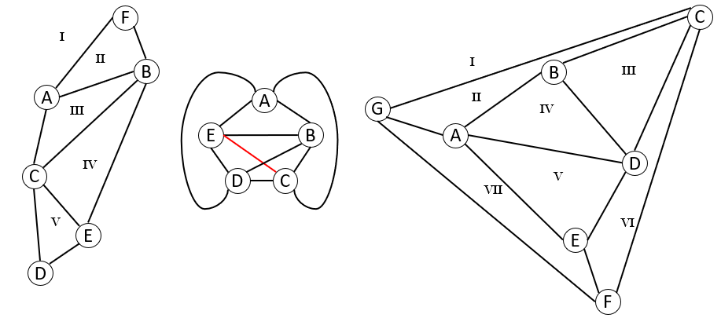
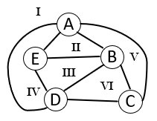
Can You Untangle it?
Some messy-looking graphs with edge crossing. Is it possible to make graphs look clean?
Graph clean G1:
Graph clean G2:
?
What strategies did you try? Connect outside.
A clean drawn graph (=without any edge crossing) is called planar graph.
Explore and Discover Patterns
A
D
B
E
Count the number of vertices (V), edges (E) and regions (F).
Record your results in the table. (A region is one of the areas restricted by edges)
C
F
Graph | V | E | F | V-E+F | planar
Clean G1 | 6 | 9 | 5 | 2 | Yes
Clean G2 | 7 | 12 | 7 | 2 | Yes
Triangle | 3 | 3 | 2 | 2 | Yes
Square | 4 | 4 | 2 | 2 | Yes
Clean K4 | 4 | 6 | 4 | 2 | Yes
Create own clean graph with exactly 6 regions | 5 | 9 | 6 | 2 | Yes
Planar graph with 6 regions.
Graph K3,3
Based on your results, can you formulate a generally valid statement?
A property of all planar graphs: V – E + F = 2
Euler Characteristic
Why does it matter?
Where might planarity be useful or necessary?
If a road cross, there must be a stop or traffic signal. Or routes must run at different heights (bridge, tunnel). Circuit design (avoid wire crossing)
Notes:
Clean = planar

Slide 6
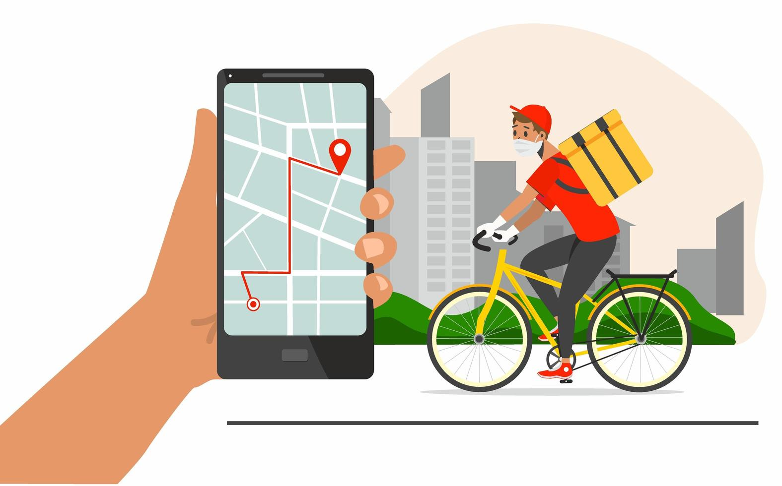
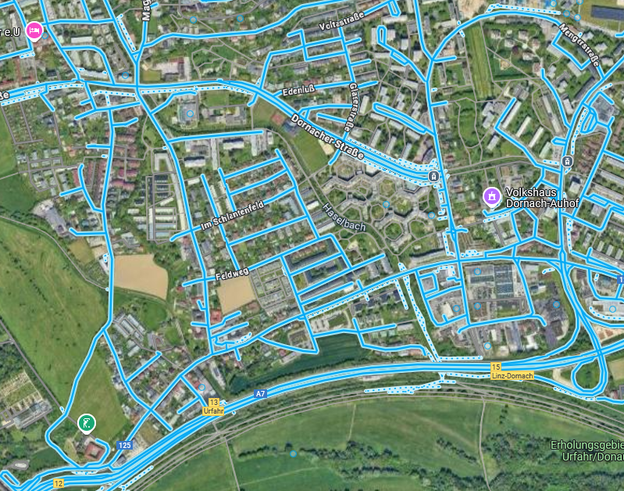
Challenge: The Fastest Route
Imagine you are a bicycle courier. You start at the restaurant at node A and need to deliver meal packages to several locations in the city.
19
F
B
14
D
16
5
12
12
24
E
C
8
Start = At restaurant A
Numbers on edges = Travel time
A
?
What‘s the shortest path from A to F. Try to solve by intuition.
Discuss with your group and write down your ideas below.
------------------------------------------------------------------------------------------------------------------------------------------------------------------------------

Slide 7
Challenge: The Fastest Route
Imagine you are a bicycle courier. You start at the restaurant at node A and need to deliver meal packages to several locations in the city.
19
F
B
14
D
16
5
12
12
24
E
C
8
Start = At restaurant A
Numbers on edges = Travel time
A
?
What‘s the shortest path from A to F. Try to solve by intuition.
Discuss with your group and write down your ideas below.
Try and guess a possible route.
Always pick the smallest edge.
Try every possible route and afterwards compare total distances.

Slide 8
What’s the best strategy?
Part 1: Explore another Graph
Below is a simple graph with cities and distances. Find shortest distance from A to F.
?
How do you find shortest path to all other cities?
2
4
D
2
A
B
3
1
F
?
How many different ways from A to F can you find?
E
2
C
5
Part 2: Guided Exploration:
?
What problems arise if you always pick the smallest edge?
--------------------------------------------------------------------------
?
Suppose you know the shortest way to get to one city.
How could that help you find the shortest way to other cities?
--------------------------------------------------------------------------
?
Is it safe to say that once we know the shortest way to a city, it will never change?
--------------------------------------------------------------------------
?
How can you keep track the best distance so far?
--------------------------------------------------------------------------

Slide 9
What’s the best strategy?
Part 1: Explore another Graph
Below is a simple graph with cities and distances. Find shortest distance from A to F.
?
How do you find shortest path to all other cities?
2
4
D
2
A
B
3
1
F
?
How many different ways from A to F can you find?
E
2
C
5
Part 2: Guided Exploration:
?
What problems arise if you always pick the smallest edge?
A shorter route could be missed. A longer first road might connect to a much shorter path later, making the total distance smaller.
?
Suppose you know the shortest way to get to one city. How could that help you find the shortest way to other cities?
Any path that goes through this city to reach its neighbors must also include that shortest path. So, if routes to its neighbors are smaller than what we knew before we update its distance.
?
Is it safe to say that once we know the shortest way to a city, it will never change?
Yes, because going through any other city will only add distance, not reduce it.
?
How can you keep track the best distance so far?
Realize the need of a distance table and a list of cities where the shortest route has already been found.

Slide 10
Dijkstra’s Algorithm
Start at A. Give it a distance of 0. All other nodes start as ∞ (unknown)
From A, check all neighbors, and update their distances.
Distance Tracking Table:
Step | Current Node | Tentative Distances | Processed Node
0 | A(0) | B = 1,C = 1,D = ∞,E = ∞,F = ∞ | A
1
2
3
4
5
2
4
A
B
D
2
1
3
F
E
2
C
5
Which node to process next after A? Why?
What happens if you find a shorter way to reach a node you’ve already visited?
?
How must the table be expanded to backtrack the path from finish to start?
Part 2: Reflection:
?
Why does Dijkstra‘s algorithm always find the shortest path?
----------------------------------------------------------------------------
?
What happens if some edges have negative weights?
----------------------------------------------------------------------------
?
Explain Dijkstra‘s algorithm in your own words?
----------------------------------------------------------------------------

Slide 11
Dijkstra’s Algorithm
Start at A. Give it a distance of 0. All other nodes start as ∞ (unknown)
From A, check all neighbors, and update their distances.
Distance Tracking Table:
Step | Current Node | Tentative Distances | Processed Node
0 | A(0) | B = 2, C = 1, D = ∞, E = ∞, F = ∞ | A
1 | C(1) | B=2, E=6, D = ∞, F = ∞ | C
2 | B(2) | D=6, E=5, , F = ∞ | B
3 | E(5) | D=6, F=7 | E
4 | D(6) | F=7 | D
5 | F(7) | - | F
2
4
D
2
A
B
1
3
F
E
2
C
5
Which node to process next after A? Why? Node C, because it has the smallest tentative distance.
What happens if you find a shorter way to reach a node you’ve already visited?
Update its tentative distance to the smaller one.
?
How must the table be expanded to backtrack the path from finish to start? Extra column to keep track of the previous node.
Part 2: Reflection:
?
Why does Dijkstra‘s algorithm always find the shortest path?
At each step the algorithm picks the smallest tentative distance from the not yet processed nodes (greedy).
?
What happens if some edges have negative weights?
With positive weights paths can only get longer, when we add edges. With negative weights paths can get shorter after adding an edge. This breaks the greedy logic.
?
Explain Dijkstra‘s algorithm in your own words?
From starting point, check all neighbors and update distances. Continue with smallest tentative distance until all nodes are processed.

Slide 12
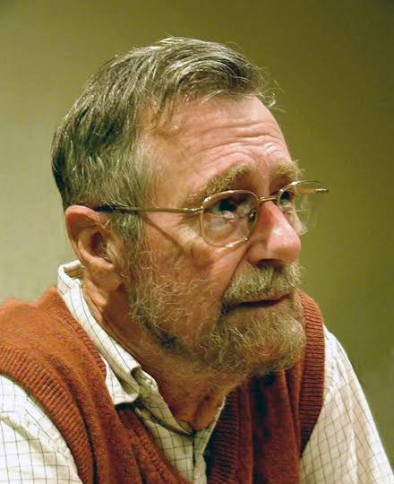
Dijkstra’s Algorithm
The Dijkstra’s algorithm finds the shortest path by always moving to the closest unvisited node.
While nodes to process
Take node (=current node) that is nearest to starting node
From the current node check each of its neighbors (which are not processed):
Calculate distance for the neighboring nodes (= distance to current node + distance to neighbor)
If new distance is less than known distance, update the tentative distance (= set to new distance) and previous node(= set to current node)
Mark current node as processed

Slide 13
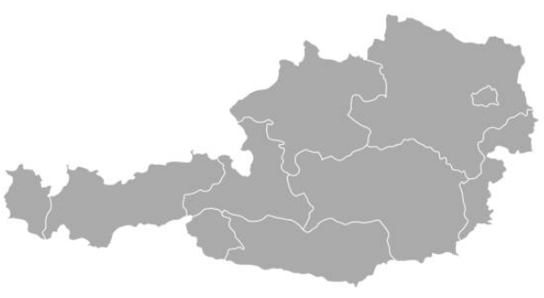
How does the Nav think?
Search the Internet for the current train connections in the federal states of Austria.
Draw a graph with at least all the federal capitals.
Determine the shortest route from Eisenstadt to Bregenz using Dijkstra's algorithm.

Slide 14
How does the Nav think?
Search the Internet for the current train connections in the federal states of Austria.
Draw a graph with at least all the federal capitals.
Determine the shortest route from Eisenstadt to Bregenz using Dijkstra's algorithm.
´Linz
99
66
Wien
107
St. Pölten
41
Salzburg
160
146
Bregenz
138
Eisenstadt
127
198
120
Innsbruck
146
85
35
98
Graz
Lienz
Villach
Klagenfurt

Slide 15
´Linz
99
66
Wien
107
St. Pölten
41
Salzburg
160
146
Bregenz
138
Eisenstadt
127
198
120
Innsbruck
146
85
35
98
Graz
Lienz
Villach
Klagenfurt

Slide 16
s | p
6
b
2
 | current | processed | a | b | c | d
0 |  |  | 0 | ∞ | ∞ | ∞
1 | a | a | 0 | 6 | 3 | ∞
2 | c | a,c | 0 | 5 | 3 | 8
3 | b | a,c,b | 0 | 5 | 3 | 7
4 | d | a,c,b,d
a
2
d
s | p
s | p
0 | -
3
c
5
s | p
s | p
6 | a
6
b
2
a
2
d
s | p
s | p
0 | -
3
c
5
s | p
3 | a
s | p
5 | c
6
b
2
a
2
d
s | p
8 | c
s | p
0 | -
3
c
5
s | p
3 | a
s | p
5 | c
6
b
2
a
2
d
s | p
7 | b
s | p
0 | -
3
c
5
s | p
3 | a
6
b
2
a
2
d
3
c
5

Slide 17
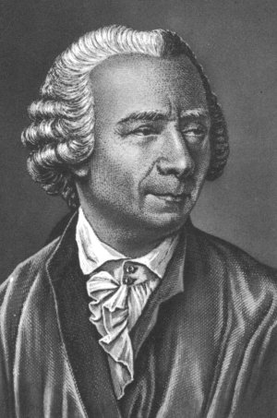
Planar Graphs
I
II
1
2
Without any edges crossing
1
2
III
3
4
IV
4
3
Euler Characteristic
The mathematician Leonard Euler noticed something very remarkable when he calculated:
Leonhard Euler
(1707-1783)
V
E
R
number of
vertices
-
number of
edges
+
number of
regions
Vertices: _______
Edges: _______
Regions: _______
B
P
V
E
R
G
-
+
=
___
This number is known as the Euler Characteristic

Slide 18
Introduction to Graphs
Formally Definition of a Graph: G=(V,E) where
V is a set of nodes
E is a set of edges
Edges
7
4
Edges can
have weights
2
Nodes
Undirected graph
directed graph
A
Path between A and C
is in both directions
Only path from A to D
A
D
B
B
C
C
D
V={A,B,C,D}
E={(A,D),(A,C),(B,A),(C,B),(D,C)}
V={A,B,C,D}
E={{A,B},{A,C},{B,C},{B,D},{C,D}}
adjacent Nodes:
Degree of a node: number of adjacent nodes
Share a common edge
C
„neighbors“
A
Degree of node A is 2
B
Notes:
Deepen Understanding:
Explore variations through more discovery:
Some connections have directions (airline flights). = Directed graphs.
Some connections have numbers/weights (distances, costs). = Weighted graphs.
Some pairs may not be connected at all. = Graphs need not be complete.

Slide 19
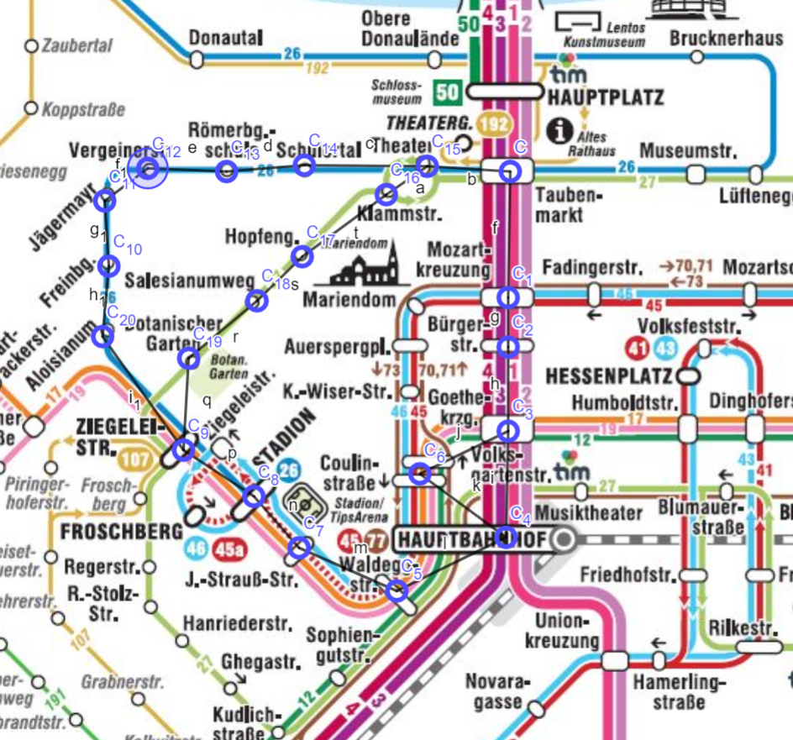
Linz

Slide 20
How many different ways are there from A to F?
Another example from point a to d?
6
b
2
 | current | processed | a | b | c | d
0
1
2
3
4
a
2
d
3
c
5

Slide 21






Social Graph
Nodes are the people, and edges represent friendships between them.
Carol
Bea
Elisa
E=
Bob
Lisa
Eric
V=
Draw the following social graph:
Bob is a friend of Carol and Sara
Sara is a friend of Paul and Darcy
Noah is a friend of Bob, Ben, and Carol
Darcy is a friend of Eric, Sara and Kate
Kate is a friend of Eric

Slide 22
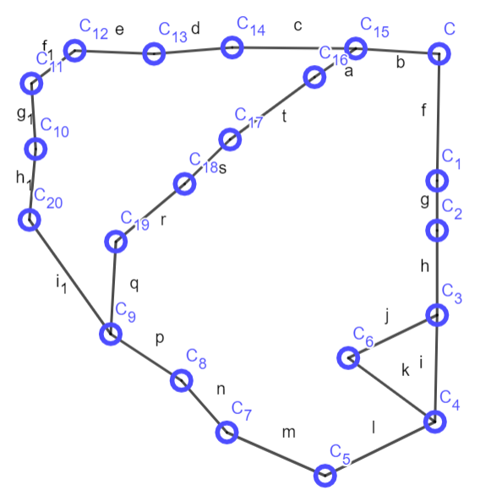
Find the shortest Path from Bürgerstr. To Ziegeleistr.

Slide 23



Edges
Nodes
A
A
A
B
D
A
C
E

Slide 24
Iter | Visited | un- visited | current | Not visited neighbors | A | B | C | D | E
0 | - | A,B,C,D,E | - |  | ∞ | ∞ | ∞ | ∞ | ∞
1 | A | B,C,D,E | A | B,C | 0
2
3
4
Iter | Visited | Not visited | current | Not visited neighbors | A | B | C | D | E
1 | -
2
3
4
5

Slide 25
While nodes to process
Take node (=current node) that is nearest to starting node
From the current node check each of its neighbors (which are not processed):
Calculate distance for the neibghoring nodes (= distance to current node + distance to neighbor)
If new distance is less than known distance, update the shortest distance (= set to new distance) and previous node(= set to current node)
Mark current node as processed

Slide 26
6
b
2
a
2
d
3
c
5
s | p
0 | -

Slide 27
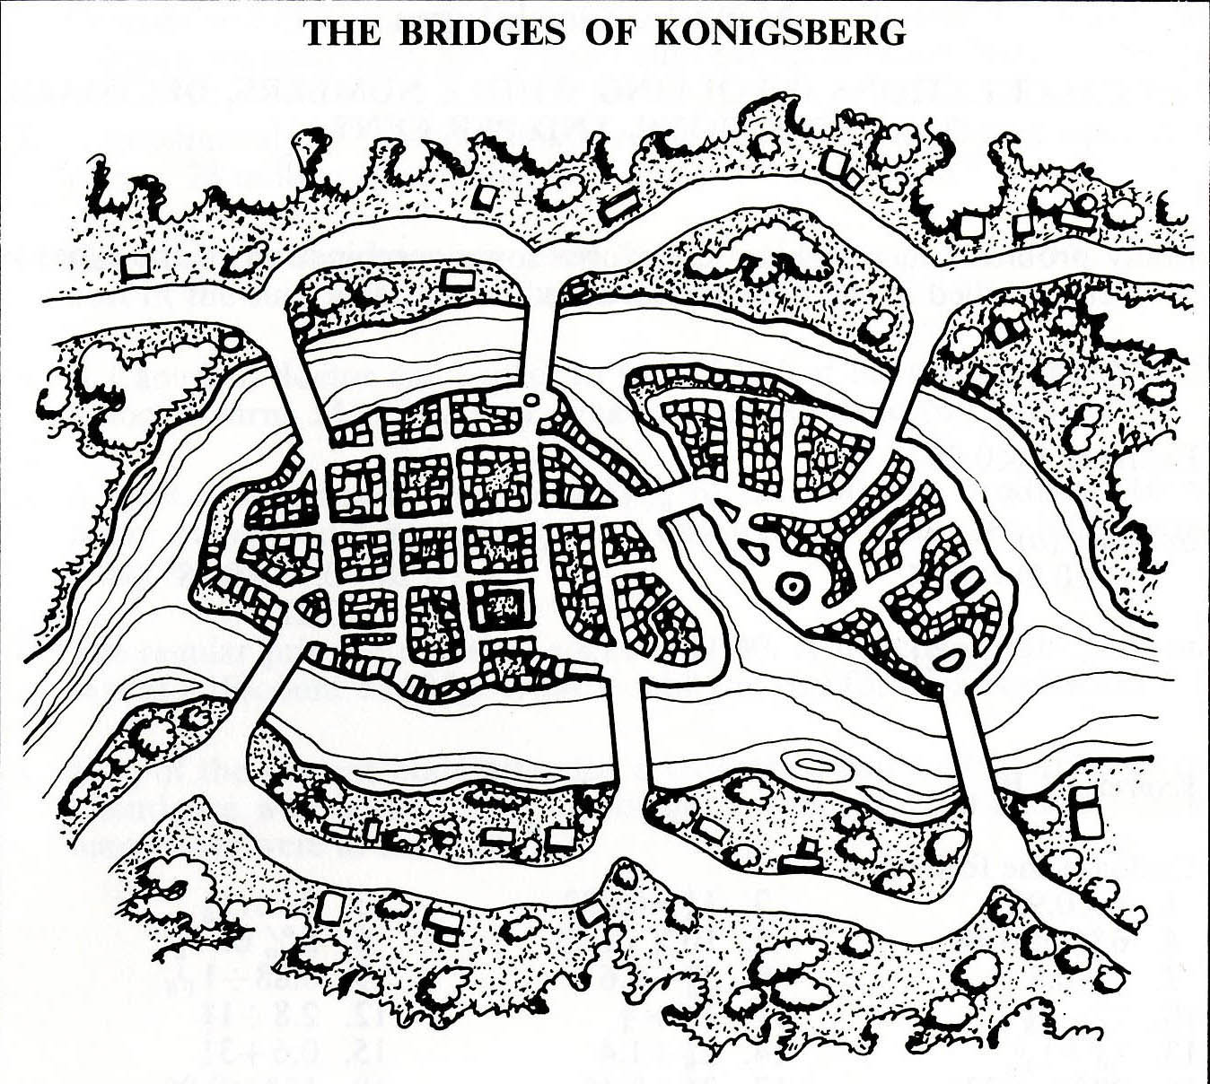

Slide 28
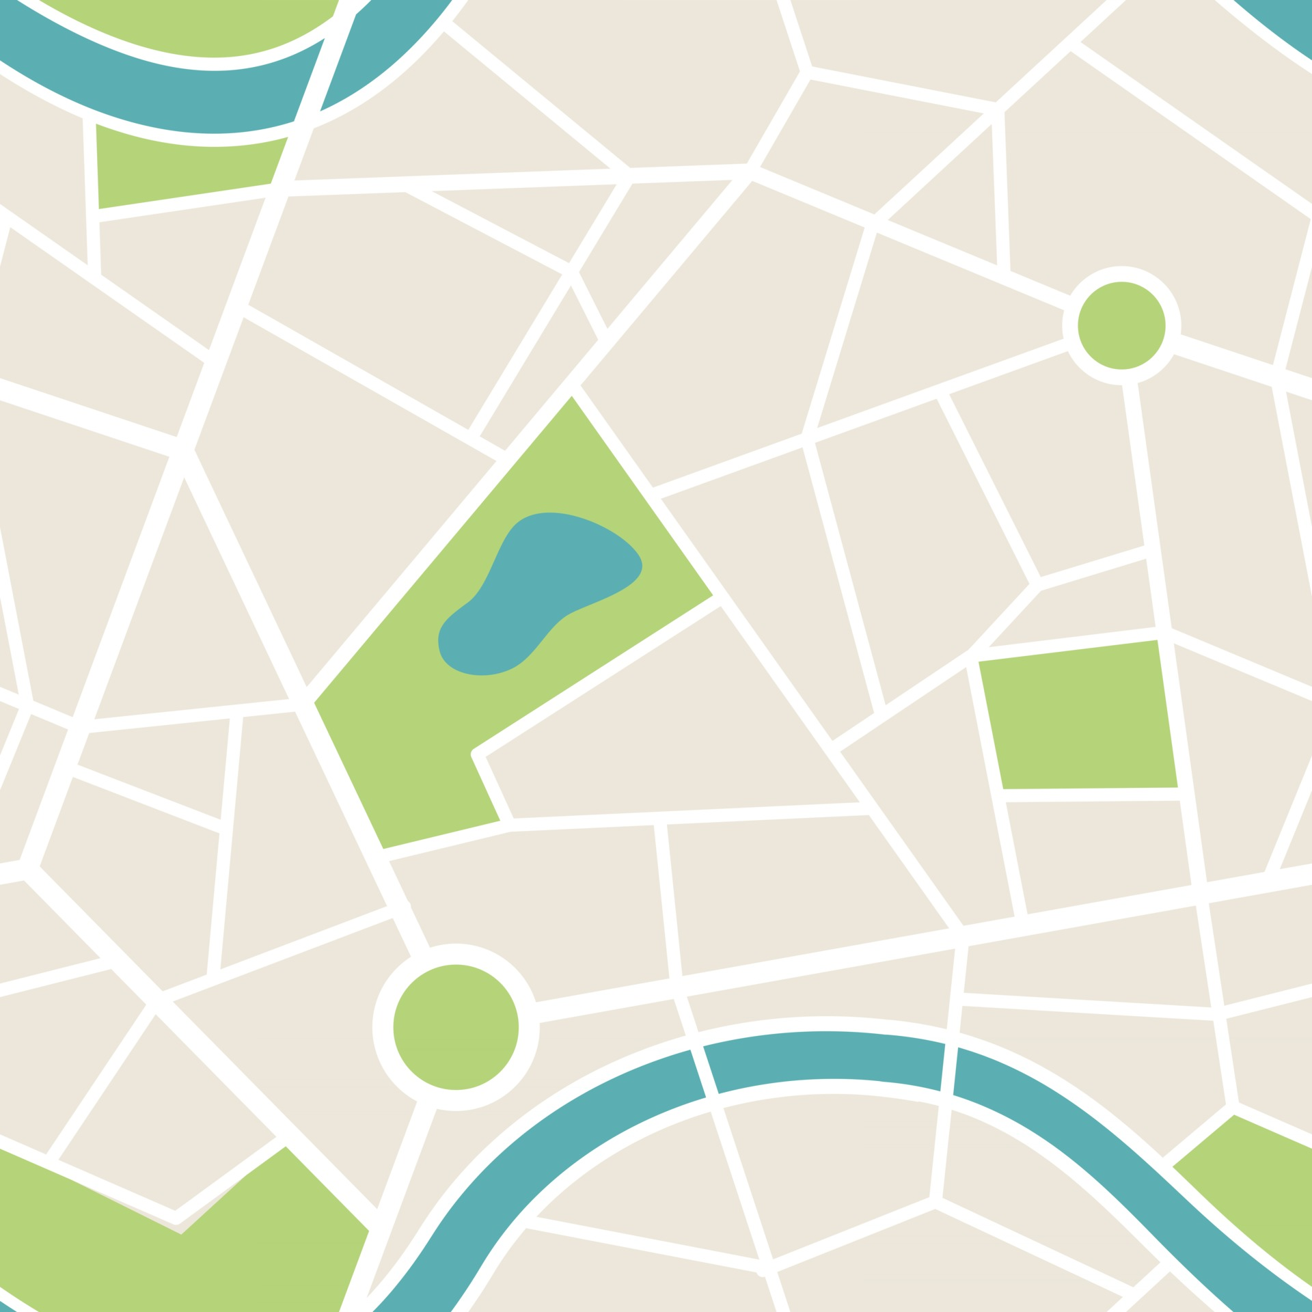
A
A
A
A
A
A

Slide 29
Graph | Nodes | Even Degree Node | Odd Degree Node | Possible
Iteration | Visited | un- visited | current | Not visited neighbors | A | B | C | D
0 | - | A,B,C,D,E | - |  | ∞ | ∞ | ∞ | ∞
1 | A | B,C,D,E | A | B,C | 0
2
3
4

